Slide 1
An-Najah National University
Far’un station to sewage Collection, Treatment and Reuse system
Presented By :
Mahmoud Hmad
And
Ala’ Oter

Slide 2
Presentation Outline
Introduction
Project objectives
Village Definition.
Wastewater Definition and Main Sources.
Overview of Wastewater Plant Design in Far’un.

Slide 3
Introduction
Water is the main source of living in the world. Without water live cannot be exist. In Palestine and due to the Israeli occupation and control of the water resources, there is a serious scarcity of water and water shortages problems.

Slide 4
Therefore, the Palestinian Authorities started to consider the construction of wastewater treatment plants and reuse treated wastewater to irrigate suitable agricultural crops and woodland..
Also It contributes to the improvement of environmental conditions and prevents further groundwater pollution.

Slide 5
Project objectives
The following are the main objectives of this graduation project:
Review the water and wastewater sanitation system in Far'un
Apply a questionnaire about water and social aspects of Far'un
Conceptual design of a wastewater treatment system for Far'un
Address the reuse potential of the treated wastewater in agriculture in Far'un

Slide 6
Village Definition
Far'un is a Palestinian village located 2 km south of the city of Tulkarem in the West Bank, Palestine.
Far’un lies on a plateau high in Tulkarem that is 200 m above mean see level.
The land area of Far'un area is approximately 4000 dunums. It has a population of 4000 as to the 2007 statistic of PCBS

Slide 7
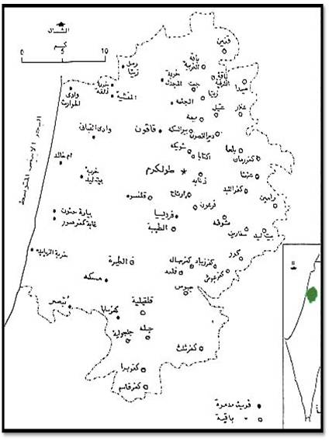

Slide 8
Wastewater Definition and Sources
Wastewater can be defined as :
Water that has been used, Spent containing dissolved or suspended solids.
Main sources :
Domestic sources/grey water.
Human excreta.
Solid waste.
Industrial wastewater.
Storm water.

Slide 9
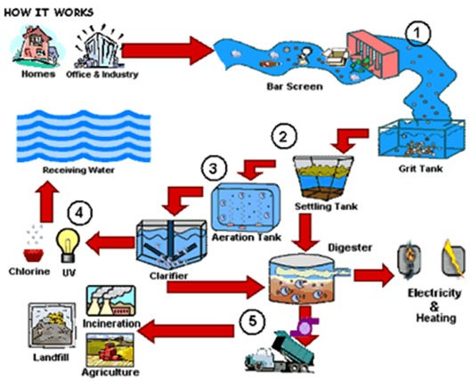

Slide 10
Overview of Basic Wastewater Treatment Process
Upon arrival via the sewer system, the wastewater is sent through a bar screen, which removes large solid objects such as sticks and rags.
Leaving the bar screen, the wastewater flow is slowed down entering the Septic tank. This allows sand, gravel, and other heavy material that was small enough not to be caught by the bar screen to settle to the bottom.

Slide 11
The screened wastewater flows into a primary Septic tank where it is held for several hours. This allows solid particles to settle to the bottom of the tank and oils and greases to float to the top.
In biological treatment process which removes dissolved organic material from wastewater. The partially treated wastewater from the Septic tank flows by gravity into an aeration tank.

Slide 13
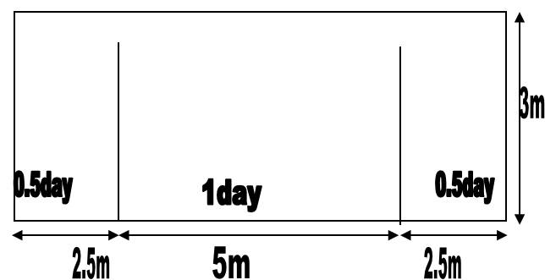

Slide 14
Then the water came’s from Septic tanks enters the Anaerobic Rock filter.
The anaerobic rock filter is a column filled with solid media (rocks) used for the treatment of the carbonaceous organic matter in wastewater. The wastewater flows upward through the column contacting the media on which anaerobic bacteria grow and are retained.

Slide 15
The specifications of the rock media used for Far'un village wastewater are illustrated in Table (3).
Table 3: Specifications of the Rock Filter Far'un
Item | Unit | Specifications
Rock Type |  | Porous Rock
Nominal Size | Mm | 70-100
Mass Per Unit Volume | Kg/m3 | 800-995
Specific Surface Area | m2/m3 | 40-165
Void Space | % | 50-60

Slide 16
Then the water came's from the rock filter goes to the sand filter which Is the last process. But the flow needed in the sand filter has to be a regular flow,
but the flow came’s from the rock filter is irregular so we have to put a siphon which regulates the flow.
Sand filters are beds of granular material, or sand, drained from underneath so that pretreated wastewater can be treated, collected and distributed to the land application system. They are normally used to polish effluent from septic tanks or other treatment processes before it is distributed on the land.
Then the water goes out can be used for irrigation.

Slide 17
Far’un Plant Design
Plant design was chosen to meet this figure:
Raw sewage BOD(mg/l) | 1190
Treatment facility | Expected BOD₅ reduction | Effluent BOD₅ (mg/l)
Interceptor(septic tank) | 60% | 100
Anaerobic rock filter | 80% | 50
Intermittent sand filter | 95% | 12.5

Slide 18
Station | First Station | Second Station
Septic tank | Basins#1 V=(8.5m×3m×3.5m). Basins#2 V=(8.5m×5.5m×3.5m). Basins#3 V=(8.5m×3m×3.5m). | Basins#1 V=(9m×2.5m×3m). Basins#2 V=(9m×5m×3m). Basins#3 V=(9m×2.5m×3m).
Rock Filter | the depth of the Rock filter=5m R=3.5m | the depth of the Rock filter=5m R=3m
Siphon | So every 48 minutes, it is one splash V= 5.43 m³ | `So every 48 minutes, it is one splash V= 4.47m³
Sand Filter | Area= 4.6×4.6 m² Number of nozzles in the sand filter= 543 nozzle in the system Number of nozzles of 1m² = 29 nozzle in 1m² We use 5 branches lines each line contains 6 nozzles in 1m². Spacing between nozzle = 16.67cm. Spacing between branches lines= 20cm | Area= 4.2×4.2 m² Number of nozzles in the sand filter= 447 nozzle in the system Number of nozzles of 1m² = 26 nozzle in 1m² We use 4 branches lines each line contains 7nozzles in 1m². Spacing between nozzle = 14.3cm. Spacing between branches lines= 25cm

Slide 19
?
Any
Questions

