Slide 1

Al-Najah National University
Engineering Faculty
Civil Engineering Department
Graduation Project:
Analysis & Design of Warehouses in Jaba’-Jenin

Slide 2
Chapter One :
Introduction

Slide 3
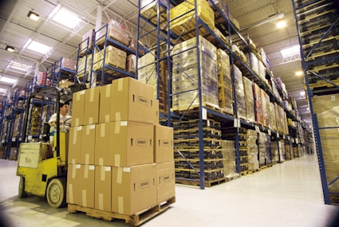
Chapter One: Introduction
Inside Warehouses Building

Slide 4
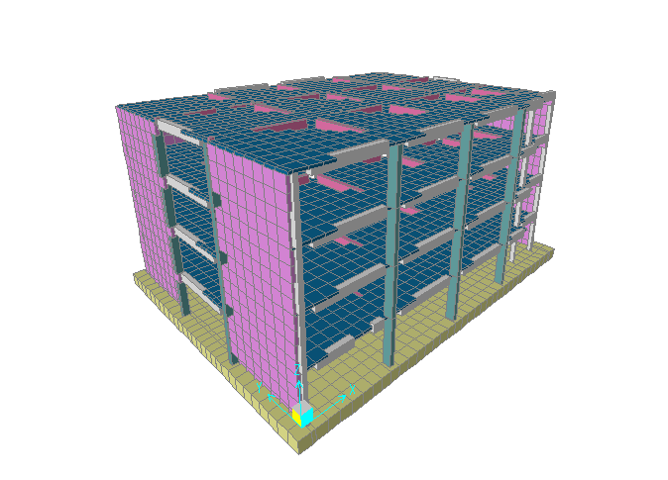
Points of Interest
Chapter One
3-D View of Warehouses Building

Slide 5
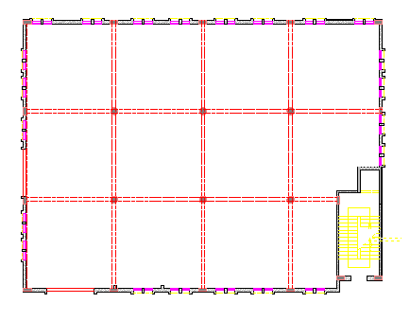
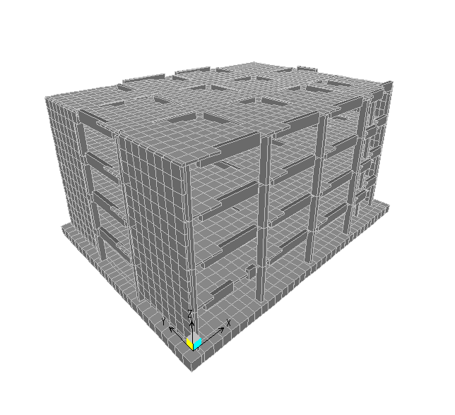
Warehouse building
Typical Plan
Chapter One
Building 3D Model

Slide 6
Codes
The following codes and standards are used in this project:
ACI 318-08: American Concrete Institute provisions for reinforced concrete structural design.
UBC-97: Uniform Building Code provisions for seismic load parameters determination.
ASTM: For material specifications
Chapter One

Slide 7
Materials
Structural Materials
Concrete:
- Concrete strength for all elements is ( f’c =30 MPa ) except mat foundation (f’c = 35MPa ).
- Modulus of elasticity equals 2.57*10⁵ MPa and for mat foundation equals 2.78*10⁵ MPa.
- Unit weight is 25 kN\m³ .
Steel:
Modulus of elasticity equals 2.04*10⁵ MPa
Steel yield strength is 420 MPa
Soil:
Bearing capacity equals 120 KN/m² MPa
Non-structural Materials
They are mainly, blocks, plasters, tiles, filling, mortar and masonry
Chapter One

Slide 8
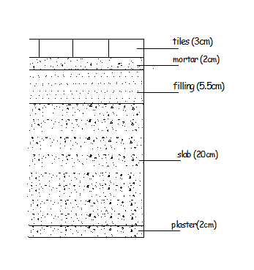
Loads
Gravity loads:
1. Dead load:
DL= SID + O.W slab=2.83+(0.2*25)=7.83 kN/m²
2. Live load: From UBC, storage warehouse LL= 250 lb/ft²
LL= 250*0.04788 =12 KN/m²
Chapter One

Slide 9
Load Combinations
From ACI318-08, load combinations are summarized as follows:
U₁ = 1.4D
U₂ = 1.2D + 1.6L+1.6 H
U₃ = 1.2D + 1.0E + 1.0L
U₄ = 0.9D + 1.0E + 1.6H
Where:
D: dead load
L: live load
E: earthquake load
H: weight and pressure load of soil.
Chapter One

Slide 10
Building Structural System
The main structural system of buildings is moment resisting frame(columns, beams) in addition to that, the shear walls are used at the staircase and for other locations in the building. Thus, the lateral forces can be resisted by the shear walls and the moment resisting frames .
The slab of the floors are two-way solid slabs with drop beams between columns.
Chapter One

Slide 11
Chapter Two :
Preliminary Analysis And Design

Slide 12
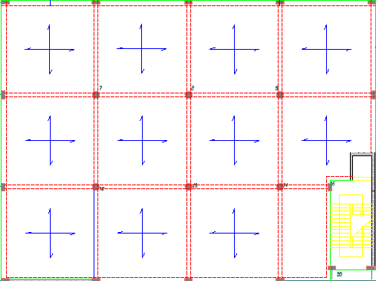
Slab System
Chapter Two

Slide 13

Thickness Determination
assuming α_{m} ≥ 2 then
Using (9.13 ACI-08 equation)
β= ln”long span”/ln”short span”= 6.9/6.8=1.03
h_{min}= 0.175 m
Use h= 0.2 m
Chapter Two

Slide 14
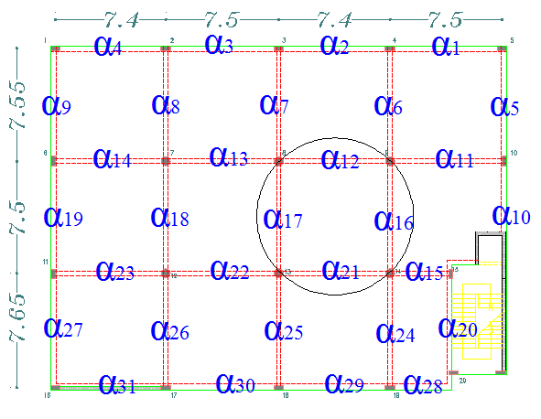
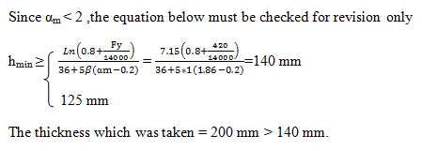
α_{m}for smallest panel
α₁₂ =1.86
α₁₇₌ 1.87
α₁₆₌ 1.87
α₂₁₌ 1.85
α_{mean} for the panel : 1.86< 2
Chapter Two

Slide 15
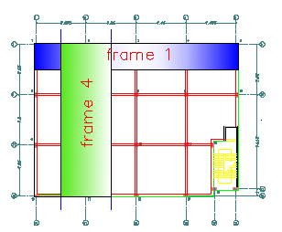
Frame Design
Building Frames
Chapter Two

Slide 16
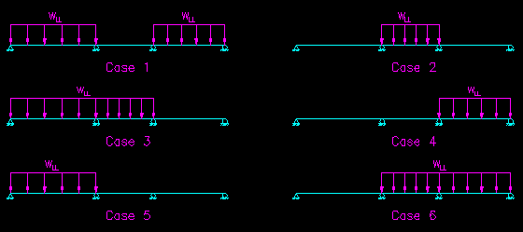
Envelope Moments
To ensure that the structures with continuity have sufficient strength and stiffness for all possible loading scenarios, moment envelope has been used.
The six critical load cases
Chapter Two

Slide 17
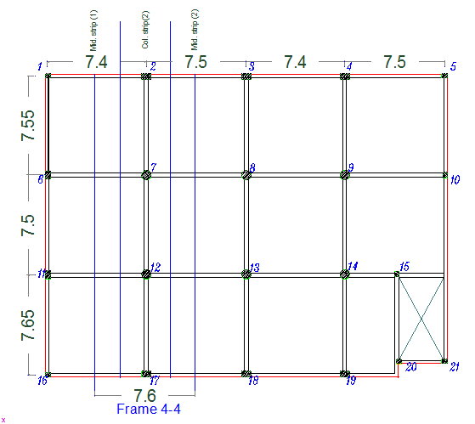
Take Frame (4-4) as an example:
Column Strip and Middle Strip on the Frame
Chapter Two

Slide 18
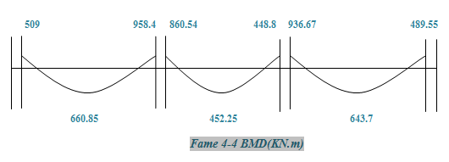
Table (13.6.4.1)
l₂/l₁ | 0.5 | 1 | 2
(α_{f1}l₂/l₁) = 0 | 75 | 75 | 75
(α_{f1}l₂/l₁) ≥ 1.0 | 90 | 75 | 45
Chapter Two

Slide 19
Table (13.6.4.2)
l₂/l₁ |  | 0.5 | 1 | 2
(α_{f1}l₂/l₁) = 0 | β_{t} = 0 | 100 | 100 | 100
 | β_{t} ≥ 2.5 | 75 | 75 | 75
(α_{f1}l₂/l₁) ≥ 1.0 | β_{t} = 0 | 100 | 100 | 100
 | β_{t} ≥ 2.5 | 90 | 75 | 45
Table (13.6.4.4)
l₂/l₁ | 0.5 | 1 | 2
(α_{f1}l₂/l₁) = 0 | 60 | 60 | 60
(α_{f1}l₂/l₁) ≥ 1.0 | 90 | 75 | 45
Chapter Two

Slide 20
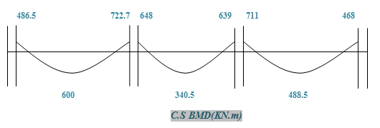
Span length(m) | l₂/l₁ | α_{f1}l₂/l₁ | % -ve & +ve moment of column strip
 |  |  | _{% +ve} | _{% -ve} _{interior} | _{% -ve exterior}
7.65 | 0.97 | 1.82 | 75.3 | 75.4 | 95.6
7.5 | 0.993 | 1.87 | 75.9 | 75.3 | -
7.55 | 0.987 | 1.88 | 75.4 | 75.9 | 95.6
Chapter Two

Slide 21
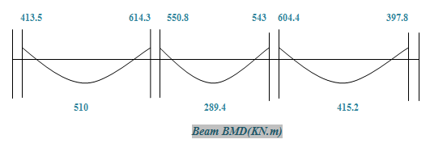
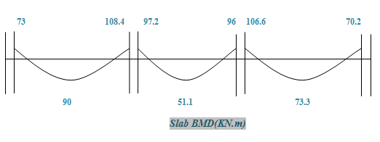
Since α >1, 85% of the moment in column strip goes to beam.
moment for column strip (slab) = moment of column strip – moment of the beam
Chapter Two

Slide 22
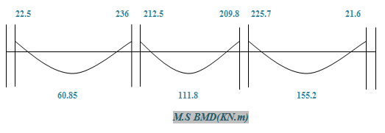
Chapter Two

Slide 23
Comparison between hand calculation & sap results of moments.
Frame 4-4
Span# | Positive moment(hand calculations) KN.m | Positive moment from SAP KN.m
1 | 789.2 | 660.8
2 | 451.3 | 452.2
3 | 811.3 | 643.7
Frame 4-4
Support# | Negative moment(hand calculations) KN.m | Negative moment from SAP KN.m
1 | 221.5 | 509
2 | 969.2 | 958.4
3 | 996.5 | 936.6
4 | 227.8 | 489.5
Chapter Two

Slide 24
Design Results
Reinforcement for column strip and middle strip
Slab Column strip reinforcement | Area of steel (mm²) | Moment Middle strip (KN.m) | Slab Middle strip reinforcement | Area of steel (mm²) | Moment Column strip (slab) (KN.m) | Span length (m)
1 Ø 12/250mm | 373.3 | -22.5 | 1 Ø 12/200mm | 1235 | -73 | 7.65
1 Ø 12/250mm | 1019 | +60.85 | 1 Ø 14/250mm | 1531.6 | +90
1 Ø 18/200mm | 1431 | -236 | 1 Ø 14/200mm | 1857 | -108.4
1 Ø 18/200mm | 1431 | -236 | 1 Ø 14/200mm | 1857 | -108.4 | 7.5
1 Ø 14/250mm | 1895 | +111.8 | 1 Ø 14/300mm | 858 | +51.1
1 Ø 18/200mm | 3940 | -225.7 | 1 Ø 14/200mm | 1825 | -106.6
1 Ø 18/200mm | 3940 | -225.7 | 1 Ø 14/200mm | 1825 | -106.6 | 7.55
1 Ø 14/250mm | 2660 | +155.2 | 1 Ø 14/300mm | 1240 | +73.3
1 Ø 12/250mm | 358.3 | -21.6 | 1 Ø 12/250mm | 1186.4 | -70.2
Chapter Two

Slide 25
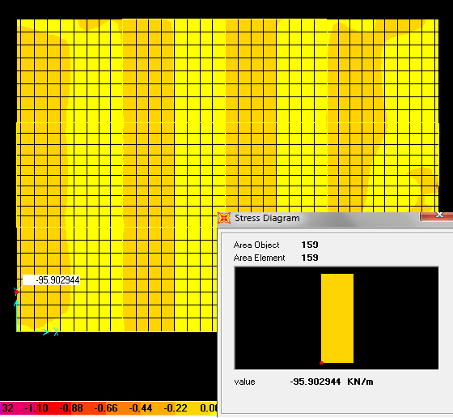

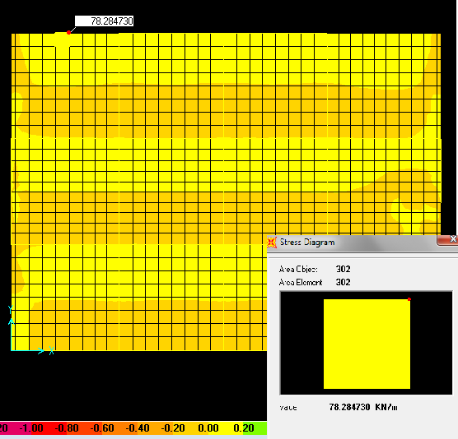

Check Shear for slab
V13 Max
Vu= 95.9KN
V23 Max
Chapter Two

Slide 26
Beam Design
Reinforcement of beams
Beams reinforcement | Area of steel (mm²) | Beam Moments (KN.m) | Length of Span(m)
8Ø 20 | 2235 | -413.5 | 7.65
8 Ø 20 | 2535 | +510
12 Ø 20 | 3595 | -614.3
12 Ø 20 | 3595 | -614.3 | 7.5
5 Ø 20 | 1417 | +289.4
12 Ø 20 | 3521 | -604.4
12 Ø 20 | 3521 | -604.4 | 7.55
7 Ø 20 | 2051 | +415.2
7 Ø 20 | 2138 | -697.8
Chapter Two

Slide 27
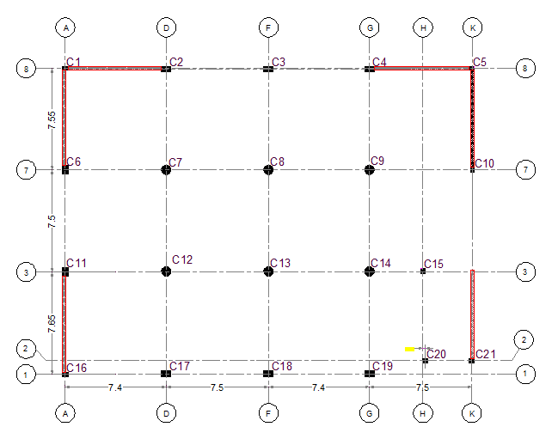
Design of Columns
Columns Layout
Chapter Two

Slide 28
Columns Classification according to SAP2000 Results.
Group # | Groups load(KN) | Maximum load(KN) | Column # | Controlling column# | Type of cur.
1 | < 1000 | 648.2 | 1,5,10,16,21 | 16 | double
2 | 1000-4000 | 3377.1 | 2,4,6,11,15,19,20 | 19 | double
3 | 4000-7000 | 6385.6 | 3,7,8,9,12,13,14,17,18 | 12 | double
Columns Reinforcement Results (Hand Calculations).
Group# | Controlling column# | Pu (KN) | As(mm2) | Reinforcements | Stirrups
1 | 16 | 1779.4 | 1200 | 6ɸ16 | 1ɸ8/300mm
2 | 19 | 3507.7 | 2800 | 14ɸ16 | 1ɸ8/300mm
3 | 12 | 5528 | 3846.5 | 16ɸ18 | 1ɸ8/300mm
Chapter Two

Slide 29
Chapter Three:
Three Dimensional Structural Analysis and Design

Slide 30
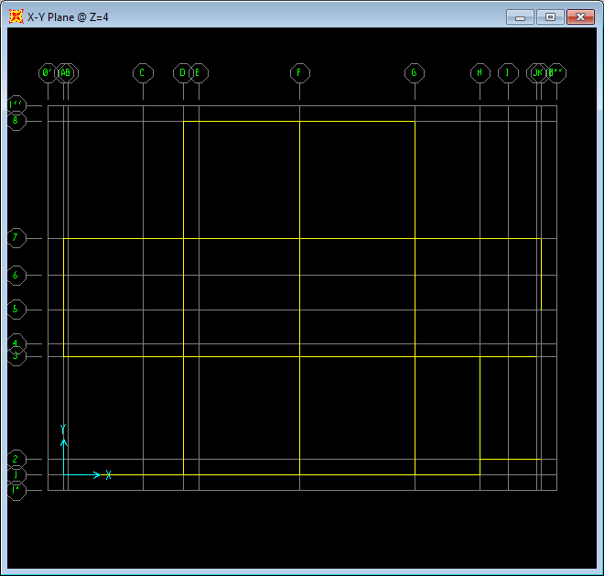
Warehouse SAP Layout
Chapter Three

Slide 31
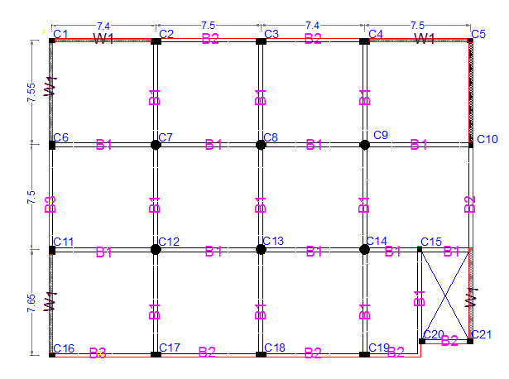
Element |  | Section(mm)
Column | C1,C5,C10,C15,C16,C20,C21 | 300X400
 | C2,C3,C4,C17,C18,C19 | 400X700
 | C6,C11 | 600X400
 | C7,C8,C9,C12,C13,C14 | Dia.=700
Beam | B1 | 600X300
 | B2 | 1000X400
 | B3 | 1050X400
Shear Wall | W1 | Thick=250
Slab | S1 | Thick=200

Slide 32
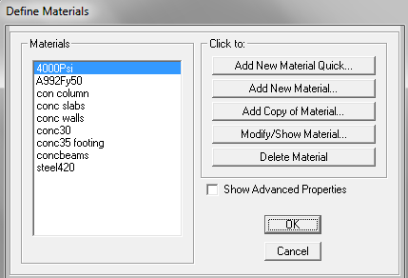
Material Definitions
Material Definition
Chapter Three

Slide 33
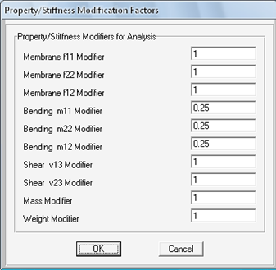
Slab Modification Factors
Slab Modification Factors
Chapter Three

Slide 34
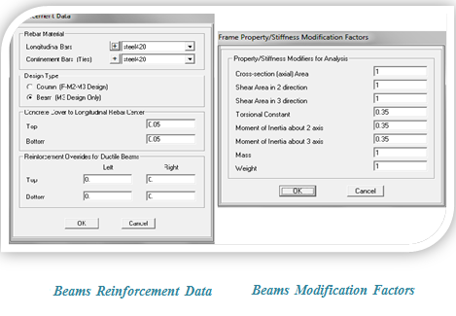
beam modification factors
Chapter Three

Slide 35
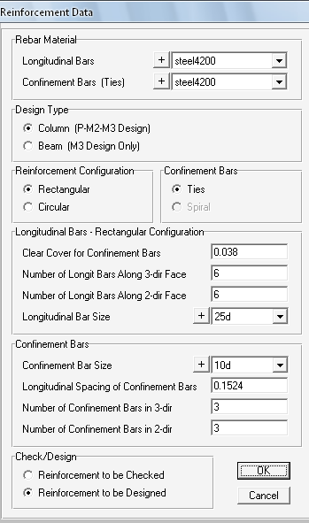
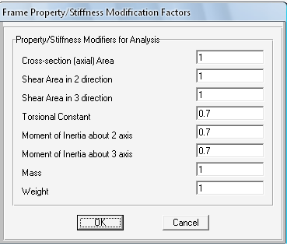
Column modification factors
Reinforcement Column Data
Chapter Three

Slide 36
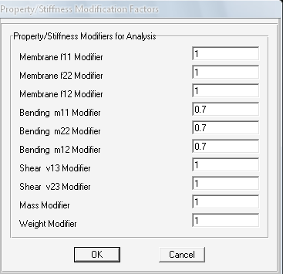
Shear Walls modification factors
Chapter Three

Slide 37
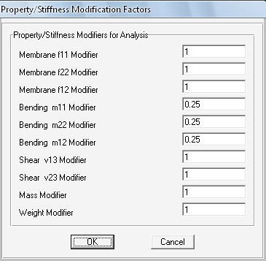
Mat Foundation modification factors
Chapter Three

Slide 38
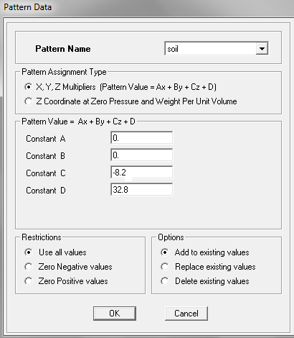
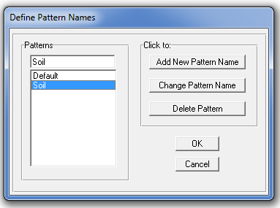
Basement walls modification factors
Chapter Three

Slide 39
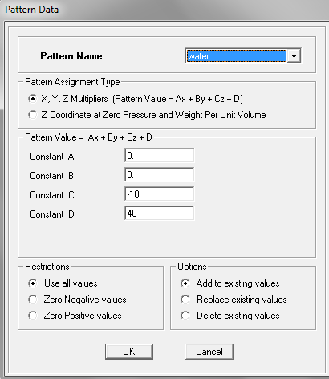
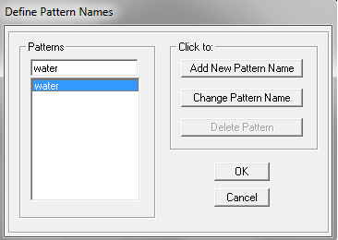
Water tank modification factors
Chapter Three

Slide 40
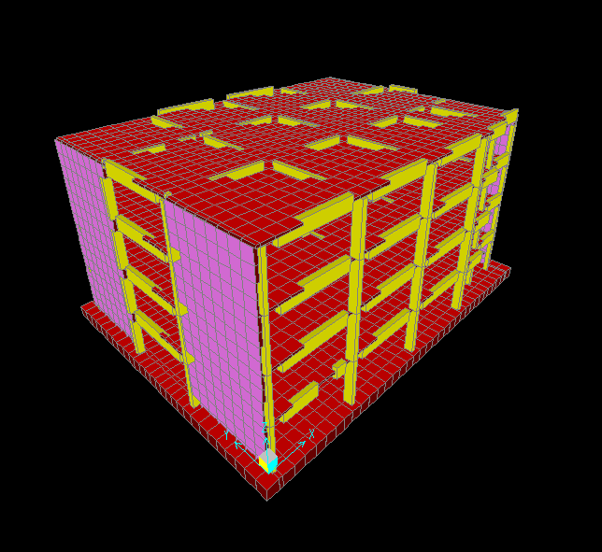
SAP Model
Warehouses SAP Model
Chapter Three

Slide 41
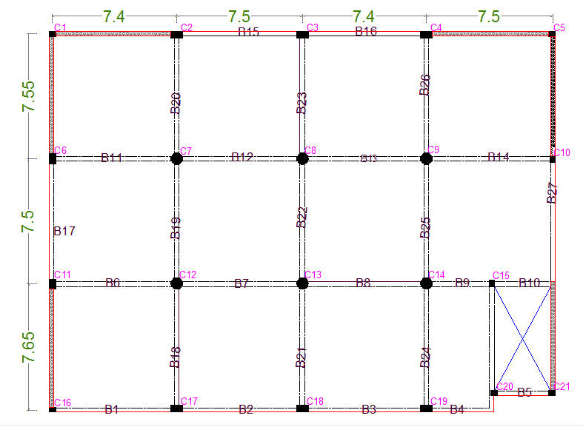
equilibrium Check:
Element | Name | Section (m) | Unit weight (KN/m³) | Dead load (KN)
Column | C1,C5,C10,C15,C16,C20,C21 | 0.3X0.4 | 25 | 336
 | C2,C3,C4,C17,C18,C19 | 0.4X0.7 | 25 | 672
 | C6,C11 | 0.6X0.4 | 25 | 192
 | C7,C8,C9,C12,C13,C14 | Dia.=0.7 | 25 | 923.6
Beam | B1 | 0.6X0.3 | 25 | 2418.3
 | B2 | 1X0.4 | 25 | 1964.8
 | B3 | 1.05X0.4 | 25 | 315
 | Exterior beam | - | 25 | 4062.24
Shear Wall | W1 | Thick=0.25 | 25 | 6510
Slab | S1 | Thick=0.25 | 25 | 25315.2
Footing | Mat Foundation | Thick=1 | 25 | 21013.2
Identification of Structural Elements

Slide 42
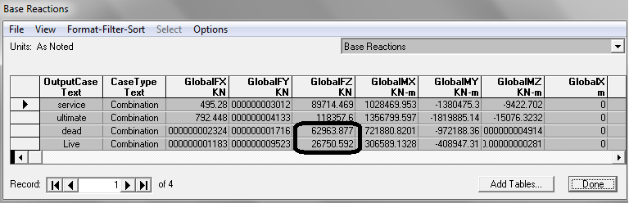

Base reaction
Chapter Three

Slide 43
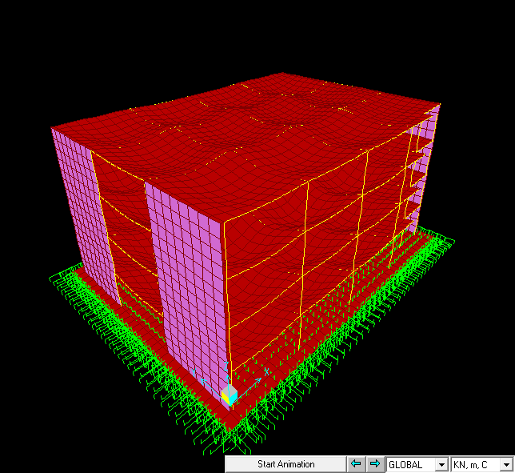
Compatibility Check:
Chapter Three
3-D Model By SAP2000

Slide 44
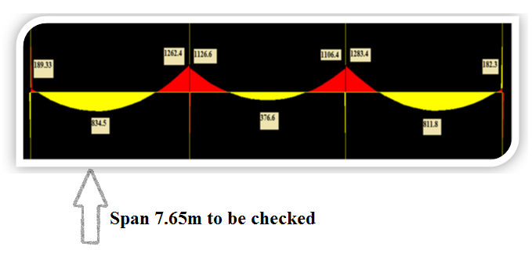
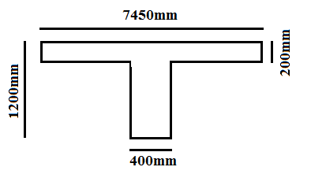

Stress-strain relationships Check:
frame width =7450 mm, the load =213.07KN
Mo=Wu L²/8 =1558.6 KN.m
From SAP, the average moment equal to 1560.3 KN.m
Stress strain relation is ok

Slide 45
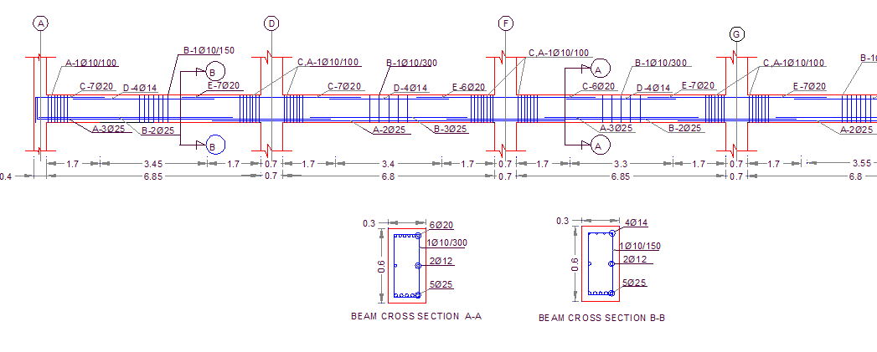
Design of Beams
Beam Reinforcement
Chapter Three

Slide 46
Beams Reinforcement (X-direction)
Beam name (X-direction) | Bottom steel |  | Top steel |  |  | Stirrups
 | A | B | C | D | E | A | B | C
B1 | 2ɸ20 | 2ɸ20 | 4 ɸ20 | 4 ɸ20 | 4 ɸ20 | 1 ɸ10/100 | 1 ɸ10/120 | 1 ɸ10/100
B2 | 2 ɸ20 | 2 ɸ20 | 4 ɸ20 | 4 ɸ20 | 4 ɸ16 | 1 ɸ10/100 | 1 ɸ10/120 | 1 ɸ10/100
B3 | 2 ɸ20 | 2 ɸ20 | 4 ɸ16 | 4 ɸ20 | 3 ɸ12 | 1 ɸ10/100 | 1 ɸ10/120 | 1 ɸ10/100
B4 | 3 ɸ12 | - | 3 ɸ12 | 4 ɸ20 | 3 ɸ12 | 1 ɸ10/150 | 1 ɸ10/300 | 1 ɸ10/300
B5 | 3 ɸ12 | 3 ɸ25 | 3 ɸ12 | 4 ɸ20 | 3 ɸ12 | 1 ɸ10/300 | 1 ɸ10/150 | 1 ɸ10/150
B6 | 2 ɸ25 | 3 ɸ25 | 7 ɸ20 | 4 ɸ14 | 7 ɸ20 | 1 ɸ10/100 | 1 ɸ10/200 | 1 ɸ10/100
B7 | 2 ɸ25 | 3 ɸ25 | 7 ɸ20 | 4 ɸ14 | 6 ɸ20 | 1 ɸ10/100 | 1 ɸ10/300 | 1 ɸ10/100
B8 | 2 ɸ25 | 2 ɸ14 | 6 ɸ20 | 4 ɸ14 | 6 ɸ20 | 1 ɸ10/100 | 1 ɸ10/300 | 1 ɸ10/100
B9 | 2 ɸ12 | 3 ɸ12 | 6 ɸ20 | 4 ɸ14 | 3 ɸ12 | 1 ɸ10/300 | 1 ɸ10/150 | 1 ɸ10/100
B10 | 3 ɸ12 | - | 3 ɸ12 | 4 ɸ14 | 3 ɸ12 | 1 ɸ10/300 | 1 ɸ10/300 | 1 ɸ10/300
B11 | 2 ɸ25 | 3 ɸ25 | 7 ɸ20 | 4 ɸ14 | 7 ɸ20 | 1 ɸ10/100 | 1 ɸ10/150 | 1 ɸ10/100
B12 | 2 ɸ25 | 3 ɸ25 | 7 ɸ20 | 4 ɸ14 | 6 ɸ20 | 1 ɸ10/100 | 1 ɸ10/300 | 1 ɸ10/100
B13 | 2 ɸ25 | 3 ɸ25 | 6 ɸ20 | 4 ɸ14 | 7 ɸ20 | 1 ɸ10/100 | 1 ɸ10/300 | 1 ɸ10/100
B14 | 2 ɸ25 | 3 ɸ25 | 7 ɸ20 | 4 ɸ14 | 6 ɸ20 | 1 ɸ10/100 | 1 ɸ10/150 | 1 ɸ10/120
B15 | 2 ɸ20 | 2 ɸ20 | 4 ɸ12 | 4 ɸ20 | 4 ɸ16 | 1 ɸ10/250 | 1 ɸ10/120 | 1 ɸ10/100
B16 | 2 ɸ20 | 2 ɸ20 | 4 ɸ16 | 4 ɸ20 | 4 ɸ12 | 1 ɸ10/100 | 1 ɸ10/120 | 1 ɸ10/100

Slide 47
Beams Reinforcement (Y-direction)
Beam name (Y-direction) | Bottom steel |  | Top steel |  |  | Stirrups
 | A | B | C | D | E | A | B | C
B17 | 2ɸ20 | 3ɸ20 | 4ɸ14 | 5ɸ20 | 4ɸ14 | 1ɸ10/100 | 1ɸ10/100 | 1ɸ10/100
B18 | 2ɸ25 | 3ɸ25 | 7ɸ20 | 4ɸ14 | 5ɸ20 | 1ɸ10/100 | 1ɸ10/300 | 1ɸ10/100
B19 | 2ɸ25 | 3 ɸ25 | 7ɸ20 | 4ɸ14 | 7ɸ20 | 1ɸ10/100 | 1ɸ10/200 | 1ɸ10/100
B20 | 2ɸ25 | 3 ɸ25 | 5ɸ20 | 4ɸ14 | 7ɸ20 | 1ɸ10/100 | 1ɸ10/300 | 1ɸ10/100
B21 | 2ɸ25 | 3 ɸ25 | 7ɸ20 | 4ɸ14 | 5ɸ20 | 1ɸ10/100 | 1ɸ10/300 | 1ɸ10/100
B22 | 2ɸ25 | 3 ɸ25 | 7ɸ20 | 4ɸ14 | 7ɸ20 | 1ɸ10/100 | 1ɸ10/200 | 1ɸ10/100
B23 | 2ɸ25 | 3 ɸ25 | 6ɸ20 | 4ɸ14 | 7ɸ20 | 1ɸ10/100 | 1ɸ10/300 | 1ɸ10/100
B24 | 2ɸ25 | 3 ɸ25 | 6ɸ20 | 4ɸ14 | 6ɸ20 | 1ɸ10/100 | 1ɸ10/150 | 1ɸ10/100
B25 | 2ɸ25 | 3 ɸ25 | 6ɸ20 | 4ɸ14 | 6ɸ20 | 1ɸ10/100 | 1ɸ10/150 | 1ɸ10/100
B26 | 2ɸ25 | 3 ɸ25 | 5ɸ20 | 4ɸ14 | 6ɸ20 | 1ɸ10/100 | 1ɸ10/200 | 1ɸ10/100
B27 | 3ɸ14 | 3 ɸ14 | 5ɸ20 | 4ɸ14 | 4ɸ14 | 1ɸ10/100 | 1ɸ10/250 | 1ɸ10/200
B28 | 3ɸ14 | 3 ɸ14 | 3ɸ12 | 5ɸ20 | 3ɸ12 | 1ɸ10/300 | 1ɸ10/150 | 1ɸ10/300

Slide 48
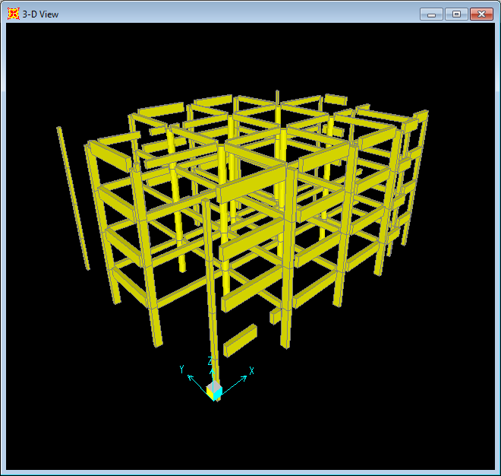
Design of columns
Chapter Three

Slide 49
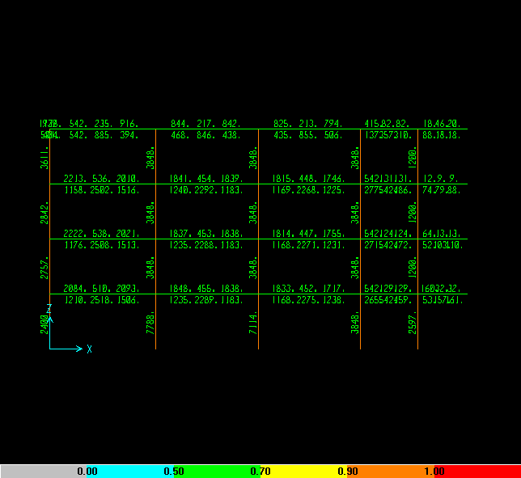
Chapter Three
Frame Taken By SAP

Slide 50
Columns group | Column dimensions(mm) | Column ID | As (mm²) | Reinforcement | Tie reinforcement | Remarks
1 | 300*400 | C10 | 1476 | 6ɸ18 | 1 ɸ10/250mm | -
 |  | C1,C5,C21 | 1200 | 6ɸ16 | 1 ɸ10/250mm
 |  | C20 | 3005 | 12ɸ18 | 1 ɸ10/250mm
2 | 400*600 | C6,C11 | 2400 | 12ɸ16 | 1 ɸ10/250mm | Double Stirrups
3 | 400*700 | C2,C4 | 2000 | 8ɸ18 | 1 ɸ 10/250mm | Double Stirrups
 |  | C19 | 2800 | 12ɸ18 | 1 ɸ10/250mm
 |  | C3 | 4622 | 10ɸ25 | 1 ɸ10/300mm
 |  | C17,C18 | 5527 | 12ɸ25 | 1 ɸ10/300mm
4 | Dia.=700 | C14 | 3448 | 16ɸ18 | 1 ɸ10/300mm | -
 |  | C8 | 6761 | 14ɸ25 | 1 ɸ 10/200mm
 |  | C7,C9,C15 | 7214 | 15ɸ25 | 1 ɸ10/250mm
 |  | C12 | 7783 | 16ɸ25 | 1 ɸ10/250mm
Column Reinforcing
Chapter Three

Slide 51

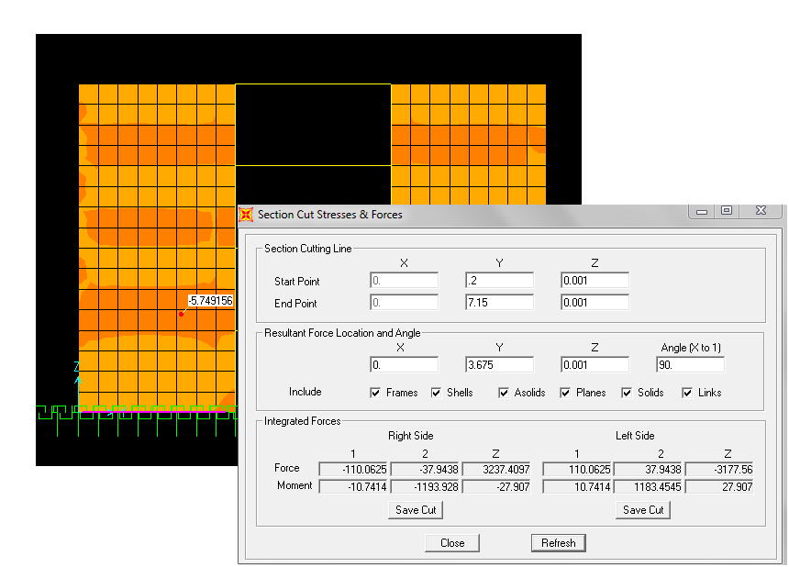
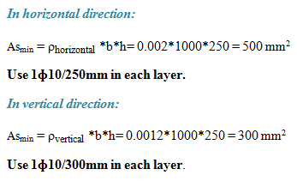
Design of walls
1. Shear Walls:
Take wall 1 as an Example:
ɸPn =2011 KN
Pu =452.8 KN
Section Cut in Wall 1

Slide 52
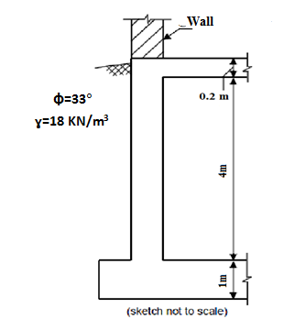
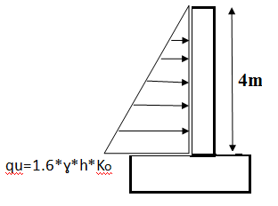
Design of walls
2. Basement Wall:
Soil load on basement wall
Chapter Three

Slide 53
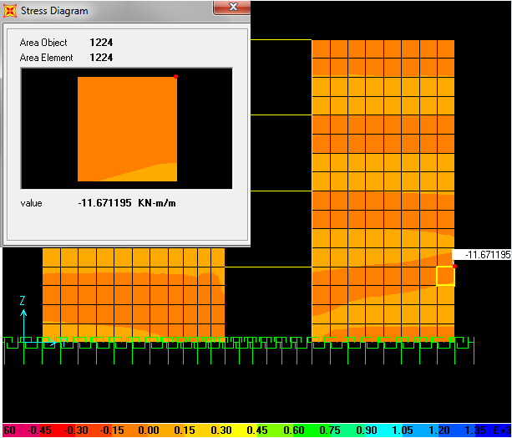
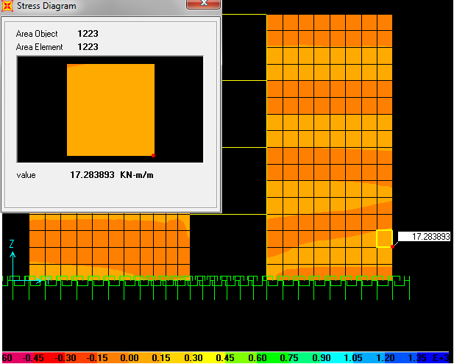
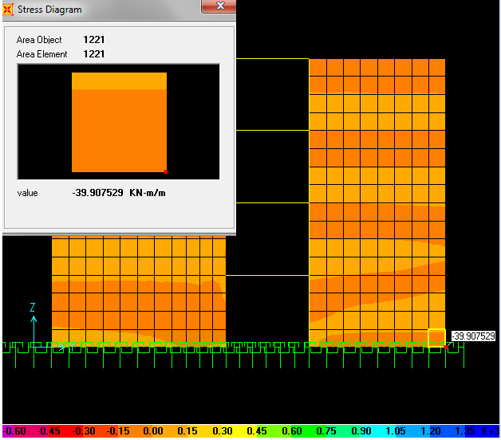
Design of walls
SAP Results of moment
Chapter Three

Slide 54
Design of walls
Moment values from SAP(KN.m) | As_{min}(mm²) | As(mm²) | Reinforcement
11.67 | 450 | 172.6 | 1 ɸ12/250 mm
17.3 | 450 | 172.1 | 1 ɸ12/250 mm
39.9 | 450 | 603.6 | 1ɸ12/150 mm
Reinforcement of basement wall
Chapter Three

Slide 55
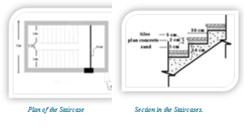
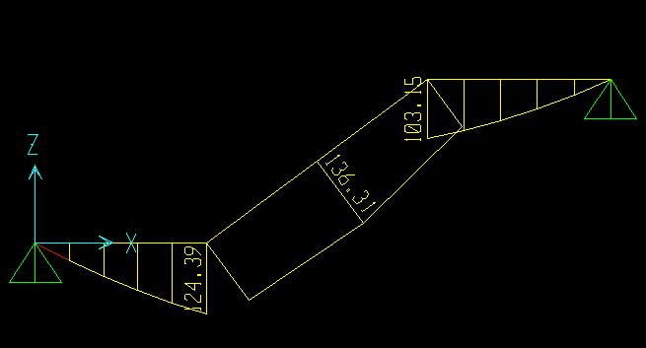
Design of stairs
Chapter Three

Slide 56

Design of stairs
Reinforcement | As ( mm²) | As_{min} (mm²) | Section dimensions(mm²) | Mu (KN.m) | Stair section
10 ɸ16 | 1889 | 360 | 200*1000 | 103.15 | Landing1
13 ɸ16 | 2602 | 360 | 200*1000 | 136.3 | flight
12 ɸ16 | 2338 | 360 | 200*1000 | 124.39 | Landing2
Chapter Three

Slide 57



Design of foundation
Mat thickness= 1m
Chapter Three

Slide 58

As an example , design frame 4-4 in Y direction
Chapter Three

Slide 59




Moment Values of Mat Foundation
Chapter Three

Slide 60




Chapter Three

Slide 61



Chapter Three

Slide 62

Design of Water Tank
3-D view of water tank
Chapter Three

Slide 63



Shear Check of Water Tank Elements
Chapter Three

Slide 64
Element | Thickness(m) | Vu(KN) | ɸVc
Roof | 0.15 | 13.42 | 68
Walls | 0.3 | 45.98 | 157.5
Mat foundation | 0.5 | 32.59 | 308
Shear in OK
Chapter Three

Slide 65




Flexural Design of Water Tank:
Chapter Three

Slide 66

Thank you
for Your Patience and Attention

