Slide 1

An-Najah National University
Engineering Faculty
Civil Engineering Department
Construction project management
Submitted in partial fulfillment of construction project management for the bachelor degree in civil engineering
Prepared by:
Omar Dao’ur Abed-Allah Sawalmeh
Mohammad Fu’ad Mohannad Abu Semri
Submitted to:
Dr. Barraq Joma’a
2011

Slide 2
Part One
Project management principles

Slide 3
The definition of (project)?
A project is a temporary endeavor undertaken to accomplish a unique product or service with a defined start and end point and specific objectives that, when attained, signify completion.
PMBOK

Slide 4
what do we mean by (Project Management)?
Project management is the discipline of planning, organizing, securing and managing resources to bring about the successful completion of specific project goals and objectives. It is sometimes conflated with program management, however technically that is actually a higher level construction: a group of related and somehow interdependent engineering projects.
Project management is the application of knowledge, skills, tools, and techniques to project activities in order to meet or exceed stakeholder needs and expectations from a project.

Slide 5
Project management is the science (and art) of organizing the components of a project, whether the project is development of a new product, the launch of a new service, a marketing campaign, or a wedding. A project isn't something that's part of normal business operations. It's typically created once, it's temporary, and it's specific. As one expert notes, "It has a beginning and an end." A project consumes resources (whether people, cash, materials, or time), and it has funding limits.

Slide 6
Project Management basics
Definition
Planning
Execution
Control
Closure

Slide 7
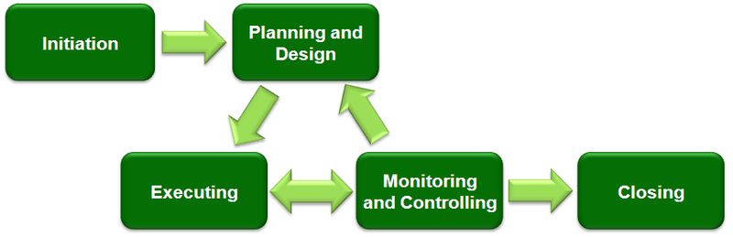

Slide 8

The triple constraint

Slide 9
Part Two The applied project

Slide 10
Description of the project
The project is a school building
Sites in Sulfeet – West Bank
The owner is the ministry of education – Palestinian Authority
The building consists of three stories
The area of the school is 671m2
The price of one square meter is 1383.1 NIS

Slide 11
Sequence of works
The main steps we have followed in our project is:
Work Breakdown Structure (WBS).
Quantity surveying.
Bill of quantity (BOQ) preparation; quantities, cost, resources, and man hours.
Activities durations.
Project cost.
Project duration.

Slide 12
WBS
Work breakdown structure is a tool used to define and group a project's discrete work elements in a way that helps organize and define the total work scope of the project.

Slide 13
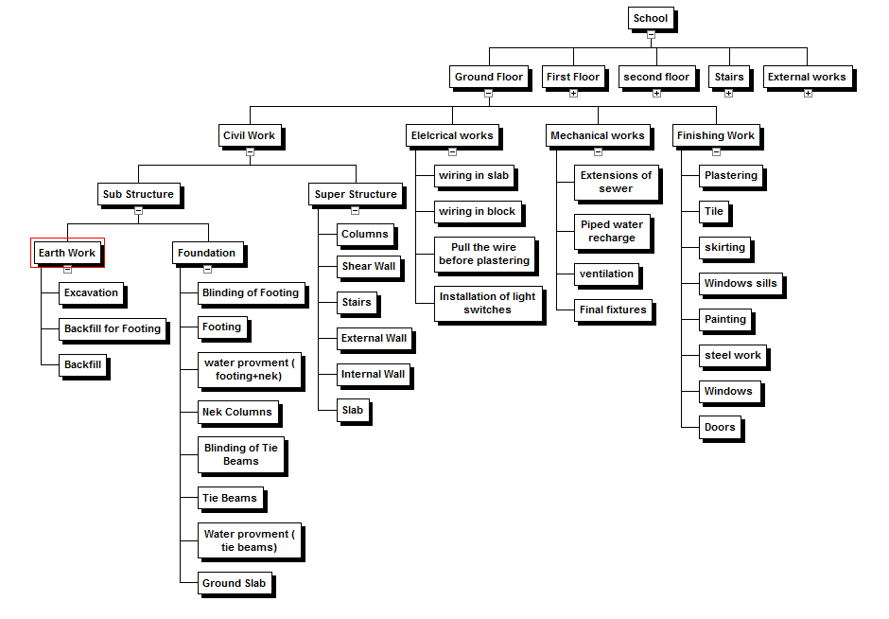
WBS of the project

Slide 14
Quantity surveying
We have used M.Excel to find the quantities of each activity due to the WBS, the calculations include (steel, concrete, frame work,..etc).
We have used the symmetry (if there), to facilitate the calculations.
For example there are five different volumes of footings, we have calculated for one footing of each type then multiple with its number.

Slide 15
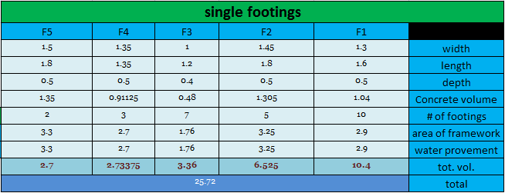
Sample calculation
Calculations of concrete volumes and frame work areas:

Slide 16
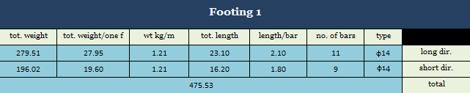
(Cont’d)
Calculations of steel weighs:

Slide 17
Activities durations :
Duration =( Mhr*total quantity) /n. of labors * no of hours
In this project : the labor work in crew such as civil crew included 5 workers and work 8 hours in day
Example :
The steel for the first slab = 5.7 ton and Mhr for steel in slab = 25
Duration =( 5.7 * 25 ) /(5*8) = 3.56 days
This means you need one crew to finish steel work in slab in 4 days

Slide 18
Project Budgeting
Estimation cost of the material , labor and non labor, for each activity , it was collect tha data from contractors .
And here some excel calculation

Slide 19
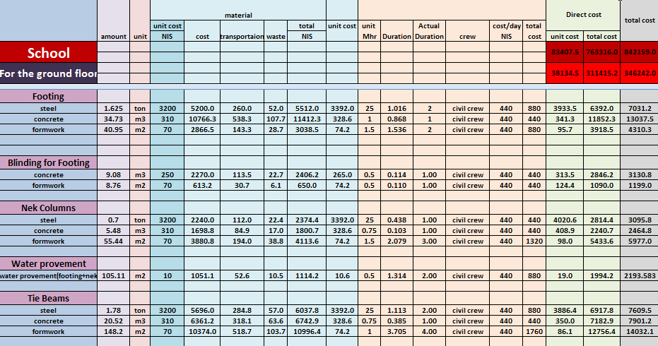
Calculate the cost of resources (Labor/Material/ equipment)

Slide 20
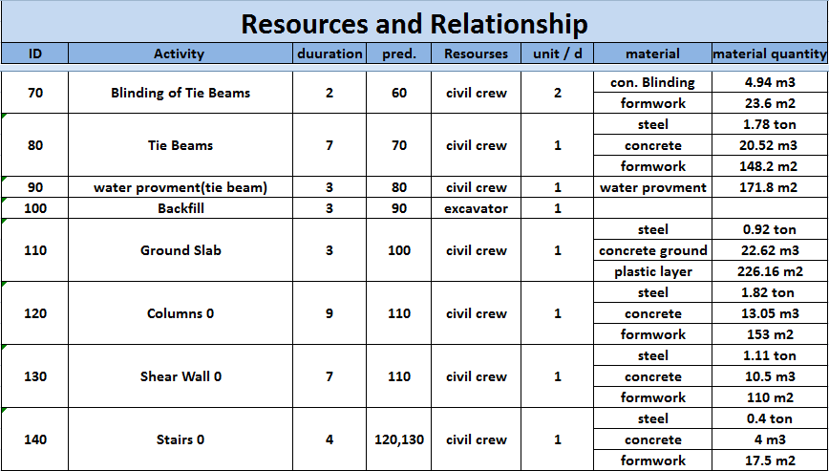

Slide 21
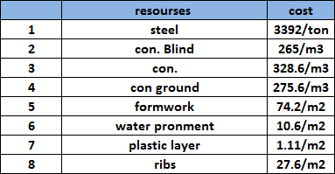
Resources and cost

Slide 22
Primavera analysis
The primavera used to :
Scheduling
Project network
Project budgeting
Project duration and CBM analysis
Resources leveling

Slide 23
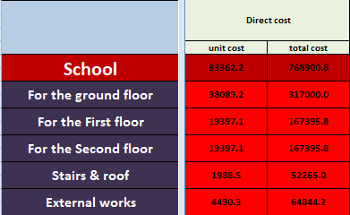
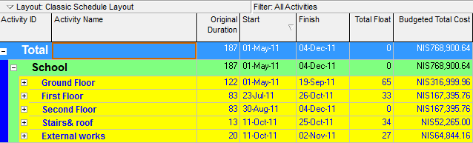
768900.8
Result from excel
768900.64
Result from primavera
The result excel and primavera are the same

Slide 24
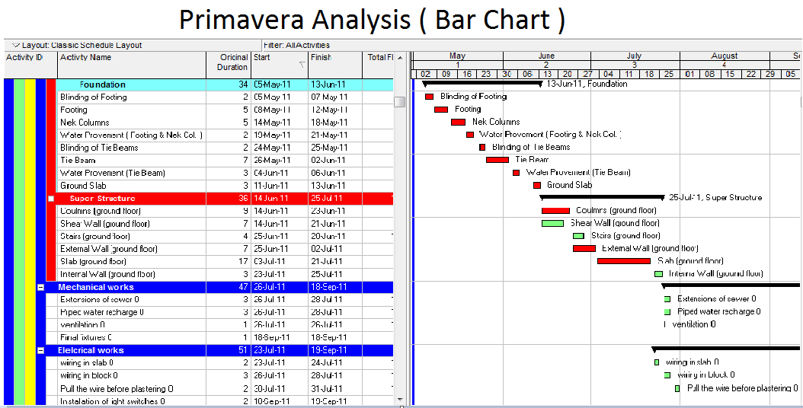

Slide 25
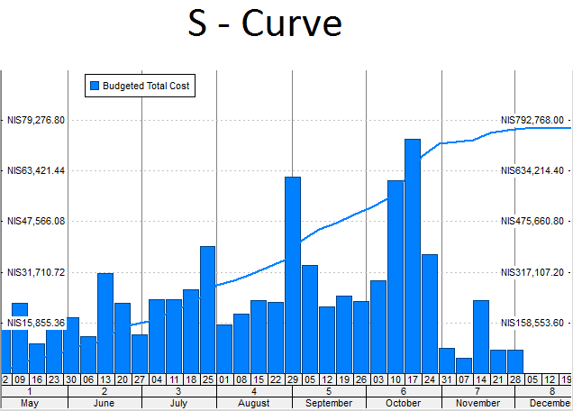

Slide 26
conclusion
The quantity surveying for each activity most be calculated according to work breakdown structur,and then the cost for activity must be determined to calculate total cost and total duration on the project.
The management principle must be used to determine the early start, early finish, free float, total float for each activity.
Time and cost most be separately

Slide 27
Cont’d
The scheduled project duration is 187 work days
38 % of activities are critical .
The price per meter square as total is approximately 1383.1 NIS
The project indirect cost estimated to be 10 % of total cost .
The profit of the project is 10 % of the total cost ( direct & indirect )

Slide 28
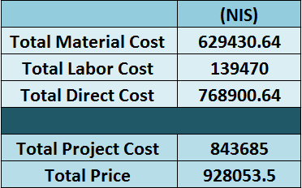

Slide 29
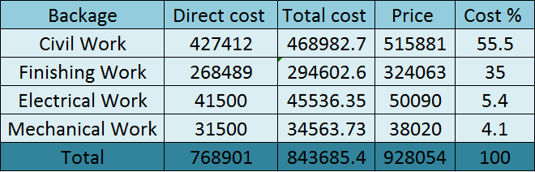

Slide 30
Thank you for
your attention

