Slide 1
The blind Eye
Faculty of Engineering
An-Najah
National University
Alaa Omar
Rana Diab
Supervised by
Dr.Raed Jaber
2016-2017

Slide 2
Outlines
-Introduction
-Methodology
-Design
-Cost
-Results
-Conclusion
-Future Work

Slide 3
Introduction
Problem Definition
Blindness is a condition of lacking the visual perception due to physiological or neurological factors partially or
fully.
4% visually
Impaired
285 million
Others
96%
7 milliard
Types of Visually impaired:
Low vision People
Blind people

Slide 4
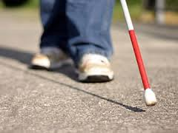
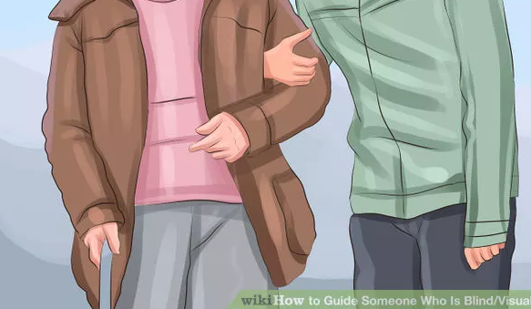
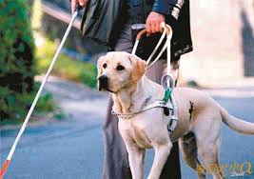
Introduction
Problem Definition
Traditional tools that help blinds in their daily work
White Cane Human Guide Guide Dog

Slide 5
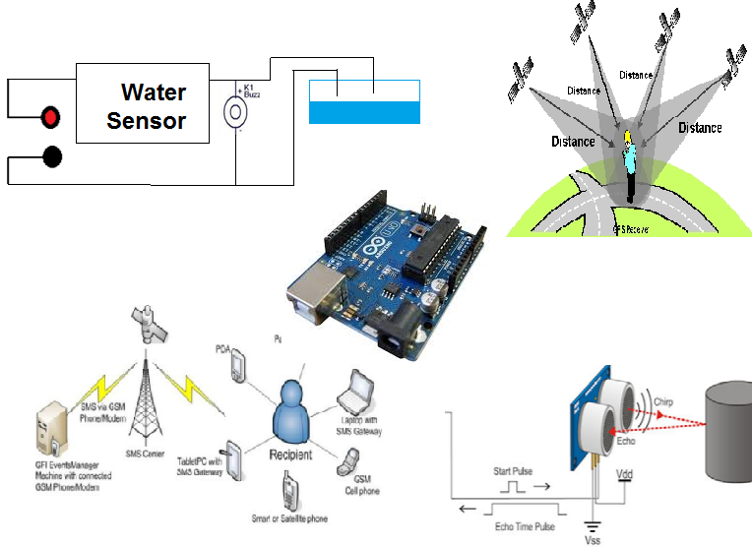
Introduction
Problem Solution
Electronic Aids

Slide 6
Introduction Objectives
-The project aims to facilitate the movement of blind and visually impaired.
-Enabling the blind to reach places without other help and communicate with the institutions of society.
-Connect the blind with his family .
-Reduce the accidents that the visually impaired or blind people exposed to.
-Identify the location of the blind person .

Slide 7
Methodology
Power
Water Sensor
GPS & GSM module
Ultrasonic Sensor
Buzzer
Push-Button
Arduino
Vibration Motors
Massage Sent

Slide 8
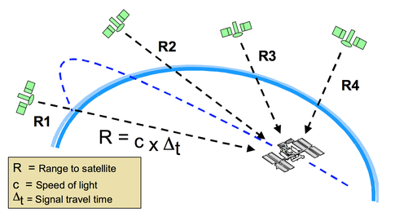
Methodology
GPS System
Principle of Work of GPS system
Three satellites are needed to determine latitude and longitude, while a fourth satellite is necessary to determine altitude.
In simple mathematical terms:
Distance is measured by how long the signal takes to reach the receiver's position multiplied by the speed of light.

Slide 9
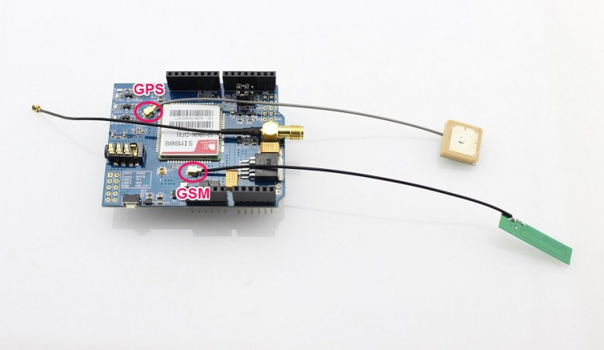
SIM808 GPRS/GSM+GPS Shield v1.1
Two-in-one function module.
The module is controlled by AT command via UART and supports 3.3V and 5V logical level
Supply voltage range 5V ~ 12V
Standard Micro SIM Card
Low power consumption, 1mA in sleep mode.
:Module Application
- Vehicle Tracking System
- Remote control of appliances
- Autism and Alzheimer patients and children

Slide 10
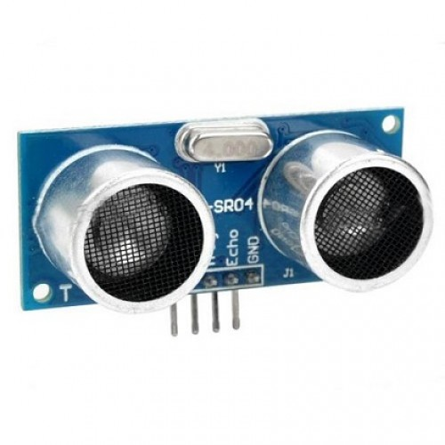
Ultrasonic Sensor
Features of Ultrasonic sensor
-low-cost
-easy method of distance measurement.
-Availability
Electric Parameter of Ultrasonic
Working Voltage | DC 5 V
Working Current | 15mA
Working Frequency | 40Hz
Max Range | 4m
Min Range | 2cm
Measuring Angle | 15 degree
Trigger Input Signal | 10uS TTL pulse
Echo Output Signal | Input TTL lever signal and the range in Proportion
Dimension | 45*20*15mm

Slide 11
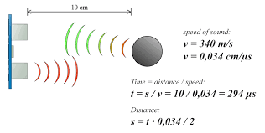
Ultrasonic Sensor
Ultrasonic transmitter transmits the signal in one direction.
The transmitted signal is then reflected back whenever there is an obstacle and it is received by the receiver.
The total time taken by the signal to get transmitted and to received back will be used to calculate the distance between the ultrasonic sensor and the obstacle.

Slide 12
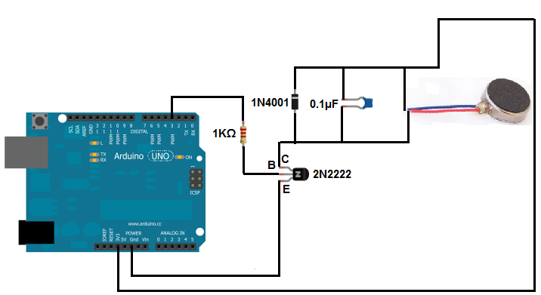
Vibrating Motor
-1027 Flat Vibrating Motor.
-lightweight.
-very good for vibrating objects. The most common use of it is in cell phone .
:-Vibration motor circuit
- 2N2222 Transistor
-Diode.
- 0.1µF Capacitor.
- 1kΩ Resistance .

Slide 13
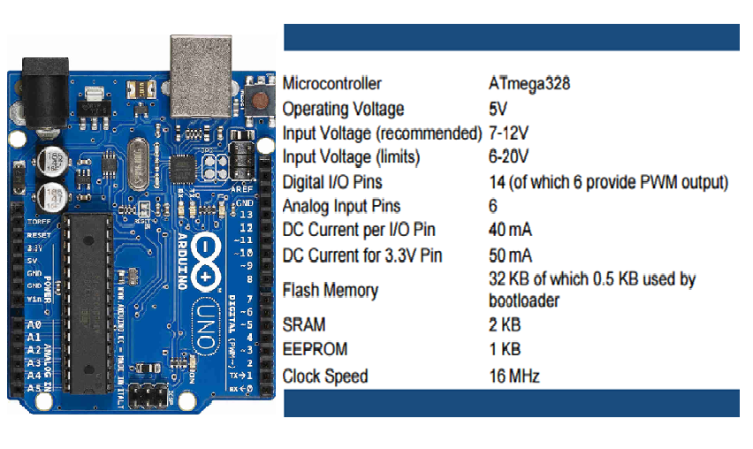
Arduino UNO

Slide 14
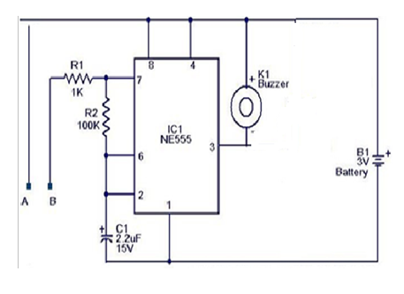
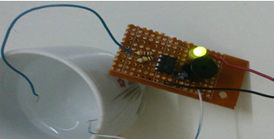
Water Sensor
Water alarm circuit consists of 555 timer that produces an audible
alarm when the terminal wires touch water.
It is placed at the bottom of the stick.

Slide 15
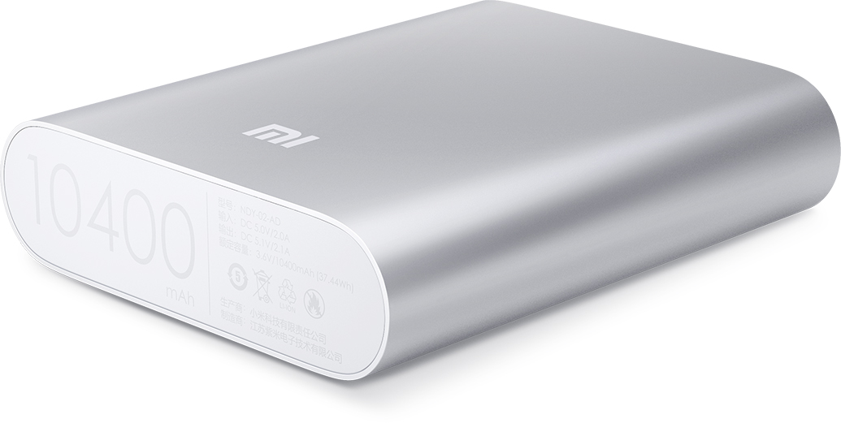
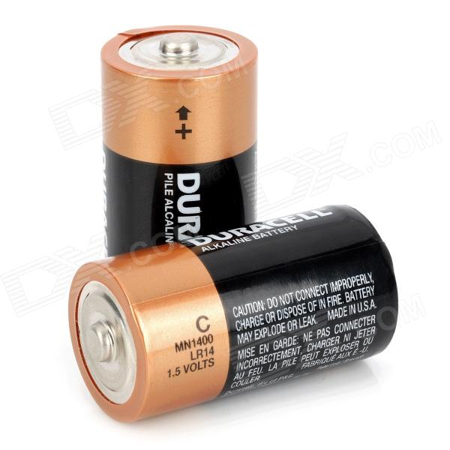
External Power
The power used to supply two Arduino is 9 V battery for first one and 2A power bank for the other one.
Water sensor is fed by 3V

Slide 16
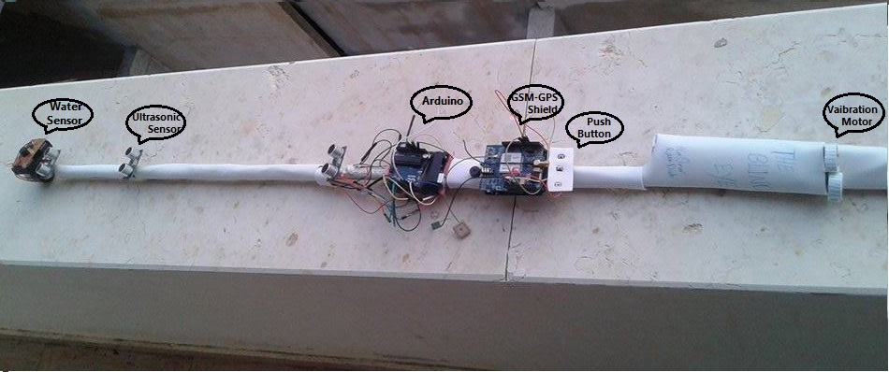
Design
The design stands on white cane .It is chosen because it`s most common walking method for blind so that it is most convenient for them.

Slide 17
Cost
Table below shows the cost of the project components.
Total cost | Price/each | Quantity | vendor | Part Number
13$ | 6.5$ | 2 | ITeC | Arduino Uno
3$ | 1$ | 3 | ITeC | Ultrasonic Sensors
73$ | 73$ | 1 | Technolab | GPS-GSM-GPRS Module
2$ | 2$ | 1 | ITeC | 9V Battery
2$ | 1$ | 2 | ITeC | Wire
6$ | 3$ | 2 | Technolab | Vibrating Mini Motor
1$ | 0.5$ | 2 | ITeC | Buzzer
0.6$ | 0.1$ | 6 | ITeC | Resistors
0.5$ | 0.5$ | 1 | ITeC | Timer
0.2$ | 0.1$ | 2 | ITeC | capacitors
0.4$ | 0.2$ | 2 | ITeC | Transistors(2N2222)
0.2$ | 0.1$ | 2 | ITeC | Diode(1N4001)
0.3$ | 0.1$ | 3 | ITeC | Bush Button
102.2$ |  |  |  | Total Cost

Slide 18
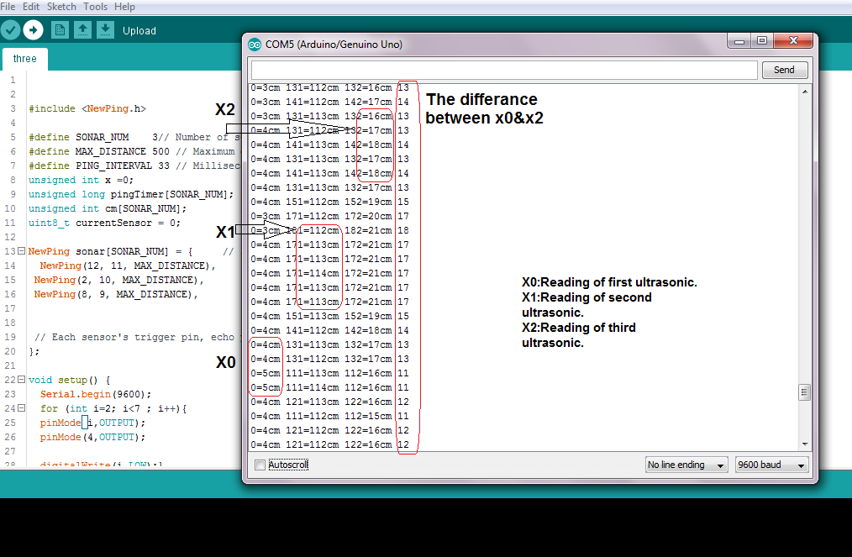
Results
Readings of Three Ultrasonic Sensors

Slide 19
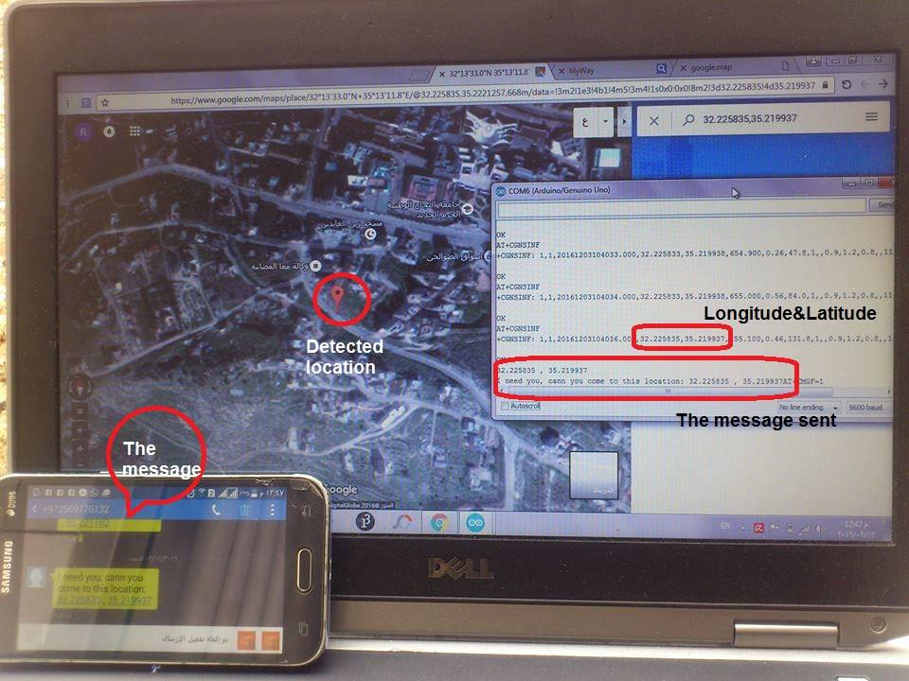
Results
Send a message for Registered numbers.

Slide 20
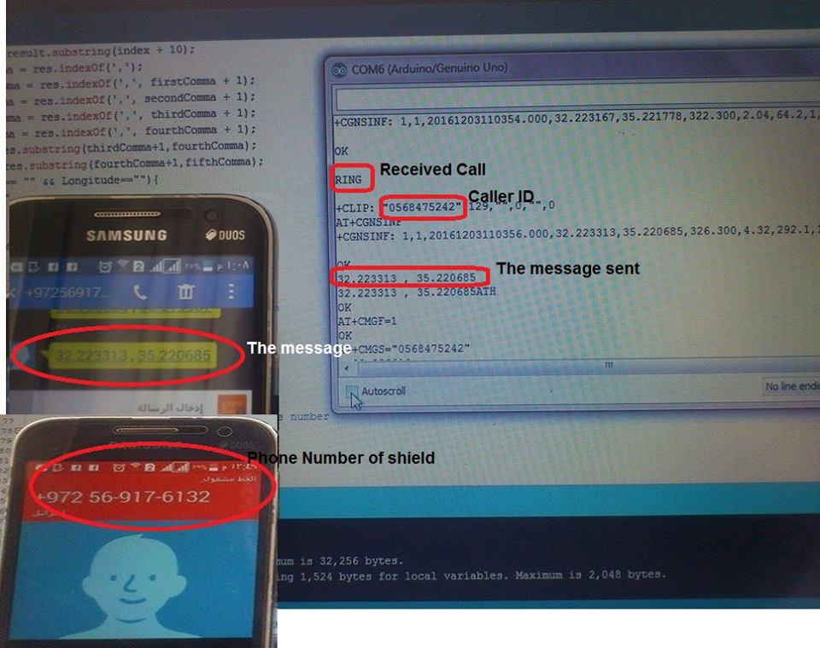
Results
making a call to detect the location of the shield.

Slide 21
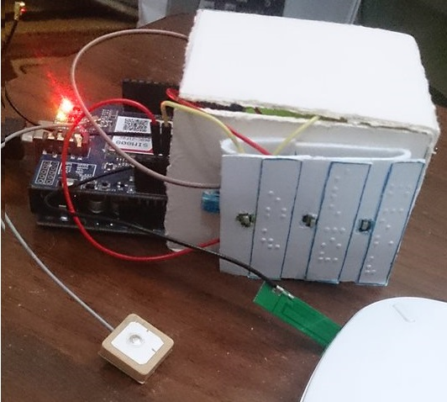
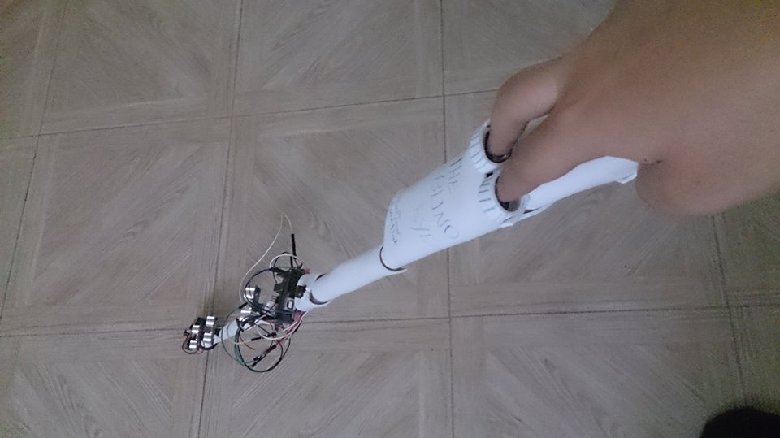
Conclusion
The main objective of this project is to assist blind or visually
impaired people to safely move among obstacles and other hurdles
faced them in their daily life, this also reduces the dependency on other
family members, friends and guidance dogs while walking around .

Slide 22
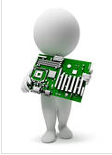
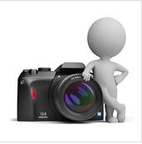
Future Work
For future enhancements, more powerful sensors can be integrated in the project to provide the detection of obstacles in a wider range.
Project could be enhanced by using other techniques such as
-RFID for indoor navigation
-Camera to make it easier for the blind to recognize objects faced him.
-The project could be developed by design a mobile application that identify blind his location, and guide him to right way with help of headphones and google mapping.

Slide 23
Questions

