Slide 1
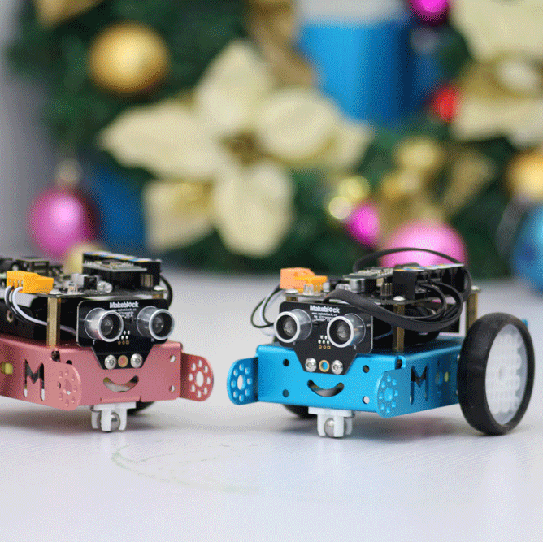
Smart Car

Slide 2
Introduction

Slide 3
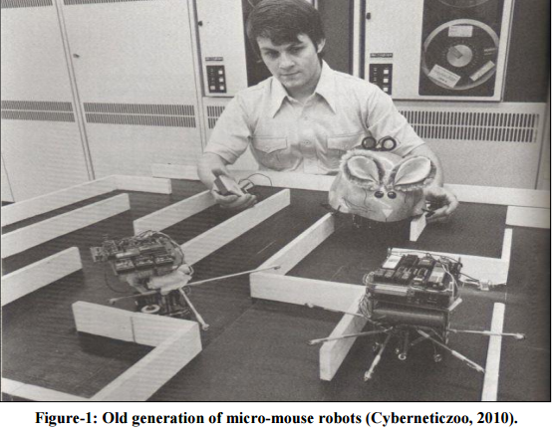

Slide 4
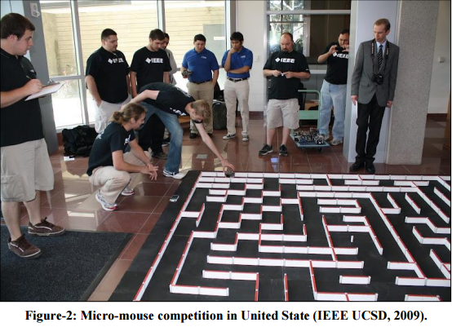
micro mouse competition

Slide 5
Objectives:
Programmed a robot to solve the maze using fill flood algorithm.

Slide 6
1-Self driven car
Theory :

Slide 7
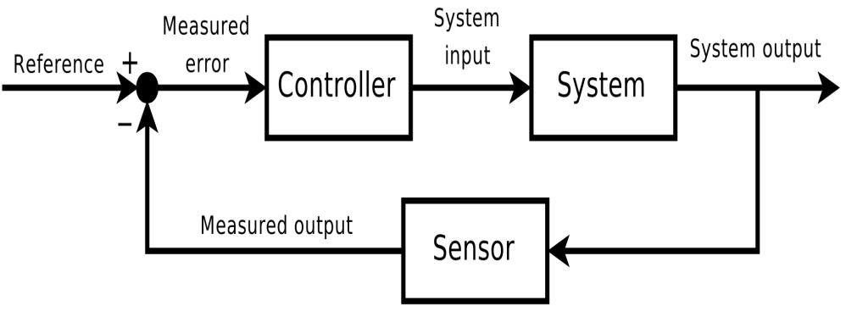
2- Closed loop

Slide 8
Electrical Part

Slide 9
Electrical Part
Motors
Sensors

Slide 10
Motors
We will use two types of motors:
DC motor
Servo motor

Slide 11
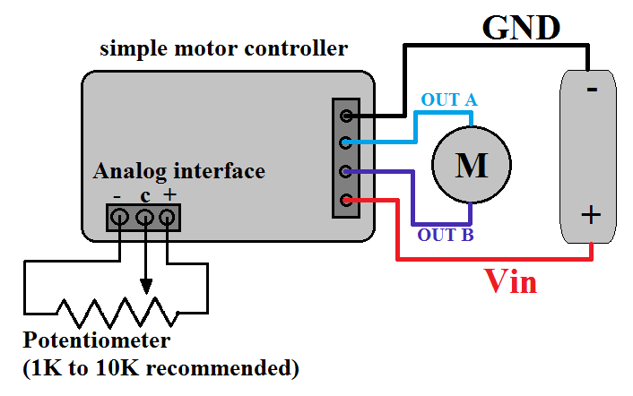
DC motor
motor drive control system

Slide 12
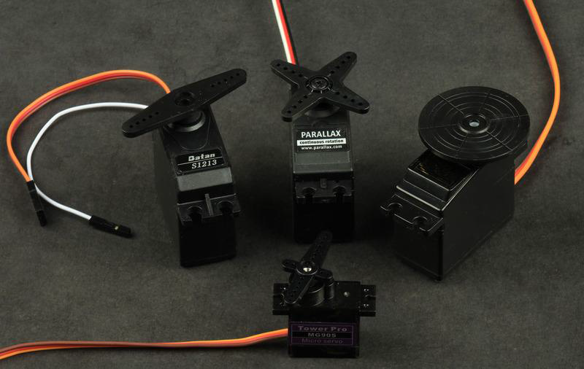
Servo motor
Feedback to the internal controller

Slide 13
Sensors
We will use two types of it :
ultarsonic sensor
IR sensor

Slide 14
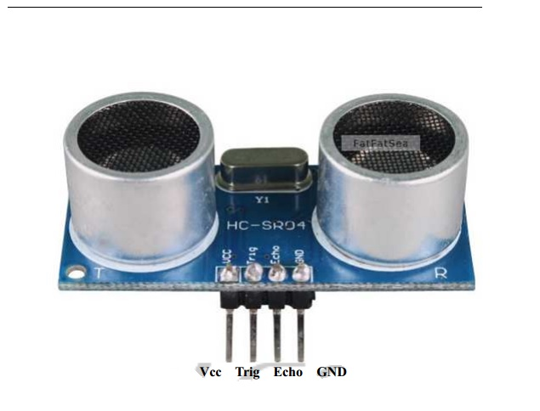
Ultarsonic Sensor

Slide 15
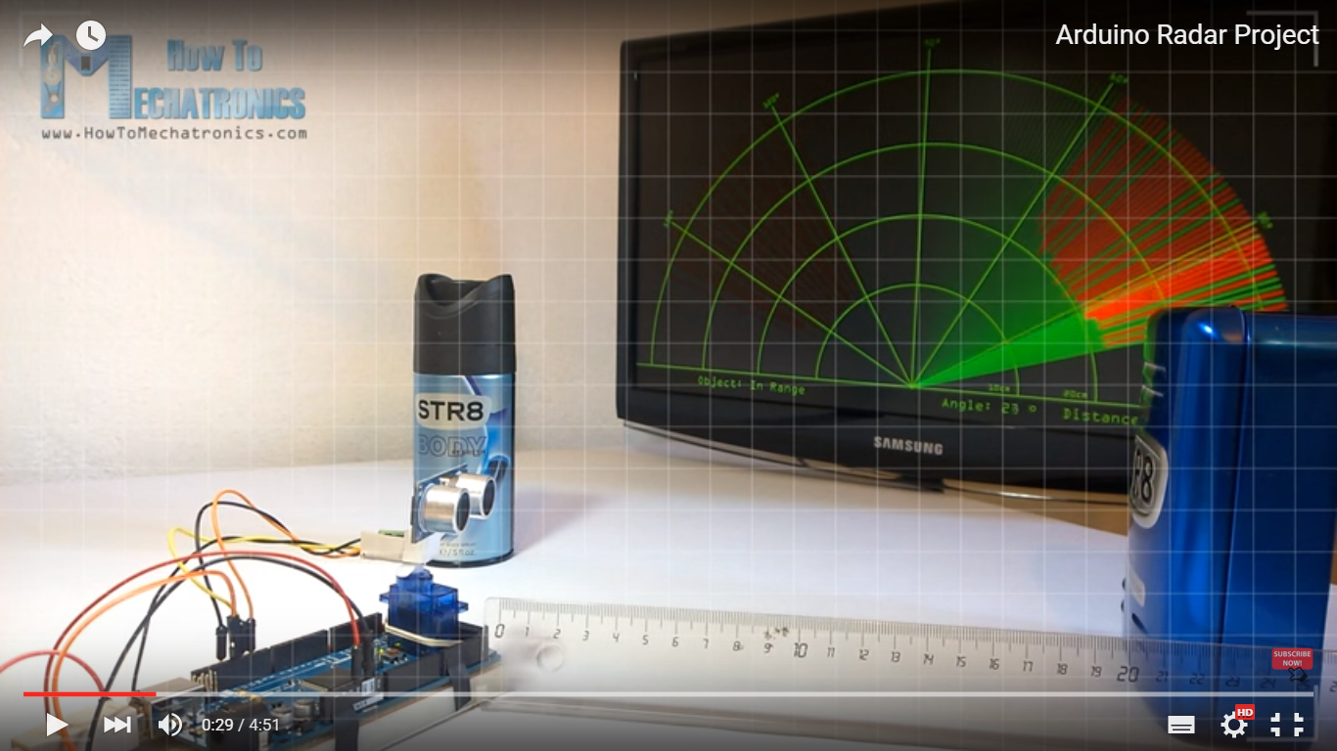

Slide 16
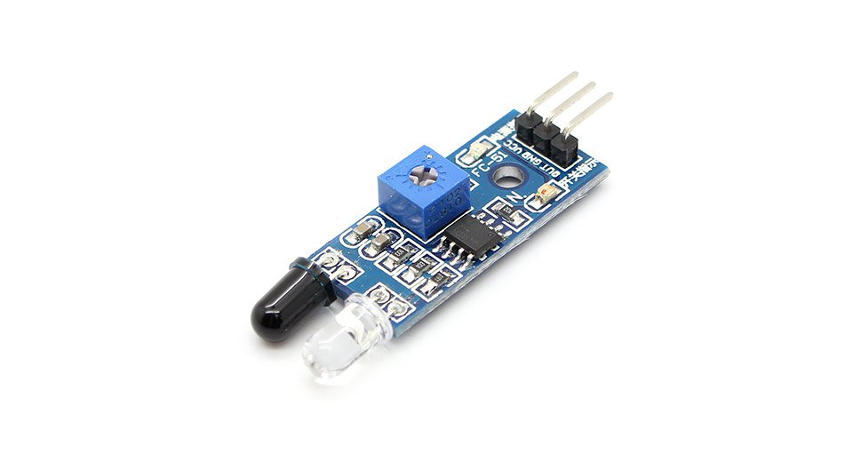
IR sensor

Slide 17
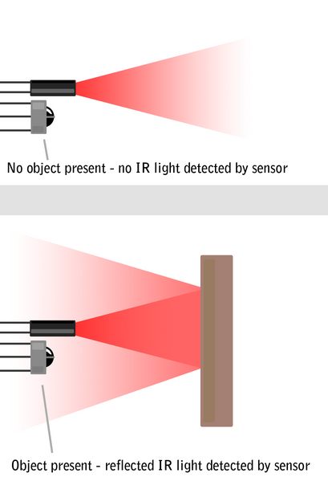
Operation of an IR Sensor

Slide 18
Hardware and
Software Description

Slide 19
Hardware

Slide 20
Hardware and Software Description
The control system of our project consists of two main type:
hardware components
software interface

Slide 21
Hardware
Hardware components include a variety of electrical and electronic components:
H-Bridge
Arduino

Slide 22
H-Bridge
Used it to change the direction of a motor, the direction of current flows and the polarity of the voltage of the motor terminal should be reversed.

Slide 23
H-bridge with four switches

Slide 24
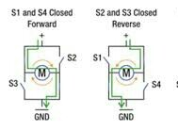
Acceptable H-bridge states

Slide 25
There is a danger in this circuit

Slide 26
Arduino
I/O platform based on open source code
language Processing
Arduino can be used with some electronic components

Slide 27
Arduino Boards
There are many, and manufacturers are constantly releasing new ones with various features

Slide 28
Arduino Uno
Is a microcontroller board.
It is made up of more component.

Slide 29
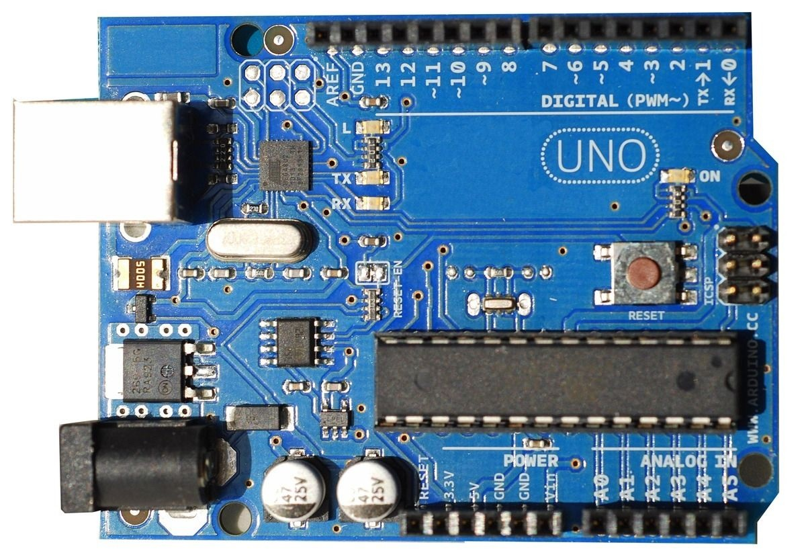

Slide 30
software

Slide 31
software
Software control part is represented by the Arduino IDE software that provides a software environment to control the machine.

Slide 32
Arduino IDE
Arduino boards are programmed by using an Arduino Integrated Development Environment.
The C programming language is used to write a computer programme
Upload to the Arduino board using a USB cable
ability to see the results of the inputs and outputs of the microprocessor.

Slide 33
Mapping System
Maze
Steps:
Wall
New distance
Lowest distance

Slide 34
We used this circuit to change the direction of the motor.

Slide 35
conclusions

Slide 36
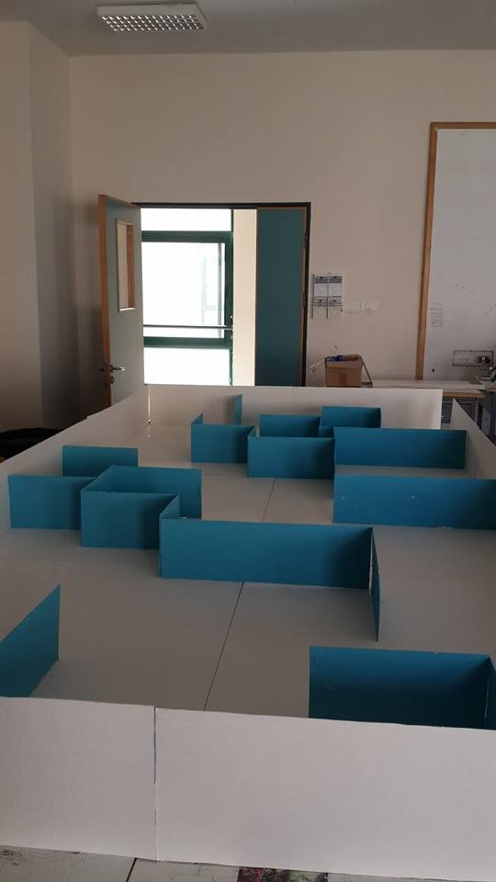

Slide 37
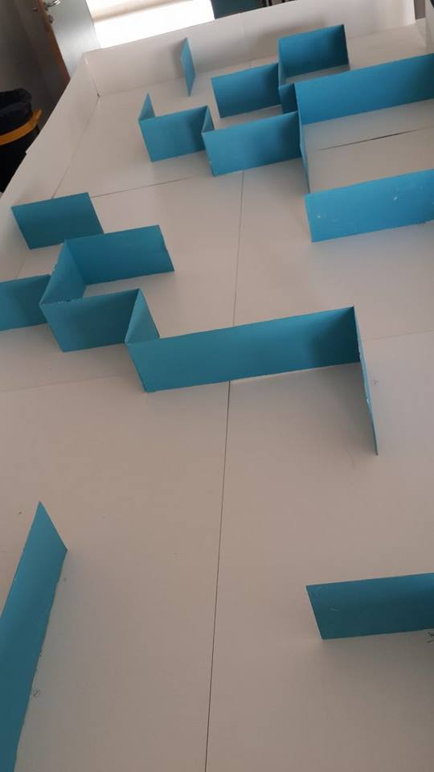

Slide 38
Thanks all

