Slide 1
بسم الله الرحمن الرحيم

Slide 2

Foundation design for Al Ashqar center
An-Najah National University
Faculty of Engineering
Civil Engineering Department
Prepared by:
Eslam Horani
Zaid Saidi
Supervisor:
Dr.Sami Hijjawi.

Slide 3
The Project
The site is located in Tulkarem city.
The building consists of seven stories, and the area of each stories is about 700 m² , the aim of this research is to design foundations that are practical and economic.

Slide 4

Project continue ………..

Slide 5
This project contains :
Chapter one: Introduction.
Chapter two: literature view .
Chapter three: site investigation and soil report.
Chapter four: Geotechnical and structural design of foundation.
Appendix and references.

Slide 6
Types of Foundations:
Shallow foundations:
Shallow foundations are those founded near to the finished ground surface, generally where the founding depth (D_{f}) is less than 3 m.
Types of shallow foundations:
1. Isolated footing.

Slide 7
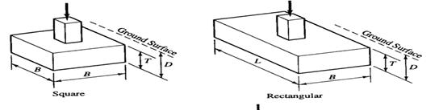
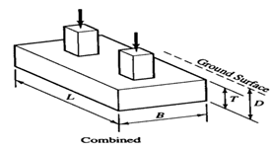
Shallow foundations types
2.Combined footings.

Slide 8
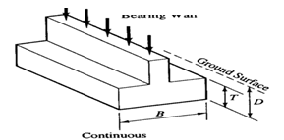
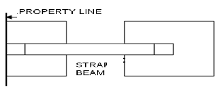
Shallow foundations types
3.Continuous footings.
4.Strap footing.

Slide 9

Shallow foundations types
5.Mat foundation.

Slide 10
Structural system
As we know any structure consist from elements ,these elements can be classified into:
Slab.
Columns.
Beams.
Walls.
Foundation.

Slide 11
loads
Load calculations:
The load calculations in this project was calculated by Sap program.
Live load = 400 Kg/ m²
super imposed dead load = 500Kg/m²

Slide 12
structural analysis using sap 2000
In this project we use sap 2000 to analyze the load and find the reaction at all columns .
The reaction of footings from column :

Slide 13
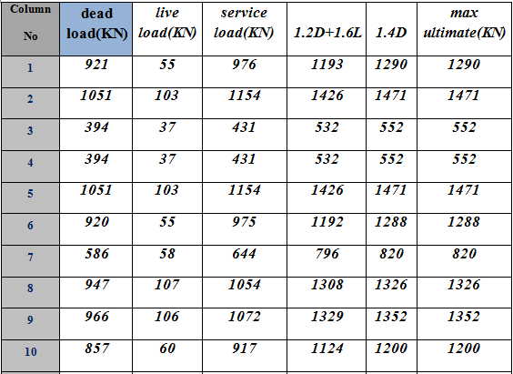
Table 1 : The reaction of footings

Slide 14
Site Investigation
The Site Investigation of the site were studied through comprehensive site investigation, carried out on January 2011 by Hijjawi Engineering laboratories.
Five boreholes were dug out in site to carry the subsurface investigation.

Slide 15
Site Description
The geological report shows that the site consists mostly of moist and plastic formations of soft creamy marlstone within the whole depth of exploration and covered by a thin layer of silty clay .
The collected sample was tested for physical and mechanical properties .the following are the main soil properties required for foundation design purposes.

Slide 16
Calculating of baring capacity of soil
Cohesion ( c ) = 20 kN/m²
Angle of internal friction (Ø) = 13
Unit weight (γ) = 16 kN/m³
According to bearing capacity equations, the allowable bearing capacity is 2.2 kg/cm².

Slide 17
Geotechnical and structural design of foundation
After analysis of the structure and loads of columns, geotechnical and structural design.
The first trial is to try to design single footing by manual calculations.
The second trial is to try to design single footing by using RCD program to area of single footing
The third trial is to design mat foundation by using SAP program

Slide 18
Design of single footing
Determine the loads
Calculate area of footing
Check for wide beam shear
Check for punching shear

Slide 19
Design for Flexural reinforcement
Check
Check
Find the value of
Calculate area of steel

Slide 20
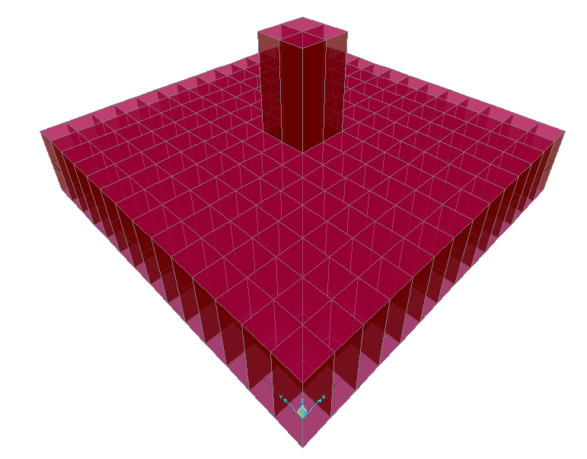
Isolated footings
Bearing capacity of the soil is 2.2 kg/cm²
Group name | Area of footing (m²) | Thickness (cm) | Bar used/m*
F1 | 2.0x2.2 | 35 | 8Φ16
F2 | 2.1x2.3 | 35 | 10Φ16
F3 | 1.3x1.5 | 35 | 5Φ16
F4 | 1.6x1.8 | 35 | 5Φ16
F5 | 2.1x2.1 | 40 | 10Φ16
F6 | 2.0x2.0 | 40 | 8Φ16
F7 | 1.5x1.5 | 35 | 5Φ16

Slide 21
Settlemnt
The allowable settlement in isolated footing
is 25 mm and the allowable differential settlement is 19
The settlement calculations for all footings are less than the allowable , the design is ok

Slide 22
Design Mat Foundation
A second foundation choice for the suggested building project is mat foundation .
Our proposed structure is symmetry and we use the SAP program for taking the moment .

Slide 23
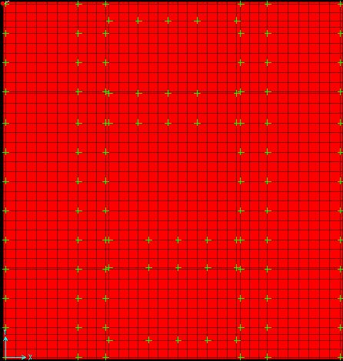
The picture below takes from SAP shows the mat foundation .

Slide 24
steps for designing the mat foundation
check punching shear for finding the depth of mat :
Applying the equation of punching shear on the critical column with load equal 150 ton.

Slide 25
steps for designing the mat foundation
Ultimate load =150 ton
h=70cm
cover = 7 cm
Assume d=63cm
Use q_{u} = q_{all} =22ton/m²
Vu=150– (30*0.63) =131 ton
Φ *Vc = Φ /6 (1+(2/β_{c})√f'_{c}*b_{o}*d
b_{o}=1051 mm
0.75/6(1+(2/(50/30)) √24*2102*630/1000=1784 kN=182 ton

Slide 26
Continue …..
Φ*Vc = Φ (0.33)√f'_{c}*b_{o}*d
=0.75*0.33* √24*2102*630/1000 =1606KN=164 ton
OK
Use
h=70cm
d=63cm

Slide 27
steps for designing the mat foundation
2. The parameter used were :
Mat depth = 0.70 m .
F_{c} = 240 kg / cm²
fy = 4200 kg / cm²

Slide 28
steps for designing the mat foundation
3. calculate steel ratio (𝜌 ) :
From SAP we find the ultimate moment on x- direction and on y-direction .
we find the maximum positive moment and the maximum negative moment.
After finding Mu we apply the equation of steel ratio (𝜌 ) then finding area of steel then number of bars .

Slide 29
steps for designing the mat foundation
AST = 𝜌 . b . d where ( b , d ) in cm .
𝜌_{min} = 0.0018 .
AST_{min} = 0.0018 * b * h .
Take the maximum positive moment and the maximum negative moment and then find the area of steel ( take the larger area of steel between the AST from moment and the AST_{min} ).

Slide 30
Result of analysis of the mat foundation
The output data and their calculations in details are according to strips and middle strips in both direction x and y axis .
M11 due to x-axis and M22 due to y-axis .
The distributing of steel bars in mat must be in correct way so as to help labors in the site of the work .
The reinforcement depends upon the sign of moment . The negative moment take the top steel and the positive moment take the bottom steel bars .

Slide 31
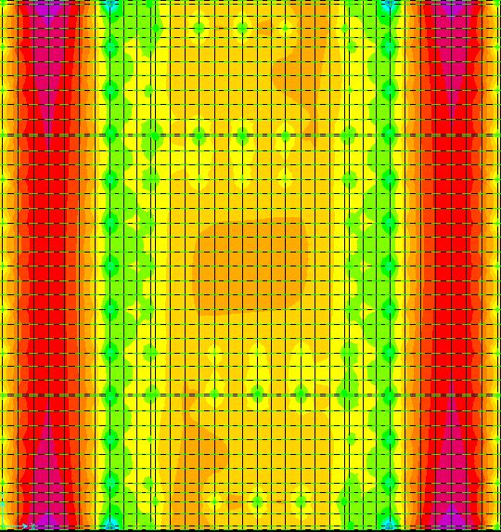
Moment in x direction ( M11 ) :

Slide 32
reinforcement in X-direction
Notes | Top steel | Bottom steel | Section
Bottom steel required under columns & between columns. | 10Φ20/m | 10Φ20/m | 1
 | 8 Φ20/m | Use 5 Φ18/m | 2
 | 7Φ20/m | 5 Φ20/m | 3
 | 7Φ20/m | 4 Φ20/m | 4
 | 7Φ20/m | 4 Φ20/m | 5
Top steel can be reduced as span length reduce as appear in BM diagram | 10Φ20/m | 10Φ20/m | 6

Slide 33
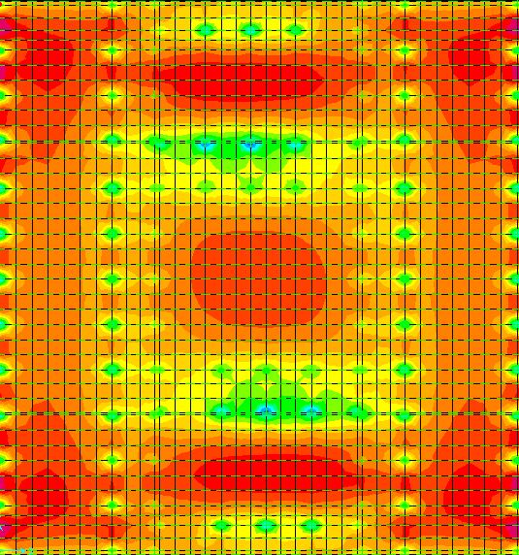
Moment in Y direction ( M22 ) :

Slide 34
reinforcement in Y-direction
Notes | Top steel | Bottom Steel | Section
Bottom steel required under columns (except column 19) & between columns. | 4 Φ20/m | 5 Φ20/m | 1
 | 4 Φ20/m | 5 Φ20/m | 2
 | 4 Φ20/m | 5 Φ20/m | 3
Top steel can be reduced as span length reduce as appear in BM diagram | 4 Φ20/m | 5 Φ20/m | 4
 | 4 Φ20/m | 5 Φ20/m | 5
 | 4 Φ20/m | 5 Φ20/m | 9

Slide 35
Settlemnt
The allowable settlement in mat footing
is 50mm and the allowable differential settlement is 19 mm
The settlement calculations for all footings are less than the allowable , the design is ok

Slide 36

Thanks for listening

