Slide 1

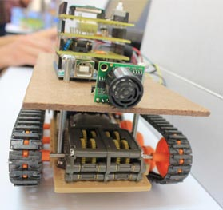
Robot Swarm
Work group :
Ibrahem Batta.
Emad Shakhshir.
Supervisor:
Dr. Ashraf Armoush

Slide 2
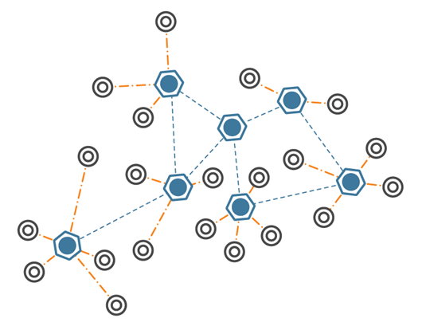
What is Robot Swarm?
It is a simple prototype to the wireless sensor network.

Slide 3
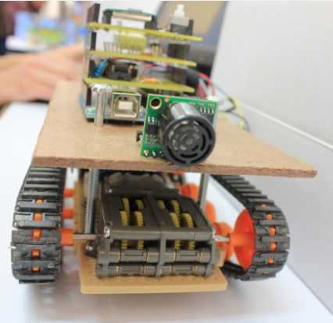
Cont.
In this project we built robots equipped with sensors. The robots job is to collect the data from the environment then send it to server wirelessly.

Slide 4
Goal
Is to design exploratory robot with this main features.
  Simple design.
  Low power consumption.
  Wide rang.
  Software support( protocol).

Slide 5
Microcontroller – AtmegaAVR
The AtmegaAVR is strong microcontroller that supported by Arduino board.
The Arduino provides this M.C with many features like power supply, USB interface, safe operating, small size, design.
AtmegaAVR microcontroller comes with powerful compiler.

Slide 6
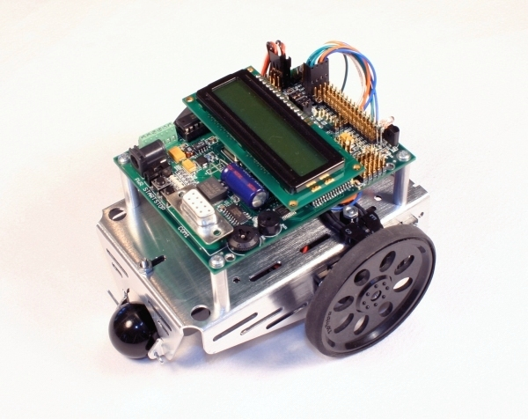
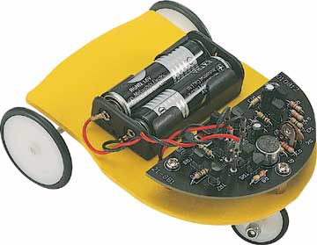
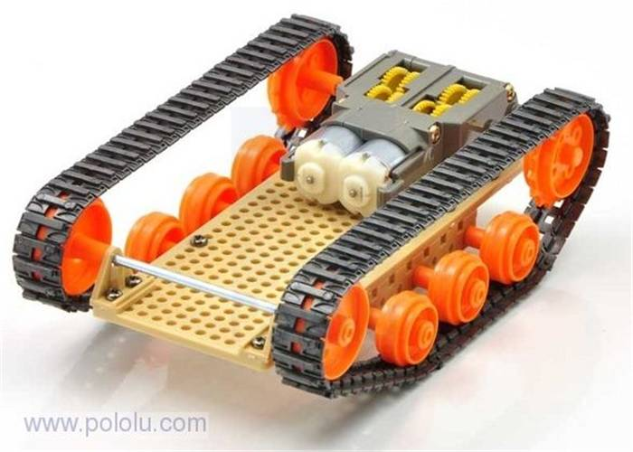
Robot Design considerations
As a start in robots design we make a deep search for robots and their designs. We found many styles.

Slide 7
Cont.
To choose the best appropriate style we apply our requirements.
  High torque – need gearbox -.
  High equilibrium.
  Ability to scan wide area.
  Design that allow adding an extra expansion.
  Ability to overcome small obstacles.

Slide 8
Cont.
    Our choice is :
Gear box
Wide area
Truck Design

Slide 9

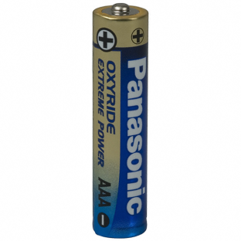
Power management
The power sources divided into two types
This separation for several reasons
  protection.
  Provide different current/volt values
  reduce the internal resistance.

Slide 10
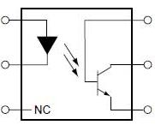
I/O Isolation
Optocoupler used to do the separation.
Completely isolate input from output

Slide 11
Motor Driving
We have two of DC motors that connected to the gear.
Need a good current sufficient to move the robot easily.
We must chose a good power values to make the robot movement with good torque and moderate speed without damage the gear.

Slide 12
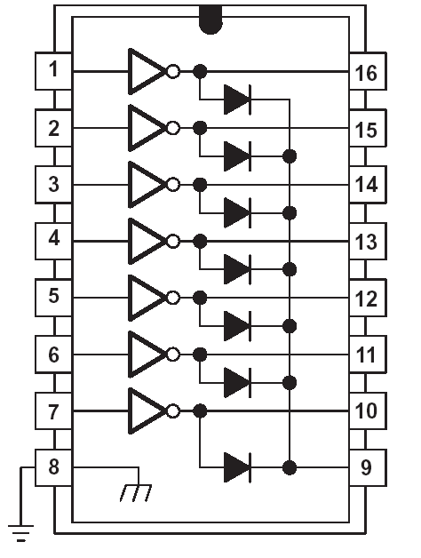
Cont.
We build a driving circuit that consists of the ULN2003 to drive the DC motors.
Input from the Optocoupler
The output with high current to the DC motor

Slide 13
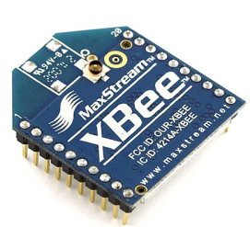
Wireless Shield
The main component in the wireless shield is the Xbee module.
It connected serially and powered from the Arduino board.
It's a very sensitive and any increase or defect in the power supply it can lead to damage.

Slide 14
Sensors
The humidity and temperature sensor.
The light intensity sensor.
Ultrasonic sensor.

Slide 15
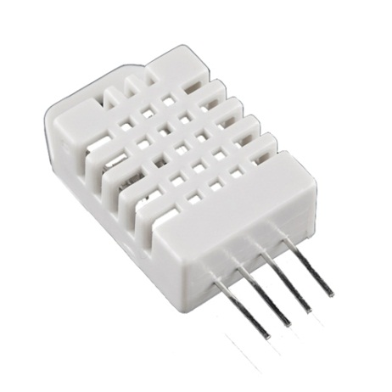
humidity and temperature sensor
The humidity and temperature sensor used is RHT03.
the output is digital.
The output is packet with 40 bit and it needs synchronization.
16 bits RH data 16 bits T data 8 bits check sum.

Slide 16
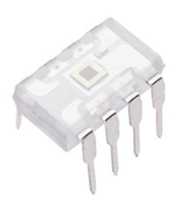
Light intensity sensor.
The light intensity sensor-TAOS079A.
The output is frequency.

Slide 17
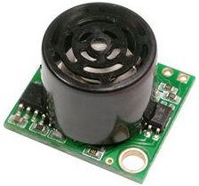
Ultra Sonic.
Ultra Sonic sensor- EZ0
The need of this sensor appears since we start moving the robot and need to avoid some obstacles.

Slide 18

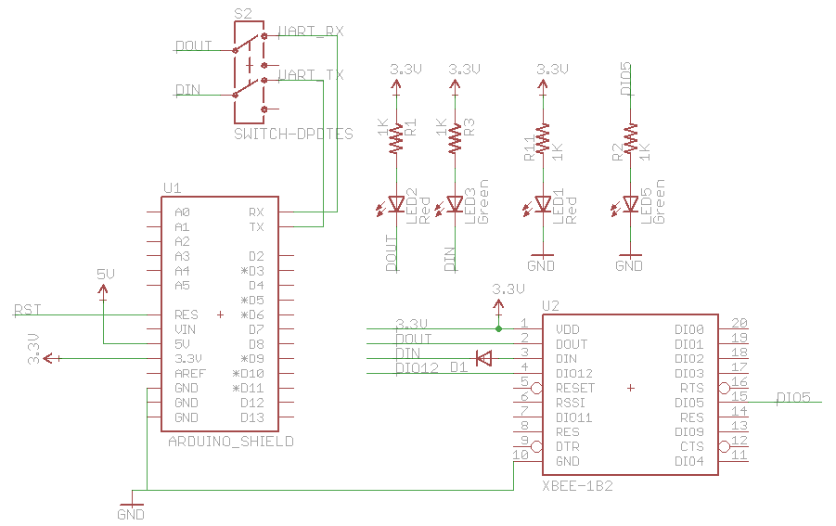
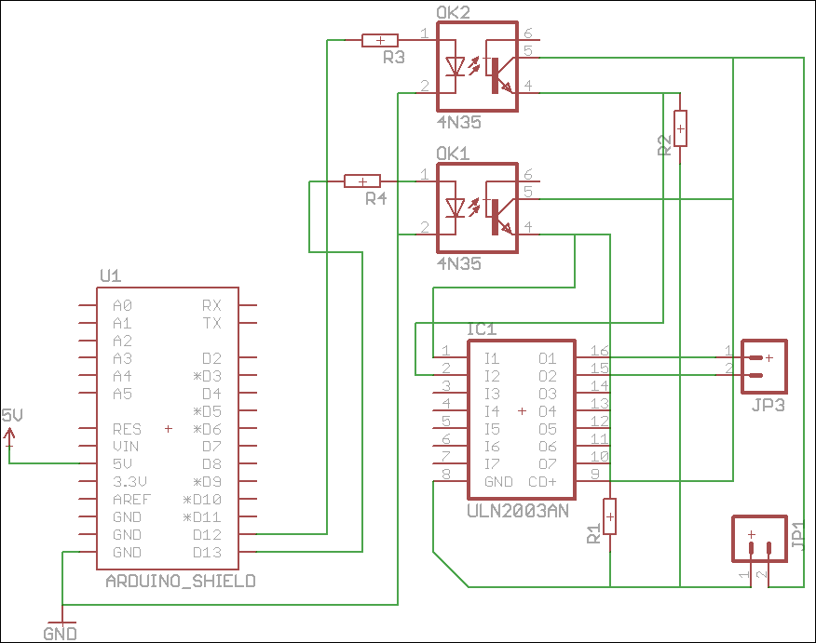
PCB
Eagle V6 software is used to create the Printed Circuit Board.

Slide 19
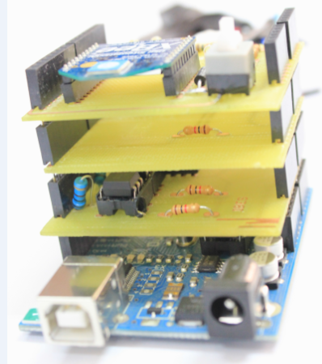
Shields Design.
The design of Arduino board obligate us to follow it.
This design solve the problem of
  Connectivity to M.C ports.
  Size.
  Power.
  Distribution of components.
  Reduce the noise.

Slide 20

Transferring protocol
Why to make a protocol ?
  To increase the performance.
  To make the transfer easier, robust, secure, ordered and reliable.

Slide 21
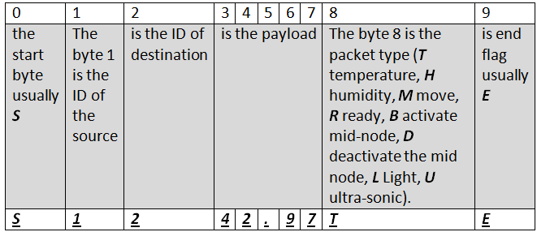
Transferring protocol
Packet content.

Slide 22
Cont.
Packets types
  Ready: is to tell the server that node is ready to associate with server.
  acknowledgment: it tell the source that the destination received the packet correctly.
  data: and it is the answer to the request mainly Temperature or humidity.
  control: It is the packets that defines the movement direction, data type request or activate/deactivate the mid node.

Slide 23
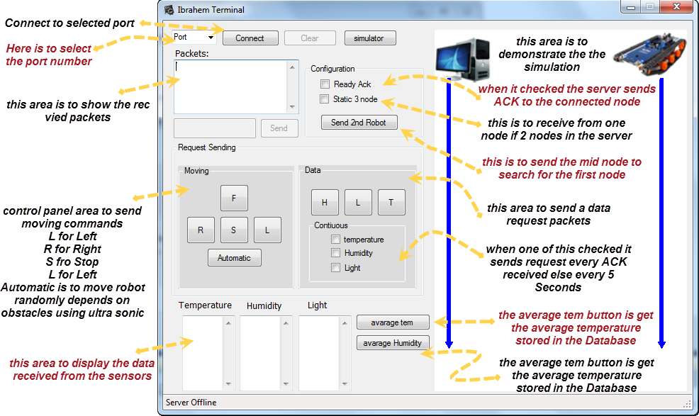
Server software

Slide 24
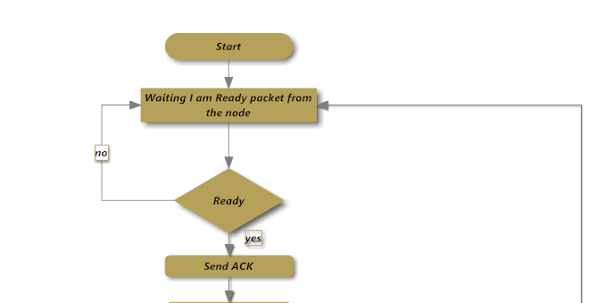
Server Criteria

Slide 25
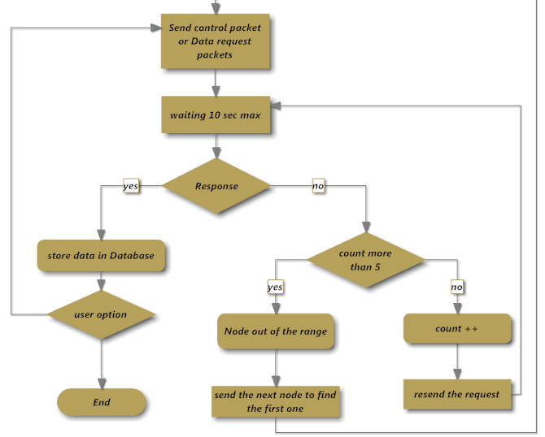

Slide 26

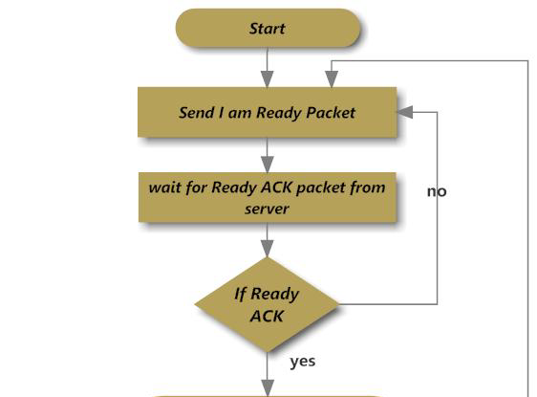
Main Node Criteria

Slide 27

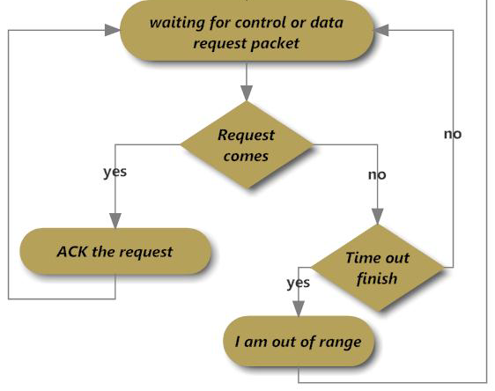

Slide 28
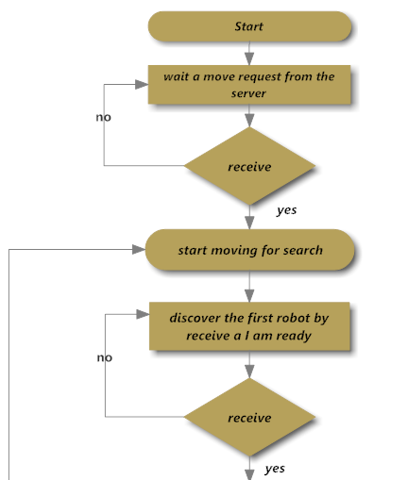
MiD Node Criteria

Slide 29
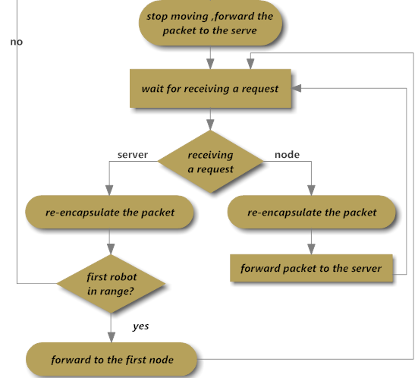

Slide 30

Any Questions ?

Slide 31

Thank you for your Attention

