Slide 1

An-Najah National University
Civil Engineering Department
Project 2 presentation
Design of Arraba Waste Water Treatment Plant
Prepared by:
Waleed Rahhal
Hamed Daghles
Saleh Abdel-Rhman
Supervised by:
Abdel Fattah R. Hasan, Ph.D.
Numan Mizyed, Ph.D, PE.
Jan, 2013

Slide 2
Outline
1.Objectives
2.Why WWTP?
3.Background
4.Impact of engineering solutions (WWTP)
5.Site selection of WWTP.
6.Population Analysis and design Flow
7.Design of WWTP.
8.Design of TF model.
9.Detailed Design of WWTP.
10. Reuse of treated wastewater.
11. Conclusion and Recommendations.

Slide 3
Objectives
Treatment of waste water, in addition to strong management
will enhance the public health and environmental.
Predict waste water flow of Arraba.
Design waste water treatment plant for Arraba.
Design a model of T.F.
Decide on optimal reuse of treated wastewater .

Slide 4

why wastewater treatment plant?
There are no sewage collection system, or WWTP.
Arraba town is an agricultural area, so the treated waste water can be used.
Due to shortage of water resources.

Slide 5
Impact of engineering solutions (WWTP)
Economical aspects:
- It offers many jobs.
- New water resource will be available.
- The resulted sludge could be used as fertilizers.
Other aspects:
- Protect the human health, from many diseases
- Reduce the pollution of groundwater.
- People satisfaction on local government will increase.

Slide 6
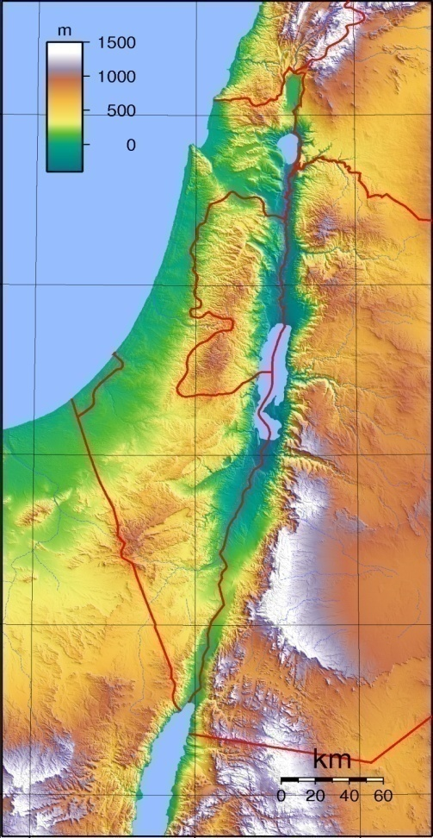
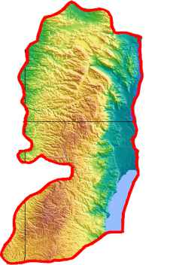



Background
- Arraba is located about 13 km southwest of the city of Jenin
- Population around 12,000 people
- Rising about 340 m from sea level
Arraba
580 mm
18-20 ºC
R H
60 %

Slide 7
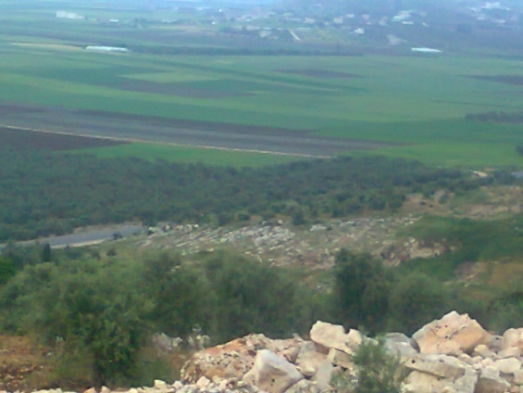
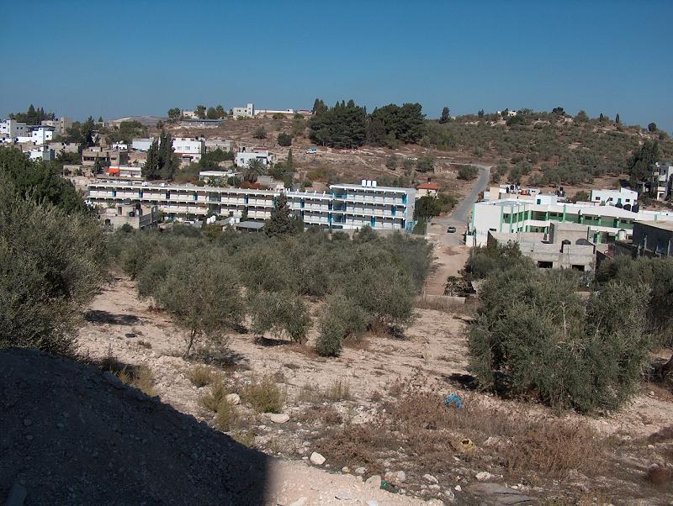
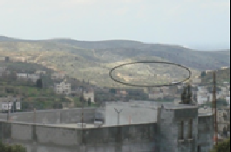
Site selection for WWTP
Multiple Decision Criteria Method was used to determine the site location.
1. At the North of Arraba (Ya’bd street)
2. At the south east of Arraba
3. At the west of Arraba

Slide 8
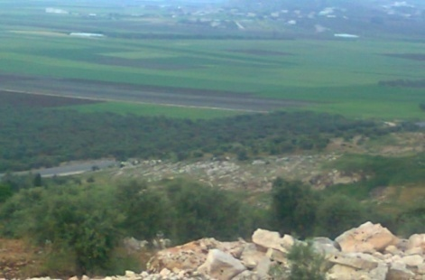
 | Location
Attributes | 1 | 2 | 3
Need for system of pumps | 1.75 | 0.75 | 0.25
Ownership of land to the municipality | 0.10 | 0.00 | 0.00
Accessibility to site | 0.45 | 0.35 | 0.25
Distance from residential areas | 0.70 | 0.30 | 0.90
The possibility of future expansion | 0.90 | 0.30 | 0.90
Service the treated water for neighboring farmland | 1.80 | 1.40 | 1.40
Social acceptance | 0.90 | 0.10 | 0.70
Ability to contact with other municipal | 0.90 | 0.100 | 0.10
Total | 7.50 | 3.30 | 4.50
1. At the North of Arraba (Ya’bd street)

Slide 9
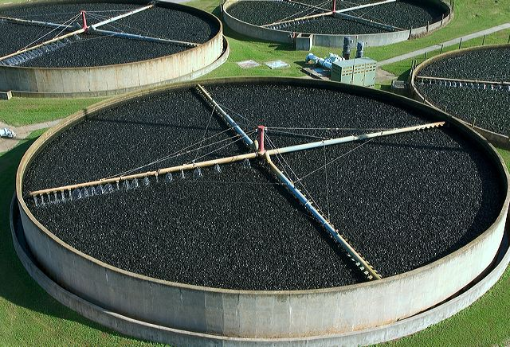
what is Trickling Filter?
Trickling filters are biological treatment process. The most
widely used design for many years was simply a bed
of stones.

Slide 10
Why is Trickling filter ?
In deed, Trickling filter System has been working on it in
many countries , but have not been applied in Palestine,
so it is a chance to apply it and stand on its effectiveness,
Also it have a lot of advantages as follow:
1. Simple, reliable, biological process.
2. Low operation cost and technology.
3. Durable process elements

Slide 11
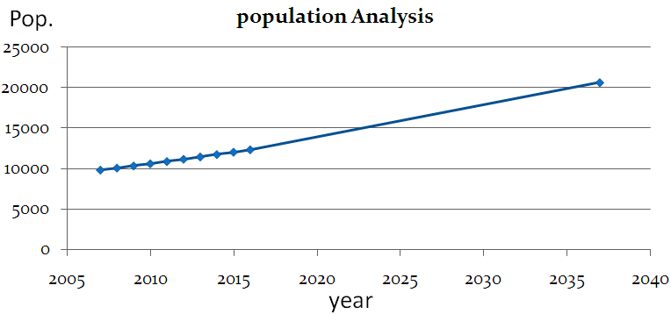
Population Analysis and design Flow
Constant compounding model was used to determine the
population at the design period, which equal 25 years
- Pop. =11153(1+0.025)²⁵= 20,677 c.

Slide 12
Peak factor =14 (P)^{-1/6} =2.67
used 3 for safety.
- Water consumption = 100 L/c.d
- Wastewater generation = 80%.
- Q _{peak} = 4944 m³/day.
- Q _{Design} = Q _{peak} + Q _{i/I} , where Q _{i/I} = 5% Q _{peak} .
So, Q _{Design} = 5191.2 m³/day (0.06 m³/sec).

Slide 13
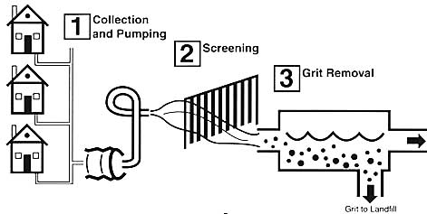
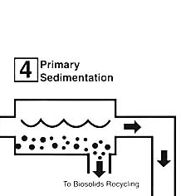
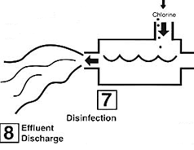
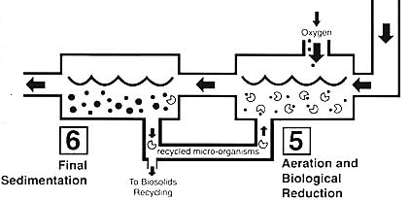
Design of WWTP
How do we treat wastewater ?
Preliminary treatment
Primary treatment
Tertiary treatment
Secondary treatment

Slide 14
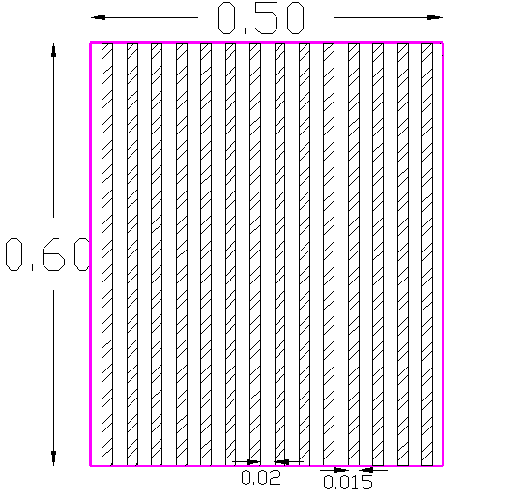
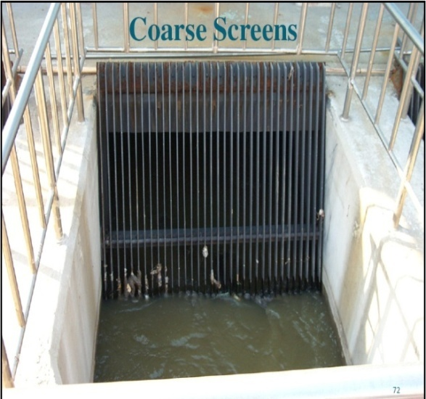
Design of WWTP
Based on American method
Units of WWTP are :
Coarse screen : The major objectives of screen is to remove large objects such as rags, paper, plastics, metals

Slide 15
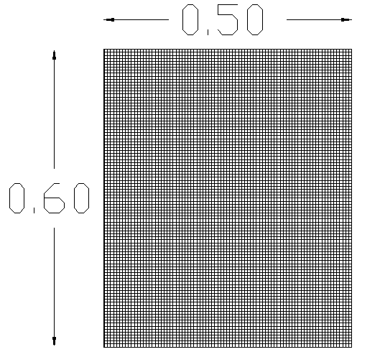
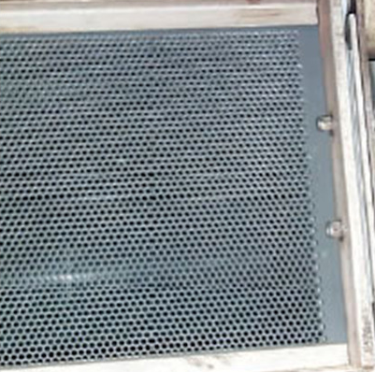
2. Fine screen: it aims to remove objects that pass through coarse screen.
3 mm bar screen in order to remove (87-93) % of solid material

Slide 16
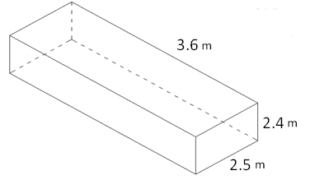
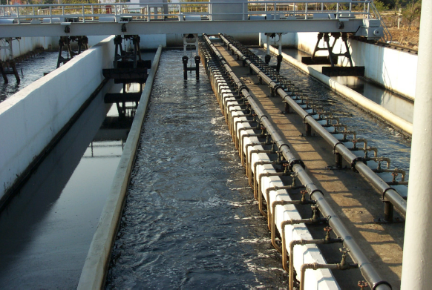
3. Grit chamber: it remove sand, gravel, broken glass, egg shells, to protect moving mechanical equipment and pumps from unnecessary wear and abrasion
Surface area (m²) | Length (m) | Width (m) | Depth(m)
9 | 3.6 | 2.5 | 2.4

Slide 17
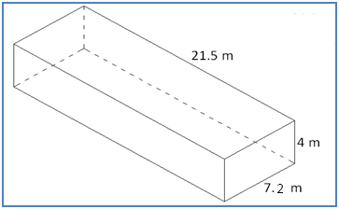
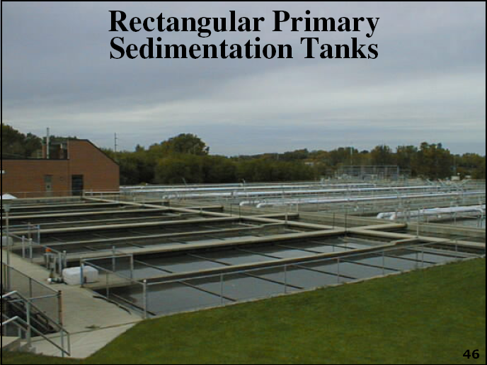
4. Primary sedimentation tank: Wastewater Sedimentation Tank plays an important role either after or before biological treatment processes to remove heavier sludge solids by means of settling and separation from the liquid phase.
Rectangular sedimentation tank
Length (m) | Width (m) | Depth(m) | Detention time(h)
21.5 | 7.2 | 4 | 3

Slide 18
5. Trickling filter
Double stage TF system with
R = 2
E1=E2
 | T.F 1 | T.F 2
Diameter (m) | 31.5 | 15
Depth (m) | 1.5 | 1.5
BOD load (Kg/m³.d) | 1.38 | 1.59
Hydraulic load (m³/m².d) | 0.013 | 0.057

Slide 19
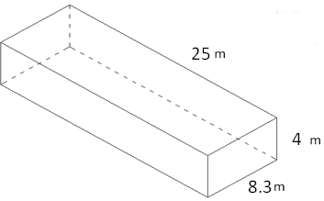
6. Secondary sedimentation tank
Secondary sedimentation tank
Length (m) | Width (m) | Depth(m) | Detention time(h)
25 | 8.3 | 4 | 4

Slide 20


Design of TF model
Q = 5 L / hr.
BOD = 500 mg / L.
Diameter = 45 cm.
Total Depth = 1m.
R = 2.
QR = 10 L / hr.

Slide 21


parameter | Low-Rate | Intermediate-Rate | High-Rate | High-Rate | Roughing
Hydraulic loading,m³/m².d | 1-4 | 4-10 | 10-40 | 10-75 | 40-200
Organic load,Kg BOD/m³.d | 0.07-0.22 | 0.24-0.48 | 0.4-2.4 | 0.6-3.2 | >1.5
Recirculation ratio | 0 | 0-1 | 1-2 | 1-2 | 0-2
Depth, m | 1.8-2.4 | 1.8-2.4 | 1.8-2.4 | 3-12.2 | 0.9-6
Filter media | Rock, gravel | Rock, gravel | Rock, gravel | plastic | plastic
Efficiency of BOD removal, % | 80-90 | 50-80 | 50-90 | 60-90 | 40-70
Power, KW/10³m³ | 2-4 | 2-8 | 6-10 | 6-10 | 10-20

Slide 22
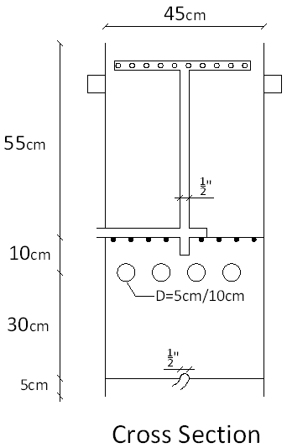
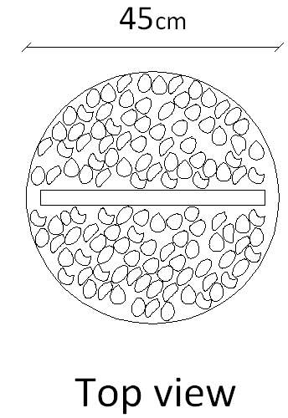

Slide 23
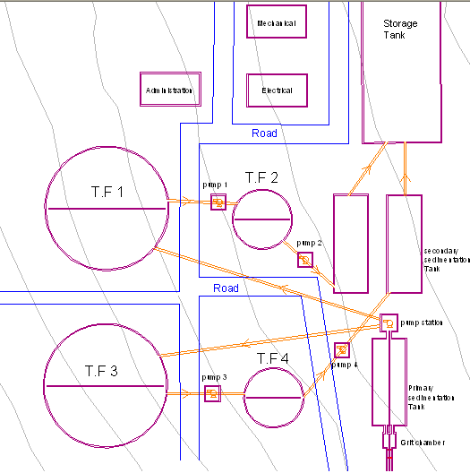
Detailed Design
General Layout
N

Slide 24
This layout will ensure the following points:
Optimal utilization of spaces
Easy movement between units during maintenance and cleaning .
The Min. number of pump station, and power needed
The pumping station was placed after the primary sedimentation tank, in order to protect the pump from unnecessary wear and abrasion

Slide 25
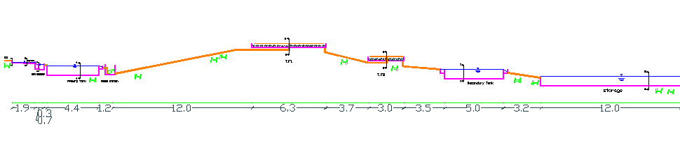
The profile of the plant

Slide 26
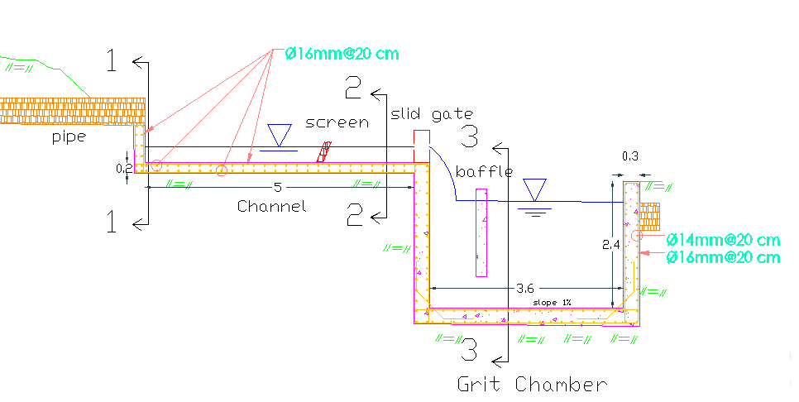
Drawing one ( Channel, screen, grit chamber )

Slide 27
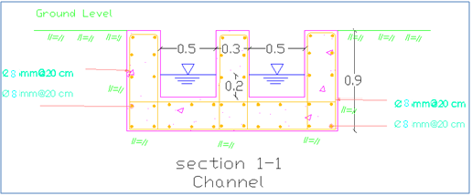
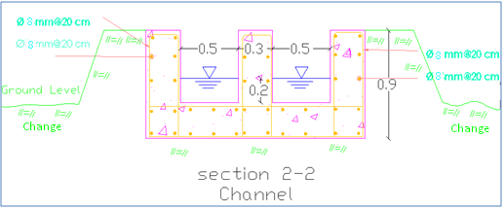
Cross Sections:

Slide 28
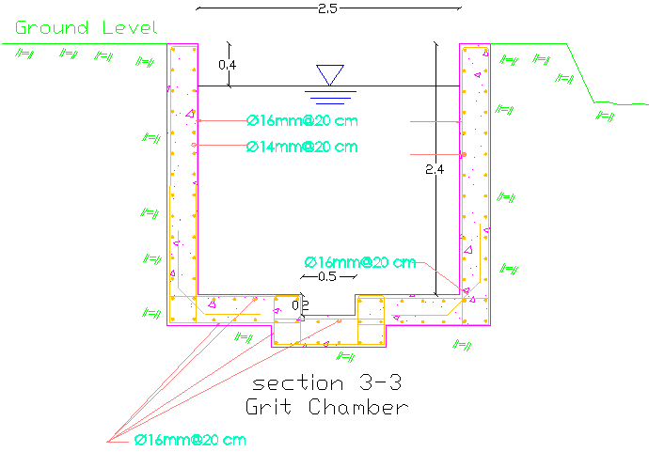

Slide 29
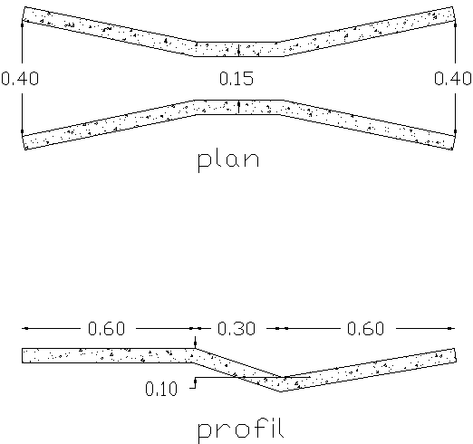
Design of parshall Flume
Parshall Flume: the most common flow measuring devices
the flume is favored over other methods because:
It will pass a wide variety of solids.
Flow rate can be determined manually or automatically.
It has low maintenance.

Slide 30
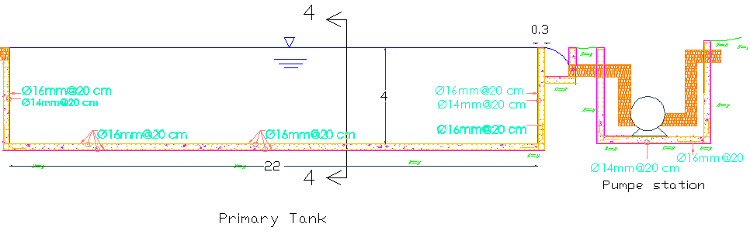
Drawing two ( primary sedimentation tank, pump station)
Pump station ( two pumps, one stand by )
Q for each pump = 108m³/h.
Δh = 14m + 10% other loss = 15.5m
Efficiency 70% , shaft power = 6.47 KW.

Slide 31
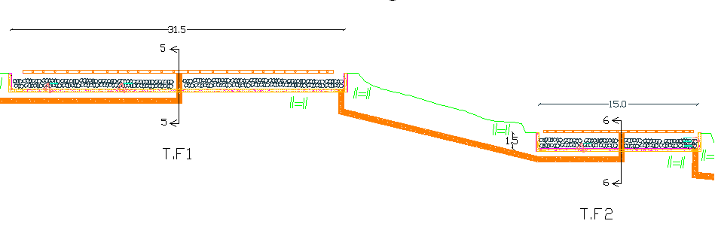
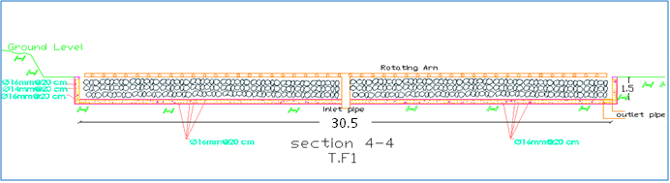
Drawing three ( Trickling filter one, Trickling filter two)
Section in Trickling filter one

Slide 32
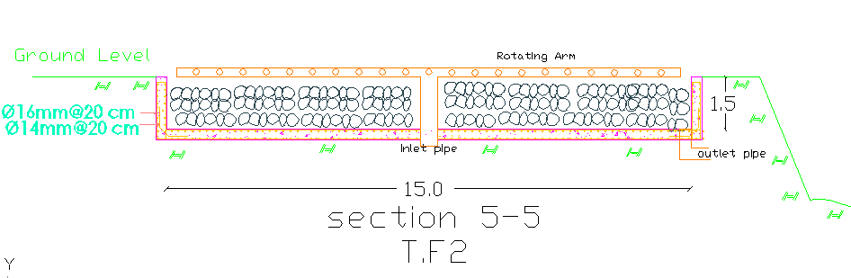
Section in Trickling filter two
Design pumps for recirculation
Trickling filter | Q (m³/h) | Δh +10%losses(m) | Efficiency | Shaft power (KW)
T.F1 | 216 m³/h | 8.25 | 70% | 6.93
T.F2 | 216 m³/h | 2.65 | 70% | 2.15
T.F3 | 216 m³/h | 7.7 | 70% | 4.53
T.F4 | 216 m³/h | 7.7 | 70% | 4.53

Slide 33
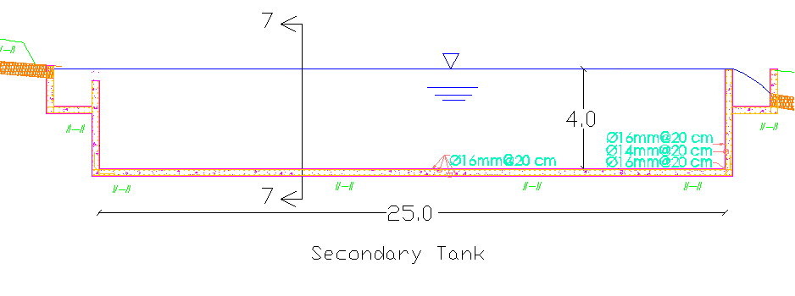
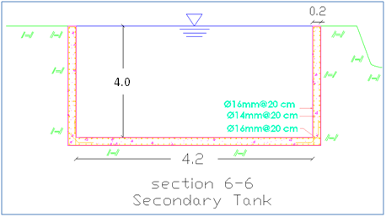
Drawing four (secondary sedimentation tank )
Section in secondary sedimentation tank

Slide 34
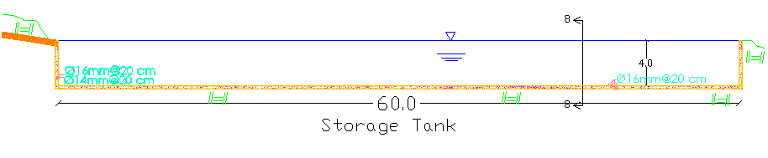
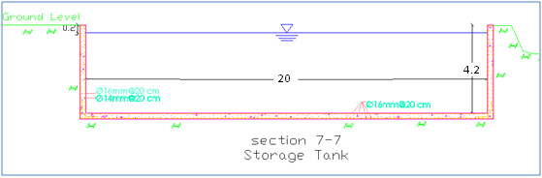
Drawing five ( Storage tank)
Section in storage tank

Slide 35
Reuse of treated wastewater
Based on the amounts of treated wastewater that will be available at the
proposed plant and crop consumptive use of crops proposed, it will be
possible to irrigate about 366 donums if no seasonal storage is utilized.
growing season starting from March to the end of November for most
vegetables grown in the area.
When greenhouses are utilized, vegetables are grown all year round including winter.
farmers depend mainly on rain water, it is accumulate in two main valleys: 1. "Annos valley" is located at half of the plain, 2. "Algrab valley “Located southeast of Arraba.

Slide 36
Study area
The planted area in Arraba is about 45,000 donum which are
distributed into the following categories:
1) 1,000 donum as irrigated area.
2) 30,000 donum as planted with rain fed vegetables
and field crops area.
3) 5,000 donum as an area planted with olives.

Slide 37
Proposed crops:
Fodder crops such as alfalfa will be safely irrigated with treated wastewater and farmers there are familiar with such crop which is demanded by local markets.
Tropical fruits such as citrus, and mangos,
Other fruits such as grapes, and apples.
And, tobacco, grass and olive trees could also be irrigated by treated wastewater.

Slide 38
Estimation of crop water requirement:
Sunshine Hours | Wind Km/day | Humidity % | Max Temp C˚ | Min Temp C˚ | Month
5.4 | 180 | 80 | 17.4 | 6.8 | January
5.6 | 190 | 84 | 18.2 | 7.1 | February
6.8 | 190 | 76 | 21.6 | 8.6 | March
7.8 | 190 | 67 | 28.3 | 11.2 | April
9.7 | 216 | 60 | 31.0 | 14.0 | May
11.3 | 226 | 63 | 32.9 | 17.3 | June
11.1 | 233 | 63 | 33.6 | 19.6 | July
10.0 | 206 | 65 | 34.2 | 21.1 | August
9.1 | 173 | 64 | 33.2 | 19.8 | September
8.1 | 130 | 65 | 30.6 | 16.1 | October
6.8 | 146 | 66 | 25.0 | 11.8 | November
5.4 | 180 | 74 | 18.8 | 8.7 | December
8.1 | 188 | 69 | 27.1 | 13.5 | Average
Climate variables of
jenin from PMA
(BeitQad station) shown
in the following table:

Slide 39
The climate in Arraba is characterized by cold wet winters and
dry hot summers.
The average monthly precipitations of the Arraba area are shown below:
Month | Rain (mm)
January | 107
February | 62
March | 65
April | 25
May | 6
June | 0
July | 0
August | 0
September | 0
October | 16
November | 40
December | 93
Total | 414

Slide 40
Monthly evapotranspiration (ET₀) in mm
Month | Alfalfa | Citrus | Grapes | Mango | Tobacco | Grass | Average
January | 20 | 34 | 15 | 44 | 27 | 44 | 31
February | 63 | 40 | 17 | 51 | 55 | 51 | 46
March | 34 | 60 | 26 | 77 | 98 | 77 | 62
April | 52 | 89 | 39 | 122 | 76 | 117 | 83
May | 68 | 115 | 51 | 171 | 0 | 152 | 93
June | 134 | 128 | 92 | 206 | 0 | 175 | 123
July | 184 | 130 | 152 | 215 | 0 | 183 | 144
August | 169 | 119 | 151 | 197 | 0 | 168 | 134
September | 142 | 101 | 127 | 166 | 0 | 142 | 113
October | 105 | 76 | 94 | 118 | 0 | 105 | 83
November | 75 | 54 | 66 | 78 | 0 | 75 | 58
December | 51 | 38 | 33 | 51 | 0 | 53 | 38
Annual sum | 1097 | 984 | 863 | 1496 | 256 | 1342 | 1008

Slide 41
Crop water demand in mm
Month | Alfalfa | Citrus | Grapes | Mango | Tobacco | Grass | Average
January | 0 | 0 | 0 | 0 | 0 | 0 | 0
February | 2 | 0 | 0 | 0 | 0 | 0 | 0
March | 0 | 0 | 0 | 15 | 39 | 15 | 12
April | 32 | 73 | 17 | 115 | 60 | 109 | 68
May | 73 | 129 | 53 | 195 | 0 | 172 | 104
June | 158 | 151 | 109 | 243 | 0 | 206 | 145
July | 217 | 153 | 179 | 253 | 0 | 216 | 170
August | 199 | 140 | 178 | 232 | 0 | 198 | 158
September | 168 | 119 | 150 | 196 | 0 | 168 | 134
October | 105 | 71 | 92 | 120 | 0 | 105 | 82
November | 42 | 17 | 31 | 45 | 0 | 42 | 30
December | 0 | 0 | 0 | 0 | 0 | 0 | 0
Annual sum | 996 | 853 | 809 | 1414 | 99 | 1231 | 903

Slide 42
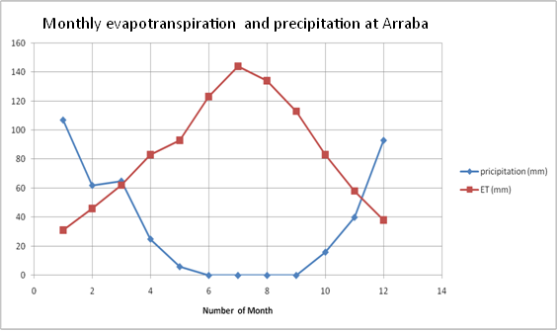
Water demand Vs. Water supply:
Average monthly precipitation vs. average monthly evapotranspiration (ET₀) shown in the following plate:

Slide 43
Monthly irrigation demand:
For treated wastewater generation, annual average was estimated at 2074 m³/day. Considering seasonal variations of wastewater production, a peak summer flow of 4944 m³/day is expected from Arraba WWTP.
So, we have two option for irrigation which are:
Option 1) If no seasonal storage option (with water spill) was utilized, then the area that could be irrigated will be about 366 dunums.
Option 2) If no spill option is to be utilized, then the area that could be irrigated will increase to be about double.

Slide 44
No seasonal storage:
 | Influent flow rate | Influent flow rate | Average irrigation demand | Irrigation demand | Water excess/spill
Month | m³/day | m³/month | mm/month | m³ | m³
January | 1660 | 51460 | 0 | 0 | 51460
February | 1660 | 46480 | 0 | 0 | 46480
March | 2074 | 64294 | 12 | 5449 | 58845
April | 2074 | 62220 | 68 | 30876 | 31344
May | 2074 | 64294 | 104 | 47222 | 17072
June | 2490 | 74700 | 145 | 65839 | 8861
July | 2490 | 77190 | 170 | 77190 | 0
August | 2490 | 77190 | 158 | 71741 | 5449
September | 2074 | 62220 | 134 | 60844 | 1376
October | 2074 | 64294 | 82 | 37233 | 27061
November | 2074 | 62220 | 30 | 13622 | 48598
December | 1660 | 51460 | 0 | 0 | 51460
Average | 2075 | 63169 | 75 | 34168 | 29000

Slide 45
With seasonal storage:
Month | Influent Flow rates | Influent Flow rates | Average irrigation demand | Irrigation demand | Water excess/deficit | Expected storage in reservoir by end of month
 | m³/day | m³/month | mm/month | m³ | m³ | m³
January | 1660 | 51460 | 0 | 0 | 51460 | 141845
February | 1660 | 46480 | 0 | 0 | 46480 | 188325
March | 2074 | 64294 | 12 | 9318 | 54976 | 243301
April | 2074 | 62220 | 68 | 52800 | 9420 | 252721
May | 2074 | 64294 | 104 | 80753 | -16459 | 236262
June | 2490 | 74700 | 145 | 112589 | -37889 | 198373
July | 2490 | 77190 | 170 | 132000 | -54810 | 143563
August | 2490 | 77190 | 158 | 122683 | -45493 | 98070
September | 2074 | 62220 | 134 | 104048 | -41828 | 56242
October | 2074 | 64294 | 82 | 63671 | 623 | 0
November | 2074 | 62220 | 30 | 23295 | 38925 | 38925
December | 1660 | 51460 | 0 | 0 | 51460 | 90385
Average | 2075 | 63169 | 75 | 58430
Annual | 24894 | 758022 | 903 | 701157

Slide 46
Conclusion and recommendations
New WWTP was designed.
The treatment method was Trickling filter.
There is a potential for reuse the treated wastewater.
We recommend the following :
Environmental impacts assessment.
Detailed design for the treatment plant to prepare final drawing, bids and bill of quantities.
Need to look for funding sources to fund the project
Public awareness program.

Slide 47
Thank You

