Slide 1

An-Najah National University
Faculty of Engineering
Department Of Mechanical Engineering
Electricity Generation Using Speed Breakers
Submitted by:
Ahmad Beshara Bilal Hawawra
Kareem Ahmad Renad Daqqa
Submitted to :
Dr. Iyad Assaf

Slide 2

Outline
Introduction .
Objectives .
Problem statement
Methodology
Result and analysis .
Recommendation and Conclusions

Slide 3
Introduction
Electricity generation depends mainly on coal, coal burning produce a large amounts of carbon.
The power sources in our world are in continuous decreasing.
Our project provides a new clean source of energy. The speed breaker is generating electricity depending mainly on car’s weight by converting the kinetic energy of the moving car into electrical energy using a DC-generator, and for every car passes on the speed breaker, the generator could generate up to 72 watt.

Slide 4
Description of the system
Speed breaker
Load applied on the speed breaker
The springs compressed
Transitional motion in rack
Rotational motion in the gears
The generator rotates
Generating electricity
Saving energy in UPS

Slide 5
Objectives of Project
To provide an environmental friendly power source.
Reducing the costs of electricity .
Producing a big amount of energy and storing it to use later when the electricity shut down.
To make cheap and easy maintainable power source.

Slide 6
Problem statement

Slide 7
Methodology
We will apply our project in Nablus ,Precisely in the city
center in the front of the taxis parking lots.
We chose this place as there is a high number of cars
pass over from this region and there is often a big
traffic. Also , the weight of the vehicles pass over is
approximately fixed and suitable for the speed breaker
,so we make sure that failure will not occur. As a result
, a high amount of power is generated and the
efficiency is high .

Slide 8

Parts Assembly

Slide 9
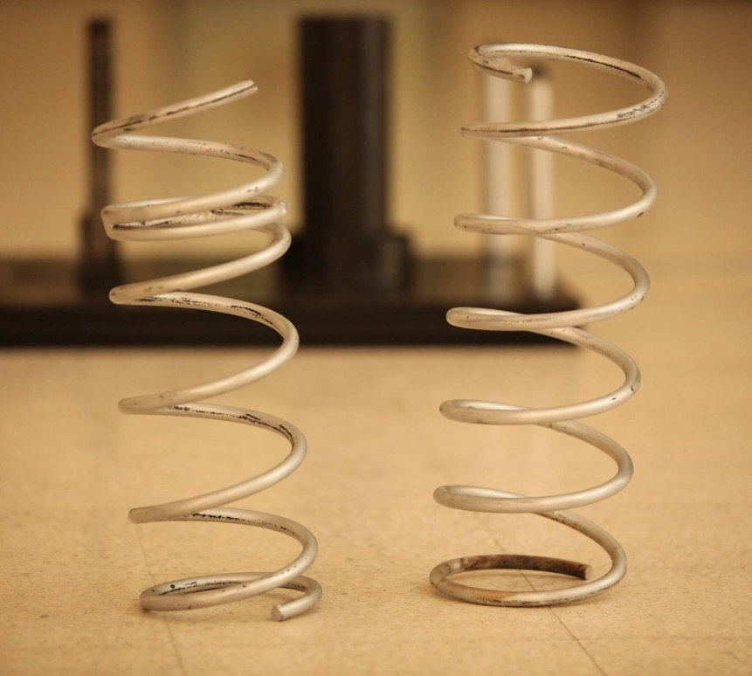
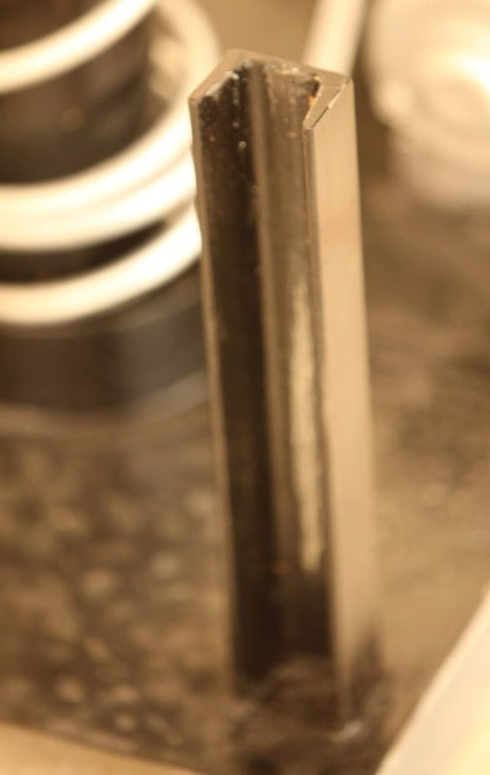
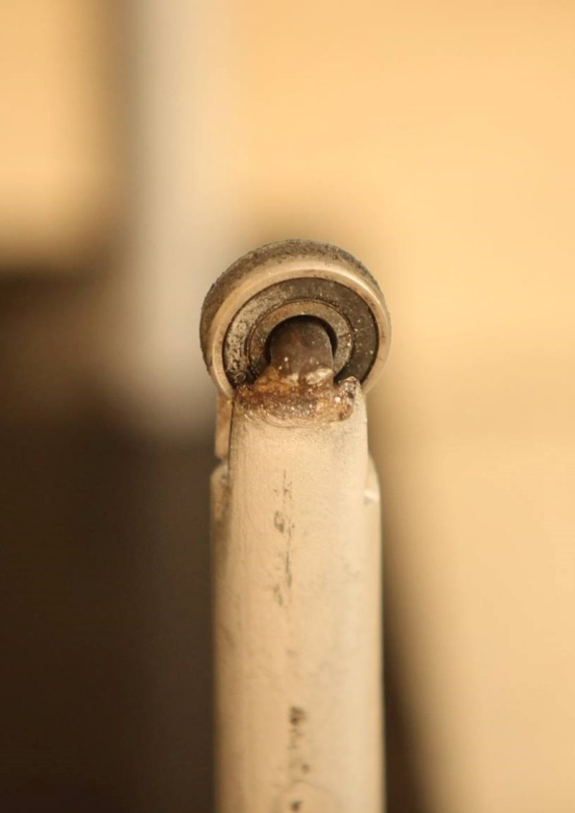
Component
1-Spring
2-Angular joint & wheel

Slide 10
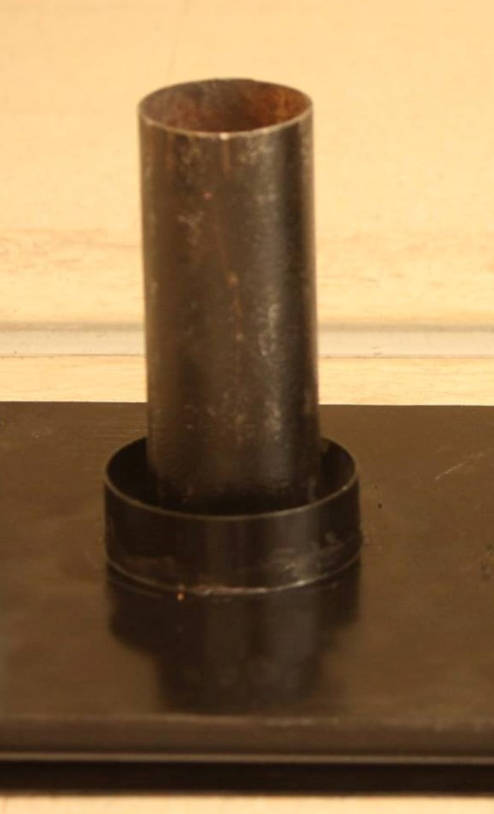
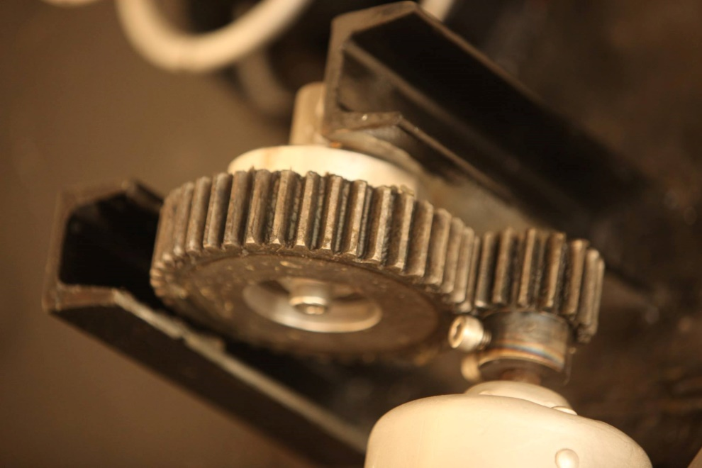
Component
3-Hollow pipe
4- spur gear&
Support guide

Slide 11
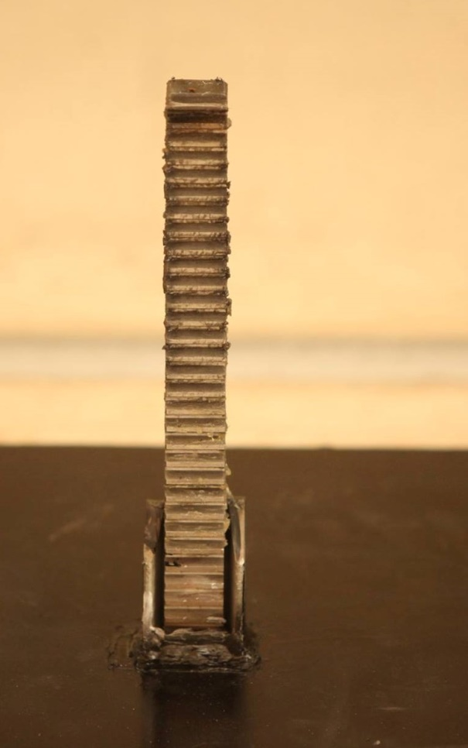
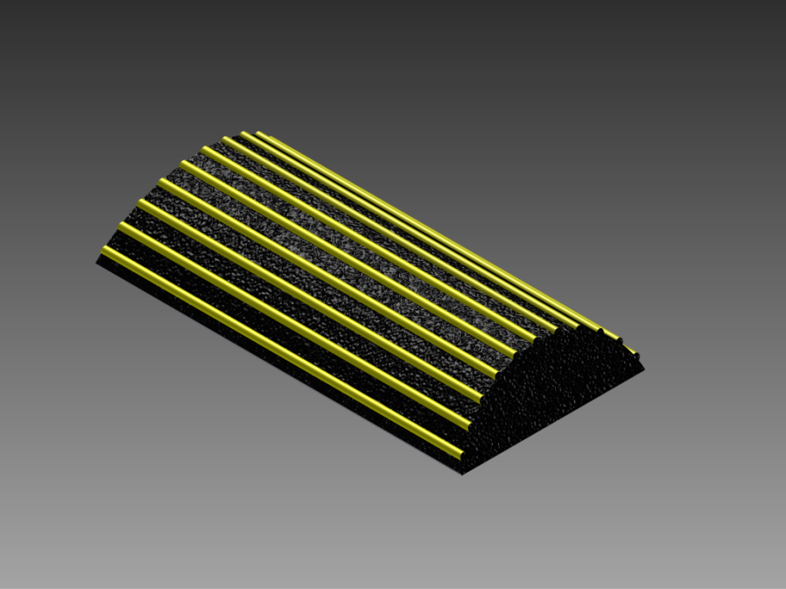
6-Rubber speed breaker
Component
5-Rack

Slide 12
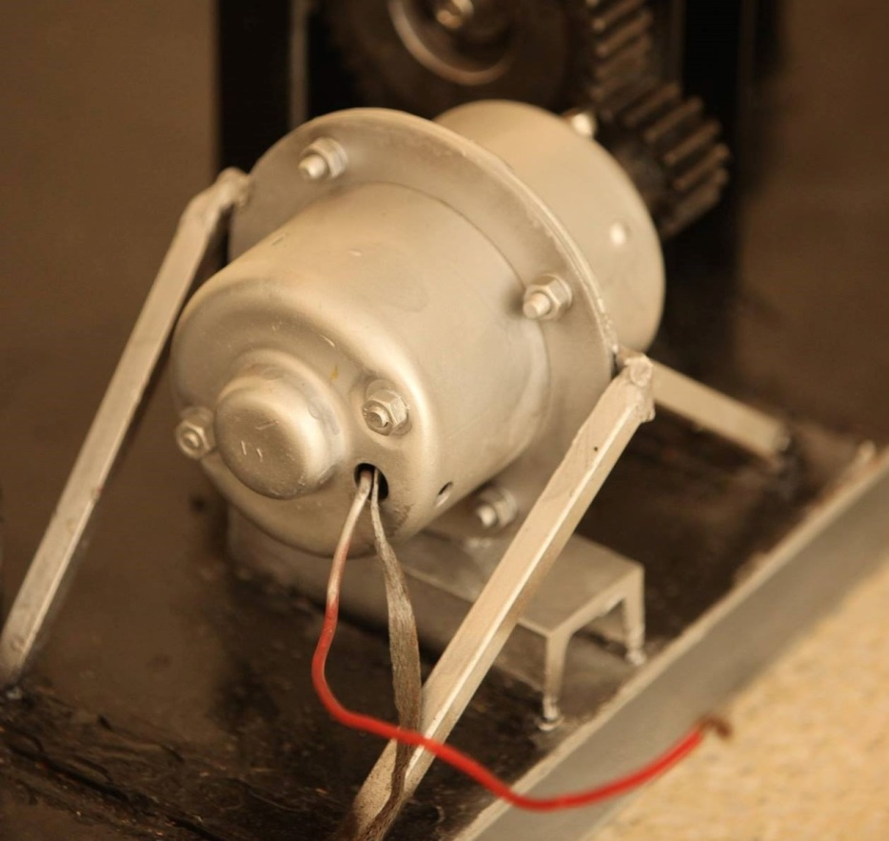
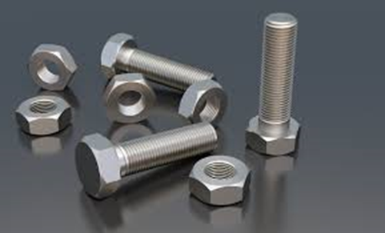
Component
7-Bolts
8-Generator

Slide 13
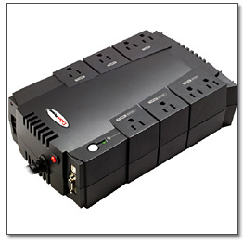
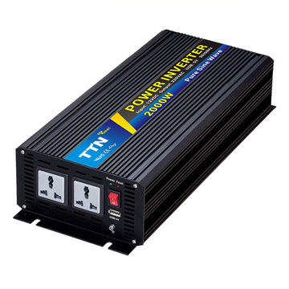
9-ups
10-invertor

Slide 14
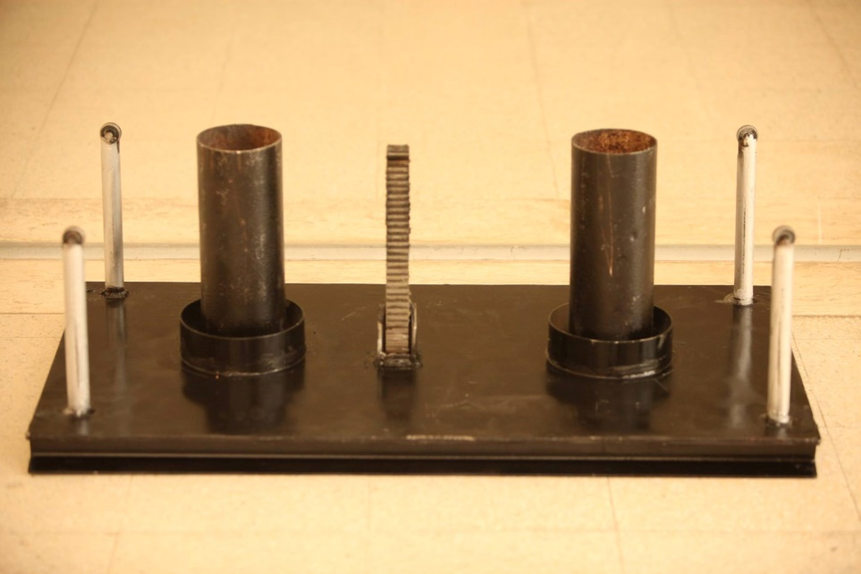
11-Steel plate
Lower plate
upper plate

Slide 15
Material for each component:
Steel material :
Steel is a strong material that is highly resistant to shaping at normal temperatures but this resistance lessens considerably at higher temperatures
Type of steel : 4140 is a 1% chromium - molybdenum e high tensile steel
this type of steel has a high fatigue life and it can be used for heavy duties
This material used for plate, gear, bolts, angular joint, support guide block, and Hollow pipes

Slide 16
Chrome-vanadium :
The material will be used is Chrome-vanadium (UNS G61500, AISI 6150 M ASTM 231-41).
This is the most popular alloy spring steel for condition involving higher stresses than can be used with the high-carbon steels and for use where fatigue resistance and long endurance are needed.
Also good for shock and impact loads
This material used for spring.

Slide 17
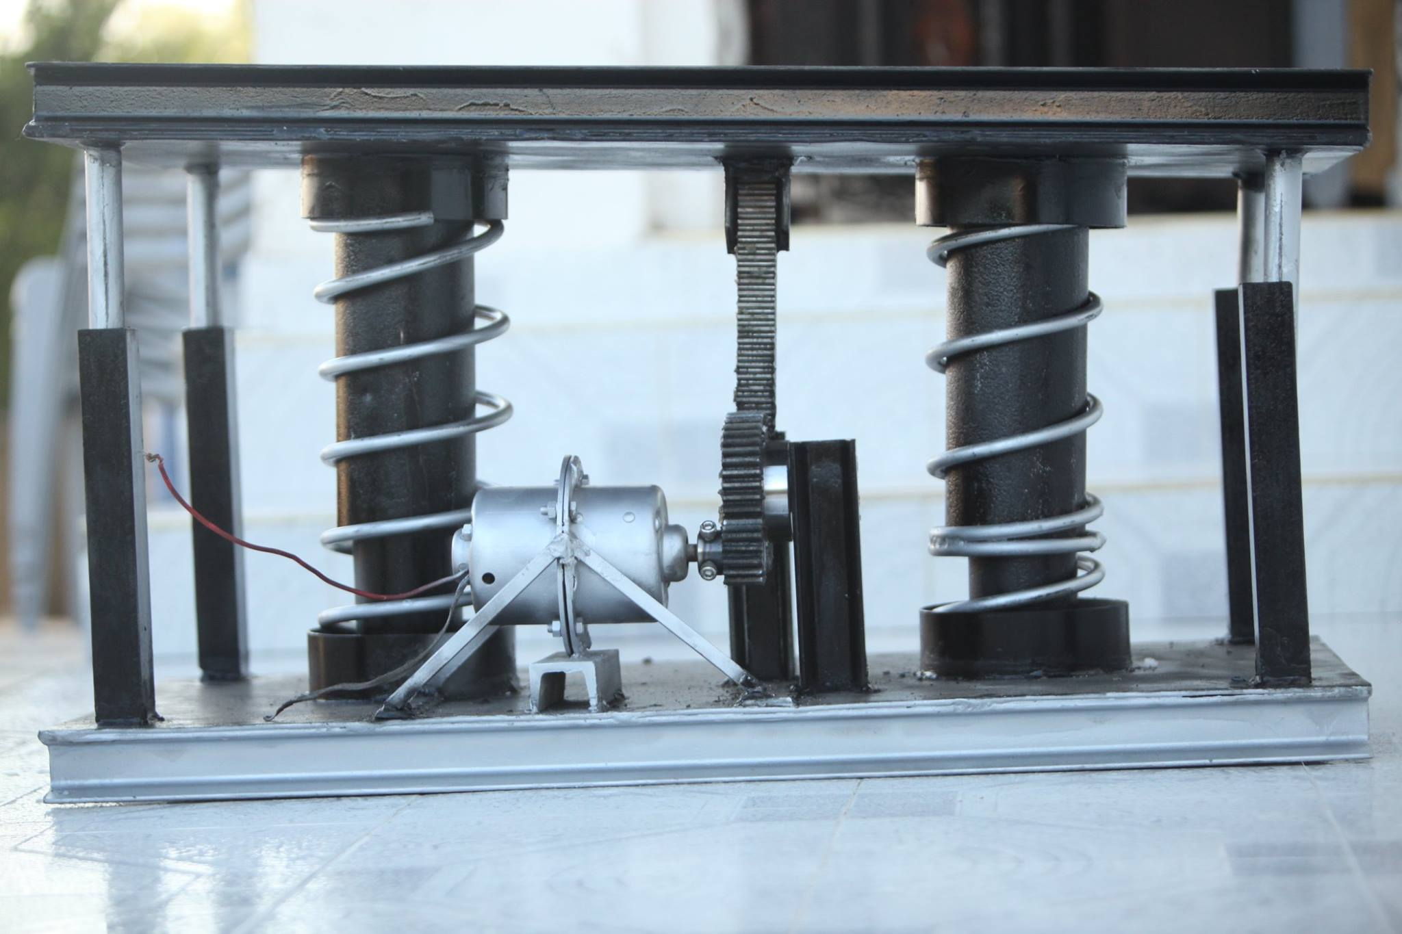
Final shape

Slide 18
How the project workفيديو

Slide 19
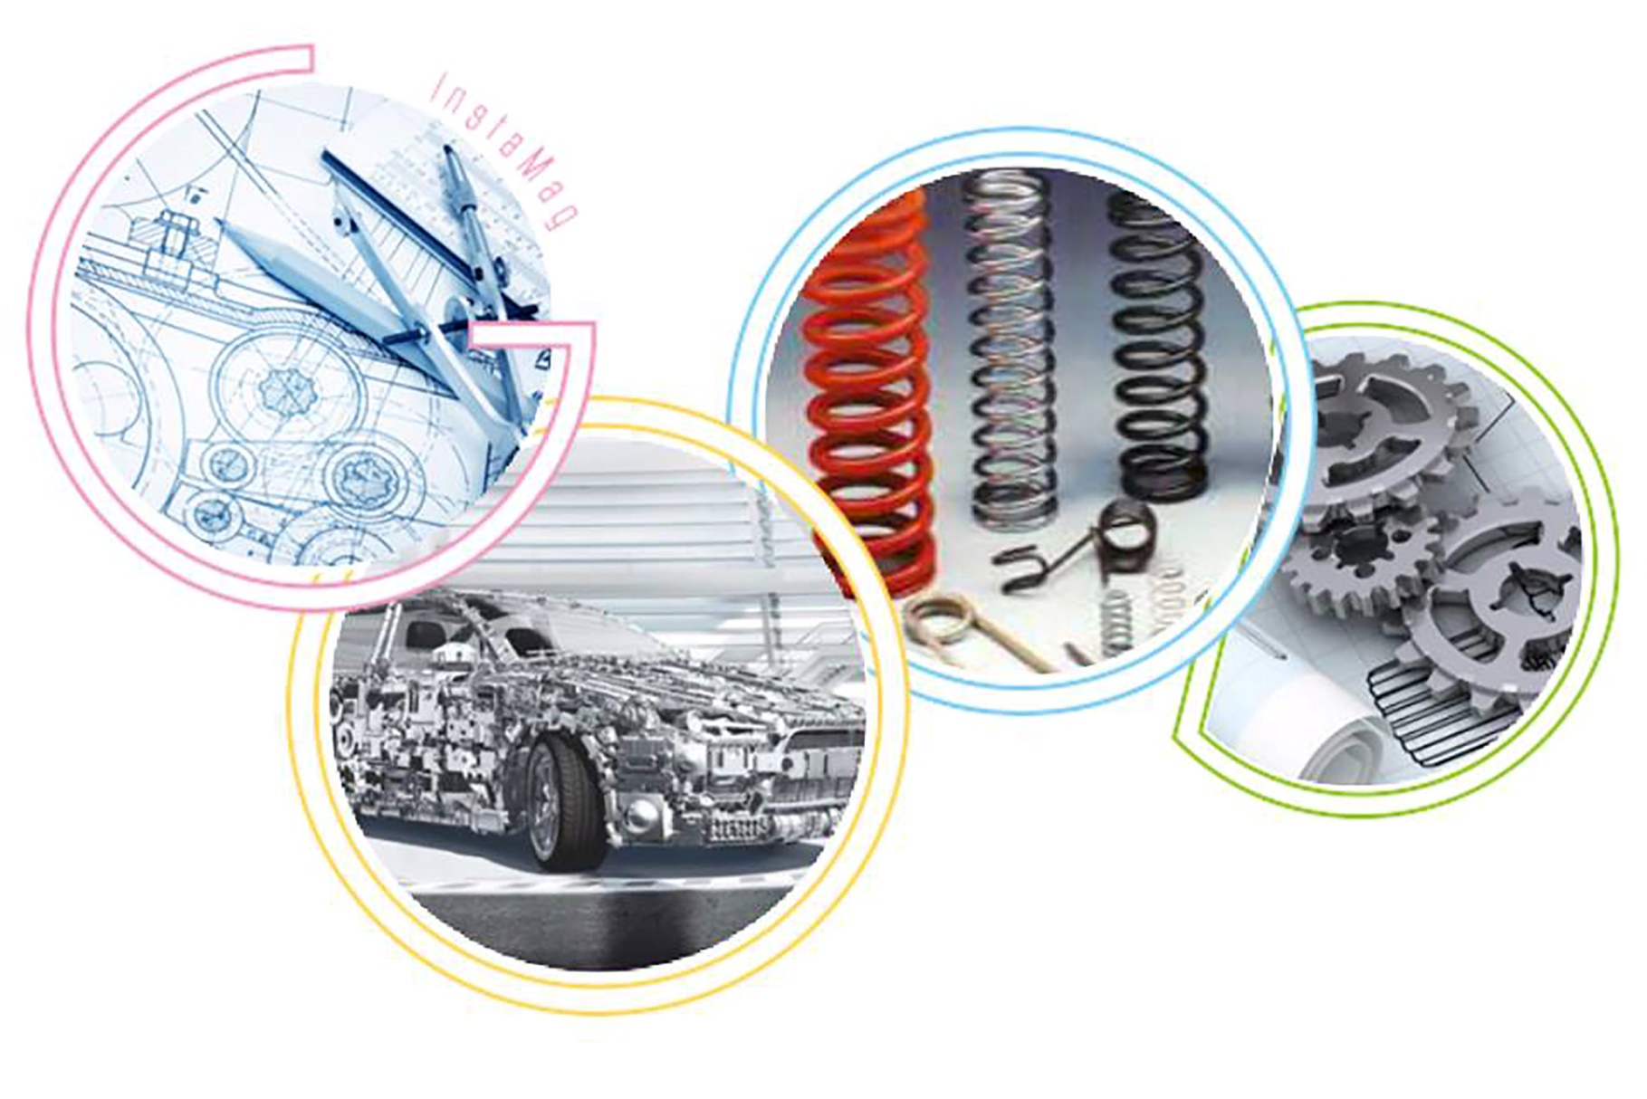
Result and analysis

Slide 20
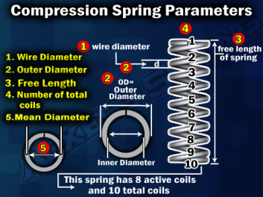
Helical compression spring
Parameters
(Na) Number of active coils.
(Nt) Number of total coils.
(OD) Outside diameter.
(Lo) Free Length
(Ls) Solid Length.
(C) Spring index.
(D) Mean diameter.
(d) Wire diameter.
(K) Spring Rate.
(P) Pitch : distance between coil.

Slide 21











Helical compression spring
Calculation:
The calculation depend on :
weight (maximum) = 2000 kg
Fmax = 2000 * 9.81 = 19620 N
weight (minimum) = 1200 k
Fmin = 1200 * 9.81= 11772 N
But etch spring will have (F /2 ) = 11772/2 = 5885 N
Material of spring Chrome-vanadium, squared and ground
F = 5885 N
G = 77200 Mpa
Lo = 500 mm
Ymax = 150 mm
d = 18 mm
D = mm
From table (10-4) [1]
A = 2005
m = 0.168
Equations that are used :

Slide 22
we choose a suitable wire diameter to satisfy the standard dimensions (the free length and the solid length , more logical and more safe )

Slide 23
Helical compression spring design for fatigue loading and fatigue life

Slide 24
N=841382.54
every car make two cycles in the springs : one by the front wheels and the other by the back wheels , every day 500 cars pass over the speed breaker so we have 1000 cycles in the springs each day
Period that does not happened fatigue
831382.54 / 1000 * 360 = 2 year

Slide 25
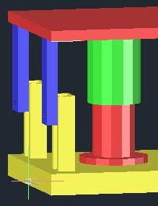
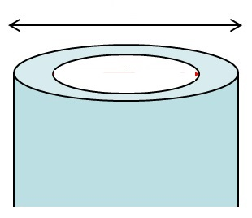
Hollow pipe
Calculation:
upper hollow pipe
Din spring = D-d =156.5-18=138.5 mm
clearance between lower hollow pipe and spring = 5mm
thickness for hollow pipe = 3mm
Din(lower H.P)= Din spring - 2*clearance -2*thickness
Din lower = 122m
clearance between upper hollow pipe and spring = 2mm
thickness for hollow pipe = 3mm
Din ( upper H.P) = Din spring -2*clearance – 2*thickness
Din upper = 128 mm
Lower hollow pipe
Dout
t

Slide 26
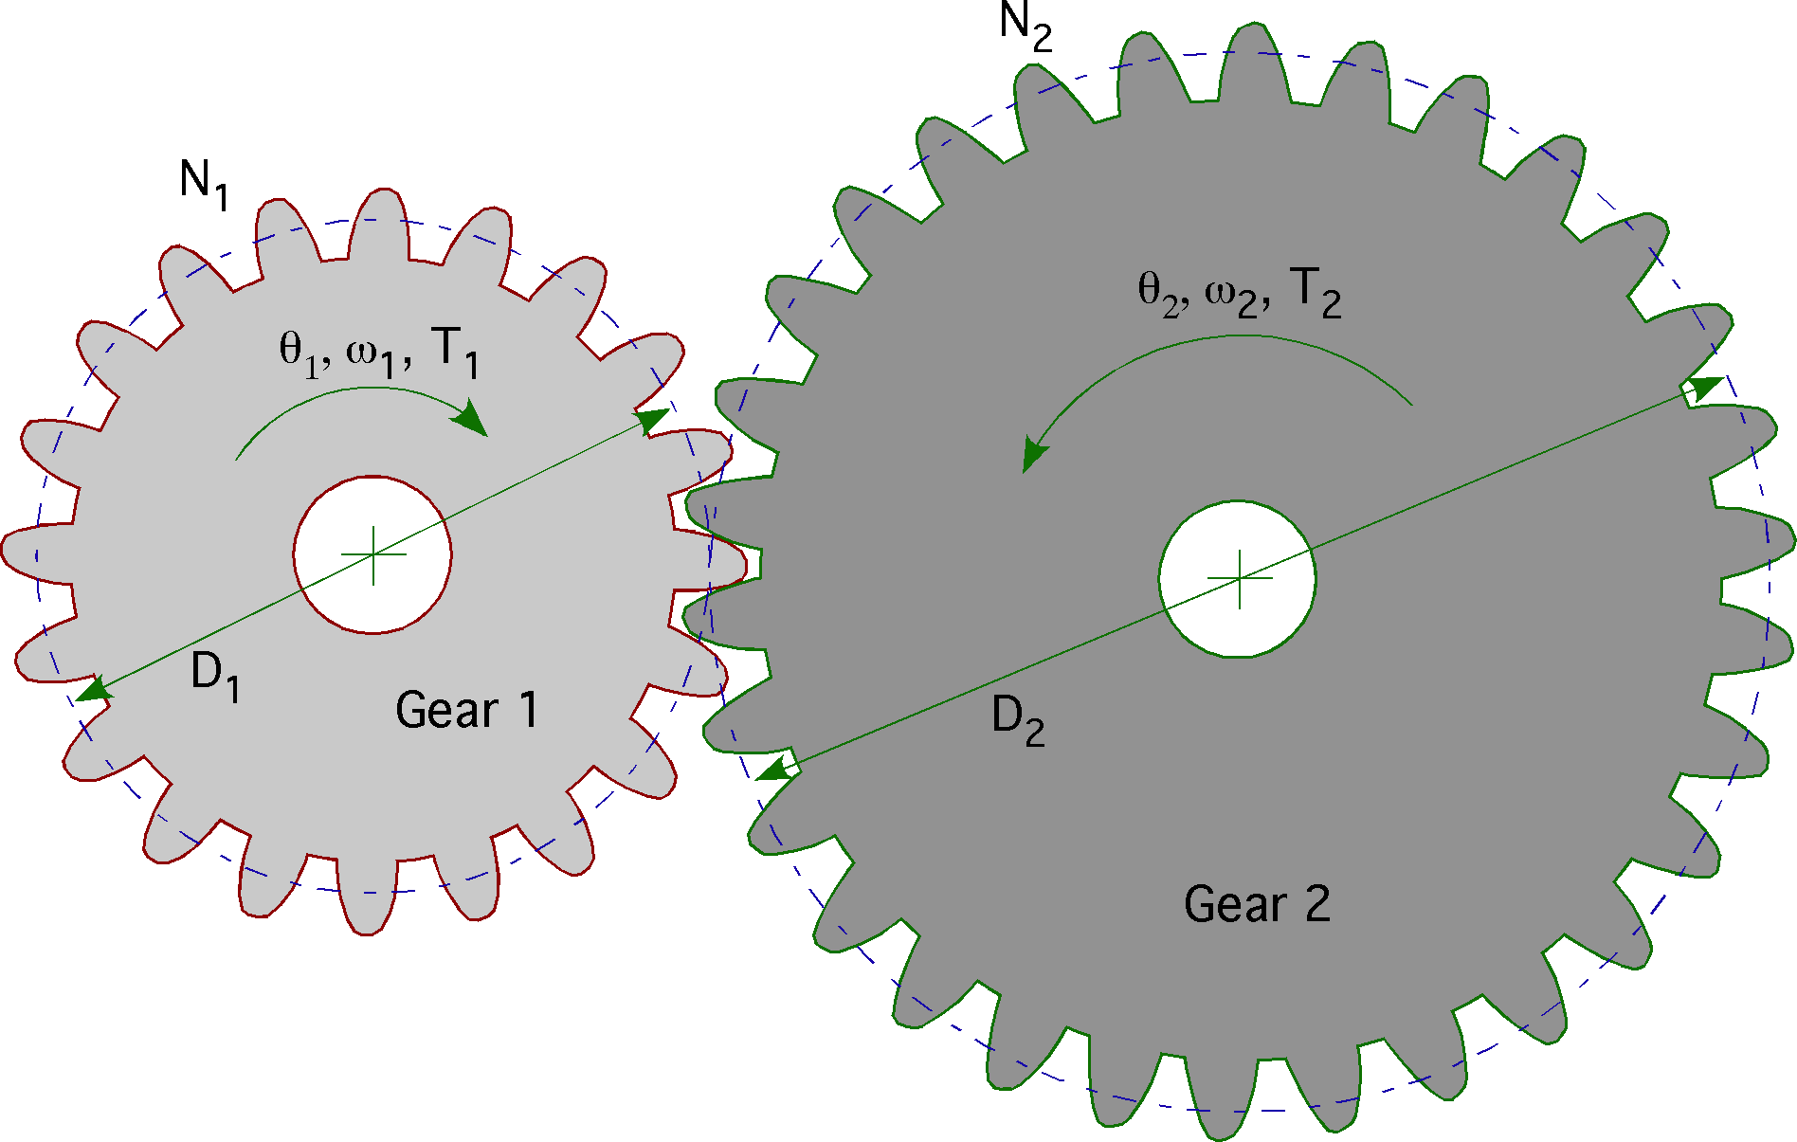
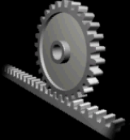
Rack , pinion and spur Gear
Spur gear:
Teeth parallel to the shaft, Used to transmitted motion from one shaft to the other shaft.
Pitch Diameter
Diametral Pitch
(N) Number of teeth
Theta : angular rotation
Rack & pinion gear:
Rack and pinion gears are used to convert the transitional motion to rotational motion

Slide 27



Rack , pinion and spur Gear
Calculation:
The calculation depend on :
Equations that are used :
S = 150 mm,
the distance that gear rotat (arc length).
Let N1 (gear) = 40 teeth
Let N2 (pinion) = 24 to 8 teeth

Slide 28
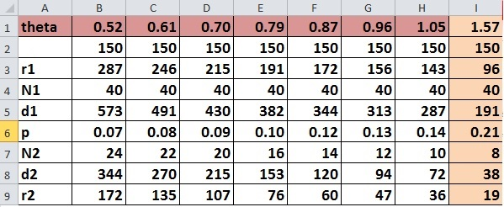
Excel sheet
s
r1 = 96 mm
N1 = 40 teeth
N2 = 8 teeth
r2 = 19mm
To check if r for gear 2 is true ?
If the arc length circumference for ger 2 , its true
S=150 mm

Slide 29
calculation for plate thickness
We will find the thickness of plate depend on
Material of plate : steel – 4140
Tensile strength = 1770 Mpa
Yield strength = 1640 Mpa
Length of plate = 300 mm
Width of plate = 500 m
Factor of safety (n) = 2
Thickness (t)
t
500 mm
3000 mm

Slide 30
V=9810 N M= 4905 N/mm
(from shear-moment diagram)
t = 4.25 mm
where
t = .25mm
We will choose the largest thickness >>> t=4mm

Slide 31
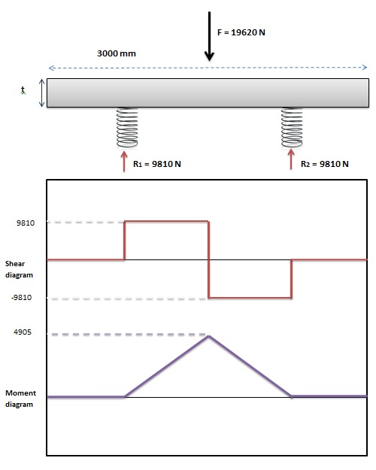

Slide 32
calculate the amount of energy produced daily by generator
For every car passes over the speed breaker , the generator could generate up to 72
watts ,and as the car passes by two levels :by the front wheels and by the back
wheels ,the generator will be able to generate up to 144 watt for every car . From
previous transportation statistics , about 500 cars will pass over the speed
breaker each day , so the amount of power generated each day is : 500*144 =
72000 watt/day

Slide 33
Recommendation and Conclusions
Conclusion
In our project , the main goal was to provide a new cheap and clean source of energy depends mainly on the moving cars weights , which means it is completely clean. The running cost of the project is zero , and the construction cost is low . so our project is economically feasible and environmental friendly .
Our project is “electricity generation using speed breaker” , it consist of :
1- 2 steel plates
2- 2 helical compression
3- 3 gears (rack , gear and pinion)
4- 4 angular joints
5- rubber speed breaker
6- 2 rods
7- support guide block
8- bolts and welding

Slide 34
Recommendations
our project is very simple and upgradeable , so anyone can understand the working procedure and modify the project .
2. the speed breaker could generate more power by using more than one generator in the same speed breaker
3. the construction cost is low , the running cost is zero and its easy to maintain
4. you can put multiple speed breakers in the streets , which means generating and saving more power .

Slide 35
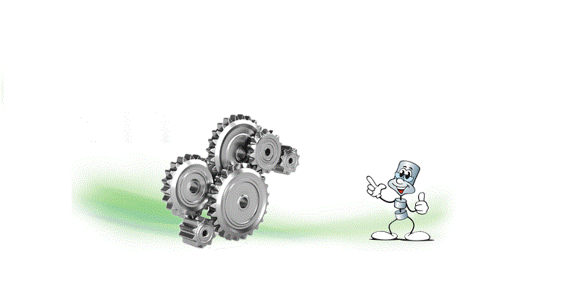

Thank you

