Slide 1
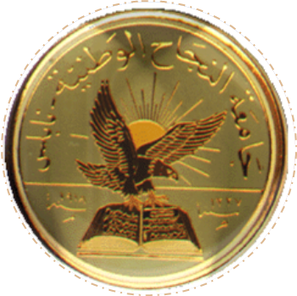
AN – Najah National University
Analysis and redesign of Water Distribution Network
&
Wastewater Network of Arraba Town
Prepared By:
Sobhi Najjar kamal Obaid
Qutaiba Yaseen
Mahmoud Abdeelgafoor
Supervisor: Dr. Amal Al-hudhud
2011

Slide 2
Introduction

Slide 3
The importance of water distribution network
water distribution networks are used to transmit water from the resources to the consumptions.
WDNs decrease the effort, time, cost and make the life easier
The efficiency is very important, and to check on this, a hydraulic analysis is carried out.

Slide 4
Water distribution networks :
The WDNs should be capable of:
Meeting the demands
Satisfactory the pressure head
The WDNs may be classified as:
Grid(looped) systems
Branching systems
Combination of the both

Slide 5
Redesign of WDNs:
The design of WDNs involves the following:
Determination of pipe diameters
Selection of pipe material

Slide 6
Objectives

Slide 7
The Objectives of the Project:
The main objectives of this project are to:
Studying and analysis the existing in arraba town
Redesign the WDN of the town
Design a wastewater network for the town

Slide 8
Study Area

Slide 9
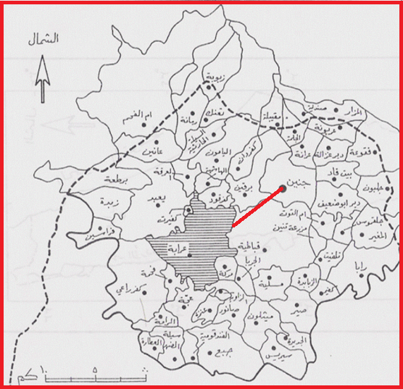
Geography and Topography:
Arraba is located about 13 km southwest of Jenin city and about 3Km west of jenin-nablus street , the street that connect between jenin and nablus city
Administratively, arraba is belongs to jenin governorate
Arraba town is rising from the sea level about 340 meters
Topographically, The area of the town's land (39, 901)DONM distributed between the mountain and easy

Slide 10
Methodology

Slide 11
Methodology
Project Processing Steps:
Site Investigation
Collecting Data
jenin Municipality
Araaba municipality
Working with Data
Supply
AutoCAD map
AutoCAD
DXF2EPA
Software
WDN
Hard copy
Analyze the WDN
Demand
Consumption
Pipes and Nodes
EPANET
Software
Results
Redesign

Slide 12
EPANET Software
EPANET is a computer software used for analyze
the water distribution networks. It can be used for
different types of application in the distribution
system analysis such as a simple network design.
EPANET analysis output are : the flow for each pipe
in the network and the velocities, the pressure for
each node and the total head, the head loss in each
pipe and more of hydraulic output analysis.

Slide 13
Arraba WDN
Arraba WDN
141 nodes
174 links
Arraba reservoir : Elevation = 410 m,
Pressure Reduced Valve (PRV) , no need

Slide 14
Data Input:
Growth rate (r) = 3.24%
Density of the population = =0.0246 person/m^2
Design Period = 25 years
water consumption per capita day = 68 L /C day
Losses: 33%

Slide 15
WDN Analysis
Steady State Analysis
Losses or leakage from the network is the difference in the supply and consumption water amounts. Losses was taken for the year of 2010 and it is about 33% , this huge value occurs due to the rehabilitation of the network in that year.
For each node we find the demand using the following formula
Demand = factor * zone area (m²) * water consumption (CMH)
factor : population rate per square meter of houses
( factor = population / total houses area )
zone area : the area that are served by a specified node, (using AutoCAD )
water consumption : consumption per capita , (68 l/c.d )
population = around 10260 persons, (Palestinian Statistical 2010).

Slide 16
Results

Slide 17
Pressure and velocity in steady state

Slide 18
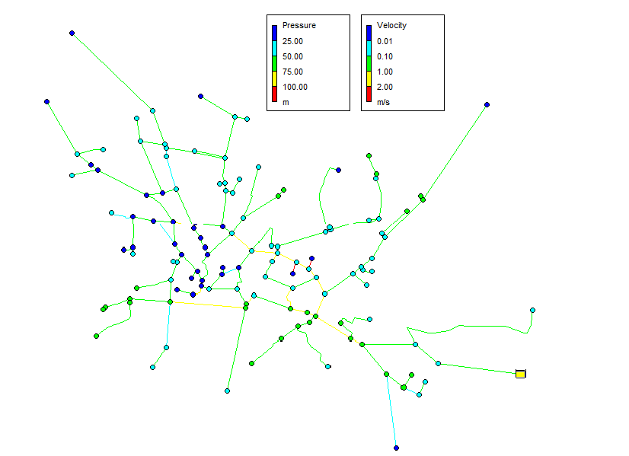
Pressure and velocity in unsteady state

Slide 19
Pressure and velocity in future

Slide 20
Recommendations

Slide 21
Recommendations
1) We advice Arraba municipality to get start working a sewer
network to prevent any pollution
2) The maps we get from Arraba need update
3) Arraba need center of its data
4) There is some people will not allow using their lands we must know where we can not work and restart design
5) Structural themes of Arraba is not enough because after 25 years the density will be high so we advice Arraba municipality to increase it

Slide 22
Design Of Arraba Waste Water Network

Slide 23
Introduction
Arraba is a town without waste water net work.
The system in Arraba to drainage waste water is septic tanks that affect the environment by polluting the soil, ground water, air and etc……
We decided to help the public in Arraba by designing waste water network for the town.

Slide 24
Objective
The main goal of the design:
1- Prevent pollution.
2- Make people comfortable.
3-In the future we can reuse waste water.

Slide 25
Procedure
data collected :
1- Calculate the future population by the following equation:
P=p₀ *(1+r)^{n}
where:
P : is the future population .
P₀: is the present population .
r : is the annual population growth rate .
n : is the period of projection .
2-The population of Arrabah in 2051 is36888 person
3- The water consumption was (120) L/C/D.
4- 80% of demand taken as waste water.

Slide 26
Constraints used in design
Velocity:we consider velocity constraints as Jenin municipality which is between (0.5-3)m/s.
The slope: to be between (0.005-0.3).
Distance between manholes: should not exceed 100 m as
Jenin municipality
Size of pipes: we used circular pipes with minimum diameter of
( 8 inches).

Slide 27
Design of sewers
The most commonly formula is Manning formula:
V=1/n * R^2/3 * S ^1/2
Where:
-n: Manning coefficient.
-S: slope of the bottom of the cannel.
-R= (A/P) :hydraulic radius.
-A: cross section area
-P: wetted parameter
Design steps: by excel sheet

Slide 28
Conclusion and Recommendation
slopes : we face two different slopes in the sewerage network so that we have to solve by using two pipes with deferent direction.
Private property : We had to deliver the sewerage network through the property and private lands because it is the best solution for the functioning of the pipeline and reach the lowest point to link treatment station.
Speed: low speed for some pipes in the network reached a speed of less than 0.5 m / s, we have to solve this problem by changing the slope of the low-speed tube by drilling an appropriate distance .

Slide 29
Results
Diameter: all pipes diameter are 200mm
Manholes : number of manholes = 66.
Pipes: number of pipes =62.
pipe materials: Polyvinyl chloride PVC.

Slide 31
Thank You…

