Slide 1

An Najah National University
Faculty of Engineering
Civil Engineering Department
DESIGN OF FOUNADATION FOR
MUSCAT PRIMARY SCHOOL – KUFUR RA’I
Prepared by
Ehab Waleed Diab
Abdul Rahim Na’em Melhim
Supervised by
Dr. Mohammad Ghazal
2010

Slide 2
INTRODUCTION
All constructions must be carried by foundation. Foundations are structural elements that connect the structure with soil. This element is not visible to the public eye since it lies down the surface of soil (substructure), and it is main function is to transfer the loads of structure to larger area so that the pressure acts on soil is reduced as we move downward till it becomes less than its bearing capacity. So foundations must be designed as safe as possible to be compatible with its duty and function of bearing.

Slide 3
Area of bearing becomes large as moving downward.

Slide 4
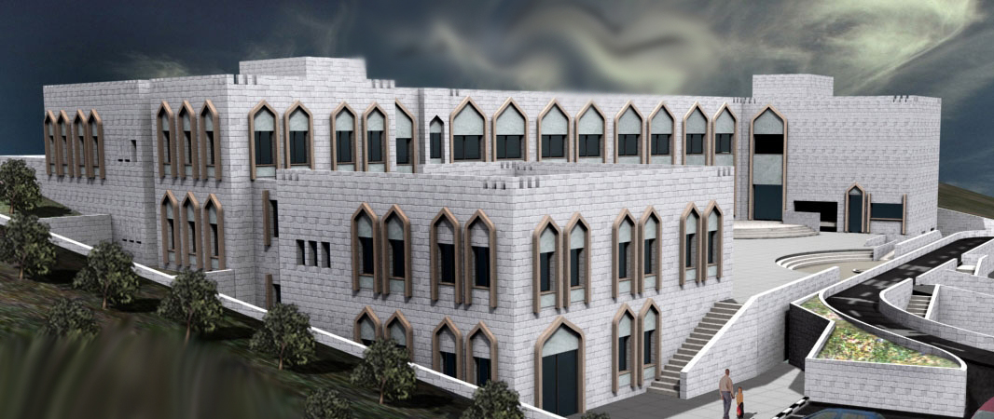
The Project
The project is a school building designed as four floors where a two floor only is carried out with 2046 m² area, the school has a mark of Omani buildings, as it is a grant from the Omani government.

Slide 5
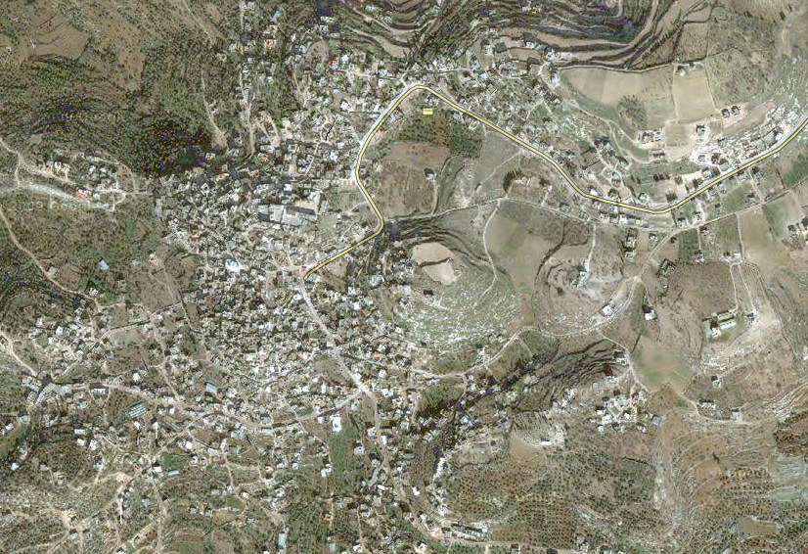
THE SITE
The site specifically in Kufur Rai town where located in the south west of the jenin district, about 20 km from the center of district, also in the middle distance between Talkarem and Jenin. See the figure below
Area of section of land 5000 m2
School occupied more than 1000 m2
School building area 2046 m2.

Slide 6
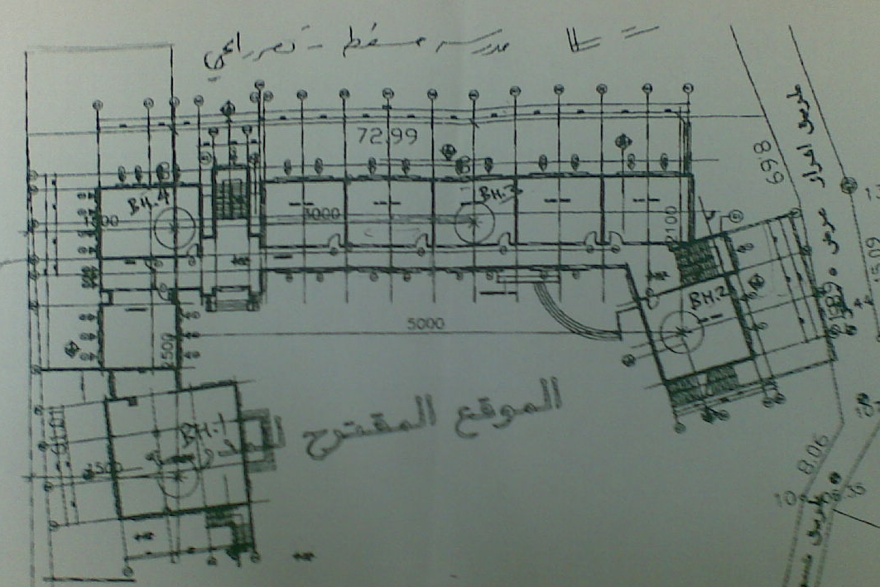
Soil testing
4
3
2
1

Slide 7
Boreholes log
Layer | Type of soil | Depth (m)
 |  | BH1 | BH2 | BH3 | BH4
1 | Dry deposits of silt clay | 0-2 | 0-1.5 | 0-3.5 | 0-3.5
2 | Soft and moist formation of creamy marlstone formation | 2-4.5 | 1.5-4.5 | 3.5-6 | 3.5-6
3 | Dry, medium hard formation of creamy marlstone formation | 4.5-10 | 4.5-10 | - | -
End of boring |  | 10 | 10 | 6 | 6

Slide 8
Results of testing
Borehole No. | Depth (m) | Moisture Content (%) | % passing sieve #200 | Liquid limit (%) | Plasticity Index (PI)
1 | 0-2 | 5.8 | 65.4 | 49.9 | 24.1
 | 2-4.5 | 9.5 | 68.7 | 51.2 | 25.1
 | 4.5-10 | 7.1 | 38.4 | NP | NP
2 | 0-1.5 | 5.6 | 66.8 | 48.4 | 22.4
 | 1.5-4.5 | 21.3 | 76.5 | 52.9 | 26.4
 | 4.5-10 | 8 | 37.4 | NP | NP
3 | 0-3.5 | 5.4 | 69.8 | 48.8 | 23.0
 | 3.5-6 | 6.3 | 34.5 | NP | NP
4 | 0-3.5 | 5.5 | 72.3 | 51.0 | 23.4
 | 3.5-6 | 6.1 | 35.1 | NP | NP

Slide 9
BEARING CAPACITY ANALYSIS
FOR THE UPPER SILTY CALY LAYER (the school building area):
Using the shear test parameters of cohesion and angle of internal friction and the soil density, the following well known Terzaghi equation with correction terms suggested by Schultze can be used to calculate the bearing capacity of rectangular foundation of any sides ratio B:L
qult = (1+ 0.3 B/L) CNc + γo DNq + (1- 0.2 B/L) (γ 1B/2) N
where:
γ o - Unit weight of soil above foundation level in KN/m³.
γ 1 - Unit weight of soil below foundation level in KN/m³.
C,Ø - Strength parameters of the soil below foundation level in KN/m² and degrees respectively.
B - Width of foundation in (m).
L - Length of foundation in (m).
Nc, Nq, N - Bearing capacity coefficients dependent on the angle of internal friction
of the soil below foundation level (dimensionless).
D - Depth of foundation (m).

Slide 10
CALCULATION FOR THE ASSUMED SINGLE FOOTING :
Considering:
B = 2.5 m
L = 2.5 m
D = 2.0 m
γ _{o}= 17 KN/m³
γ₁ = 17 KN/m³
C = 45 KN/m² (average)
Ø = 14 º
and reducing C and Ø according to Terzaghi to
C' = 2/3 C = 28.1 KN/m²
tan Ø' = 2/3 tan Ø , Ø' = 10º
The bearing capacity was computed by a special computer program using both Terzaghi and Vesic methods. The sheet with computation is attached. Based on the calculations, a bearing capacity range of 1.53-1.78 Kg/cm² was obtained at a depth of 2m from the existing ground for shallow isolated footings on the top layer of silty clay.
Borehole No. | Cohesion (Kg/cm²) | Angle of internal Friction Ф(^{ο})
1 | 43 | 15
2 | 45 | 15
3 | 45 | 15
4 | 46 | 14

Slide 11
FOR THE MARLESTONE LAYER (average depth=4.0-4.5m from the surface) (the sanitary unit’s area):
According to the known codes of engineering practice, the bearing capacity of rocks is taken as a percentage of the unconfined compressive strength of rock core samples tested in accordance with ASTM D-2938.
Following the Jordanian Code for Foundations and Retaining Walls (Amman- 1992) [§3/7/1-2], the mentioned percentage is 5% for rocks with RQD ≤ 75 % and the bearing capacity should not exceed 10 Kg/cm².
Taking the lowest compressive strength value of rock core specimens from the table (2) and applying the percentage of 5%, the strength will be:
Q_{all} = 5 % x 73 = 3.7 Kg/cm²

Slide 12
SELECTION OF FOUNDATION TYPE
According to the nature and characteristics of the materials encountered in the drilled boreholes (top layer of silty clay followed by medium hard marlstone), we recommend the following solutions for foundations:
UNDER THE SCHOOL BUILDING:
It is recommended to excavate the ground to a depth of at least 2.0m from the existing surface, compact the reached ground to at least 95% of maximum dry density (modified Proctor), and then:
* Spread and properly compact a granular material (base course) of at least 60cm thickness over the excavated level. The replacement can consist of one rockfill layer and two base course layers each compacted to at least 98% of maximum dry density (modified Proctor).
* Use of isolated and/or continuous footings (with tie beams) on the compacted surface. The recommended bearing capacity is 2.0 kg/cm² over the compacted granular fill.

Slide 13
The other alternative for the foundations of the school building is to excavate the top layer of silty clay and lay foundations at any depth on or below -3.5m from the existing ground (on the medium hard marlstone) with bearing capacity of not more than 3.7 kg/cm².

Slide 14
UNDER THE SANITARY UNITS:
It is recommended to excavate the ground and penetrate the top silty clay layer reaching the layer of medium hard marlstone and use isolated footings.
The recommended bearing capacity within this layer is 3.5 kg/cm².

Slide 15
Structural Design
Using ACI code, the ultimate loads calculated considering load combination:
P_{u} =1.2Dead + 1.6Live.
Using in this project the following materials characteristics:
f’_{c} =240kg/cm² (B 300)
Where: f’c is the compressive strength of concrete
f_{y} = 4200 kg/cm²
fy is the yield strength of steel

Slide 16
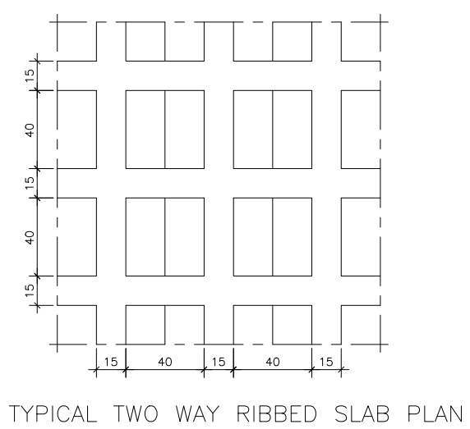
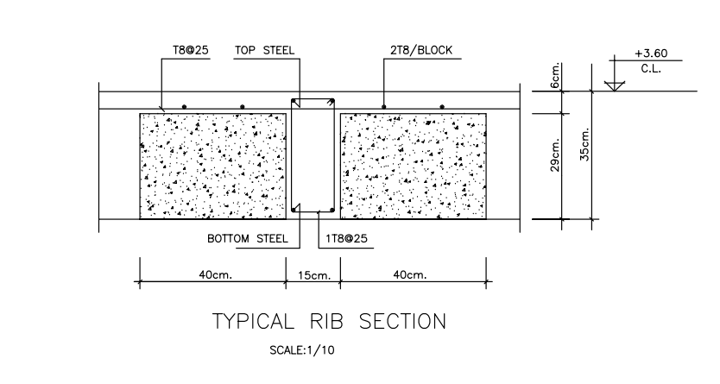
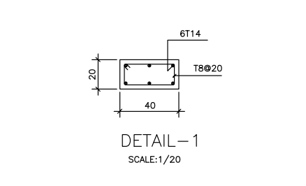
0.35 m
1.65 m
From the figures shown above and sections details:-
Number of blocks =18
Volume of blocks = 18*(0.4*0.2*0.29) = 0.4176 m³
Volume of the concrete = (1.65*1.65*0.35) = 0.953 - 0.4176 m³
= 0.5354

Slide 17
Weight of concrete = 0.5354*2.5=1.3385 ton
Wight of blocks =0.4176 * 1.2 = 0.50 ton
So total weight of the slab section
= 1.3385 + 0.50 = 1.839 ton
So the load per unit area = 1.839/ (1.65 * 1.65)
= 0.6753 ton\m²
Consider super imposed dead load + partial walls
= 0.15 + 0.1 = 0.25 ton\m²
So the total dead load = 0.6753 +0.25 =0.925 ton\m²
The live load considered to be 0.4 ton\m²
So the Ultimate Load
((1.2* 0.925) + (1.6*0.4))= 1.75
Ultimate factor = 1.75/ (0.925+0.4) = 1.32

Slide 18
SUMMARY OF LOADS ACTING ON THE FOOTINGS
This table shows the dimensions and the load acting by column and walls on the footings, where the shaded cells represent shear walls or columns attached with walls in the same footings (eccentric).
Col No. | Dimensions(cm) | Service Load | Col No. | Dimensions(cm) | Service Load | Col No. | Dimensions(cm) | Service Load(tn)
C1 | 20*80 | 66.41 | C22 | 20*60 | 49.50 | C43(w) | 20\m | 50\m
C2 | 20*80 | 100.49 | C23 | 20*80 | 56.10 | C44(w) | 20\m | 50\m
C3 | 20*80 | 100.49 | C24 | 20*60 | 49.50 | C45(w) | 20\m | 50 \m
C4 | 20*80 | 100.49 | C25 | 20*80 | 56.10 | C46(w) | 20\m | 50\m
C5 | 20*80 | 100.49 | C26 | 20*60 | 49.50 | C47 | 20*60 | 100.80
C6 | 20*80 | 100.49 | C27 | 20*80 | 56.10 | C48 | 60*60 | 367.50
C7 | 20*80 | 100.49 | C28 | 20*60 | 49.50 | C49 | 20*60 | 76.80
C8 | 20*80 | 100.49 | C29 | 20*80 | 56.10 | C50 | 20*60 | 32.40
C9 | 20*80 | 100.49 | C30 | 20*60 | 35.10 | C51 | 60*60 | 319.20
C10 | 20*80 | 91.35 | C31 | 60*60 | 108.00 | C52 | 20*60 | 73.50
C11 | 20*80 | 56.10 | C32 | 60*60 | 135.00 | C53 | 20*80 | 91.35
C12 | 20*100 | 117.00 | C33 | 20*70 | 138.00 | C54 | 20*60 | 57.60
C13 | 20*120 | 174.00 | C34 | 20*80 | 102.30 | C55 | 20*80 | 47.85
C14 | 20*120 | 174.00 | C35 | 85*85 | 270.00 | C56 | 20*80 | 102.30
C15 | 20*120 | 174.00 | C36 | 20*90 | 132.00 | C57 | 20*80 | 73.50
C16 | 20*120 | 174.00 | C37 | 20*120 | 174.00 | C58 | 20*85 | 97.65
C17 | 20*120 | 174.00 | C38 | 20*60 | 85.50 | C59 | 20*80 | 56.10
C18 | 20*120 | 174.00 | C39 | 20*40 | 26.25 | C60(w) | 20\m | 50\m
C19 | 20*120 | 174.00 | C40 | 20*50 | 49.50 | C61 | 20*80 | 134.64
C20 | 20*120 | 174.00 | C41 | 20*90 | 122.40
C21 | 20*120 | 174.00 | C42 | 20*60 | 57.60

Slide 19
DESIGNS OF SINGLE FOOTINGS
provide area | L | B | Required area | service load | Footing
2.94 | 2.1 | 1.4 | 2.85 | 100.49 | F1
2.7 | 2 | 1.35 | 2.6 | 91.35 | F2
1.7 | 1.7 | 1 | 1.63 | 56.1 | F3
3.45 | 2.3 | 1.5 | 3.35 | 117 | F4
5.04 | 2.8 | 1.8 | 4.92 | 174 | F5
1.45 | 1.45 | 1 | 1.401 | 49.5 | F6
1.7 | 1.7 | 1 | 1.63 | 56.1 | F7
1.2 | 1.2 | 1 | 1.09 | 35.10 | F8
3.24 | 1.8 | 1.8 | 3.18 | 108.00 | F9
4 | 2 | 2 | 3.89 | 135.00 | F10
3.96 | 2.2 | 1.8 | 3.86 | 138.00 | F11
2.94 | 2.1 | 1.4 | 2.9 | 102.30 | F12
7.84 | 2.8 | 2.8 | 7.75 | 270.00 | F13
3.8775 | 2.35 | 1.65 | 3.81 | 132.00 | F14
2.4725 | 2.15 | 1.15 | 2.43 | 174.00 | F15
3.68 | 2.3 | 1.6 | 3.64 | 122.40 | F16
1.76 | 1.6 | 1.1 | 1.71 | 57.60 | F17
2.925 | 1.95 | 1.5 | 2.89 | 100.80 | F18
10.89 | 3.3 | 3.3 | 10.83 | 367.50 | F19
2.21 | 1.7 | 1.3 | 2.16 | 76.80 | F20
0.96 | 1.2 | 0.8 | .88 | 32.40 | F21
9.3 | 3.1 | 3 | 9.24 | 319.20 | F22
2.125 | 1.7 | 1.25 | 1.95 | 73.50 | F23
2.7 | 2 | 1.35 | 2.61 | 91.35 | F24
1.8 | 1.5 | 1.2 | 1.75 | 57.60 | F25
1.5 | 1.5 | 1 | 1.42 | 47.85 | F26
3.045 | 2.1 | 1.45 | 2.9 | 102.30 | F27
3.91 | 2.3 | 1.7 | 3.81 | 134.64 | F28

Slide 20
THICKNESSES OF FOOTINGS
Depth of footing will be controlled by wide beam shear (one way action) and punching shear (two way action).
Wide Beam Shear:
Shear cracks are form at distance “d” from the face of column, and extend to the compression zone, the compression zone will be fails due to combination of compression and shear stress.
Punching Shear:
Formation of inclined cracks around the perimeter of the concentrated load may cause failure of footing.
Max, formation of these cracks occurred at distance “d\2” from each face of he column.

Slide 21
Thickness of F1
F'_{c} = 240 Kg /cm² (B300)
F_{y} = 4200 Kg /cm²
The design based on 1 meter
Service load =100.49 ton , Ultimate load =132.64 ton
= 1.4*2.1 = 2.94 m²
Wide beam shear:
q_{u}= 132.64/2.94 = 45.115 ton /m²
V_{u} = 45.115 * (.65-d)
Φ *V_{c} = 0.75 * 0.53√240 *1.0 * d *10
Φ *V_{c} >= V_{u} from that d=27 cm
Punching shear:
*Punching shear:
P_{u(punching)} ≤ φV_{cp}
P_{u(punching)}= P_{u(column)}-q_{ult}((b+d)(h+d))

Slide 22
=132.64-45.115((.2+.27)(0.8+.27))
=109.95ton
V_{cp}=1.06* *A₀*d
Where,
A₀: parmeter of the critical section (at distance (d/2) from the face of column)
φV_{cp}=0.75*1.06* *10*(2(.2+.27)+2(0.8+.27))*.27
=102.42ton<109.95ton (Not Ok)
Try a new depth (d=0.32 m)
P_{u(punching)}=106.36ton
φV_{cp}=0.75*1.06* *10*(2(.2+0.32)+2(0.8+0.32))*0.32
=129.27 ton>106.36 (Ok)
Take cover=8cm
So that, total depth of footing=h=40cm
d =32cm cover = 8 cm

Slide 23
Steel Reinforcement (Flexural):
Steel Reinforcement (Flexural):
Isolated footing represented as cantilever, so the max moment occurs at the face of the column:
Ultimate moment at the face of the column (M_{ult}) =q_{ult}*[²/2 =45.115*[²/2] = 9.53 ton.m
M_{n} = , where, Φ=0.9
M_{n} =10.58ton.m
M_{n} =R_{n}bd²
10.58ton. m=R_{n}x(100cm)x(32cm)²
R_{n} =10.33kg/cm²
ρ = (1- )
Where:-
ρ: Steel ratio.
m==20.59
so that ρ=.0025
A_{s.=} 8.08
A_{s.min}=0.0018*100*60= 7.2cm²
As. used= 8.08cm²
Use 5 Φ 16 (1 Φ16 /25cm c/c)

Slide 24
In the other direction:
Ultimate moment at the face of the column
(M_{ult})=q_{ult}*[²/2]=45.115 *[²/2]= 8.12 ton.m
M_{n} = , where, Φ=0.9
M_{n} =9.02ton.m
M_{n} =R_{n}bd²
9.02x100 ton.cm=R_{n}x(100cm)x(32cm)²
R_{n} =8.8kg/cm²
ρ= .0021
A_{s}=6.85
A_{s.min}=0.0018*100*40= 7.2cm²
Use 4 Φ 16 (1 Φ16 /28cm c/c)

Slide 25
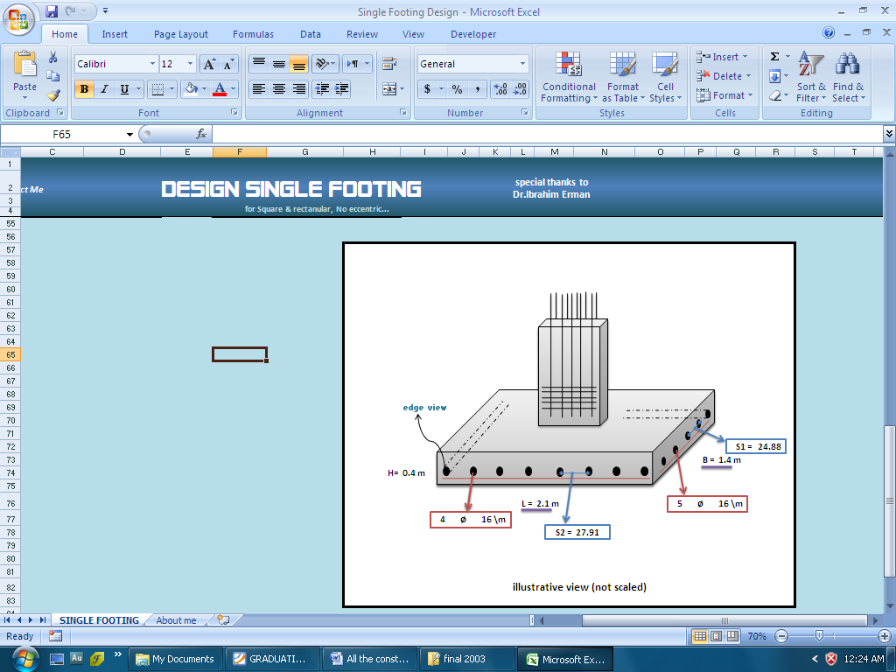
Check Development length:
L_{d} = 0.73 *420*16 = 1001.3 mm ( for Φ16 mm in tension )
√24
Provided = 1400 mm in short direction and 2100 mm in long direction ok

Slide 26
SUMMARY OF DIMENSIONS
h (m) | d (m) | L (m) | B (m) | Footing
.4 | .32 | 2.1 | 1.4 | F1
.35 | .27 | 2 | 1.35 | F2
.3 | .22 | 1.7 | 1 | F3
.4 | .32 | 2.3 | 1.5 | F4
.45 | .37 | 2.8 | 1.8 | F5
.3 | .22 | 1.45 | 1 | F6
.3 | .22 | 1.7 | 1 | F7
.25 | .17 | 1.2 | 1 | F8
.35 | .27 | 1.8 | 1.8 | F9
.4 | .32 | 2 | 2 | F10
.5 | .42 | 2.2 | 1.8 | F11
.4 | .32 | 2.1 | 1.4 | F12
.55 | .47 | 2.8 | 2.8 | F13
.45 | .37 | 2.35 | 1.65 | F14
.45 | .37 | 2.15 | 1.15 | F15
.4 | .32 | 2.3 | 1.6 | F16
.3 | .22 | 1.6 | 1.1 | F17
.4 | .32 | 1.95 | 1.5 | F18
.75 | .67 | 3.3 | 3.3 | F19
.35 | .27 | 1.7 | 1.3 | F20
.25 | .17 | 1.2 | 0.8 | F21
.7 | .62 | 3.1 | 3 | F22
.35 | .27 | 1.7 | 1.25 | F23
.35 | .27 | 2 | 1.35 | F24
.3 | .22 | 1.5 | 1.2 | F25
.25 | .17 | 1.5 | 1 | F26
.4 | .32 | 2.1 | 1.45 | F27
.45 | .37 | 2.3 | 1.7 | F28

Slide 27
The following table shows summary of single footing reinforcement:
Reinforcement in long direction/cm/m | Reinforcement in short direction/cm/m | Footing
1ø16/27 | 1ø16/25 | F1
1ø16/27 | 1ø16/25 | F2
1ø14/28 | 1ø14/28 | F3
1ø16/18 | 1ø16/28 | F4
1ø16/19 | 1ø16/ 19 | F5
1ø14/28 | 1ø14/28 | F6
1ø14/28 | 1ø14/ 28 | F7
1ø12/23 | 1ø12/ 25 | F8
1ø14/19 | 1ø16/25 | F9
1ø16/22 | 1ø16/ 22 | F10
1ø16/21 | 1ø16/ 22 | F11
1ø16/28 | 1ø16/ 25 | F12
1ø16/16 | 1ø16/ 16 | F13
1ø16/23 | 1ø16/ 23 | F14
1ø16/19 | 1ø16/ 19 | F15
1ø16/22 | 1ø16 / 22 | F16
1ø14/29 | 1ø14/32 | F17
1ø14/19 | 1ø14/ 18 | F18
1ø25/30 | 1ø25/ 30 | F19
1ø14/22 | 1ø14/ 22 | F20
1ø12/25 | 1ø12/ 25 | F21
1ø20/22 | 1ø20/20 | F22
1ø16/30 | 1ø16/29 | F23
1ø16/27 | 1ø16/25 | F24
1ø16/30 | 1ø16/28 | F25
1ø12/20 | 1ø12/25 | F26
1ø16/27 | 1ø16/25 | F27
1ø16/21 | 1ø16/21 | F28

Slide 28
ELASTIC SETTELMENT:
Settlement calculations essential to check whether the settlement of the footing with initial dimensions is acceptable or not.
Se = q₀*α *B'* (1-μ_{s}²)/E_{s} *I_{s} *I_{f} ……… equ(4:17)
Where:
q₀ : Net applied pressure at foundation level (KN/m²)
α : = 4 for center , = 1 for corner
B' : = (B/2) for center , = B for corner
μ_{s} : Soil poisson ratio.
E_{s} : Average modules of elasticity of soil
I_{s} : shape factor
I_{s} = F₁ + ( (1-2µ_{s})/(1-µ_{s}) )*F₂ ...........equ(4:18)
F₁ & F₂ = f( m' , n' )
m' = (L/B) for center and corner
n' = H/(B/2) for center , = (H/B) for corner
I_{f}: Depth factor , = f( (D_{f}/B) , μ_{s} , (L/B) )
Note: f1, f2 & If from “Principle of Foundation Engineering 5th edition”[1].

Slide 29
Footing 19:
S_{e} = q₀*α *B'* (1-μ_{s}²) *I_{s} *I_{f}/E_{s}
q₀ = (367.5*9.81) / (3.3*3.3) =331.05 KN/m²
α: = 4 for center
= 1.65 (assume D_{f} =1.5 m) B’: = (B/2) for center
μ_{s}:= 0.3 KN/m² E_{s} = 25 *10³
I_{s} : shape factor
F₁ & F₂ = 0.498,0 .016respectively
m' = 1 , n' = 10
Therefore:
I_{s} = 0.498 + ((1- 2*0.3)/ (1-0.3))*0.016 = 0.5
I_{f} = f ((D_{f}/B), μ_{s} , (L/B) ) = 0. 606
And, Se = .024 * 1000 = 24 mm
Settlement calculations carried out based on settlement of center of footing which more than settlement of corner , in addition to calculate settlement as a flexible footing , but if the footing is rigid , the settlement value will be reduce.
All values of settlement less than 25 mm is acceptable value.

Slide 30
DESIN OF TIE BEAMS
Tie beams are beams used to connect between columns necks, its function to provide resistance moments applied on the columns, Tie beams useful in building that designed to resist earthquakes load to provide limitation of footings movement, and it’s also important if settlement occurs.
The moment applied on the columns is low, so assuming a tie beam with dimensions of 30 cm width and 60 cm depth.
Steel reinforcement:
Use minimum area of steel:
As _{min} = ρ_{min} b d
ρ_{min}= 14/f_{y} …..………equ(4:19)
ρ_{min}=0.0033
As =0.0033*30*55 =5.5cm²
b=30 cm
h=60cm
Cover=5cm
Use 1 Φ 12 /20cm top steel.
Use1 Φ 12 /20cm bottom steel.

Slide 31
DESIGN OF WALL FOOTING
Ultimate load /m' = 66t/m' (From SAP2000)
Service load /m' = 50t/m' (from SAP2000)
Wall width = service load /allowable bearing capacity
B = 50 /35 = 1.42 m
Use B=1.5 m
Check shear:
q_{u} = 66/1.5 = 44 t/m²
V_{u} = q_{u} * L
= 44 (0.65 –d)
Φ *V_{c} = 0.75 * 0.53√240 *d *10
From that: d= 27cm (try H=35 , d=30)

Slide 32
Steel reinforcement:
Max moment in wall footing occurs at in the middle between center line of wall and face of wall
So, Bending Moment = q_{u}*L²/2
M = 44 (.4225)/2 =9.295ton.m
ρ= 0.85 *240 ( 1- (√(1-(2.61*9.295*10⁵) ) ) = 0.0028
4200 240*100*30²
A_{st} =0.0028 * 100*30 = 8.4 cm²/m
(1 Φ14 /18 cm c/c)
In the other direction use min area of steel
A_{stmin} = 0.0018(100)(35) =6.3 cm²
(1 Φ14 /24 cm c/c)

Slide 33
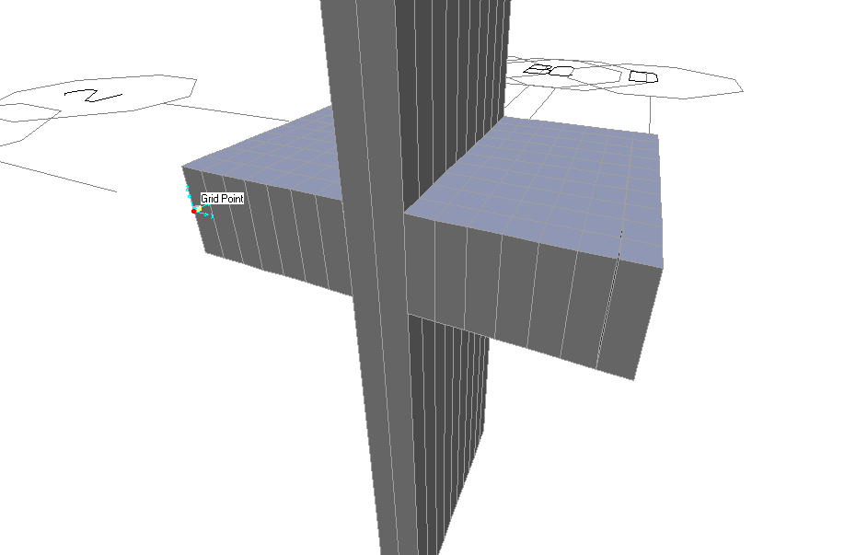
SAP ANALYSIS AND DESIGN:
Wall Footing:

Slide 34
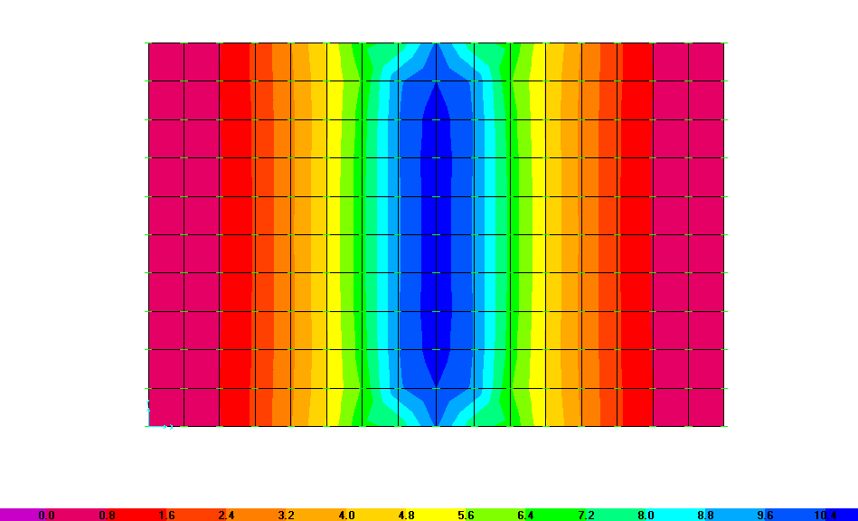
The figure below show bending moment in x-direction using SAP2000

Slide 35
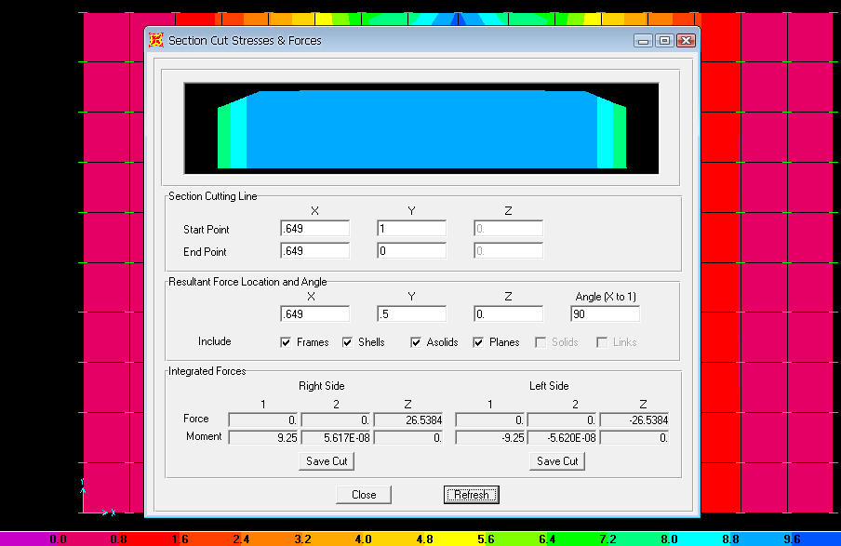
The figure below shows the values of moment at distance d from the face of the column (section cut):
Steel Reinforcement
From the figure above the moment is 9.25
ρ= 0.00279
A_{st} =0.00279 * 100*30 = 8.3 cm²/m

Slide 36
So the reinforcement in the main direction:
(1 Φ14 /18 cm c/c)
In the Other direction use min area of steel
A_{stmin} = 0.0018(100) (35) =6.3 cm²
(1 Φ14 /24 cm c/c)

Slide 37
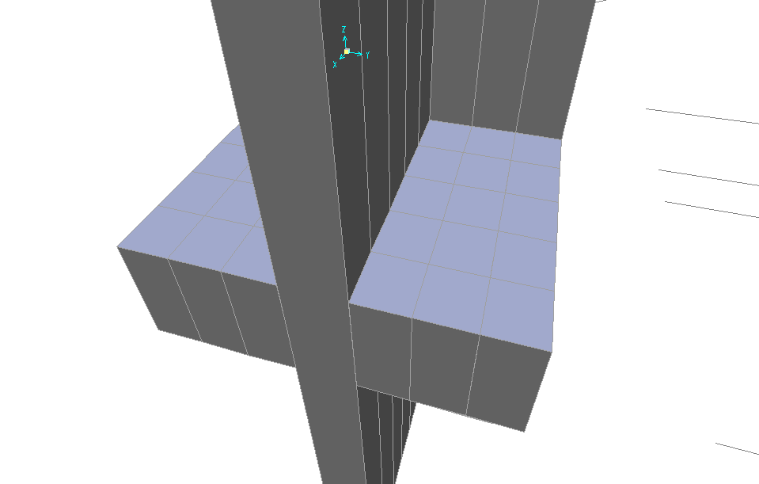
Eccentric footing:
For Footing 2 (L= 1.6 m, B= 1.2 m, d= 0.4 m)
Column
`
Wall

Slide 38
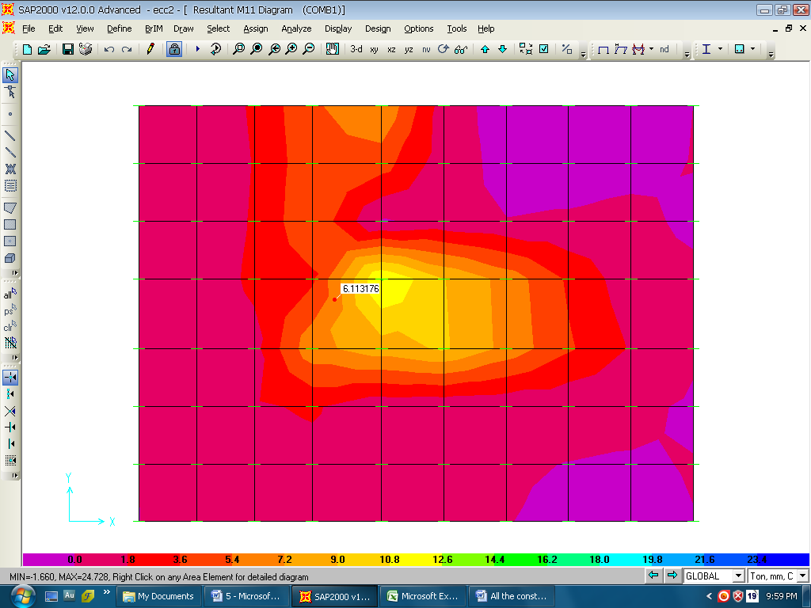
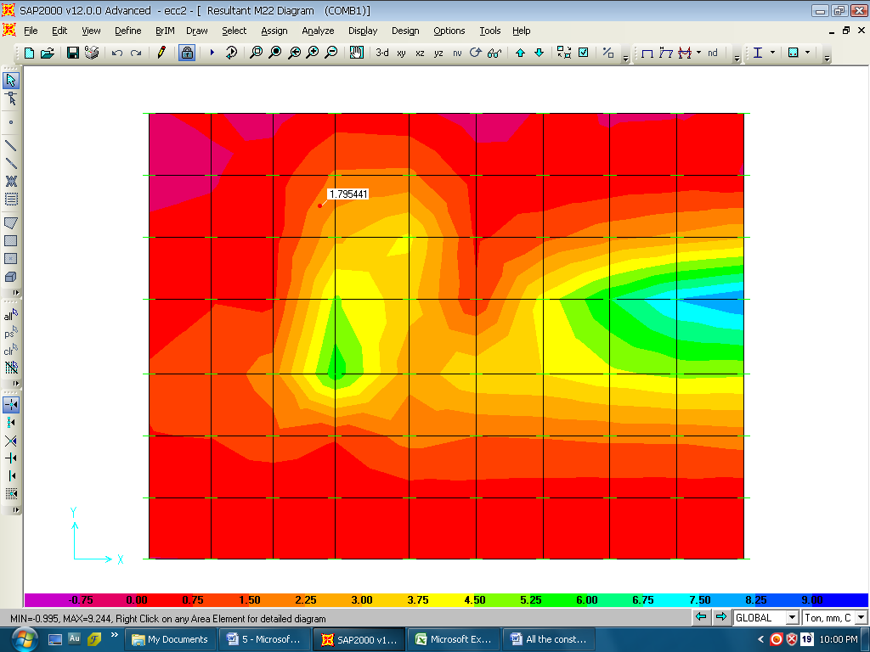
The moment in the x-direction shown in the figure:
The moment in the y-direction below shown in the figure

Slide 39
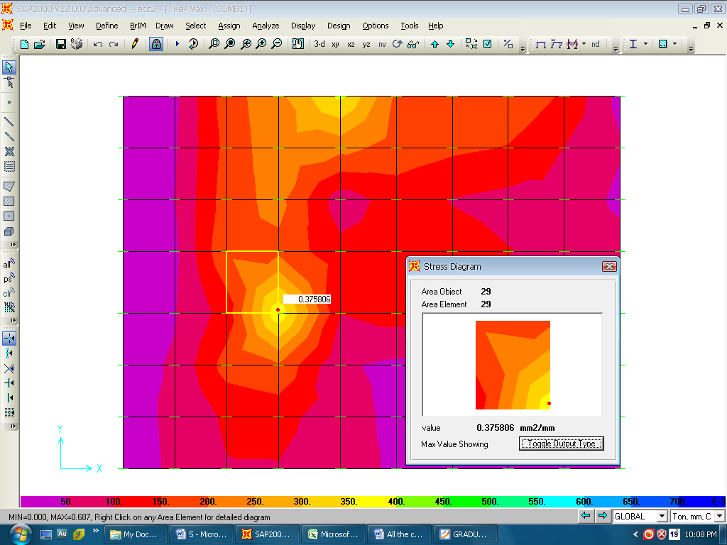
The figure below shows the area of steel (As1) in x- direction that recommended in the design:
The maximum area of steel in the x-direction As1= 3.8 cm2

Slide 40
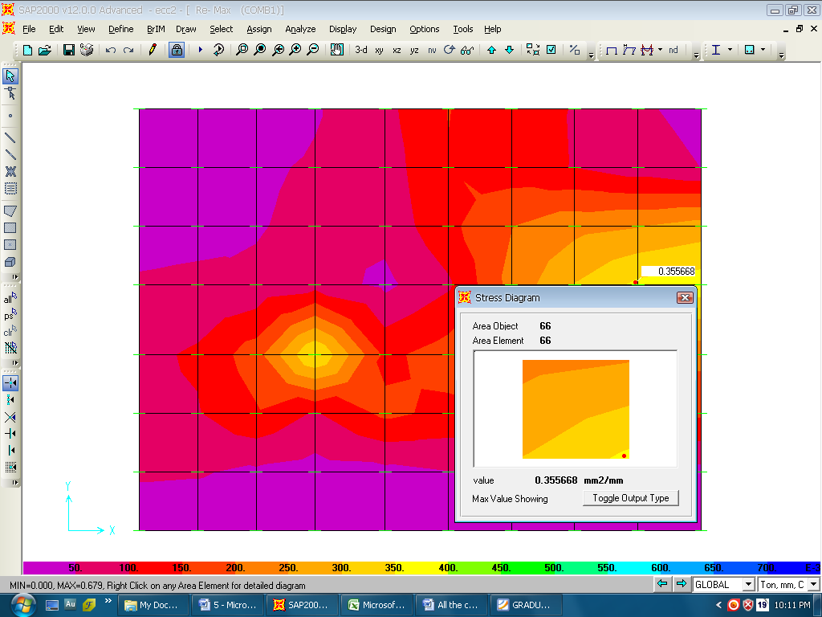
The figure below shows the area of steel (As2) in y- direction that recommended in the design:
The maximum area of steel in the x-direction As1= 3.6 cm2

Slide 41
Since both areas in x and y is too small, it is recommended now to use the minimum area of reinforcement:
As min = 0.0018 * 100 *40 = 7.2 cm2
1 ø 14 \ 21 cm

Slide 42
Summary of reinforcement for the eccentric footings
Footing | L * B * d (m) | Reinforcement in L | Reinforcement in B
F1 | 1.8 * 1.4 * 0.4 | 1ø14/21 cm | 1ø14/21 cm
F52 | 1.35*1.8*0.35 | 1ø14/20 cm | 1ø14/21 cm
F53 | 1.5 * 2 *0.4 | 1ø16/28 cm | 1ø14/20 cm
F55 | 1* 1.6 * 0.3 | 1ø14/29 cm | 1ø14/29 cm
F57 | 1.3*1.9*0.35 | 1ø14/24 cm | 1ø14/24 cm
F58 | 1.5*2.2*0.4 | 1ø16/25 cm | 1ø14/20 cm
F59 | 1.1*1.7*0.3 | 1ø12/21 cm | 1ø12/21 cm

Slide 43
PROKON ANALYSIS AND DESIGN
Retaining shear walls:
The figure beside shows an illustrative view of the retaining wall in the project, where it carrying a part of building in addition of countering the lateral soil pressure.
Beam
Soil
Wall
This model designed using Prokon Calc Pad,
Considering the axial load acts on the footing
Wall
comes from the wall and the building, in addition to the bending moment resulting from the lateral soil pressure.
Footing

Slide 44

Beam
Q *L ²/30
Soil
Wall
Q *L ²/15
Moment = 41.5 * 4² /15
= 44.6 KN.m
Footing
q = 4* 17 * 0.61
= 41.5 KN.m
Ka = 0.61
γ = 17 KN\ m³

Slide 45
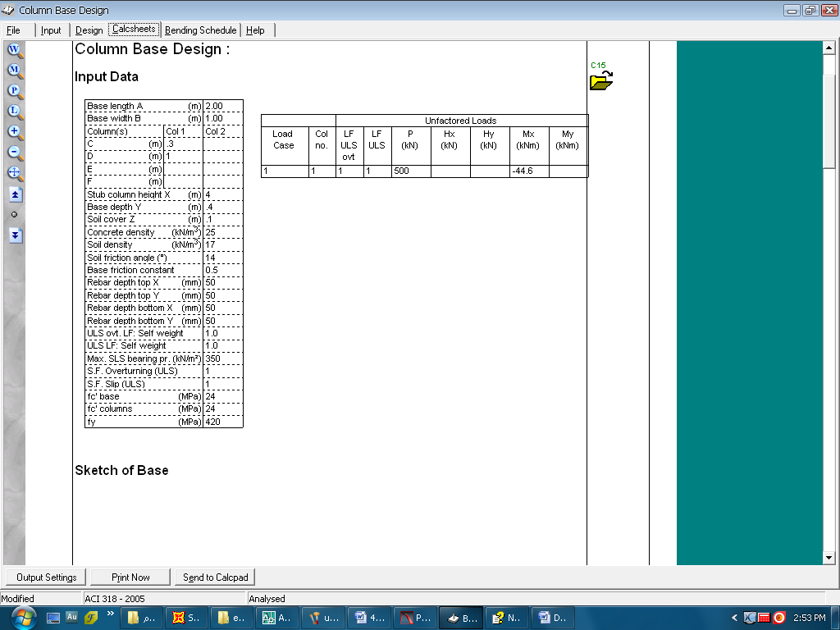
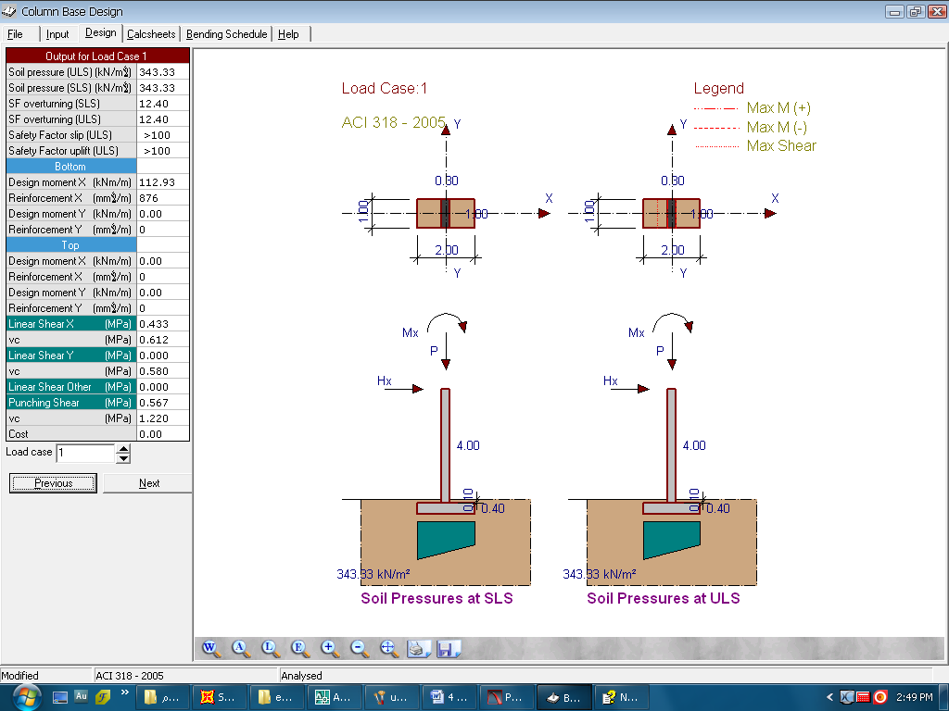
The figure below shows an illustrative sketch and details of the wall existing in the projects.

Slide 46
