Slide 1
AN-Najah National University Engineering College Mechanical Engineering Dep.
Effect of heat treatment temp in the micro hardness and tensile properties
Supervisor : Dr. Osayd Abdul Fattah
Feras Shuqair
Saif Soliman
Nemir Injass
Mo’men Nabeel

Slide 2
Outlines
Abstract
Law Carbon Steel
Equipment
Experimental procedure
Results and Analysis
Conclusions

Slide 3
Abstract
Project’s Abstract:
In this project we must study the effect of heat treatment temperature in the micro hardness and tensile properties for low carbon steel 1010, by increasing the quenching temperature above A1 to 1150° C (maximum solubility limits).
After quenching we must tempered the steel and study the effect of the heat treatment by using tensile and micro hardness testing machines to find the relation between the heat treatment temperatures and the above properties.

Slide 4
Law Carbon Steel
Low carbon steel has carbon content of 0.15% to 0.45%. Low carbon steel is the most common type of steel as its price is relatively low while its provides material properties that are acceptable for many applications. It is neither externally brittle nor ductile due to its low carbon content. It has lower tensile strength and malleable.

Slide 5
Equipment
1- furnace temperature 0-1100 °C .
2- Curve turning tool
3- Tensile test machine.
4- Quenching oil SAE 10/40.
5- Turning machine.
6- micro Hardness test machine.

Slide 6
Experimental procedure
Tensile specimen procedure :
The long of specimen is 40 cm and has a diameter 14 mm
The specimen has been clamped on turning machine
to coarse the surfaces.
After finishing a turning process the specimen put into furnace to heated .
Heat the specimen to austenite region. (γ)
From the phase diagram we see the austenite region (γ) starts from 750 co to 1100 co maximum solubility limits.

Slide 7
Experimental procedure
Heat the 24 specimen to 750 °C.
The specimen heated for 15 minutes, take the three specimens from the furnace and quench rapidly in oil.
Rise the temperature to 800 co for the 18 remains specimen and keep it in furnace for 15 minutes ,after that take another 3 specimens from the furnace and quench it in oil.
Continue heating by step 50 co for the other specimen and another 3 specimens and repeat as the previous step.
Tempering the entire specimen in furnace about 550 co for 1:30 Houre.
Put the specimen in Tensile testing machine.

Slide 8
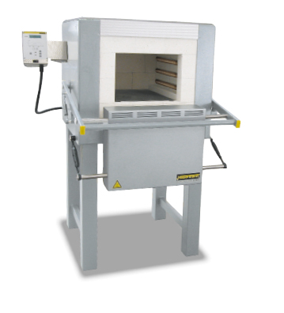
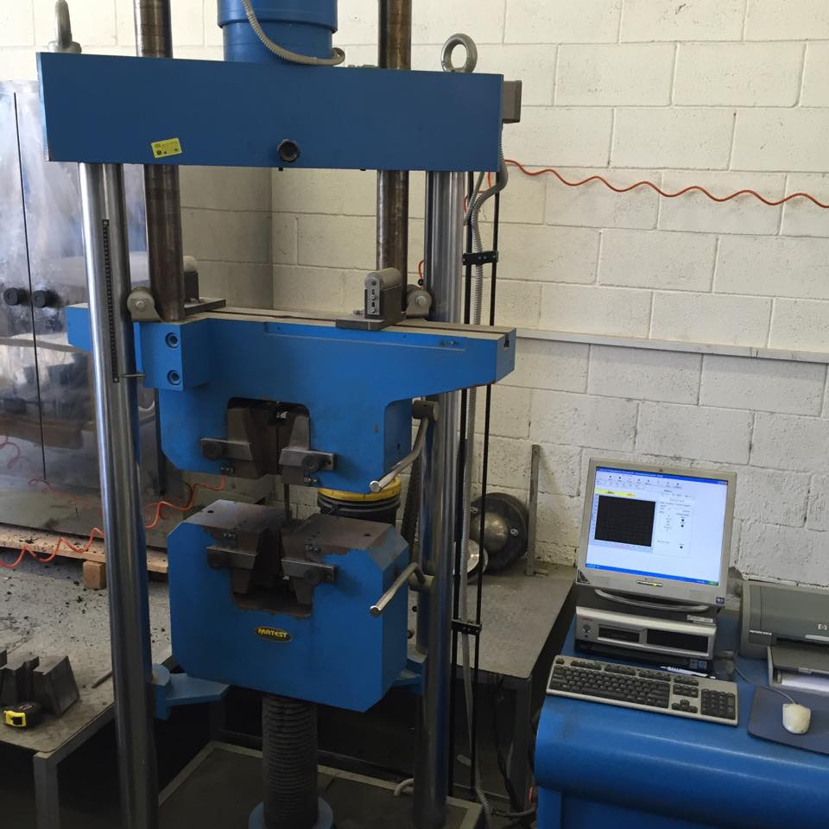
Experimental procedure
Furnace
Tensile test machine

Slide 9
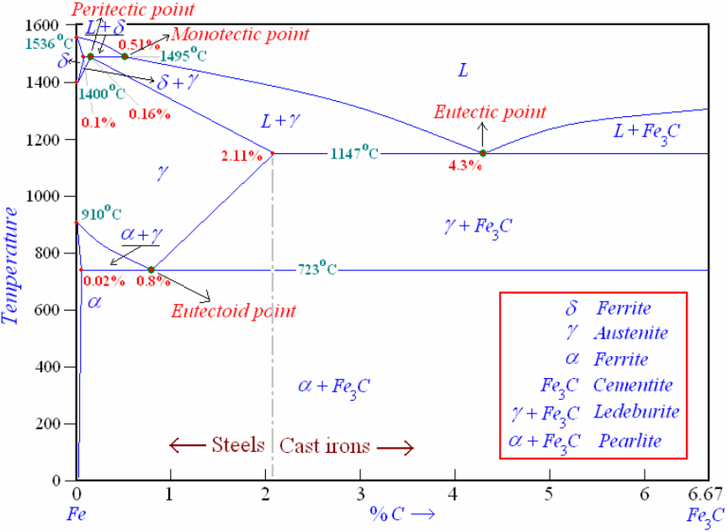
Experimental procedure
Iron – Iron carbide phase diagram.

Slide 10
Results and Analysis
Results and Analysis of Tensile test
Specimen No. | Annealing temp.(°C) | Average Yield Strength(Mpa) | Average UTS | Average Elongation%
1 | 25 | 200 | 350 | 11.56
2 | 750 | 218.70 | 347.76 | 55.37
3 | 800 | 252.17 | 343.20 | 65.97
4 | 850 | 243.39 | 343.21 | 59.30
5 | 900 | 246.85 | 354.38 | 61.10
6 | 950 | 234.94 | 349.70 | 55.67
7 | 1000 | 243.80 | 346.50 | 51.67
8 | 1050 | 233.86 | 351.05 | 57.35
9 | 1100 | 227.80 | 345.46 | 61.37

Slide 11
Results and Analysis Temp Vs Average Yield Strength

Slide 12
Results and Analysis Temp Vs Average UTS

Slide 13
Results and Analysis Temp Vs Average Elongation

Slide 14
Results and Analysis Effect of heat Treatment on the Average Micro Hardness
Specimen No. | Annealing temp.(°C) | Average Micro Hardness
1 | 25 | 901.73
2 | 750 | 670.40
3 | 800 | 699.13
4 | 850 | 691.75
5 | 900 | 659.30
6 | 950 | 673.60
7 | 1000 | 685.83
8 | 1050 | 757.07
9 | 1100 | 698.83

Slide 15
Results and Analysis Temp Vs Average Hardness

Slide 16
Conclusions
Increasing the heat treatment temperature cause to improve the properties of the steel, and increase the Yield Strength, and the maximum Yield Strength at 800°C. the percentage increasing was 26%.

Slide 17
Thank You

