Slide 1
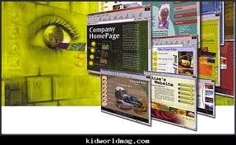
Communication Management

Slide 2
Website of Qabatia Municipality Project
Developed by:
Mohammad AL-Ahmad.
Moath Attar.
Submitted to:
Dr. Barraq Jomah.

Slide 3

Introduction:
What is Municipality ?
Project
A municipality is the smallest administrative subdivision of officials government political.
purpose:
Municipality is appointed to manage the affairs of a local political unit.

Slide 4
Information about Qabatiya Municipality:
Qabatiya municipality :
located in Jenin city it is far about 7 km to the south from jenin . And a population is about 20,000 inhabitants. With an area of about 6000 acres.

Slide 5
The municipality is composed of 6 main departments:
1.Department of Administration
2. Department of Health
3. Department of Finance
4. Structural Department
5. Department of Water .
6. Department of Electricity.

Slide 6
Why selected Qabatia Municipality
The world now Has developed and has a big jumping in the field of technology and which impact positively on business .
so that we selected a vital municipality in our country as a model in the development of the traditional system to the electronic system. And see what are deferent?

Slide 7
Effective communication begins with first understanding how the communication process works.
Effective communication:

Slide 8
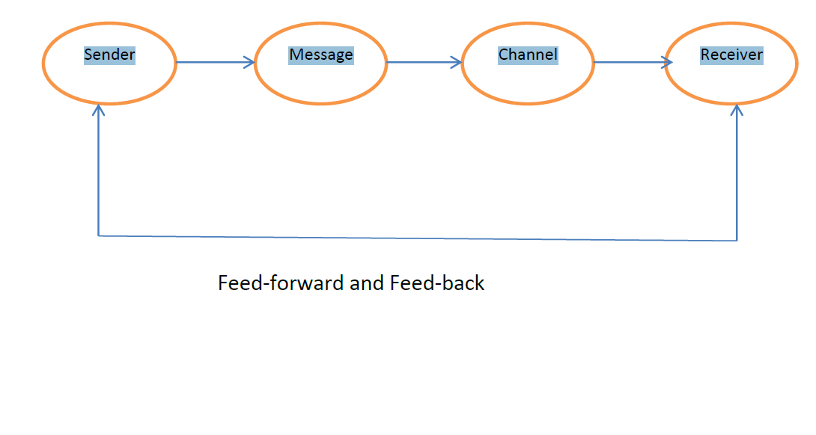

Slide 9
1- We will study the Municipality of Qabatiya.
2-Improve the organizational structure of the municipality.
3-To clarify the relationships between the employees.
Objective of the project:

Slide 10
4-Exchange information electronically among its employees through a website was implemented by a program called FrontPage. Instead of the traditional way of exchange of information in the municipality.
5-Know the status of the structural project in terms of budget and time.

Slide 11

Website
Website:
Is the electronic system consists of a set of processes and Standards for data exchange and business between the companies electronically.
Purpose:
Organize sending and receiving the documents between employees and departments and electronic exchange of data.
Notes:
It is important to be in safe side in every thing as impose date لكي نكون بعيدين عن الغرامات التأخير الي ممكن ان تحصل إذا اخرنا عن الموعد المحددand and % complete of activity to know we are ahead or behinde or a متقدمين او خسرانين

Slide 12
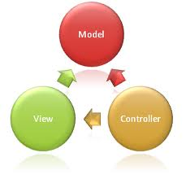

This Website Consists of Two Computer Languages:
FrontPage
ASP.NET
work as convert any text or excel sheet to codes and connect with data base.
work as design pages.
Notes:
By questionnaire we observe if HR work with rise morale by manager they coused to increase the company profit so both of this in positive relationship with communication so that we connect cost and HR with communication related to it.
AND cost by communication we interest to select best cost or purchase for any thing if any problems occurs and interest also to increase my profit
That also relationshipe togother example : if we know the works for this project are lated time so we must accelerate but we should study 3 case then selecte what we must do???
1- pay for owner the ضريبة تأخير
2- accelarated and bring other HR to do it early
3- pay for HR overtime

Slide 13
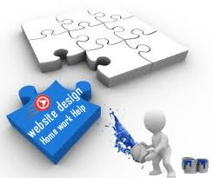
FrontPage Language
Front page :
This program used for design web pages depends on html language.
The most powerful feature of FrontPage:
It allows to create websites without having to learn HTML language.
Notes:
to be able control, and to avoid the risk in project as much as possible before happen.

Slide 14

ASP.NET Language
ASP.NET language:
This language will be just for employees only. And to deal with data base which in ASQL server.
The important of this language:
  Connect with data base to make users and password for employees and save any thing for any project on data base.
Notes:
Quality Materials
Quality Events (time)
Quality Plan
Quality Control

Slide 15
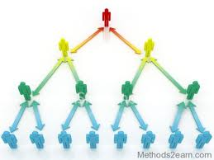
The Website Level to Communicate
The website has four levels:
A-The first as Supervising engineer on site who inter the daily report and edit any changes.
B-The second level as project manager who will pricing tenders and monitors the project.

Slide 16
C-The third level municipality manager who concerned with cost and time of project and he want to know the project is winner or loser, and the project is head or late.
D-The fourth level for IT Department to generate a new account or delete account and to convert the files to codes.

Slide 17
Status Project Depend on some relationship:
Cost Performance Index (CPI) = BCWP / ACWP
if CPI=1 on budget
CPI < 1 over budge
CPI > 1 under budge
Schedule Performance Index (SPI) = BCWP /BCWS
If SPI = 1 on schedule
SPI < 1 behind schedule
SPI > 1 ahead of schedule

Slide 18
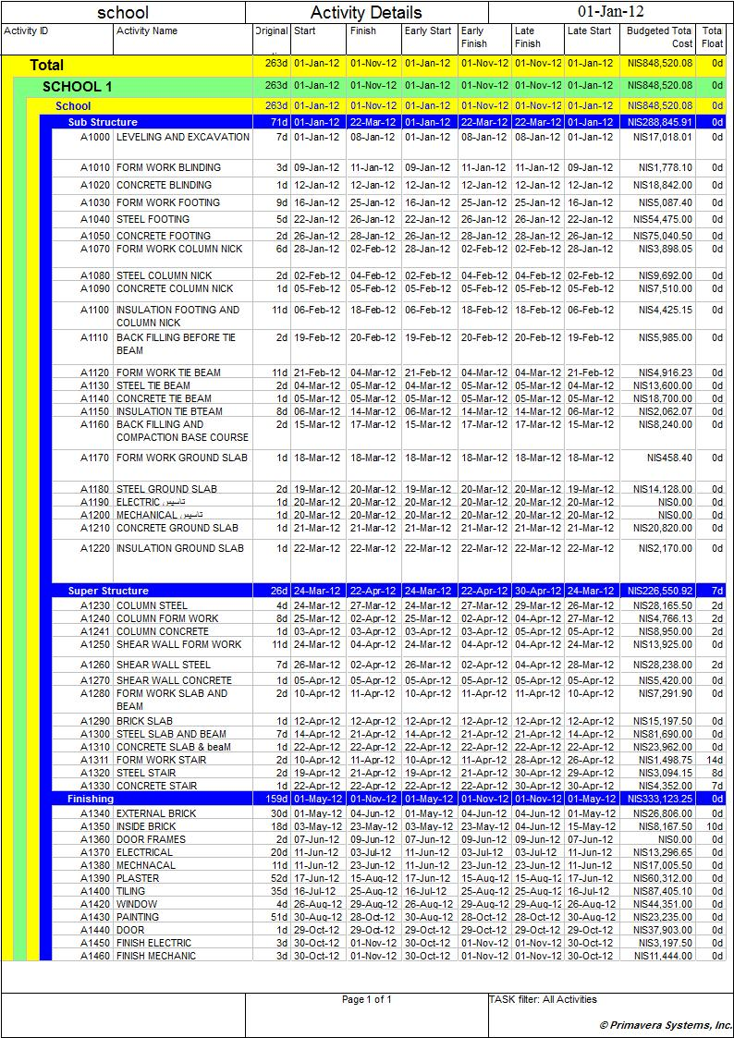

Slide 19
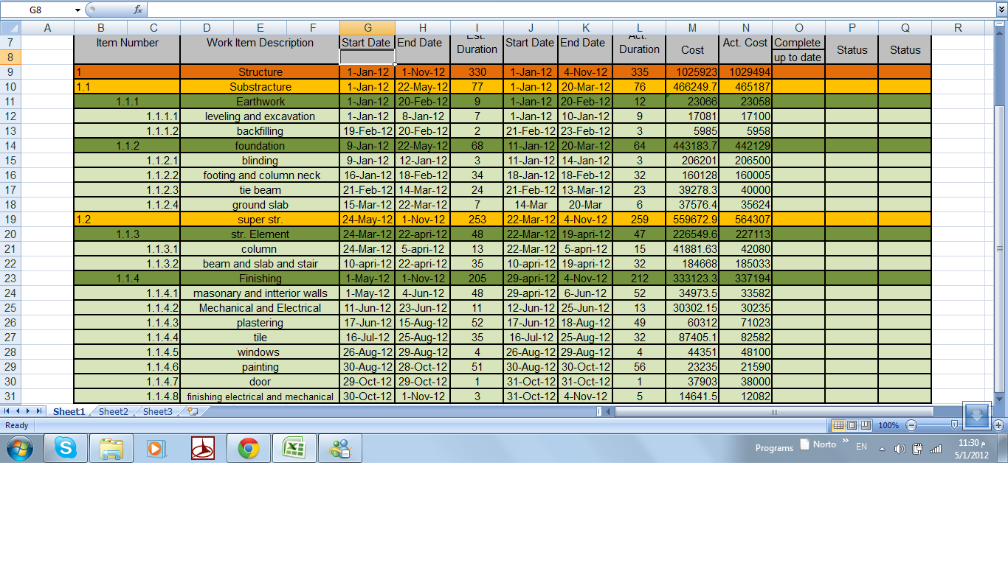

Slide 20
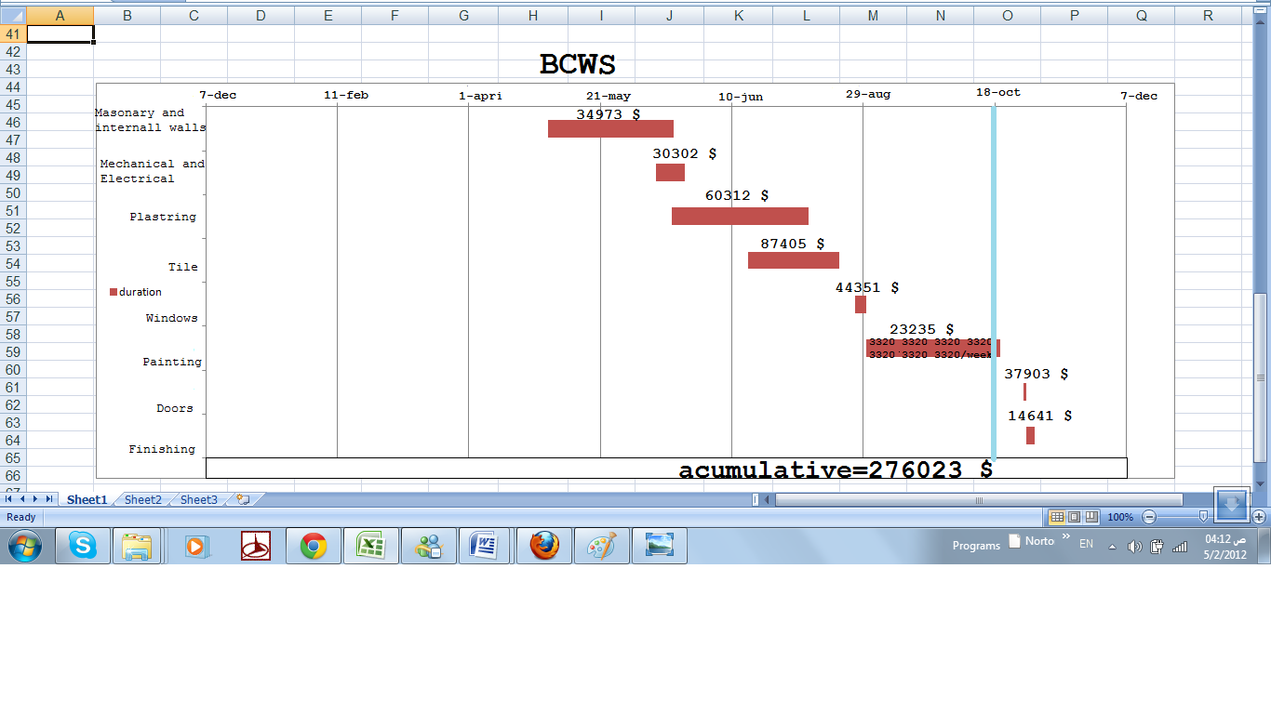
1-Budgeted cost of work scheduled (BCWS):
related to the schedule cost and duration

Slide 21
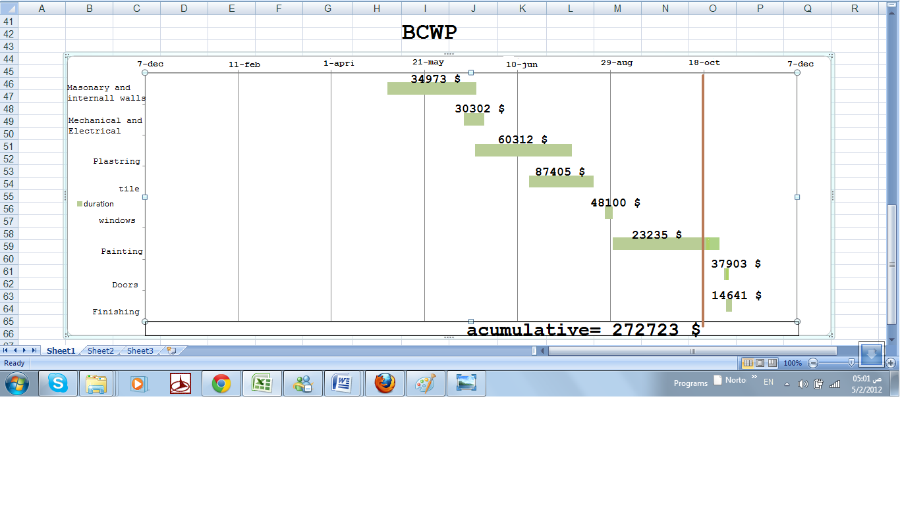
2-Budgeted cost for work performance (BCWP):
related to the schedule cost but actual duration.

Slide 22
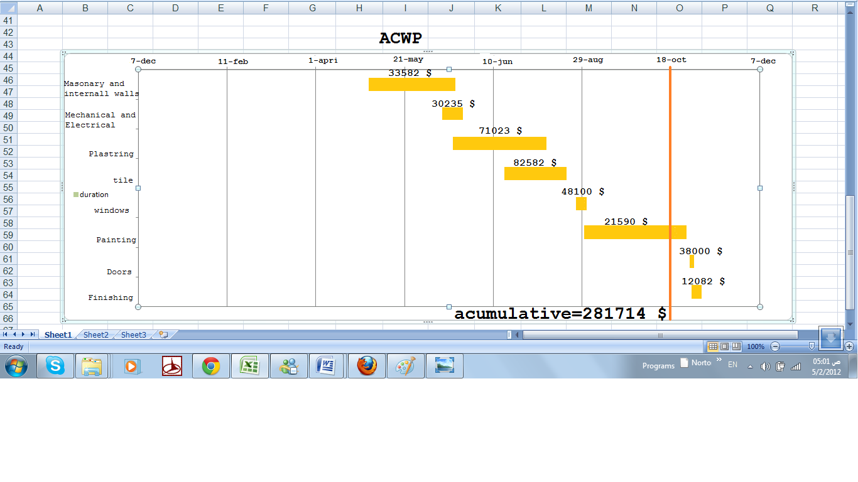
3-Actual cost of work performanced (ACWP):
Related to actual cost and duration

Slide 23
Results:
1. Improve the relation between staff.
2. Provision of time.
3. Increase competitive advantage for the municipality.
4. Improve the internal management.
5. This technology has lowered operating costs.

Slide 24

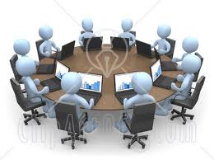

Recommendation:
Difficulty Training Employees.
Equipment Expense
Security Issues.

Slide 25


