Slide 1
Derivation of Synthaic

Slide 2
بسم الله الرحمن الرحيم
قال الله تعالى:
“الله الذي خلق السموات والارض وأنزل من السمآء ماء فأخرج به من الثمرات رزقا لكم وسخر لكم الفلك لتجرى في البحر بأمره وسخر لكم الأنهار”
صدق الله العظيم

Slide 3
introduction
Water is a finite resource, essential for agriculture, industry and human existence itself. Without water of adequate quantity, sustainable development is not possible. To ensure the availability of water when and where it is needed and to safeguard its quality, water resources management is essential. Wars arise between nations because of water. Peace agreement signed between the Palestinian and the Israelis have chapters about water rights and have discussed the amounts of water for each part for the future use

Slide 4
objectives
To characterize the features of Wadi El-Quilt catchment
To divide the catchment into three or four-sub-
catchments, and draw the stream network.
To develop the unit hydrograph for each sub-catchment using Snyder’s, and SCS methods, and to compare the results
The main objective of this project is to derive the unit hydrograph of Wadi Al-Qilt catchment

Slide 5
Research Questions
This research will answer the following questions:
What are the geographical features of Al-Qilt catchment?
What are the unit hydrograph for Al-Qilt catchment?

Slide 6
Methodology
objective
Data collection
1
Runoff analysis
Data analysis
Result
Snyder's method
SCS Method

Slide 7
Hydrology and Hydrologic Cycle
Hydrology is the science, which deals with the occurrence, distribution and disposal of water on the planet earth; it is the science which deals with the various phases of the hydrologic cycle
Hydrologic cycle is the water transfer cycle, which occurs continuously in nature; the three important phases of the
hydrologic cycle are
a. Evaporation and evapotranspiration
b. Precipitation and
c. Runoff

Slide 8
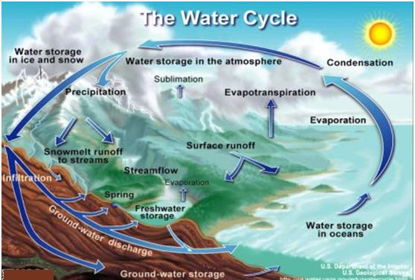
Water cycle

Slide 9
Rainfall Runoff Process
Precipitation
Infiltration
Surface Runoff

Slide 10
Runoff Modeling for Ungauged Catchment
Estimation of flow characteristics of ungauged catchments is usually based on transferring or extrapolating information from gauged to ungauged sites, a process called regionalization. Several regionalization approaches have been used, and the most common method involves derivation of empirical relationships between flow and catchment characteristics

Slide 11
Factor Affecting Rainfall Runoff Relationship
1- Rainfall (storm) Factors
Rainfall intensity
Rainfall duration
The spatial distribution of rainfall
The type of storm
The direction of storm

Slide 12
Factor Affecting Rainfall Runoff Relationship
2- Catchment Characteristics
Catchment size
Catchment shape
Drainage Patterns
Slope of the Catchment
Soil in the catchment

Slide 13
Water Resources in Palestine ((west Bank Case
Ground water

Slide 14
Water Resources in Palestine ((west Bank Case
Surface water
The surface water resources in the West Bank consist of three major components:
the Jordan River Basin,
the Dead Sea and
the western wadis;
No major lakes or rivers that emerge from within the West Bank exist.

Slide 15
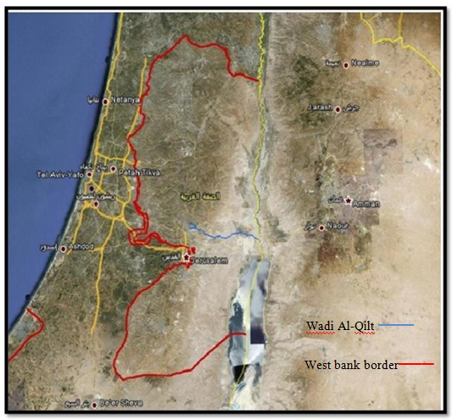

WADI AL_QILT CATCHMENT
Location
Wadi Al Qilt is located in the eastern part of the West Bank. The study area includes part of Ramallah, Al Bireh and Jerusalem

Slide 16
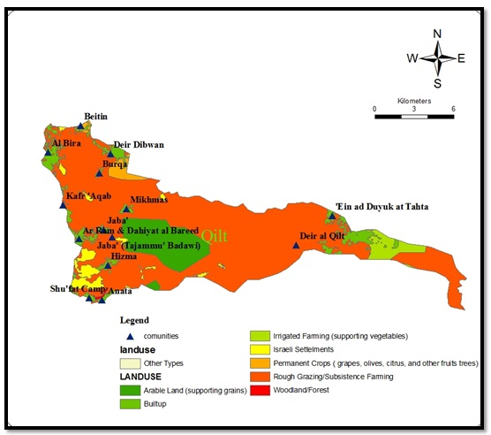
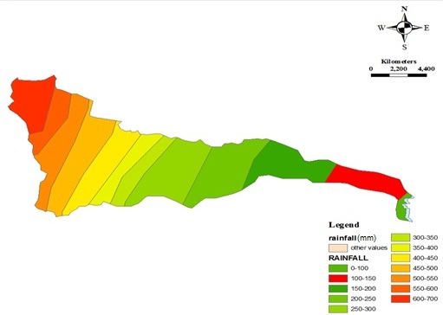
WADI AL_QILT CATCHMENT
Land use Rainfall

Slide 17
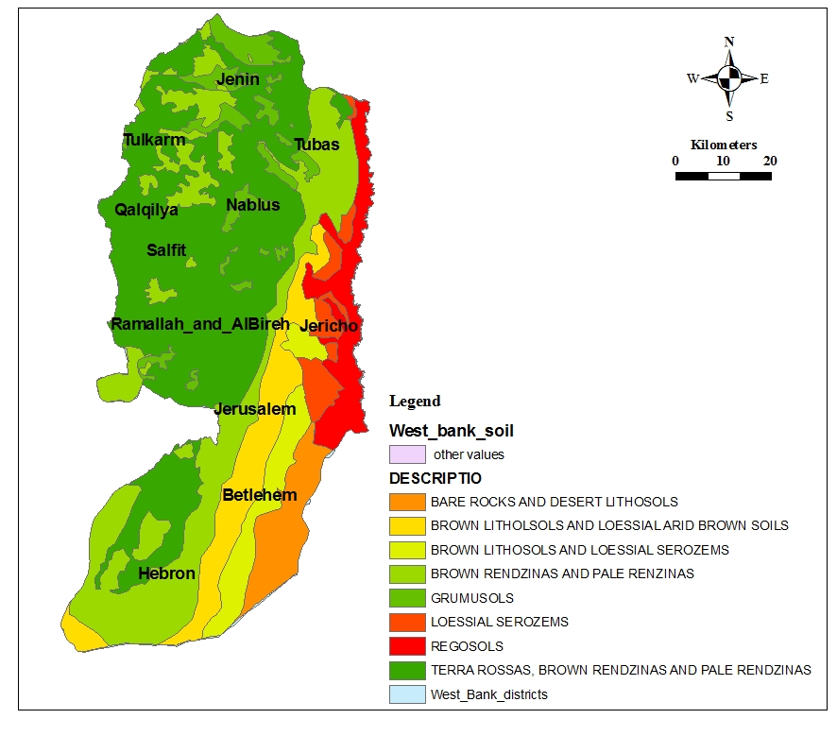
WADI AL_QILT CATCHMENT
Soil Geology

Slide 18
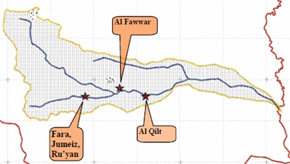
WADI AL_QILT CATCHMENT
Springs

Slide 19
Synthetic Unit Hydrographs Methods
Unit hydrographs are estimated in practice either from rainfall and runoff measurements or
By using empirical relationships
Empirical relationships lead to construct synthetic unit hydrographs
Synthetic unit hydrographs methods are commonly used to characterize ungaged catchments

Slide 20
Rainfall Runoff Models
In this study, two different models used to estimate synthetic unit hydrographs are applied to Wadi Al-Qilt catchment, these are:
1. Those relating hydrograph characteristics (peak flow rate, base time, etc) to catchment characteristics.
2. Those based on dimensionless unit hydrograph.

Slide 21
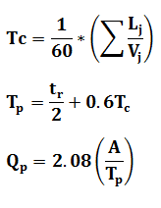
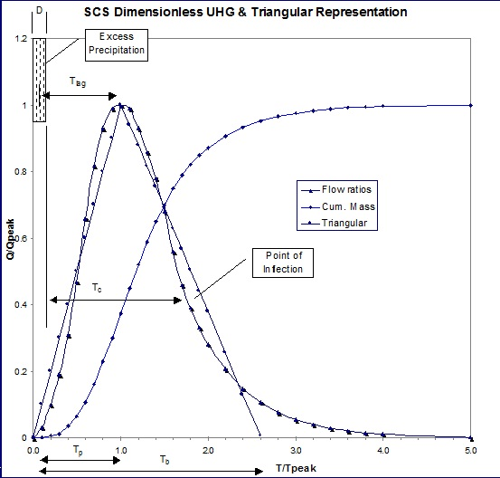
SCS Method
The SCS synthetic unit hydrograph is the dimensionless unit hydrograph developed by the Soil Conservation Service.

Slide 22
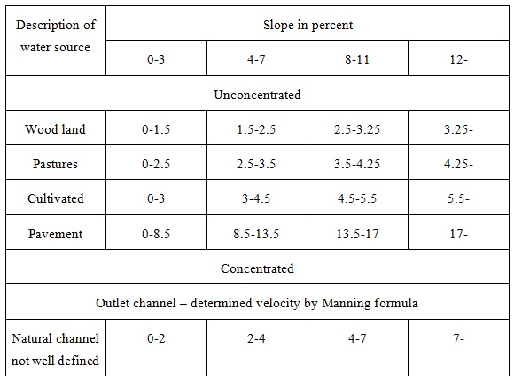
SCS Method
approximate average velocities in ft/s of runoff flow for calculating time of concentration

Slide 23
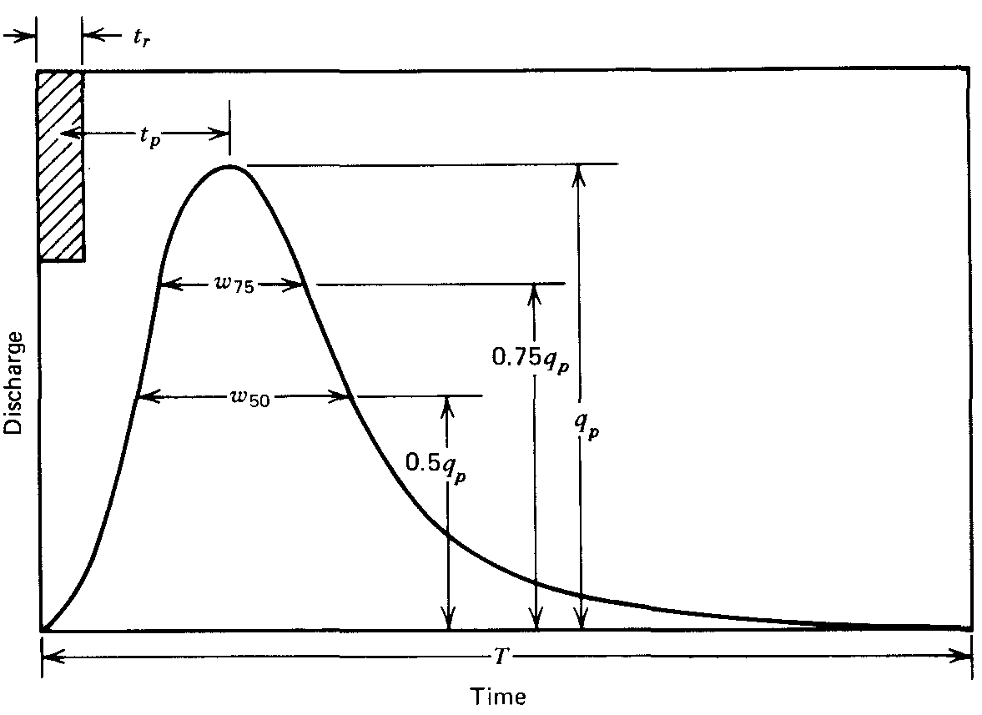
Snyder's Method
The method of Snyder allows computation of lag time, time base, unit-hydrograph duration , peak discharge, and hydrograph time widths at 50% and 75% of peak flow
By using the above points, a sketch of the unit hydrograph is obtained

Slide 24
Snyder's Method
Snyder’s observations indicated that the peak runoff per unit rainfall excess, Q_{P} (m³/sec) is given by
The duration of rainfall excess, t_{r}, is related to the time lag, t_{L}, by
where t_{L} is the time lag in hours from excess rainfall centroid to the peak runoff, A is the catchment area in km², and C_{p} is the peaking coefficient

Slide 25
Snyder's Method
The basin time lag is:
t_{L} = C₁C_{t}(L×L_{C})^{0.3}
where:
t_{L} is in hours
L is the length of the main stream in kilometers from the outlet to the divide
L_{c} is the distance in kilometers from the outlet to a point on the stream nearest the centroid of the catchment
C₁ coefficient and equals 0.75
C_{t} is a coefficient ranges from 1.35 to 1.65 with potential variability outside this range depending on the nature of the catchment

Slide 26
Snyder's Method
t_{LR} = t_{L} + 0.25 × (t_{R} – t_{r})
where t_{R} is the desired duration of the rainfall excess and t_{LR} is the lag of the desired unit hydrograph
The time to peak is:
t_{p} = (t_{R}/2) + t_{LR}
For durations other than the standard duration, the peak runoff, Q_{PR}, is given by

Slide 27
Snyder's Method
The time base of the unit hydrograph, T_{b} , in hours is estimated by the following relation:
T_{b} = 72 + 3t_{LR}
where W₅₀ and W₇₅ are the widths in hours of the unit hydrograph at 50% and 75% of Q_{PR} (widths are distributed 1/3 before Q_{P} and 2/3 after) where Q_{PR} is the peak discharge in m³/s and A is the catchment area in km²

Slide 28
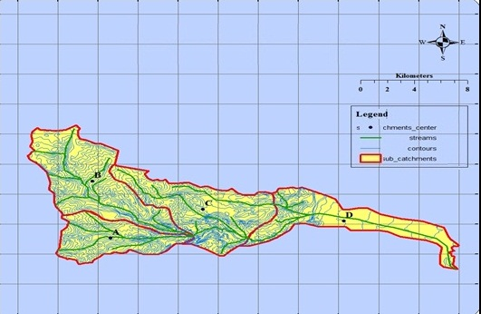
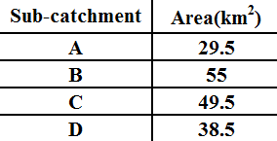
Sub-Catchments

Slide 29

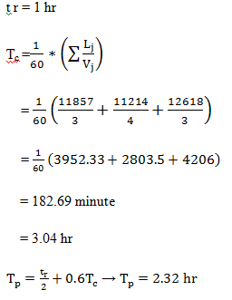
SCS Analysis
Sub-Catchment A

Slide 30
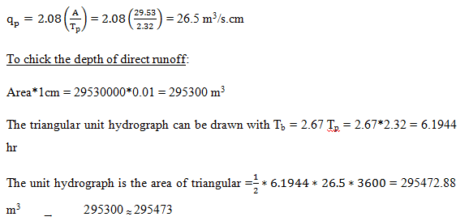
SCS Analysis
Sub-Catchment A

Slide 31
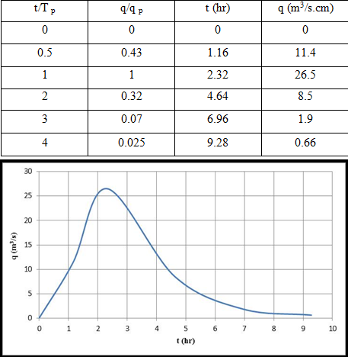
SCS Analysis
Sub-Catchment A

Slide 32
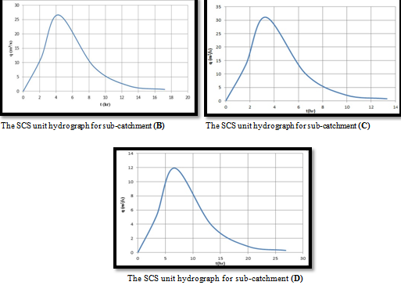
SCS Analysis
Sub-Catchments Unit Hydrograph

Slide 33
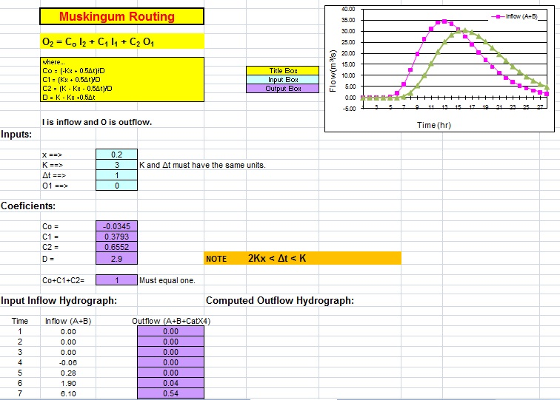
Flow Routing
Muskingum Method

Slide 34
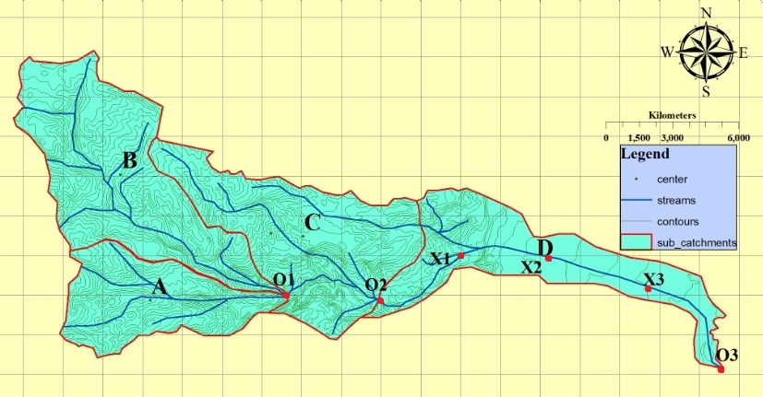
Flow Routing
Muskingum Method

Slide 35
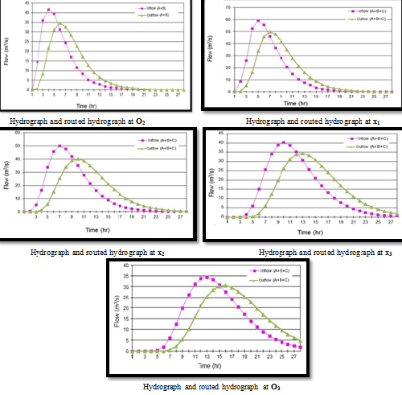
Flow Routing
Muskingum Method

Slide 36
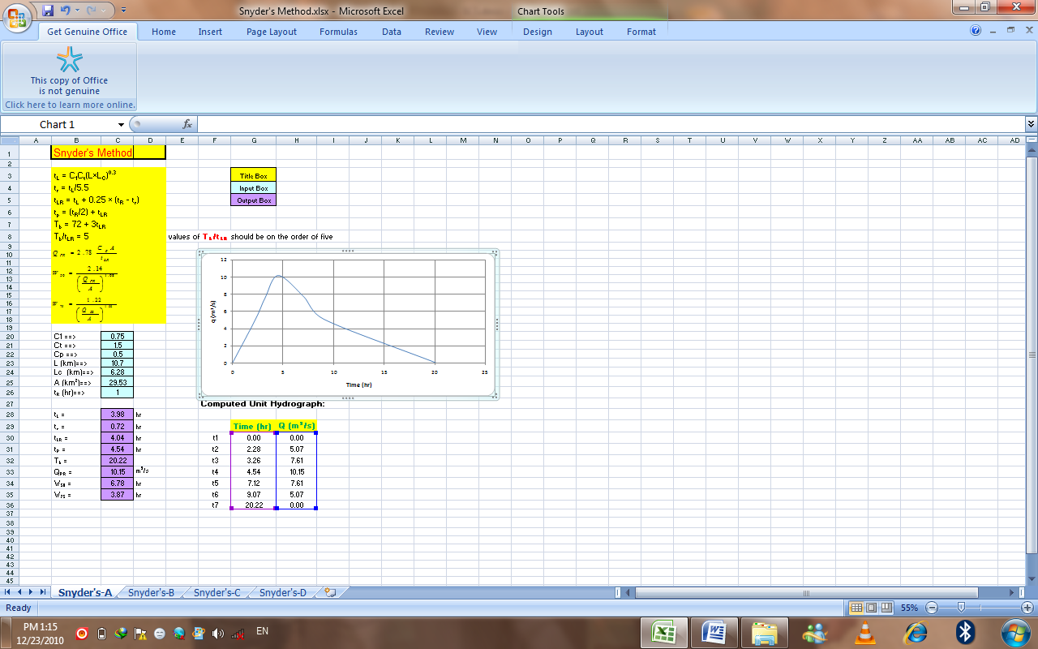
Snyder's Method

Slide 37
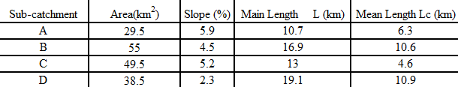
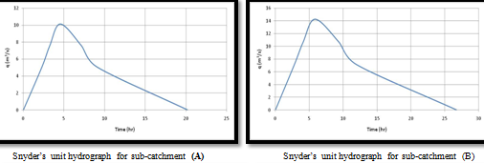
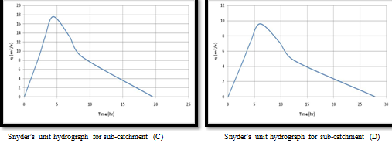
Snyder's Method
Sub-Catchments Unit Hydrograph

Slide 38
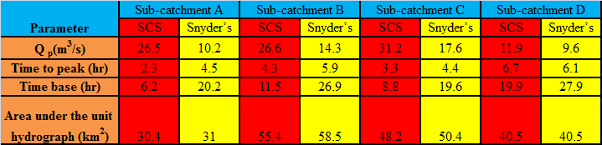
Comparison Results
Snyder SCS

Slide 39
Recomendations
Unfortunately, water resources in Palestine, just as in most of the other countries in the Middle East, are scarce. This makes the careful management of these resources and their use essential, especially in view of the rapid population growth rates and socio-economic development potential.
The location of Wadi Al-Qilt catchment gives it significant importance since it locate between three large cities (Ramallah and Al-Berah, Jerusalem, and Jericho) and due to its large area which means great flow which its direction to the Jordan Valley

Slide 40
Recommendations
*Install an instrument at Wadi Al-Qilt to measure the flow to estimate the real hydrograph
*Further research studies are needed to develop water quality modeling rates to get more information and indications
*Make more studies to collect information about the springs, quality and quantity information
*Develop a model to simulate the relationship between rainfall and runoff in semi-arid regions

Slide 41
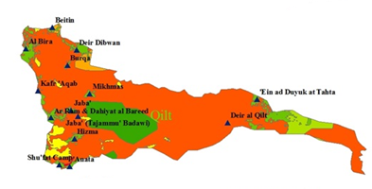
THANKS FOR YOUR ATTENTION

