Slide 1
The Design of Water And Wastewater Networks For Qilqis
For Hebron southern Regions Prepared by Under Supervision of Amer Mutlak Zalloum Dr.Anan Jayoussi.

Slide 2
Outline
Objectives
Study Area
Design Methodology
Questionnaire Analysis
Water Network Design And Results
Wastewater Network Design And Results

Slide 3
Objectives
Design a reliable water and wastewater network.
Meet the PWA design standards
Make sure that the networks performance are acceptable for the required design period.

Slide 4
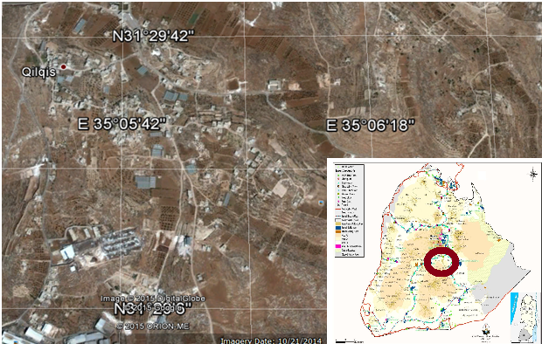
Study Area
This project provided for Qilqis village, which is locate to the south of Hebron city.

Slide 5
Study Area
Information about Qilqis:
1- Expected population at the end of the design period=7282 person.
2-Total area=7639 dunums.
3-Density= .95 person/dunum.
4-Cunsumption/Capital=120 L/d.
5-Losses in water network=10.8%.
6-Requierd demand=135 L/c.d.
7-MaxDF=1.6 and MinDF=.45 .
8- Wastewater production=80%*Consumption/Capital=96 L/c.d.
9- Infiltration=20%*Consumption/Capital=24.
10-Harmon’s Peaking Factor=3.1.
11- sewer load/capital =96*3.1+24=321.6 L/c.d.
12- sewer load/Dunum= 306.72L/D/D.

Slide 6
Design Methodology
Water And Wastewater Networks
Gathering Data
Modified Data
AutoCAD
Loads Calculation/Dunum
GIS
Drawing
Water And Sewer Cad
Networks Modifications
Thiessen Polygon
Results
Run

Slide 7
Questionnaire Analysis
1- Availability Of water Distribution Network

Slide 8
Questionnaire Analysis
2-Main Water Source

Slide 9
Questionnaire Analysis
3- Relation between Monthly Consumption/family and Number Of Family Members

Slide 10
Questionnaire Analysis
4- Relation between Monthly Consumption/family and Income (NIS)

Slide 11
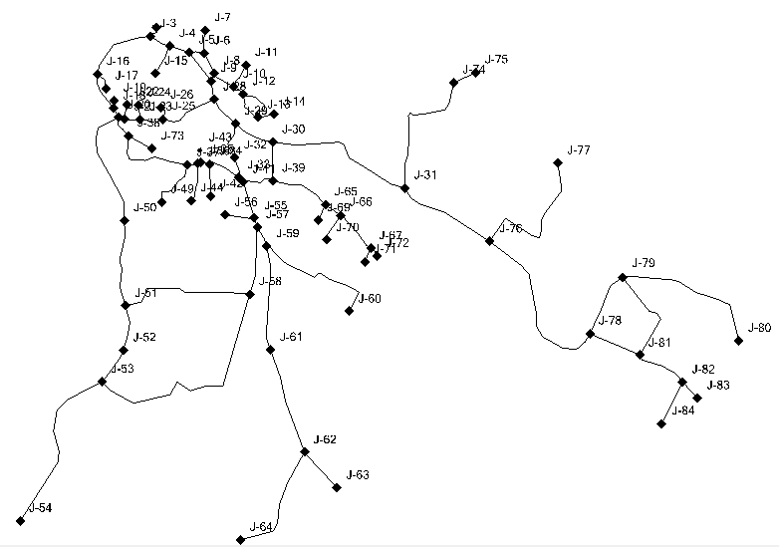
Water Distribution Network
WDN layout for Qilqis village.

Slide 12
Constraints
Constraints are provided to Guarantee performance of network:
1- velocity (.01-3)m/s.
2-pressure (20-100)mH2O.

Slide 13
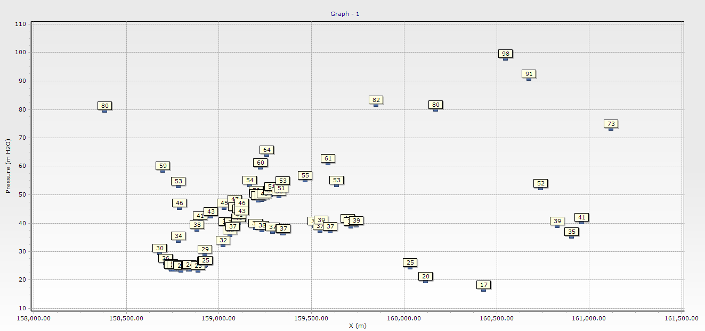
Design Results
Analysis For Junctions at high demand conditions

Slide 14
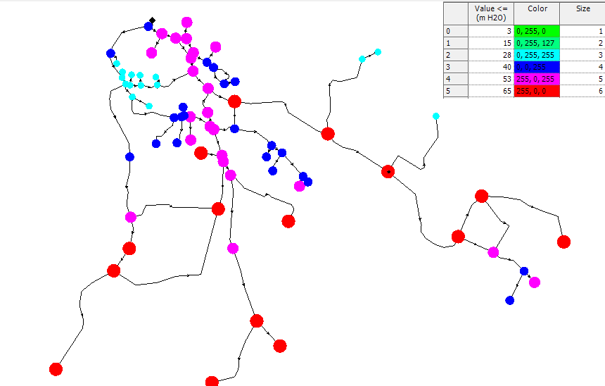
Analysis For Junctions high demand conditions

Slide 15
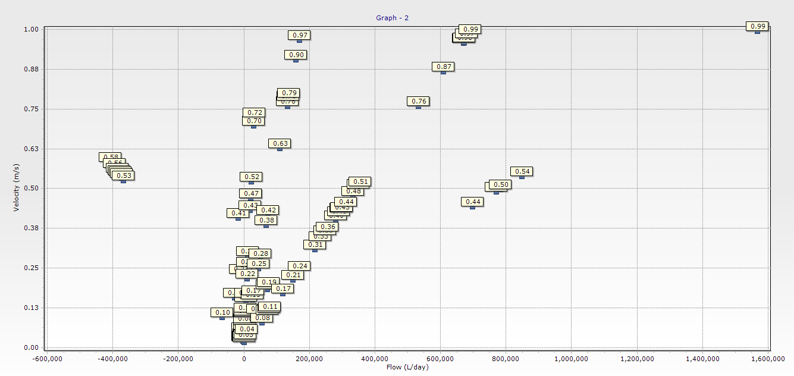
Analysis For pipes at high demand conditions

Slide 16
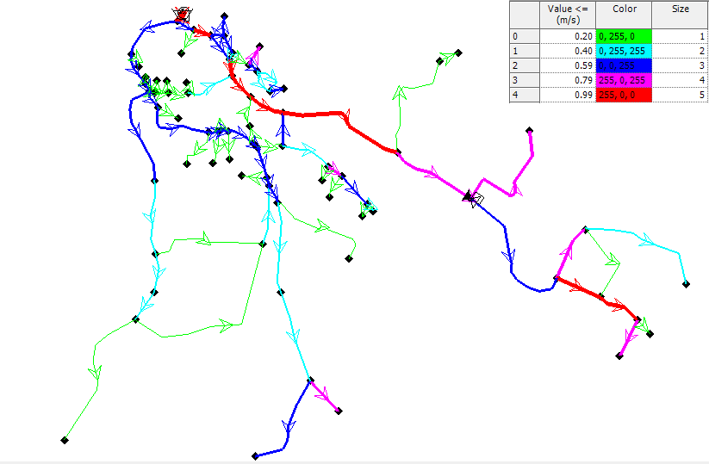
Analysis For pipes

Slide 17
Results
Comments on results:
1-pressure vary from 24 to102 mH2O at low demand conditions and 17 to 98 at high demand conditions.
2- Velocity within pipes vary from .01 to .28 m/s low demand conditions and .02 to .99 m/s high demand conditions

Slide 18
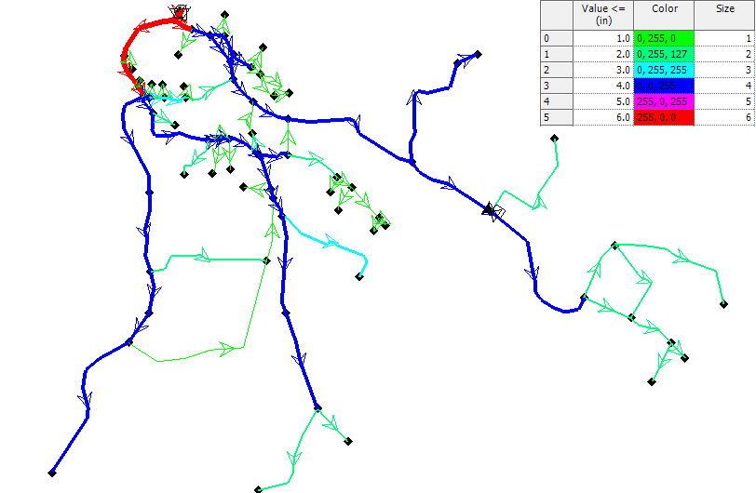
Diameters
.

Slide 19
WDN Expected Cost

Slide 20
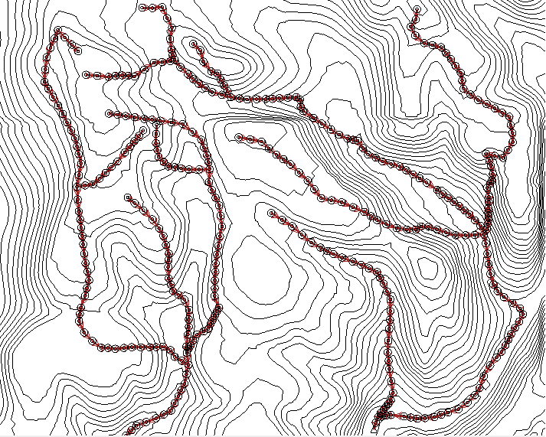
Wastewater Collection Network
WCN layout for Qilqis village

Slide 21
Constraints
Slope from .5%-15%.
Velocity from .1-3 m/s.
Cover from 1-5 m.

Slide 22
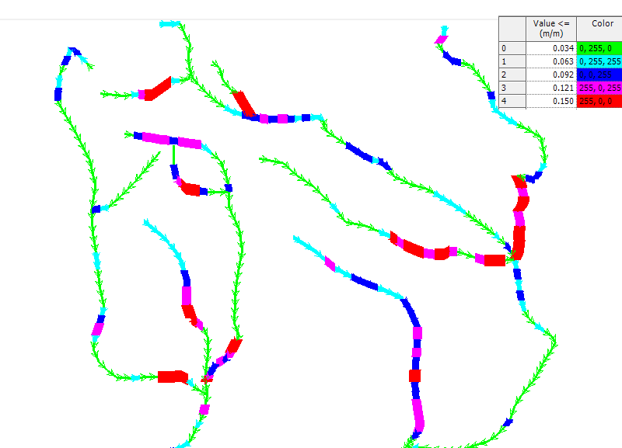
Design Results
Slope

Slide 23
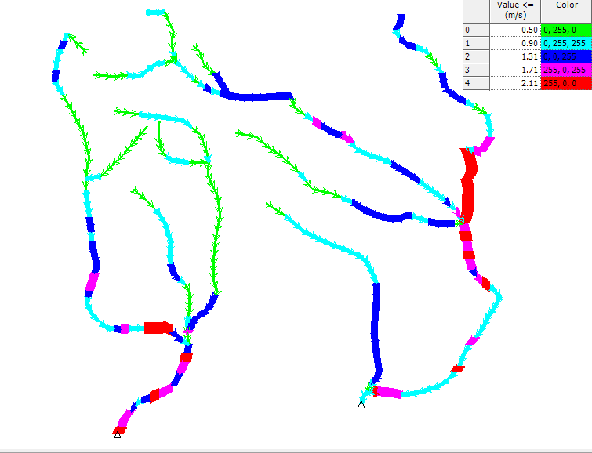
Design Results
Velocity

Slide 24
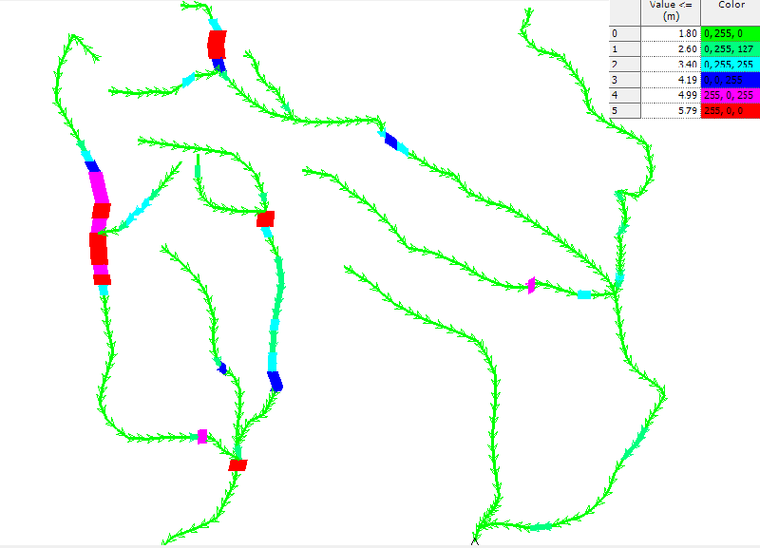
Design Results
Cover

Slide 25
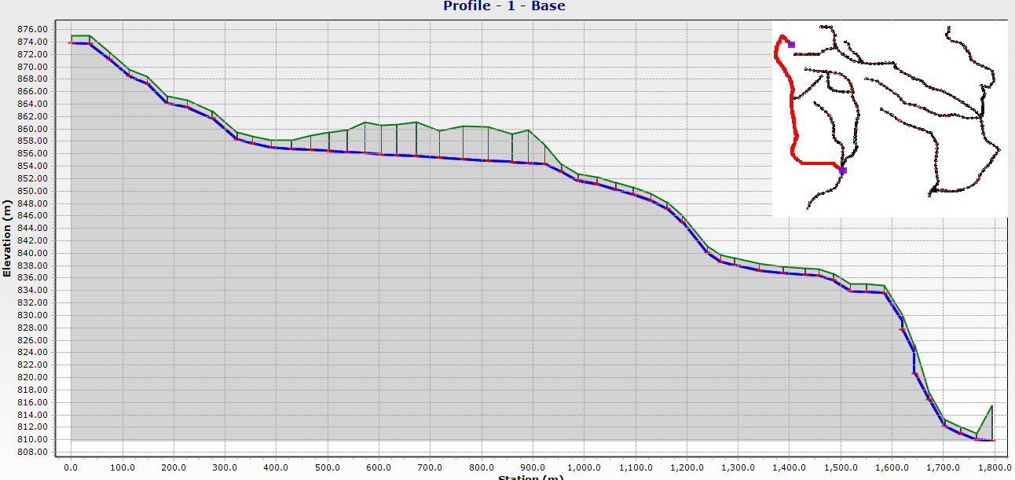
Profile

Slide 26
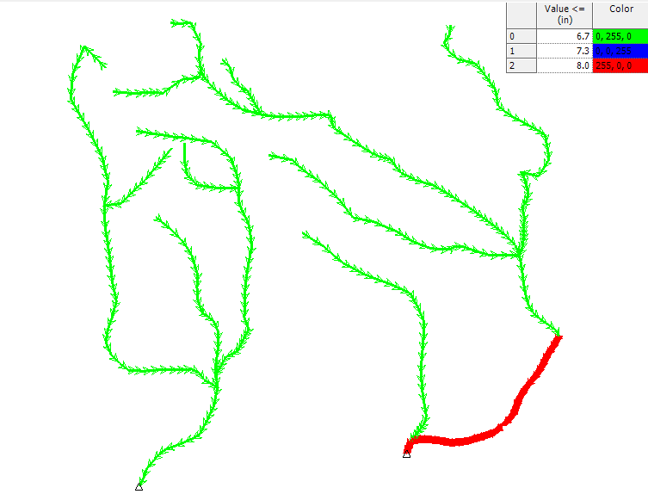
Diameters

Slide 27
Results
Slope vary from .5%-15%
Cover vary from 1to 5.79 m
Velocity vary from .1-2.11 m/s
Diameters 6 and 8 inch

