Slide 1
Design of A Sewer Network For Siries Village
Prepared by :
Hasan Hisham Opisi
Mohammad Farez Fahmy
Slaiman Munjid Blaibleh
Submitted to : Dr. Sameer Shadeed

Slide 2
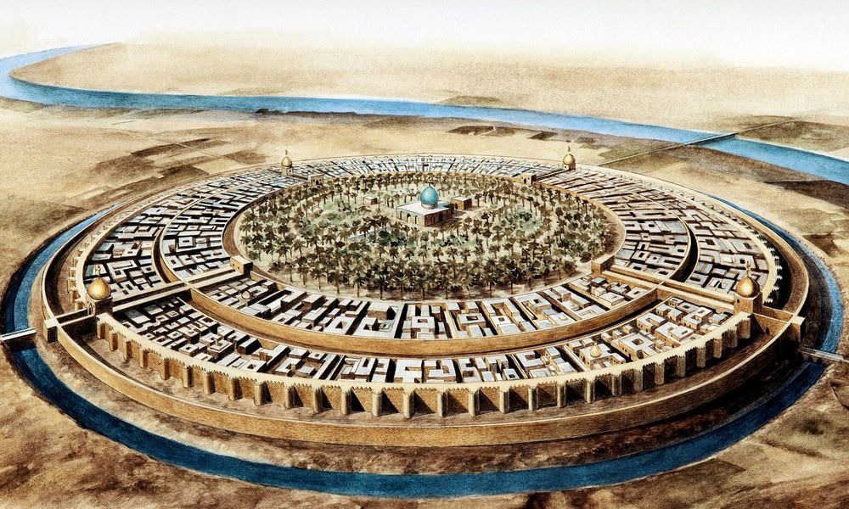
Introduction
The most important element to the human being in life is water, where 80% of water demand is converted to wastewater.

Slide 3
Objectives
The main objectives of this project are:
Design a water distribution network.
Design a wastewater collection network.

Slide 4
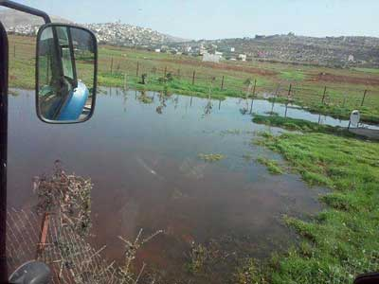
SIGNIFICANCE OF THE WORK

Slide 5

STUDY AREA :SIRIS VILLAGE

Slide 6
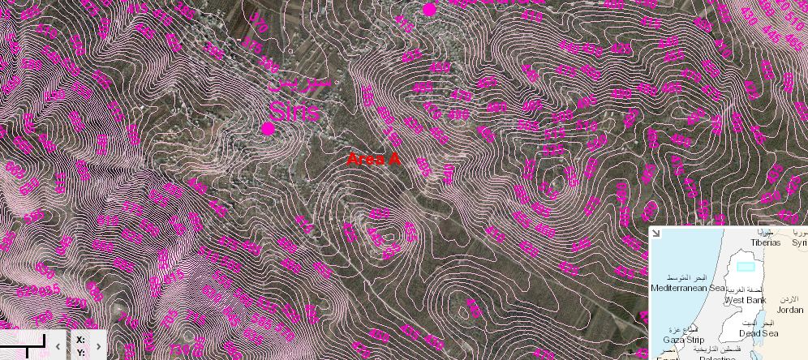
TOPOGRAPHY

Slide 7
TOPOGRAPHY
Maximum elevation = 465 m above MSL
Minimum elevation = 372 m above MSL
Mean elevation = 411 m above MSL

Slide 8
AREA AND LAND USE
Total Area = 12500 donums
Built up Area = 19 donums
Agricultural land = 11000 donums
Forests and open areas = 1400 donums

Slide 9
Methodology
Data Collection.
Designing by SewerCAD program.
Results and recommendations.
Preparation of data.

Slide 10
DATA COLLECTION
Boundary of the study area.
Contour map
Roads network
Structural plane
Population number

Slide 11
POPULATION
Population | Year
494 | 1922
608 | 1931
830 | 1945
1,300 | 1982
2,200 | 1987
3,757 | 1997
4,898 | 2005
5,182 | 2007

Slide 12
PREPARATION OF DATA
Population forecasting using Arithmetic growth rate equation ; According to the population curve of the village we have choose arithmetic growth equation to predict the population in 2066:

Slide 13

PREPARATION OF DATA
Pn = P + n*k
Future population ( 2066 ) = 13600 capita

Slide 14
Calculation of Sanitary Load
Demand = 120L /day / capita
Assume hourly factor = 4
Wastewater generation 80%
Load calculation = Wastewater generation + infiltration
Wastewater generation =
0.8 * 0.12 * 13600 * 4 = 5222.4 CM /day
Infiltration = 0.2 * 0.8 * 0.12 * 13600 = 261.12 CM / day
Sanitary load = 5222.4 + 261.12 = 5483.52 CM / day

Slide 15
Sewer Collection Network
Sewer Systems
Sewerage Elements

Slide 16
Related hydraulic concepts
A General procedure for design flow rates quantification.
Average water consumption (lpcd).
Average wastewater generation (80% of water consumption).
Total average wastewater flow = average wastewater x community size.
Max hourly waste water (which is the design value) = total average waste water x hourly factor.

Slide 17


Related hydraulic concepts
The Energy Equation.
Friction Loss Methods.

Slide 18
Draw the Network by SewerCAD program.
Length of conduit will not exceed 50 m.
Avoid making closed loops.
Putting manholes every intersection and curves

Slide 19
CONSTRAINTS
Velocity ( 0.6 – 3 )m/s
Cover ( 1 – 5 )m.
Slope( 1 – 15 )%.

Slide 20
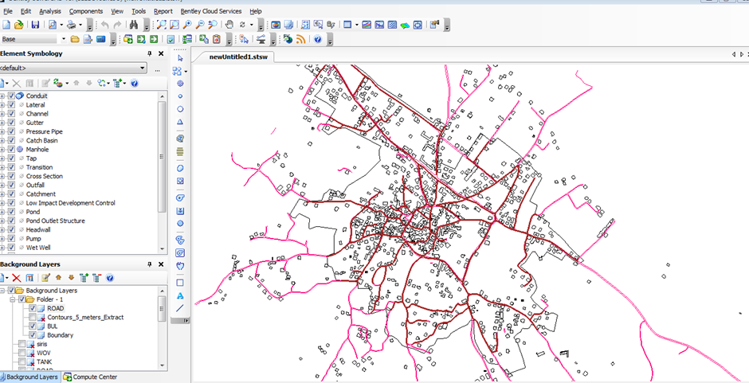
Draw the Network by SewerCAD program.

Slide 21
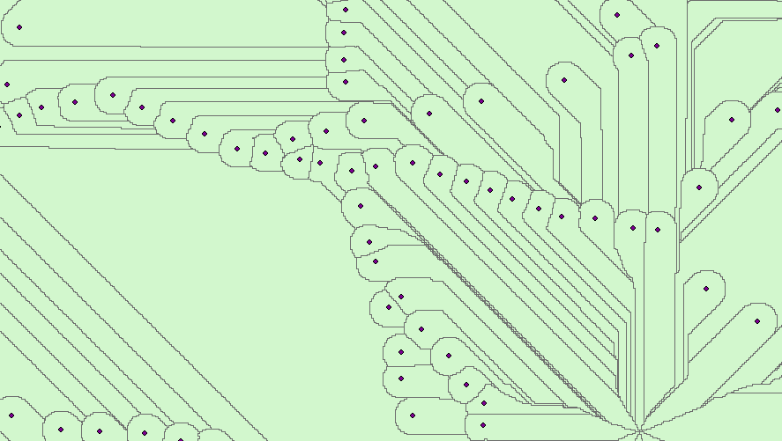
Allocating the area for each manhole
Allocating areas by ArcGIS programe using ArchHydro tool.

Slide 22
Calculating the loads on each manhole
wastewater load for each manhole(L\day) =
(Area covered by each manhole)*(population density)* (water consumption) * (Peak factor) + (infiltration)

Slide 23
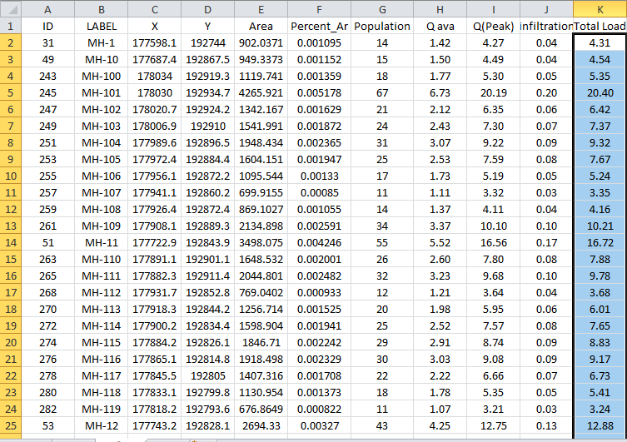
Calculating the loads on each manhole
Load distribution in excel sheet to make Model builder

Slide 24
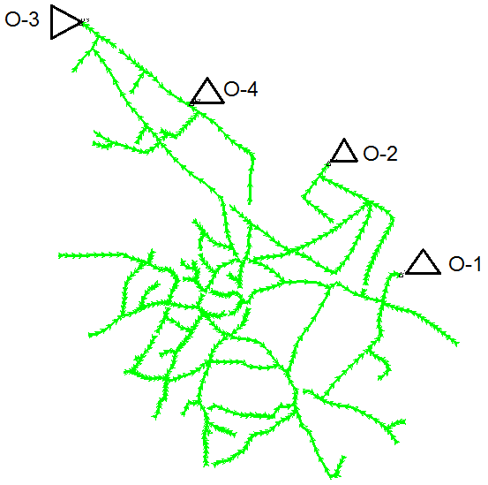
Layout the network
We have four outfalls in the area.

Slide 25
RESULTS

Slide 26
RESULTS

Slide 27
RESULTS

Slide 28
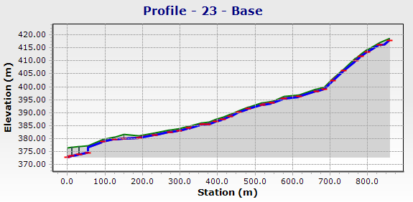

Slide 29
Conclusion:
All constraints are achieved and there are no problems in the model, and all the results are in the ranges as specifications and criteria
We used 8 & 10 inch diameters for all conduits and PVC material.

Slide 30
Recommendation:
We recommend constructing a sewer network because the people will be very pleased and most of their problems will be removed.

Slide 31
THANK YOU

