Slide 1
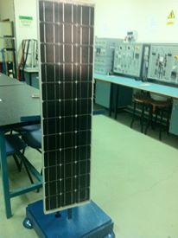

Solar Tracking
An-Najah National University
Faculty of Engineering
Supervisor:
Prof. Marwan Mahmoud
Prepared by:
Laith Musallam
Gazi Arar
Dec / 2013

Slide 2
OUTLINE
Aim of our project.
Why Solar Tracking?
Block diagram for the design of solar tracker.
PV module.
PV sensors.
Microcontroller.
H-Bridge.
DC motors.
Control operations of motors.
Flaw charts.
Test on the output of PIC

Slide 3
Aim of our project.
Develop a solar tracking System

Slide 4
Why Solar Tracking?
The efficiency of PV panel depend on the solar radiation.
More solar radiation give us more efficiency.
The solar radiation depends on the cosine of the incidence angle(θ).

Slide 5
Why Solar Tracking? Cont.
We need to keep the PV panel perpendicular to the sun throughout the year in order to make it more efficient .
i.e. , make θ (incidence angle) = 0 so the solar radiation is maximum.

Slide 6
Block diagram for solar tracker
PV module
4-PV sensors fixed on the PV module
PIC 16F877A
2-DC motors rotate the PV module
2H-Bridges

Slide 7
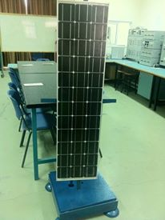
PV module
we take a module of 53W peak power . it has a rated voltage 21v and rated current 3.45A.
we have prepared a mechanical holder for this module . we consider to be the best possible design in terms of flexibility rotation to match that with the ability of the motors .

Slide 8
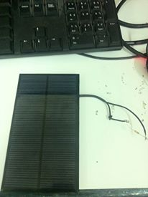
4-PV sensors
we use for PV cells as sensors . Each two sensors put on each axis of the PV module. (up/down and left/right).
The rated of PV sensors is 8.5 open circuit voltage, 270mA short circuit current and 1.65W maximum power.
At solar radiation = 1000W/m2 we achieved the I-V curve of the PV sensors .

Slide 9
4-PV sensors Cont.
We achieved the following table .
I load (mA) | V load (v)
260 | 0
234 | 6.9
0 | 8.5

Slide 10
4-PV sensors Cont.
Plot the table.
I-V curve for the PV
sensor.
(Y-axis is the current,
X-axis is the voltage)

Slide 11
4-PV sensors Cont.
we calibrated the sensors to give us 5v as a maximum voltage at standard conditions. (G=1000W/m2, T=25C) .
This voltage in order to match the PIC.
To achieve that, we use some approximations.
-3.768V+260=5/R
R=20ohms
This value of resistance
must be connect in parallel
in each sensor

Slide 12
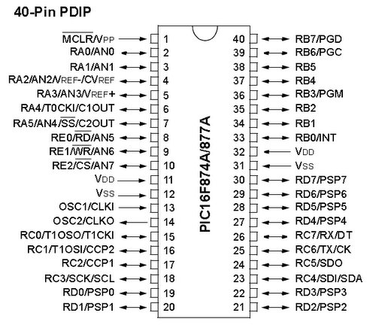
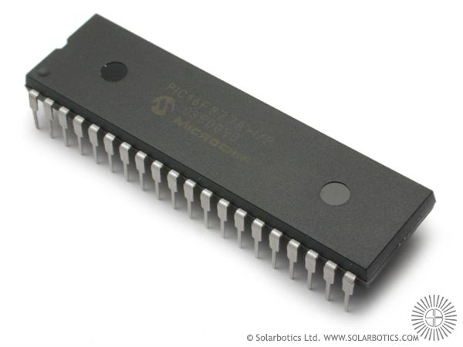
Microcontroller
We use PIC16F877A.
This is the heart of our project. which performs all commanding and controlling operations.

Slide 13
Microcontroller Cont.
The pins A0,A1,A2and A3 are an input pins (these pins take the signal from PV sensors).
The pins C1,C2,C4 and C5 defined as output pins .
These pins send the signals to the H-Bridges.
Output Pins | Read the sensor on | Input Pin
C2,C4 | Left | A0
C2,C4 | Right | A1
C1,C5 | Up | A2
C1,C5 | Down | A3

Slide 14
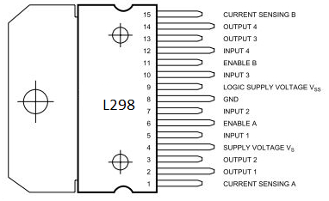
H- Bridges
This circuit was needed to switch the direction of the current in the motor in order to switch the direction of the rotation.

Slide 15
H- Bridges Cont.

Slide 16
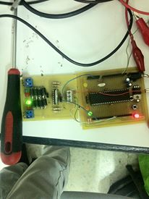
H- Bridges Cont.
H-Bridges take the signals from the output pins of the PIC.
Each two outputs of the H-Bridge connected to a DC motor.

Slide 17
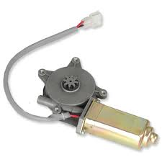
DC Motors
we need for a low speed motor so we choose a special motors.
We use a window motor with a rated current 2.2A and rated voltage 12v to track the system for left and right .

Slide 18
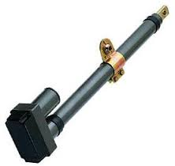
DC Motors Cont.
Another motor used is a dish motor for tracking the system up and down with rated 1.5A and 12v .

Slide 19
Control operation of the motors
The control operation for the left/right motor
comments | Direction of rotation | C4 | C2
Voltage of left sensor =voltage of right sensor | No rotation | 0 | 0
Voltage of left sensor larger | Left | 1 | 0
Voltage of right sensor larger | Right | 0 | 1
 | impossible | 1 | 1

Slide 20
Control operation of the motors Cont.
The control operation for the up/down motor .
comments | Direction of rotation | C5 | C1
Voltage of up sensor =voltage of down sensor | No rotation | 0 | 0
Voltage of up sensor larger | Up | 1 | 0
Voltage of down sensor larger | Down | 0 | 1
 | impossible | 1 | 1

Slide 21
Flaw Chart to control the rotation of the left/ right motor
Read left and right sensorsA0, A1
Calculate the difference between them
Is 0.1<difference <3
Is the left sensor> the right sensor
C2 & C4 = 0,The left /right motor stopped
no
C2=1, C4=0 . rotate the L/R motor to right
no
yes
Delay
yes
Compare the left and right sensors (A0.A1)
C2=0, C4=1 . rotate the L/R motor to left
Remove to control the rotation of the up/down motor
Delay
Delay
Read left and right sensorsA0, A1

Slide 22
Flaw Chart to control the rotation of the up/ down motor .
Read up/ down sensorsA2, A3
Calculate the difference between them
Is 0.1<difference <3
Is the up sensor> the down sensor
C1 & C5 = 0,The up/down motor stopped
no
C1=1, C5=0 . rotate the U/D motor to down
no
yes
Delay
yes
Compare the up and down sensors (A2,A3)
C1=0, C5=1 . rotate the U/D motor to up
Remove to control the rotation of the left/right motor
Delay
Delay
Read up down sensorsA2, A3

Slide 23
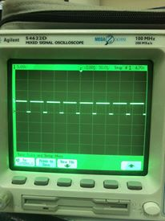
Test on the output of PIC
we conducted a test on the PIC and we make sure the output of the PIC is true.
The following figure show the results of this test .

