Slide 1
بسم الله الرحمن الرحيم
An-Najah National University
Engineering college
Civil engineering department
Foundation Design of Al – Jasser Building
Submitted to : Dr. Isam Jardaneh
Prepared by:
Sulayman Hamad

Slide 2
Introduction
The building is located at Balata – Asskar Street, Nablus, Palestine. The proposed building will have a plan area of about 700 square meters and will be consisted of at most of 9 stories. The site is leveled and excavated to foundation level which is about 7 m below the main street level.

Slide 3
STRUCTURAL ANALASIS
The load comes to the footing from the slab (dead load and live load ) to beams to columns so we want to study dead load and live load
The proposed building under consideration has its own weight and expected weight that analyzed by tributary area.
We find two types of load; services and ultimate.
Notes:
He load

Slide 4
The dead load
The dead load acting on the structure can be determined by reviewing to architecture, mechanical, and electrical drawing for the building from these drawings the structural engineer can calculate the volume of any parts then multiply this volume by density to get own weight.

Slide 5
Live loads
Live loads value depends on the type of the structure, these loads coming from moveable weights such as the weights of furniture or inhabitants, usually found by multiply factor of live loads which equal 0.3 t / m² with tributary area effects on each column or shear wall.

Slide 6
Design of Foundation
the following loads :
Dead Load (own weight).
Super imposed dead load =250kg/m².
Live loads =250kg/m².
Using ACI code [5] , the ultimate loads calculated using the following combinations:
P_{u} =1.4Dead.
P_{u} =1.2Dead + 1.6Live.
Using in this project the following materials characteristics:
f’_{c} =240kg/cm² ( B 300 )
where : f’c is the compressive strength of concrete
f_{y} = 4200 kg/cm²
where :f_{y} is the yield strength of steel

Slide 7
Determine area of footing
Required area = Service load/q_{u}
_{Were} q_{u} = 20 t /sqe meter

Slide 8
size (mxm) | (Ultimate load (ton | Service load (ton) | Foot number
3.368976106 | 227 | 162.14 | H20
3.4278273 | 235 | 167.8 | B21
3.872983346 | 300 | 214.3 | F12
3.879432948 | 301 | 215 | B25
3.879432948 | 301 | 215 | H25
3.930648801 | 309 | 220.7 | H18
3.974921383 | 316 | 225.7 | H5
4.01248053 | 322 | 230 | F15
4.183300133 | 350 | 250 | B7
4.183300133 | 350 | 250 | D25
4.189272013 | 351 | 250.7 | F6
4.248529157 | 361 | 257.9 | A14
4.277849927 | 366 | 261.4 | H29
4.301162634 | 370 | 264.3 | D30
4.318564576 | 373 | 266.4 | H15
4.358898944 | 380 | 271.4 | A9
4.376071297 | 383 | 273.6 | D14
4.376071297 | 383 | 273.6 | H10
4.393176527 | 386 | 275.7 | B13
4.449719092 | 396 | 282.8 | G6
4.494441011 | 404 | 288.6 | D7
4.511097427 | 407 | 290.7 | B32
4.57165178 | 418 | 298.6 | F19
4.57165178 | 418 | 298.6 | G22
4.593473631 | 422 | 301.4 | F29
4.604345773 | 424 | 302.9 | F23
4.671723451 | 436.5 | 311.8 | G28
4.724404724 | 446.4 | 318.9 | G18
5.059644256 | 512 | 365.7 | G14

Slide 9
We need to divide the footing from area to three groups :
1. A = 4 x 4 m
2. B = 4.5 x 4.5 m
3. C = 5 x 5 m

Slide 10
Size (mxm) | group of footing | Foot number
4x4 | A | H20
4x4 | A | B21
4x4 | A | F12
4x4 | A | B25
4x4 | A | H25
4x4 | A | H18
4x4 | A | H5
4x4 | A | F15
4.5x4.5 | B | B7
4.5x4.5 | B | D25
4.5x 4.5 | B | F6
4.5x 4.5 | B | A14
4.5x 4.5 | B | H29
4.5x 4.5 | B | D30
4.5x 4.5 | B | H15
4.5x 4.5 | B | A9
4.5x 4.5 | B | D14
4.5x 4.5 | B | H10
4.5x 4.5 | B | B13
4.5x 4.5 | B | G6
4.5x 4.5 | B | D7
5 x 5 | C | B32
5 x 5 | C | F19
5 x 5 | C | G22
5 x 5 | C | F29
5 x 5 | C | F23
5 x 5 | C | G28
5 x 5 | C | G18
5 x 5 | C | G14

Slide 11
We evaluate the thickness of single footing type A :
It is d =50 cm
And evaluate the area of steel it =
Use 25 Φ 18 (1 Φ18 /16cm )
provide 64cm²

Slide 12
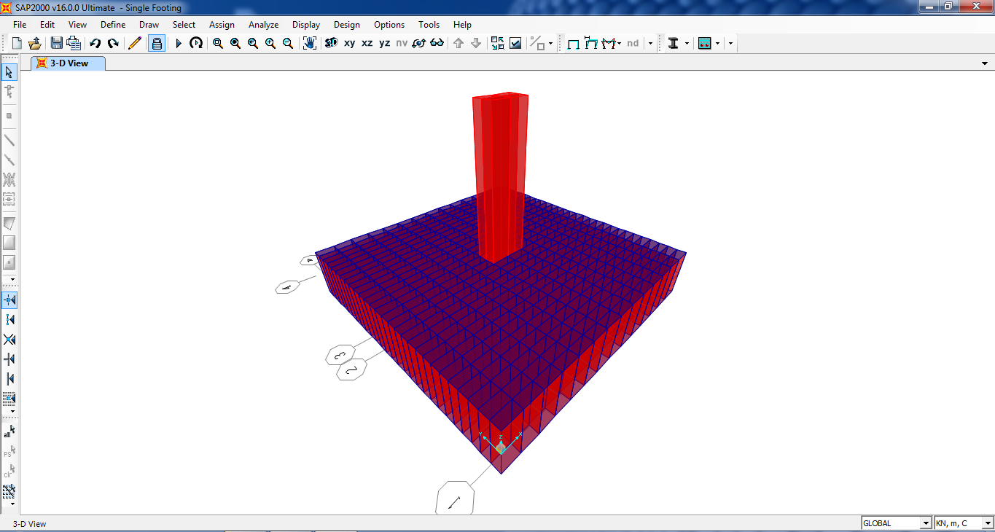
We design footing on sab 2000

Slide 13
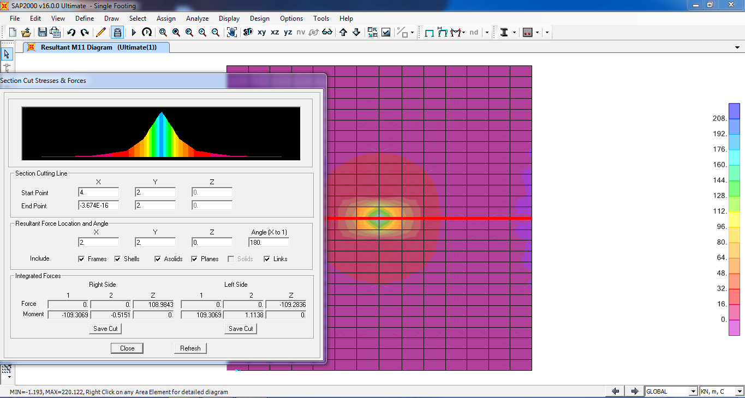
Momant 1-1

Slide 14
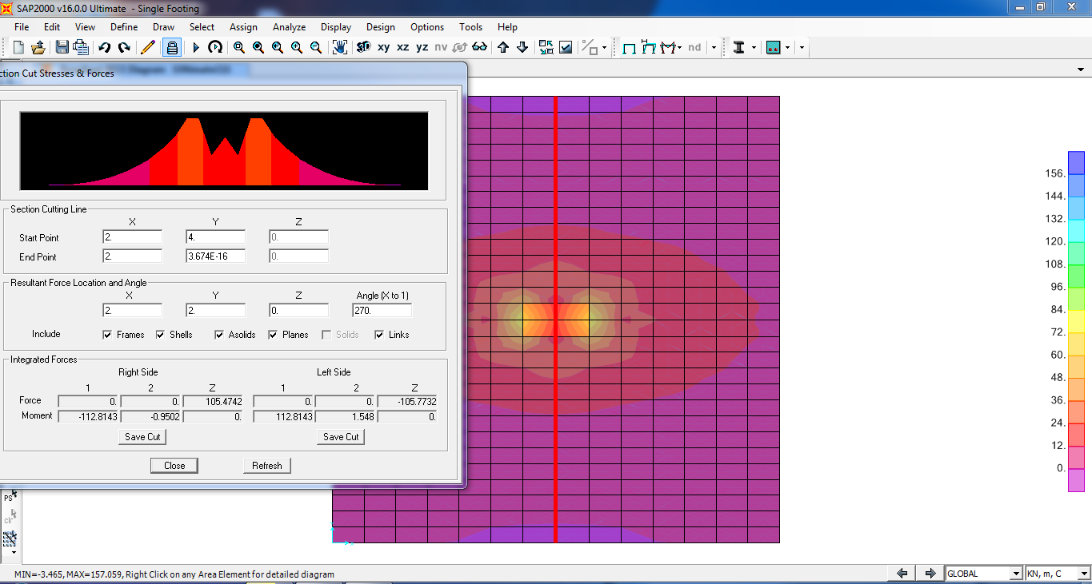
Momant 2-2

Slide 15
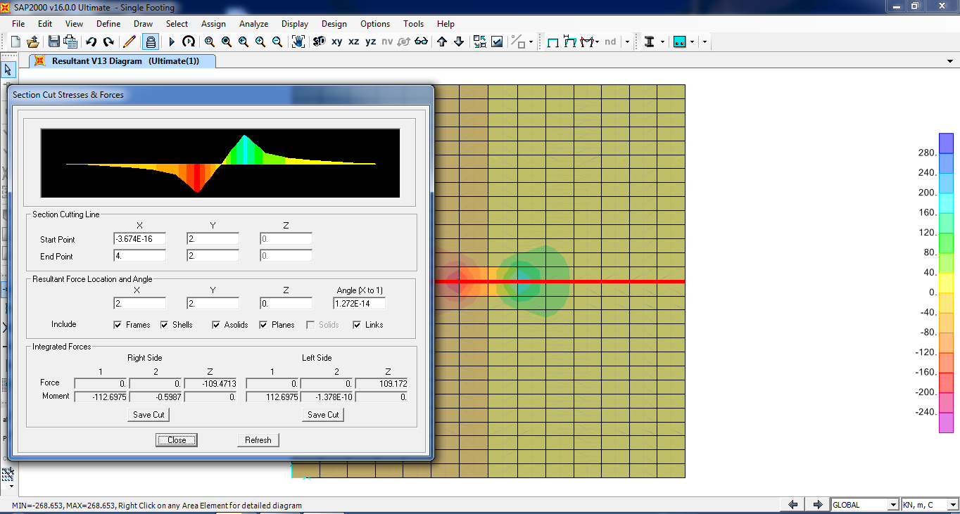
Shear 3-1

Slide 16
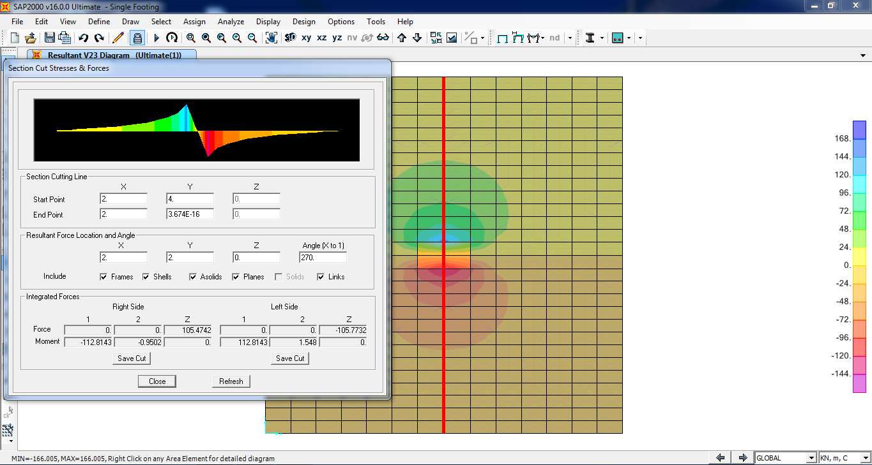
Shear 3-2

Slide 17
Any qusetions

Slide 18
Thanks for you

