Slide 1

“Design of gas leakage detection system”
Academic Year: 2013\2014
Group Members Jehad Hamdan (10941142)
Motaz Hindyh (10941100)
Owais Abd-aljawad (10825689)
Malik Eshtayah (10901013)
Department Name: Mechatronics Engineering
Supervisor Name : Dr. Bashir Nouri

Slide 2
1. Introduction.
2. Components.
3. Circuit of transmitter.
4. Circuit of receiver.
5. Future Work.
6. Conclusion.
Table of Contacts

Slide 3
Part 1: Introduction.
Gas sources are found every where in our daily life ( houses, hotels, factories, and restaurant, and are used for many applications.
As many aspects of our life depend on the gas sources so that if a gas leakage problem is occurred it will some times cause disasters ( suffocations, fires, explosions, and so death).

Slide 4
From this point the idea of design a device to control the gas leakage and to avoid these problems is established.
The control will be accomplished by detect the gas leakage and then the device will immediately close the gas source by wireless.

Slide 5
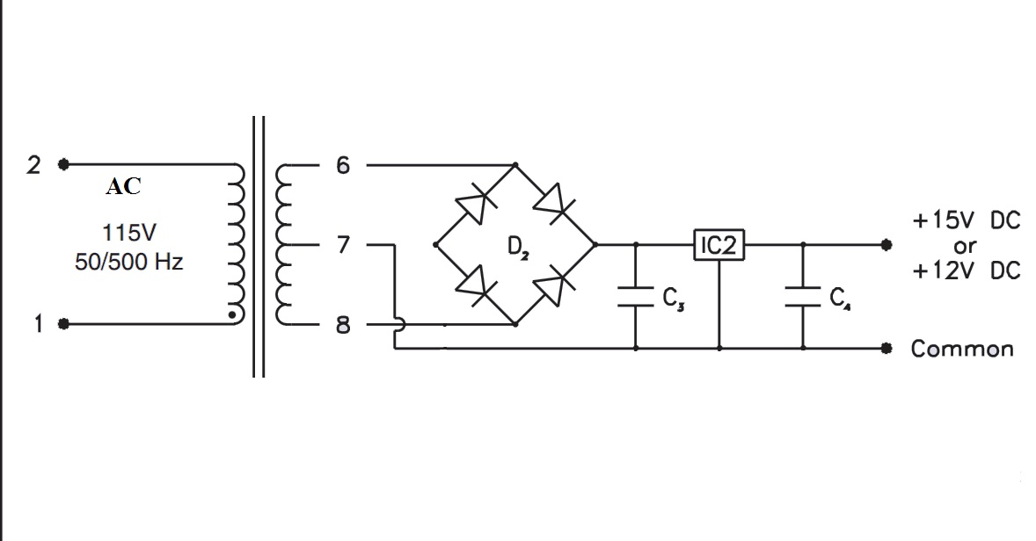
Part 2: Components
Center tab transformer , Bridge, and Voltage Regulator.
Input voltage converted from high voltage AC to low voltage DC.

Slide 6
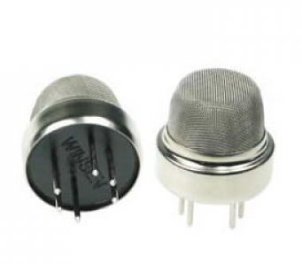
2. Gas Sensor (MQ-6).
Properties
Catalytic Sensor.
Has high sensitivity of LPG gases.

Slide 7
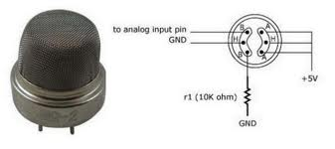
Connection circuits of Sensor.

Slide 8
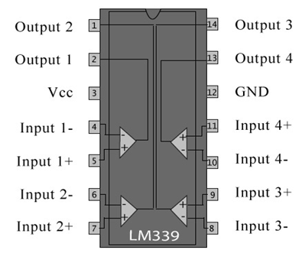
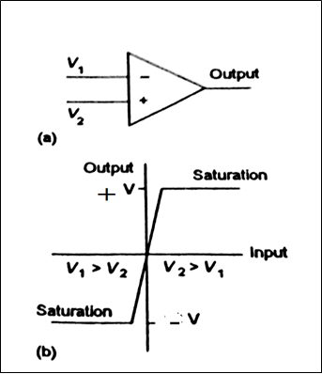
3. Comparator Amplifier (LM339)
LM339 is a comparator IC with four inbuilt comparators. A comparator is a simple circuit that moves signals between the analog and digital worlds.

Slide 9
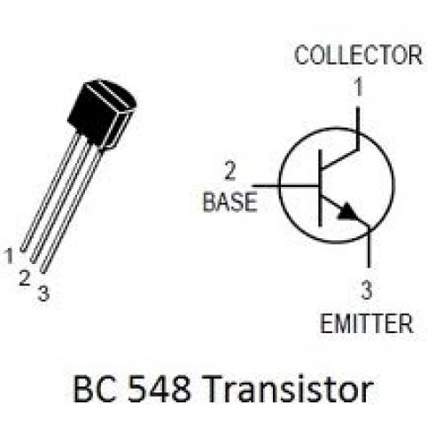
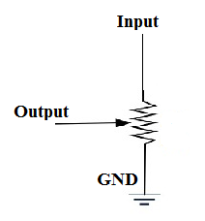
3. Bipolar junction transistor and Potentiometer
Transistor is NPN type and work as a switch.
Potentiometer (0 – 10 K ohm).

Slide 10
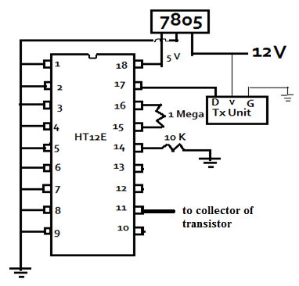
4. Encoder (HT12E)
They are capable of encoding information, which consists of N address bits and N data bits. Each address/data input can be set to one of the two logic states.

Slide 11
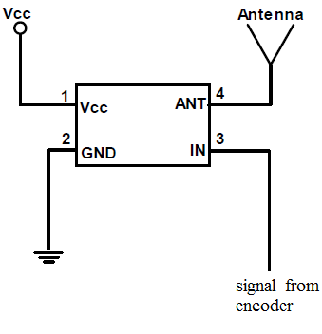
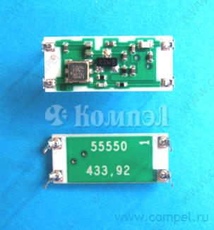
5. Radio wave transmitter (RT4433.9)
A radio transmitter is an electronic device when connected to an antenna, produces an electromagnetic signal.

Slide 12
6. Radio wave receiver (RR3433.92)
This component use to receiver the signal from transmitter and send it to decoder.

Slide 13
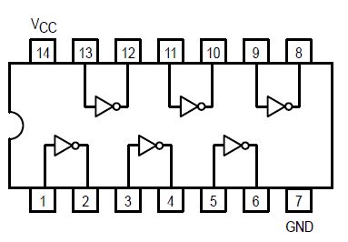
7. Inverter (74LS04)

Slide 14
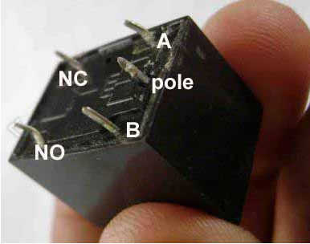
8. Relay
A relay is an electrically operated switch.

Slide 15
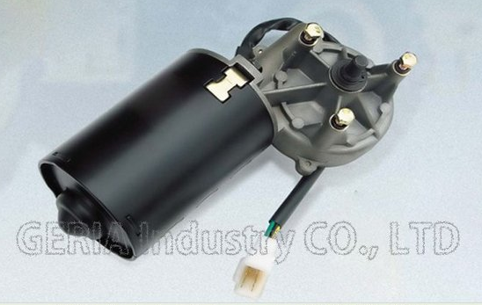
9. Motor.
Voltage | 12V
Breaking torque | 70N.m
Working torque | 14N.m
No load speed | 30-45rpm
No load current | 3.5-4.5A
Working speed | 26-38rpm
Working current | 12-16A
DC Motor for Wiper Blade Windshield

Slide 16

10. Alarm

Slide 17
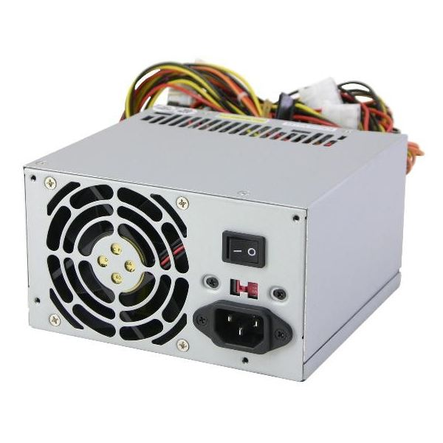
11. Power supply

Slide 18
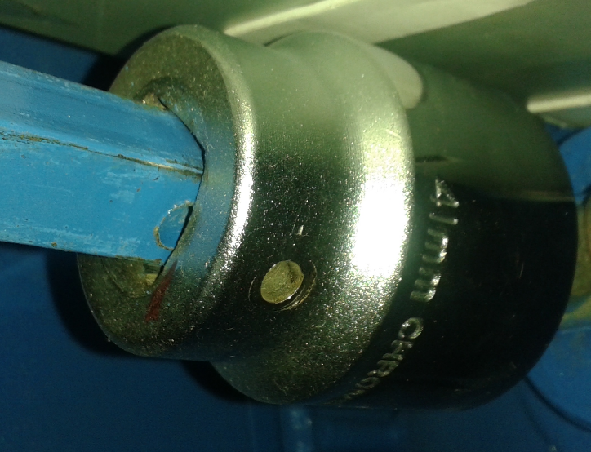
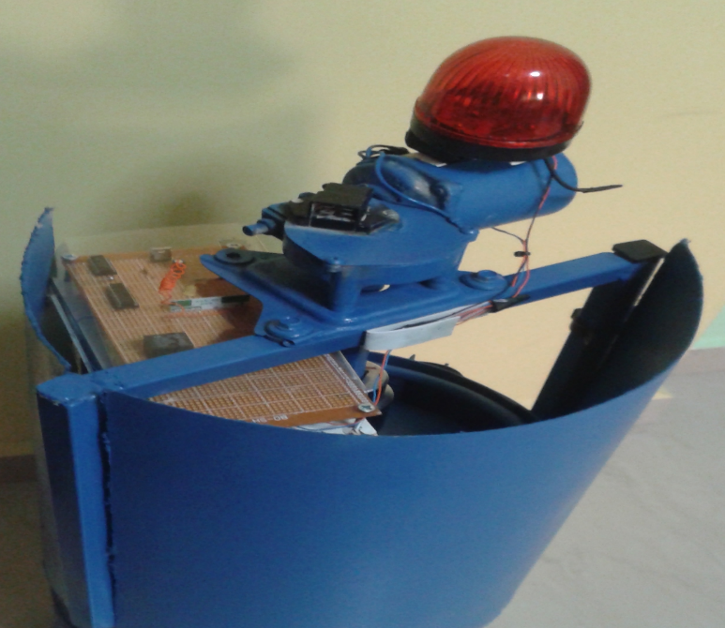
12. Mechanical parts

Slide 19
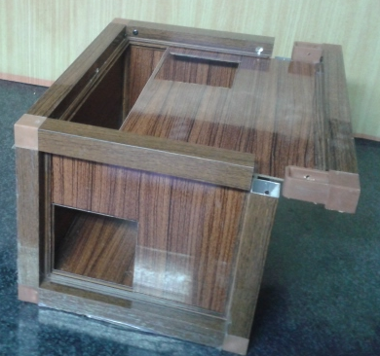
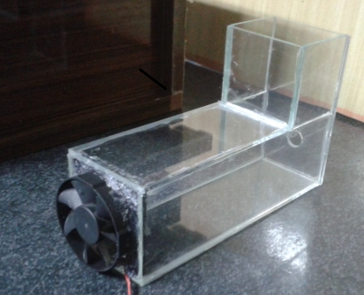
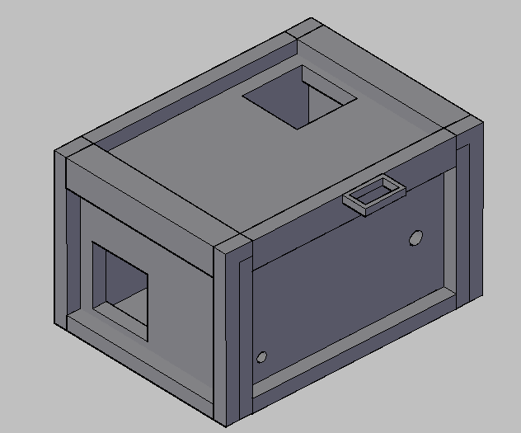

Slide 20
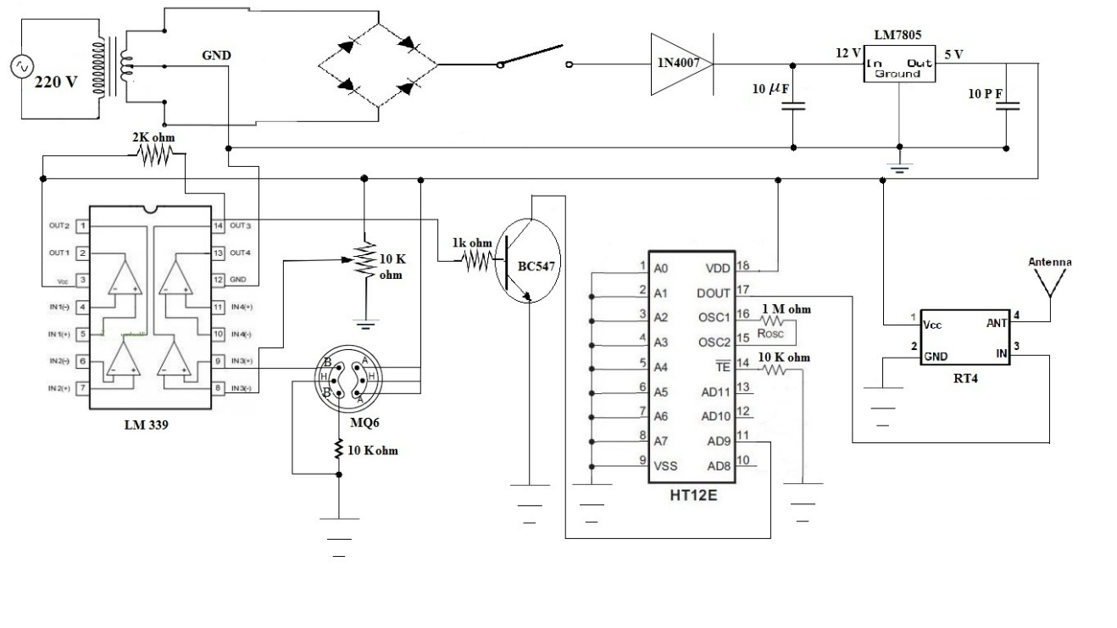
Part 3: Circuit of transmitter
P
T
C

Slide 21
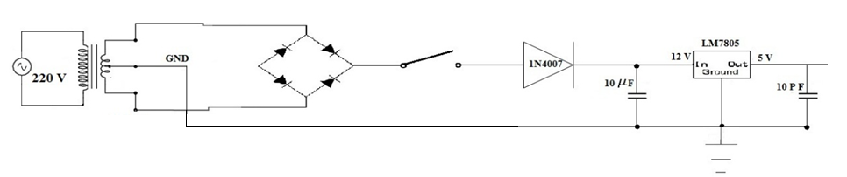
Power Supply of transmit

Slide 22
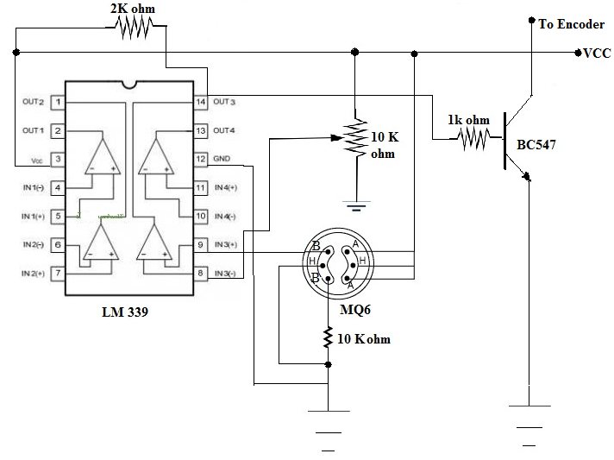
Comparator Circuit.

Slide 23
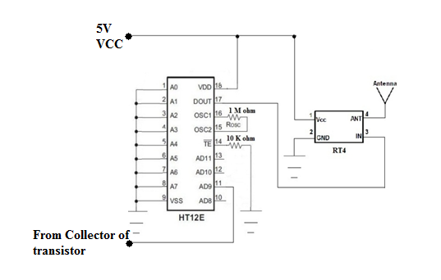
Transmitter Part

Slide 24
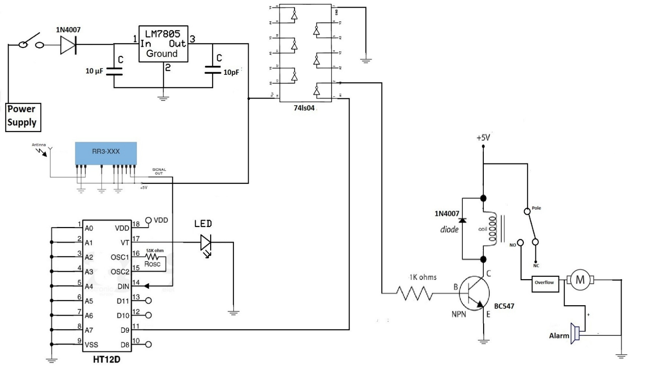
Part 4: Circuit of Receiver.
P
R
C
D

Slide 25
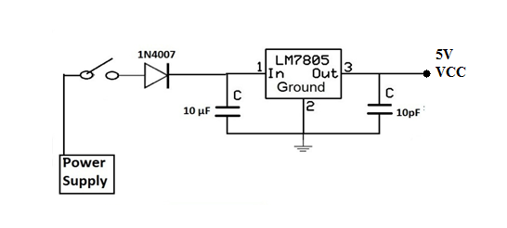
Power Supply of Receiver

Slide 26
Receiver

Slide 27
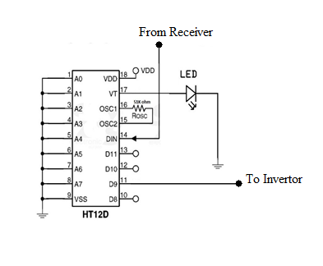
Decoder

Slide 28
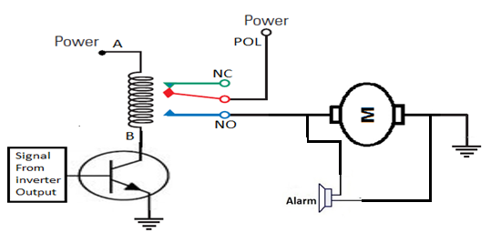
Connect motor to relay

Slide 29
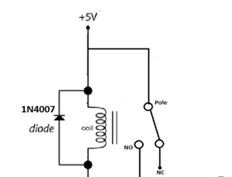
Back EMF (Relay of Protection).

Slide 30
Part 5: Conclusion
The essential aim from the project is to clos the source of gas in the case of the gas leakage, and this aim has been checked by work test.
This project have many of benefits, which will reduce the cases of death that occur due to suffocation, also it reduce the injuries that occur due to fire.
The project is cost effectively, which the cost is not expansive.
The device has a capability to work to detect many of gases, and this can be achieved by changing the type of the sensor.

Slide 31
device has many of features, and for example it supported by wireless communication, which can be working in large distance (100m).
Finally, this project is unique in the world, where it is a rare device relating to this function.

Slide 32
Part 6: Future Work.
make a device that is able to send a warning message to the civil defense center in the case of hazard.
The project can be connected to the fire fighting system which is attached in the buildings so in case of fire the fire fighting system can send a signal to the receiver so the gas piping will be protected.

Slide 33
We hope you were excited
Thank You for Coming
Thank you for being attended

