Slide 1
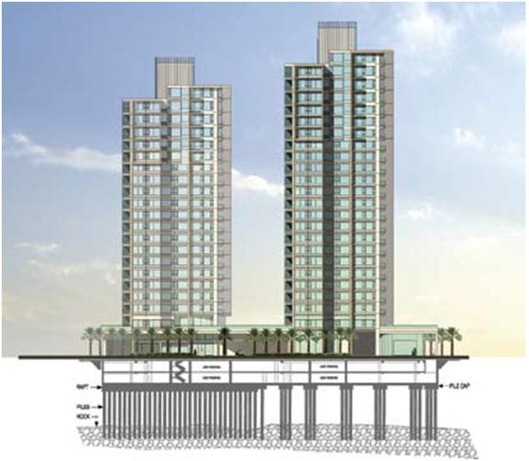

Slide 2

GRADUATION PROJECT
Foundation System Design for Al Nimmer Commercial Building
Prepared by: Noor S.Issa
Hala S.Qasem
Heba A.Massri
Iman Abu Durrah

Slide 3
Project Objectives
To provide some background information about foundation systems.
To design piles foundation system for the proposed building.
To design Mat over Piles as an alternative foundation system.
To make cost & duration estimation for both systems.

Slide 4
Building Description
The plan area = 405m ².
Number of floors =13 floors such that:
Two basement floors (3.5 m height).
One ground floor and ten replicated stories (3 m).
Located at the city center of Nablus.

Slide 5
Introduction
The main purpose of foundation is to receive structural loads and external loads applied to the structure and transmit them in to the soil at a given depth below the ground safely (without causing soil failure or unsafe differential settlement of the supported structure).

Slide 6
General Requirements of Foundations
Depth must be adequate and below the zone of seasonal volume changes.
System must be safe against overturning, rotation, sliding, and soil rupture.
The foundation should be economical.

Slide 7
Review of Foundation Types
Shallow Foundations:
Isolated (Spread) Foundations.
Combined Foundation.
Continuous(Wall) Foundation.
Strip Foundation.
Mat Foundation.

Slide 8
Review of Foundation Types
Deep Foundations:
Piles.
piers.
Caissons.

Slide 9
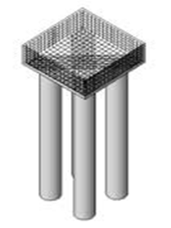
Piles
piles are long members that transfer the load to deeper soil or rock of high bearing capacity avoiding shallow soil of low bearing capacity, and they can be precast or cast in situ.

Slide 10
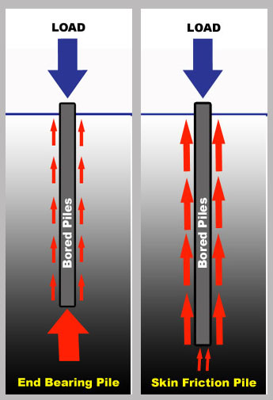
Piles
Classification of piles with respect to load transmission:
End bearing piles.
Skin friction piles (cohesion piles).
Combination of friction and end bearing piles.

Slide 11
Structural Analysis
A structural analysis has been done for the proposed building using the software program SAP in order to determine the superstructure loads acting on the foundation level, and the readings were very close to the manual measurements when comparing them.

Slide 12
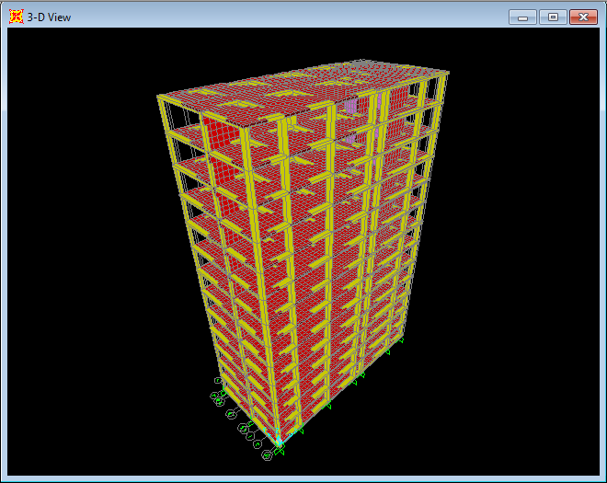
Sap Model for The Building

Slide 13
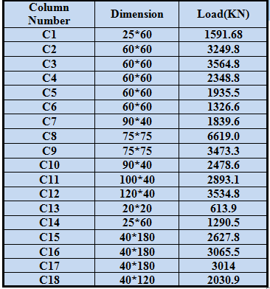
Results of Structural Analysis
Allowable loads of columns at the foundation level.

Slide 14
Results of Structural Analysis
Load of building :
Manually:
building load =101118.5 KN.
From SAP:
building load =99171.87 KN.
Error = 1.96% < 5%.

Slide 15
Subsurface Exploration
Three boreholes were dug out, one is 20 m depth and two are 12 m depth according to the standards, from these boreholes the main soil type is sedimentary dark brownish silty clay of high plasticity with pebbles.
Lab tests has been conducted on soil samples from the boreholes at different depths, these tests included moisture content, atterberg limits, and undrained cohesion.

Slide 16
Recommendations
Piles Foundation is recommended for this site.
Excavation support system should be constructed for this project (about 8 m below the existing ground surface).

Slide 17
Piles Foundation Design
Types and Capacity of Piles:
AllPiles program was used to determine the allowable bearing capacity for some common types of piles each has a specific diameter and length.

Slide 18

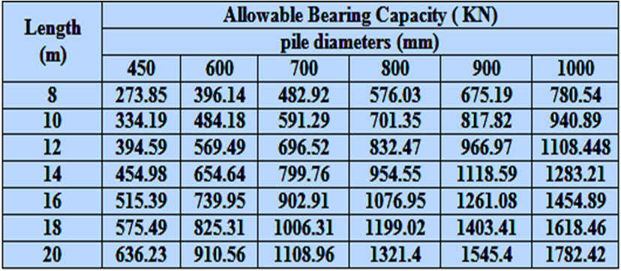
The Allowable Bearing Capacity of Piles From AllPiles

Slide 19
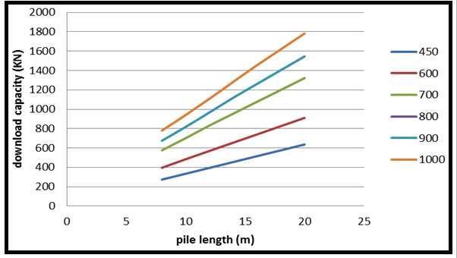
The Allowable Bearing Capacity of Piles From AllPiles

Slide 20
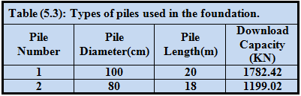
Types of Piles Used
The two main types of piles that found to be the most suitable to be used for this loading system are mentioned in the table below.

Slide 21
Foundation Design
Foundation design includes:
Design of piles and caps under columns.
Design of piles and caps under shear walls.
Design of tie beams between pile’s caps.

Slide 22
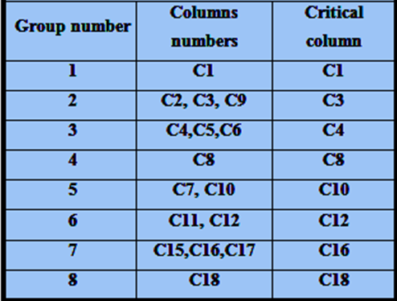
Critical Columns
Columns were divided into groups, each has a representative column (the critical one) as in the following table.

Slide 23
Design Calculations
For every critical column the calculations are:
Number of piles needed under column.
Cap dimensions and piles distribution.
Depth of cap (according to one way shear).
Checking punching for both column and piles.
Steel reinforcement for both piles and piles cap.

Slide 24

Design Theories
No. of piles under column=
Minimum center to center spacing =2.5diam between adjacent piles.
20 cm minimum clear distance between the edges of cap and pile, that acts as a cover for the pile.

Slide 25

Design Theories
Depth of cap according to one way shear:
Vu.pile = ФVc =
Punching check:
If Bc ≤ 2;
If Bc > 2;

Slide 26
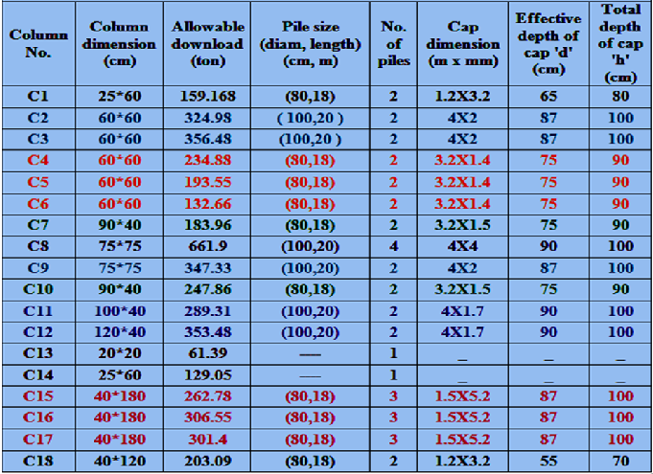

Slide 27

Design Theories
Main Reinforcement:
As =ρ b d.
Minimum Reinforcement:
Asmin= .0018 bh.

Slide 28
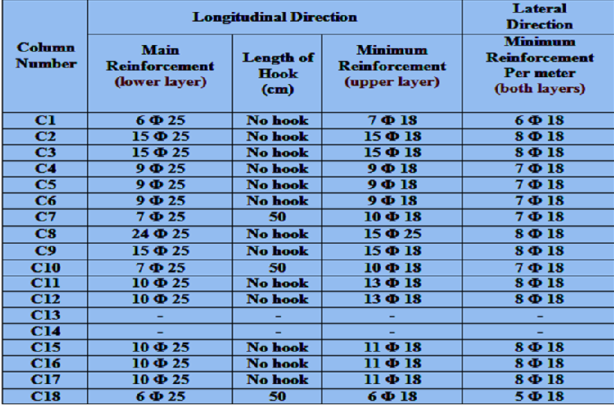

Slide 29
Piles Reinforcement (Theory)
Vertical Reinforcement:
Pile capacity =ФPn >Vu.pile As.pile = 0.5% Ag.
ФPn = 0.7x0.85x [(0.85xƒc x (Ag – As) + (As fy)].
Spiral Reinforcement:
Assume bars diameter (12 mm).
Find spacing between spirals from the equation:

Slide 30
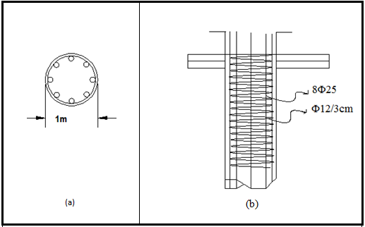
Piles Reinforcement

Slide 31

Design of Shear Walls
No. of piles under shear wall=
Shear wall No.1 8 piles.
Shear wall No.2 3 piles.
Minimum center to center spacing = 2.5diam.

Slide 32
Design of Shear Walls
Piles reactions are at the center of shear wall so:
Effective depth of cap “d” =30 cm (minimum),
and total depth “h”= 45 cm.
As =A shrinkage=.0018bh (zero moment).
Longitudinal Reinforcement 5Ф18.
Lateral Reinforcement 4Ф18\m.

Slide 33
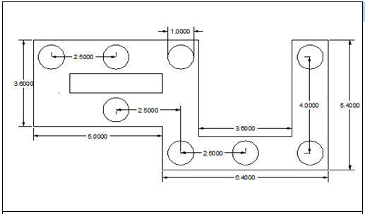
Plan View of Shear Wall

Slide 34

Design of Tie Beams
Assume b=50 cm (for all tie beams).
Maximum load of tie beam "Q"=10 % of the maximum load of columns Q=66.19 ton.
ρ = .8 %.
As= = ρbd
As = 30.086 cm², so use 10 ɸ 25.
d = 75 cm, so h= 80 cm.

Slide 35
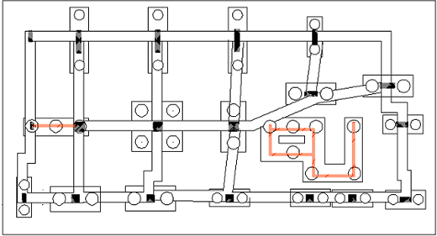
Plan View of Piles' Caps & Tie Beams

Slide 36
MAT OVER PILES
qu.mat =
Qmat = mat load= qall.mat xAmat.
=156.4 x 405 = 63342.6 KN.
Piles load= building load - mat load.
= 99171.88 – 63342.63= 35829.28 KN.

Slide 37
MAT OVER PILES
Piles used for mat are 80 cm diameter and 16 m length.
Number of piles= = 44 piles.
Depth of mat “d” = 100 cm such that for the most critical column (No.8) no punching occurs:
Φ Vc = 4555 KN > Vu.max = 4326.65 KN (from SAP).

Slide 38
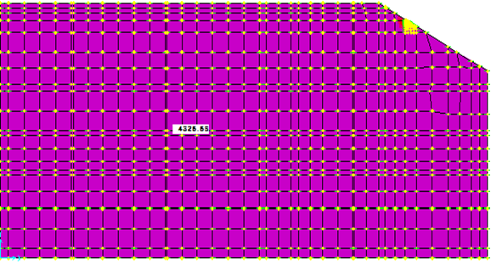
Maximum Shear Force From SAP

Slide 39
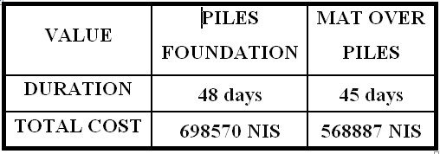
Cost and Duration Estimation

Slide 40
THANK YOU

