Slide 1
An-Najah National University
Faculty Of Engineering
Civil Engineering Department
Analysis and Design Structural Building
for (tower)
Prepared by :
Mohammad Shqair & Salah Odeh
Submitted to:
Dr. Wael Abu Assab

Slide 2
Outline :
Chapter one: Introduction.
Chapter two: Preliminary Design.
Chapter three: 3D modeling by SAP2000

Slide 3
Abstract
The purpose of this project is design building of 16 stories on area of (339 m²).
Analysis will be done statically and dynamically in 3D representation to be as close as possible to reality, and then we will design column, beams, slabs, and other structural elements.
The loads considered here are gravity loads, wind loads and seismic loads.
The 3D analysis will be done using SAP2000 and elements are designed accordingly also comparison between dynamic and static results will be highlighted.

Slide 4
Chapter One : Introduction
Project Description:
The building is composed of 16 stories above the ground. The area of each story is about 339 m², and its height is 4 m.
And structural design details are provided.

Slide 5
Scope of the Report:
Manual preliminary analysis and design of selected elements "slabs, columns and beams ".
3D analysis by SAP 2000.

Slide 6
Material:
Selection of required material depends on availability in the local resources and economic factors, material used are:
Reinforced concrete:
1. Slabs: 𝒇'_{c}=280kg/cm² .
2. Columns: 𝒇'_{c} =280kg/cm² .
3. For all structural elements the yield strength of steel bars, ℱ_{y}=4200kg/cm² (high strength steel).

Slide 7
Concrete
-Consists of aggregates (gravels and sand), water and cement.
-Concrete strength use in all parts is f'c=28 $Mpa$
-Modulus of elasticity $Ec=4500\sqrt{f′c}=23811.8 Mpa$
-Unit weight =25 KN/$m^{2}$

Slide 8
Loads:
-There are two types of loads in this part of the project we will consider dead load and live load.
-Snow load will be neglected because in Nablus city the amount is too little and for small duration.
Type one: Gravity loads
Live load: it is not permanent load .It comes from the people machines and any movable objects in the buildings. The amount of live load depends on the type of the structure
Dead load: it is associated with the own weight of the structure and any permanent component. Dead loads are also known as permanent loads

Slide 9
Type two: Lateral loads:
1- Wind load: the calculation of wind load according to British standard
2- Horizontal Seismic Force: It is important to design the structures to resist the horizontal seismic forces because it may be subjected destructive earthquake. In this part we will perform simple calculation for the lateral earthquake force using the equivalent static method and UBC as follow:
$$V=Cs×W$$

Slide 10
Load Combinations:
Combining factored loads using strength design:
1.4(D)
1.2(D) + 1.6(L + H) + 0.5(Lr)
1.2D + 1.6(Lr) + (L or 0.8W)
1.2D + 1.6W + L + 0.5(Lr)
1.2D + 1.0E + L + 0.2S
0.9D + 1.6W + 1.6H
0.9D + 1.0E + 1.6H

Slide 11
Soil (for Foundation): The allowable bearing capacity of soil is taken as (300KN/m²) this value has been founded from the soil test.
Design Code and standards:
ACI 318-08:American Concrete Institute provisions for reinforced concrete structure design.
UBC-97: code which is used here for seismic load parameters determination.
The British code (for wind loads).

Slide 12
Chapter two : Preliminary Design
This chapter provides manual (hand calculations) analysis and design of slabs, beams and columns using simplified one dimensional analysis
Structural Systems
This project is divided into two parts as shown in drawings
In part A:
First and second floors are designed as mixed one way ribbed slab and two way ribbed slab.
In part B:
Other floors are designed as one way ribbed slabs .

Slide 13
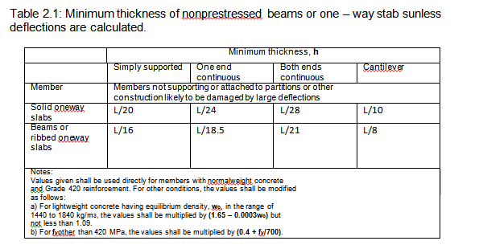
Design of slabs
One way ribbed slab :
The thickness of slab (h_{min}) is given using ACI code Table 2.1

Slide 14
In part a and b:
The most critical span in part a is the middle span which is 5.65 m length which is located between grid lines.
The most critical span in part b is the middle span which is 5.65 m length which is located between grid lines.
h_{min} = Ln /21 =5650/21= 269 mm
We use thickness of slab 320mm
So, the block dimensions will be:
Length= 400 mm
Height= 140 mm
Width= 200 mm

Slide 15
Own weight of slab:
Refer to Table for material unit weights:
Own weight:
= [(0.52x0.06) + (0.12x0.14)] x25+0.4x0.14x12 = 1.872 KN/m
Weight/m² = 1.872/0.52 = 3.6 KN/ m²
Super imposed dead load:
SID =0.015x23+0.1x19+0.02x23+0.03x26=3.5KN/m²
Partition loads: 1KN/m²
Total dead load: DL = 1+ 3.5 + 3.6=8.1 KN/m²
Live load: L.L = 2 KN/m²
Ultimate load:
W_{u} = 1.2 D.L +1.6 L.L W_{u}=1.2x8.1+1.6x2=12.92 KN/m²

Slide 16
Two way ribbed slab:
For part a :
A deflection is the most important factor that controls the minimum thickness, and below the calculation for thickness:
The most critical panel that may give the maximum thickness has dimensions of (11.62 x 9.8) m clear, which its spans have the minimum ($β$)and maximum effective length $ln$refer to figure 2.1.
$Β$= (long span/short span) =11.62 /9.8 = 1.19
$$hmin= ln\left(0.8+\frac{fy}{1400}\right)/(36+9β)$$
h_{min} = $ln$ (0.8 +420/1400)/(36 +9 x1.19 ) = 0.20 m.
Let it 25 cm

Slide 17
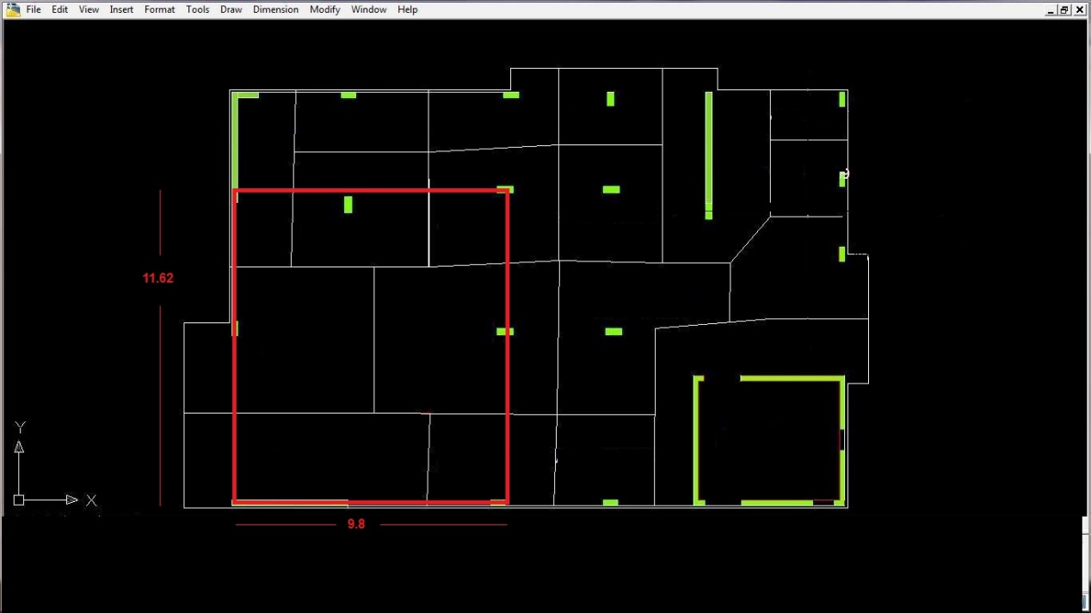

Slide 18
Own weight of slab: Refer to Table for material unit weights:
Own weight of slab:
O.W = [(55x55x10) +(15x24x55) + (2)(15x24x20)] x 25 + [x40x24x20]x12 = 2.072 KN/m
Own weight: O.W =2.072 / (0.55)² =6.85 KN/m²
Super imposed dead load: SID =4.5 KN/m²
Total dead load: D.L =6.85 +4.5 =11.35 KN/m²
Live load L=6 KN/m²
Ultimate load:
W_{u}=1.2 (D.L) +1.6(L.L) W_{u}=1.2x11.35 +1.6x6=23.22 KN/m²

Slide 19
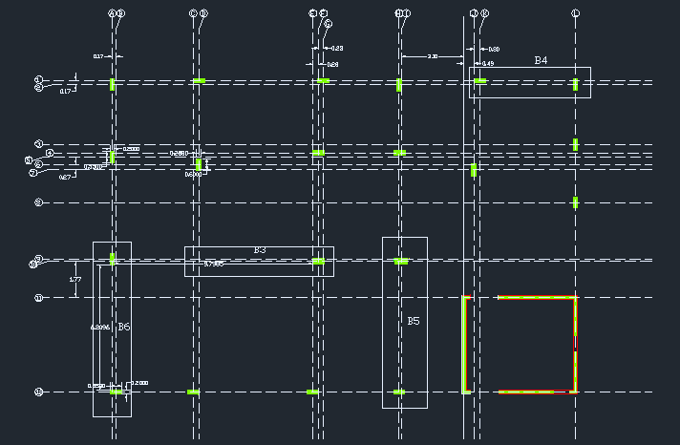
Beams analysis and design
Part A:
Beam (B3A),(B4 A),and (B6 A) in basement floor (show below in figure).

Slide 20
For beam (B6A):
h_{min}= $\frac{6600}{21}$ =314.28 mm
Assume that the beam dimensions are:400 mm depth, and 250 mm width.
Load on beam:
From slab: = 3.2 x 23.22= 74.3 KN/m.
Beam own weight:=0.4 x 0.25 x 25 = 2.5 KN/m.
Total load on beam (W_{u}):= (1.2 x 2.5) + 74.3 = 77.3 KN/m.
Ln = 6.60 – (2 x0.25) = 6.1 m.

Slide 21
M_{u}⁻⁻_{exterior} = $\frac{w_{u}\ln^{2}}{16}$ = (77.3)(6.1)² /16 = 179.8KN.m
$ρ=\frac{0.85 f`c}{fy}(1−\sqrt{1− \frac{2.61∗{10}^{6}M_{u}}{b d^{2}f`c }}$)
$ρ= \frac{0.85∗ 28}{420}(1−\sqrt{1− \frac{2.61∗{10}^{6}∗179.8}{250 ∗ {\left(340\right)}^{2}∗28 }}$) = 0.0199
A_{s} = $ρ b d= 0.0199∗250∗340=1694.4$ mm²
Use bar diameter Ø18 mm, and area of bar = 254 mm²
Number of bars = $\frac{1694.4}{254}$ = 6.67
Use 7 Ø18

Slide 22
M_{u}—_{interior} = $\frac{w_{u}\ln^{2}}{10}$ = (77.3) (6.1)² /10 = 287.6KN.m
$ρ= \frac{0.85∗ 28}{420}(1−\sqrt{1− \frac{2.61∗{10}^{6}∗287.6}{250 ∗ {\left(340\right)}^{2}∗28 }}$) = 0.0414
A_{s} = $ρ b d= 0.0414∗250∗340=$3520.8 mm²
Use bar diameter Ø25 mm, area of bar = 490 mm²
Number of bars = $\frac{3520.8}{490}$ = 7.18 bars
Use 8Ø25

Slide 23
M_{u}⁺= $\frac{w_{u}\ln^{2}}{14}$ = (77.3)(6.1)² /14 = 205.4KN.m
$ρ= \frac{0.85∗ 28}{420}(1−\sqrt{1− \frac{2.61∗{10}^{6}∗205.4}{250 ∗ {\left(340\right)}^{2}∗28 }}$) = 0.024
A_{s} = $ρ b d= 0.024∗250∗340=$2019 mm²
Use bar diameter Ø18 mm, and area of bar = 254
Number of bars = $\frac{2019}{254}$ = 7.95
Use 8 Ø18

Slide 24
Part B:
For beam (B4 B):
h_{min}= $\frac{6000}{21}$ = 285.7 mm
Assume that the beam dimensions are:400mm depth, and 250mm width.
Load on beam:
From slab:= 3.2 x 12.92 = 41.3 KN/m.
Beam own weight:=0.4 x 0.25 x 25 = 2.5 KN/m.
Total load on beam (W_{u}):= (1.2 x 2.5) + 41.3 = 44.3 KN/m.
Ln = 6.00 – (2 x0.25) = 5.5 m.

Slide 25
M_{u}⁻⁻_{exterior} = $\frac{w_{u}\ln^{2}}{16}$ = (44.3)(5.5)² /16 = 83.75 KN.m
$ρ= \frac{0.85∗ 28}{420}(1−\sqrt{1− \frac{2.61∗{10}^{6}∗83.75}{250 ∗ {\left(340\right)}^{2}∗28 }}$) = 0.0082
A_{s} = $ρ b d= 0.0082∗250∗340=699$ mm²
Use bar diameter Ø18 mm, and area of bar = 254 mm²
Number of bars = $\frac{699}{254}$ = 2.75
Use 3 Ø18

Slide 26
M_{u}—_{interior} = $\frac{w_{u}\ln^{2}}{10}$ = (44.3) (5.5)² /10 =134 KN.m
$ρ= \frac{0.85∗ 28}{420}(1−\sqrt{1− \frac{2.61∗{10}^{6}∗134}{250 ∗ {\left(340\right)}^{2}∗28 }}$) = 0.0139
A_{s} = $ρ b d= 0.0139∗250∗340=$1187.27 mm²
Use bar diameter Ø25 mm, area of bar = 490 mm²
Number of bars = $\frac{1187.27}{490}$ = 2.4 bars
Use 3 Ø25

Slide 27
M_{u}⁺= $\frac{w_{u}\ln^{2}}{14}$ = (44.3)(5.5)² /14 = 95.7 KN.m
$ρ= \frac{0.85∗ 28}{420}(1−\sqrt{1− \frac{2.61∗{10}^{6}∗95.7}{250 ∗ {\left(340\right)}^{2}∗28 }}$) = 0.0095
A_{s} = $ρ b d= 0.0095∗250∗340=$812 mm²
Use bar diameter Ø18 mm, and area of bar = 254
Number of bars = $\frac{812}{254}$ = 3.19
Use 4 Ø18

Slide 28
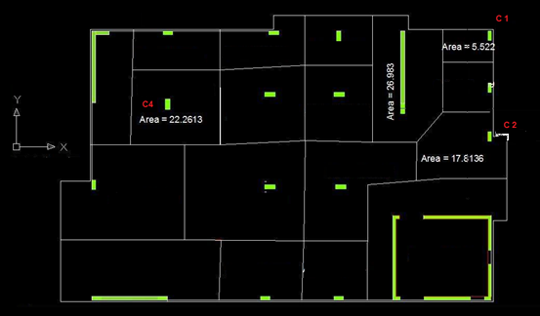
Column analysis and design:
Columns show in figure below are to be analysed and designed. (We will calculate the load on columns by using tributary area concept).

Slide 29
For column C1 :
The area around this column equals to: Area = 5.522 m²
And it carried four floors,
W_{u} from one way ribbed slab is equal to (12.92 KN/m²)
P_{u1} = 16 x 5.522 x 12.92 = 1141.5 KN
Loads from beams own weight is equal to:
P_{u2} = {1.2 [0.2 x 0.5 x1.7 + 0.3 x 0.5 x 1.7] x25} x 16 = 228.8 KN
Loads from external partition are equal to:
P_{u3} = 16 X (1.7+1.7) X 30 =1632 KN.
Total load on the column is equal to
P_{u}= P_{u1} +P_{u2}+ P_{u3} = 3002.3 KN

Slide 30
We have:
$Ø$ = 0.65$f`c$= 28 MPa
$fy$= 420 Mpa And we assume ρ = 0.01.
$$ØPn=Ø (0.8)(0.85 f`c\left(Ag−As\right)+fy As)$$
3002.3 x 1000 = 0.65 (0.8)(0.85 x 28(Ag – 0.01Ag ) +420 x 0.01 Ag )
3002300 = 14.4 Ag
Ag = 208493 mm²
Take column 600 x 350 mm (Ag = 600 x 350 = 210000 mm²)

Slide 31
Mat foundation :
In case of soils having low bearing capacity, heavy structural loads are usually supported by providing mat foundations.
Mat Foundations provides an economical solution to difficult site conditions.
Mat foundations consists of thick reinforced concrete slab covering the entire area of the bottom of the structure like a floor.

Slide 32
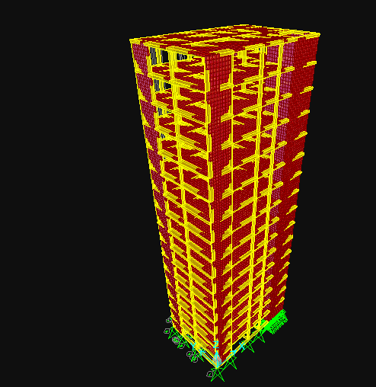
Chapter Three : 3D modeling by SAP200

Slide 33
THANKS FOR LISTENING

