Slide 1

Structural Design of AL-Rehana Building
An-Najah National University
Faculty of Engineering
Civil Engineering Department
Graduation Project II
Prepared By:
Basel Hassan Supervisor :
Majd Barham Dr. Munther Diab
Mo’tasem Saidi
Saleh Se’bas

Slide 2
Presentation Outline
  Introduction.
  Preliminary Design.
  3D- Modeling & Checks.
  Slabs.
  Design of columns (static).
  Dynamic analysis :
  Dynamic analysis for seismic loading
  Analysis and design of slabs (dynamic)
  Analysis and design of beams (dynamic)
  Analysis and design of columns (dynamic)
  Design of footing
  Special structural elements
  Stairs
  Tie beams

Slide 3
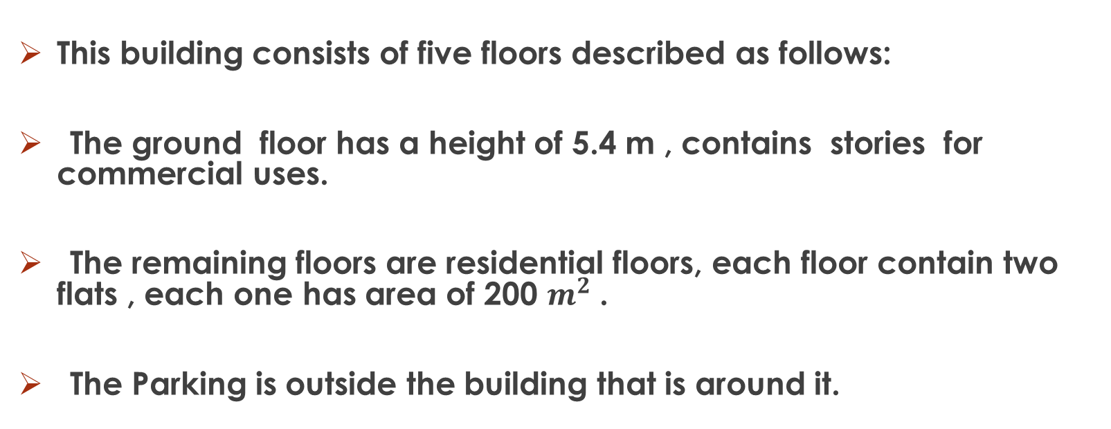
Introduction
This building consists of five floors described as follows:
The ground floor has a height of 5.4 m , contains stories for commercial uses.
The remaining floors are residential floors, each floor contain two flats , each one has area of 200 $m^{2}$ .
The Parking is outside the building that is around it.

Slide 4
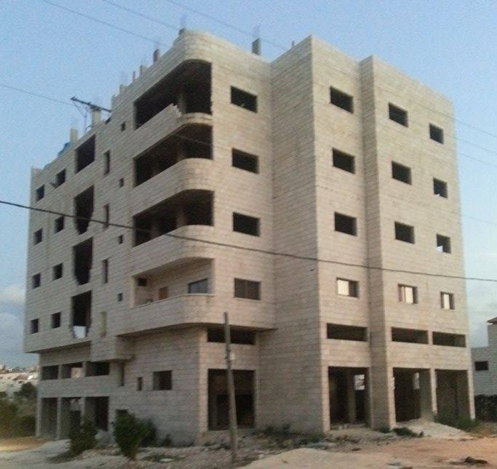

Slide 5
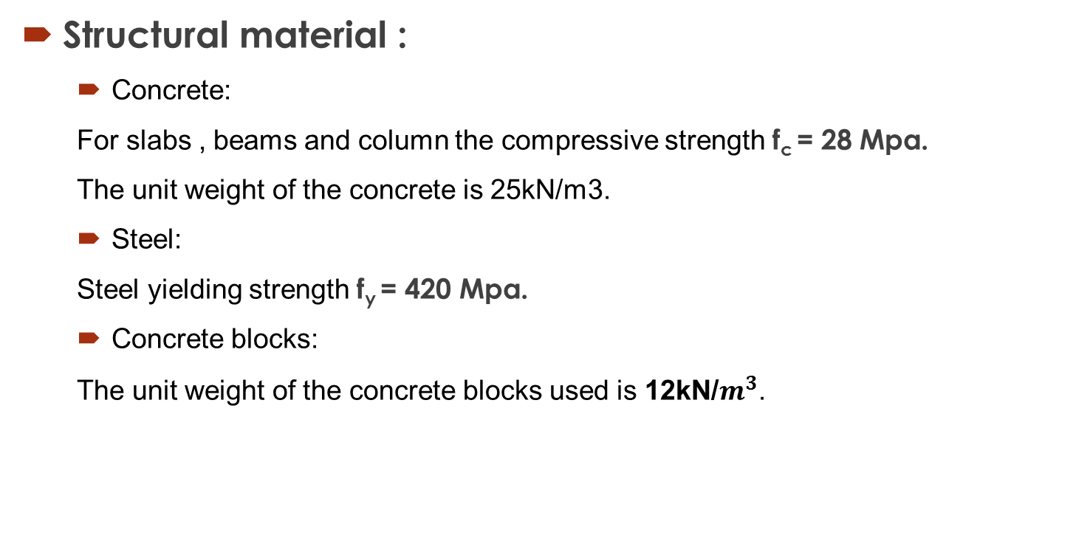
Introduction
Structural material :
  Concrete:
  For slabs , beams and column the compressive strength f_{c} = 28 Mpa.
  The unit weight of the concrete is 25kN/m3.
  Steel:
  Steel yielding strength f_{y} = 420 Mpa.
  Concrete blocks:
  The unit weight of the concrete blocks used is 12kN/$m^{3}$.

Slide 6
NonStructural material :

Slide 7
Introduction
Loads
  Dead loads:
  Static & constant loads, including the weight of structural elements (own weight)
  super imposed dead loads = 3.5 KN/m²
  Live loads:
  Non permanent loads on the structure like weight of people, furniture, water tank & the building content. = 3.5 KN/m²
  Perimeter Wall:
  The weight of the perimeter wall 18 kN/m.

Slide 8
Introduction
Codes
  The most commonly used code in the modern world that used mainly in Palestine is ACI 318-08 which is used in this project.
  Load combination:
  U1 = 1.4(D.L)
  U2 = 1.2(D.L )+ 1.6(L.L)
  Sap2000 programm , will be used in analysis of the structure.

Slide 9
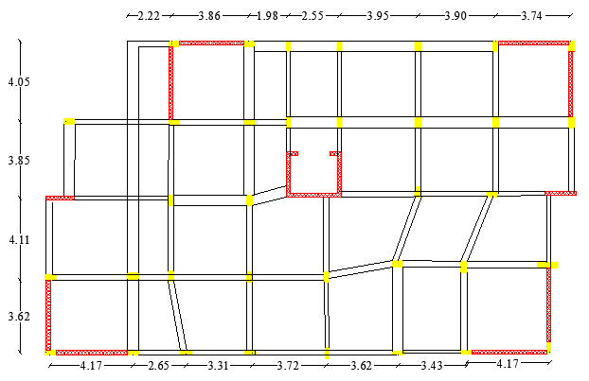
Preliminary Design of Slabs
  In this project two slab systems are used which are:
  * One way solid slab.
  * One way ribbed slab.
  slab plan:

Slide 10
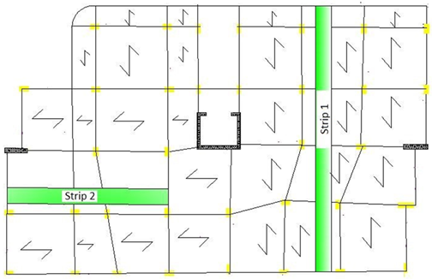
Preliminary Design of Slabs

Slide 11
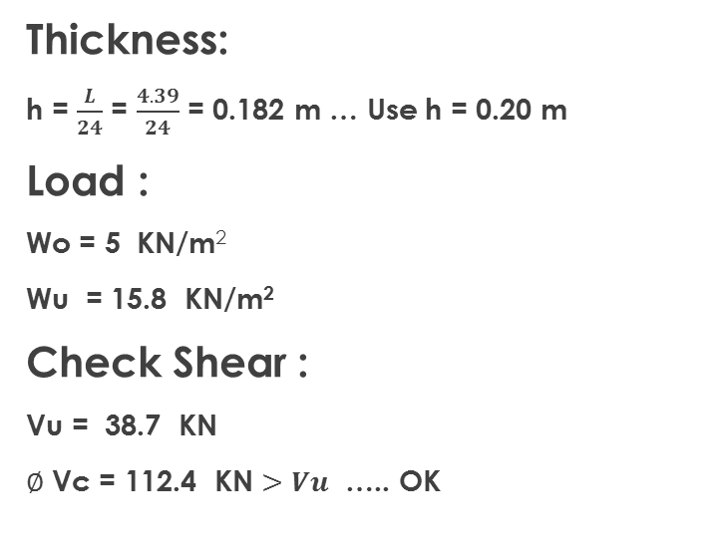
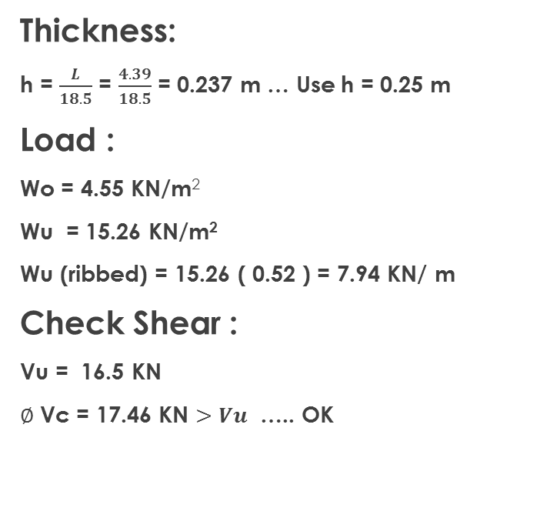
Preliminary Design of Slabs strip 1
Solid Slab
Ribbed Slab
Thickness:
h = $\frac{L}{24}$ = $\frac{4.39}{24}$ = 0.182 m … Use h = 0.20 m
Load :
Wo = 5 KN/m²
Wu = 15.8 KN/m²
Check Shear :
Vu = 38.7 KN
$∅$ Vc = 112.4 KN $>Vu$ ….. OK
Thickness:
h = $\frac{L}{18.5}$ = $\frac{4.39}{18.5}$ = 0.237 m … Use h = 0.25 m
Load :
Wo = 4.55 KN/m²
Wu = 15.26 KN/m²
Wu (ribbed) = 15.26 ( 0.52 ) = 7.94 KN/ m
Check Shear :
Vu = 16.5 KN
$∅$ Vc = 17.46 KN $>Vu$ ….. OK

Slide 12
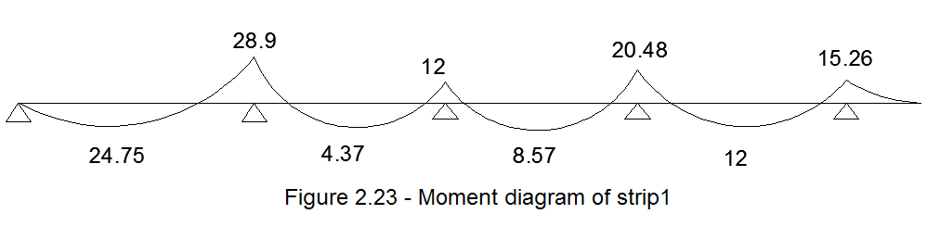
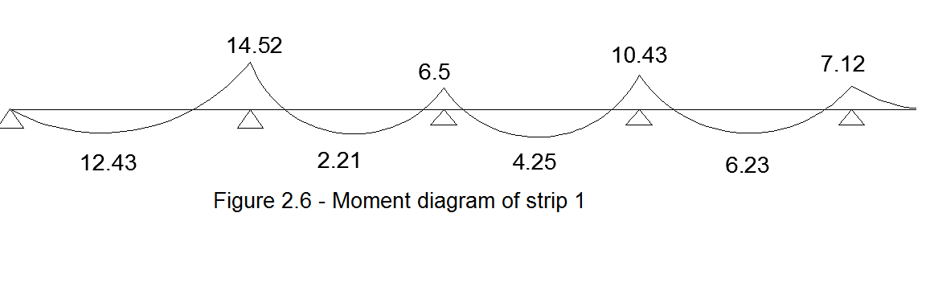
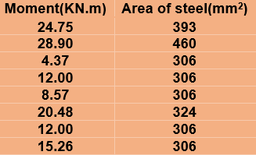
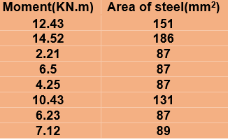
Preliminary Design of Slabs
strip 1
Solid Slab
Ribbed Slab

Slide 13
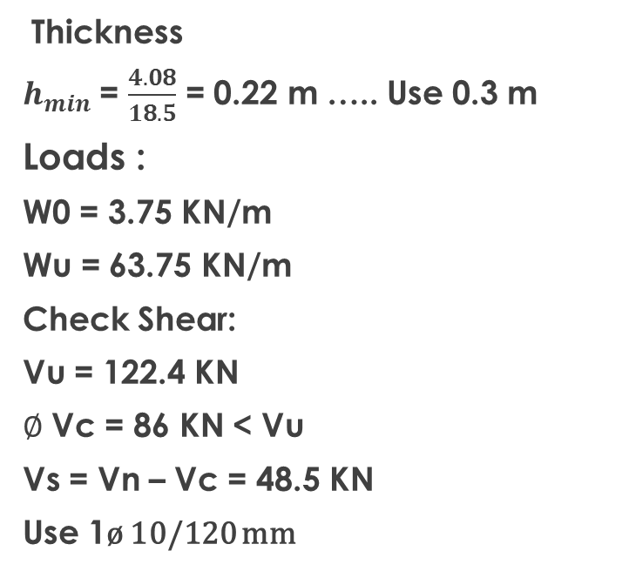
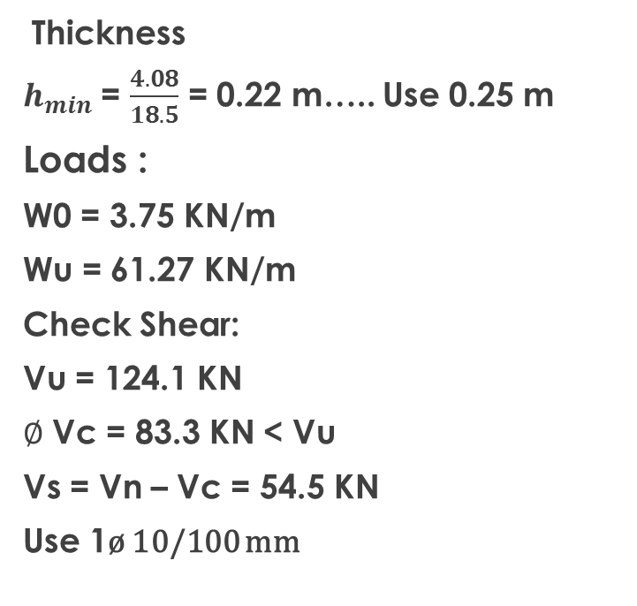
Preliminary Design of Beams
Beam 1
Solid Slab
Ribbed Slab
Thickness
$h_{min}$ = $\frac{4.08}{18.5}$ = 0.22 m ….. Use 0.3 m
Loads :
W0 = 3.75 KN/m
Wu = 63.75 KN/m
Check Shear:
Vu = 122.4 KN
$∅$ Vc = 86 KN < Vu
Vs = Vn – Vc = 48.5 KN
Use 1ø 10/120 mm
Thickness
$h_{min}$ = $\frac{4.08}{18.5}$ = 0.22 m….. Use 0.25 m
Loads :
W0 = 3.75 KN/m
Wu = 61.27 KN/m
Check Shear:
Vu = 124.1 KN
$∅$ Vc = 83.3 KN < Vu
Vs = Vn – Vc = 54.5 KN
Use 1ø 10/100 mm

Slide 14
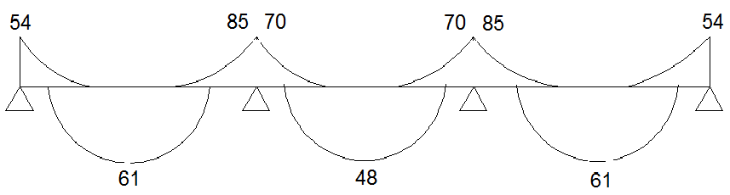
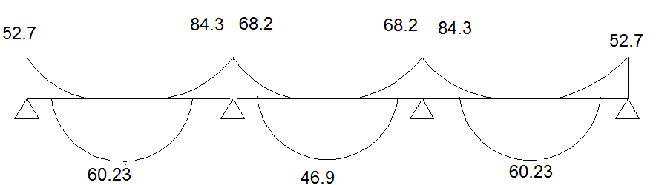
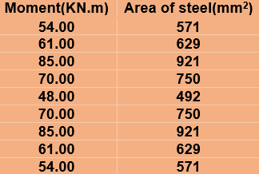
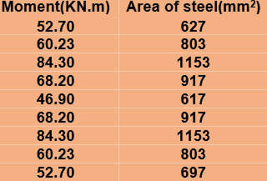
Preliminary Design of Beams
Beam 1
Solid Slab
Ribbed Slab

Slide 15
3D-Modeling & Checks
Modifier values for different structural elements.
Structural element | modifier
Column &shear walls | 0.70
Slabs | 0.25
Beams | 0.35

Slide 16
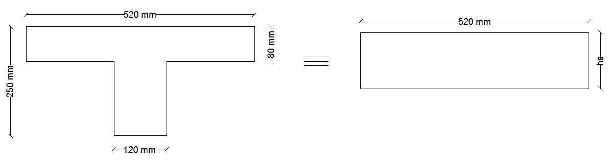
3D-Modeling & Checks

Slide 17
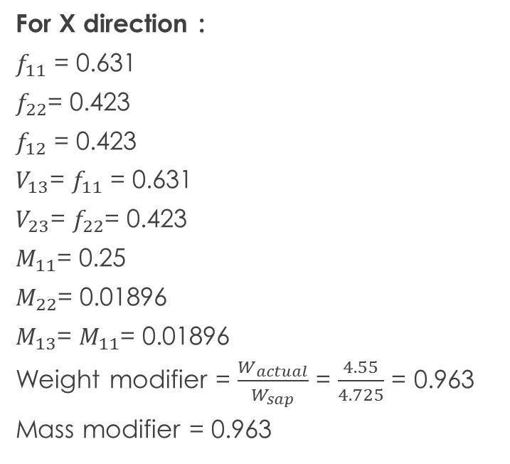
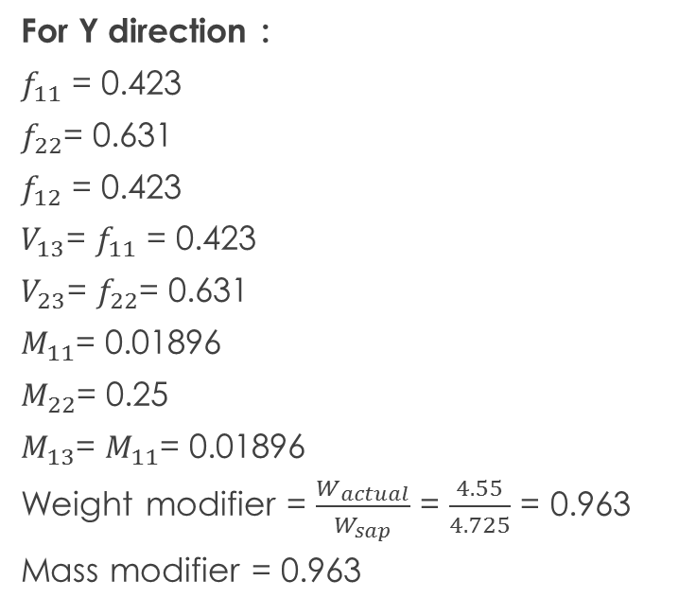
3D-Modeling & Checks
Modifier calculations for ribbed slab
For Y direction :
$f_{11}$ = 0.423
$f_{22}$= 0.631
$f_{12}$ = 0.423
$V_{13}$= $f_{11}$ = 0.423
$V_{23}$= $f_{22}$= 0.631
$M_{11}$= 0.01896
$M_{22}$= 0.25
$M_{13}$= $M_{11}$= 0.01896
Weight modifier = $\frac{W_{actual}}{W_{sap}}$ = $\frac{4.55}{4.725}$ = 0.963
Mass modifier = 0.963
For X direction :
$f_{11}$ = 0.631
$f_{22}$= 0.423
$f_{12}$ = 0.423
$V_{13}$= $f_{11}$ = 0.631
$V_{23}$= $f_{22}$= 0.423
$M_{11}$= 0.25
$M_{22}$= 0.01896
$M_{13}$= $M_{11}$= 0.01896
Weight modifier = $\frac{W_{actual}}{W_{sap}}$ = $\frac{4.55}{4.725}$ = 0.963
Mass modifier = 0.963

Slide 18
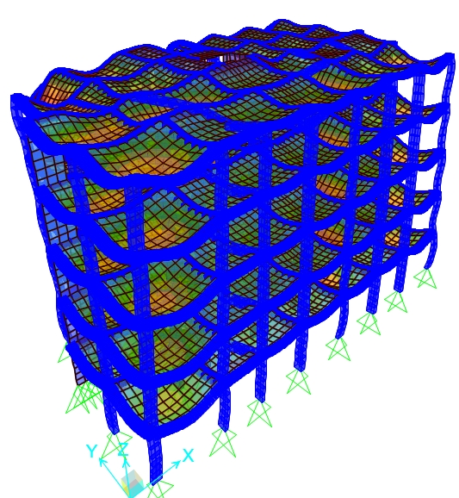
3D-Modeling & Checks
Compatibility:
The structure works as one unit is verified.

Slide 19
3D-Modeling & Checks
Solid Slab
Equilibrium: (5% acceptable)
Slab weight = 9665.5 KN
Columns weight = 2145 KN
Beams weight = 4462.72 KN
Shear wall weight = 911.63 KN
External Walls = 7785 KN
Total dead load(by hand) = 24969.9 KN Total dead load (from SAP) =25107.737 KN
Difference %=[(25107.737 -24969.9)/ 25107.737] *100%=0.55% <5% so it is Ok

Slide 20
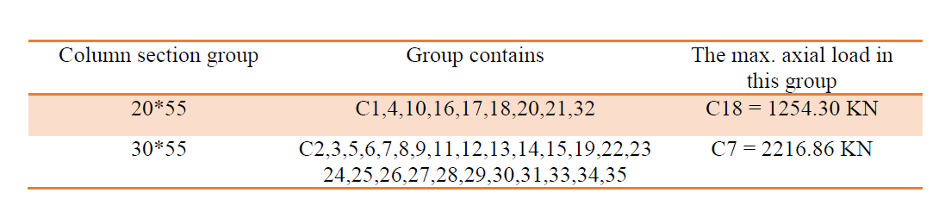
Design of Columns (Static)
We will take the columns that have the same dimension and design them together, so there are two groups of columns which there are 20*55 & 30*55
Pu=0.8Ф[0.85f'c(Ag-As)+Fy*As]=
Ф=0.65 for tied columns.
f'c=28 Mpa
As=ρ*Ag
Assume ρ=0.01 (economical percentage of steel)
Fy=420 Mpa

Slide 21
Design of Columns (Static)
Sample Calculation
The group of (20*55):
The max. load that we found in this group is 1254.30 KN
1254.30*10^3 = 0.8*0.65 [0.85*28 ((550*200)-As)+ 420*As]
As = 521.64 mm2 use 6Ф12
For stirrups:
use Ф8 mm stirrup:
And a spacing S between the stirrups is the minimum of:
16 *db =224 mm
48 *ds =384 mm
use Ф8mm /200mm.

Slide 22
Dynamic Analysis
Dynamic analysis for seismic loading
1.Introduction
The main methods of dynamic analysis are the response spectrum analysis and the time- history analysis. UBC 97 code and response spectrum analysis are used in this project for seismic loads.
Manual computations from UBC 97 code are use with
appropriate factors Ca, Cv, R, I, and Z.

Slide 23
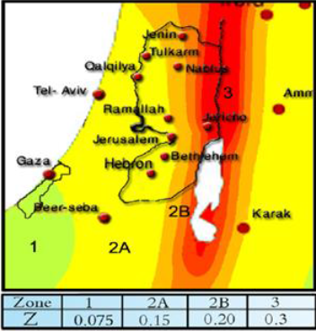
Dynamic Analysis
Dynamic analysis for seismic loading
Main factors according to UBC 97 code:
Z= seismic zone factor, for Tulkarem city (Zone 2A); Z= 0.15
2. Seismic Loads

Slide 24
Dynamic Analysis
Dynamic analysis for seismic loading
2. Seismic Loads
I= importance factor. From Table 16K (UBC 97), I= 1
R= numerical coefficient representative of the inherent over strength and global ductility capacity of lateral- force- resisting systems.
R = 6.5 (Dual systems concrete shear walls with IMRF) according to Table 16-N in the UBC97
Soil is rock so soil profile type SD from Table16-J (UBC 97)
Ca=acceleration seismic coefficient, from Table 16-Q (UBC 97) Ca=0.22
Cv= velocity seismic coefficient, from Table 16-R (UBC 97) Cv=0.32

Slide 25
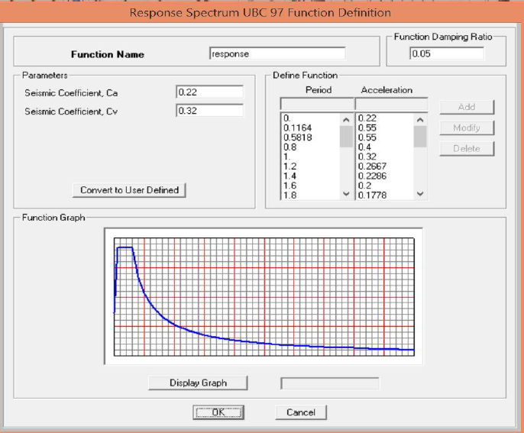
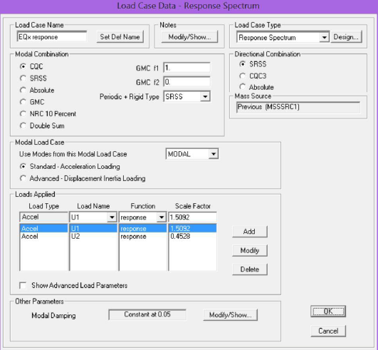
Dynamic Analysis
Dynamic analysis for seismic loading
Definition of response spectrum function:

Slide 26

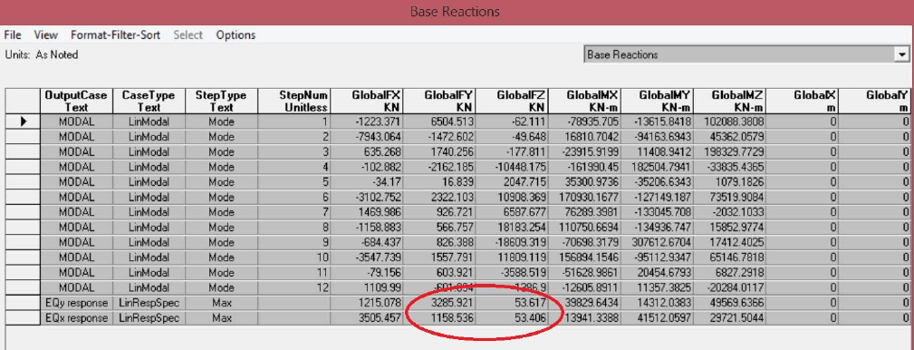

Slide 27
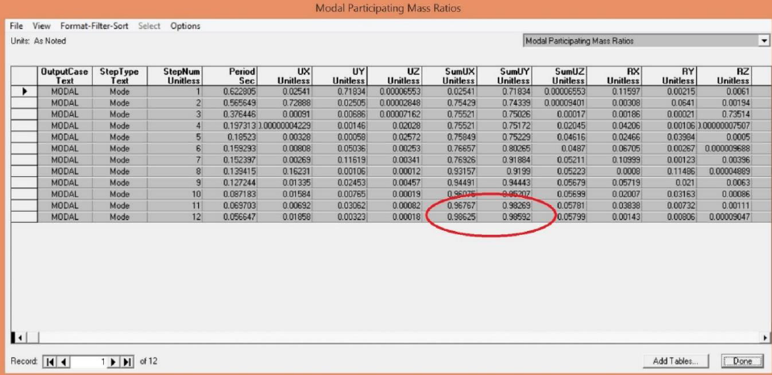
For modal mass participation ratio

Slide 28
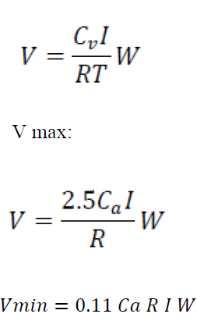
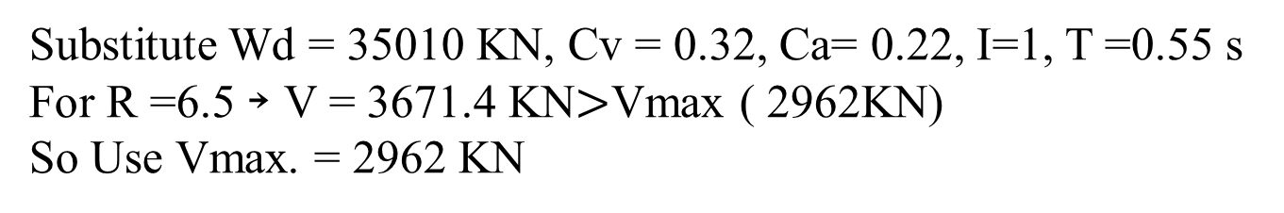
3. Total base shear V check
Total base shear can be calculated manually by this equation:
Substitute Wd = 35010 KN, Cv = 0.32, Ca= 0.22, I=1, T =0.55 s
For R =6.5 ￫ V = 3671.4 KN$>$Vmax ( 2962KN)
So Use Vmax. = 2962 KN

Slide 29
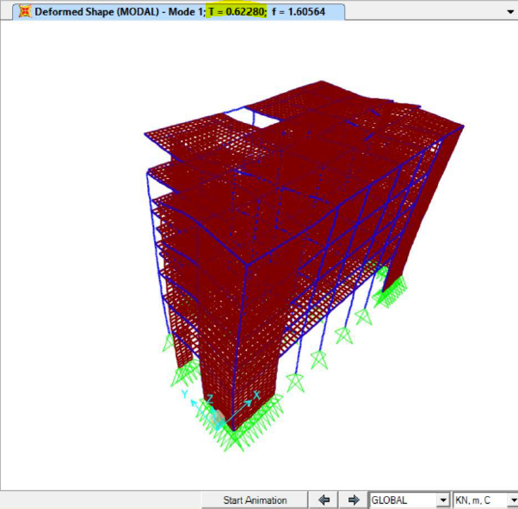
4. Period T Check:
The following equation is used to check T:
T= Ct (hn)3/4 where:
hn is the height of structure in meters = 4 floor *3.25m + 5.4m = 18.4 m
Ct is a constant = 0.03 , but we devide on 0.3048 to convert for foot .
Then T= 0.645 seconds.
T model 0.622 sec is nearly equal relative to 0.645 sec .

Slide 30
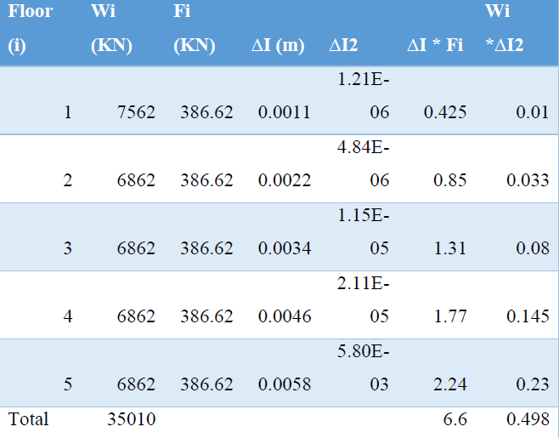

When we applied 1 KN/m2 on the structure another more accurate equation is used to check T result:
By relouf method
T = 2 $π \sqrt{\frac{0.498 }{6.6}}$ = 0.55 Sec

Slide 31
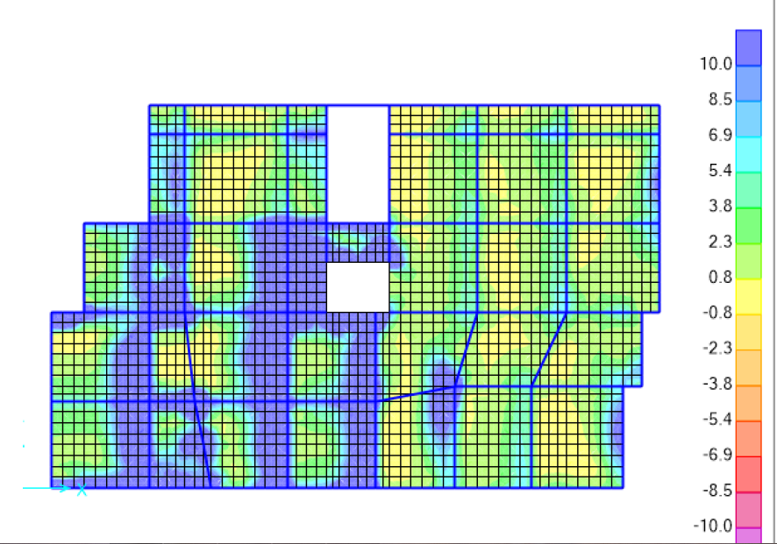
Dynamic Analysis
Analysis and design of slabs (dynamic)
Shear force contour
Check For Shear

Slide 32
Dynamic Analysis
Analysis and design of slabs (dynamic)
The maximum shear force at distance d/2 from face of support = 34.6 KN.
ØVc= 0.75 × 1/6 (√28 ×170×1000) /1000
ØVc =112.4 KN
Vu =34.6 KN
ØVc=112>Vu=34.6 →no need for shear reinforcement.

Slide 33
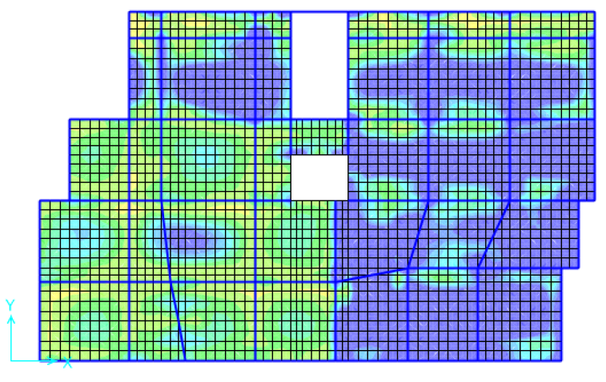
Dynamic Analysis
Analysis and design of slabs (dynamic)
M22 contours diagram

Slide 34
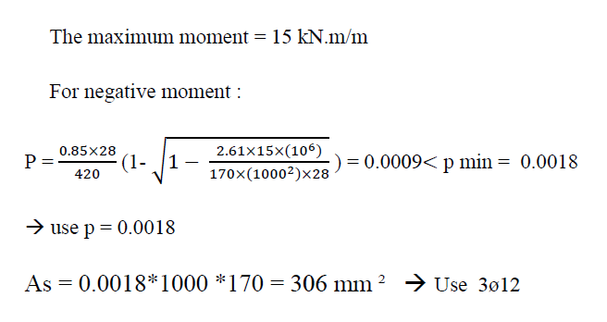
Dynamic Analysis
Analysis and design of slabs (dynamic)
Design of flexure

Slide 35
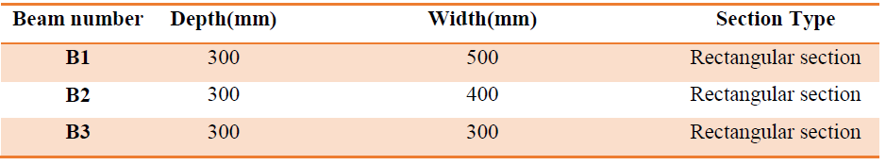
Dynamic Analysis
Analysis and design of beams (dynamic)
Third basement Beams Dimensions

Slide 36
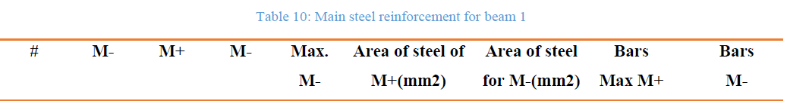
Dynamic Analysis
Analysis and design of beams (dynamic)
Critical beam in group B1 (300*500)

Slide 37
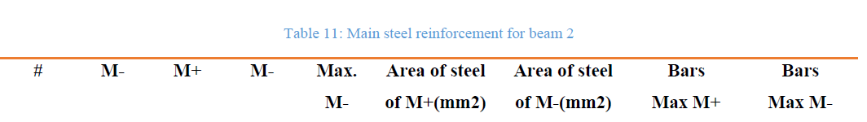
Dynamic Analysis
Analysis and design of beams (dynamic)
Critical beam in group B2 (300*400)

Slide 38
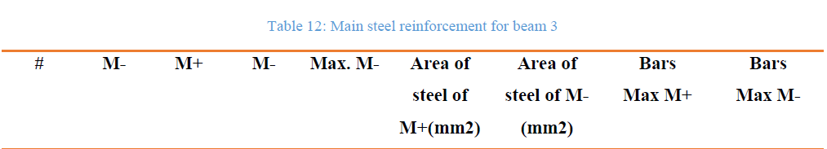
Dynamic Analysis
Analysis and design of beams (dynamic)
Critical beam in group B3 (300*300)

Slide 39
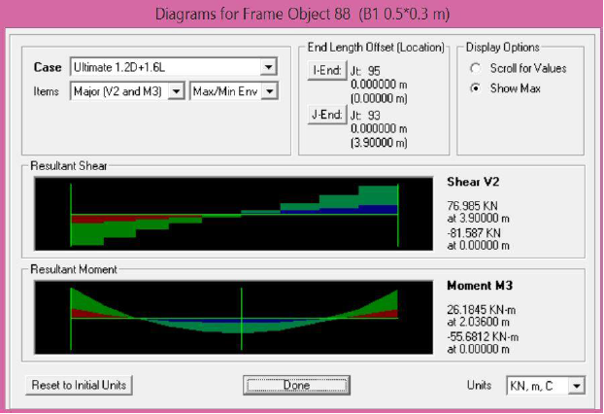
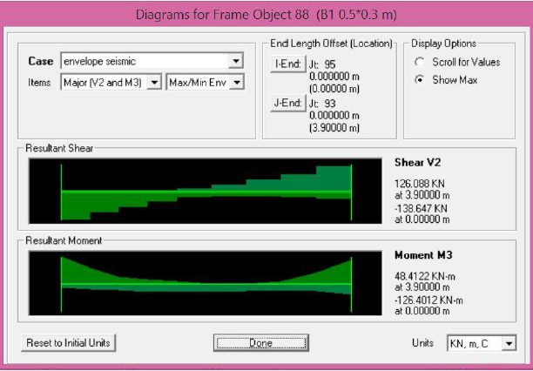
Dynamic Analysis
Analysis and design of beams (dynamic)
This pictures show the differents in inflection points , moments and shear between static and dynamic :
Static
Dynamic

Slide 40
Dynamic Analysis
Analysis and design of columns (dynamic)

Slide 41
Design OF Footings
Single Footing Design:
F’c =28 Mpa, Fy=420Mpa
qall=300 kN/m2
Taking footing F1 Column #6 to be calculated:
Column dimensions (55*30) cm

Slide 42
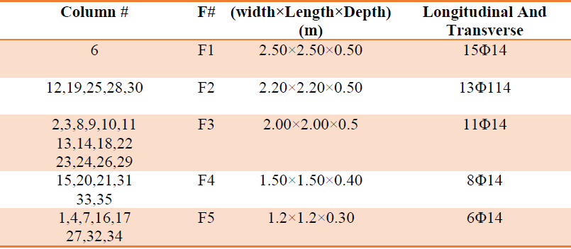
Design OF Footings
Footings Dimension & Reinforcement

Slide 43
SPECIAL STRUCTURAL ELEMENTS
1. Stairs Design
F’c = 28Mpa
Fy =420Mpa.
SID Load = 3kN/m2.
Live load = 4kN/m2.
# of running = 4.2/ 0.28 = 15
# of rising =2.75/0.17 = 16
# of steps for one flight = 15 steps

Slide 44
SPECIAL STRUCTURAL ELEMENTS
Thickness of the stairs :
Assume simply supported slab:
hmin = 0.85*(L/20)
= 0.85*(4.2/20)
= 0.18 m …… Take h=20cm with cover 3cm

Slide 45
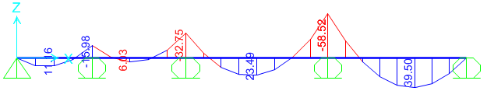
SPECIAL STRUCTURAL ELEMENTS
2. Tie Beam design:
Tie Beam at X-direction (exterior beam):
Materials:
f’c=28 Mpa.
fy=420Mpa.
Loads:
Wall load=18KN/m.
Ultimate load from ground slab=1.2(0.1*25+3.5) + 1.6(3.5)=12.8KN/m2
Beam Dimensions:
Width=250mm.
Depth=500mm.
Flexure Design:
-For Mu=58.52 KN.m
ρ=0.00314<0.0033
As=0.0033*250*450
= 371 mm2 ➔ Use ( 3φ14 )
Since ρ for maximum moment < ρmin ➔ use ρmin for all moments

Slide 46
Thank You All
for your attention
☺

