Slide 3
Contents
Introduction
Electric Wheel Chair (EWC) Mechanical structure
EWC Power System
EWC Control System
Future Improvement

Slide 4
Introduction
“Give me a wheelchair that is light and compact, that fits in a small plane when I need to fly out in the wet season. Make sure it’s comfortable, does not give me pressure sores, to make me look like a cripple straight out of hospital. It has to be easy to push because I want to get out, go crabbing in the boat and go fishing on the beach.” (Hales S 2001) This quotation describes the needs of a wheelchair user in the community.
A people with special needs is( 3_4)% of the total population.
Electric wheel chairs (EWC) provide functional mobility for people with both lower and upper extremity impairments. EWC are becoming increasingly important as more users transition from manual mobility to electric powered mobility specially in Palestine which has high percent of disabled people due to many reasons

Slide 5
Our Contribution
Our contribution was to install all the components in the project and do tests to get our Goal . To find the best solution for each situation individually. So, we will save power and money. And it will be a very good business here in Palestine. We will startup so soon

Slide 6
ELECTRIC WHEELCHAIR

Slide 7
Mechanical Structure
Satisfies the international standards
Satisfies the main target of this project

Slide 8
EWC Control System
Microcontroller
Drive
Power Switches
Heat Sinking
Optical Encoder
Joystick

Slide 9
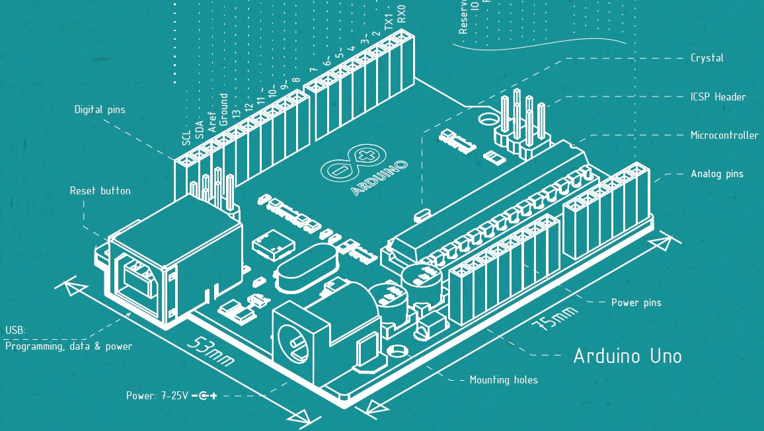
Microcontroller
Arduino

Slide 10
Microcontroller
Arduino

Slide 11
Drive
Why Drive Circuit?
Isolation between low voltage(Microcontroller) and high voltage.
Regulating the direction and speed of the motor.
H-Bridge
H-bridge is an electronic circuit, containing four switching elements, which enables a voltage to be applied across a load in either direction, in an H like configuration. This circuit allows DC Motor to run clockwise or anti-clockwise.

Slide 12
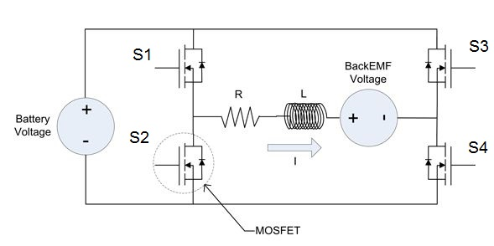
Drive
Components of H-Bridge
Power switches
Catch diode

Slide 13
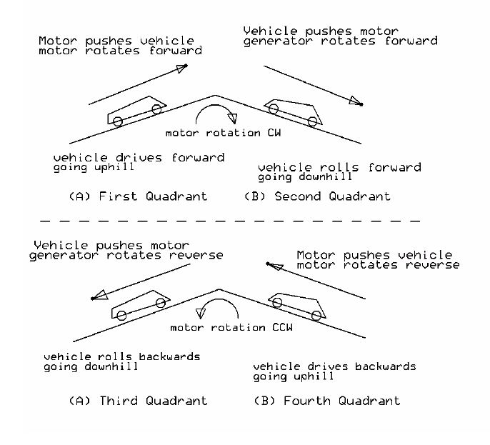
Drive
Four Quadrant operations

Slide 14
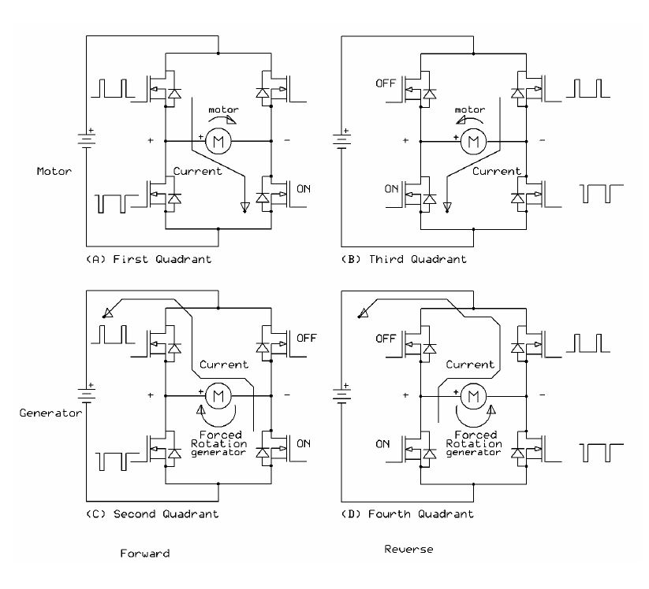
Drive
4-Q Current Paths in H-Bridge

Slide 15
Drive
Regenerative braking
Whenever the back-EMF is greater than this voltage, you get regenerative braking.
Dynamic braking

Slide 16
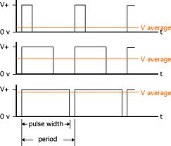
Drive
Pulse width modulation (PWM)
The presence of PWM technique:
Control Motor Speed
Soft Starting
Overcome DeadBand Region

Slide 17
Drive Circuit

Slide 18
Isolator

Slide 19
Power Switches
Power MOSFETs
Gate Frequency
Gate Driver
Thermal Problem & voltage drop

Slide 20
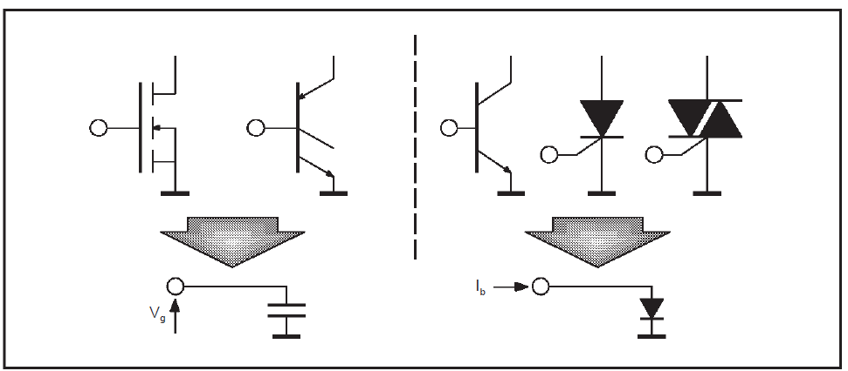
Power Switches
Gate Driver
Power MOSFETs and IGBTs
are simply voltage driven
switches, because their isolated
gate behaves like a capacitor.
In order for the MOSFET to conduct, two requirements must be met:
The MOSFET should have a reference ground
The voltage between the gate and the source should be between 5V and 20V.

Slide 21
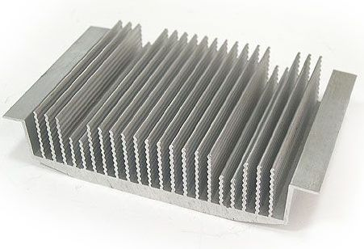
Heat Sinking
Thermal power :
P = I * (I * R) = I² * R
Where R: Junction Resistor
Heat sinks are rated by
their thermal resistance
(Rth) in °C/W.
Rth = (Tmax - Tair) / P
Tmax: Max. allowed
Element Temperature
Tair: surrounding air
Rth chosen should be less than calculated.

Slide 22
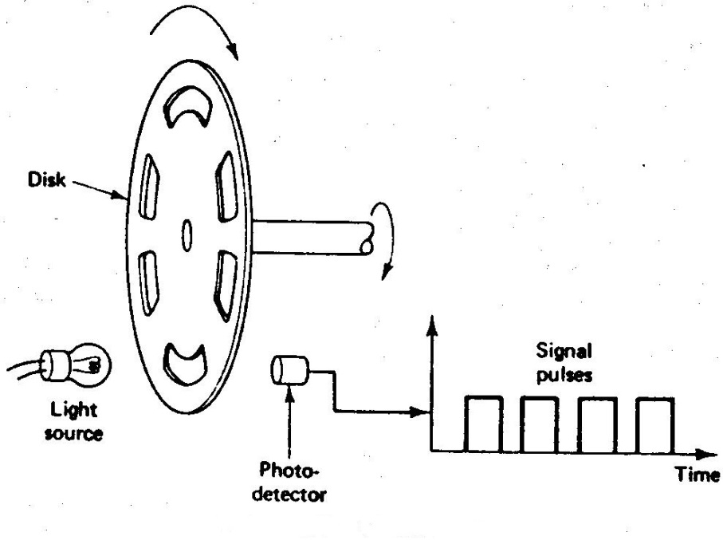
Optical Encoder
To measure the speed.
Just one photo detector
required.
To measure the speed
and the direction two
photo detector with 90
degree phase shift required.

Slide 23
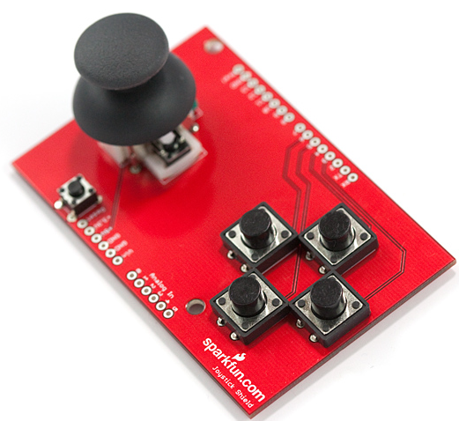
Joystick
The joystick can move in two dimensions (X and Y ).
Variable Resistors occur variable
voltages(potentiometer)

Slide 24
Programming
void setup() {
// put your setup code here, to run once:
Serial.begin( 9600 );
pinMode( A0,INPUT );
pinMode( A1,INPUT );
pinMode( 2,INPUT );//right enoder
pinMode( 12,INPUT );//left enoder
pinMode( 5,OUTPUT );
pinMode( 6,OUTPUT );
pinMode( 3,OUTPUT );
pinMode( 9,OUTPUT );
pinMode( 7,OUTPUT );
pinMode( 8,OUTPUT );
}
void loop() {
getMotor1Speed();
getMotor2Speed();
// put your main code here, to run repeatedly:
getJoystick();
if(SPD <0 ){
SPD = SPD*-1;
}
// forworad or backword
fun1();
stopMotor();
analogWrite(8,0);
analogWrite(7,0); }

Slide 25
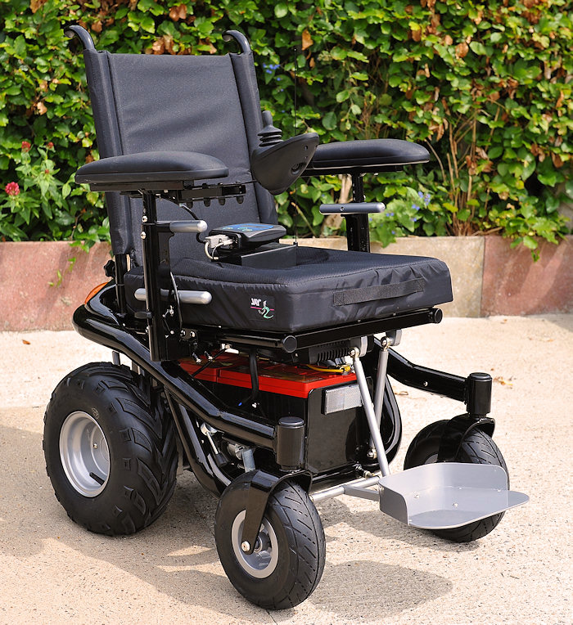
Future Work

Slide 26
Questions?

Slide 27
Thank You ☺

