Slide 1
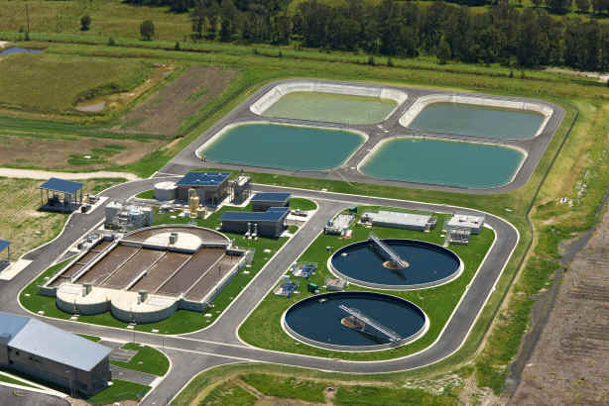
An-Najah National University
Civil Engineering Department
Jenin Wastewater treatment Plant
Analysis Of Current Situation And Design Of New Plant
Prepared By :
Qaed Shaer
Obada Faqeeh
Mohammad Samarah
Supervised By: Abdel Fattah R. Hasan , PHD
Spring 2011

Slide 2
Wastewater Treatment
Wastewater treatment is a major practice required for civilized societies in order to protect public health and efficiently manage the water sector.
Wastewater treatment objectives include:
(1) prevention of disease and nuisance conditions.
(2) avoidance of contamination of water supplies and navigable waters.
(3)maintenance of clean water supply for irrigation
(4) general conservation of water for all uses.
The process removes organics, solids and pathogenic organisms form the water or changes them from complex makeup to stable minerals or organics that can be compatible with the environment.

Slide 3
The City Of Jenin
The City of Jenin is located in the northern part of the West Bank.
The total population of the city of Jenin in addition to the refugee camp is estimated at 49375 inhabitants. (2007)
The total Municipal area is 11000 donums of which an area of 7000 donums is considered to be as built area. Jenin is situated at 104 meters above mean see level.
The Jenin city depends on many water supplies such as groundwater represented by both wells and springs, water supplied from the municipality by network , and the water provided from Mecorot.
Water consumption is estimated to be approximately 85 l/c.d .

Slide 4
Wastewater Disposal And Characteristics
Approximately 60% of the wastewater generated from households in the Jenin City is collected by sewer networks and conveyed to central facilities for treatment and disposal.
The cesspits are the main methods of wastewater disposal in the Jenin.
Characteristics of Wastewater for the city of Jenin.
PH | BOD | COD | TSS | Cloride | sodium
7.5 | 1,100 | 1,440 | 1,088 | 1,400 | 700
Nitrates | Nitrate N | Nitrite | Phospha | Phospho
182 | 41.4 | 0.2 | 46 | 15.3

Slide 5
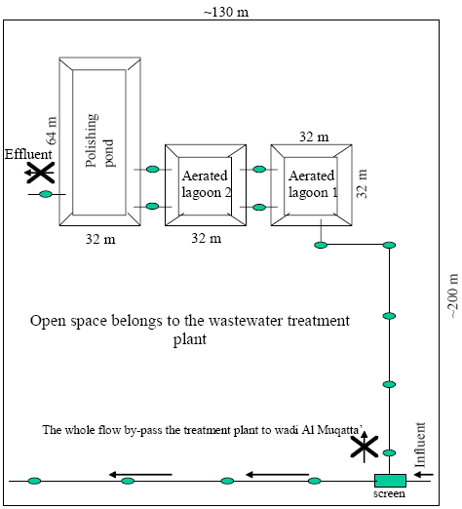
Analysis Of Current And Rehabilitated Situation
The current Wastewater treatment plant WWTP of Jenin was constructed in 1972 west of the city. The WWTP consists of two aerated lagoons in series followed by a polishing pond .

Slide 6
Dimensions of the existing WWTP in Jenin
Dimensions | Aerated Lagoon 1 | Aerated Lagoon 2 | Polishing Pond
Width (m) | 27 | 26 | 26.75
Length (m) | 28.5 | 28.75 | 57.5
Depth (m) | 3.8 | 3.6 | 3.3
Surface area (m2) | 770 | 750 | 1540
Volume (m3) | 2926 | 2700 | 5082
 | Influent | Effluent
Aerated lagoon 1 | 1100 mg/l BOD | 766
Aerated lagoon 2 | 766 | 558.32
Polishing pond | 6.4*10^8 (CFU/100 ml) fecal coliform | 3.76 * 10^8

Slide 7
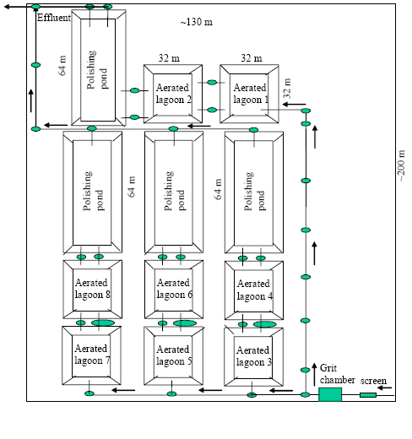
 | Influent | Effluent
Aerated lagoon 1 | 1100 mg/l BOD | 703.32 mg/l BOD
Aerated lagoon 2 | 703.32 mg/l BOD | 449.7 mg/l BOD
Polishing pond | 6.4*10^8 (CFU/100 ml) fecal coliform | 1.16 * 10^8

Slide 8
Design of new WWTP (input & assumption)
Project period 50 years
Number of people after 50 years P=P0 * (1 + R) ^{N}= 305736 inhabitants
Water consumption 100 l/c.d
Waste return 85%
The average design flow 26000 m³/day
Peak dry weather flow = 2167 m³/hr
Peak wet weather flow = 4334 m³/hr

Slide 9
TREATMENT TRAIN

Slide 10
Preliminary treatment
1- SCREEN
The first step in the treatment of sewage is to remove floating and suspended matter such as cloth, paper, pieces of wood , etc.
Peak design wet weather flow = 1.2 m3/s
Velocity through rack at peak wet weather flow = 0.90 m/s
Velocity through rack at maximum design dry weather flow = 0.6 m/s
ϴ= 60⁰ , with a mechanical cleaning device
Upstream depth of wastewater = 1.2 m

Slide 11
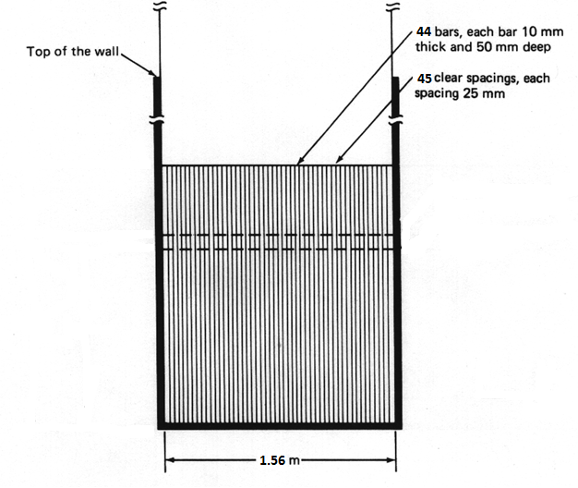
Head loss = 0.065 m
efficiency coefficient = 72%

Slide 12
2- GRIT CHAMBER
The next step is to remove smaller objects (such as sand, broken glass, silt , and coffee grounds). If these objects ( heavy particulate matter) are not removed, they can damage pumps and other mechanical devices. These objects also have a tendency to settle in corners and bends, thus reducing flow capacity and eventually clogging pipes and channels.
In this project 2 grit chambers are used
Retention Time (min) | 4
Length (m) | 8
Width (m) | 3
Depth (m) | 4.5
Air Needed (m³/s) | 0.06372
Grit Volume (m³/d ) | 1.36

Slide 13
3- Equalization tank
In this project the equalization tank is proposed in order to prevent shocks in flow. Average flow pumped from this tank will be used to design all next stages.
A single tank 2455 m3 is used to store the water for 45 minute.

Slide 14
PRIMARY TREATMENT
1- Primary Sedimentation Tank
The purpose of primary treatment (primary sedimentation or primary clarification) is to remove settleable organic and flotable solids.
Normally, each primary clarification unit can be expected to remove 90 to 95% settleable solids, 40 to 60% TSS, and 25 to 35% BOD.
Q = 26000 m³/d
T = 2.0 hr
Over flow rate 40m³ /m² .d
Weir loading 200 m³/m .d
Provide 4 tanks

Slide 15
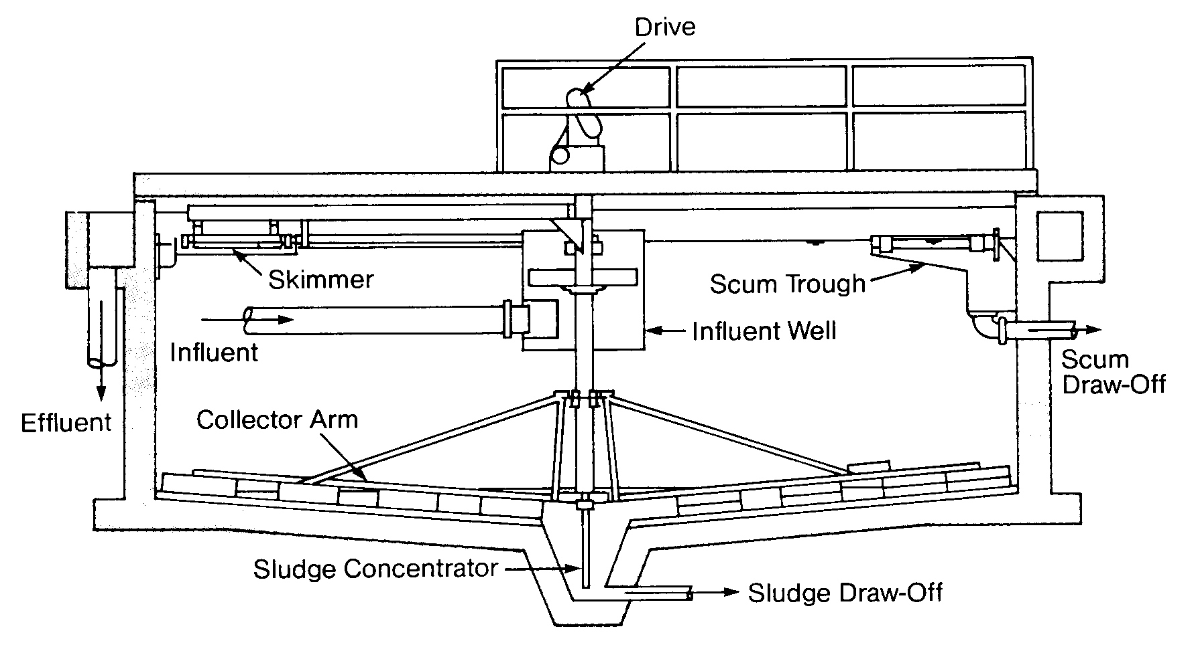
Weir length | 130 m
Diameter | 14.5 m
Side water depth | 3.3 m
Circumference | 182.2 m
Effluent BOD | 715 mg/l
Sludge weight | 16770 Kg /day
Volume of sludge | 3354 m^3/day

Slide 16
Secondary Treatment
1- Up flow Anaerobic Sludge Blanket Reactors (UASB)
Up flow anaerobic sludge blanket reactors (UASBs) are high-rate anaerobic Wastewater treatment units.
They are used for the primary treatment of domestic wastewaters and high strength industrial and agro-industrial wastewaters. They have also been found satisfactory for the treatment of mixed domestic and industrial wastewaters.
UASBs have a short hydraulic retention time, of the order of 6–12 hours.
Use 6 tanks with 16 m diameter and 6 m depth
BOD removal = 100 (1 – T^{-0.68})
Effluent BOD = 196.5 mg/l
Sludge production = 0.2 Kg / Kg BOD removed = 2696.2 Kg/day = 5392.4 m³/day
Effluent SS = 193.5 mg/l

Slide 17
2- Intermediate sedimentation tank
Sedimentation tanks between trickling filters , or between a filter and subsequent biological aeration , in two-stage , secondary treatment are called intermediate clarifiers. The following may be used for sizing intermediate settling tanks the overflow rate should not exceed 41m3/m2.d minimum side water depth is 7ft , and wire loading should be less than 124 m^3/m.d and should not be over 248 m3/m.d for larger plants.
4 tanks with15 m diameter
Side water depth = 3.3 m

Slide 18
3- Aerobic Biological Treatment
Aerobic biological wastewater treatment is the process by which microorganisms use the waste’s organic component, in the presence of oxygen, to produce cell growth and end products of carbon dioxide and water.
Activated sludge refers to biological treatment processes that use a suspended growth of organisms to remove BOD and suspended solids.
Main Types Of Activated Sludge:
1- Conventional Treatment
2- Step Aeration
3- Extended Aeration
4- High – Purity Oxygen
In this project step aeration treatment is used

Slide 19
MLSS = (1500-3500) mg/L use 2500
F / M = (0.2-0.5) g BOD/d.g MLSS use 0.35
Q = 26000 m^{^3}/d
R = 30%
Provide 2 rectangular tanks with 10 m width , 65 m length and,4.5m depth
BOD Load (g / m^3 .d ) | 873.5 within range (640-960)
Effluent BOD (mg/l) | 29.5 < 30
Amount of sludge (Kg/d) | 2452.31
Oxygen demand (Kg/d) | 221572
Corrected Demand (Kg/KWH) | 1.565
Energy Required (KWH) | 5900
Air Supply (Kg/d) | 4251.5

Slide 20
4-Secondary Sedimentation Tanks
The secondary sedimentation tanks settle out the secondary sludge which is the organic matter. This sludge is pumped back into the inlet end of the primary sedimentation tanks and settles with the raw sludge. At this stage the most suspended solids are removed.
Overflow rate ≤ 33 m³/m².d
Weir loading ≤ 124 m³/m.d
Minimum side water depth 2.13 m
Retention time (2 hr – 3 hr) use 3 hr
BOD Removed (80-90 %)
Flow rate = 26000 m³/d
Provide 4 circular tanks with a diameter of 17 m and side water depth of 3.6 m
Weir length = 130 m < Circumference =214 m

Slide 21
Advanced treatment:
Chlorine Contact Tank:
The most common use of chlorine in wastewater treatment is for disinfection. Other uses include odor control and activated sludge bulking control. Chlorination takes prior to the discharge of the final effluent to the receiving waters.

Slide 22
Reuse of Wastewater Effluent And Sludge
There are many ways to use the effluent water in it.
But for the situation of Jenin city the most effective solution for the effluent water is to use it in irrigation since the city of Jenin is considered as agricultural area, or may be flow to Wadi.
Also the produced sludge from the treatment processes can be eliminated by many ways , but for the situation of Jenin the most effective solution nowadays is to store the sludge in a tank to kill the Bacteria then disposal from it into a landfill since people now do not accept to use the sludge as a natural fertilizer but in the future if people accept to use it as fertilizer a sludge treatment units should be designed.
A sludge storage tank with 1285 m³ volume are used to store the sludge for 3 months.

Slide 23
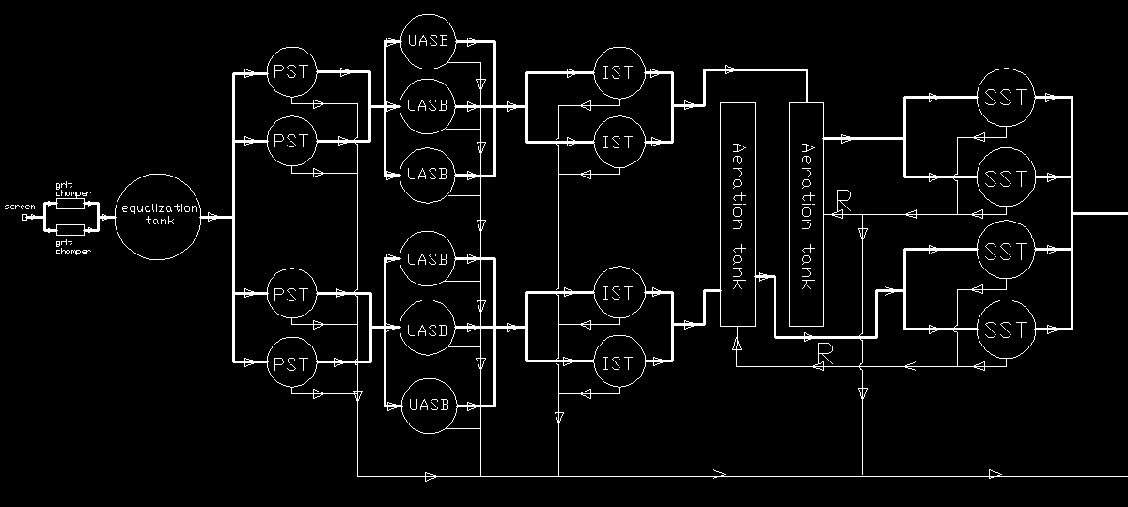
Plant layout

Slide 24
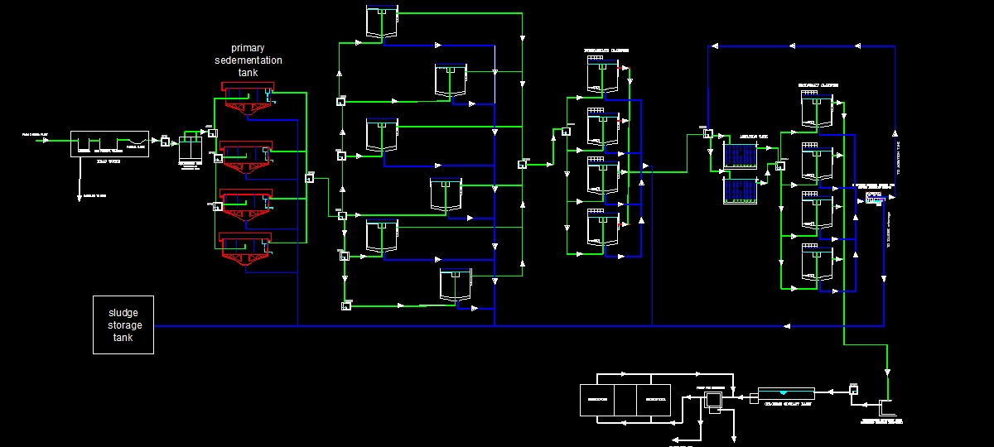

Slide 25
Thank you for listening

