Slide 1
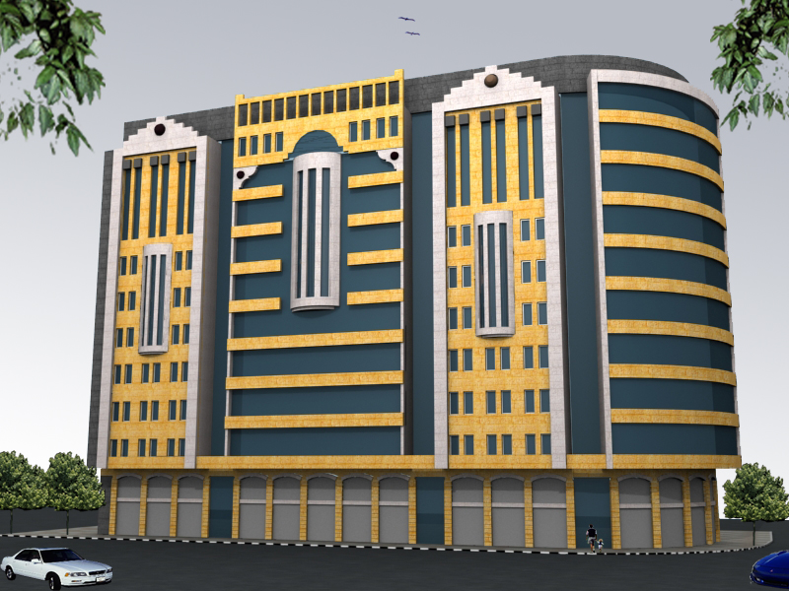
AL-ATAA CENTER

Slide 2
AL-ATA' CENTER "12 s t o r i e s" NEW BUILDING FOOTING DESIGN
Prepared by:
Mostafa Suboh
Wael Suboh
Supervisor :
Dr.Sami Hijjawi
Dr.Mohammad Ghazzal

Slide 3
: Site Description
Nablus is the largest commercial city in Palestine .Because of this importance its full by large commercial building complexes. And "AL-ATTA'A" commercial building is one of those .Its located in the middle of Nablus in "AL BASATEEN" area which is a green and well-known as a high plasticity clay soil, the area of ​​the building is up to 800 square meters.

Slide 4
Soil Properties:
45 KN/m² | Cohesion
6 degree | Angle of friction
26 | Plasticity index “PI”
1.4 Kg/cm² | Bearing Capacity

Slide 5
Information about Building
12 stories:
Two as parking
One as storage.
Nine as Offices.
Area : 800 square meters.

Slide 6
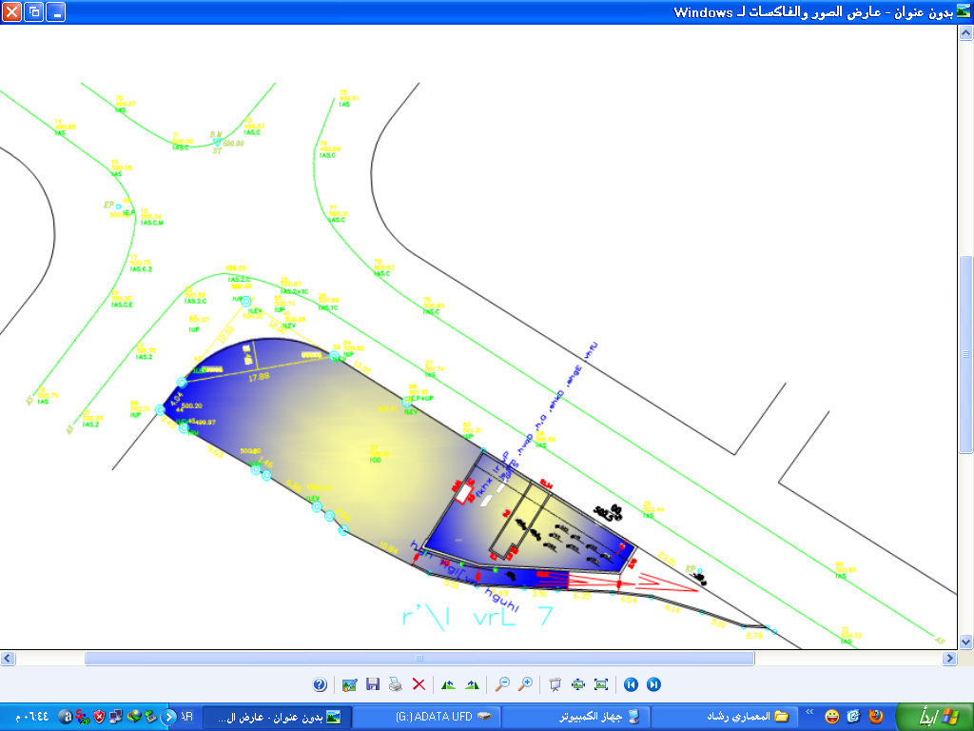

Slide 7
Assumptions of Calculation :
Parking:
SID = 3 KN/m² , LL = 6 KN/m²
Storage:
SID = 3 KN/m² , LL = 8 KN/m²
Office:
SID = 3 KN/m² , LL = 3.5 KN/m²

Slide 8
Columns Loads :
By Tributary Area Method :
Ultimate load KN | Allowable load KN | Column
1238 | 940 | C19
2720 | 2064 | C17
4512 | 3423 | C7
5629 | 4271 | C22
7021 | 5327 | C29
8317 | 6311 | C45
9240 | 7011 | C28

Slide 9
Piles Foundation :
Length = 23 m
Diameter = 80 cm
Pile Load = 1243 KN

Slide 10
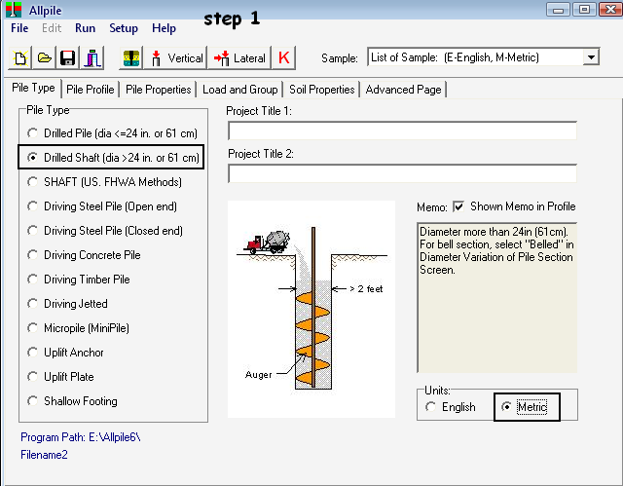

Slide 11
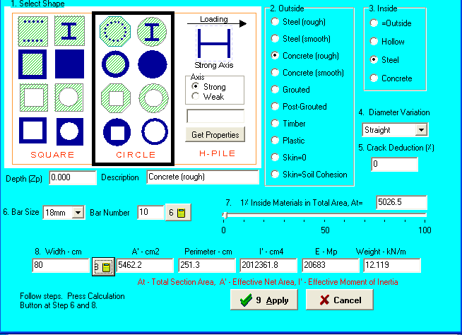

Slide 12
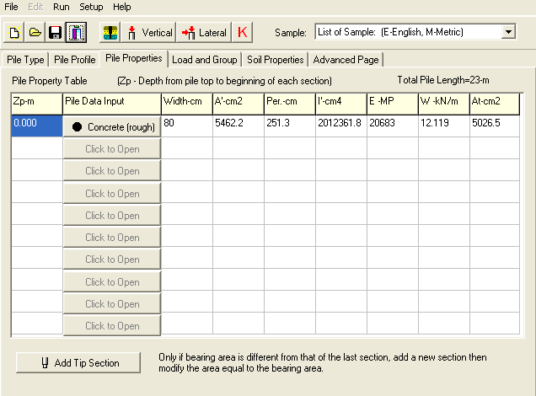

Slide 13
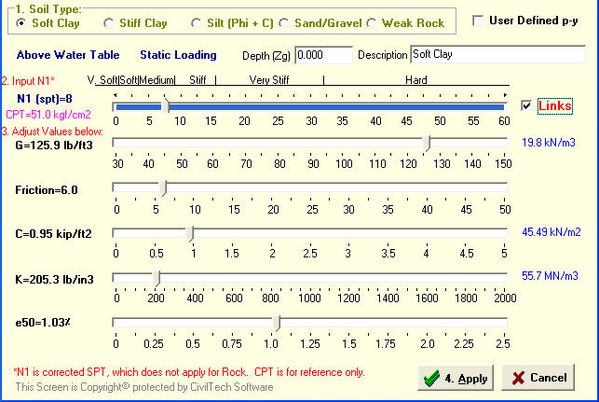

Slide 14
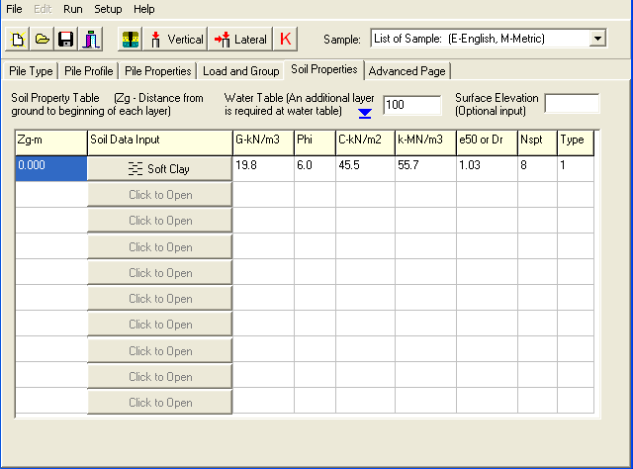

Slide 15
Number Of Piles | Column
1 | C19
2 | C17
3 | C7
4 | C22
5 | C29
5 | C45
6 | C28

Slide 16
Diameter of piles (CM) | Length of piles (M) | NO. of piles | Ultimate load (KN) | Service load (KN) | Column name
80 | 23 | 8 | 13414 | 10178 | C1+ C2
80 | 23 | 5 | 8317 | 6310 | C45

Slide 17
Design of reinforcement in the piles:
As = ρ_{min} * area = 0 .005 * (π \4) * (800)²
= 2512 mm ²
Ø18 = area = 255mm
Use 10 Ф 18
Perimeter = 2 π D = 502.4 cm
Spacing = 502.4/10 = 50 cm.

Slide 18
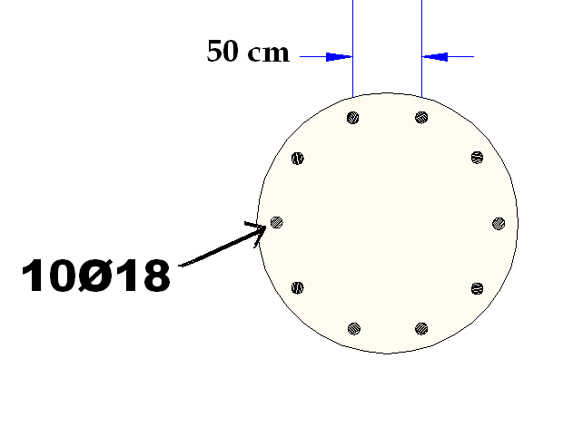
Pile reinforcement

Slide 19
Caps Design
An example of hand calculation we choose Cap (column 45):
Allowable load = 6310 KN
Ultimate load = 8317 KN
Assume d = 1150mm
Ф Vc = 0.75*(1/6)*((35)^0.5)*4000*1.150 =3400 KN
Ru = 8317/5 = 1663➔ Vu = 2*1663 =3326 < Ф Vc =➔ OK

Slide 20
Check column punching:
Ф Vc = 0.75*(1/3)*((35)^0.5)*((2*1750)+(2*1550)*1.150 = 5613 KN
Vu = 6310 – 1663 = 4647 < Ф Vc ==➔ OK
Vu =1663 KN < Ф Vc ===➔ OK
Check pile punching:
Ф Vc = 0.75*(1/3)*((35) ^0.5)*1.150*(2*600+ (2*3.14/4)*(400+575))
= 4646 KN

Slide 21
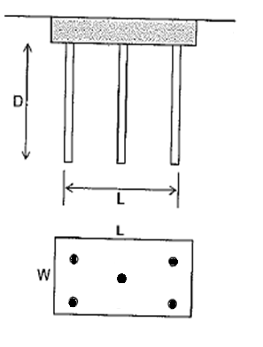
For cap (45) :

Slide 22
Results From SAP
For Cap(45) :
V13 = 2700 KN
V23 = 2700 KN
M11 = 950 KN.m/m
M22 = 950 KN.m/m

Slide 23
Reinforcement for cap (45)
The same in two directions :
As(cal) = 2420 mm²
As (min) = 2160 mm²
As (used) = 2420 mm²
Reinf.\m = 10 Ф 18

Slide 24
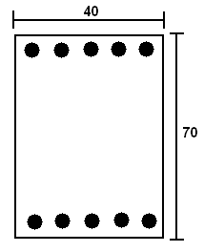
Design of grade beams:
As = ρbd = (0.0033)(400)(640) = 844.8 mm² ➔ use 5Ø16 bottom steel. ➔ Use 5Ø16 top steel. ➔ Cover = 6cm.

Slide 25
The alternative between mat and pile
Time\cost trade off analysis

Slide 26
Mat Foundation
time | Cost (NIS) | 90 cm | Mat depth
5days | 175 000 | 50 ton | Steel weight
1 day | 198 800 | 710 m3 | concrete
8 days | 33 000 | 1320 m3 | excavation
1 days | 8 325 | 30 cm | Rock-Fill
3days | 32 400 | 90 cm | Base coarse
 | 15 000 | 15 worker | worker
18 days | 463 000 |  | total

Slide 27
Pile foundation:
time | Cost (NIS) | 80cm* 23m | pile
2 days | 231 000 | 66 ton | steel
1day | 532 000 | 1900 m3 | concrete
1 days | 10 800 | 30 cm | Base coarse
2 days | 133 116 | one | Pile drilling machine
 | 3000 | 5 workers | worker
6 days | 910 000 |  | total

Slide 28
Under this formation we choose
* If we want to save time we use the
Nis) 910 000 6 days ( pile
* If we want to save money use the 463 000 nis) 18 days ) mat

Slide 29
THANK YOU ….

