Slide 1

Graduation Project 2
Structural Analysis And Design of Al-Masri Building
An-Najah National University
Faculty of Engineering
Civil Engineering Department
By:
Ala Fayez Aqel 11107076
Basheer Awni Abo Yaqoub 10927409
Mohammad Ameen Zyoud 11213937
Supervisor :
Dr. Mohammad Samaaneh

Slide 2
Outline
Introduction.
Gravity and Lateral loads.
3D modeling using SAP.
Design of Slab.
Design of Beams.
Design of Columns and Shear walls.
Design of Footings and Ground Beams.

Slide 3
INTRODUCTION

Slide 4
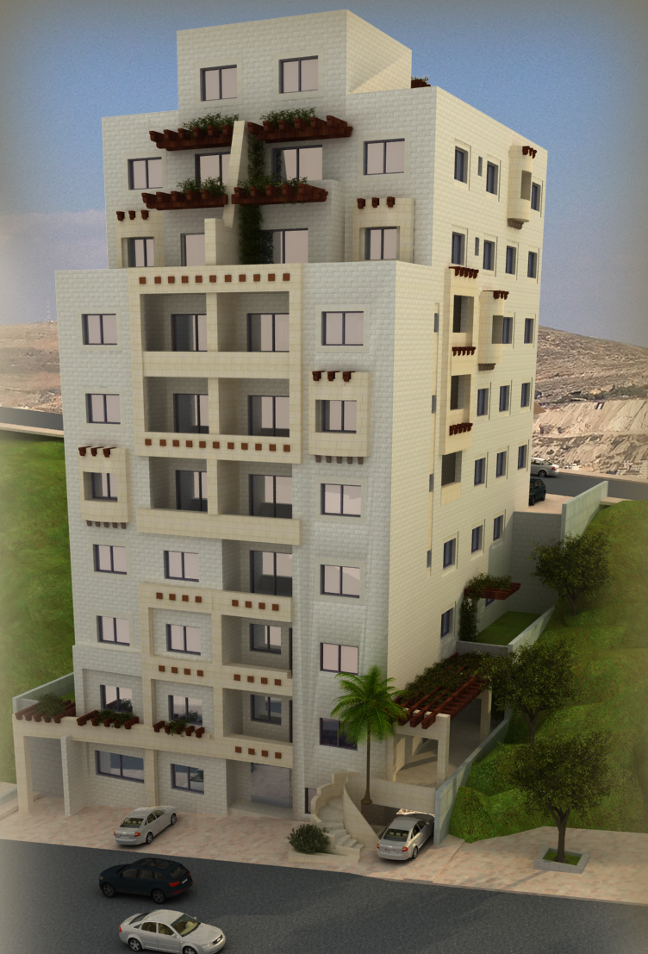
Al-Masri Building
Location : Nablus City
9 Floors.
Floor area : 7 floors - 370 m²
2 floors – 265 m²
.Two street

Slide 5
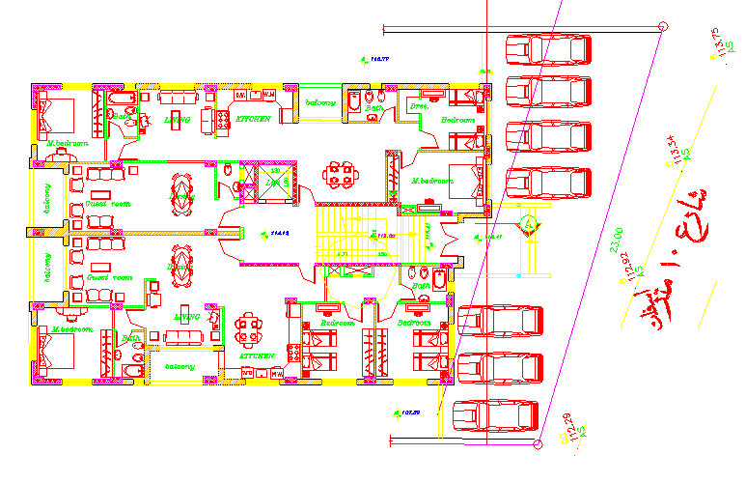
Floors consists:
Two Residential Apartments in each floor.

Slide 6
Codes
ACI 318-11 (American Concrete Institute)
UBC-97 (Uniform Building Code)
ASCE-2010 (American Society of Civil Engineers).

Slide 7
Preliminary Design
The choice of the system for slab in the building is very important to resist the internal forces and stability.
Comparison | Solid Slab | Ribbed Slab
Weight | Heavier than ribbed | Light
Area of steel | More | Less
Beams | Bigger | Smaller
framework | Approximately the same
Cost | Bigger | smaller

Slide 8
GRAVITY & LATERAL
LOADS

Slide 9
Loads
Gravity
Lateral
Seismic
Dead
live
Superimposed

Slide 10
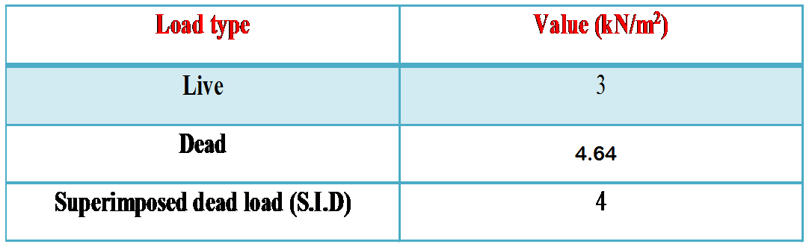

Slide 11
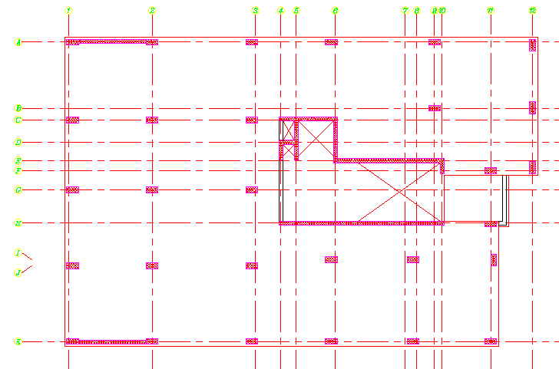
Shear resisting
system

Slide 12
Response spectrum
  A response spectrum is a plot of the maximum response amplitude (displacement, velocity, or acceleration) versus the modal period

Slide 13
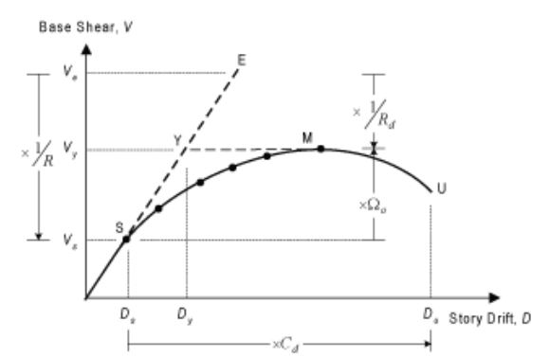
Seismic design factors
R= Modification factor
Cd= Deflection Amplification Factor

Slide 14
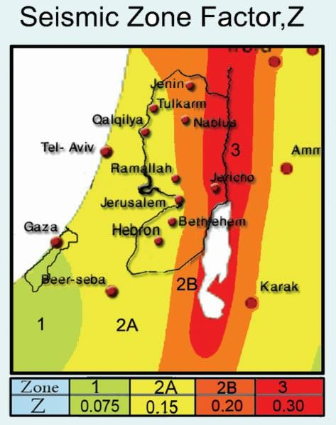
seismic zone is 2B →Z=0.2
Site Soil Classification is S_{B}
Ca=0.2
Cv=0.2
I= 1.
𝑅 = 5.5

Slide 15




Code | Value of base shear (Hand Calc.)(kN)
UBC-97 | 2440
= (0.2*1*59715.02) / (5.5*0.89) = 2439.83 KN
= 5428.64 KN

Slide 16
Load combinations
U = 1.4D
U = 1.2D + 1.6L + 0.5(Lr or S or R)
U = 1.2D + 1.6(Lr or S or R) + (1.0L or 0.5W)
U = 1.2D + 1.0W + 1.0L + 0.5(Lr or S or R)
U = 1.2D + 1.0E + 1.0L + 0.2S
U = 0.9D + 1.0W
U = 0.9D + 1.0E

Slide 17
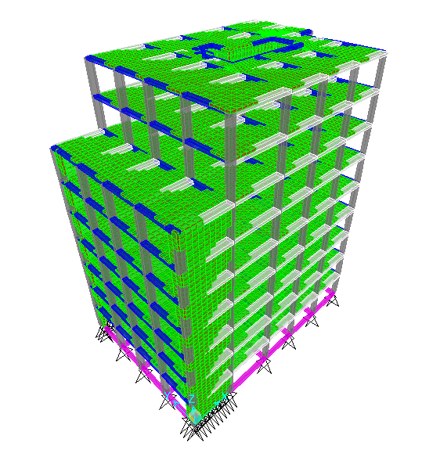
THREE DIMENSIONAL STRUCTURAL
ANALYSIS

Slide 18
Modifiers for each element
Modifier | Element
0.7 | Column
0.35 | Beam
0.7 | Shear wall

Slide 19
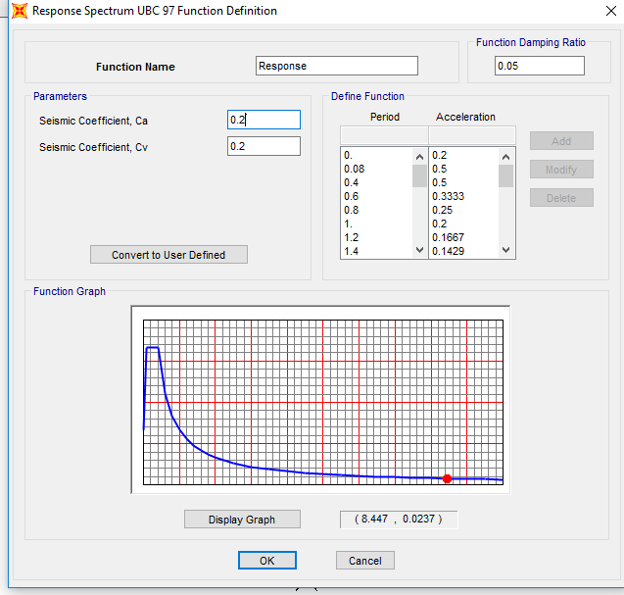

Slide 20
Strength check
Shear & torsion
No red elements
No problems
Rebar percentage
All is okay

Slide 21
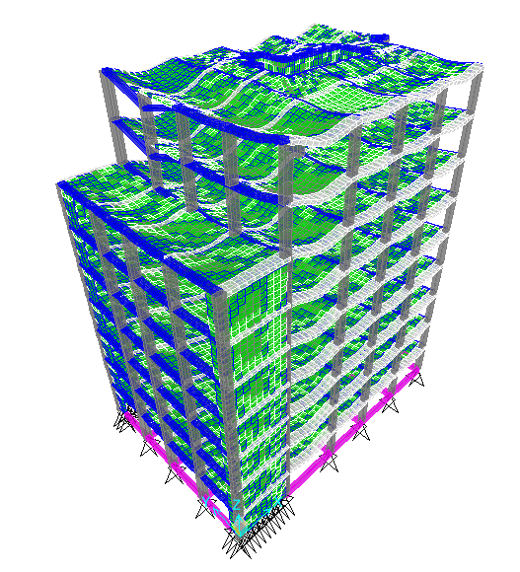
Compatibility of structural model

Slide 22
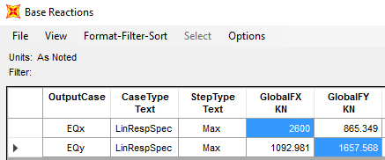
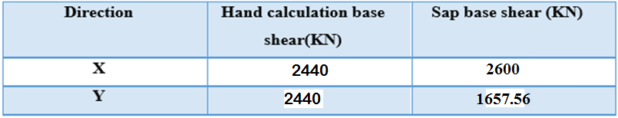
Lateral loads check
Seismic load, UBC

Slide 23
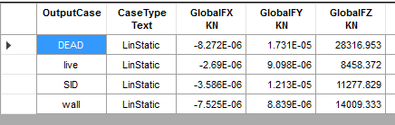
Equilibrium
Load type | Hand results KN | SAP results KN | Difference%
Dead | 29626.39 | 28316.95 | 4.62
SD | 8458.37 | 8458.37 | 0
Live | 11277.829 | 11277.829 | 0
Wall | 14009.33 | 14009.33 | 0

Slide 24
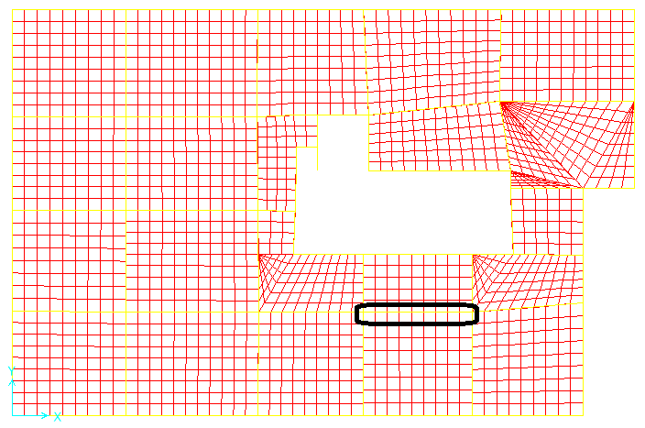
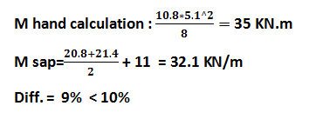
Stress Strain relationship (internal equilibrium)
Using live load

Slide 25
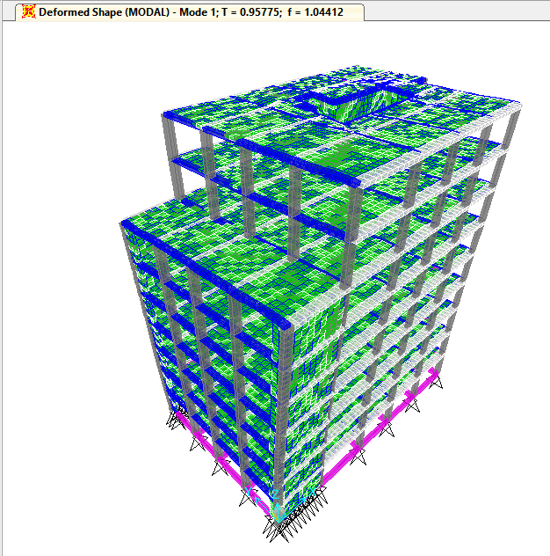
Period and modal participation ratio
T= Ct (Hn)^{3/4}
Hn is the height of structure in meters = 9 floor * 3.12m = 28.08 m
Ct is a constant = 0.0731
Then T= 0.89 seconds.

Slide 26
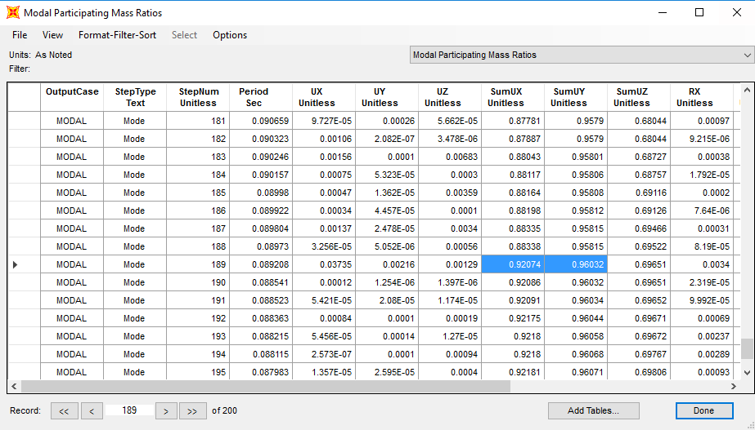
The type of modes is Eigen Vectors.
For our structure case, Eigen Vectors analysis needs more than 150 modes to reach 90% of participating mass ratios.
However, 189 modes are needed when using Eigen Vectors method.

Slide 27
DESIGN OF SLAB

Slide 28
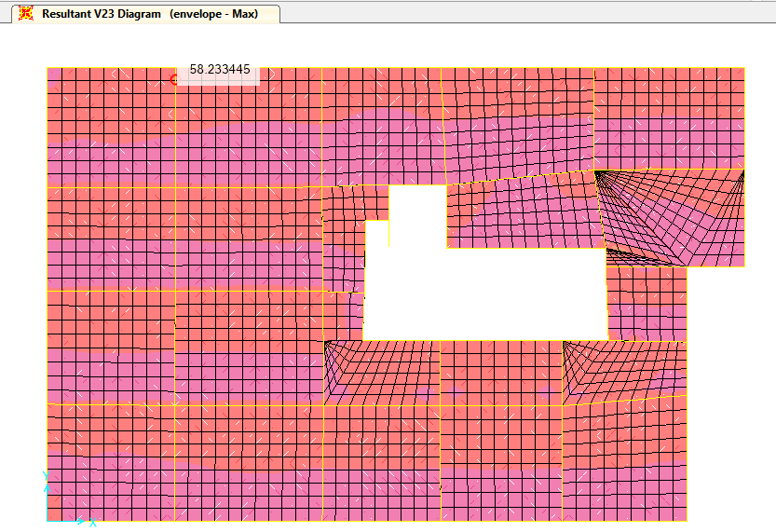
Shear on slab :
фVc = 23 KN
Max Vu = 58.23 KN /m
= 8.43 KN
23 > 8.43 KN so
Shear is OK

Slide 29
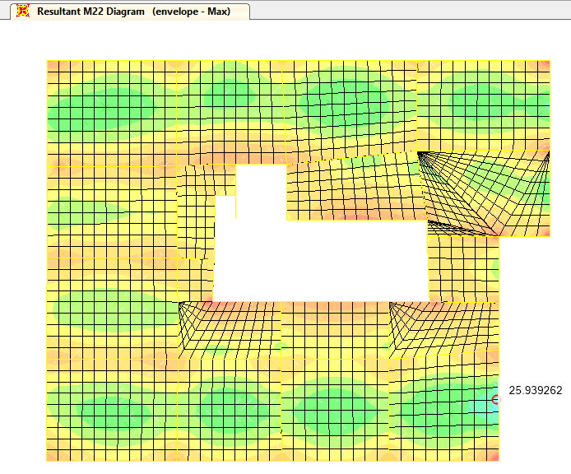
Maximum moment in the
slab is 25.93 KN.m/m

Slide 30
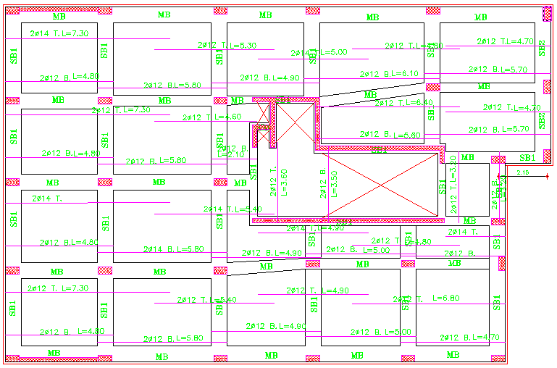
Steel Reinforcement :
For positive moments:
use (2ф12)
For negative moments:
use (2ф12)

Slide 31
DESIGN OF BEAMS

Slide 32
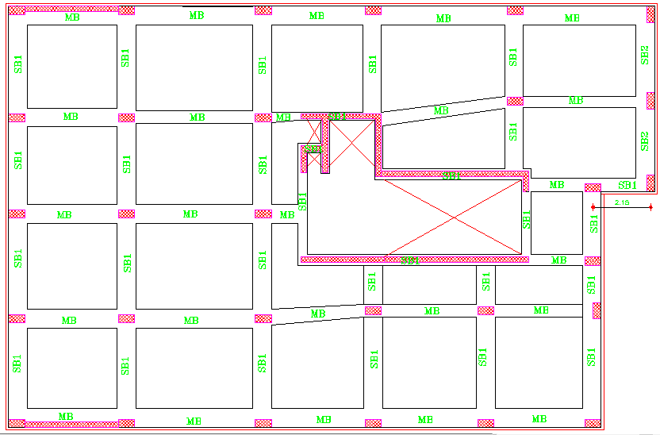

Slide 33
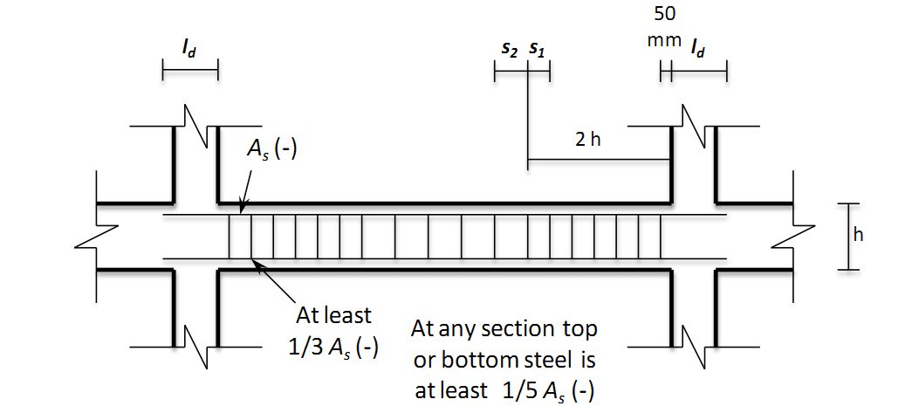
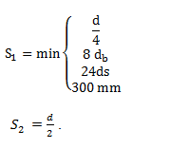
ACI318-11 code requirements :
The first hoop shell be located not more than 50mm from the face of supporting member .

Slide 34
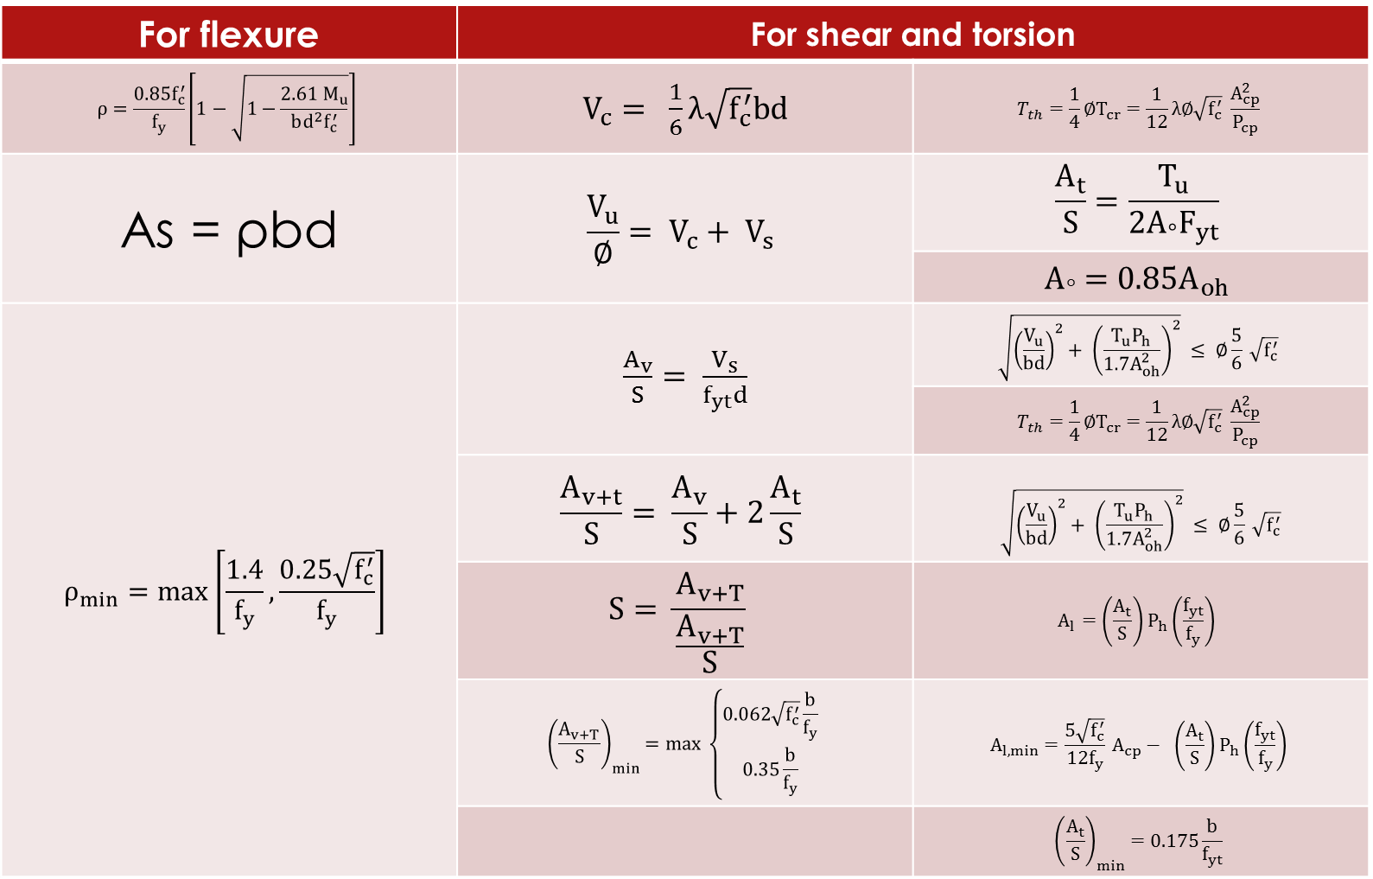
Equations:
For shear and flexure |  | For Torsion
 |  | As = ρbd

Slide 35
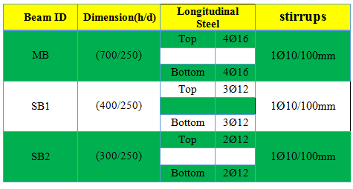

Slide 36
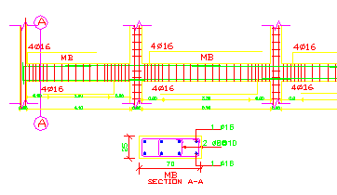
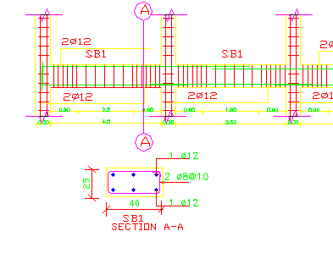
Beams section

Slide 37
DESIGN OF COLUMNS AND SHEAR WALLS

Slide 38
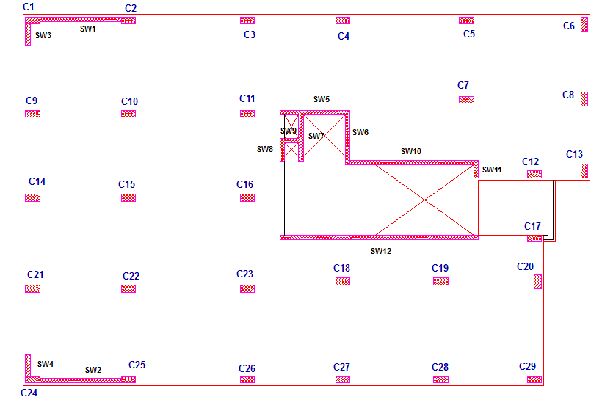

Slide 39
All columns in the project:
(60x30cm), 29 columns.
Design methodology:-
The design based on taking the critical edge, intermediate, and corner columns of C28,C8 and C6.
Drawing the interaction diagram for C28,C8 and C6.
Using SAP to get the axial force and moments on each column.
Choosing the proper steel ratio.
Determining the spacing between hoops.

Slide 40
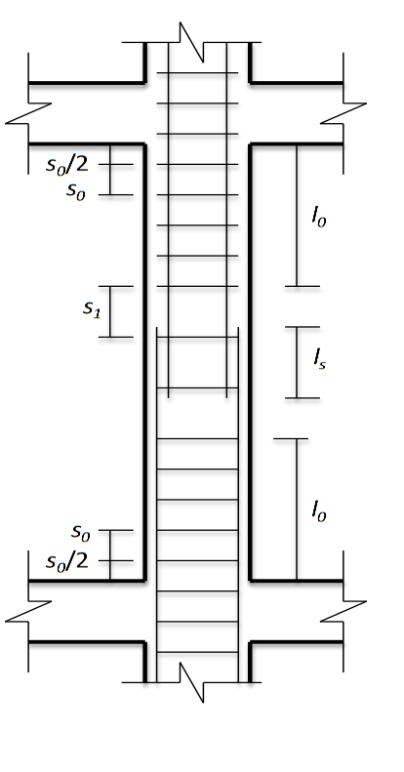
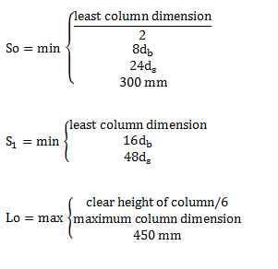
    ACI318-11 Code requirements for steel reinforcement :

Slide 41
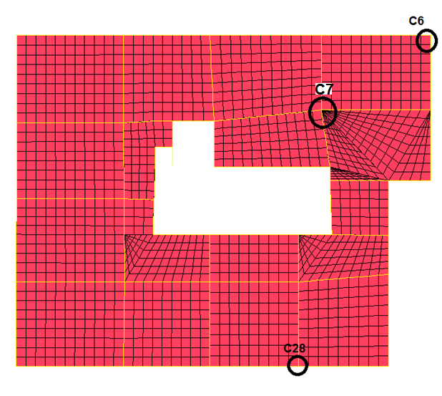

Slide 42
Axial Force (kN) | Dimensions(cm*cm) | Column ID
419.49 | 600*300 | C1
484.30 | 600*300 | C2
1626.62 | 600*300 | C3
1643.02 | 600*300 | C4
1823.16 | 600*300 | C5
1279.17 | 600*300 | C6
1325.29 | 600*300 | C7
1426.97 | 600*300 | C8
1060.63 | 600*300 | C9
1440.59 | 600*300 | C10
969.91 | 600*300 | C11
1004.40 | 600*300 | C12
767.08 | 600*300 | C13
1169.14 | 600*300 | C14
1479.04 | 600*300 | C15
882.79 | 600*300 | C16
800.24 | 600*300 | C17
1018.88 | 600*300 | C18
1054.36 | 600*300 | C19
1155.11 | 600*300 | C20
1092.92 | 600*300 | C21
1493.43 | 600*300 | C22
1455.76 | 600*300 | C23
400.69 | 600*300 | C24
488.66 | 600*300 | C25
1670.1 | 600*300 | C26
1551.13 | 600*300 | C27
1583.64 | 600*300 | C28
1277.70 | 600*300 | C29

Slide 43
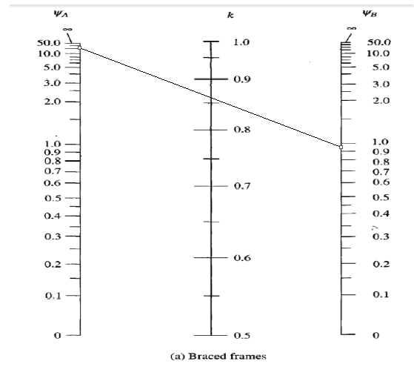
Ψ_{A} = 20
ΨB = 0.94 r= 0.3h = 0.3*0.6 = 0.18
Lu = 3.12 m k = 0.86
Calculate slenderness ratio
KLu/r = (0.86*3.12)/0.18 = 14.90 < 22

Slide 44
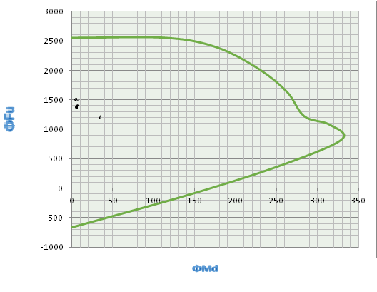
c3
The distribution of (M,P) point for check columns on C28,C8and C6 interaction diagram

Slide 45
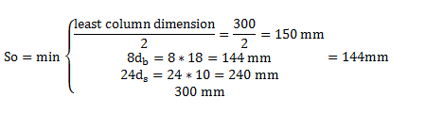

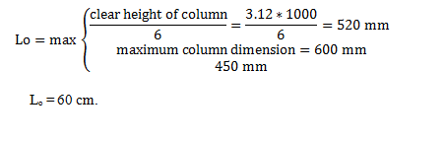
Using a rebar percentage equal 1% for all columns is suitable ,economical and very safe.
The longitudinal steel for all columns :
(8 Ø 18)

Slide 46
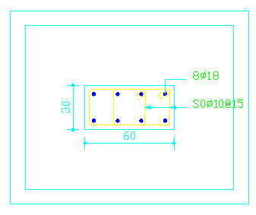

Slide 47
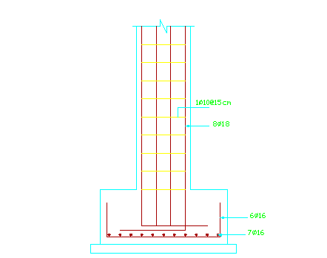
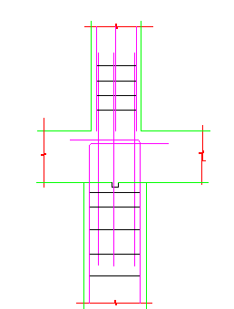

Slide 48
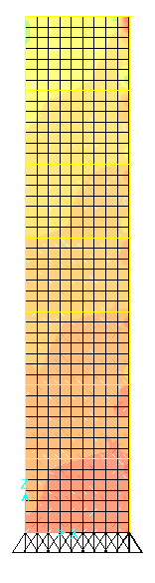
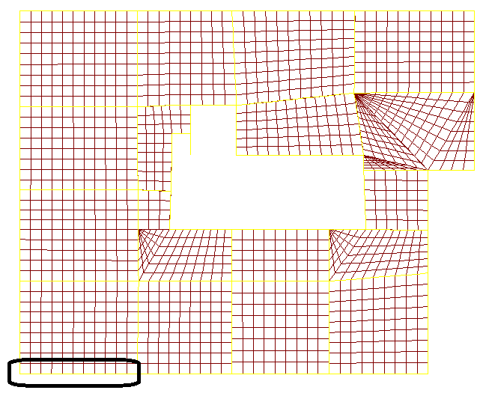
Design of shear wall :

Slide 49
Minimum reinforcement in shear walls according to ACI318-11
Minimum ratio of vertical reinforcement area area, ρ, shall be:
  0.0012 for deformed bars not larger than 16mm in diameter with F_{y} not less than 420 MPa.
Minimum ratio of horizontal reinforcement area, ρ, shall be:
  0.002 for deformed bars not larger than 16mm in diameter with F_{y} not less than 420 MPa.
Vertical and horizontal reinforcement shall not be spaced farther apart than three times the wall thickness, nor farther apart than 450 mm.

Slide 50
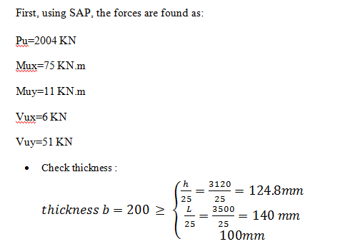

Slide 51
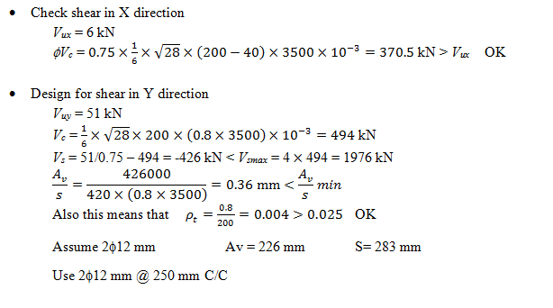

Slide 52
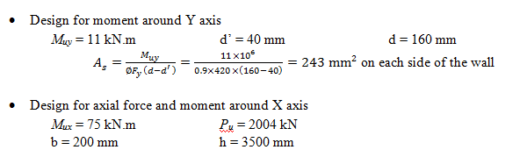

Slide 53

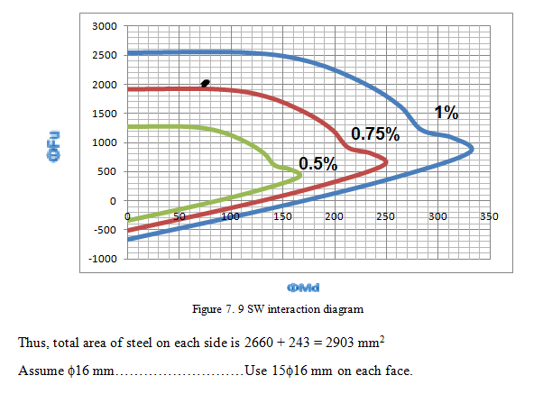

Slide 54
DESIGN OF FOOTING

Slide 55
Soil type : Rock.
Allowable Bearing Capacity: 300 kN/m²
Grouping of footings are shown in table below:
Groups ID | Capacity in service load (KN) | Dimensions (m) | Group column
Group 1 (F1) | 850 | 1.70x1.70*0.60 | C5,C6,C16,C29
Group 2 (F2) | 1500 | 2.30x2.30*0.60 | C2,C3,C11,C12,C17,C19,C21,C22,C26,C27
Group 3 (F3) | 1800 | 2.50x2.50*0.60 | C1,C4,C18
Group 4 (F4) | 2200 | 2.70x2.70*0.60 | C7,C8,C10,C13,C14,C15,C20,C23,C24,C25,C28

Slide 56
Design of Footing F4
Maximum load on F5 comes from C7.
Envelop Ultimate load | Service load(kN) | Footing Dim. | Column Dim. | Footing ID | Column ID
2348.21 | 2064.77 | 2.70 *2.70 *0.6 | 0.6x0.3 | F4 | C7
Check punching for column:
ɸV_{cp} = 1027 KN.
V_{up} = 758 KN < V_{cp} ➔ punching is OK.
Wide Beam shear check:
ɸVc = 324 KN.
Vu = 332.12 (0.56) = 186 KN < Vc ➔ wide beam shear OK.

Slide 57
Longitudinal:
Mu = 239.13 KN.m
ρ= 0.00269
As = 1318.1 mm²
A_{s,min}= 0.0018*1000*600 = 1080 mm²
use A_{S} ➔ 7 ɸ18
For Transverse Reinforcement:
Mu = 120 KN.m
ρ = 0.00133
As = 651.7 mm²
A_{s,min} = 0.0018*1000*600= 1080 mm²
➔ use A_{s,min}➔ 6ɸ18

Slide 58
DESIGN OF GROUND BEAMS

Slide 59
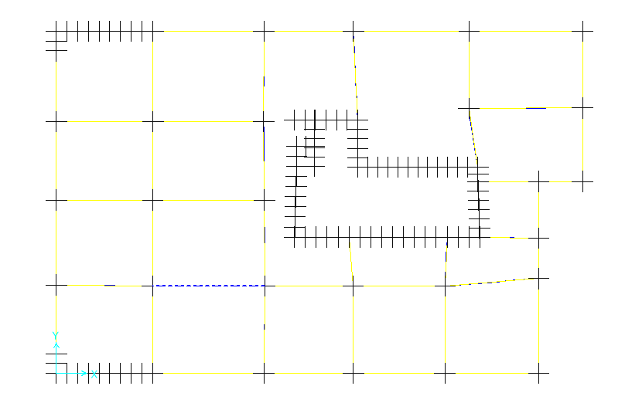

Slide 60
Ground beams:
- GB : (500/300).
Design philosophy:
By applying a 2 mm displacement at a joint under a footing that have the tallest ground beam.
Then, determine the area of steel by using a half of steel ratio resulting from the moment.

Slide 61
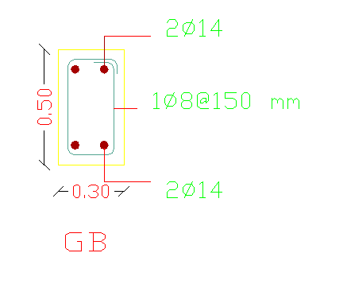
Transverse steel | Bottom steel | Top steel | Vu (kN) | Mu (kN.m) | GB ID
1ɸ8 / 100mm | 2ɸ14 | 2ɸ14 | 13.31 | 8.11 | GB

Slide 62


