Slide 1


An-Najah National University
Faculty of Engineering
Civil Engineering Department
Design of Wastewater Collection System for Asira Ash-Shamaliya
Malik Abboushi
Abdulla Hajj Mohammad
Fadi Hamaydeh
Under direction of
Dr. Sameer Shadeed

Slide 2
Introduction
Water is the most important thing in our life. And the disposal of wastewater is very important also.
In Palestine, the sewerage problems facing the communities are serious and have a significant impact on the environment.
This project aims to design a wastewater collection system for Asira Ash-Shamaliya.

Slide 3
Objectives
Determine the amount of wastewater generated in Asira Ash- Shamaliya.
Design of WWCS.
Laying out the designed WWCS.

Slide 4
Study Area
Asira Ash-Shamaliya is a Palestinian village from west bank villages that follow Nablus city. It is located to the North of the Nablus city, and is about 6 km away. It is considered as a mountainous area with an elevation of 648 meters above the sea level.
There is no wastewater collection system in Asira Ash-Shamaliya, so wastewater is drained using cesspits located near or under houses. This leads to many environmental crises, like soil and groundwater pollution.

Slide 5
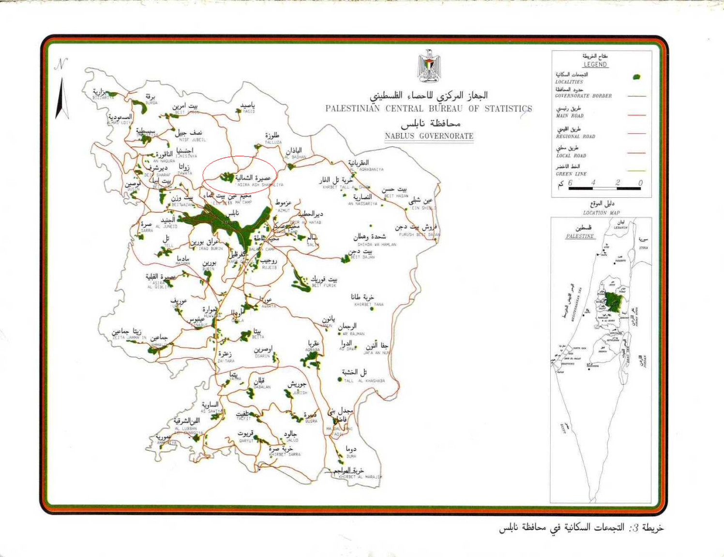

Slide 6
Population
Year | Population
1931 | 1542
1945 | 2060
1961 | 3232
1967 | 3217
1975 | 3620
1987 | 4586
1992 | 5090
1997 | 5724
2000 | 6421

Slide 7
The design period is 25 years, so to predict the population after the design period the following equation was used:
P_{F}= P_{o} (1+i)^{n}
with growth rate (i)= 3.5%
This gives a population of 21784 persons in 2036.

Slide 8
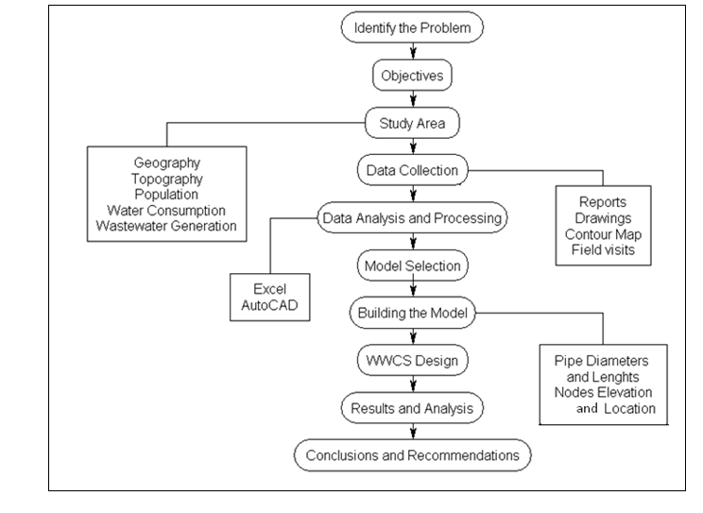
Methodology

Slide 9
Data Collecting
From Asira Ash-Shamaliya municipality a map of the village, which includes roads, buildings and contours, was brought.
From the Palestinian Water Authority specifications and limitation were brought to be considered in the design.

Slide 10
System Layout
The layout of the collection system should include a plan of the area to be served, show roads, buildings and topography.
Main sewers are located to pass through the lowest point in the drainage area and to extend through the entire area to the drainage divide, land slopes should be toward the main sewer, collecting sewers are connected to the main sewer, and should be located in all streets within the area to provide service throughout the drainage basin.

Slide 11
SewerCAD Model
SewerCAD was used to draw the network taking in consideration the limitations and specifications; like maximum length.
Manholes locations were chosen at changes in direction, slope, pipe size or at intersections of collection sewers.
From SewerCAD, pipes lengths and manholes elevations were determined; to be used in the network design.
Two outlets were made due to the rough topography of the village.

Slide 12
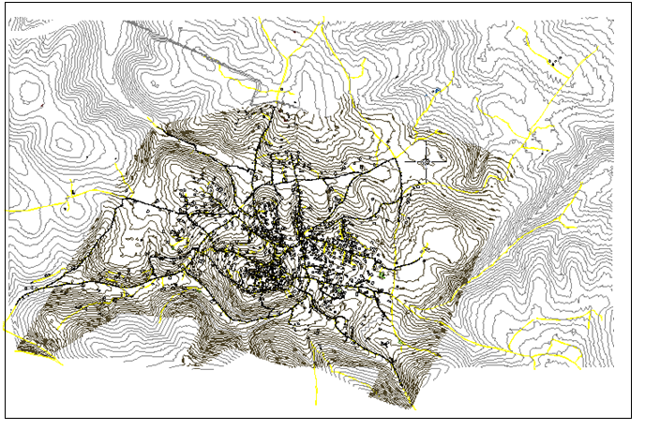
SewerCAD Model

Slide 13
Design Criteria
The system is designed as open channel, no pumps are used, steady and uniform flow is assumed.
Manning’s equation was used to calculate the velocity in the pipes.
The velocity was limited between 0.5 m/s and 3 m/s and the slope between 0.005 m/m and 0.1 m/m.
Water consumption was taken to be 120 l/cd and 80% as back flow.

Slide 14
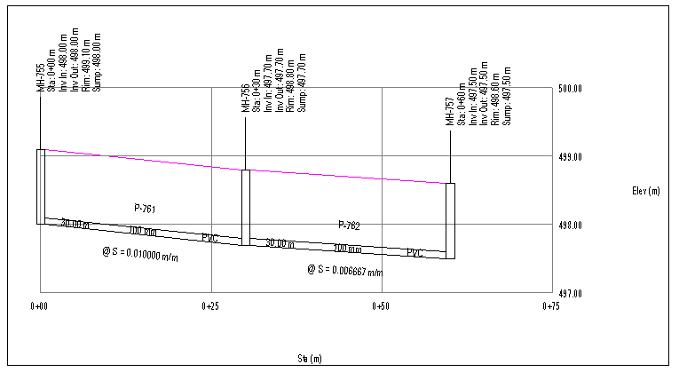
A Line Profile

Slide 15
System Design
To find the flow on each manhole village was divided into areas, and by knowing the population density, the number of people served by each manhole was found. Thus, the flow was found.
The flows, lengths of pipes and manhole elevations were incorporated to an Excel sheet.
The minimum diameters were found by Excel throughout selecting slopes and velocities that are between the limits.

Slide 16
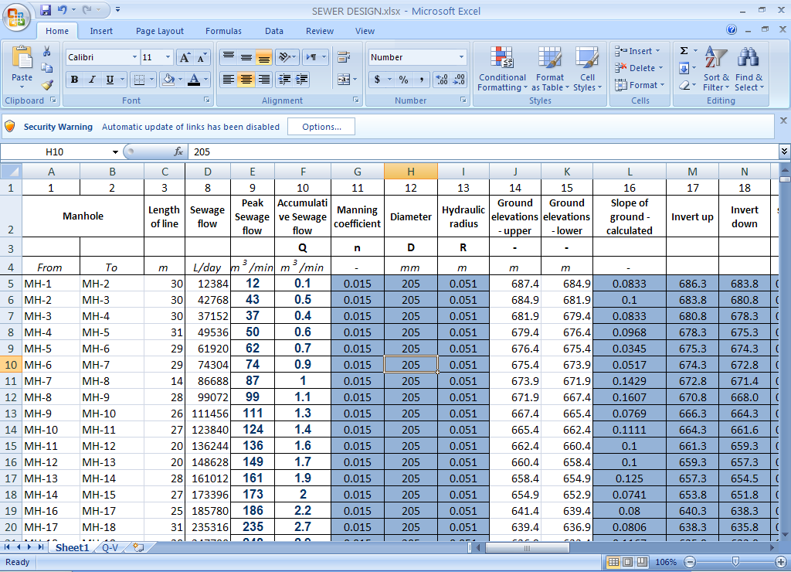
Excel Sheet

Slide 17
Conclusions
The network is to be construct of nearly 900 manhole linking between 8 or 10 inches pipes.
Two outlets to the network were used.
Deep manholes were used wherever necessary.

Slide 18
Recommendations
Its highly recommended to construct a wastewater collection system in Asira Ash-Shamaliya, since it lacks to such system.
Public awareness campaigns should be carried out to aware the residents of Asira Ash-Shamaliya of the hazards of the cesspits on the people and the environment.

Slide 19

And that’s it

