Slide 1
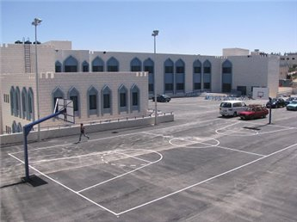
Muskat Secondary School Project
Prepared By:
Abdulrahman Hamdan
Ezz Eddein Dereih
Ahmad Mlatat

Slide 2
Presentation Contents
Project objective, assumptions, constraints, methodology, project description and WBS.
(Abdulrahman Hamdan).
Productivity in Palestine, factors affecting productivity, sample of calculations, list of activities and project cost.
(Ahmad Mlatat).
Primavera scheduling, redesign process.
(Ezz Al- Eldin Dariah).

Slide 3
Objective of the project
To search the causes of variance in
Cost (over-cost)
Time (delay).

Slide 4
Assumptions of the project
Good project management leads to finish the work on time.
The use of scheduling systems (like primavera) will predict the total period of the project.
Productivity of labors will affect the total duration of the project and its quality.

Slide 5
Constraints of the project
This project is being performed in Palestine, so it is bounded by:
Cost of materials in Palestine.
Productivity and cost of Labors in Palestine .
Geography of the construction site.

Slide 6
Methodology of the work
Studying the architectural, structural, Mechanical and electrical drawings.
Making Work break down structure (WBS) for the project.
Quantity surveying for this project.
Collecting the productivity rates in Palestine.
Scheduling this project using modern computer programs (primavera).
Redesign of some parts of the school.

Slide 7
Project Description
The school is located in Qalqilia city. It consists of Four floors.
Table of areas of the building
Floor name | Area (m2)
Basement | 304
Ground | 932
First | 748
Roof | 62
Total | 2046

Slide 8
Project Description
1
2
3
4
The project area is 2046 m2.
The school consists of three floors ( Basement, Ground, First and Roof floor), and there are many external works.
The owner of the project is Municipality of Qalqilia (State Oman charitable funded
According to the contract the school has to be finished in 425 days, it has to be paid 400$ for the delay in each day.

Slide 9
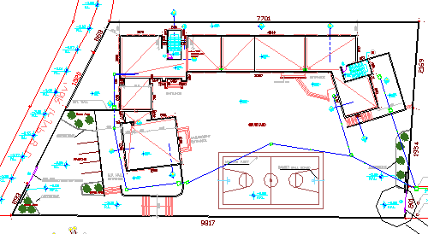
Site Plan

Slide 10
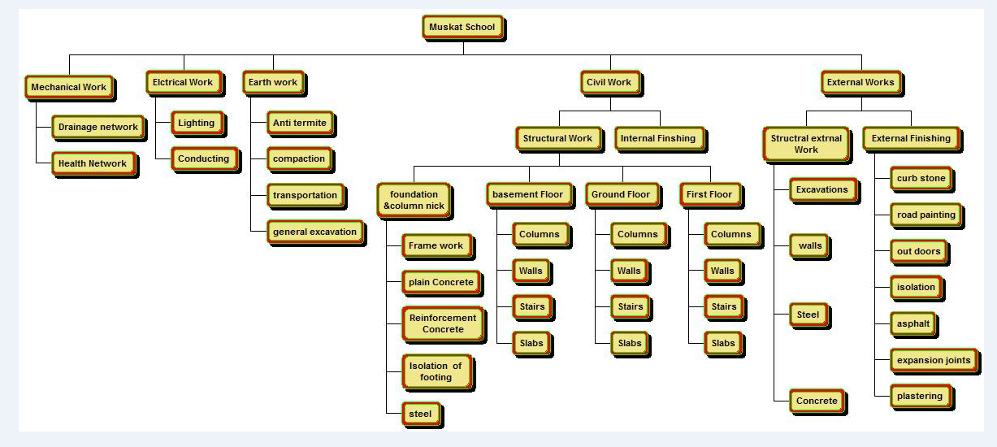

Slide 11
Activity Duration
After determining the productivity rates for each labor from statistical studies, we determine the duration according to this equation:
Duration = (Quantity /(NO. of crew*productivity ))
For example : the duration of tiling for Ground floor is estimated as follows:
Quantity =1585 m2
Productivity = 24 m2 /day /crew , crew (1 Skilled + 1 Unskilled )
NO of crew = 3
Duration = (1585 /(24*3)) = 23 days

Slide 12
Productivity in Palestine
Productivity: is the output per labor hour.
It is the responsibility of those who are concerned with cost of the project.
Affect the total duration of the project and the duration of each activity.

Slide 13
Factor affecting productivity
The main factors that affect the productivity in the Palestine are:
Past experience.
Age.
Motivation.

Slide 14
Factor affecting productivity
Other Factors that affect the productivity in the Palestine are:
Close control from contractor or client.
The duration of work in day.
The competitiveness from other workman in the site.
The quality and complexity of the work.
The safety factors in the site.
The relationship between workers and employer.

Slide 15
Productivity Rates in Palestine
Steel in Slab:
Groups | Sat | Sun | Mon | Tues. | Wed | Thu
A | 0.6 | 0.68 | 0.78 | 0.73 | 0.76 | 0.65
B | 0.58 | 0.7 | 0.74 | 0.65 | 0.58 | 0.68
C | 0.53 | 0.67 | 0.72 | 0.8 | 0.63 | 0.69
The average of productivity rates in steel in slabs is (0.6-1.0)ton/day and the wage of each group is 230 NIS/day.

Slide 16
Sample of Calculations
Slabs:
Concrete in 1m² in Slab= Depth of cover *1m²+ Width of rib *slab thickness*1m²
= 0.06*1+ 0.2*0.29= 0.118 mᵌ/m².
steel in Baem1= Length *No. of bars*Weight/m*No. of beams
= 6.5*4*1.21*1+5.9*3*1.21*1= 52.48 kg.
Internal Blocks:
Area of internal blokes work=width *length =3.92*3.05=11.96 m².
Number of blocks = (area of blocks *12.5)= 150 units.

Slide 17
List of Activities
Table 2 Muskat school activity list |  |  |  |  |  |  |  |  |  |  |  |  |  |  | 10% Indirect cost |  |  | 10% Profit factor
Item NO. | Work item description | Unit | Quantitiy | Material cost (NIS) |  | Labor cost |  |  |  |  |  | Total direct cost (NIS) |  |  | Total cost (NIS) |  |  | Total price (NIS)
 |  |  |  | Unit cost | Total cost | P.Rate/d | #of Crews | Duration | cost/d | Total cost |  | Unit cost | Total cost |  | Unit cost | Total cost |  | Unit price | total price
1.0 | School
1.1 | Earth work
1.1.1 | general excavation | CM | 3000 | 28 | 84000 | 85 | 2 | 18 | 200 | 7200 |  | 30.4 | 91200 |  | 33.44 | 100320 |  | 36.79 | 110352
1.1.2 | excavation | CM | 100 | 43 | 4300 | 55 | 1 | 2 | 200 | 400 |  | 47 | 4700 |  | 51.7 | 5170 |  | 56.87 | 5687
1.1.3 | backfill | CM | 880 | 40 | 35200 | 120 | 1 | 8 | 2000 | 16000 |  | 58.19 | 51200 |  | 64 | 56320 |  | 70.4 | 61952
1.1.4 | compaction | CM | 213 | 55 | 11715 | 120 | 1 | 2 | 2700 | 5400 |  | 80.36 | 17115 |  | 88.39 | 18826.5 |  | 97.23 | 20709.15
1.1.5 | transportation | CM | 231 | 55 | 12705 | 120 | 1 | 2 | 3000 | 6000 |  | 80.98 | 18705 |  | 89.08 | 20575.5 |  | 97.98 | 22633.05
1.1.6 | Anti termite | SM | 1000 | 0 | 0 | 120 | 2 | 5 | 170 | 1700 |  | 1.7 | 1700 |  | 1.87 | 1870 |  | 2.06 | 2057
 |  |  |  |  |  |  |  |  |  |  |  |  | 184620 |  |  | 203082 |  |  | 223390.2
1.2 | structur
1.2.1 | foundation &column nick
1.2.1.1 | Formwork | SM | 1535 | 5 | 7675 | 28 | 3 | 19 | 240 | 13680 |  | 13.92 | 21355 |  | 15.31 | 23490.5 |  | 16.84 | 25839.55
1.2.1.2 | Steel | Ton | 55.5 | 3200 | 177600 | 0.7 | 4 | 20 | 230 | 18400 |  | 3531.54 | 196000 |  | 3884.69 | 215600 |  | 4273.16 | 237160

Slide 18
Project Cost
Package | Direct Cost | Total Cost | Price | Cost%
Civil Work | 1531325 | 1684458 | 1852904 | 43.63
Finishing Work | 848480 | 933327 | 1026660 | 24.18
Mechanical Work | 64100 | 70510 | 77561 | 1.83
Electrical Work | 32850 | 36135 | 39749 | 0.94
External Work | 1033564 | 1136921 | 1250613 | 29.45
Total (NIS) | 3510319 | 3861351 | 4247487 | 100

Slide 19
Primavera analysis
The primavera used to :
Scheduling.
Project network
Project budgeting
Project duration and CBM analysis
Resources leveling
Project updating.

Slide 20
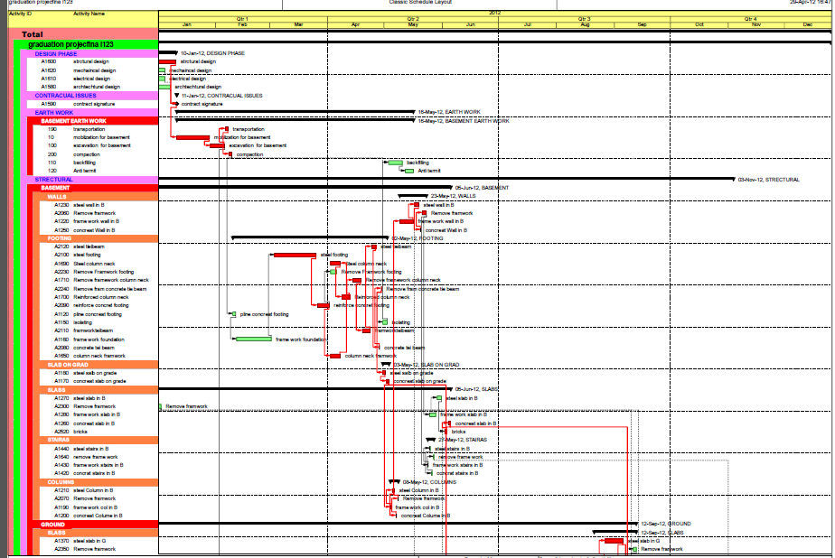
Activities Relations from Primavera

Slide 21
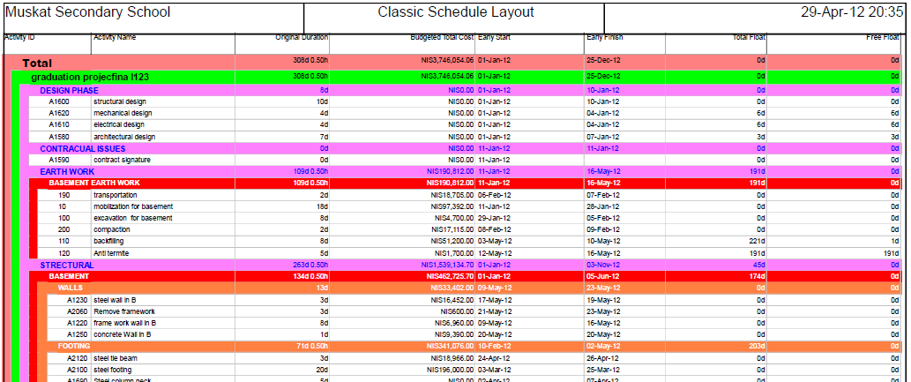
List of Activities from Primavera

Slide 22
Cost from primavera
The total direct cost from primavera equals
3746054 NIS.
The total direct cost based on manual calculations equals to 3748678 NIS.
The differences between two values is less than 0.1%. So, the result acceptable.

Slide 23
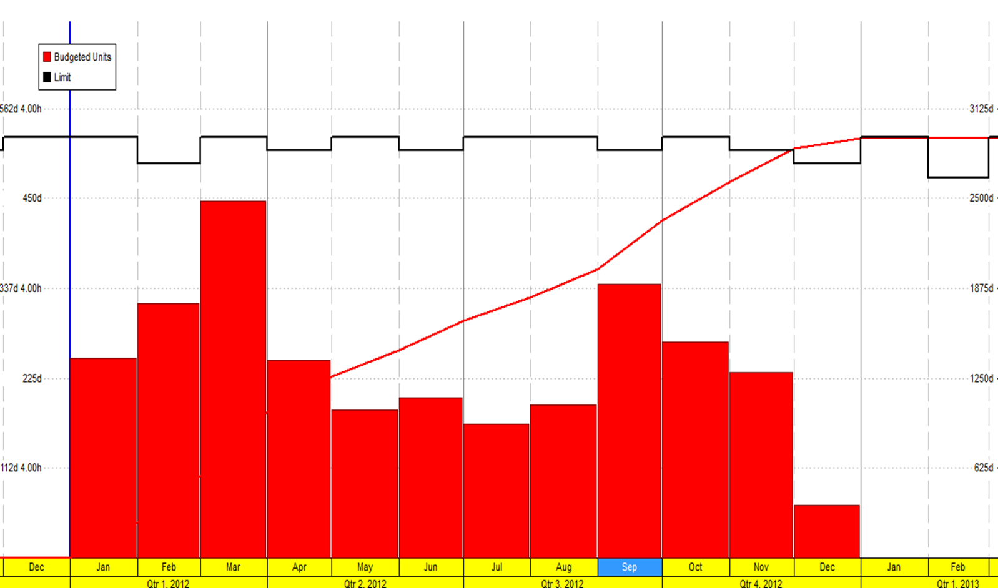
Resource profile
Monthly resource usage profile before leveling

Slide 24
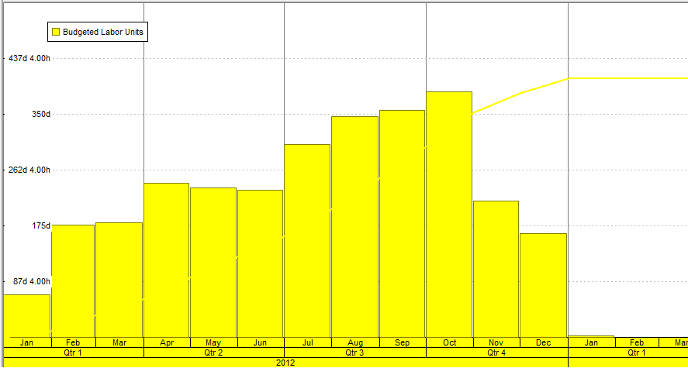
Resource profile
Resource usage profile after leveling

Slide 25
Redesigning some part of the school
Objectives:
To search the most economical structural system. (detailed design).
To be sure that the project meets the minimum requirements by the code. (conceptual design).

Slide 26
Structural Systems
The choice of adequate and economical floor system depends on:
the type of the building.
Architectural layout.
Aesthetic features.
And spans between columns.

Slide 27
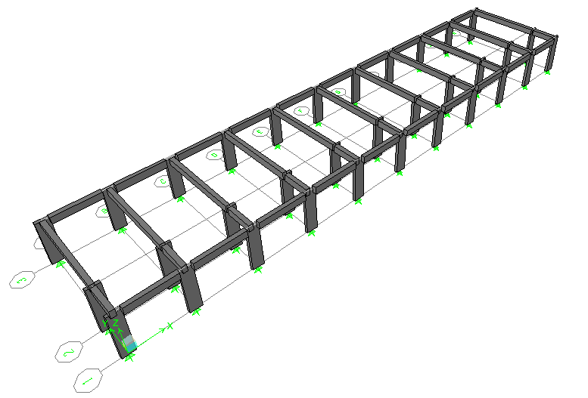
Redesign of floor system
The structural system that being used is one way ribbed slab.
One way solid slab structural system is used in the redesign process.
The code used in the design is ACI318-08.
3D modeling of structure is used using Etabs Program.

Slide 28
Structural dimensions and destails
The slab thickness is determined based on deflection criterion (ACI318, 2008):
For both end continuous:
H = L/28 = 4.20/28 = 15 cm.
For one end continuous:
H = L/24 = 3.90/24 = 16.25 cm.
Try slab thickness of 20cm.
The ultimate load acting on the slab is:
W_{u(slab)} = 1.2(0.17*24.5+4)+1.6*(3) = 15 KN/m².
ACI: American Concrete Institute.

Slide 29
Structural Reinforcement
Bars |  | AS(mm²)
As+ | As- | As min | As+ | As- | Description
4ø12 | 4ø12 | 360 | 347 | 353 | Slab
6ø12 | 6ø12 | 440 | 515 | 592 | B1
3ø20 | 4ø20 | 440 | 860 | 1047 | B2
4ø12 | 4ø12 | 440 | 115 | 195 | B3
4ø12 | 4ø12 | 440 | 74 | 103 | B4
Columns dimensions are (0.2*0.8)m.
Beams dimensions are (0.2*0.8)m.

Slide 30
Conclusions
The duration that are specified by the consultant in order to complete the project (425 days) is more than that required by the analysis (315 days) using excel sheets and primavera program.
It seems that the structural system used in floors is reinforced with amounts exceed the required by analysis.
The total project cost is 4209200 NIS.
The price per meter as total equal 2060 NIS.
36% of activities are critical.

Slide 31
Recommendation
Scheduling programs like primavera should be used to predict total number of days required to complete the project.
There are some structural systems seems to under-reinforced. so, a redesign is required.
The project has to be updated continuously to be sure that project is being performed according to the plan.

Slide 32
Thanks for your attention

