Slide 1
Project Management

Slide 2
Introduction:
Case study
Assumptions
Methodology
Discussion

Slide 3
Our Case Study:
Project title: Continues Education Building.
Project Location: Palestine-Tulkarem
Implemented by: PTU- kadoorie
Financed by: German Palestinian Development Cooperation, (KFW) and (UNDP)
Contractor: Zeta Company for Contracting
Designer: (A.E.G)
Supervisor: PTU & UNDP

Slide 4
Cont’ed
Project Delivery Systems: Design-Bid-Build (DBB).
Type of the contract: Unit price.
The project total area: Is 700 m2.
Bid Price: 1,745,685 NIS
Project duration (as the bid documents): 9 months

Slide 5
Assumptions:
The project will performed by a local construction company.
Working day = 8 hours
Working days are all days except Fridays and holidays.
The electrical and mechanical work done by sub-contractor.
Contract will be calculated in Shekels.
Limited resources, no need for resource levelling
The calculation made as a contractor’s.

Slide 6
Methodology:
Creating the WBS of the project
Developing activity list
Surveying quantities
Estimating durations & time schedule:
Cost estimating

Slide 7
Work break down structure WBS:
Continues Education Building
Substructure
Site preparation
Earth works
Superstructure
Foundations
Structural Elemnts
Finishing

Slide 8
Activity list:

Slide 9


Surveying quantities
AutoCAD, Excel
Bills of quantities, Design Drawings.
Contractor’s calculations
  Factor of waste
  Earth works
Paints, mortar and plaster materials
Notes:
I am going to talk about quantity surveying, Activities durations and time scheduling
After we've created Activity list that included all activities which will be performed on the project. It became necessary to know the quantities of materials needed to complete these activities, in a process called quantity surveying.
We have surveyed the quantities using AutoCAD and excel software depending on the bills of quantities and design drawings that belong to our project.
Since we represent the contractor part we took this on mind in quantity surveying, so we used the factor of waste of materials,
In earth works we used shrinkage and swelling factors of materials, and 0.5 m allowance added for measuring excavation for working space.
We used to convert the measured quantities to equivalents quantities that available in the local market for example in the paints works we convert the quantities from m2 to barrels and drums.

Slide 10
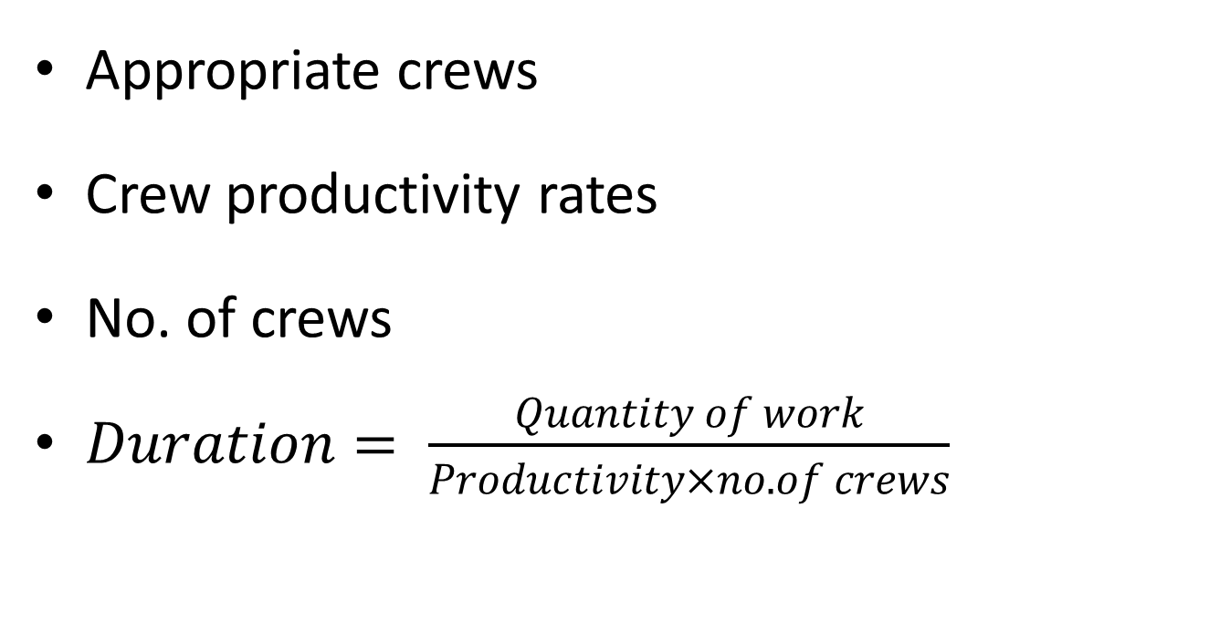
Activities durations:
Appropriate crews
Crew productivity rates
No. of crews
$Duration= \frac{Quantity of work}{Productivity×no. of crews}$
Notes:
The next step is activities duration estimate:
We have estimated each activity duration as follows:
First we assumed an appropriate crew for each activity,
And assumed productivity rate for this crew
Then we assigned a certain number of crews to the activity and by applying this equation
$$Duration= \frac{Quantity of work}{Productivity×no. of crews}$$
By round up the answer we find the duration of the activity.

Slide 11

Time schedule
Using primavera
Determining relationships
Critical path method
Notes:
Well … let’s talk now about time schedule:
We used primavera software to do this job as follows
We fed it with the activities, their durations and dependencies.
This software depends on critical path method which is an algorithm for scheduling a set of project activities. It is considered an important tool for effective project management

Slide 12
Critical Activities:
Soil Test
Excavation works
Footings
Column's Necks (C.N)
Ground Beams (G.B)
Slab on grade (S.G)
Columns
Slab
Block works
Backfill and compaction works
Plastering works
Tiless works
Painting works
Notes:
The longest path in a network, from start to finish, including lags and constraints. Represent project duration
Any delay in these activities delays the project, so the project manager must take care to finish these activities within the schedule. On the other hand if he needs to minimize the project duration he must minimize this path duration by crash.

Slide 13
Durations:
153 working days
184 calendar days
The project starts at 12/4/2011 and ends at 12/10/2011 [As our schedule]
Notes:
According to our schedule the project takes

Slide 14
Cost estimate:
Material
Labor
Equipment
Price

Slide 15
Cost results:
The cost of mechanical works = 129,550 NIS
The cost of electrical works = 267,990 NIS
The cost of structural works = 936,910 NIS
The price of the project= 1,766,920NIS
The Total cost of the project = 1,330,260 NIS

Slide 16
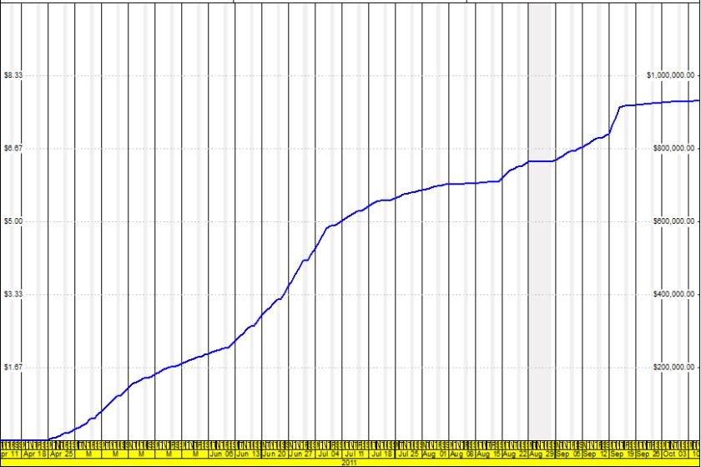
S- Curve:

Slide 17
Discussion:
Bid price is 1,745,685 NIS. Bid project duration is 9 months.
Our estimated price 1,766,920 NIS. Our scheduled time 6 months.
Delay of the project
Low quality
Notes:
the project delayed by more than 4 months over than the bid original duration (9 months), that can be avoided by control process ( schedule updating).
project finished within the planed budget despite the liquidated damages due to delay in implementation of the project, this gives us an indication of the low level of quality in implementation of activities

Slide 18
Thank you ☺

