Slide 1

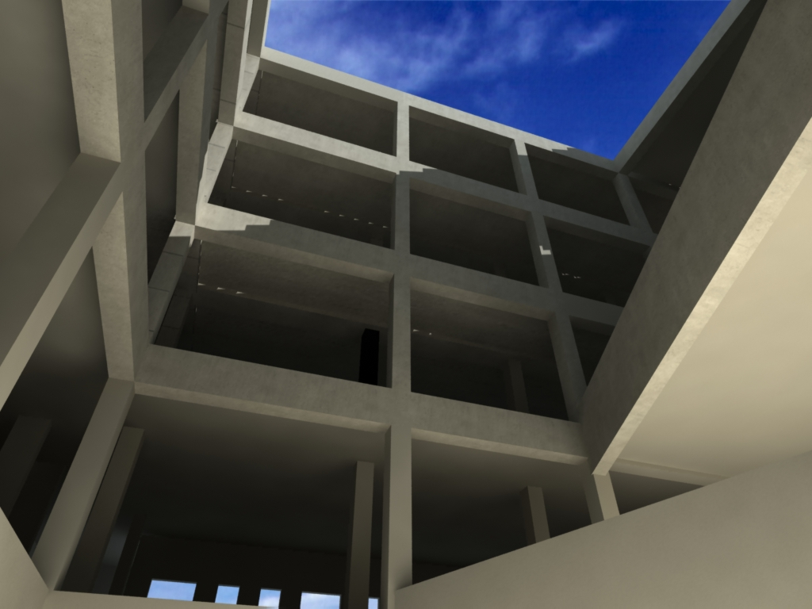
Evaluation of The Structural Design of Nursing and Optical Faculty- An Najah National University
Prepared by:
Ahmad F. Amad
Ahmad A. Zeineddin
Fawzi S. Abu-Aladas
Mahhmoud A. Sukkar
Supervisor:
Mr. Ibrahim M. Arman

Slide 2
Outline
Project description.
Three dimensional modeling.
Structural design and evaluation

Slide 3

Project Objectives
Evaluation
Comparison

Slide 4
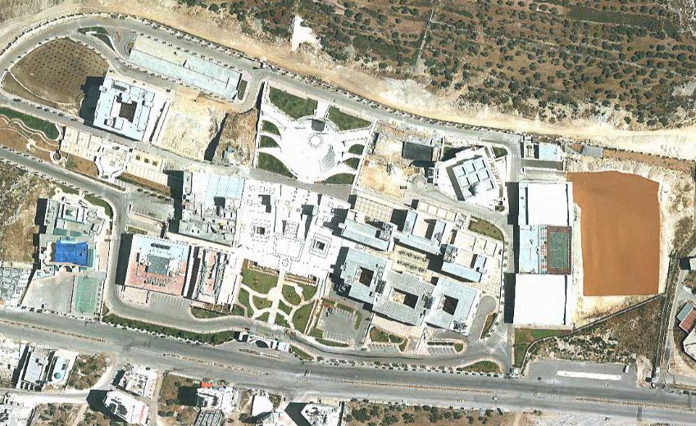
Location

Slide 5
Project Description
The building is used for educational purposes.
The faculty consists of seven floors.
Six main floors and roof floor.
The building includes mechanical rooms and three small water tanks.
The project has two axes of symmetry.

Slide 6
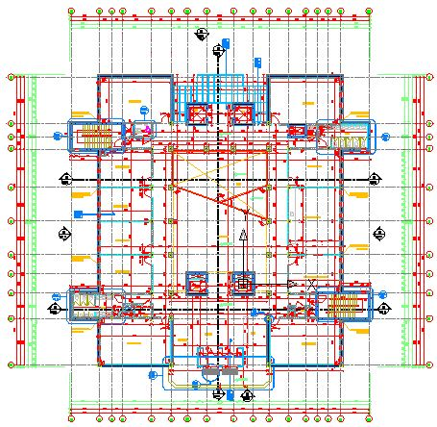
Plan of Ground Floor

Slide 7
Loads
Gravity loads:
Dead load.
Live load.
Snow load:1.5 KN/m².
CASE | LOAD (KN/m²)
Offices, class rooms | 3.0
MECHANICAL ROOMS | 7.5
Staircase | 4.0
Roofs:
With access | 1.5
Without access | 1.0
Mechanical equipment | 7.5

Slide 8
Loads
Lateral loads:
Wind loads.
Seismic loads (UBC-97 is used).
I= 1
Seismic zone 2B.
Z=0.2
Cv=0.2
Cs=0.2
R=5.5
Soil profile type =Sp

Slide 9
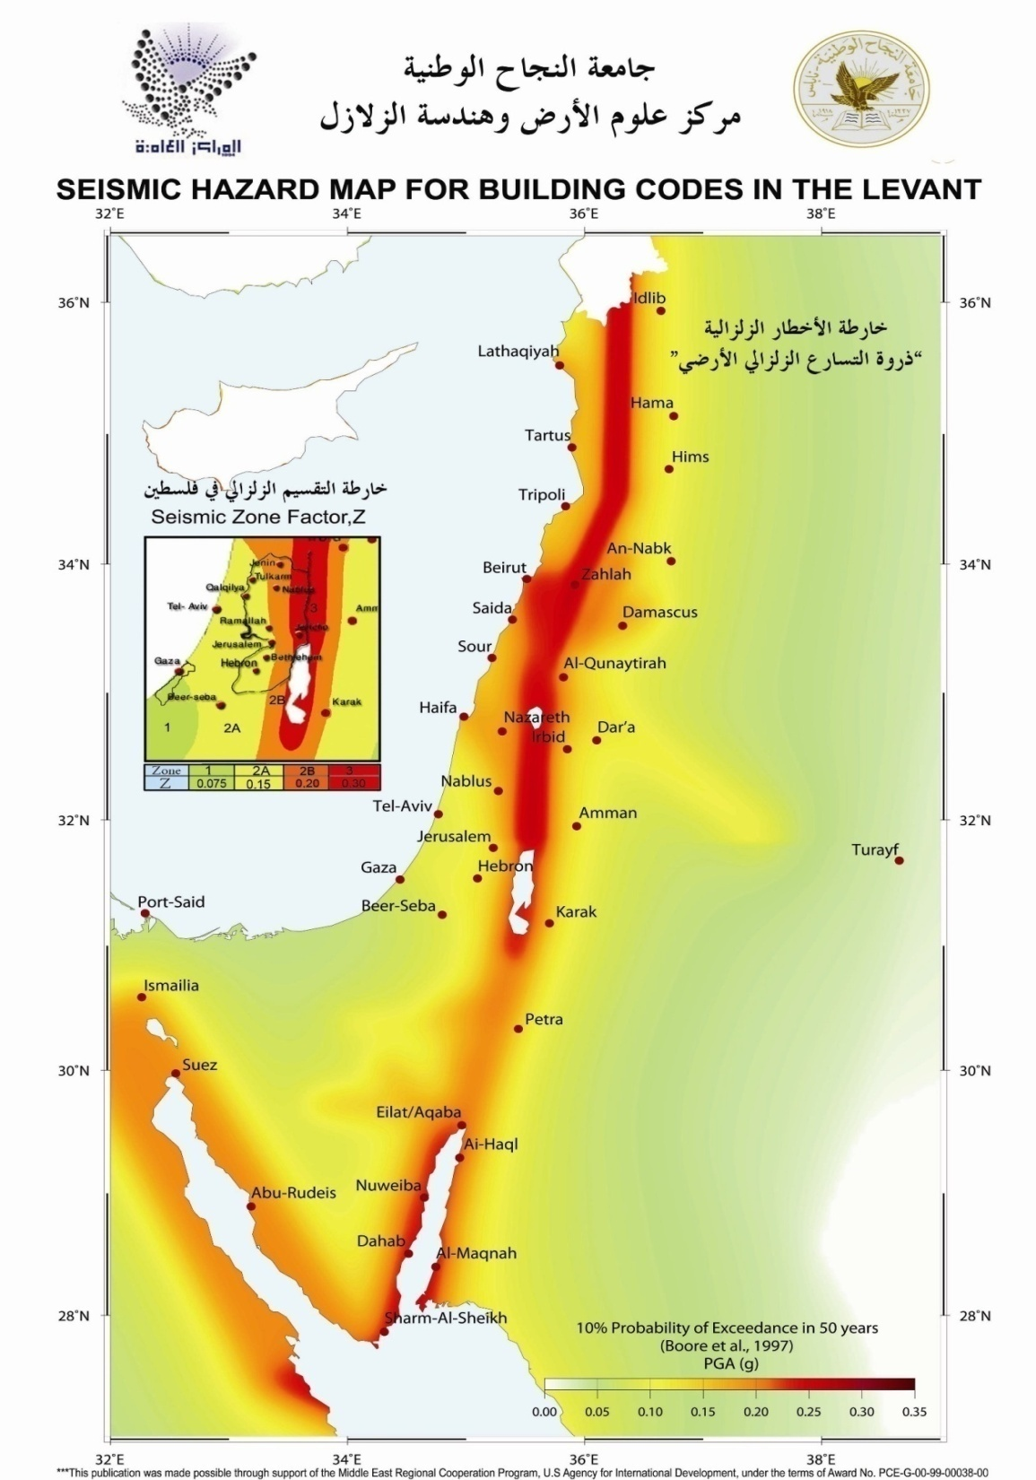

Slide 10
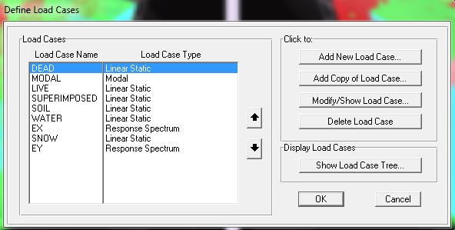
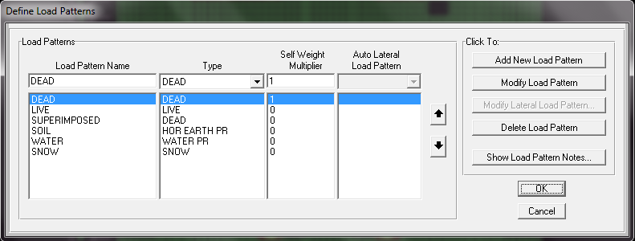
Load Cases and Load Patterns

Slide 11
Design Codes
ACI 318 – 02 American concrete institute
UBC – 97 Uniform building code
ASCE7 – 02 American society of civil engineering
JCLF – 06 Jordan code for loads and forces
JSC – 05 Jordan seismic code.

Slide 12
Structural System
Shear walls.
Frames, which consist of:
Beams.
Columns.

Slide 13
Three dimensional modeling

Slide 14
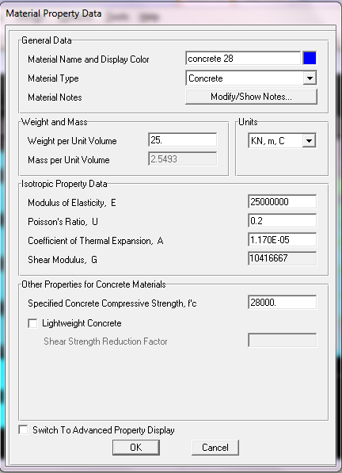
Material Property for concrete

Slide 15
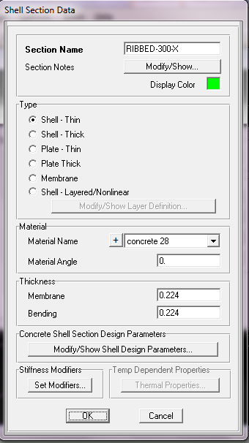
Shell Data
Ribbed slab definition

Slide 16

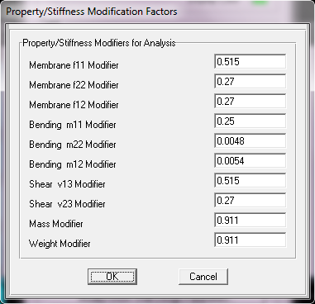







Modifiers equations
where:
Modifiers for ribbed slab

Slide 17
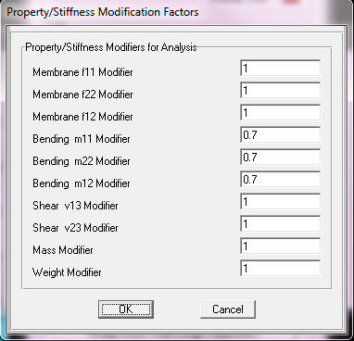
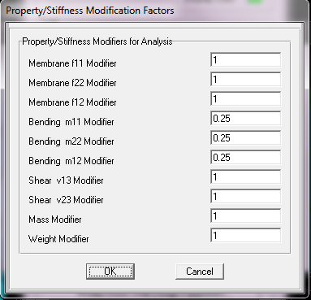
Modifiers
Shear wall
Two way solid slab

Slide 18
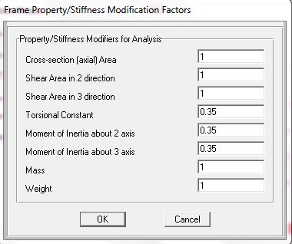
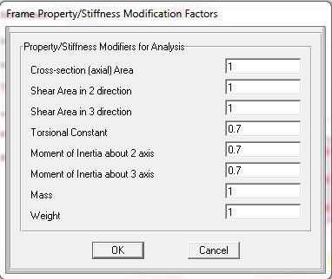
Modifiers
For beams
For columns

Slide 19
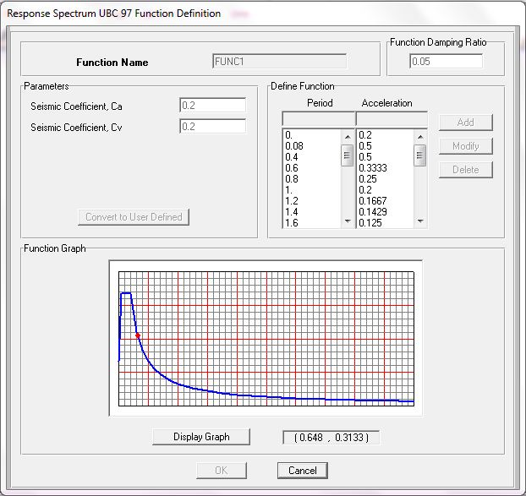
Response Spectrum

Slide 20
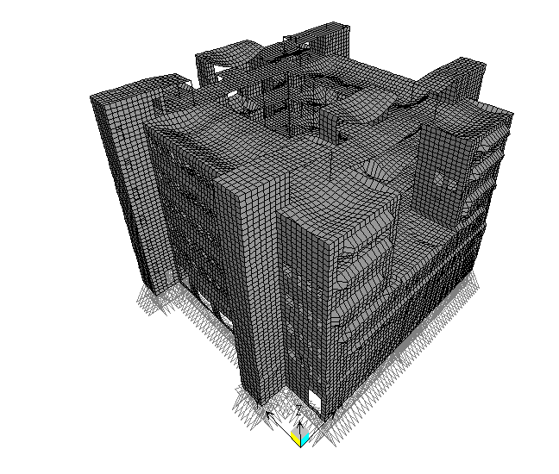
Compatibility

Slide 21
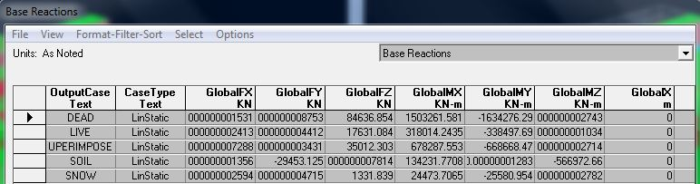
EQUILIBRIUM this result from sap

Slide 22

Dead load
This include own weight for all structural elements Slabs, Beams, columns and walls.
floor | weights (KN)
B3 | 7184.74
B2 | 15775.82
B1 | 13096
GF | 13964.56
F1 | 10331.02
F2 | 10103.91
RF | 9396.28
TR | 1215.66
total | 81068.08

Slide 23

Live load
Live load in this project has different values depending on the function, which are mechanical room, offices, class rooms and stairs.
floor NO | TOTAL LIVE LOAD(KN)
B2 | 3765.75
B1 | 3200.4
GF | 3652.5
F1 | 2553.9
F2 | 2553.9
RF | 1721.955
TF | 198
total | 17646.405

Slide 24


Snow load
Roof floor and top roof are exposed to snow load
floor | snow LOAD
TF | 296.97
RF | 1044.765
total | 1341.735
Error =
* 100% =0.7%.
Super imposed dead load
This project has two SID; first one on the slab (include partition load tiles and fill) and the other outer shear wall (include masonry, mortar and plaster)
Floor number | Super imposed dead load (KN)
B2 | 4507.2
B1 | 4208.8
GF | 4146.68
F1 | 3346.8
F2 | 3346.8
RF | 0
TF | 0
Total | 19556.28
Total SID= 14232.2 + 19556.28 = 33778.5
Error =
*100% =3.4%

Slide 25
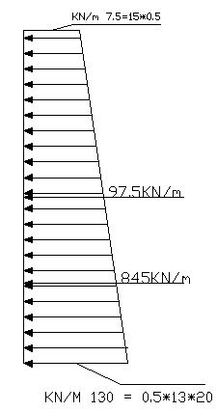
Soil load :
Soil is covering the three basements floor in the north approach, and this affect on retaining wall.
K 0 = 1- sin α (α= 30 0), k =0.5
Unit weight equal 20 KN/m³
Live load = 15 KN/m
Long of wall=31.25m
Total load = (845*31.25)+(97.5*31.25) =29453.1 KN/m
Error =0%

Slide 26
Check moment in beams
The live load is chosen as an example of load carried by beams to make the comparison:
Beam Name | Moment by T.A.M (KN.m) | Moment by SAP (KN.m) | % of error
GB5 | 11.34 | 10.5 | 7.98
1B1 | 46.25 | 44.17 | 4.7
2B11 | 69.77 | 71.75 | 2.76

Slide 27

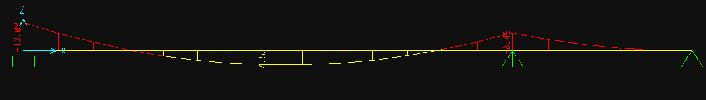

Check moment in slabs

Slide 28
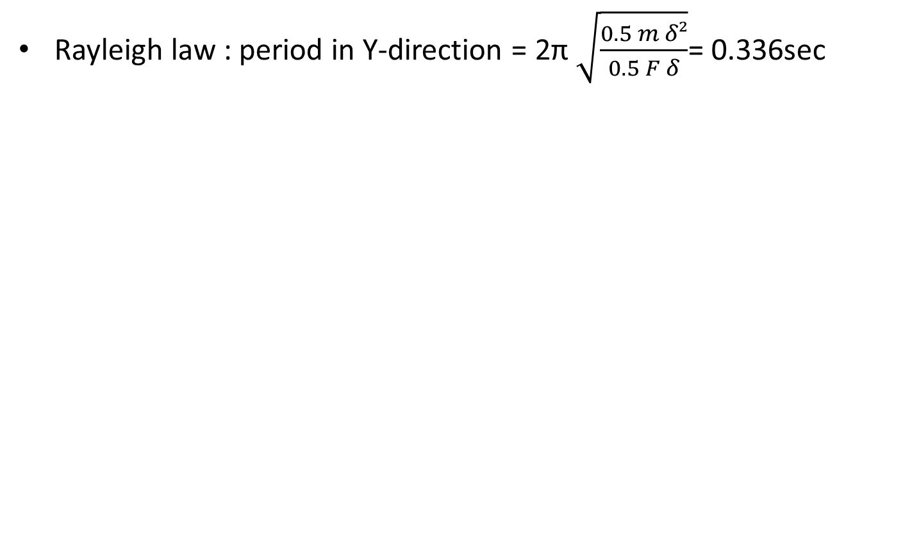
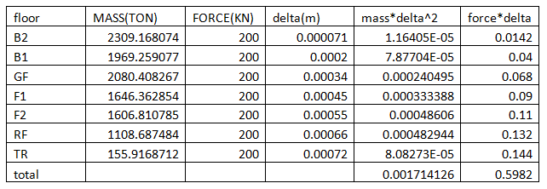
Period calculation
Period from SAP2000=0.327 S
Error = 2.75 %

Slide 29
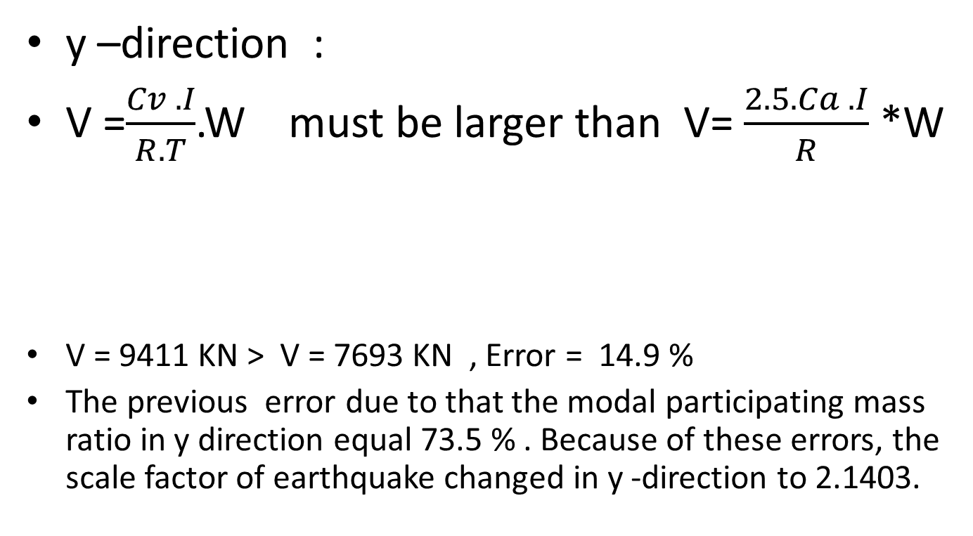


Seismic load

Slide 30
Structural design and evaluation

Slide 31
Columns
Number of columns at the building 216 columns.
The columns uniformed into 9 sets in the basement floors and 8 sets in the upper floors.
Floor | Columns sets
B3 | 3BC1 | 3BC2 | 3BC3 | 3BC4 | 3BC5 | 3BC6 | 3BC7 | 3BC8 | 3BC9
B2 | 2BC1 | 2BC2 | 2BC3 | 2BC4 | 2BC5 | 2BC6 | 2BC7 | 2BC8 | 2BC9
B1 | 1BC1 | 1BC2 | 1BC3 | 1BC4 | 1BC5 | 1BC6 | 1BC7 | 1BC8 | 1BC9
Gr | GC1 | GC2 | GC3 | GC4 | GC5 | GC6 | GC7 | GC8 | -
1 | 1C1 | 1C2 | 1C3 | 1C4 | 1C5 | 1C6 | 1C7 | 1C8 | -
2 | 2C1 | 2C2 | 2C3 | 2C4 | 2C5 | 2C6 | 2C7 | 2C8 | -
Rf | RC1 | RC2 | RPC1 | RPC2 | - | - | - | - | -

Slide 32
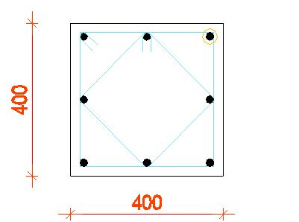
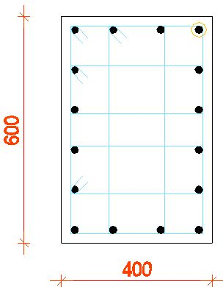
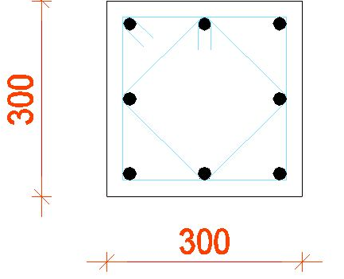
Columns
Dimensions

Slide 33
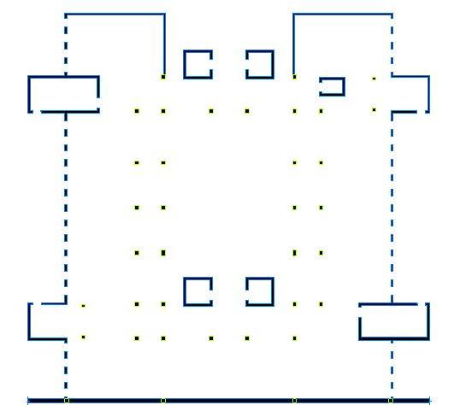
Columns
Plan shows columns distribution at the floor

Slide 34
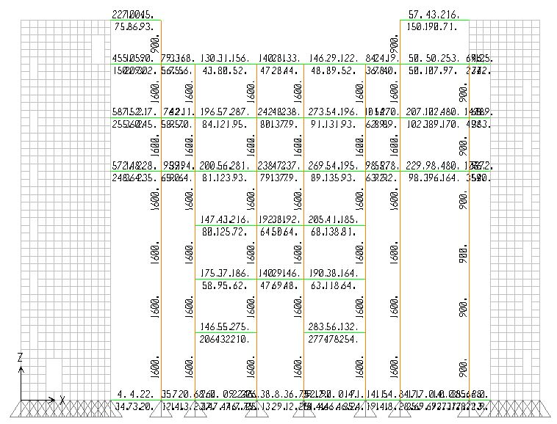
Columns
The design of the columns.
SAP2000
Longitudinal
Lateral

Slide 35
Columns
Comparison between SAP2000 and office’s designs for the ground floor
Floor No. |  |  |  | Reinforcement from structural drawings |  |  |  |  |  |  |  | Reinforcement from SAP2000
Gr | (mm) | (mm) | (mm)² | Longitudinal reinforcement |  |  |  | Lateral reinforcement |  |  |  | Longitudinal |  |  | Lateral reinforcement |  |  |  |  | Longitudinal | Lateral
Column No. | Width | Depth | area | # bars | ɸ | Ab | As | # legs | ɸ | Av | S | As | ɸ | # bars | As | ɸ | # legs | Max. S | Practical S | Comments | Comments
GC1 | 300 | 300 | 90000 | 8 | 14 | 153.86 | 1230.88 | 4 | 10 | 314 | 200 | 900 | 14 | 6 | 157 | 10 | 4 | 224 | 200 | Safe | Safe
GC2 | 400 | 400 | 160000 | 8 | 16 | 200.96 | 1607.68 | 4 | 10 | 314 | 200 | 1600 | 16 | 8 | 157 | 10 | 4 | 256 | 250 | Safe | Safe
GC3 | 400 | 400 | 160000 | 8 | 16 | 200.96 | 1607.68 | 4 | 10 | 314 | 200 | 1600 | 16 | 8 | 157 | 10 | 4 | 256 | 250 | Safe | Safe
GC4 | 400 | 400 | 160000 | 8 | 20 | 314 | 2512 | 4 | 10 | 314 | 200 | 1600 | 20 | 6 | 157 | 10 | 4 | 320 | 300 | Safe | Safe
GC5 | 400 | 400 | 160000 | 8 | 18 | 254.34 | 2034.72 | 4 | 10 | 314 | 200 | 1600 | 18 | 8 | 157 | 10 | 4 | 288 | 250 | Safe | Safe
GC6 | 400 | 400 | 160000 | 8 | 18 | 254.34 | 2034.72 | 4 | 10 | 314 | 200 | 1600 | 18 | 8 | 157 | 10 | 4 | 288 | 250 | Safe | Safe
GC7 | 400 | 400 | 160000 | 8 | 16 | 200.96 | 1607.68 | 4 | 10 | 314 | 200 | 1600 | 16 | 8 | 157 | 10 | 4 | 256 | 250 | Safe | Safe
GC8 | 400 | 400 | 160000 | 8 | 16 | 200.96 | 1607.68 | 4 | 10 | 314 | 200 | 1600 | 16 | 8 | 157 | 10 | 4 | 256 | 250 | Safe | Safe

Slide 36
Columns
Comments on columns design:
3BC2 & 2BC2
3BC8
1C1
1C2

Slide 37


Columns
The column 1C1
Moments in 1C1
Moments in GC1

Slide 38


Columns
The column 2C1
Axial loads in 2C1
Axial loads in GC1

Slide 39
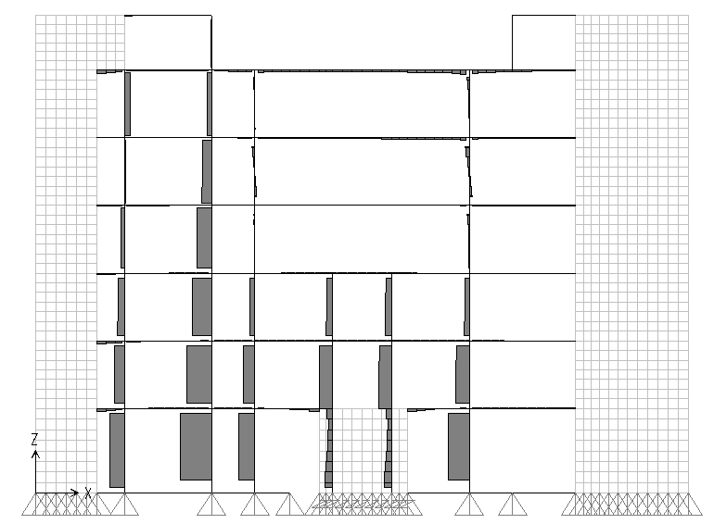
Columns
Axial forces diagram from SAP2000

Slide 40
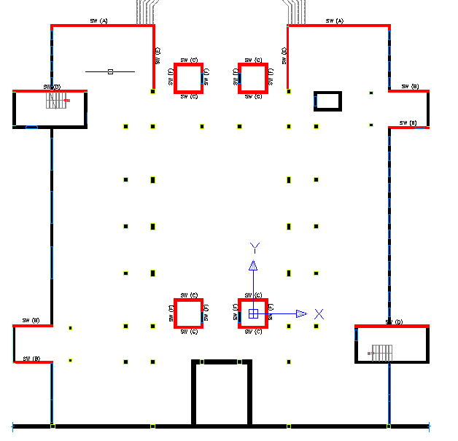
Shear walls
All the exterior walls and the elevators’ wells are shear walls.
Shear walls were treated as columns.

Slide 41
Shear walls
The shear walls were taken.
Shear wall | Width (m) | Depth (m) | P (KN) | M (KN/m)
A | 9.3 | 0.2 | 4477.6 | 5203.375
B | 3.625 | 0.2 | 2231.61 | 332.54
C | 2.5 | 0.25 | 1296.6 | 171
D | 6.625 | 0.25 | 3901.54 | 3208
E | 6 | 0.2 | 4191.49 | 3699
F | 2.5 | 0.25 | 963.66 | 152.75

Slide 42
Shear walls

Slide 43
Beams
Number of beams sets varies from 12 to 16 depending on the floor.
Number of spans and the dimension of the beams different from one set to another.

Slide 44
Beams
list of selected beams
Beam Name | Floor | Width | Depth
2BB9 | B2 | 400 | 800
2BB10 | B2 | 300 | 1500
1BB1 | B1 | 300 | 600
1BB2 | B1 | 300 | 600
1BB4 | B1 | 300 | 800
Gb1 | Gb | 300 | 600
Gb7 | Gb | 250 | 800
Gb10 | Gb | 300 | 1500
1B2 | B1 | 300 | 1005
1B12 | B1 | 250 | 800
1B16 | B1 | 400 | 800
2B2 | B2 | 300 | 1005
2B12 | B2 | 250 | 800
2B15 | B2 | 800 | 300
Rb2 | Rb | 300 | 900
Rb8 | Rb | 400 | 800
Rb17 | Rb | 400 | 800

Slide 45


Beams
Design of beams:
Longitudinal reinforcing.
Lateral reinforcing.
Structural drawings.

Slide 46
Beams
TOP
 |  |  |  |  |  | Structural Drawings |  |  |  |  |  | SAP2000
 |  |  |  |  |  | Left |  | Middle |  | Right |  | Left |  | Middle |  | Right
Beam No. | Floor | width | depth | para. | Span | # Bars | ɸ | # Bars | ɸ | # Bars | ɸ | # Bars | ɸ | # Bars | ɸ | # Bars | ɸ | Comments
2BB9 | B2 | 400 | 800 | 2400 | 1 | 3 | 25 | 3 | 16 | 3 | 16 | 2 | 25 | 2 | 16 | 4 | 16 | The left and middle are safe, the right is not safe
 |  | 400 | 800 | 2400 | 2 | 3 | 25 | 3 | 16 | 3 | 25 | 2 | 25 | 2 | 16 | 2 | 25 | All are safe
 |  | 400 | 800 | 2400 | 3 | 3 | 25 | 3 | 16 | 3 | 25 | 2 | 25 | 2 | 16 | 2 | 25 | All are safe
 |  | 400 | 800 | 2400 | 4 | 3 | 16 | 3 | 16 | 3 | 25 | 7 | 16 | 3 | 16 | 2 | 25 | The left is not safe, the middle and right safe

Slide 47


Beams
Top reinforcing differences.
Moment from gravity combination
Moment from earthquake combination

Slide 48
Beams
Comments on beams:
Longitudinal reinforcing steel.
Lateral reinforcing.
Deflection.

Slide 49
Slabs
There is two types of slabs; one way ribbed slab and two way solid slab.
All slabs have a thickness of 30 cm.
A representative strip were taken in solid slabs and a representative sample slab were taken in ribbed slab.

Slide 50
Slabs
Design of slabs:
Two way solid slabs.
One way ribbed slab.

Slide 51
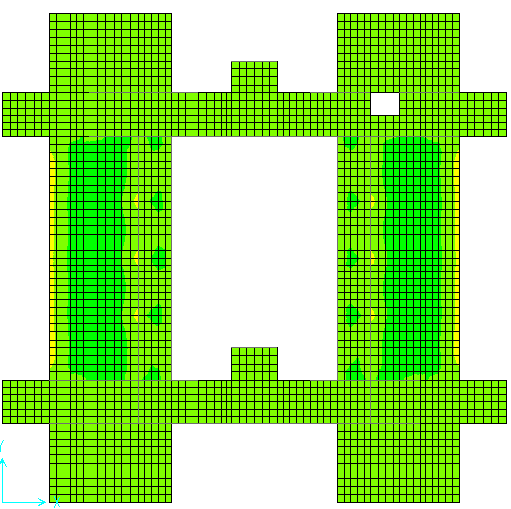
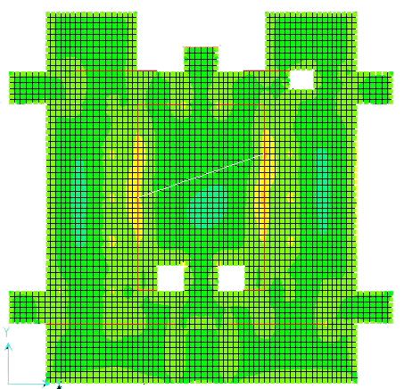
Slabs

Slide 52
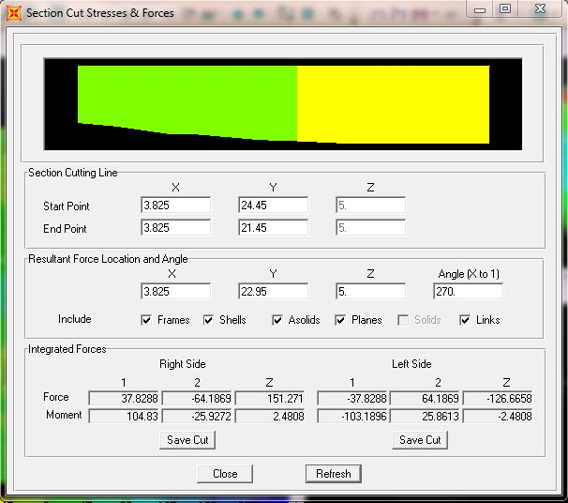
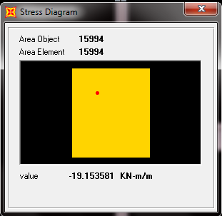
Slabs

Slide 53
Slabs
Sample strip
TOP
 |  |  |  |  | Left |  |  | Middle |  |  | Right
 | Center |  |  |  | SAP2000 |  | office | SAP2000 |  | office | SAP2000 |  | office
Floor | Line | Span | Span length | Span width | p | As(mm2/m) | As (mm2/m) | p | As(mm2/m) | As (mm2/m) | p | As(mm2/m) | As (mm2/m)
B2 | 5 | 1 | 6825 | 3000 | 0.001074 | 279.16 | 565.2 | 0.000000 | 0.00 | 565.2 | 0.000583 | 151.59 | 3018.325
 |  | 2 | 2550 | 3000 | 0.000587 | 152.65 | 3018.325 | 0.000666 | 173.22 | 3018.325 | 0.002143 | 557.24 | 3018.325
 |  | 3 | 12650 | 3000 | 0.001918 | 498.70 | 3018.325 | 0.000000 | 0.00 | 565.2 | 0.003156 | 820.45 | 3018.325
 |  | 4 | 2550 | 3000 | 0.002309 | 600.40 | 3018.325 | 0.000862 | 224.08 | 3018.325 | 0.000482 | 125.19 | 3018.325
 |  | 5 | 6825 | 3000 | 0.000810 | 210.68 | 3018.325 | 0.000000 | 0.00 | 565.2 | 0.001506 | 391.59 | 565.2

Slide 54
Slabs
Top moments on the strip ((K, P), (4, 9)) from moments M22
 | Gridlines |  |  | Top
 |  |  |  | sap |  |  | office |  | sap |  |  | office |  | sap |  |  | office
Floor | X | Y | Span | L | ƿ | As (SAP) | As | Different | M | ƿ | As | As | Different | R | ƿ | As | As | Different
1 | K,P | 4,9 | 1 | 19 | 0.0093 | 364.61 | 804.6 | -440.01 | 10 | 0.0047 | 183.7 | 804.6 | -620.92 | 20 | 0.0099 | 385.82 | 804.6 | -418.8
 |  |  | 2 | 25 | 0.0127 | 495.79 | 804.6 | -308.83 | 0 | 0.0000 | 0.00 | 157.0 | -157.00 | 30 | 0.0157 | 613.32 | 157.0 | 456.3

Slide 55
Slabs
Comments on slabs
Flexural steel.
Punching shear.
Deflection.

Slide 56
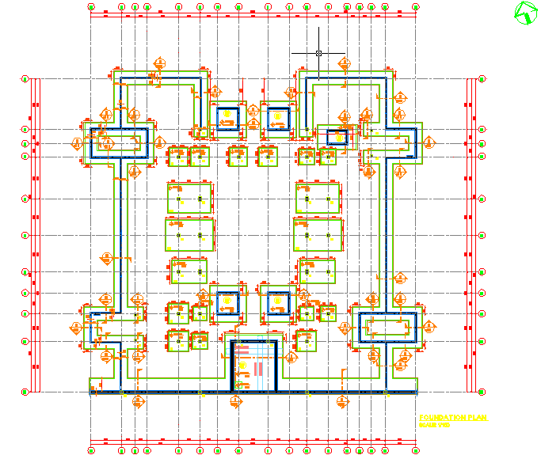
Footing

Slide 57
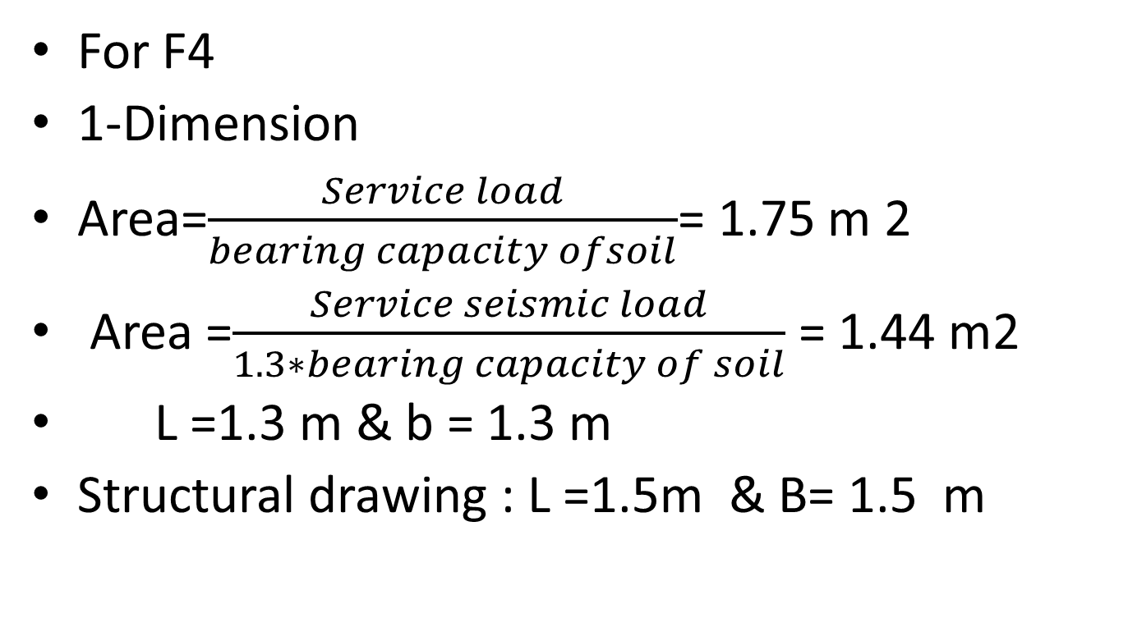
Single footing :

Slide 58
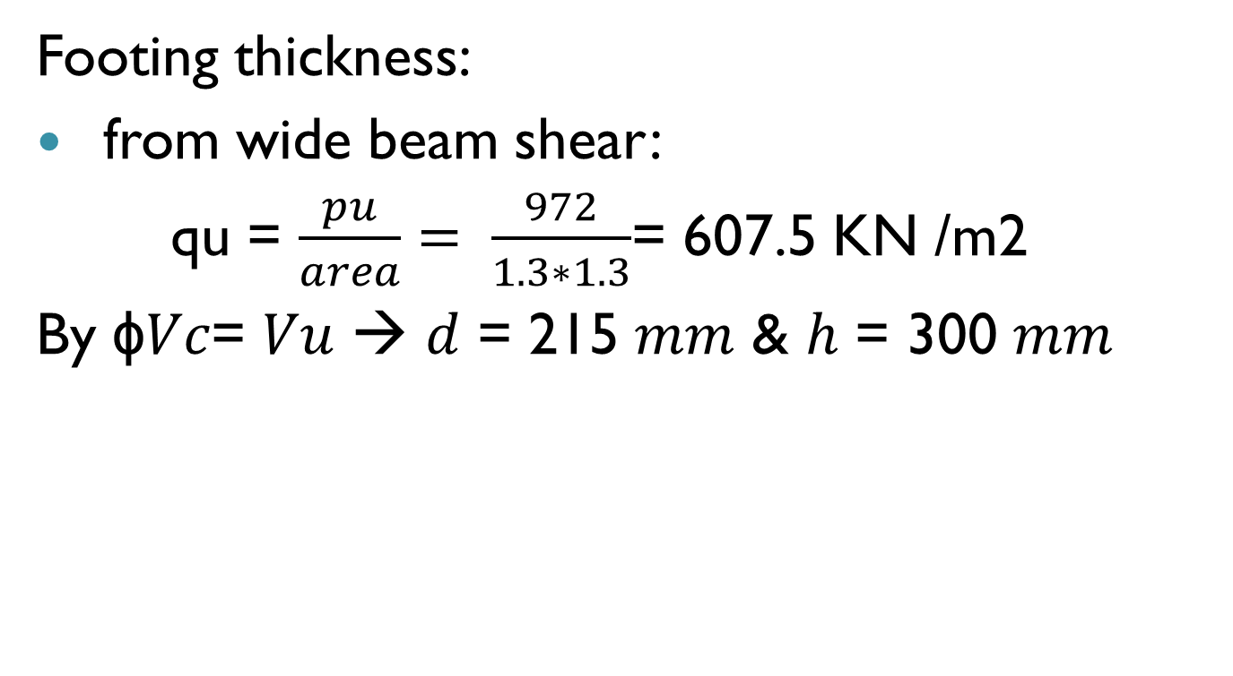
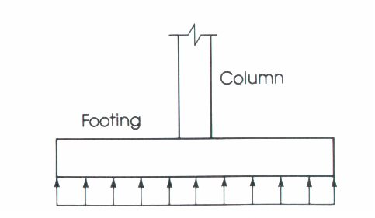
Single footing :

Slide 59
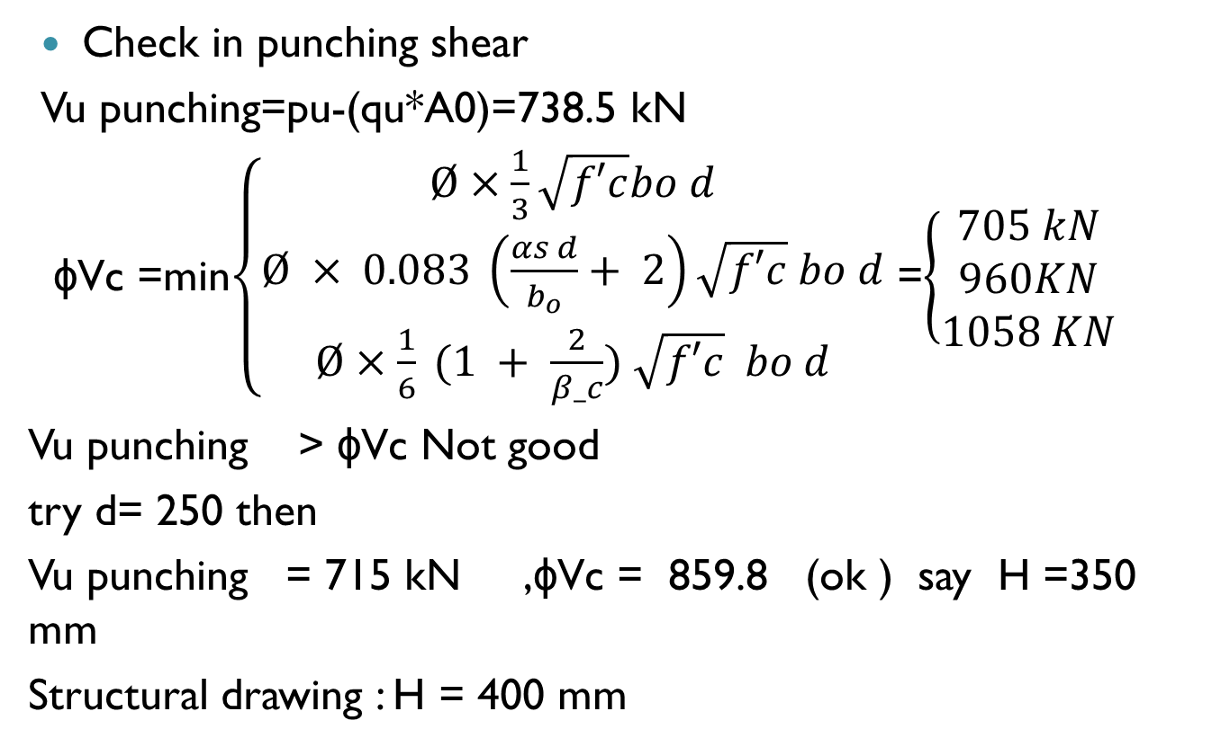
Single footing :

Slide 60
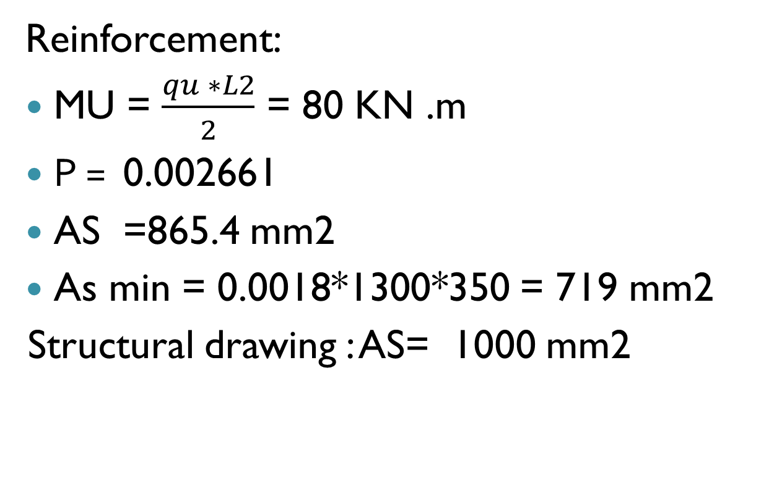
Single footing :

Slide 61
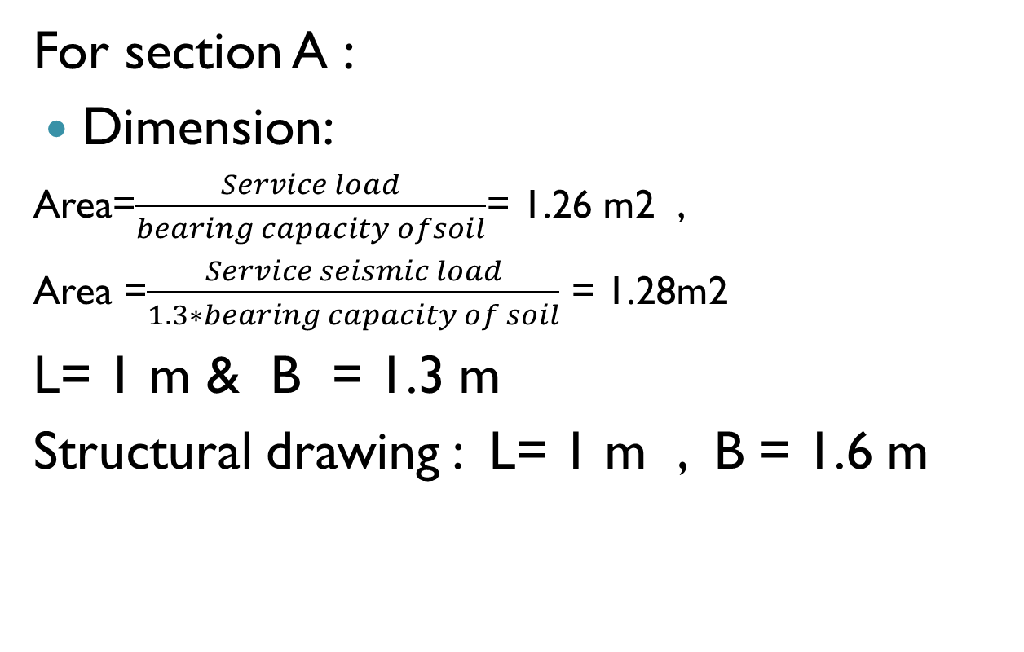
Wall footing

Slide 62
Wall footing
Footing thicknesses:
from wide beam shear
qu = 616.5 KN /m2
ɸVc = Vu → d=266 mm & H =350mm
Office design : H = 500 mm
Reinforcement:
MU = 93.2 KN .m
𝛲 = 0.00359 ,𝐴𝑆 = 954 𝑚𝑚2/𝑚,𝐴𝑠 𝑚𝑖𝑛 == 630 𝑚𝑚2/𝑚
Longitudinal reinforcement = 630*1.3 =819 𝑚𝑚2
Structural drawing : long direction= 1230 𝑚𝑚2
short direction = 1004.8 𝑚𝑚2/𝑚

Slide 63
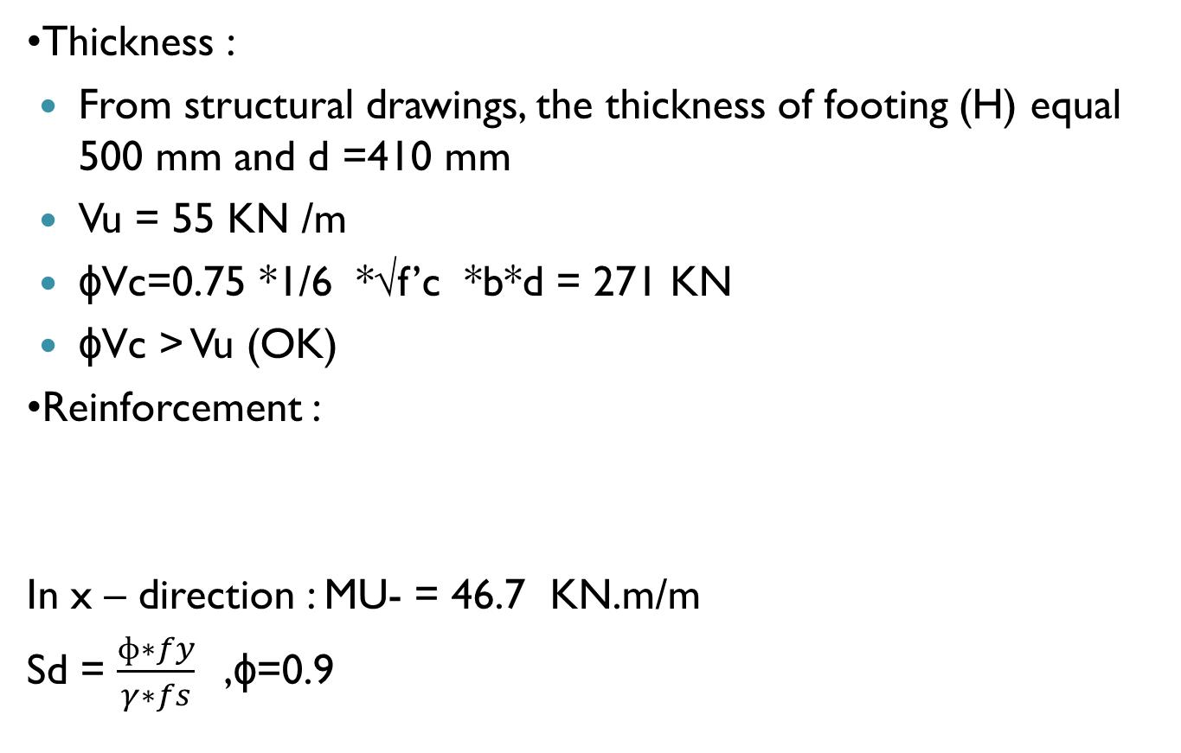
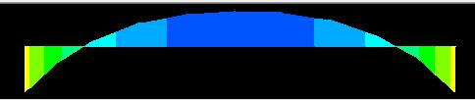
Water tank footing

Slide 64
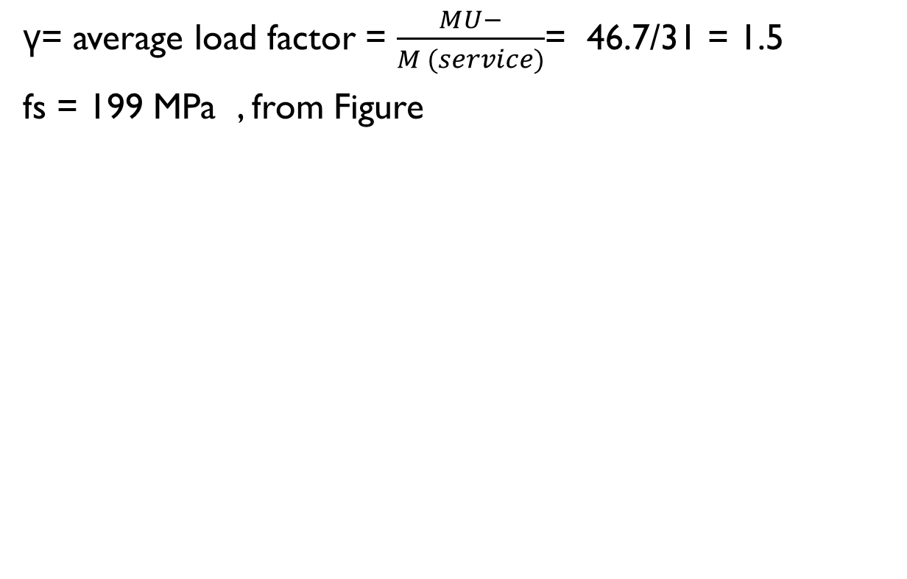
Water tank footing

Slide 65
Water tank footing
Sd = 1.26
Mu design = sd * Mu -* µ = 1.26 * 46.7 * 1.025 = 60.3 KN. m/m
Ρ = 0.000955→ AS==391mm2/m
Use Asmin=0.0018*1000*500=900mm2/m.
Structural drawing :As = 2453.1 mm2/m

Slide 66
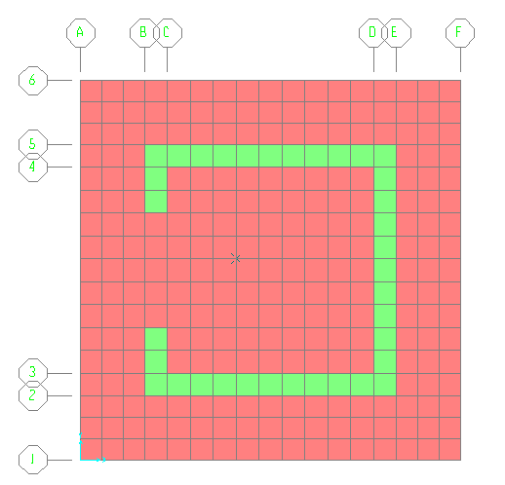
Elevator footing

Slide 67
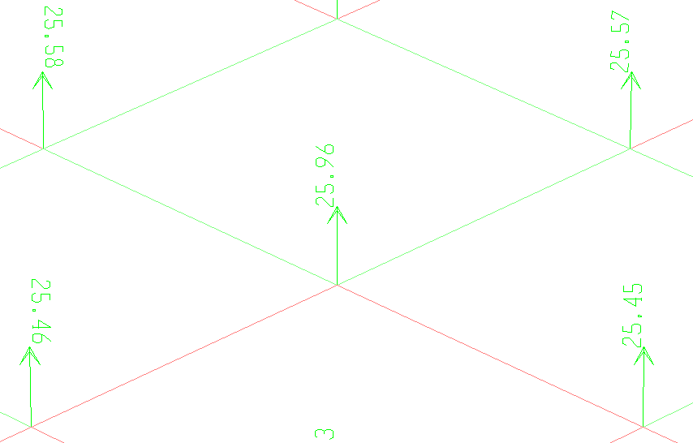

Elevator footing
Dimension
Stress=$\frac{25.96}{(0.25∗0.25) }=$415.4 KPa<450KPa .

Slide 68
Elevator footing
Thickness
structural drawing noted the thickness of footing (H) equal to 500 mm and d =410 mm.
Vu = 222.7 KN /m
ɸVc = 0.75 *1/6 *√(f’c) *b*d = 271KN/ m
ɸVc > Vu (OK)
Reinforcement
M- = 139.6 KN.m/m , Ρ = 0.002237 ,
AS = 917 mm2 /m
Asmin = 900 mm2 /m .
Structural drawing : As = 2453.1 mm2 /m

Slide 69
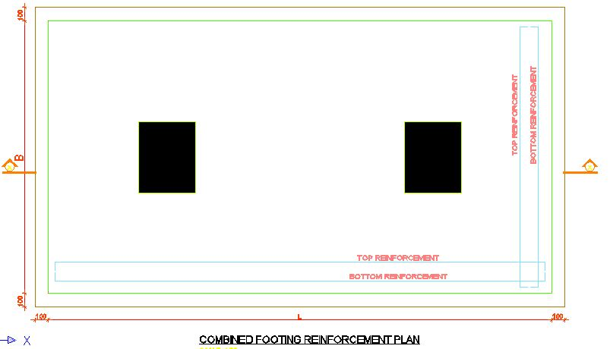
Combined footing design
A combined footing contains two columns lie at the intersection of grids E6 and F6 will be evaluated.

Slide 70
Check on dimensions
Area Of Footing
Designed | 19.25 m²
Required | 9.256 m²
Footing Thickness
 | Can be resisted (KN) | Applied (KN) | Met or not
Wide beam shear | 1666.82 | 1790 | met
Punching shear | 6135.4 | 3199.6 | doesn’t meet

Slide 71
Reinforcement check:
Bottom Steel
In long direction |  |  | In short direction
Reinforcement from AutoCAD drawings | As (mm²) | As calculated (mm) | Reinforcement from AutoCAD drawings | As (mm²/m) | As calculated (mm²/m)
ɸ25@150 | 3437 | 8391.6 | ɸ20@150 | 2198 | 1440
Top Steel
In long direction |  |  | In short direction
Reinforcement from AutoCAD drawings | As (mm²) | As calculated (mm) | Reinforcement from AutoCAD drawings | As (mm²/m) | As calculated (mm²/m)
ɸ18@150 | 1782 | 8391.6 | ɸ16@150 | 1407 | 1440

Slide 72
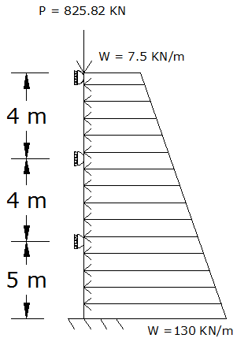
Retaining wall design
Structural Model
Retaining wall lies in southern side of the building, has a thickness of 40 cm and a height of 13 m, supported by slabs in B3, B2 and B1.

Slide 73
Reinforcement of wall
Vertical reinforcement
Floor | from soil side |  |  | From building side
 | Reinforcement from AutoCAD drawings | As (mm²) | As(mm²)(from SAP) | Reinforcement from AutoCAD drawings | As (mm) | As (from SAP)
B3 | Ø20/200 | 1570 | 1122 | Ø16/200 | 1005 | 1360
B2 | Ø20/200 | 1570 | 1122 | Ø16/200 | 1005 | 1122
B1 | Ø16/200 | 1005 | 1122 | Ø12/200 | 565 | 1122
GF | Ø12/200 | 565 | 1122 | Ø12/200 | 565 | 1122
Horizontal reinforcement
Floor | Reinforcement from AutoCAD drawings | As (mm²) | As (shrinkage)
B3 | Ø12/200 | 565 | 360
B2 | Ø12/200 | 565 | 360
B1 | Ø10/200 | 392.5 | 360
GF | Ø10/200 | 392.5 | 360

Slide 74
Check on dimensions
1- Check footing dimensions depending on bearing capacity (didn't met).
2- Check on footing thickness from wide beam shear (met).
Reinforcement of wall footing
Footing reinforcement
 | Short Direction |  |  | Long Direction
 | from AutoCAD drawings | As(mm²/m) | As(mm²/m) (calculated) | from AutoCAD drawings | As(mm²/m) | As(mm²/m) (calculated)
Top steel | Ø14/200 | 770 | 450 | Ø14/200 | 770 | 450
Bottom steel | Ø20/200 | 1570 | 6660 | Ø16/200 | 1005 | 1419

Slide 75
Conclusion
1- The office’s engineers did not consider the earthquake effects on the upper floors and they ignore the effect of shear walls on the columns behavior.
2- Shear wall reinforced more than required.
3- Slabs is reinforced more than needed in both the two way solid slab and the one way ribbed slab.
4- The design of single footings, wall footings, water tanks and elevators footings is acceptable, but the design of retaining wall and combined footing wasn’t.

Slide 76
Thank you for your attention

