Slide 1


AN-NAJAH NATIONAL UNIVERSITY
FACULTY OF ENGINEERING
DEPARTMENT OF MECHANICAL ENGINEERING
ANOVEL DESIGN FOR MEASURMENT OF
“THERMAL CONDUCTIVITY OF STONES”
Supervisor : The students:
Dr . Mohammed Abu-Hilal. Abed-EL- Fatah Abu Tayon (10611834)
Fadi Mousa (10640050)
Anas Shayeb (10611813)
Azhar Salman (10611856)

Slide 2
Outline :
Introduction
Method of Determined Thermal Conductivity
Hilton Device
Result

Slide 3
Abstract and Objective:
Determine the thermal conductivity of building stones:
Help us to select the best stone used in building.
Reduce the amount of energy used in air conditioning.
Maintain temperatures inside the building in preferable range.

Slide 4
Introduction:
properties needed in building stones:
Have the high strength.
Have suitable thermal conductivity.
Good insulator for sound and heat.
The stones give a beautiful shape for building.

Slide 5
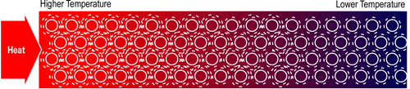
Heat Conduction:
Heat conduction is the transfer of thermal energy between neighboring molecules in a substance due to a temperature gradient, as shown in the Fig.

Slide 6
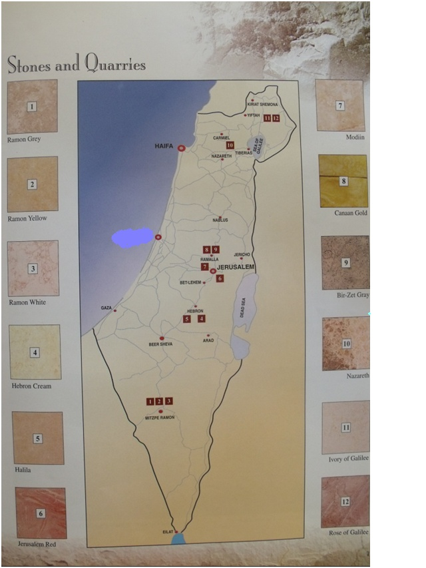

Slide 7
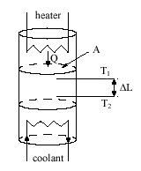
Method of Determined Thermal Conductivity:
Measurement of Heat Flux :

Slide 8
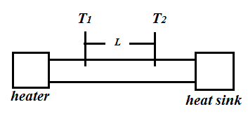

Static Method of Measuring Thermal conductivity:
Liner thermal conductivity

Slide 9
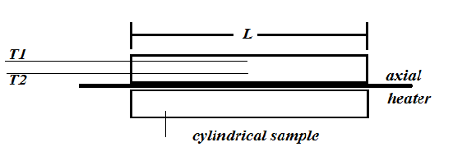

Radial thermal conductivity

Slide 10
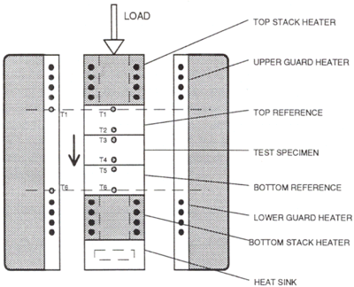
Comparative Measurement

Slide 11
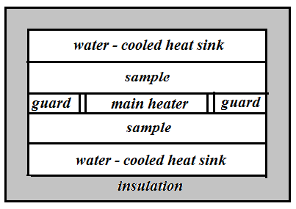
Guarded Hot Plate Method

Slide 12
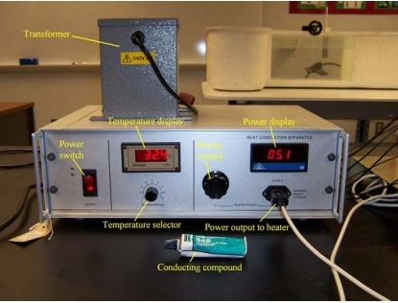
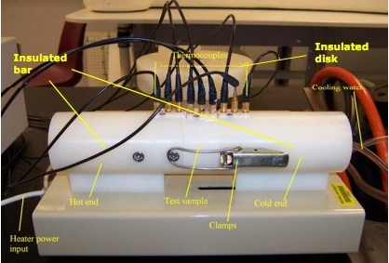
Hilton device:
Our experiments were performed using Hilton’s device to compare the results for the same stone with the results founded by our device.
By using Hilton's device we get the following results :

Slide 13
Temperatures distribution of Hebron pink stone at Q=15W:
X(mm) | 10 | 20 | 30 | 35 | 50 | 65 | 70 | 80 | 90
T(ċ) | T₁ | T₂ | T₃ | T₄ | T₅ | T₆ | T₇ | T₈ | T₉
Q =15 | 115 | 110 | 104 | 101.42 | 60.815 | 20.2 | 20.2 | 19.7 | 19.8
Q =15 | 118.8 | 115.8 | 103.5 | 101.225 | 59.87 | 18.508 | 18.5 | 17.4 | 17.6

Slide 15
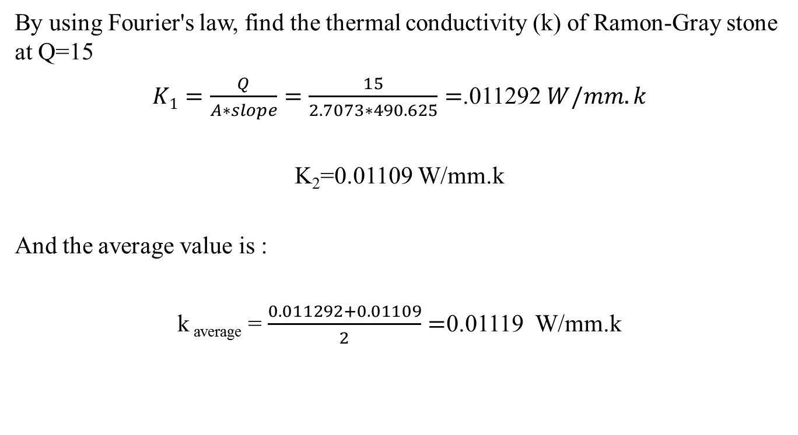
Sample of calculations:
By using Fourier's law, find the thermal conductivity (k) of Ramon-Gray stone at Q=15
$K1=\frac{Q}{A∗slope}=\frac{15}{2.7073∗490.625}=$.011292 $W/mm.k$
K₂=0.01109 W/mm.k
And the average value is :
k _{average} = $\frac{0.011292+0.01109}{2}=$0.01119 W/mm.k

Slide 16
Name of Stones | Commercial Name | Density (kg/ m3) | Absorption (%) | Compression Strength (MPa) | Thermal conductivity (W/(mm.k)
Ramon-Gray Figure (1.4) | Jerusalem gray or desert beige | 2660 | 0.5 | 10.45 | 0.01442
Hebron-White Figure 1.5)) | Jerusalem Cream, Yata, Shyuch, Injasa | 2656 | 0.5 | 11.9 | 0.01478
Hebron-Cream Figure (1.6) | Yata yellow, Jerusalem yellow, Shyuch, Injasa | 2609 | 1.2 | 9.9 | 0.01446
Hebron Pink Figure (1.7) | Yata pink, Jerusalem pink zahari | 2625 | 1.0 | 10.9 | 0.01282
Halila Figure (1.8) | Antique Gold, Jerusalem Antique Gold and Tufach and Galil-Gold, | 2532 | 1.5 | 12.2 | 0.01451
Jerusalem Red Figure (1.9) | Salib, Gilo and Mizi-yahudi | 2775 | 0.4 | _ | 0.01349
Birzeit-Gray Figure (1.10) | Benjamin Gray | 2675 | 0.7 | 10.5 | 0.0129
Birzet-Yellow Figure (1.11) | Benjamin Gold | 2652 | 0.7 | 10.8 | 0.01242
jamaeen | Azraq jara3a |  |  |  | 0.01302

Slide 17
Device consist of :
- Steel cover:
Have two side slots for insert and eject the sample.
- Water basin:
collect water from the cooling lines in order to perform recirculation process using a pump.
- pump:
Used in recirculation process from the basin to the cooling lines.
- Heater:
Provide 300 watt power.
- Thermocouple:
Two sensors used to read the stone temperature at two different points.
- Insulation:
Cover the sample to prevent heat losses in Undesirable directions.

Slide 18
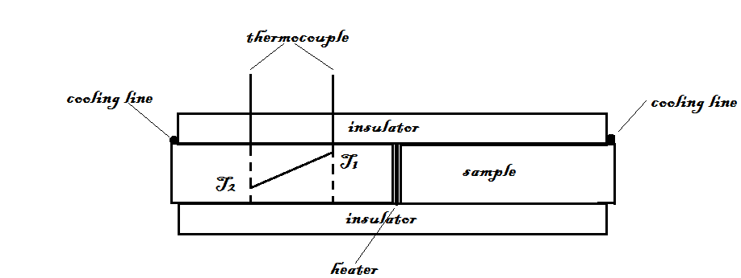
Temperature gradient between the two under consideration points:

Slide 19
Results:
the temperature gradient ∆T which founded at the two under consideration points when the system reach the steady state condition, can be substituted directly in Fourier's law to get the thermal conductivity of the sample.
We perform our experiments and get the following results:

Slide 20

Temperature distribution for Hebron-Cream stone :
By using Fourier's law , find the thermal conductivity (k) at Q=150 W.
k = $Q∗\frac{∆X}{A∗∆T}=75∗\frac{100−30}{\left(170−77.3\right)∗(100∗40)}=0.01416 \frac{W}{mm.k}$
k =$−Q∗\frac{∆X}{A∗∆T}=75∗\frac{100−30}{\left(175−80\right)∗(100∗40)}=$0.013815$\frac{W}{mm.k}$
And the average of k is equal :
k _{average} = $\frac{0.01416+0.013815}{2}=0.01399$ $\frac{W}{mm.k}$
X(mm) | 30 | 100
T(ċ) | T₁ | T₂
Q =150 w | 170 | 77.3
Q =150 w | 175 | 80

Slide 21
Name of Stones | Commercial Name | Density (kg/ m3) | Absorption (%) | Compression Strength (MPa) | Thermal conductivity (W/(mm.k)
Ramon-Gray Figure (1.4) | Jerusalem gray or desert beige | 2660 | 0.5 | 10.45 | 0.01397
Hebron-White Figure 1.5)) | Jerusalem Cream, Yata, Shyuch, Injasa | 2656 | 0.5 | 11.9 | 0.01403
Hebron-Cream Figure (1.6) | Yata yellow, Jerusalem yellow, Shyuch, Injasa | 2609 | 1.2 | 9.9 | 0.01399
Hebron Pink Figure (1.7) | Yata pink, Jerusalem pink zahari | 2625 | 1.0 | 10.9 | 0.01301
Halila Figure (1.8) | Antique Gold, Jerusalem Antique Gold and Tufach and Galil-Gold, | 2532 | 1.5 | 12.2 | 0.014
Jerusalem Red Figure (1.9) | Salib, Gilo and Mizi-yahudi | 2775 | 0.4 | _ | 0.013
Birzeit-Gray Figure (1.10) | Benjamin Gray | 2675 | 0.7 | 10.5 | 0.0122
Birzet-Yellow Figure (1.11) | Benjamin Gold | 2652 | 0.7 | 10.8 | 0.0121
jamaeen | Azraq jara3a |  |  |  | 0.01204

Slide 22
Thank you for listening

