Slide 1
Black Carbon Burner
An-Najah National University
Faculty of Engineering
Mechanical & Mechatronics Engineering Department
Prepared by:
1- Khaled Abu Ghazaleh.
2- Osama Halawah.
3- Fadi Khoury.
4- Nader Shuqo.
5- Ammar Abu Rabie.
Supervisor:
Dr. Ramiz A. Al Khaldi
May-2016

Slide 2
Our Project:
1

Slide 3
Outline:
Introduction
Black Carbon Burner (Definition & History)
Black Carbon Burner Components
Results & Analysis
Discussion
Conclusion & Recommendation
2

Slide 4
Introduction
Abstract and Literature Review
The Main Purpose & objectives
Earlier Courses
3

Slide 5
Abstract and Literature Review
Sources :
1- Waste Tires
2- Olive Trees
Main Advantages:
1- Low Cost
2- Available
Pulverized Black Carbon
4

Slide 6
The Main Purpose & Objectives
Design and fabricate ''Black Carbon Burner'‘.
Disadvantage of using Diesel fuel .
Available in west bank and easy to maintain.
5

Slide 7
Earlier Courses
1- Heat Transfer: the heat will transfer through the burner.
2- Thermodynamics: the percentage of combustion from Thermodynamics equations.
3- Mechanical Design: to make the calculations to each part that used in our project .
4- Control Systems: controls the burner automatically by giving an automatic spark .
6

Slide 8
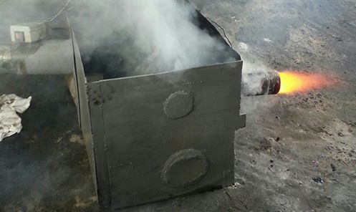
Black Carbon Burner
Definition & History:
Coal Burner is a mechanical device that burns pulverized coal
7

Slide 9
Black Carbon Burner Components
Mechanical Parts:
1- Coal Hopper.
2- Screw Conveyor.
3- Draft Fan.
4- Coal Burner.
Electrical Parts:
1- Temperature Sensor.
2- Spark.
3- Light Sensor.
4- Monitor.
8

Slide 10
Mechanical Parts
1- Coal Hopper:
The Main location to where
the coal is provided.
9

Slide 11
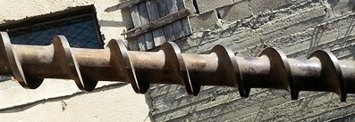
Mechanical Parts
2- Screw Conveyor:
Helical Screw with shaft to
transfer the pulverized coal.
10

Slide 12
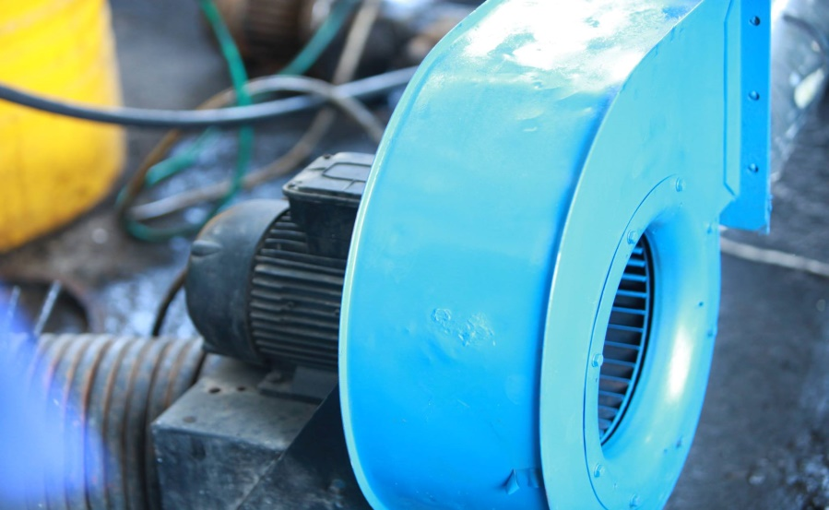
Mechanical Parts
3- Draft Fan:
Centrifugal Fan provides a
positive pressure.
.
11

Slide 13
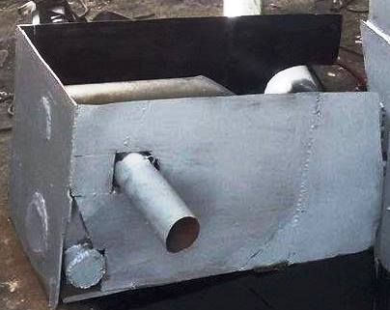
Mechanical Parts
4- Coal Burner:
Coal mixes with air to
Produce a high flame.
12

Slide 14
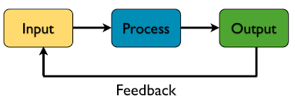
Control System
Any Control System Consists of:
13

Slide 15
Control System
Switch
To the spark and monitor
Feedback
14

Slide 16
Electrical Parts
1- Temperature Sensor:
Two temperature sensors are used
to measure the ambient and the
burner’s temperatures.
15

Slide 17
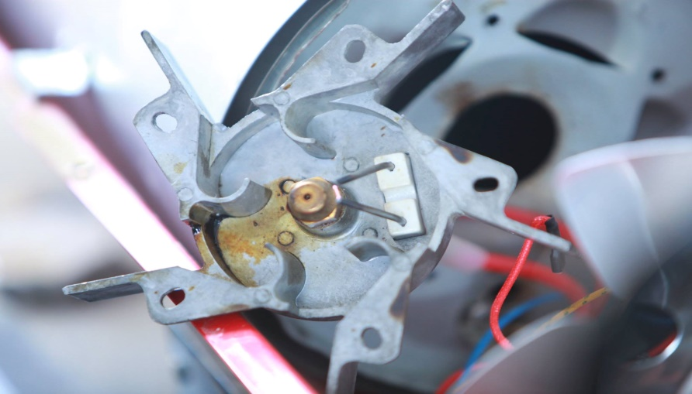
Electrical Parts
2- Spark:
It is used to give a flame when
The switch is pressed.
16

Slide 18
Electrical Parts
3- Light Sensor:
senses the light of the fire inside
the burner to turn off the spark.
17

Slide 19
Electrical Parts
4- Monitor:
Used to display the value of the
temperature inside the burner.
Watch The Video
18

Slide 20
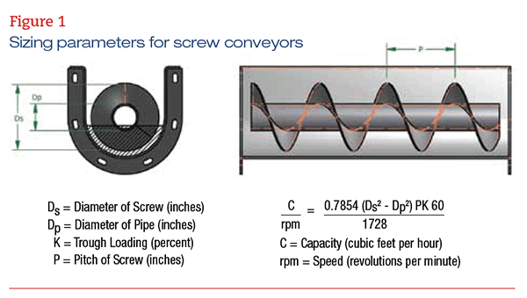
Results & Analysis
1- Screw Conveyor Calculations:
● Mass of flow rate for black carbon (m) = 132.246Ib/hr = 59.5 kg/hr
● Density of black carbon = 45 Ib/ft³.
NEXT
19

Slide 21
Results & Analysis
● Trough Loading (K) = 30%.
● Diameter of screw (Ds) = 60 mm = 2.3622 in.
● Diameter of pipe (D_{P}) = 35 mm = 1.37795 in.
● Pitch (P) =1.5748 in.
20

Slide 22
Results & Analysis
21

Slide 23
Results & Analysis
2- Draft Fan Calculations:
Combustion is a fast chemical reaction between combustible components and an oxidizing agent. Mostly air is used for combustion. Dry air contains 21%O₂ and 79% N₂ and so 1 mole of O₂ carries with it 3.76 moles of N₂.
C+ (O₂+3.76 N₂) = CO₂+3.76 N₂ + heat
(12)C + (32) O + (28) N → (44) CO₂+ (28)3.76 N₂
(1)C + (32/12) O + (28/12) N → (44/12) CO₂+ (28/12)*(3.76/2) N₂
1kgC +2.67 kgO+ 8.77 kg N→3.67 kgCO₂+ 4.385 kg N_{2.}
22

Slide 24
Results & Analysis
For 1 kg Black Carbon required to burn we need:
2.67kgO + 8.77kg N
2.67(1O+3.2N), that means 1 kg of Oxygen → 4.2 kg of air, therefore:
→ (4.2 * 2.67) = 11.2 kg of air, So:
1 kg of Black Carbon required 11.2 kg of air
23

Slide 25
Results & Analysis
Corresponding to the last assumption:
Mass flow rate = 132.246 Ib/hr = 59.5 kg/hr = 0.0165 kg/sec.
For the screw conveyor, the velocity equals 62 rpm = 1.03 rps.
24

Slide 26
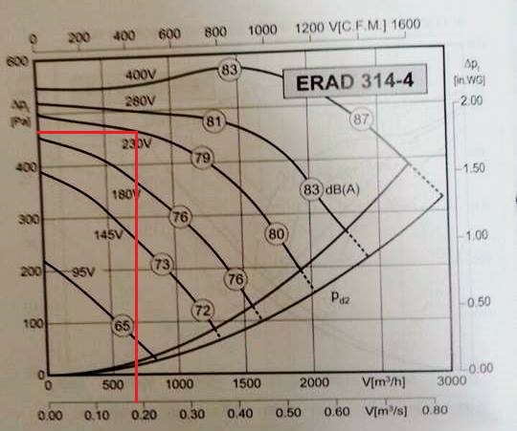
Results & Analysis
From the following chart, the value of the head pressure = 470 Pa
25

Slide 27
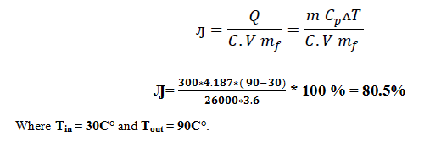
Results & Analysis
In General, the efficiency for oil (diesel) burner lies between 70-85% and the companies select it to be approximately 80% .
26

Slide 28
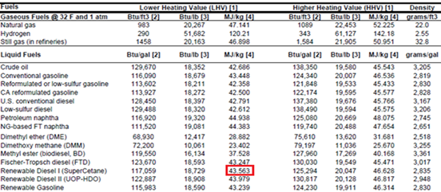
Results & Analysis
From the below table, we can calculate the caloric value of Diesel.
Calorific Value of Diesel = 43563 KJ/Kg.
27

Slide 29
Results & Analysis
Cost Calculations:
3.6 Kg is the amount of black carbon inserted to find the efficiency of black carbon burner.
The mass for the coal = 3.6 kg, and if we assume the cost of 1 kg coal = 0.125$,
Then the cost at the maximum efficiency will be 3.6*0.125 = 0.45 $.
For Black Carbon:
28

Slide 30
Results & Analysis
29

Slide 31
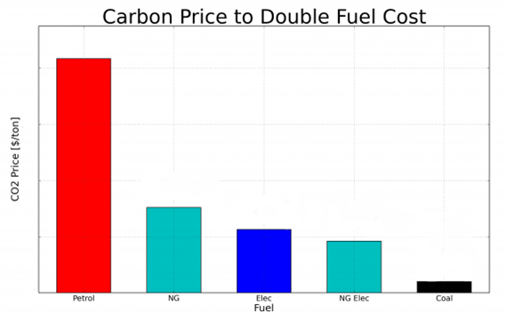
Results & Analysis
30

Slide 32
Discussion
Depending on the following results, The coal fuel was the most effective fuel because of many reasons: High calorific value and low cost.
Fuel Type
Coal Fuel | Diesel Fuel
0.7208 Kg/L | 0.845 Kg/L | Density
26000 KJ/Kg | 43563 KJ/Kg | Calorific Value
59.5 Kg/hr | 82.5 L/hr | Consumption
80.5% | 80% | Efficiency
21717 $/year | 361350 $/year | Cost
Comparison
30

Slide 33
Discussion
Combustion efficiency relay to some factors like:
1- The nature of combustion.
2- Combustion speed.
3- The heat value.
30

Slide 34
Conclusion & Recommendation
In conclusion and in light of what has been previously mentioned, an innovative alternative source of energy to replace the fossil diesel fuel has been put on the table by conducting this research project at which a series of mechanical and chemical calculations and results indicated that this project can be considered as a success project.
Depending on the previous calculation and analysis, we advice to use our project as an alternative source to operate the factories.
Conclusion:
Recommendation:
32

Slide 35
Thank you!!!

