Slide 2
Outlines :
Introduction .
Construction .
Control .
Devices :
Stepper .
Encoder .
Limit switch .
Mechanical Operation.

Slide 3
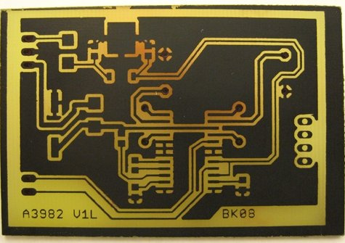
PCB
Printed circuit board

Slide 4
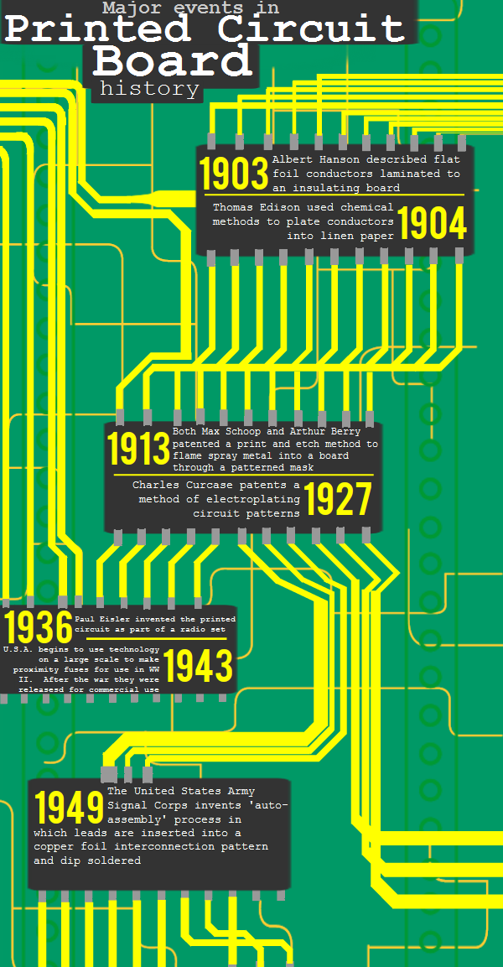
History of the PCB
It began in 1903 and developed through time

Slide 5
PCB Methods
Milling
Laser
Photoengraving
Notes:
The following methods are commonly used to cut steel:
Oxygen-acetylene flame cutting, commonly used for general cutting and edge preparation operations, such as beveling, notching…
Laser cutting, which is mechanically guided, is generally useful for cutting plate; thickness limitations vary.
Plasma cutting, which is mechanically guided, is generally useful for cutting plate of up to 3/4-in. thickness.

Slide 6
Why drilling milling cnc ?

Slide 7
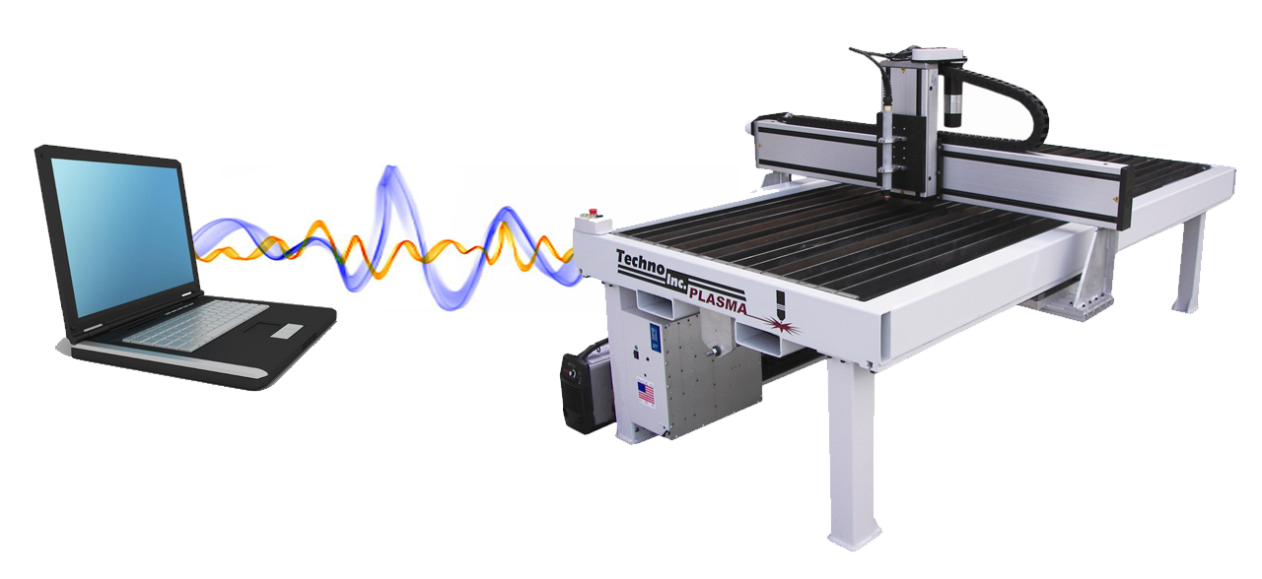
What is CNC
Computer Numerical Control
CAD Drawing Physical Part
Reduce human error
Notes:
It/s an computer numerical control that reciver

Slide 8
Construction of the PCB
A stepper motor-lead screw combination is used on all three axis to make axis movements . The shaft of the motors are coupled to lead screws. The screws are beared at two ends by ball bearings. With this mechanism the rotational movement of the stepper motors are converted to linear movements to drive the axis .

Slide 9
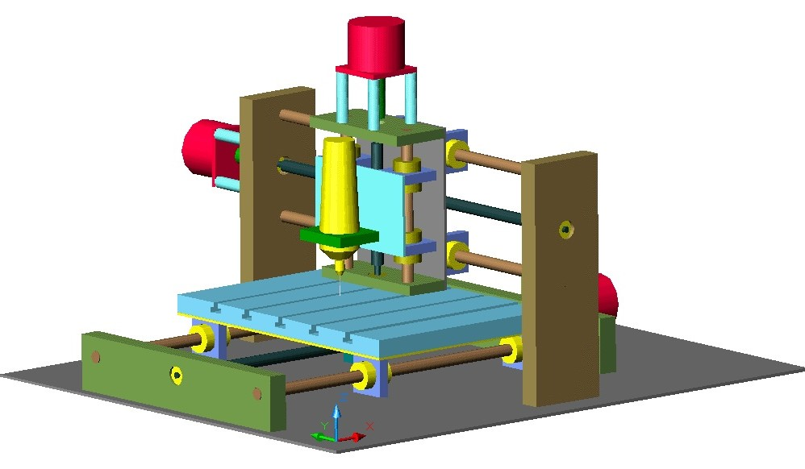
As we can see here ,a 3D solid diagram of the CNC .

Slide 10
Connecting the PC to the steppers’ drivers :
There are two methods to connect the PC to the steppers' drivers ,,,,,method 1 it’s an easy connection method and method 2 it’s a hard connection method . the easy one talks about the mack3 and the interface board ,while the hard one talks about the obtained programs and the PIC.

Slide 11
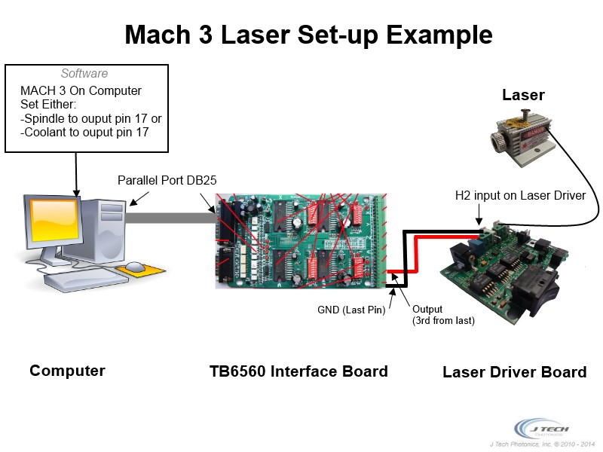
Method 1 - (mack3 and the interface board) :

Slide 12
Method 2 - (PIC and the obtained programs) :

Slide 13
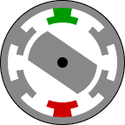
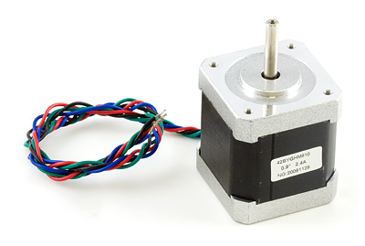
Stepper Motor
Open Loop
Easy to control
Low cost
High resolution

Slide 14
Stepper Motor
Unipolar: In unipolar stepper motors the number of phases is twice the number of coils, since each coil is divided into
Bipolar :Bipolar permanent magnet and hybrid motors are constructed with exactly the same mechanism as is used on unipolar motors, but the two windings are wired more simply with no center taps,and known for their excellent .size/torque ratio

Slide 15
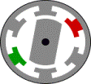
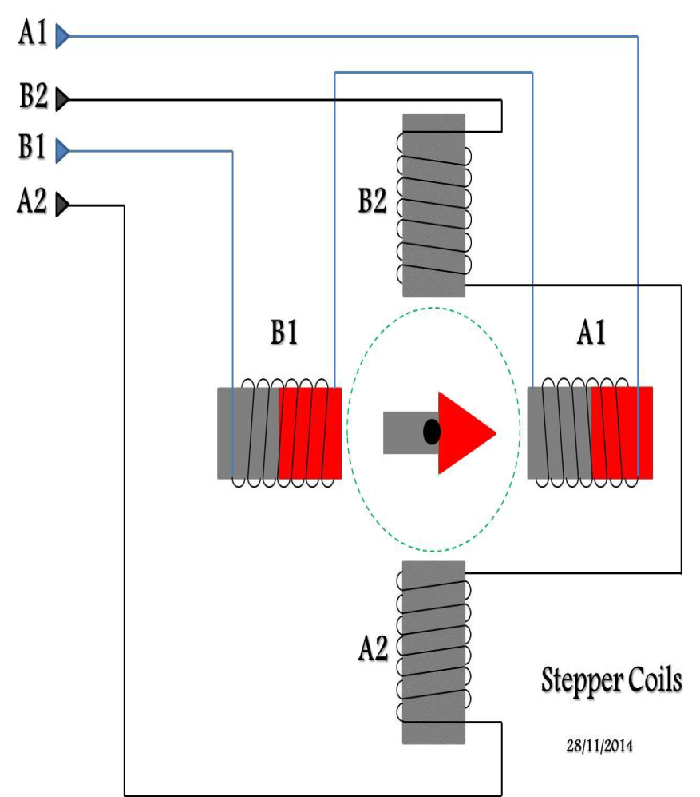
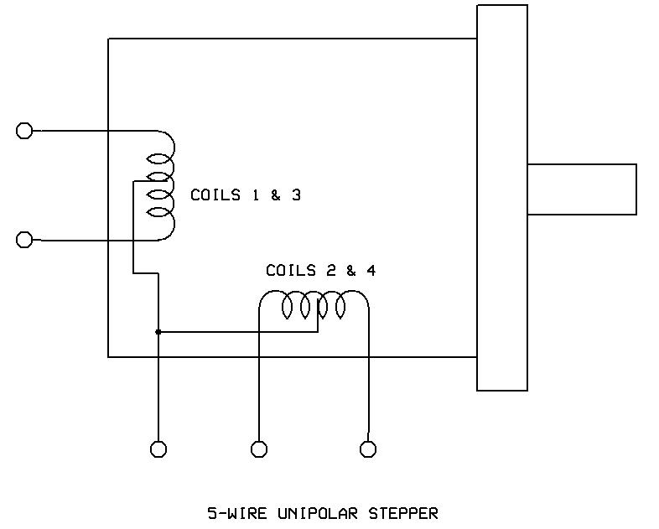
Unipolar Stepper Motor Bipolar Stepper Motor

Slide 16
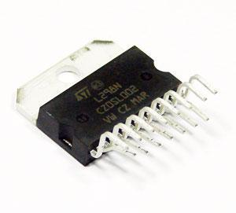
L298 H-Bridge
The L298 has four output pins that connected to the stepper motor.
L297 Controller is stepper motor controller IC generates four phase drive signals for two phase bipolar and four phase unipolar stepper motors.

Slide 17
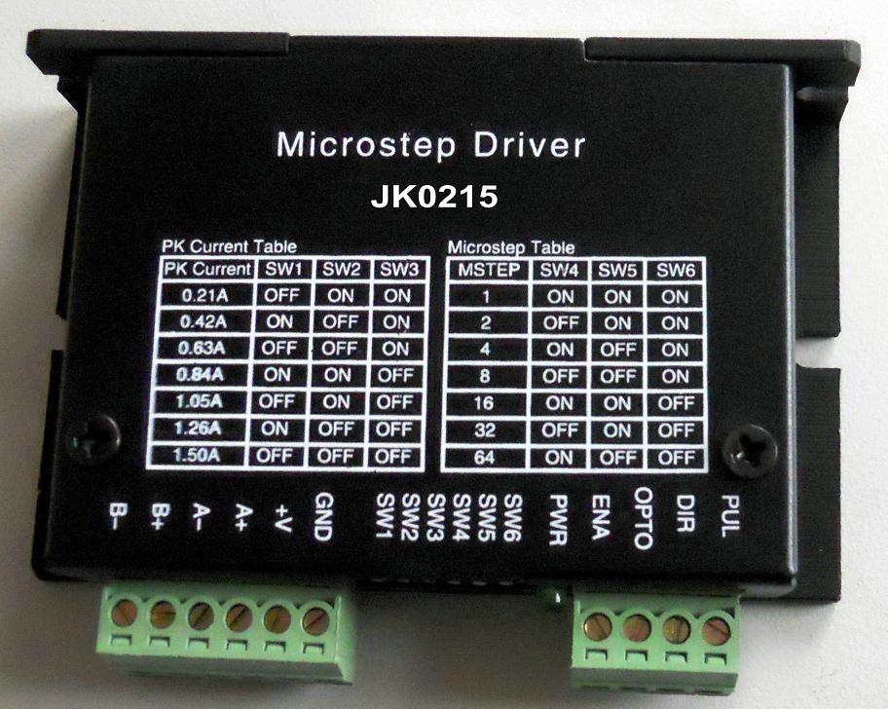
Stepper motor driver
Receives two signal
Step pulses
Direction signal
Accurate the suitable coil

Slide 18
Encoders :
An encoder is a sensor of mechanical motion that generates digital signals in response to motion.
An encoder is able to provide information concerning position, velocity and direction.

Slide 19
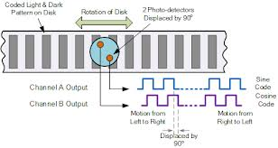
There are two different types of encoders:
Linear encoder : A linear encoder responds to motion along a linear path.

Slide 20
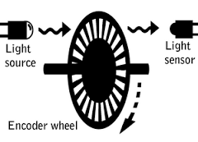
Rotary encoder : Responds to rotational motion.

Slide 21
Linear and rotary encoders are broken down into two main types:
Incremental encoder :
In incremental encoder the transparent disk or path contains opaque sections that are equally spaced to determine movement. The encoder generates a train of equally spaced pulses as it rotates.

Slide 22
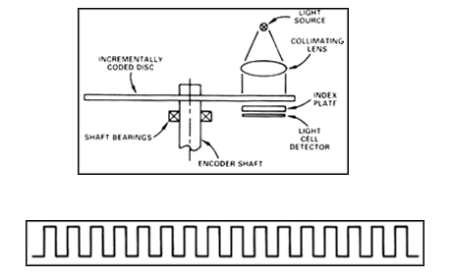


Slide 23
Absolute encoder :
The output signal generated from an absolute encoder is in digital bits .
Each position has its own unique bit configuration. As a result , it allows you to know the specific position .

Slide 24
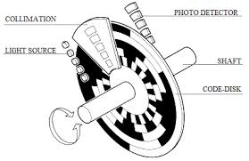
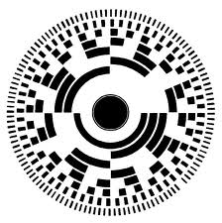

Slide 25

Open loop without encoder :
There is no feedback .
The program remembers the last move and calculates the previous move or steps .
It will not notice if an extra step is made .

Slide 26

Closed loop with encoder :
There is feedback .
The encoder updates your program with the motor’s current position .
It will notice if an extra step is made .

Slide 27
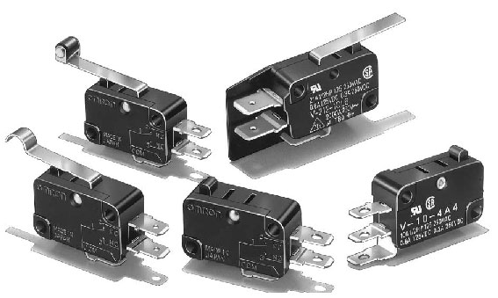
Limit switches :
A limit switch is a switch operated by the motion of a machine part or presence of an object.
We are going to use it to guarantee the machine doesn’t exceed the path
during movement .

Slide 29
Mechanical operation
Each mechanical operation has its own set of requirements in terms of tolerance and accuracy .
Know about base material composition.
Know about equipments and tools.
resulting in higher quality PCB

Slide 30
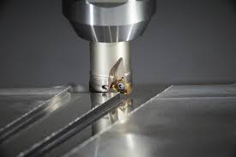
Milling
remove material from the surface of a work piece.

Slide 31
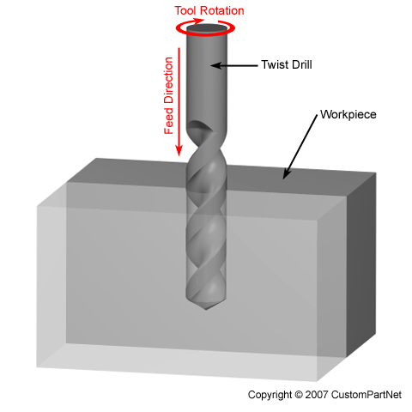
Drilling
Drilling operation is one of the important mechanical process to make PCB.
Drilled hole quality depends on:
- type of laminate.
- type of bits .

Slide 32
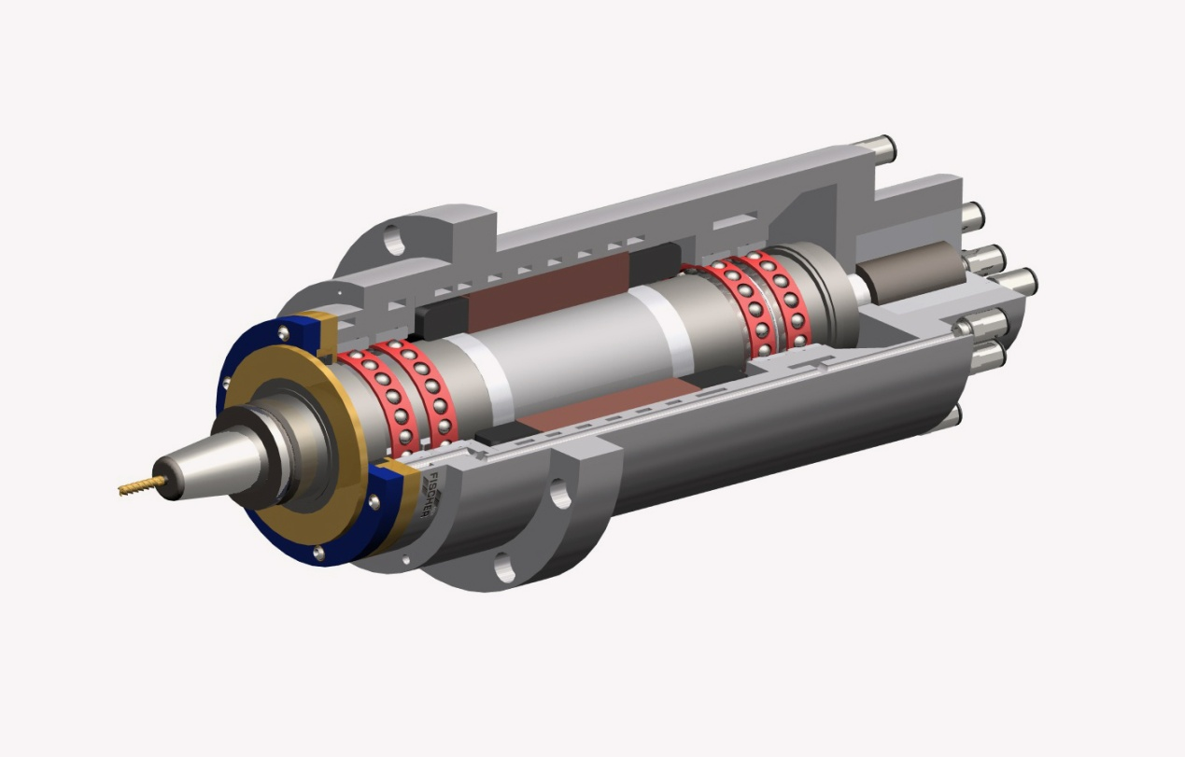
Spindle motor
spindle motor and it links on Z-axis
It used to milling and drilling by the tools
speeds must in excess of 10000-20000 rpm

Slide 33
Base material
Laminates for PCBs are composites material
filler material impregnated with resin .

Slide 34
Filler
provide mechanical strength stability and rigidity to the laminate.
however the most common material used are paper and glass fiber

Slide 35
Resins
Resins are used to impregnate the selected fillers.
commonly used resins in the manufacture of base materials polyester ,epoxy, …
selection of resins takes into account electrical , mechanical , chemical and thermal characteristics.

Slide 36
COPPER FOIL
The conductive layer on a laminate can be made of copper .
many thickness of the copper foil
for examples : 12 Mm , 18 Mm , 35Mm , 70Mm

Slide 37
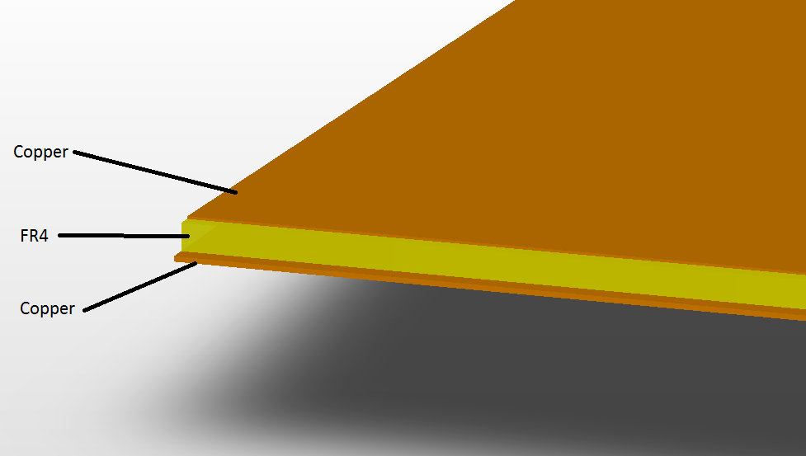
Copper clad laminate
Filler : fiber glass
Resins: epoxy
Properties:
flame retardant , chemical resistant , low water absorption.

Slide 38
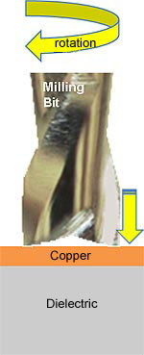
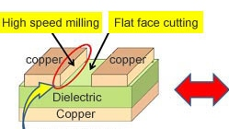
Drilling mechanism

Slide 39
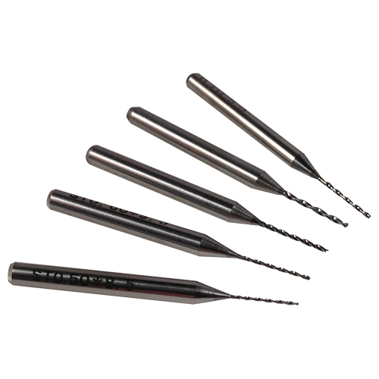
Tools
most PCBs are drilled with carbide bits rather than high speed steel (HSS).
Carbide bits have good resistance to heat and high hardness.
The standard PCB drill for holes of 0.6 mm

Slide 40
Drill speed and feed rate:
Drill speed : is the speed of the drill spindle ( rpm )
Feed rate : the feed indicates the depth to which the drill penetrates into the material in one revolution

Slide 41
Drilling ,type of laminates ,tools
drilling quality depends upon the quality of resin and supporting fiber of laminate and the tools
commonly available copper clad laminates are G-10, epoxy glass/FR4
The drills used are of the tungsten – carbide type.
In order to de- lamination, the PCB must be given strong support with backing plates during milling

Slide 42
THANK YOU!

