Slide 1

Soil Nailing
An-Najah National University Engineering College Civil Engineering Department
Prepared by: Tareq Khader Tamer Hremat
Supervisor Dr. Isam Jardaneh

Slide 2
Excavation Support Systems
Basic Elements of a Soil Nail Wall
Favorable and unfavorable soil for soil nailing
Construction sequence
Design of soil nailing

Slide 3
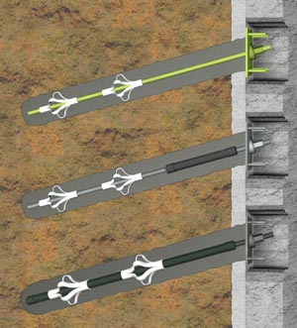
Soil Nailing Is classified as an internally supported system by placing reinforcements in and through the potential failure mass of the soil.

Slide 4
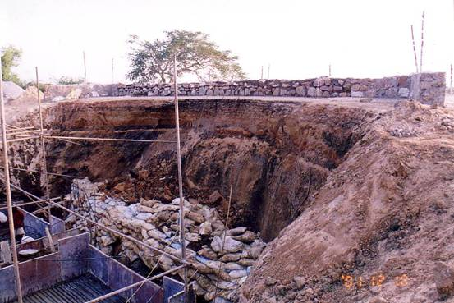
Open Excavation

Slide 5
Braced Excavation

Slide 6
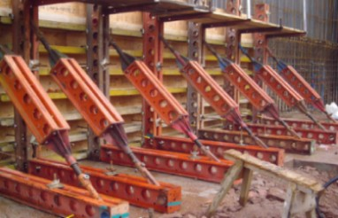
Soldier beam

Slide 7
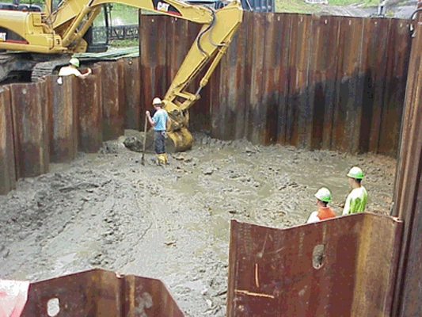
Sheet pile

Slide 8
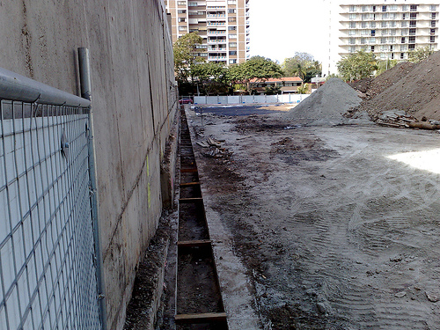
Slurry wall

Slide 9
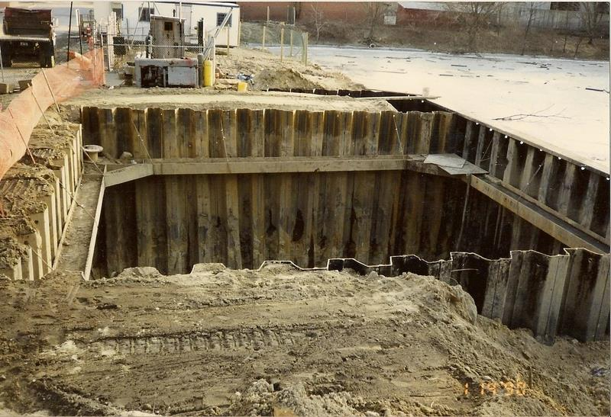
Cofferdam

Slide 10
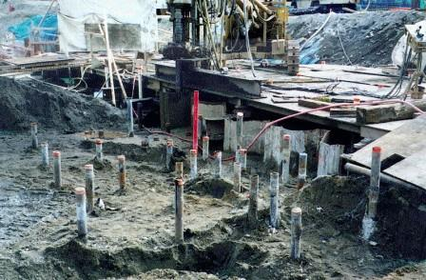
Soil Grouting

Slide 11
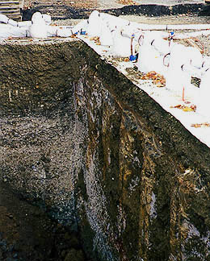
Soil Freezing

Slide 12
Basic Elements of a Soil Nail Wall

Slide 13
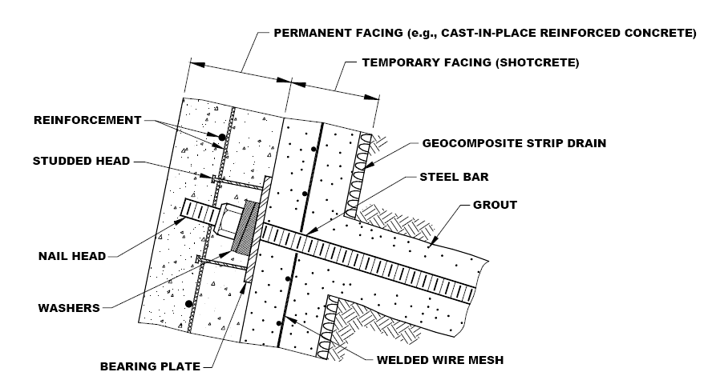

Slide 15
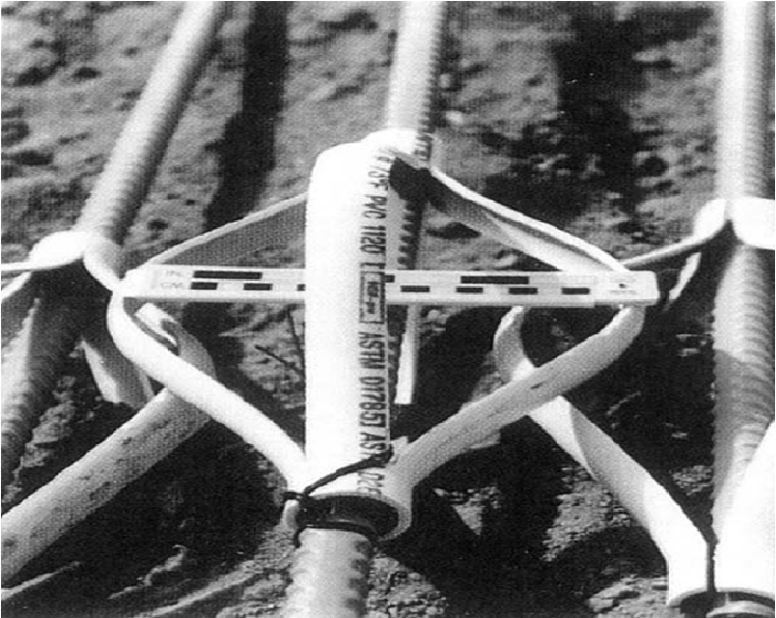
Centralizers

Slide 16
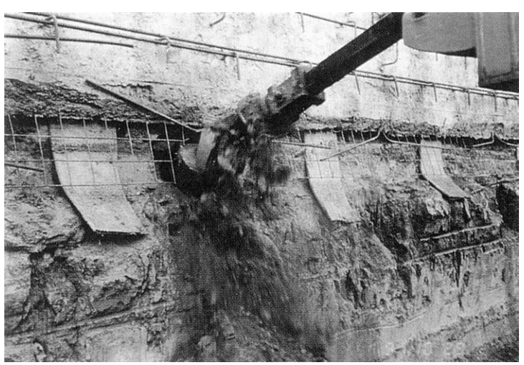
Drainage System

Slide 17
Favorable Soil for Soil Nailing
Stiff to hard fine-grained soils
Dense to very dense granular soils
Glacial soils

Slide 18
Unfavorable Soil for Soil Nailing
Dry, poorly graded cohesionless soils
Soils with high groundwater
Soft to very soft fine-grained soils
Soils with cobbles and boulders
Organic soils

Slide 19
Construction Sequence

Slide 20
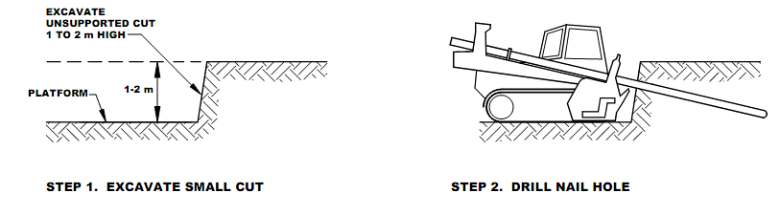

Slide 21
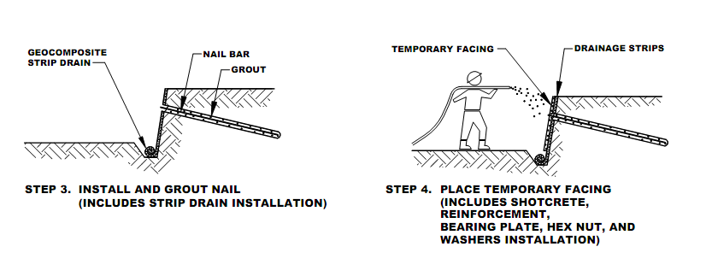

Slide 22
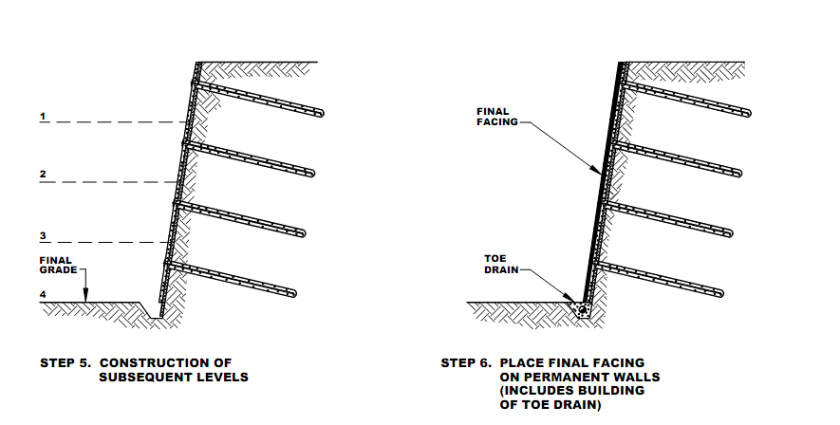

Slide 23
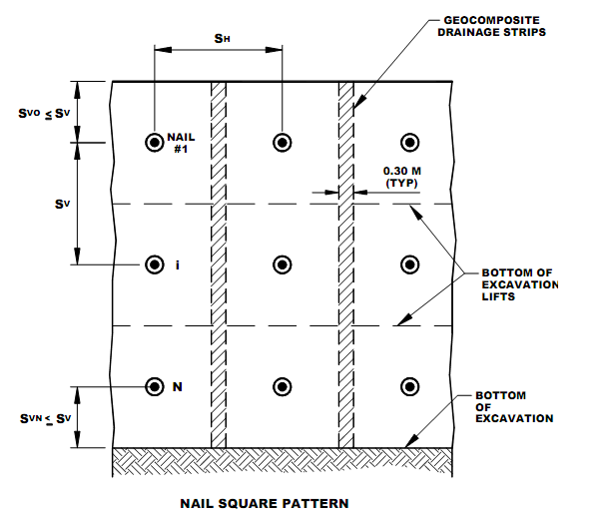
Soil Nail Vertical and Horizontal Spacing

Slide 24
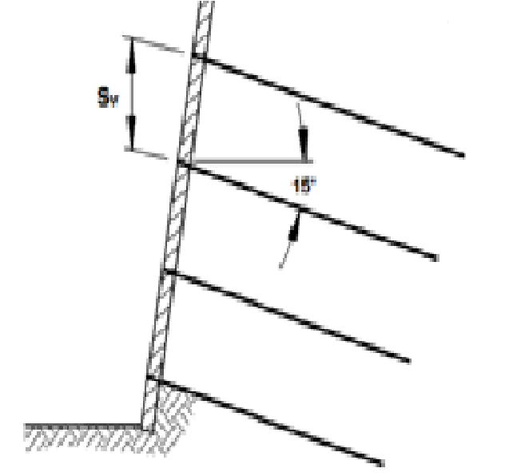
Soil nails are typically installed at an inclination ranging from 10 to 20 degrees from horizontal with a typical inclination of 15 degrees.

Slide 25
Design of soil nailing

Slide 26
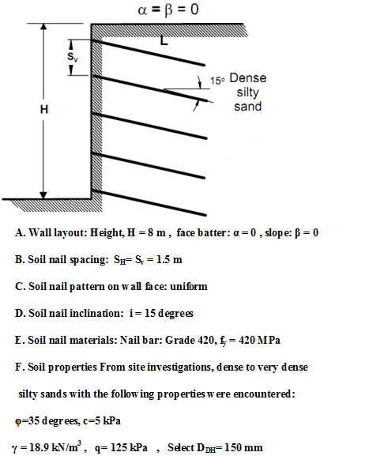

Slide 27
Design using SNAIL

Slide 28
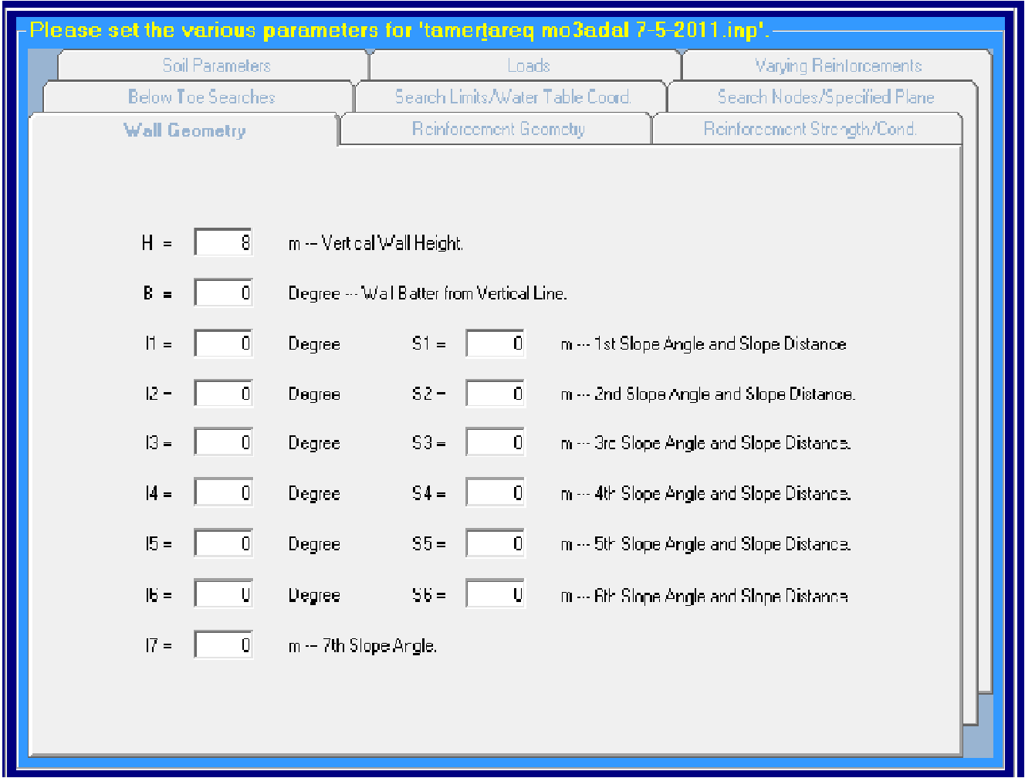

Slide 29
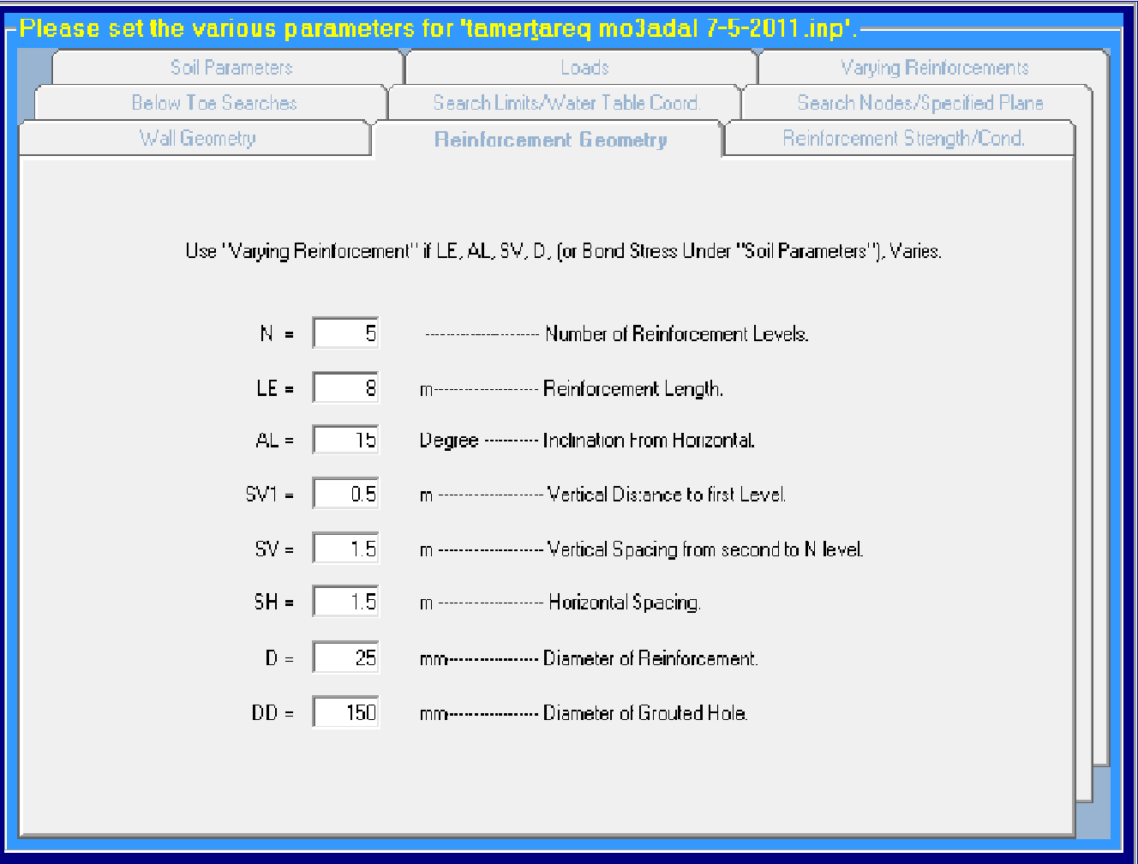

Slide 30
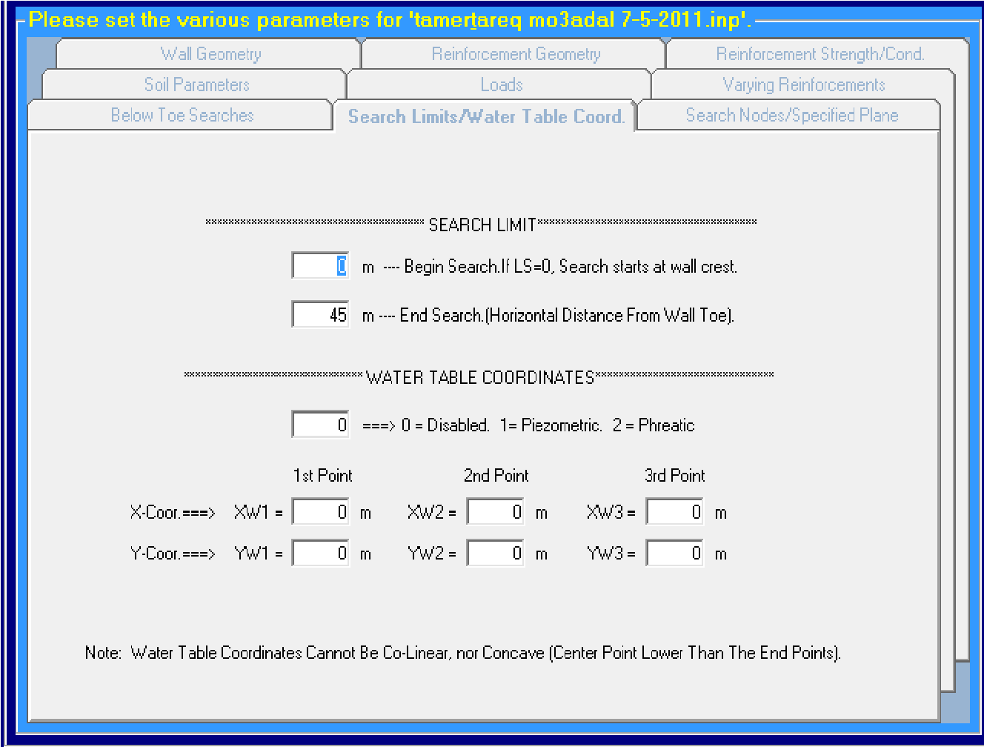

Slide 31
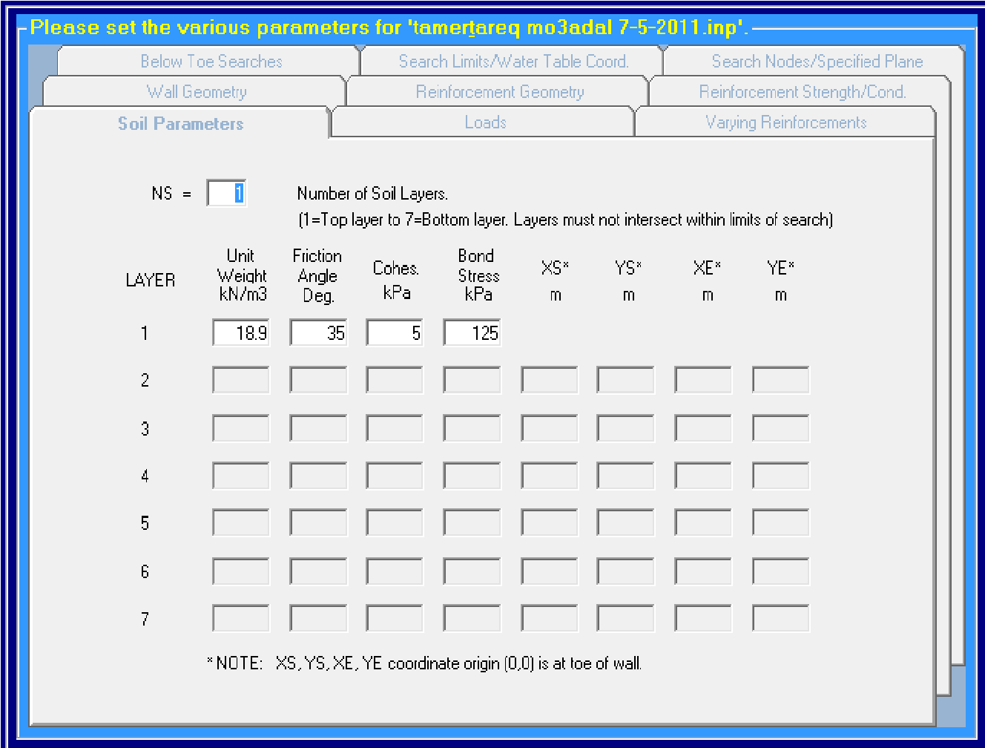

Slide 32
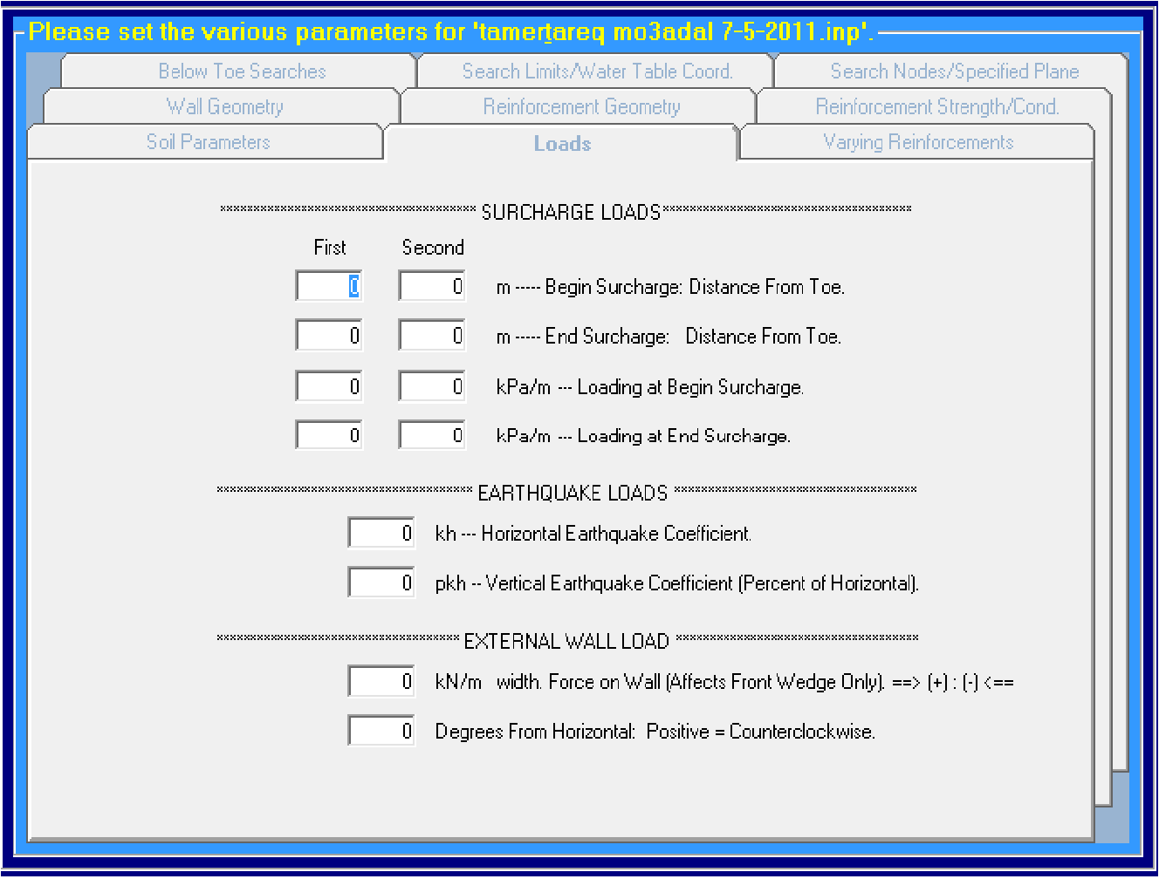

Slide 33
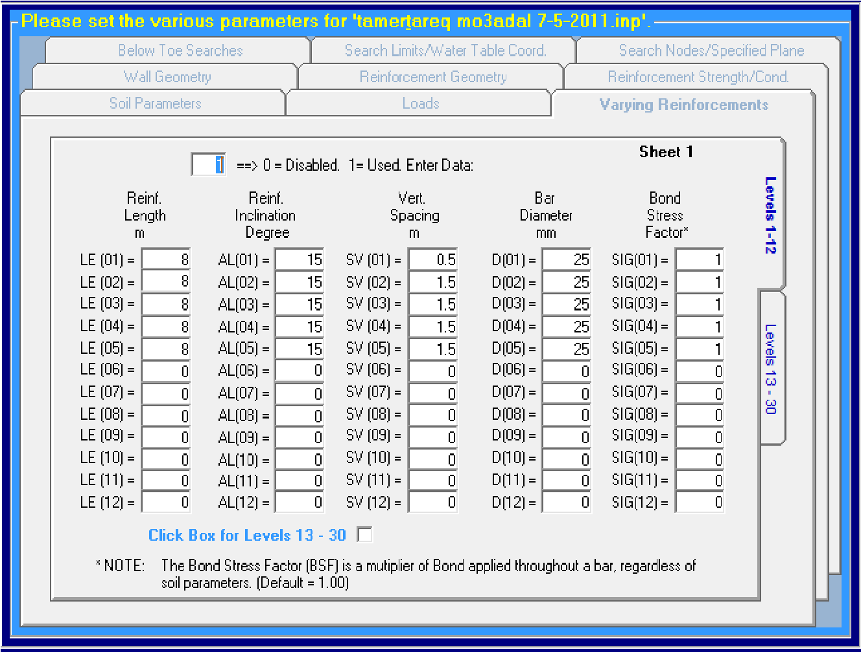

Slide 34
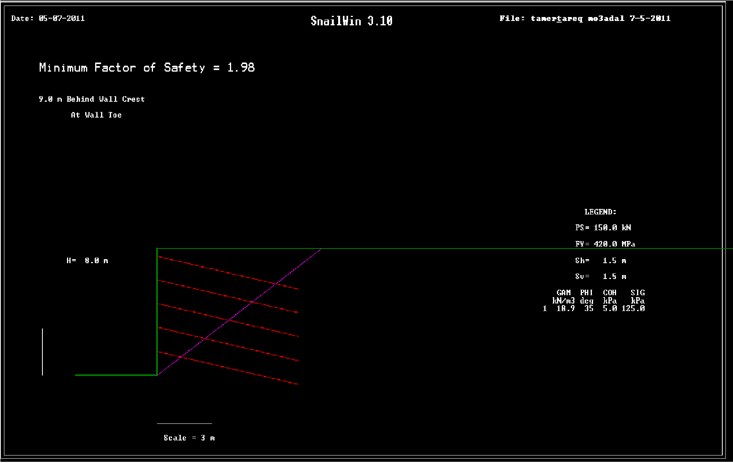

Slide 35
Thank you

