Slide 1
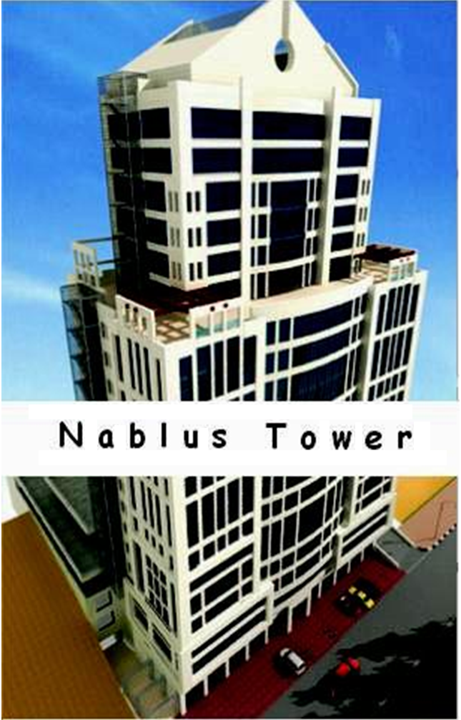


Slide 2
Introduction
Nablus tower is a multi storey building of 21 stories. These stories produce heavy loads above the soil. This building is relatively heavy if we compared it with the ordinary buildings in the city which almost do not exceed 12 or 13 stories each. So the design of the footing will be more critical and needs special care and attention .

Slide 3
This tower is the first tower in Nablus city and in the north of West Bank. It lies in Rafeedia main street to the west of Nablus
The height of the tower is 80 meters .
The area of the first 15 stories is 990m²
And the area for the last 6 stories is 530 m²

Slide 4
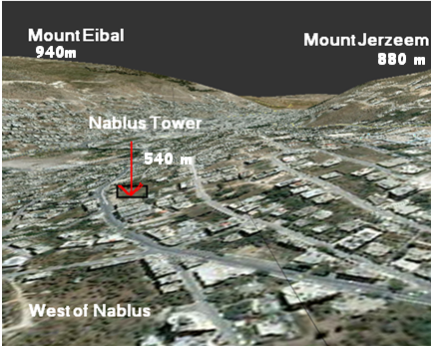
GOOGLE EARTH

Slide 5
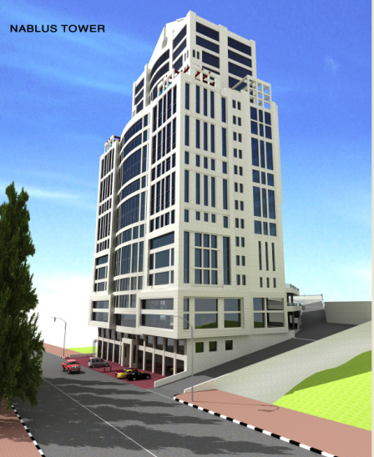
Picture shows model for the tower

Slide 6
Scope of the project
1- Select the most appropriate types of foundations for the project.
2- Design the selected footings.
3- Calculate the settlement.
4- Estimate costs of the foundations designed.

Slide 7
summary of test results
Shear Parameters |  | Specific gravity | Atterberg limits |  | % finer sieve #200 | Moisture Content (%) | Sample depth (m) | BH.No.
Ф (º) | C (KN/m²) |  | PI | LL
20 | 18 | 2.73 | 16.5 | 38.4 | 42.8 | 9.5 | 0-6 | 1
18 | 28 | 2.73 | 22.7 | 50.2 | 48.8 | 20.5 | 6-20
21 | 17 | 2.73 | 15.9 | 37.5 | 44.2 | 10.2 | 0-6 | 2
 |  | 2.73 | 19.9 | 41.2 | 51 | 18.5 | 6-7
 |  | 2.73 |  |  |  | 22.1 | 7-20
24 | 15 | 2.72 | 16.9 | 37.5 | 45.5 | 9.8 | 0-7 | 3
 |  | 2.73 |  |  |  | 17.5 | 7-20
21 | 18 |  |  |  |  | 10 | 0-3 | 4
 |  |  |  |  |  | 18.1 | 3-6
 |  |  | 20.6 | 59.4 | 49.5 | 20 | 6-20
20 | 17 |  |  |  | 45.9 | 9.7 | 0-6 | 5
 |  | 2.73 | 20 | 44.3 | 52.1 | 22.8 | 6-14
 |  |  |  |  |  | 20.6 | 14-20
21 | 18 | 2.73 | 16.4 | 37.9 | 42.9 | 11.2 | 0-6 | 6
 |  | 2.73 | 19.8 | 41 | 44.8 | 17.1 | 6-7
 |  |  |  |  |  | 19.8 | 7-20

Slide 8
Structural Analysis
The weights of the whole structure were calculated by using the Tributary area method ,then we have found the loads on each column.
Total load of the whole structure =
Loads from first 15 stories + last 6 =
28531 + 6100 = 34631 ton.

Slide 9
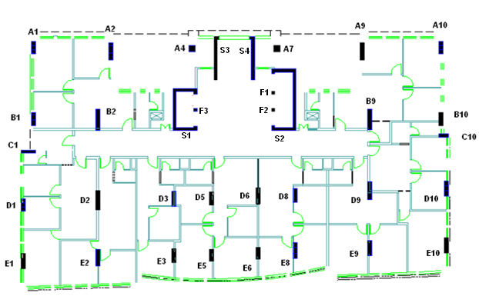
columns plan including shear walls and the external wall

Slide 10
Columns Loads , service and ultimate
Col. | Service Load (tons) | Ultimate Loads(tons)
A1 | 555 | 702
A2 | 1115 | 1419
A9 | 1250 | 1591
A10 | 577 | 730
B1+C1 | 905 | 1158
B2 | 1915 | 2470
B9 | 1582 | 2040
B10+C10 | 754 | 965
D1 | 597 | 763
D2 | 1261 | 1625
D3+D5 | 1759 | 2271
D6+D8 | 1707 | 2203
D9 | 1293 | 1667
D10 | 636 | 814
E1 | 612 | 781
E2 | 1037 | 1263
E3+E5 | 1236 | 1592
E6+E8 | 1200 | 1546
E9 | 942 | 1213
E10 | 596 | 735

Slide 11
Design of footings
After calculating the loads on each column, we have decided to use PILE FOUNDATION SYSTEM due to the heavy loads existed, the soil bearing capacity is medium, so this had led us also to use this system.
In this design we made many iterations to achieve the perfect design.
Using one pile or two piles in one cap is not preferred because of the instability in this case, so we have tried to use 5 piles in one cap or more depending on the loads on each column.

Slide 12
Number of piles in the one cap was restricted by the geometry of the whole system. The over lapping between piles was the main reason in this case. The minimum distance between two piles was 2.5 the diameter of the pile
So the loads and the minimum distance between two piles were the two main factors in the design.
The diameter of the pile is 100 cm and it is the same in every pile, also we tried in this case to achieve practical design.

Slide 13
The footing under the shear walls area was designed in a different way. Due to the heavy loads and the limited area, piles are not chosen. We have designed it as MAT FOUNDATION.
The area of mat foundation is approximately 180 m²

Slide 14

Pile Design
The design of the piles was done by ALL PILE program.

Slide 15
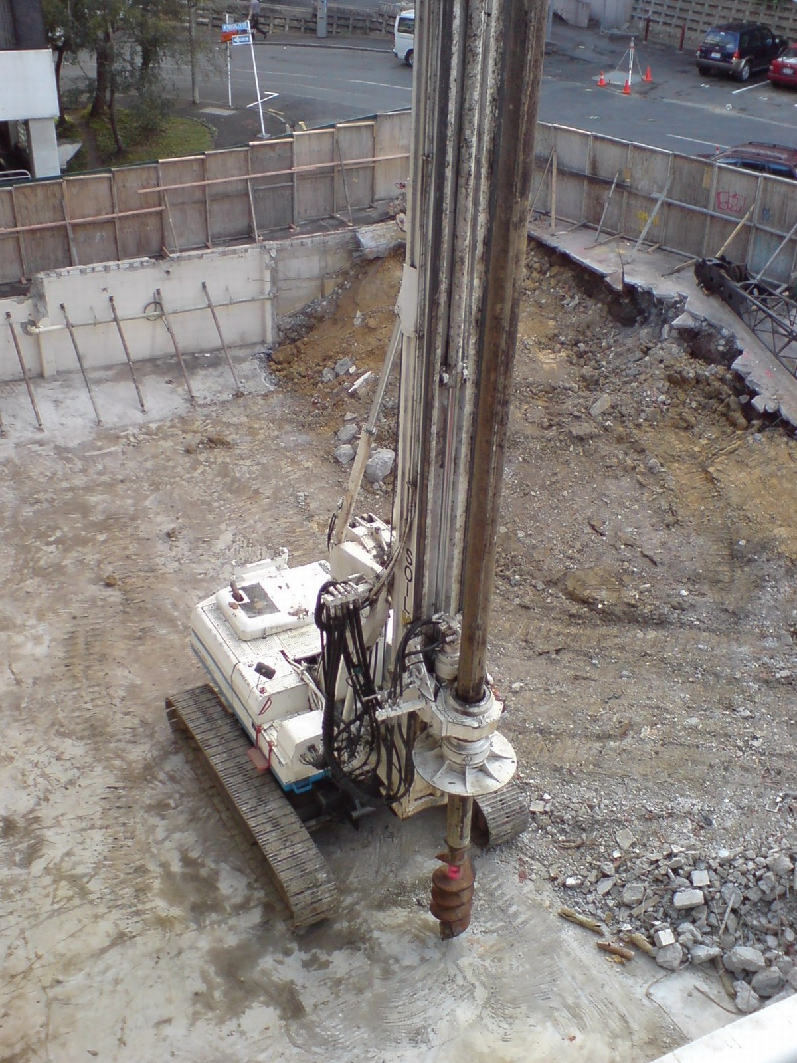
Pile drilling

Slide 16
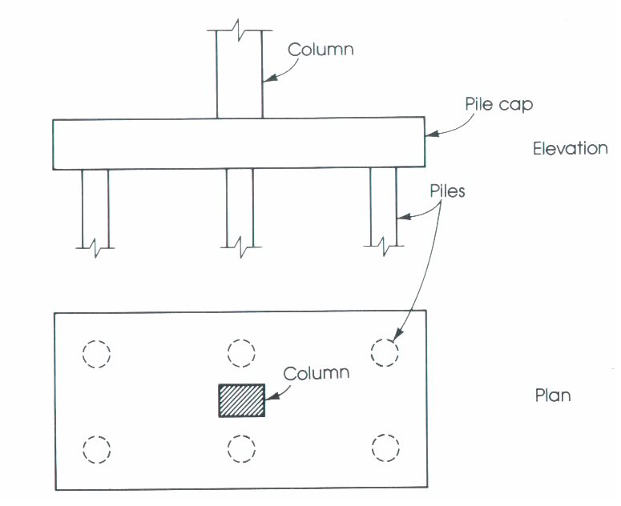
Pile system

Slide 17
piles design results
Col. | Service Load (tons) | Ultimate Loads(tons) | No. of Piles | Length(m) | Diameter (cm)
A1 | 555 | 702 | 5 | 16 | 100
A2 | 1115 | 1419 | 5 | 26 | 100
A9 | 1250 | 1591 | 6 | 26 | 100
A10 | 577 | 730 | 5 | 17 | 100
B1+C1 | 905 | 1158 | 5 | 23 | 100
B2 | 1915 | 2470 | 9 | 26 | 100
B9 | 1582 | 2040 | 8 | 25 | 100
B10+C10 | 754 | 965 | 5 | 20 | 100
D1 | 597 | 763 | 5 | 17 | 100
D2 | 1261 | 1625 | 6 | 26 | 100
D3+D5 | 1759 | 2271 | 7 | 27 | 100
D6+D8 | 1707 | 2203 | 7 | 27 | 100
D9 | 1293 | 1667 | 6 | 26 | 100
D10 | 636 | 814 | 5 | 18 | 100
E1 | 612 | 781 | 5 | 17 | 100
E2 | 1037 | 1263 | 5 | 26 | 100
E3+E5 | 1236 | 1592 | 6 | 26 | 100
E6+E8 | 1200 | 1546 | 6 | 25 | 100
E9 | 942 | 1213 | 5 | 24 | 100
E10 | 596 | 735 | 5 | 17 | 100

Slide 18
group piles settlement calculations
Col. | Settl. in one pile (mm) | Bg(m) | group pile settlement(mm) | Rs | N ^{0.5}
A1 | 1.5 | 5.6 | 3.5 | 2.33 | 2.24
A2 | 3 | 5.6 | 7.1 | 2.37 | 2.24
A9 | 3 | 3.7 | 5.8 | 1.93 | 2.45
A10 | 1.6 | 5.6 | 3.8 | 2.38 | 2.24
B1+C1 | 2.5 | 3.7 | 4.8 | 1.92 | 2.24
B2 | 3 | 6.2 | 7.5 | 2.5 | 3
B9 | 2.8 | 6.3 | 7 | 2.5 | 2.83
B10+C10 | 2 | 5.6 | 4.7 | 2.35 | 2.24
D1 | 1.6 | 5.6 | 3.8 | 2.38 | 2.24
D2 | 3 | 5.6 | 7.1 | 2.37 | 2.45
D3+D5 | 3.2 | 6.2 | 8 | 2.5 | 2.65
D6+D8 | 3.2 | 6.2 | 8 | 2.5 | 2.65
D9 | 3 | 3.7 | 5.8 | 1.93 | 2.45
D10 | 1.8 | 5.6 | 4.3 | 2.39 | 2.24
E1 | 1.6 | 5.6 | 3.8 | 2.38 | 2.24
E2 | 3 | 5.6 | 7.1 | 2.37 | 2.24
E3+E5 | 3 | 6.2 | 7.5 | 2.5 | 2.45
E6+E8 | 2.9 | 6.2 | 7.2 | 2.48 | 2.45
E9 | 2.7 | 5.6 | 6.4 | 2.37 | 2.24
E10 | 1.7 | 5.6 | 4 | 2.35 | 2.24

Slide 19
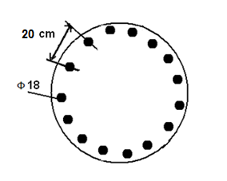
Design of Reinforcement in the Piles :
As = ρ X area = 0.005 (π/4)(1000)² = 3927 mm ²
Use 15 Ф 18
It is recommended to use spiral stirrups 1Ф8 mm / 10 cm .

Slide 20
Caps Design
Col. | Depth(m) | Col. | Depth(m)
A1 | 0.50 | D3+D5 | 2.0
A2 | 0.85 | D6+D8 | 1.50
A9 | 1.50 | D9 | 1.60
A10 | 0.50 | D10 | 0.55
B1+C1 | 0.50 | E1 | 0.45
B2 | 1.50 | E2 | 0.75
B9 | 1.85 | E3+E5 | 0.65
B10+C10 | 1.55 | E6+E8 | 0.60
D1 | 0.50 | E9 | 0.80
D2 | 0.90 | E10 | 0.50

Slide 21
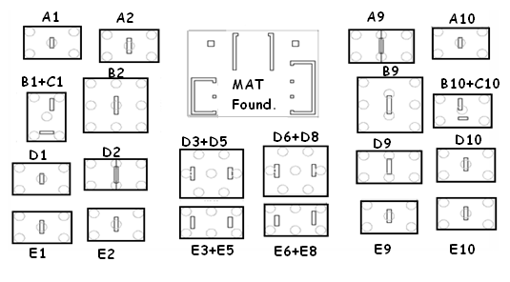
caps and piles distribution

Slide 22
Reinforcement in x direction
Col. | Depth(h) | M11(KN.M) | As(cal) | As min | As used | reinf.
A1 | 0.5 | 449 | 5772 | 1650 | 5772 | 7Ф32
A2 | 0.85 | 941 | 4390 | 2805 | 4390 | 6Ф32
A9 | 1.5 | 1286 | 2764 | 4950 | 4950 | 6Ф32
A10 | 0.5 | 496 | 6575 | 1650 | 6575 | 8Ф32
B1+C1 | 0.5 | 321 | 3849 | 1650 | 3849 | 8Ф25
B2 | 1.5 | 845 | 1805 | 4950 | 4950 | 6Ф32
B9 | 1.85 | 1968 | 3301 | 6105 | 6105 | 8Ф32
B10+C10 | 1.55 | 477 | 975 | 5115 | 5115 | 7Ф32
D1 | 0.5 | 394 | 4905 | 1650 | 4905 | 6Ф32
D2 | 0.9 | 1042 | 4471 | 2970 | 4471 | 6Ф32
D3+D5 | 2 | 755 | 1145 | 6600 | 6600 | 8Ф32
D6+D8 | 1.5 | 918.5 | 1964 | 4950 | 4950 | 6Ф32
D9 | 1.6 | 110 | 215 | 5280 | 5280 | 7Ф32
D10 | 0.55 | 478 | 4801 | 1815 | 4801 | 6Ф32
E1 | 0.50 | 291 | 3440 | 1650 | 3440 | 7Ф25
E2 | 0.75 | 742 | 4191 | 2475 | 4191 | 9Ф25
E3+E5 | 0.65 | 615 | 4441 | 2145 | 4441 | 6Ф32
E6+E8 | 0.6 | 560 | 4716 | 1980 | 4716 | 6Ф32
E9 | 0.8 | 762 | 3869 | 2640 | 3869 | 8Ф25
E10 | 0.5 | 474 | 6191 | 1650 | 6191 | 8Ф32

Slide 23
reinforcement in y- direction
Col. | Depth(h) | M22(KN.M) | As(cal) | As min | As used | reinf.
A1 | 0.5 | 114 | 1253 | 1650 | 1650 | 4Ф25
A2 | 0.85 | 188 | 837 | 2805 | 2805 | 6Ф25
A9 | 1.5 | 363 | 771 | 4950 | 4950 | 6Ф32
A10 | 0.6 | 143 | 1106 | 1650 | 1650 | 4Ф25
B1+C1 | 0.5 | 541 | 7412 | 1650 | 7412 | 9Ф32
B2 | 1.5 | 408 | 867 | 4950 | 4950 | 6Ф32
B9 | 1.85 | 162 | 268 | 6105 | 6105 | 8Ф32
B10+C10 | 1.55 | 880 | 1807 | 5115 | 5115 | 7Ф32
D1 | 0.5 | 124 | 1368 | 1650 | 1650 | 4Ф25
D2 | 0.9 | 190 | 779 | 2970 | 2970 | 6Ф25
D3+D5 | 2 | 505 | 765 | 6600 | 6600 | 8Ф32
D6+D8 | 1.5 | 546 | 1162 | 4950 | 4950 | 6Ф32
D9 | 1.6 | 367 | 721 | 5280 | 5280 | 7Ф32
D10 | 0.55 | 105 | 947 | 1815 | 1815 | 4Ф25
E1 | 0.50 | 115 | 1246 | 1650 | 1650 | 4Ф25
E2 | 0.75 | 216 | 1162 | 2475 | 2475 | 5Ф25
E3+E5 | 0.65 | 741 | 5470 | 2145 | 5470 | 7Ф32
E6+E8 | 0.6 | 608 | 5180 | 1980 | 5180 | 7Ф32
E9 | 0.8 | 206 | 1003 | 2640 | 2640 | 6Ф25
E10 | 0.5 | 141 | 1565 | 1650 | 1650 | 4Ф25

Slide 24
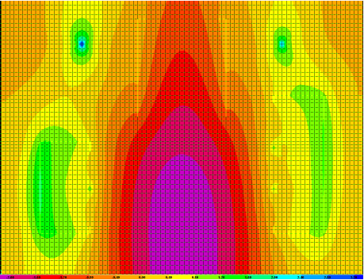
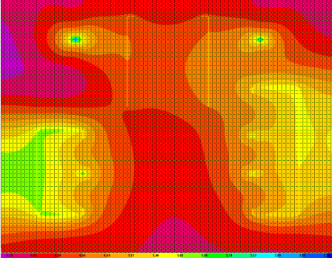
Distribution of moments in the Mat Foundation
M11
M22

Slide 25
Moments are not uniformly distributed , so
there were no column strips nor middle strip .
We divided the mat into several parts .Then we read the maximum moment in each part, and the reinforcement calculated was depending on this reading .

Slide 26
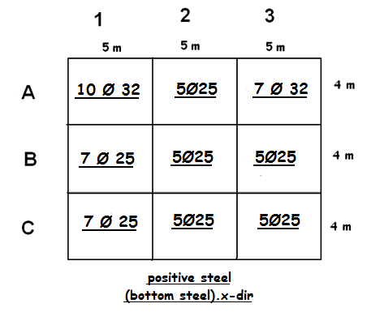
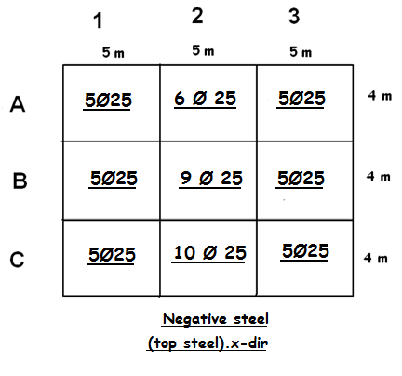
Reinforcement in mat Foundation
X - direction

Slide 27
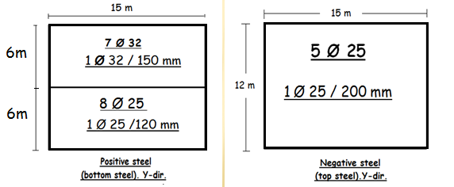
Y – direction

Slide 28
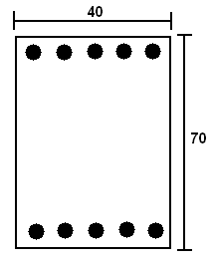
Design of grade beams
The dimensions were suggested to be 40*70 cm as below
As = ρ * b * d = (0.0033)(400)(640) = 844.8 mm²
➔ use 5Ø16 bottom steel.
➔ use 5Ø16 top steel.
cover = 6cm .
(Av/s) = Min ((3.5 bw/fy) , (0.2 bw /fy)) ➔ (Av/s) = 0.033.
use 1Ø10/30 cm

Slide 29
cost Estimation
In order to estimate the total cost we have to calculate the concrete cost , the steel costs, and the cost of drilling the piles .
Concrete costs based on size calculations .
Steel costs based on weight calculations.
Drilling costs based on lengths costs (the diameter is constant)

Slide 30
The total cost of concrete = 3152*320 = 1008640
Total cost of steel= 112*3300 = 369600 NIS
Cost of the drilling = 2690*50 = 134500 NIS
Total cost of the concrete , steel , and drilling
= 1008650+369600+134500 = 1,512,750 NIS.
≈ 1.513.000 NIS

Slide 31

Finished
Thank you for listening

