Slide 1
Analysis & Redesign Of Al-Yamoun Water Distribution Network-Jenin/Palestine
Prepared By
Waleed Osama Alkilani Anas Ahmad Khalid

Slide 2
Study Area “ Alyamoun “
Location : 9 km west of Jenin
Elevation : 160 m above mean sea level
Population : 20000 inhabitants

Slide 3
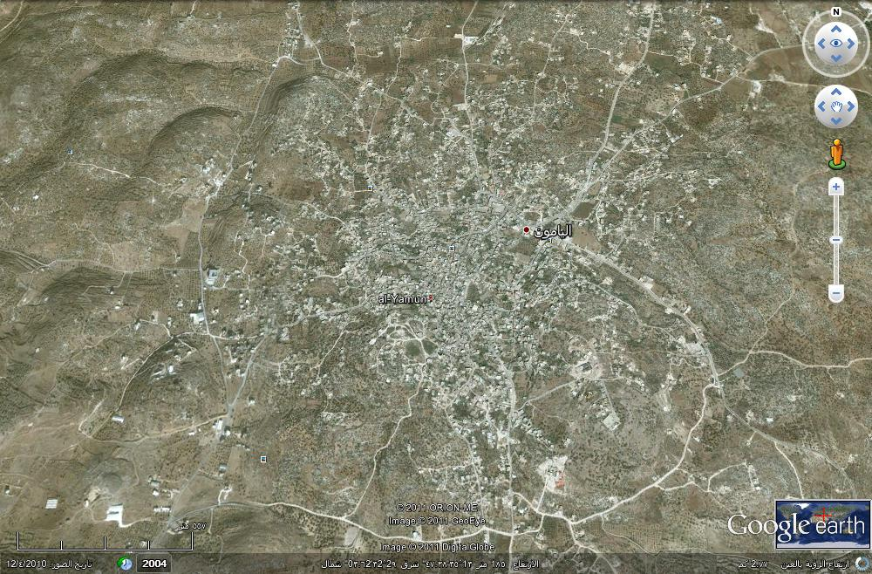

Slide 4
The aim of the project
The aim of the project is to analyze Alyamoun's water supply network and modify or redesign the network to meet the requirements for the next 30 years.

Slide 5
Network
Pipes:
The pipes were used in the network are 103 Pipes ranges from 75 mm to 300 mm .
Nodes:
The nodes in the network are 95 nodes .
Water tanks:
We have two tanks in the network

Slide 6
Questionnaire Analysis
The average per capita consumption = 81 (L/capita/day).
The average number of persons in the family from the questionnaire was 8 Persons.
It was found that families with highest number of persons consume more, which shown in Figures below

Slide 7
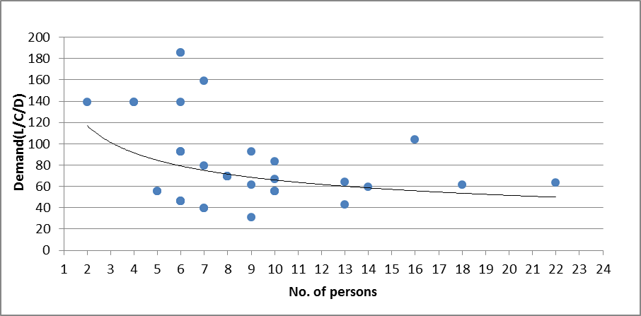

Slide 8
Income :
It can be noticed that the consumption not affected by the income , the relation is shown in figure below :

Slide 10
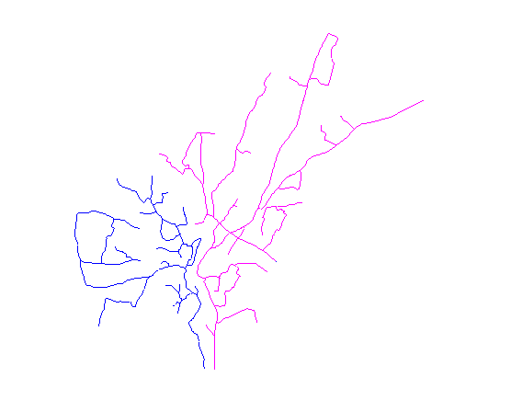
Network

Slide 11
The current situation of the water network:
The data were logged into EPANET program .
Hazen-Williams equation was used .
the factor (C) was considered in our network C =120 .

Slide 12
Problems found in the network's current situation:
● High pressure :
Nodes located in low-lying areas .
Which represented by the red color.
● Low pressure :
Nodes closed to reservoirs and their elevation is high .
Which represented by the blue color .

Slide 13
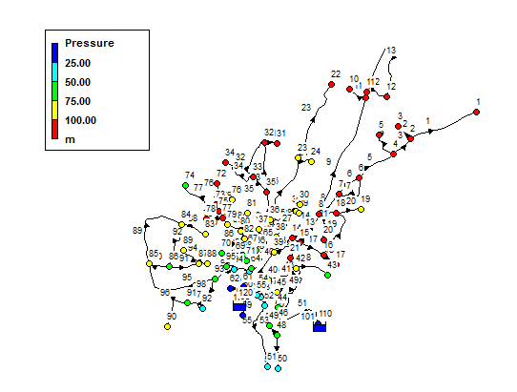
The current situation of the water network:

Slide 14
● High velocity in pipes:
No high velocity were found because of large diameters in the network.
● Low velocity in pipes:
This network in general has low velocity values because of it's large pipes diameters .

Slide 15
Future Network
Future population
Pf = Pp( 1 + i ) ⁿ
Where:
Pf: future population
Pp: present population (20000)
i: growth rate ( 3.0% )
n: number of years to be designed for ( 30 years ).
Pf = 20000*( 1 + .03 )^30 = 48650 person ( future population ) .

Slide 16
Estimation of future water demand
By WHO, The future consumption was considered to be 100 L/C/D
To estimate the future water demand for each node, the nodal water demand will multiply by a factor F, which equal:
F = (future demand/existing demand) * (future population/existing population)
Thus the multiply factor will be: F = 3

Slide 17
Future situation of the water network:
● High pressure :
The maximum pressure value here at node 9 which equal 115.15 m , which means we don't have a problem with this value .
● Low pressure :
There are few junctions with low pressure and these values don’t' cause a problem for our network.

Slide 18
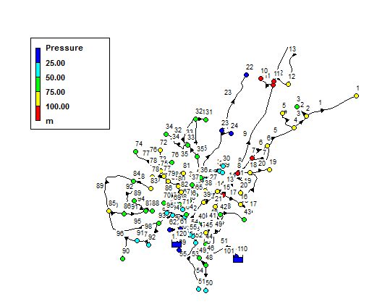

Slide 19
● High velocity :
We have a few pipes with high velocity, so we can increase their diameters to satisfy our criteria.
● Low velocity :
This network in general has low velocity values because its pipes diameters are relatively high .

Slide 20
Cost estimation for the new network
New diameter (mm) | Old diameter (mm) | Pipe ID
100 | 75 | 24
150 | 100 | 39

Slide 21
Approximate costs for new diameters
Total cost ( $ ) | Cost ( $/m|) | Length (m) | Diameter (mm)
6864 | 52 | 132 | 100
5520.5 | 61 | 90.5 | 150
12384.5 | Total cost ( $ )

