Slide 1
Construction Project Management
Presentation of
Prepared By : Ahmad Bdair, Saeed Naser
Mohammad Ablan, Mohammad Sabbah

Slide 2
What is the “Project”?
A project is a temporary endeavor undertaken to create a unique product or service.
Temporary : the project has an end date.
Unique : the project's results is different from the results of other functions of the organization

Slide 3
What is the Project Management?
Project management:
Is the process of combining systems, techniques, and knowledge to complete a project within established goals of time, budget, and scope.

Slide 4
Who is the project Manager?
The person responsible for accomplishing the project objectives.
is often a client representative and has to determine and implement the
exact needs of the client .

Slide 5
Management Functions
1
2
Organizing
3
Planning
4
Leading
Controlling

Slide 6
Management Skills
Conceptual Skills
Human Skills
Technical Skills

Slide 7
Principles In Management
Project Scope Management
Project Quality Management
Project Time Management
Project Communication Management
Project Cost Management
Project Integration Management
Resource Management
Project Procurement Management
Project Risk Management

Slide 8
Our Graduation Project

Slide 9
Project Overview
Project Title:
Municipality of Tulkarm
Location:
Tulkarm City
It is located in the western strip of the city

Slide 10
Project Overview
This Project consists of 2 floors above the ground surface,
the first one consists of stores and the second one contains the employee's offices and meeting and Cafeteria.
The area of the first floor is 1200.76 m2 same as the second floor..

Slide 11




Assumptions
The project was divided in several units.
Working days are all days except Fridays and holydays .
The electrical and mechanical works will be done by sub contractors.

Slide 12
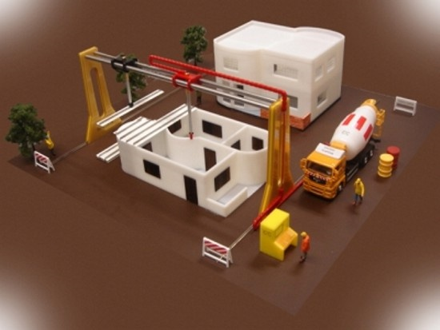
Construction Method
The structural method that used is :
  finishing the structural
part for the ground floor
and then starting on the
above floor structural
work , and in the same
time starting with
finishing works for
the previous floor.

Slide 13
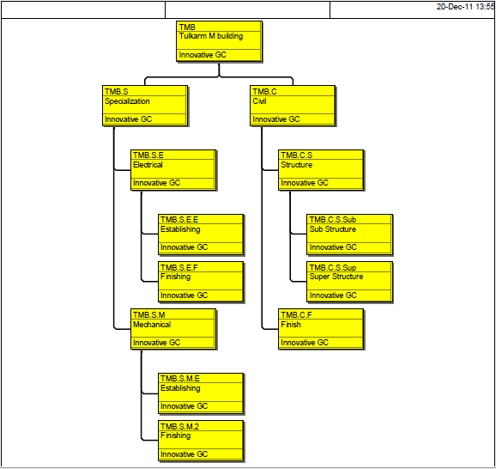
Work Breakdown Structure

Slide 14

Bill of Quantity Preparation
Calculations were made depending on
Drawings to find
the quantities
and tabulating it.

Slide 15
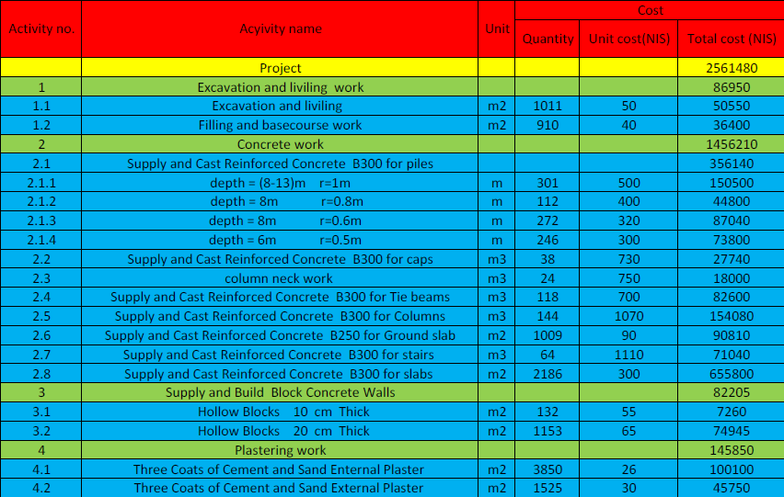
Bill of Quantity Preparation

Slide 16
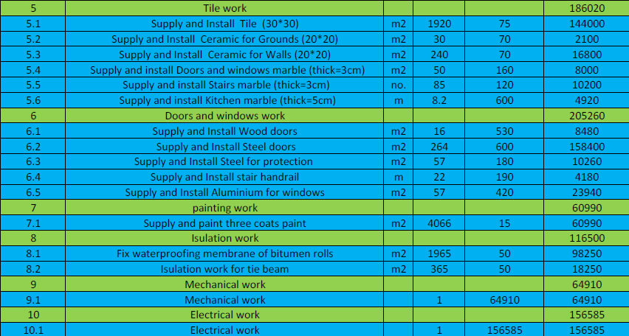
Bill of Quantity Preparation

Slide 17
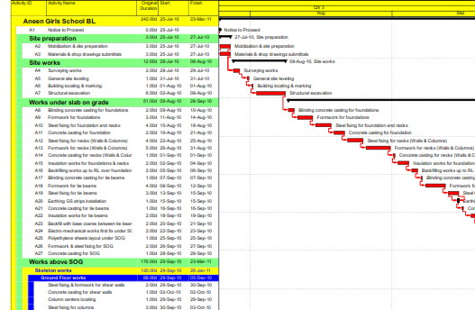
Activity List
The activity list entered
in the (Primavera) program
and it’s dependency also
were managed on this
program.
The dependency of the
activities were constructed according to our method of construction.

Slide 18
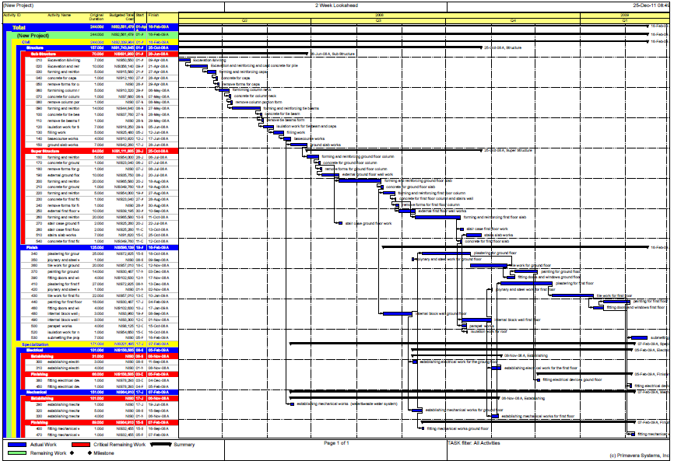
Schedule planning by primavera 6.0

Slide 19
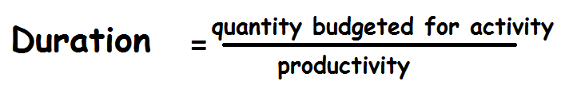
Activities Durations
The activity duration depends on the productivity of labors and machines.
In this project the productivity taken from site engineers and contractors

Slide 20
Pricing
The cost process based upon past experience for the contractor and some of labors.
The pricing for each element of unit was different from each other
Some units were priced according to the area, others were priced according to the volume

Slide 21
Results
Cost Results
Total cost of project calculated using Primavera = 2,561,480 NIS
The cost of structural works = 1,743,845 NIS
The cost of mechanical works = 64,910 NIS
The cost of electrical works = 156,585 NIS
The cost of finishing works = 596,139 NIS

Slide 22
Duration Results
The total duration of the project as planed in this case study is 244 working days.

Slide 23

Update project
After the work schedule and start the implementation, we need to update the project data into compare the project actually and the planned project and the impact on the schedule.

Slide 24
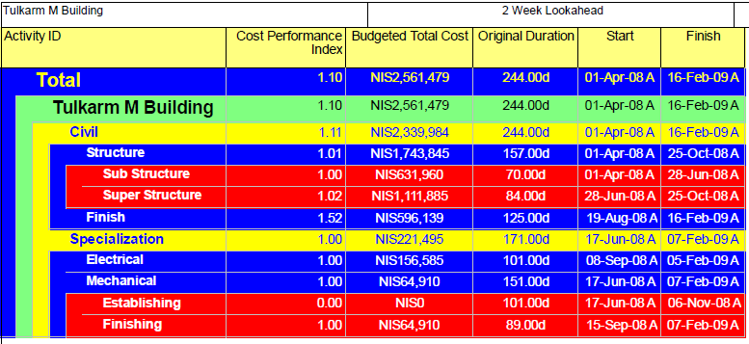
Earned Value
Cost Performance Index (CPI) =1.1 >1 … Under Budget
Schedule Performance Index (SPI) =0.93 < 1 …. Behind schedule (project delayed).

Slide 25
S-Curve
    cost control of this project made By using (S-Curve).
    For this project the S-Curve is done by plotting cumulative cost with time as shown.

Slide 26
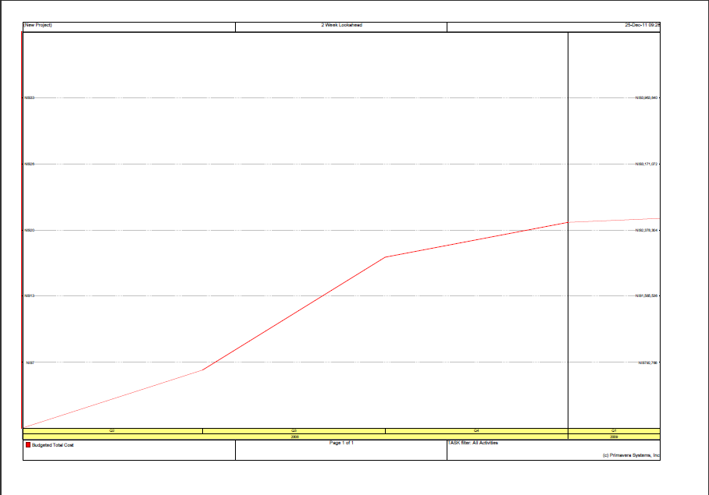
S-curve

Slide 27
Check The Structural Design
Check design for Slab:
Structural system is one way ribbed slab.
From structural drawing h=32 cm
According to AISC code and from table 9.5(a)
Simply supported L/16 = 430/16 =27 cm
One end continuous L/18.5 = 430/18.5 = 24 cm
We have one end continuous
Assume 7 cm cover
Thickness = 24cm
So, 32 cm designed > 24 cm
The slab thickness is OK

Slide 28
Check The Structural Design
Check design for column
The most critical column is an interior column C79
Tributary area = {(540 + 510)/2} * {(450 + 440)/2}
= 24.675 m²
Load combination:
Load = 1.2(D.L) + 1.6(L.L)
For ground floor:
Load = 1.2(1000) + 1.6(500) = 2000 kg/m²
For other floors :
Load = 1.2(1000) + 1.6(250) = 1600 kg/m²

Slide 29
Check The Structural Design
Total load on the column:
Assume As = 0.01Ag
Load = (24.675*2000) + 3(24.675*1600) =1677900 N
Pn = (0.8) (0.65) {0.85(24) (Ag - 0.01Ag) + 0.01Ag (420)}
1677900 = 0.51(29.445Ag)
Ag = 167790/15
Ag = 11186 mm²
The design Ag:
600 *300 = 180000 mm² > 11186 mm²
The design is OK

Slide 30
تم بحمد الله
Thank you
Happy to hear your questions

