Slide 1

An-Najah National University Engineering College Civil Engineering Department
Graduation Project
3D Dynamic Design For Al-Tahreer Office Building
Supervised by: Dr. Abdul Razzaq Touqan

Slide 2
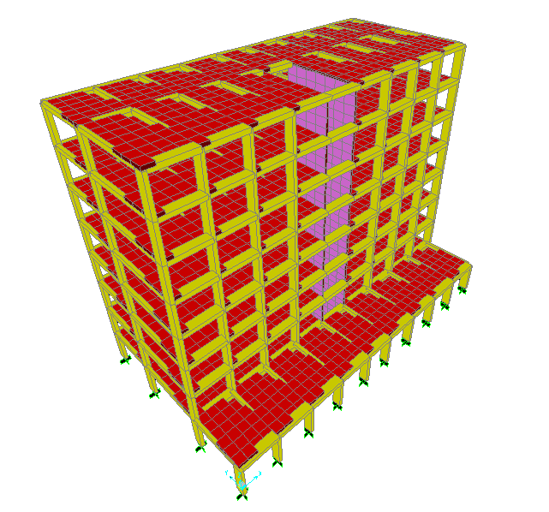

Slide 3
Chapter One Introduction

Slide 4
Project Description
Eight-story office building, on an area of 542.5m² in Nablus city on a soil of 4 kg/cm² bearing capacity.
The building has a setback area of 163 m², starts from the second floor.
The ground floor will contain garages.

Slide 5
Design Determinants
Materials
Concrete: -
For slabs, beams and footings: concrete B300
with f’c = 240 Kg/cm²
For Columns: concrete B400
with f’c = 320 Kg/cm²
Reinforcing Steel: Steel GR60
with fy =4200 Kg/cm²
Soil: Bearing capacity = 4 Kg/cm²
Block: 12 kN/m³ Density.

Slide 6
Design Determinants
Loading
Dead loads are static and constant loads, including the weight of structural elements, and super imposed dead loads (SDL) of 4.5KN/m².
Live loads are non permanent loads on the structure like weight of people, furniture, water tanks and the building content. (LL) was considered to be 2.5KN/m².
Earthquake as a lateral load.

Slide 7
Design Determinants
Codes
For Design:
American Concrete Institute (ACI-2008)
For Loads:
ASCE Minimum Design Loads for Buildings and Other Structures (ASCE 7-05)

Slide 8
Chapter Two Prelimenary Design

Slide 9
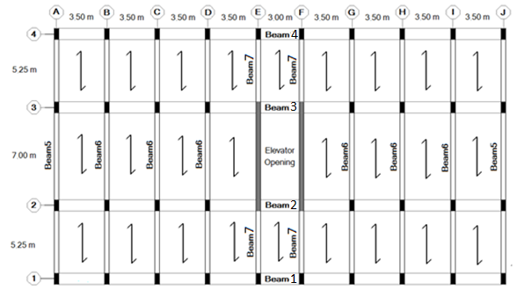
Plan View

Slide 10
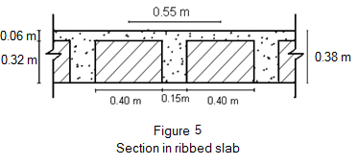
One-way ribbed slab with hidden beams
Slab thickness:
From the replicated story L=7m is one end continuous span:-
h = = = 0.38 m
Check wide beam shear:
From SAP2000
Vu max = 33.03 KN
øVc = 34.35 KN
Slab is OK

Slide 11

One-way ribbed slab with hidden beams
Column
All columns are tied with dimensions of (0.80 x 0.30)m, the long dimension is in Y-direction.
Conceptually
The column carries: 1.62x80x30 = 3888 kN.
For interior columns:
Ultimate load: 17.17x3.5x( )x8 = 2945 kN.

Slide 12

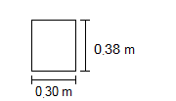
One-way ribbed slab with hidden beams
Beam
Main beams (directed in X):
h min. = = 0.19 m
Dimensions: 0.80 x 0.38 m
Secondary beams (directed in Y):
Dimensions: 0.30 x 0.38 m

Slide 13
Chapter Three 3D Modeling and Checks

Slide 14
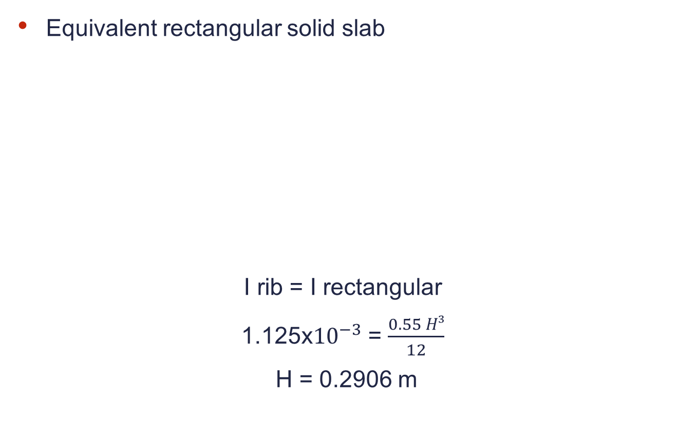
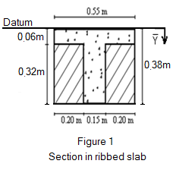
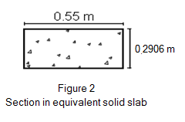

3D Modeling and Checks

Slide 15
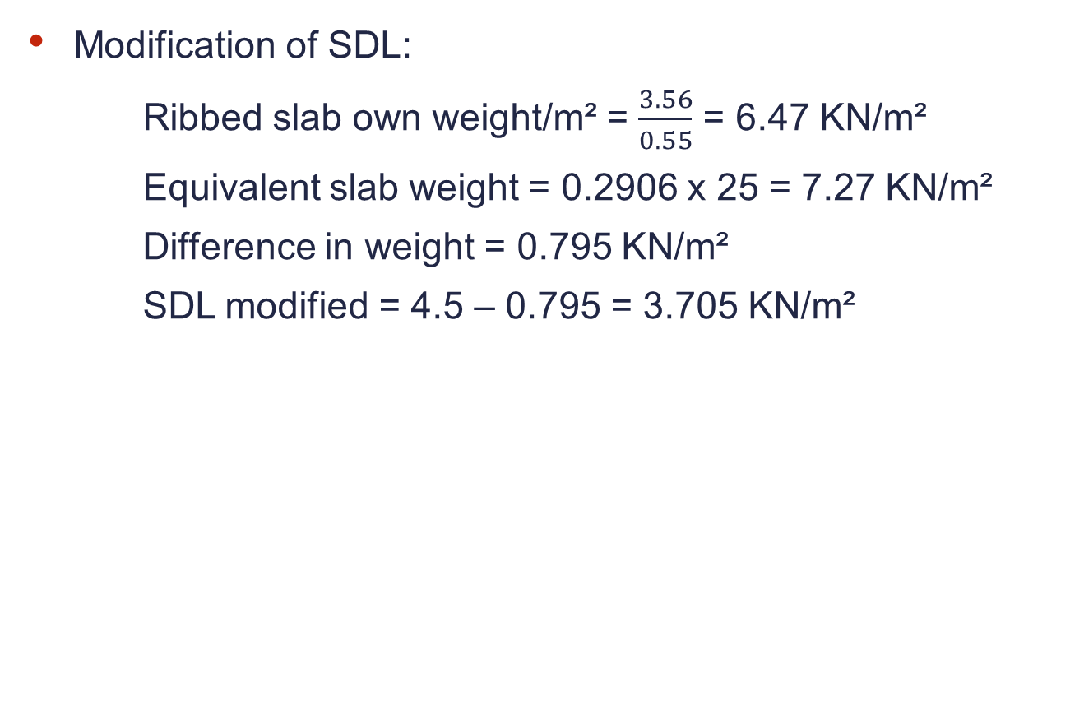
`
3D Modeling and Checks

Slide 16
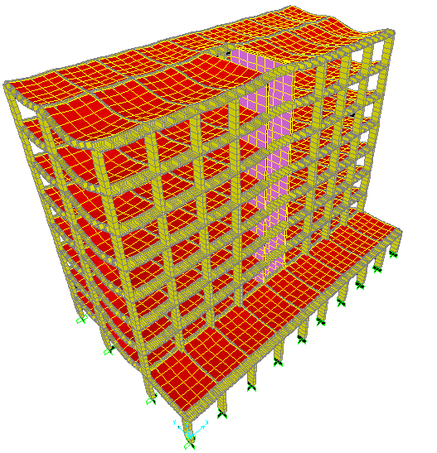
3D Modeling and Checks
Compatibility

Slide 17
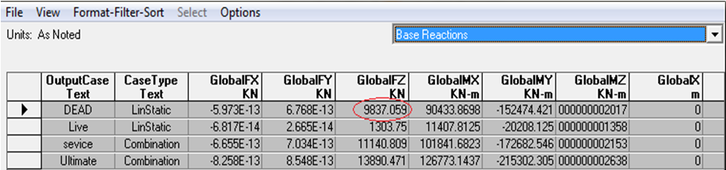

3D Modeling and Checks
Equilibrium
For Dead load:
Manually: Total dead weight = 9675.22 KN
By SAP2000: Total dead weight = 9837.059 KN
Error = = 1.6% < 5% …… OK

Slide 18
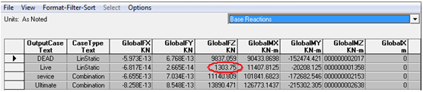
3D Modeling and Checks
Equilibrium
For Live load:
Manually: Total live load = 1303.75 KN
By SAP2000: Total live load= 1303.75 KN
Error = 0.0 % .…… OK

Slide 19
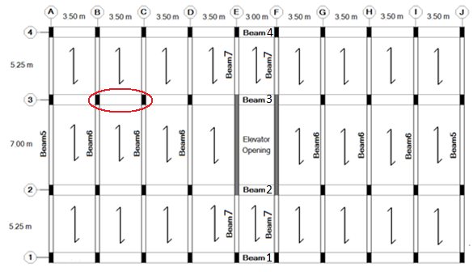
3D Modeling and Checks
Stress Strain Relationship
Beam 3B-3C in the first floor is to be checked

Slide 20


3D Modeling and Checks
Stress Strain Relationship
The ultimate load carried by beam:
Wu = 111.42 kN/m
As a simply supported beam:
Mu = = = 170.61 kN.m

Slide 21
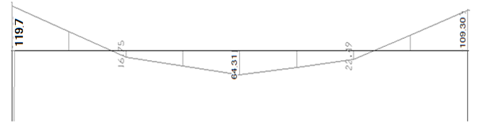

3D Modeling and Checks
Stress Strain Relationship
SAP2000 analysis is shown in the figure
Summation of –ve. and +ve. Moments = 178.81kN.m
Error = = 4.6% < 10% ……….…OK

Slide 22
Chapter Four Static Design

Slide 23
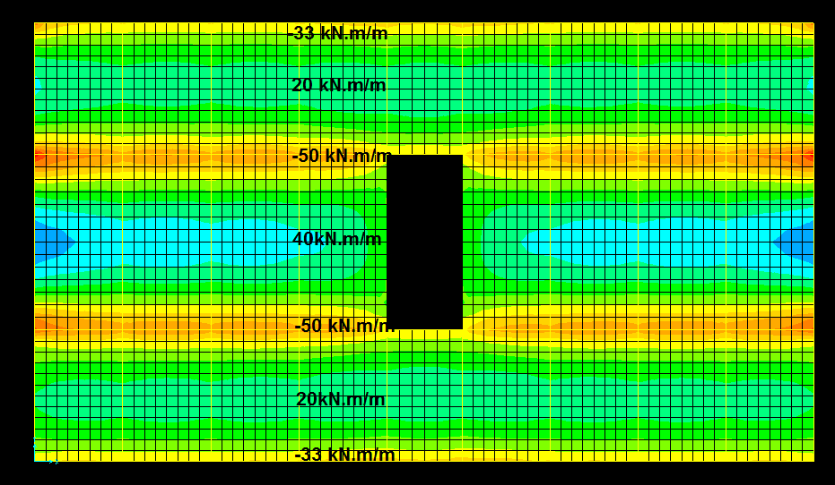
Static Design
Slabs
First floor moment diagram in kN.m/m:

Slide 24
Static Design
For –ve. Moments:
Mu = 33x0.55 = 18.13 kN.m / rib
→ As min. = 168.3 mm² (use 2Ø12)
Mu = 50x0.55 = 27.5 kN.m/rib
→ As = 223.7 mm² (use 2Ø12)
For +ve. Moment:
Mu = 20x0.55 = 11 kN.m/rib
→ As min. = 168.3 mm² (use 2Ø12)
Mu = 40x0.55 = 22 kN.m/rib
→ As = 172 mm² (use 2Ø12)

Slide 25
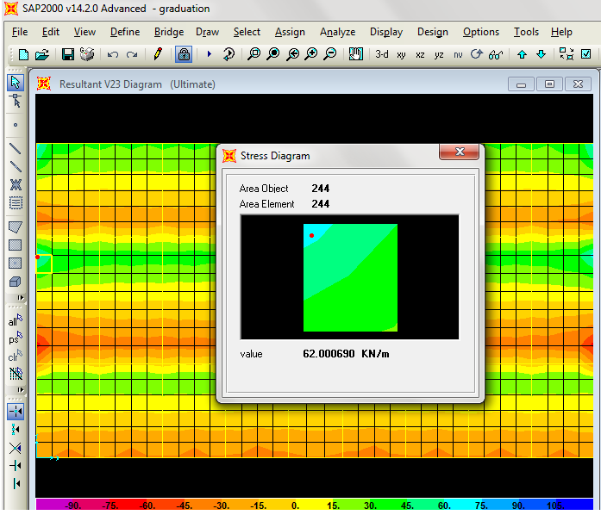
Static Design
First floor shear force diagram in kN/m:

Slide 26
Static Design
ØVc = 34.35 kN
Vu = 62x0.55 = 34.1 kN/rib < ØVc
Shear reinforcement is not required
(use stirrups 1Ø8/300 mm)

Slide 27
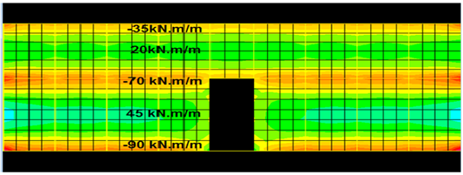
Static Design
Replicated floors moment diagram in kN.m/m:
For –ve. Moments:
Mu = 35x0.55 = 19.25 kN.m / rib
→ As min. = 170 mm² (use 2Ø12)
Mu = 70x0.55 = 38.5 kN.m/rib
→ As = 319.77 mm² (use 2Ø14)

Slide 28
Static Design
Mu = 90x0.55 = 49.5 kN.m / rib
→ As = 420.14 mm² (use 3Ø14)
For +ve. Moment:
Mu = 20x0.55 = 11 kN.m/rib
→ As min. = 168.3 mm² (use 2Ø12)
Mu = 45x0.55 = 24.75 kN.m/rib
→ As = 194.29 mm² (use 2Ø12)

Slide 29
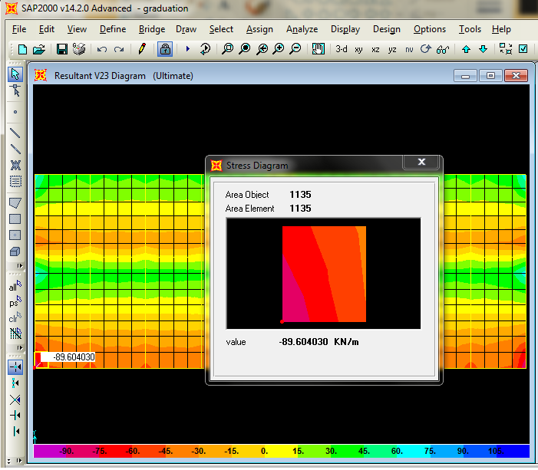
Static Design
Replicated floors shear force diagram in kN/m:

Slide 30
Static Design
ØVc = 34.35 kN
Vu = 89.6x0.55 = 49.28 kN/rib > ØVc
Av/s = 0.1393 mm²/mm
Av =100.53 mm² (Ø8mm stirrups)
→ S = 721 mm
(use stirrups 1Ø8 /150mm)

Slide 31
Static Design
Shrinkage steel for slab (all floors):
As shrinkage = 0.0018*b*h
As shrinkage = 0.0018*1000*60 = 108mm²/m
Use 1Φ8mm/ rib

Slide 32
Static Design
Beams

Slide 33
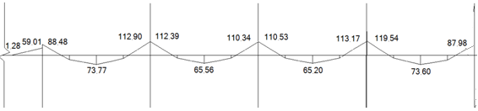
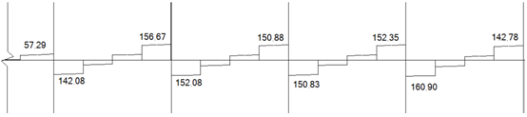
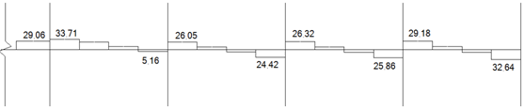
Static Design
The moment, shear and torsion diagrams for beam3:

Slide 34

Static Design
SAP2000 design for moment:
Manual design for moment:
Longitudinal steel reinforcement:

Slide 35

Static Design
For stirrups (shear and torsion):
= 0.801 mm²/mm
Av = 2x113.1 = 226.2 mm² (Ø12 mm stirrups)
S = 282.4 mm
Use 1Ø12 / 150 mm

Slide 36
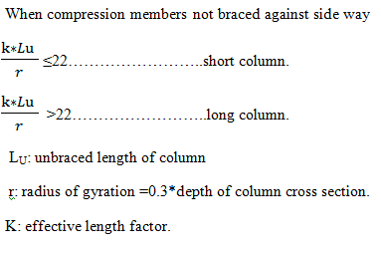
Static Design
Columns
Column type:

Slide 37
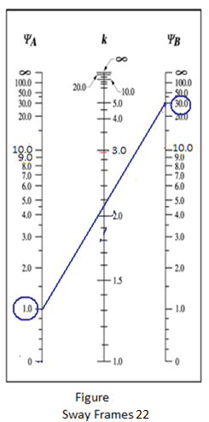

Static Design
Calculating the value of (K):
Take column (c-3) in floor no.1
Ψ_{A} = 1.0
Ψ_{B}= 29.6
→ K = 2.2
For rectangular sections:
➔ r = 0.3 h = 0.24m
L_{u}=3.12m
= 28.6 ≥ 22
→ Long column

Slide 38

Static Design
Take column (C-3) in floor no.1
P_{u}=3558.39kN
M₂₋₂₌42.33kN.m(maximum value)
M₃₋₃₌ 0.241kN.m( maximum value)
Since M₃₋₃ is very small neglect it ( column subjected to uniaxial load)
Assume column subjected to major moment M₂₋₂ only
End moments at y-directions are M₁₌25.2kN.m & M₂=42.33kN.m
M_{c} = δ_{s}×M₂
δ_{ns} = ≥ 1

Slide 39
Static Design
M₂: the maximum moment occurring anywhere along the column.
M₂ ≥ M_{2min}
M₂ = maximum of (42.33 or 25.2) ➔M₂=42.33kN.m
M_{2min} = P_{u} (0.015+0.03h) (h in m)
= 3558.39(0.015+0.03*0.8)= 138.8kN.m
M_{c} = δ_{ns}*M₂ = 1.431 (42.33) = 60.6 kN.m
M_{c} ≤ M_{2,min} ➔ 60.6 ≤ 138.8 ----- OK
P_{u} = 3558.39kN

Slide 40
Static Design
Pdesign = 3884.7kN
P design > Pu ----- OK
As = 0.01 Ag
→ 24 cm²
As from sap = 24.84 cm²
→ Use 14 Ø16mm

Slide 41
Static Design
Design for shear:
0.5 Vc = 201.9kN
Vu = 21.67kN
Vu< 0.5 Vc
Use 1 Ø10mm stirrups @25cm.

Slide 42


Static Design
Footings
By taking group3 as an example:
Area of footing = = 7.13 m²
Dimensions: (3m x 2.5m)
Q_{ultimate}= = 479 kN/m²
From Vu = ØVc
d = 0.48 m
Group | Range (kN)
1 | 1400 - 1900
2 | 1900 - 2400
3 | 2400 - 2900
Setback | Use The Max. Value = 181.2

Slide 43
Static Design
For punching shear:
Vup = 3115 kN > Vcp = 2398 kN ….. Not OK
For d = 0.58 → Vcp > Vup …….. OK
Final dimensions of the footing: (3 x 2.5 x 0.65)m
Reinforcement:
Mu = Q_{ultimate} * L² /2 = 289.7 kN.m
As= ρ*b*d= 0.00233*1000*580= 1293.4mm²
As min= 0.0018*1000*650 = 1170 mm²
As= 1293.4 mm² (1Ø16 / 150mm) in each direction.
Hook is not needed

Slide 44
Chapter Five Dynamic Design

Slide 45
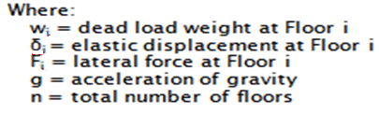

Dynamic Design
Periodic analysis
T
and by assuming force of 1.0 kN/m².

Slide 46
Dynamic Design
 |  | 8 stories, force in X- direction
story | mi | Fi | Δi | mΔi | mΔi² | Fδi | T
 | (Ton) | (kN) | (m) | (Ton.m) | (Ton.m2) | (Kn.m) | (sec)
1 | 1059.52 | 521.5 | 0.0097 | 10.27734 | 0.09969 | 5.05855
2 | 840.7 | 358.38 | 0.0254 | 21.35378 | 0.542386 | 9.102852
3 | 840.7 | 358.38 | 0.04 | 33.628 | 1.34512 | 14.3352
4 | 840.7 | 358.38 | 0.0524 | 44.05268 | 2.30836 | 18.77911
5 | 840.7 | 358.38 | 0.0624 | 52.45968 | 3.273484 | 22.36291
6 | 840.7 | 358.38 | 0.0699 | 58.76493 | 4.107669 | 25.05076
7 | 840.7 | 358.38 | 0.075 | 63.0525 | 4.728938 | 26.8785
8 | 840.7 | 358.38 | 0.0778 | 65.40646 | 5.088623 | 27.88196
 |  |  |  | SUM | 21.49427 | 149.4499 | 2.382832
Tx = 2.03 sec. (from SAP2000 analysis)

Slide 47
Dynamic Design
 |  | 8 stories, force in Y- direction
story | mi | Fi | Δi | mΔi | mΔi² | Fδi | T
 | (Ton) | (kN) | (m) | (Ton.m) | (Ton.m2) | (Kn.m) | (sec)
1 | 1059.52 | 521.5 | 0.0008 | 0.847616 | 0.000678 | 0.4172
2 | 840.7 | 358.38 | 0.0024 | 2.01768 | 0.004842 | 0.860112
3 | 840.7 | 358.38 | 0.0044 | 3.69908 | 0.016276 | 1.576872
4 | 840.7 | 358.38 | 0.0066 | 5.54862 | 0.036621 | 2.365308
5 | 840.7 | 358.38 | 0.009 | 7.5663 | 0.068097 | 3.22542
6 | 840.7 | 358.38 | 0.0114 | 9.58398 | 0.109257 | 4.085532
7 | 840.7 | 358.38 | 0.0137 | 11.51759 | 0.157791 | 4.909806
8 | 840.7 | 358.38 | 0.0159 | 13.36713 | 0.212537 | 5.698242
 |  |  |  | SUM | 0.6061 | 23.13849 | 1.016914
Ty = 0.86 sec. (from SAP2000 analysis)

Slide 48

Dynamic Design
IBC 2006
For Nablus

Slide 49
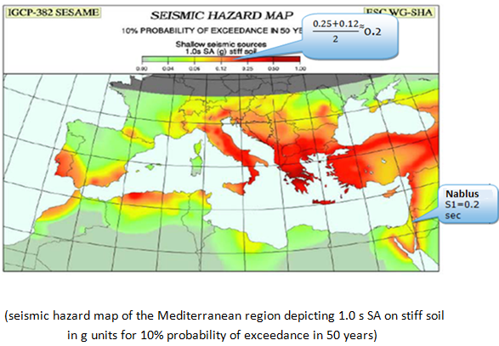
Dynamic Design
For Nablus

Slide 50
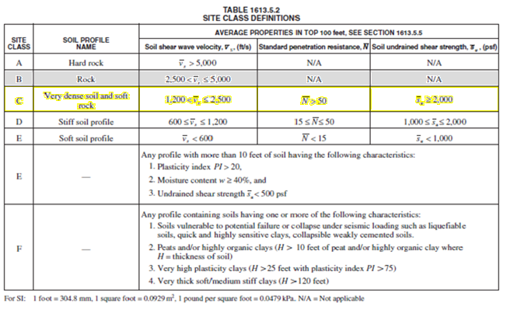
Dynamic Design
For Nablus

Slide 51
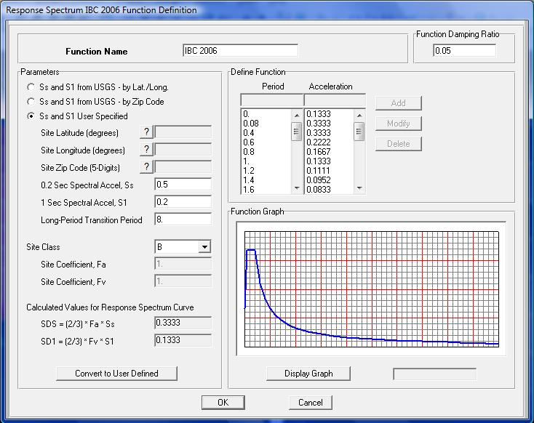
Dynamic Design
Design using response spectrum

Slide 52
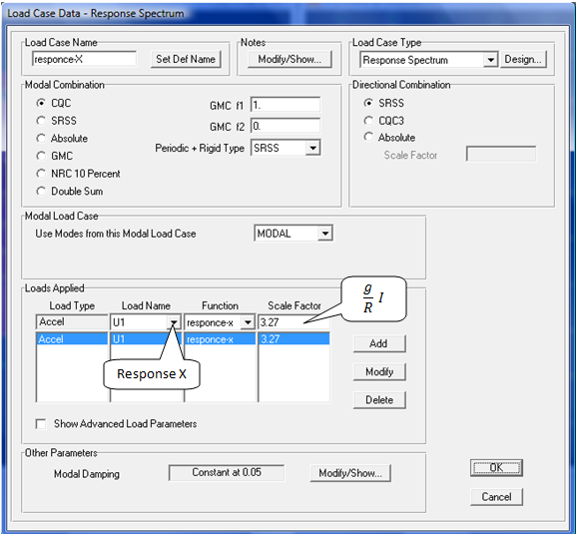
Dynamic Design
R = 3 (Ordinary R.C. moment frame, IBC 2006)

Slide 53
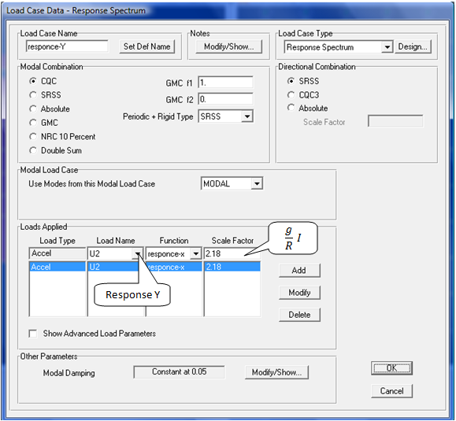
Dynamic Design
R = 4.5 (Ordinary R.C. shear wall, IBC 2006)

Slide 54
Dynamic Design
By taking the envelope of the following combinations:
COMB1 = 1.4 D
COMB2 = 1.2 D + 1.0 L + 1.0 Response X
COMB3 = 1.2 D + 1.0 L + 1.0 Response Y
COMB4 = 0.9 D + 1.0 Response X
COMB5 = 0.9 D + 1.0 Response Y
Ultimate = 1.2 D + 1.6 L

Slide 55
Dynamic Design
The design results were compared between envelope and ultimate combinations, and the result was:
In slabs and columns static design controls.
In beams dynamic design controls.

Slide 56

Dynamic Design
In beams:
the static area of steel for Beam3 (moments)
The dynamic area of steel for Beam3 (moments)
The Final steel reinforcement (Longitudinal)
Stirrups: Use stirrups 1 Ø 12 / 150 mm.

Slide 57
Chapter Six Special Study

Slide 58
Special Study
Part1: (Dynamic)
A comparison will be in the periods of the building, and how the depth of the tie beam affects the periods due to fixity.
Part2: (Static)
A comparison will show the effects of both fixed foundation and pinned foundation with tie beam on the structural elements.

Slide 59
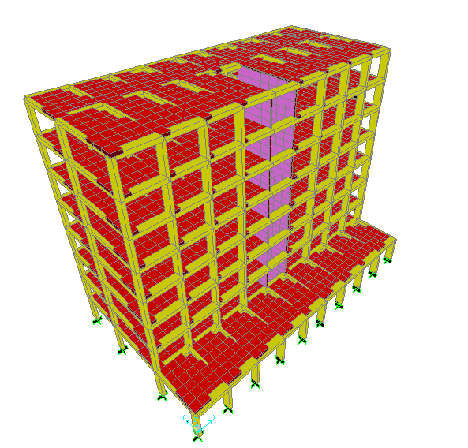
Special Study
Part1: (dynamic)
The fixation in foundation will affect the period of the building, the degree of fixation is inverse proportional to the period of the building.
In our building, the period obtained when we used fixed foundation is:
Tx = 2.03 sec.
Ty = 0.86 sec.

Slide 60
Special Study
The width of the tie beam taken is equal to the smallest dimension of the column which equals 0.3 m, this width will be constant in the study whereas the depth will be variable.
The initial tie beam depth will be 0.3 m and will be enlarged by 0.1 m until reaching the depth that make the building periods constant and equal to the periods obtained when fixed footing were used.

Slide 61
Special Study
The table below shows the dimensions of the tie beam and the periodic analysis:
Width (m) | Depth (m) | Tx (sec.) | Ty (sec.)
0.3 | 0.3 | 2.179 | 0.871
0.3 | 0.4 | 2.166 | 0.870
0.3 | 0.5 | 2.083 | 0.870
0.3 | 0.6 | 2.065 | 0.869
0.3 | 0.7 | 2.055 | 0.869
0.3 | 0.8 | 2.049 | 0.868
0.3 | 0.9 | 2.045 | 0.867
0.3 | 1.0 | 2.042 | 0.867
0.3 | 1.1 | 2.040 | 0.867
0.3 | 1.2 | 2.038 | 0.866
0.3 | 1.3 | 2.038 | 0.866
0.3 | 1.4 | 2.037 | 0.865
0.3 | 1.5 | 2.037 | 0.865

Slide 62
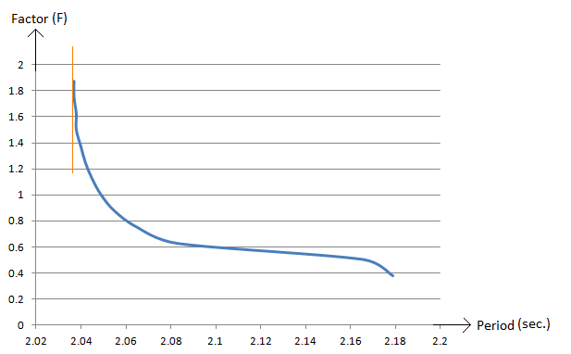
Special Study
the relationship between depth (y-axis) and period (X-axis), in which the depth represented by factor X multiplied by the largest dimension of the column, by an equation of:
Factor(F) X Largest column dimension
→ gives the periods obtained in fixed footing

Slide 63
Special Study
Within an error less than 5%, the Factor (F) is equal to 1.65, in which the slope of the tangent = 0.

Slide 64
Special Study
Part2: (static)
A comparsion between loading results (shear and moment) of the structural elements obtained from the model with fixed foundation versus the model with pinned foundation and tie beam.

Slide 65
Special Study
Static analysis results
 | slab |  | beam |  | column |  | footing
foundation type | Max (-ve) moment (kN.m) | Max (+ve) moment (kN.m) | max moment (kN.m) | max shear (kN) | max axial force (kN) | max moment (kN.m) | max moment (kN.m) | max axial (kN)
fixed | 50 | 40 | 119.54 | 160.9 | 2426.60 | 42.42 | 25.19 | 3558.37
Pinned with tie beams | 50 | 40 | 119.74 | 160.9 | 2426.23 | 39.92 | 0 | 3610.54
Difference (%) | 0 | 0 | 0.17 | 0 | 0.02 | 5.9 | 100 | 1.4

Slide 66
Special Study
The only change occurred in foundations. The base moment reactions in (fixed) case were carried by the tie beams in (pin foundations+ tie beams) case. As a result in the second case (pin+ ties), design the footing just for axial load.
Small difference in axial load in the case of tie beams comes from the additional own weight of tie beams

Slide 67
Thank You For Listening
Jihad Afouri
Sohaib Zayed
Ahmad Zahalqa
Samer Tahayenah

