Slide 1
SMART HAND.
2016
Prepared By: Ameera Qasim Thabet Hashash Suyoof Bani Odeh
Graduation Project
Supervisor:
Dr.Salamah Abd Alfatah

Slide 2
Project Definition
Our project’s main goal is to help people with disabilities –especially those who lose their hands in some accidents like wars, by providing them with a robotic hand.

Slide 3
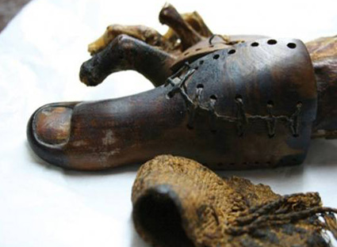
Project Definition(history)

Slide 4
Iron hand
.

Slide 5
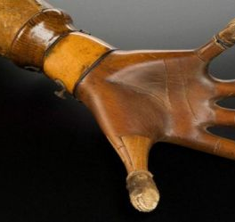
.
.

Slide 6
Project Definition
.
Prosthetics now days have come a long way in term of functionality, flexibility and the material used to develop them, some are made from plastic. The socket, which the part of the limb is fitted in, is usually made from polypropylene.

Slide 7
.
Modern science have now presented us with other types, now the prosthetics are moved by brain signals and muscle movements, these artificial hand are still under a lot of research and development, and the results are promising.

Slide 8
SYSTEM DESUGN
This about the hardware components used to solve the inherited design problems. These problems include reading the muscle signals which is solved by using a touch sensor. In addition, signal analysis is done by Arduino microcontroller. Moreover, movements are controlled by motors.

Slide 9
Hardware components
servo motor
Microcontroller(arduinonano) .
touch sensor.
3d printed hand
battery 4.8v.

Slide 10
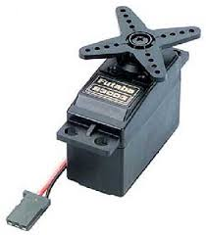
servo motor

Slide 11
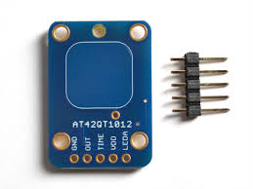
touch sensor

Slide 12
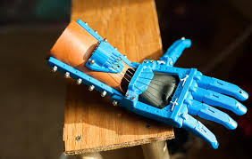
3d printed hand

Slide 13
PROGRAMMING
In This chapter we will talks about the artificial limb programming, and the software that will control the motors which used to impart the motion in the hand and we want to take a bout Mechanism of Action ,when the hand close to touch sensor , the sensor will sent the signal to ardouino kit which is programmed to do the Certain functions.

Slide 14
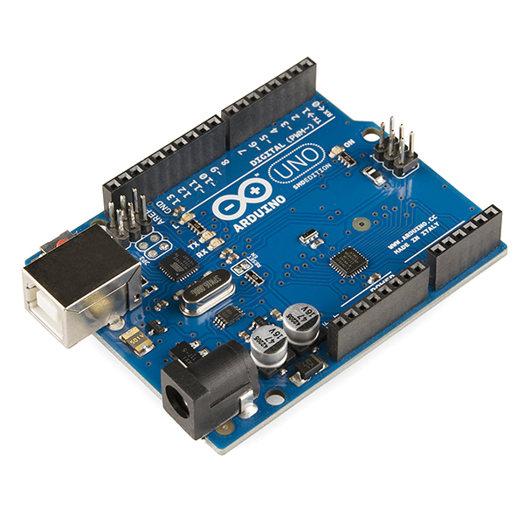
Arduino Kit

Slide 15
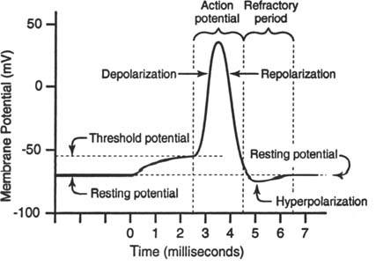
Electrical events in muscle contraction:

Slide 16
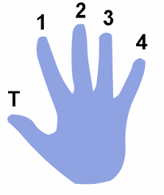
the hand in natural state

Slide 17
the functions of hand
State | Touch sensor (2) | Touch sensor (1) | #of state
The hand close | 0 | 1 | 1
The hand open | 0 | 0 | 2
The motor for finger(1)and finger (T) was closed | 1 | 0 | 3
The motor for finger (1) is on only | 1 | 1 | 4

Slide 18
Summary
Prosthetics industry came along way since the Egyptian and the Middle Ages, we are no longer looking at the prosthetics as an accessory, and advanced technology is giving us the opportunity to build a prosthetic that could really replace the imputed limp .

Slide 19
.
Touch sensors which depend on muscles movement contact with Arduino Kit [ was programmed to do specific function ] ,connected to 5 servo motors every one control a finger in our hand that is our project component , connected together to give someone the ability to live a normal life again . from human mind , simple component , small cost we can make a big difference in someone life .

Slide 20
Thank You
Our Parents
Prof. Salamah Abd Alfatah
Our University
Nablus Municipality
Our Friends

