Slide 1
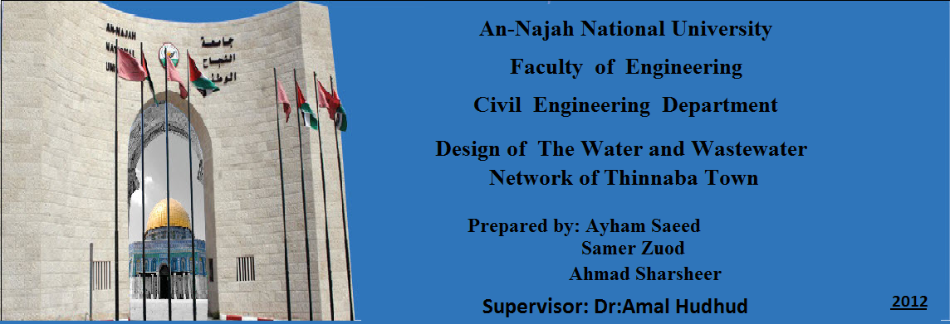

Slide 2

Introduction

Slide 3
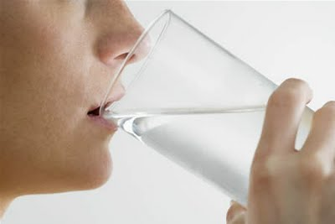
Before going ahead into our project I want first talk in a brief about the importance of water, water is essential to sustain a life and as our project is talking about improving networks that means improving access to safe drinking water , I mean more benefits to health .
Our project is mainly dealing with how to design a new WDN network using EPANET and design a new wastewater network .

Slide 4
Introduction
Water distribution networks (WDNs) are used to transmit and distribute water from its sources to the houses and all consumption locations.
WDNs decreases the efforts, time and make life easier than in the past time.
The efficiency of WDNs are very important, and to check on this, a hydraulic analysis is carried out.

Slide 5
Introduction
The traditional way to dispose of waste water is cesspit.
The solution is to design sewage collection system .

Slide 6
Objectives

Slide 7
Objectives
wastewater collection
To design a WDN for the Thinnabah using EPANET
To hydraulically design a wastewater collection system for Thinnabah
To estimate the potential cost of sewage network
water distribution network
Potential cost

Slide 8
Methodology

Slide 9
Methodology
Data Collection
Collects map & missing data.
Prepare map by AutoCAD
Solve the problems to provide suitable data.
Model Development
Use EPANET .
Evaluation of Results
Velocity & Pressure in future state.
Conclusions and Recommendations
Improve WDN & WWN for Thinnaba

Slide 10
Description of Study Area

Slide 11
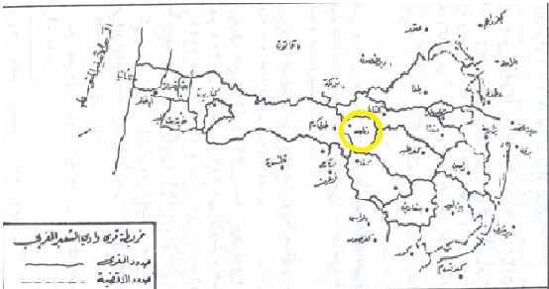

Slide 12
Description of Study Area
The "Thinnaba" village locate On the face of Tulkarm, east with a small deviation to the north at a distance 2km from the center of the city and Separates between them and the city Tulkarm camp that is one of Thinnaba land , So is a suburb of Tulkarm and Track administratively to Tulkarm Municipality , Rising from the sea level 138 m, The area of ​​the urban village of around 1200 acres, The total land area of ​​5600 acres, surrounded by the territory of Tulkarm, Kafr Al- Labad, Shuofa, and Anabta

Slide 13
Topography

Slide 14
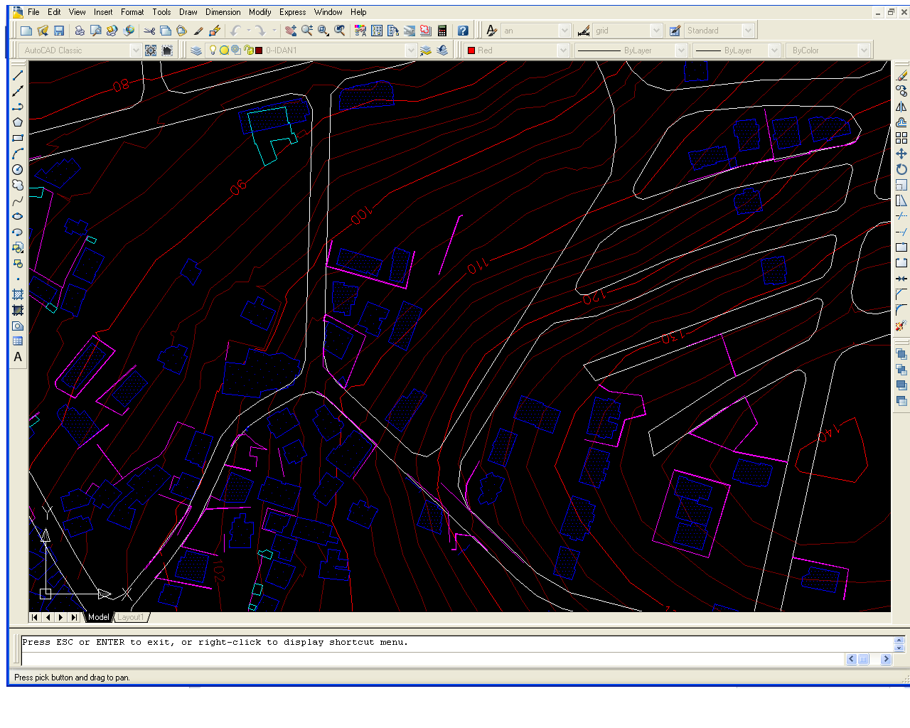
Topography The surface elevation of Thinnaba varies between 80 m to 138 m depicts the topography of Thinnaba.

Slide 15
Population

Slide 16
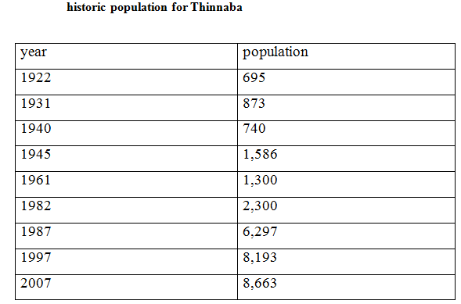
Population

Slide 17
Climate

Slide 18
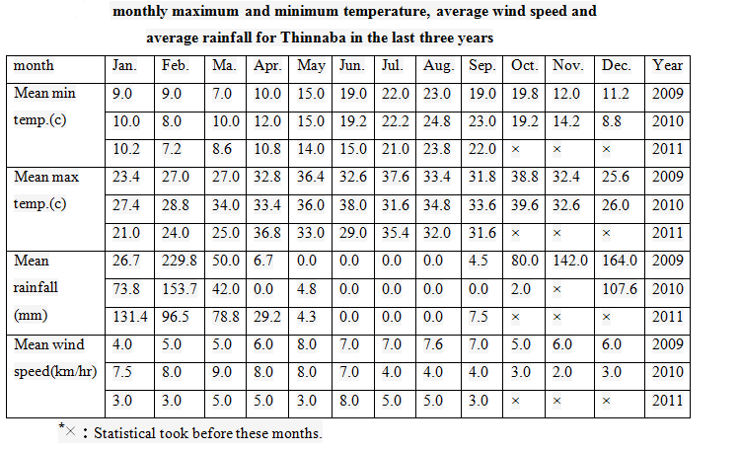
Climate

Slide 19
Source of Drinking Water

Slide 20
Source of Drinking Water
Thinnaba town is supplied with water through a Thinnaba well owned by a municipal. Where the distribution of water on the population of the town through this well through the town reservoir.
The second source of water for the Thinnaba population is rainwater that is collected during the winter in the combination wells that are generated in the vicinity of the house, where water is collected from the roofs of houses.

Slide 21
Questioner Analysis

Slide 22
Questioner Analysis
The first category was general information about the sex, level of income and average number of the family which was 7 person.
The second category talk about the water network, source of water which is Tulkarm municipality, the lake of water at what time of the year, time of supplying water. The people get water every day.
Third one talk about the sewage system, the way of disposal of it and found that the sewage system serve of population, while depends on the cesspits.

Slide 23
The Capita Consumption

Slide 24
The Capita Consumption
The total amount of water consumed without losses by the population as the months mentioned equal 269167 m³.
The capita consumption per day without losses equal (269167*1000)/(9330*30*18) = 53.43 liter.
Where the 9330, represents population for 2010 is estimated by the equation that will explain later.
Since the losses in the Tulkarm area is 45% based on information obtained from the Municipality of Tulkarm, so the total amount of water consumption with losses equal
269167/(1 - 0.45) = 489394.55 m³.
The capita consumption per day with losses equal (489394.55*1000)/(9330*30*18) = 97.14 liter.

Slide 25
Population

Slide 26
Population
Many method used to predict future population:
1. The mathematical method:
2. The engineering method:
3. Approximate graphical method .
4. Graphical Method .
P = P_{o} + AT
P = P_{o} ( 1 + R )^{n}

Slide 27
in study of water distribution network of Thinnaba town we calculate future population according engineering method . In the beginning, we will calculate the population in 2010 year from 2007 year: P = P_{o} ( 1 + R )^{n} P₂₀₁₀ = P₂₀₀₇ ( 1 + 0.025 )³ P₂₀₁₀ = 8663(1+0.025)³ P₂₀₁₀= 9330 person

Slide 28
Finally, we will estimate the population after 25 years:
P = P_{o} ( 1 + R )^{n} P₂₀₃₅ = P₂₀₁₀( 1 + 0.025 )²⁵ P₂₀₃₅ = 9330(1+0.025)²⁵ P₂₀₃₅= 17300 person In other words, the population after 25 years is expected to reach 17300 and this figure is adopted in this study to calculate the amount of consumption.

Slide 29
EPANET Software

Slide 30
EPANET Software
EPANET is a computer software used for analyze
the water distribution networks. It can be used for
different types of application in the distribution
system analysis such as a simple network design.
EPANET analysis output are : the flow for each pipe
in the network and the velocities, the pressure for
each node and the total head, the head loss in each
pipe and more of hydraulic output analysis.

Slide 31
The Design of Water Distribution Network of Thinnaba
Network layout:
A. By using AutoCAD program
1. Drawing lines in the streets represent pipes
2. Drawing points which represent junctions
3. Divide the village into areas (polygons)
B. By using Epanet program
1. Drawing junctions
2. Drawing pipes

Slide 32
EPANET input data requirements
For pipes length, diameter, roughness (c=150).
For junctions elevation, demand.

Slide 33
Preparing data
Junction :
1- Elevation → contour maps
2- Base demand = consumption / 1-losses
Consumption=53.43 L/C/d
Losses=45%
Demand = 97.14 L/c/d
Demand for each node = density*area *base demand.
Density = # of population /total area = 0.0912 person /m²

Slide 34
Preparing data
pipe:
1 . Find the length of each pipe using AutoCAD program.
2. Assume an adequate diameter for each pipe.
3. Specify start and end node for each pipe.
4. The pipes are of polyethylene. The roughness of it is 150 as reported by C = Hazen-Williams roughness Coefficient
reservoirs:
Determine the elevation of the reservoir, and insert the total head in EPANET

Slide 35


Future demand for nodes (m³ / hr)
1. Demand in the crowded areas:
Future demand for each node (m³ / hr) = [future demand (l/c/d) * Density (person/m²)*area of houses served by the node (m²)]/ (24 * 1000).
Demand in not crowded areas
multiplied it is existing demand by future factor
Future factor = *
Future factor = 2.710533
3. Demand for new nodes

Slide 36
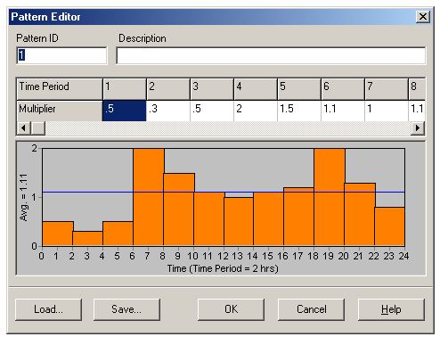
Transition Steady State for the Future Condition
To make the network more realistic for design an extended period of operation will create a Time Pattern that makes demands at the nodes vary in a periodic way over the course of a day.
The pattern time step was set to 2 hours . This will cause demands to change at 12 different times of the day.

Slide 37
Design considerations
After running process, checks have to be made to make sure that the velocity in pipes and the head at nodes fulfill required criteria which indicate that:
Allowable nodal pressure arranges between (20 −100) meter head.
Allowable velocity in the pipes arrange between (0.2 −3) meters per second.

Slide 38
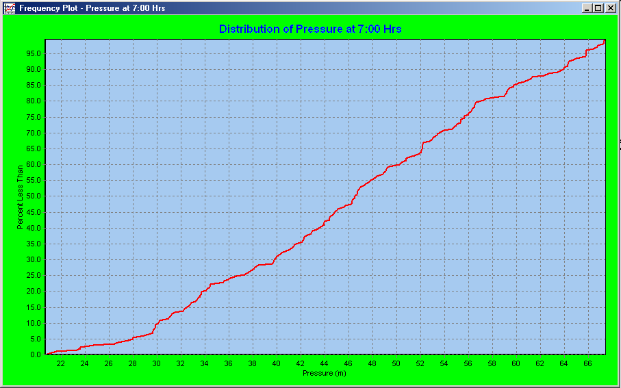
The Result
Pressure:
in the figure below we can see the values of the pressure, where no negative pressure ranges and all the values above where (20) m and less than (100) m
percent distribution pressure in Thinnaba Town

Slide 39
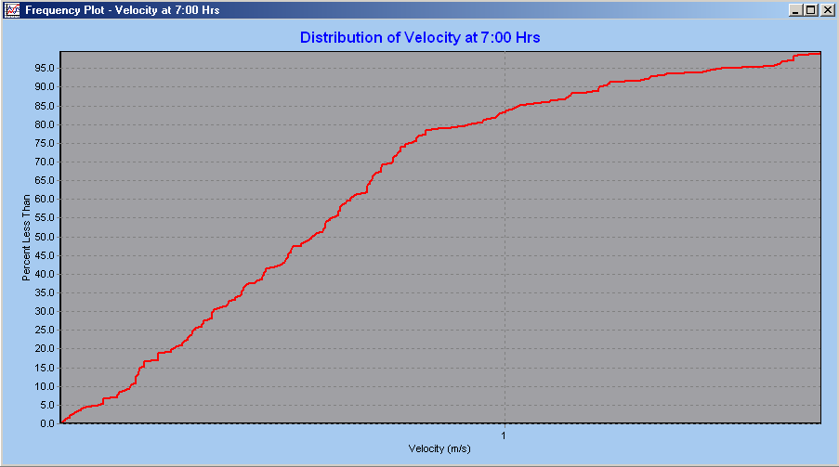
The Result
Velocity:
We can see the values of velocity, where all the values in the range ( 0.2 – 3 ) m/s , except for some values ​​because of little demand
percent distribution velocity in Thinnaba Town

Slide 40
Conclusion
The following are the main conclusions:
The water loss in Thinnaba WDN are very high where part of that is attributed to leakage.
From the output results we notice that the future velocities in most pipes are acceptable since ; they had values within the permissible limits (0.2 – 3) m/s , except for some values ​​because of little demand.
Also from the output we notice that all nodes have ahead pressure greater than the minimum standard limit (20) m, which means all of these nodes are capable to meet the future demands placed on it. Furthermore all the nodes have pressure
lower than the maximum permissible head (100) m.
EPANET is good software to carry out a hydraulic analysis, and it is easy to use.

Slide 41
Recommendation
The following are the main recommendation:
To reduce water losses in Thinnaba Town.
1.Rehabilitation and renewal the water meters for houses since the existing meters are very old.
License the illegal connections
Monitoring the water network to reduce the water thievery.
Rehabilitate the old parts of the WDN.
Change all very old pipes because of the suffering people of pure water.

Slide 42
The Design of the Wastewater Collection System for Thinnaba
Problems :
The existing network in Thinnaba is new but not serves all the village.
sewer system serve 75% of population, while 25% depends on the cesspits

Slide 43
Methodology
1. Drawing network using AutoCAD
Manholes
Line
polygon

Slide 44
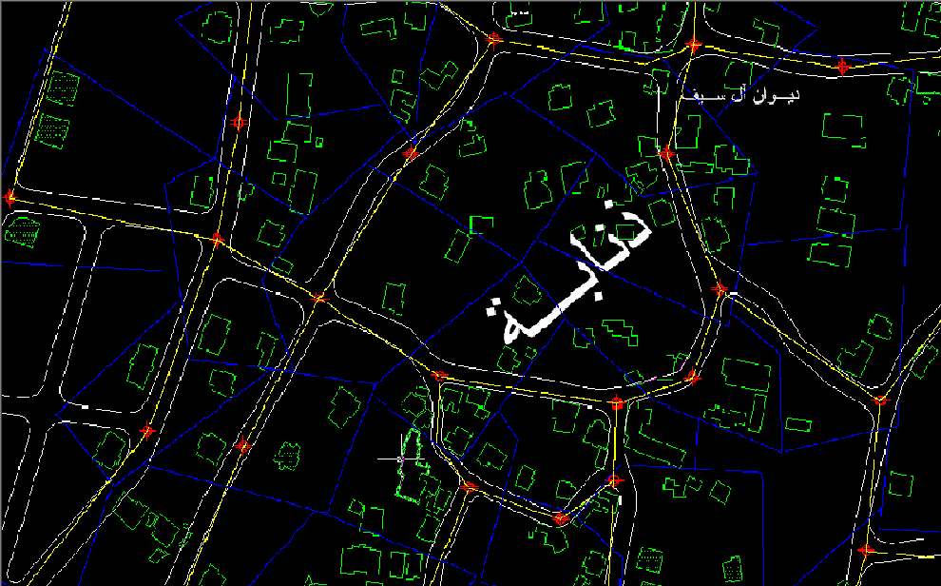
Network layout

Slide 45
2. taking some information from the map in AutoCAD
Number of person in each polygon.
Length of the pipe.
Elevation of each manholes.
3. Using Excel sheet to design
Calculate maximum hourly flow
Slope
Velocity(use manning)

Slide 46
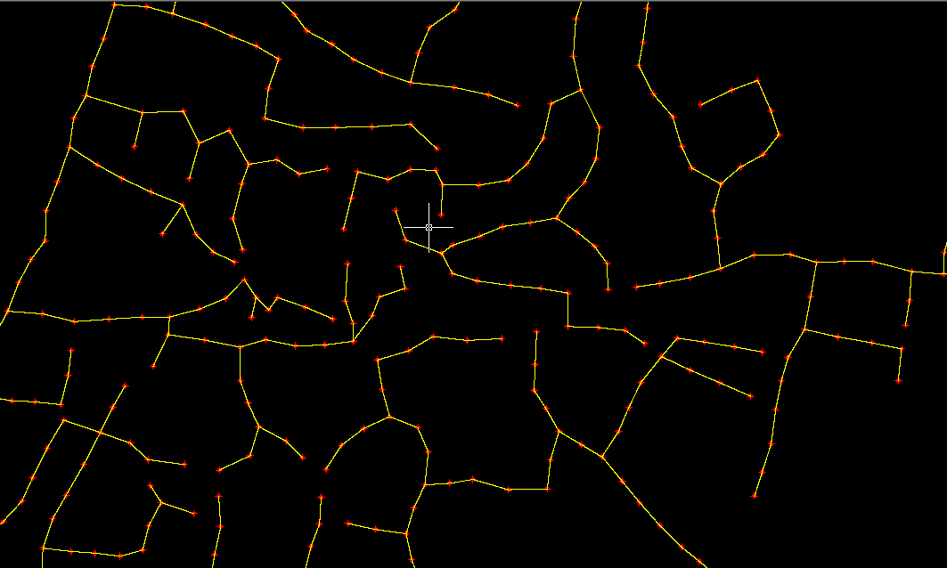
Layout of the design network

Slide 47
Estimate the cost of the network
Cost of excavation =239297.1 NIS
Cost of Sewer = 1572924.1 NIS
Cost of manholes = 225000 NIS
Cost of covers = 195000 NIS.
Cost of basement concrete = 9072 NIS
Cost of base coarse = 274542.72 NIS
Cost of Asphalt = 1143928 NIS
sewage network
Total cost =3659763.92 NIS

Slide 48
Thank you …

