Slide 1

PIPELINE INSPICTION ROBOT
By students:
Fares Nasasrah
Kareem Malhis
Mahmoud Hasan
Yazan Musmar
Supervisor: Dr. Bashir NOURI

Slide 2
Presentation Outline
Introduction
Mechanical Principle
Electronic Principle
Operation Orders
Experiments and Results
Conclusion

Slide 3
Introduction
Objectives
The robot was built, worked well and the feedback was taken
Project Aim
The inspection inside the pipe.

Slide 4
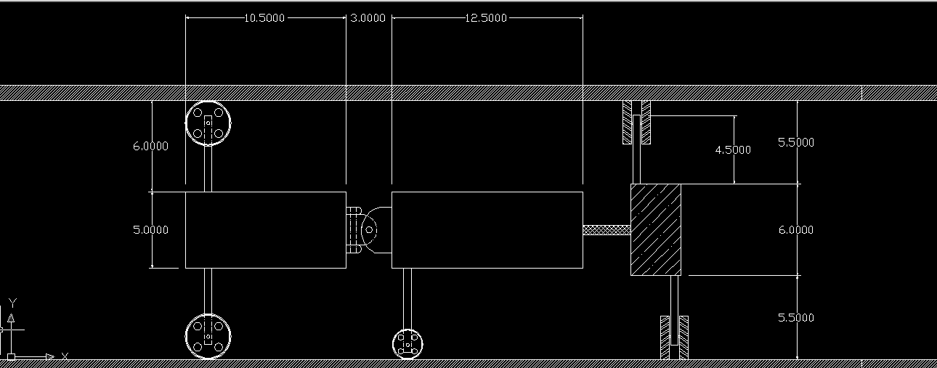
Mechanical Principle
Main Body
Wheel system
Joints
Gearbox

Slide 5
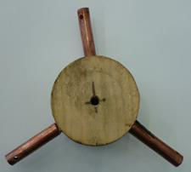
Mechanical Principle
Plastic Cylinders
Wooden Cylinder

Slide 6
Mechanical Principle
Wheel Joint
Universal Joint

Slide 7
Mechanical Principle
𝜃= tan (d/2𝜋𝑟)
  The angle needed to be made to make the robot moves exactly the pitch distance

Slide 8
Mechanical Principle
Gearbox

Slide 9
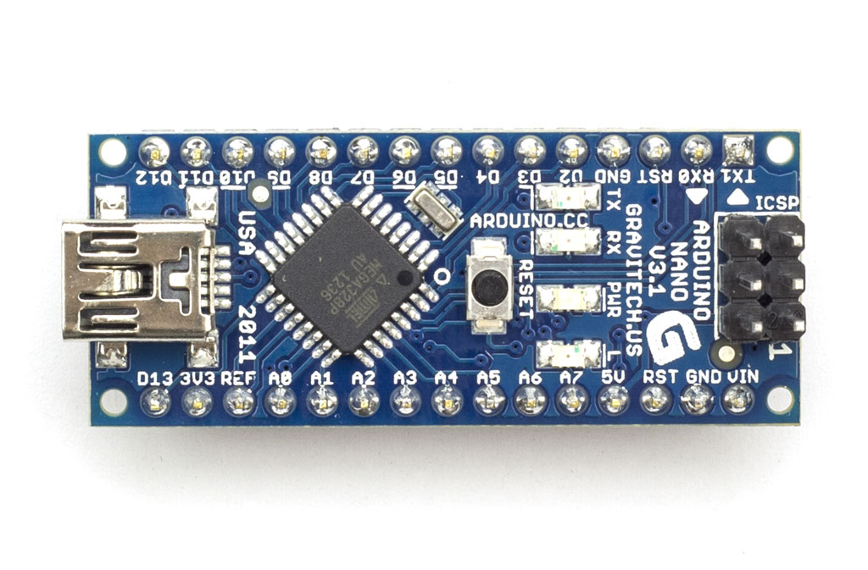
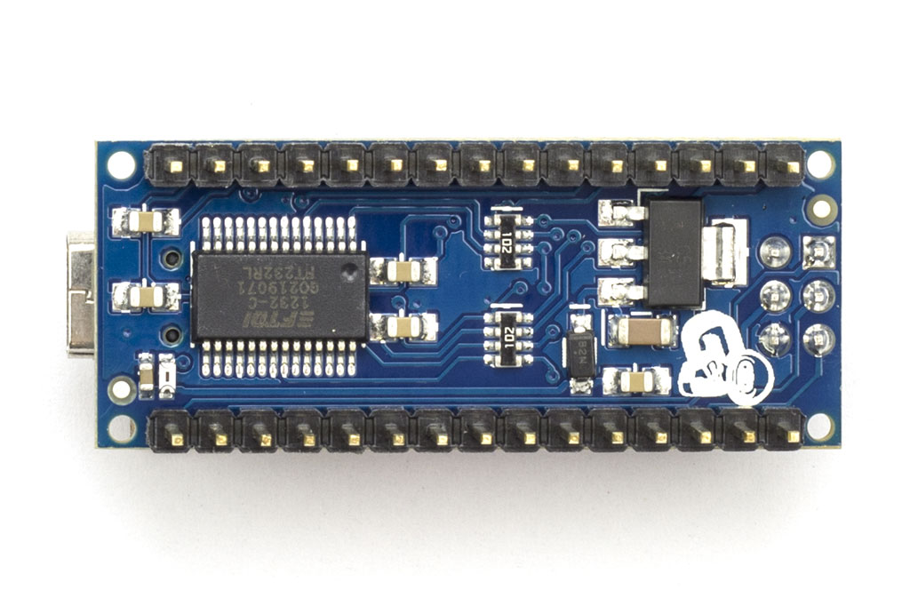
Electronic parts
The used Microcontroller
“Arduino Nano”
Top View for the Nano
Back View for the Nano

Slide 10
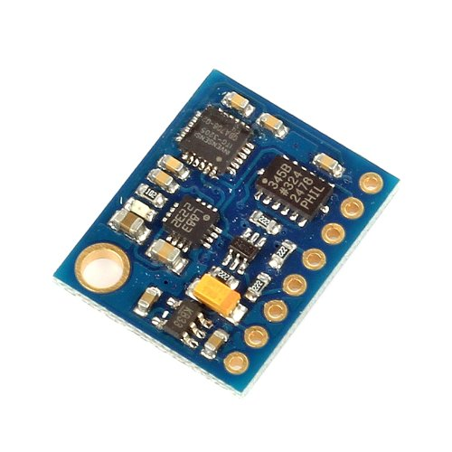
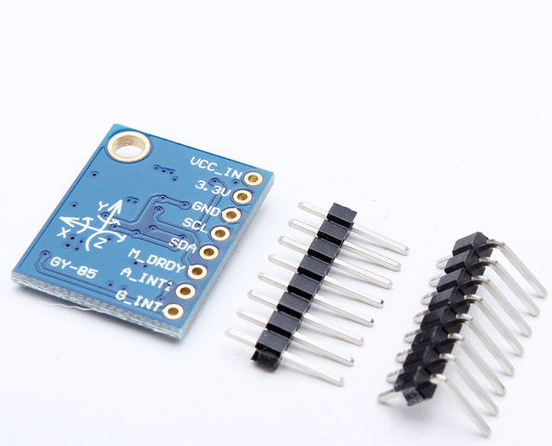

Electronic parts
GY-85
“Contains a Gyroscope Sensor
and Accelerometer Sensor”
To determine the siope.
  Combine readings with the
  complementary filter equation
  $Absolute Angle = Kp × \left(Angle\right)+ Kd × \left(Angular Velocity\right)$
  Where : Kp & Kd Constants and (Kp + Kd = 1)

Slide 11
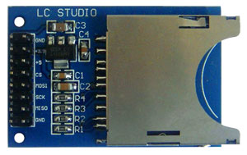
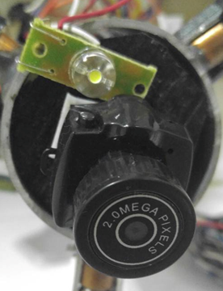
Electronic parts
SD Module is used
To save the readings
Camera with Xenon light
To take inside pictures

Slide 12
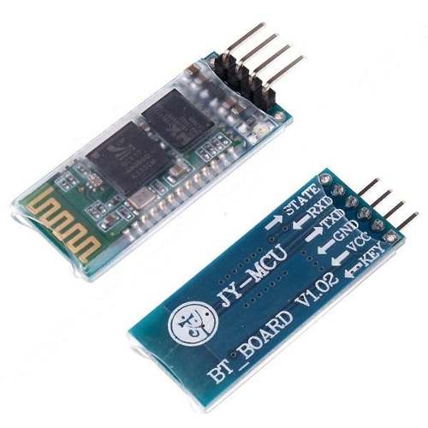
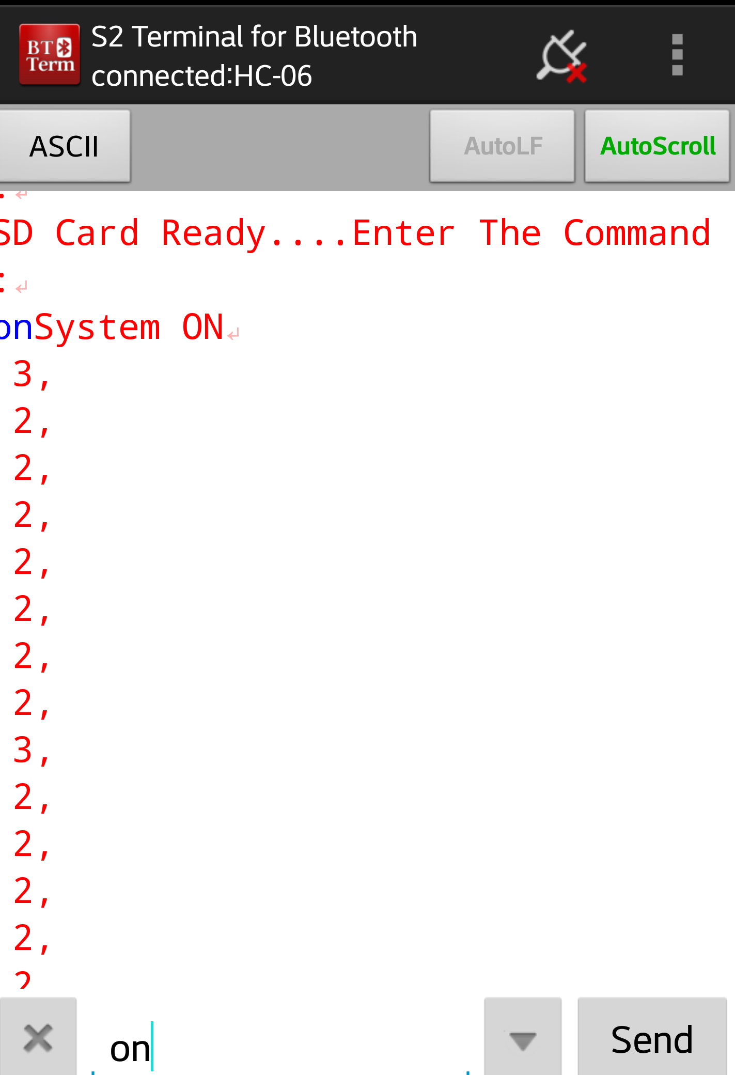
Electronic parts
Bluetooth

Slide 13
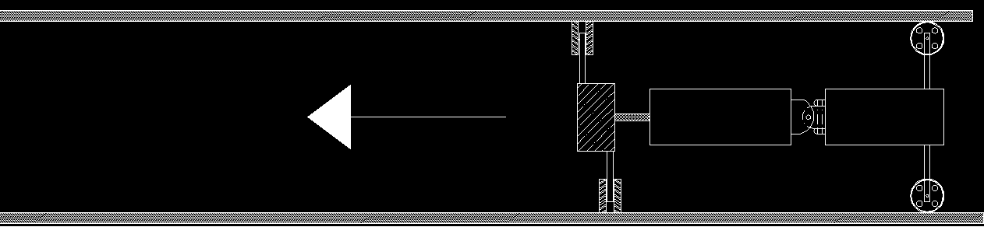
Experiments and Results
Results for 0° Angle slope

Slide 14
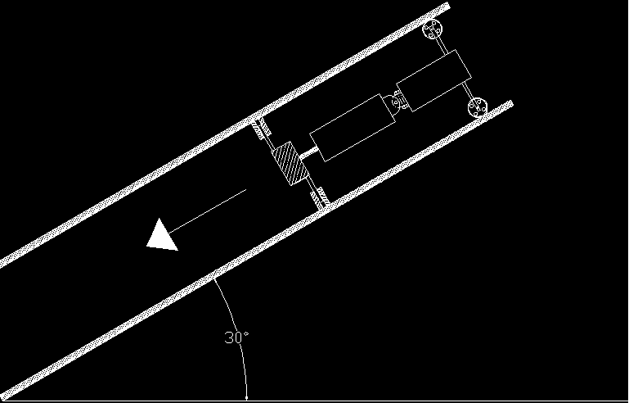
Experiments and Results
Results for 30° Angle slope

Slide 15
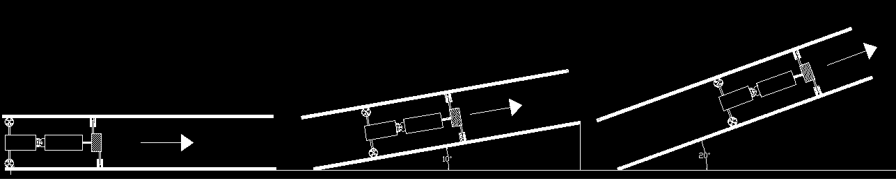
Experiments and Results
Results for continuous change
in Angle

Slide 16
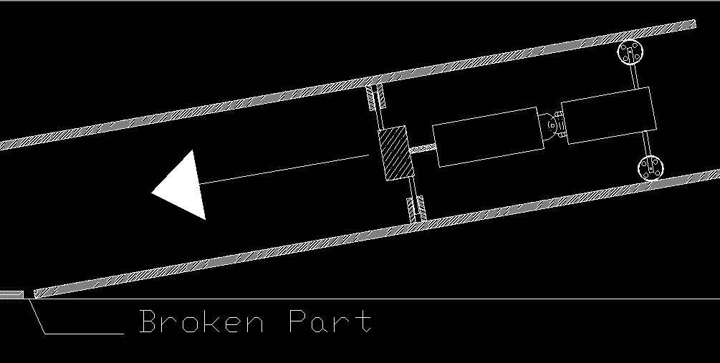
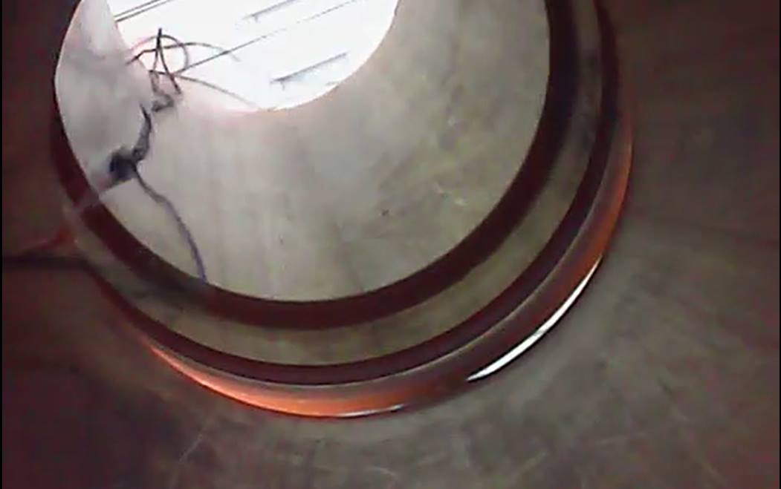
Experiments and Results
Failure in Joining Two Pipes

Slide 17
Conclusion
With this acceptable readings and results, we can say that the robot was stable and the electronic and programing parts achieved their required mission

Slide 18
Recommendation
To develop the robot to deal with a specific range of diameters.
Better way to fix the parts of the robot, may be using screws could help.
Use rubber wheels instead of plastic wheels.
Use more advanced methods to detect the welding problem such as X-ray.

Slide 19


