Slide 1
Pipe Cutting Machine by Gaz Mahdi Bani Fadel Nabeel Sartawi Rafat Rayan Mustafa Blbise DR . Iyad Assaf 2015 - 2016

Slide 2
Types of cutting
We have many types of cutting these types are :
1- Plasma Arc Cutting (PAC):.
2 - Arc and Oxygen Arc Cutting:
3 - Exothermic cutting:
4 - Carbon Arc Cutting (CAC):
5- Oxygen Lance Cutting (OLC):
6- Underwater Cutting:
7- Water Jet Cutting:
8 - Laser Cutting:
9 - Powder and Flux Cutting:
10 - Chemical Flux Cutting (OC-F):

Slide 3
Types of Cutting Machines by Gas:
1 -PUG Cutting Machine:
Profile Gas Cutting Machine helps a Fabricator in cutting production costs and increases efficiency. It is designed for heavy duty jobs and also for precision jobs. It works on single phase supply and it is operated by 1/12 H.P. single phase motor
Some Advantages of the machine:
1 - Easy to handle
2- Body: Made of pressed steel with asbestos heat deflector.
3 -Cutter: Injector type, specially designed to prevent backfire.

Slide 4
2 - Portable Pipe Cutting and Beveling Machine:
The portable pipe cutting and beveling machine has been designed to meet such requirements. It’s simple to operate and gives excellent finish on the cut surface when operated at correct cutting conditions
The Portable Pipe Cutting and Beveling Machine has two types:
1 - The Track Band machine which is automatically maintained square to the pipe by a band.
2 - The Un-Tracked machine that must be set and maintained square to the pipe manually.

Slide 5
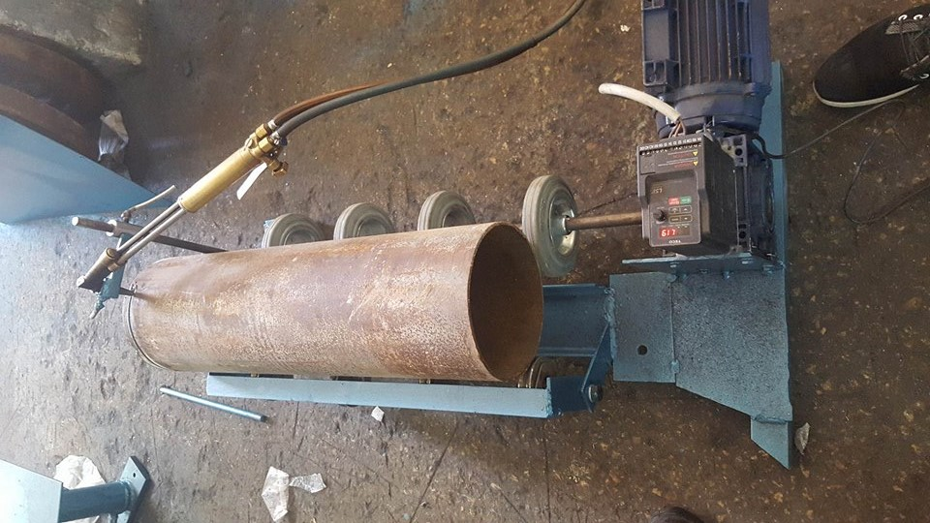
3 - Pipe Cutting Machine by Gas:
As we said before this machine can cut many types of steel. The diameter of pipe will be cut is up to 250mm and it’s thickness is 5mm.the machine consists of three main parts, design part, control part and cutting part

Slide 6
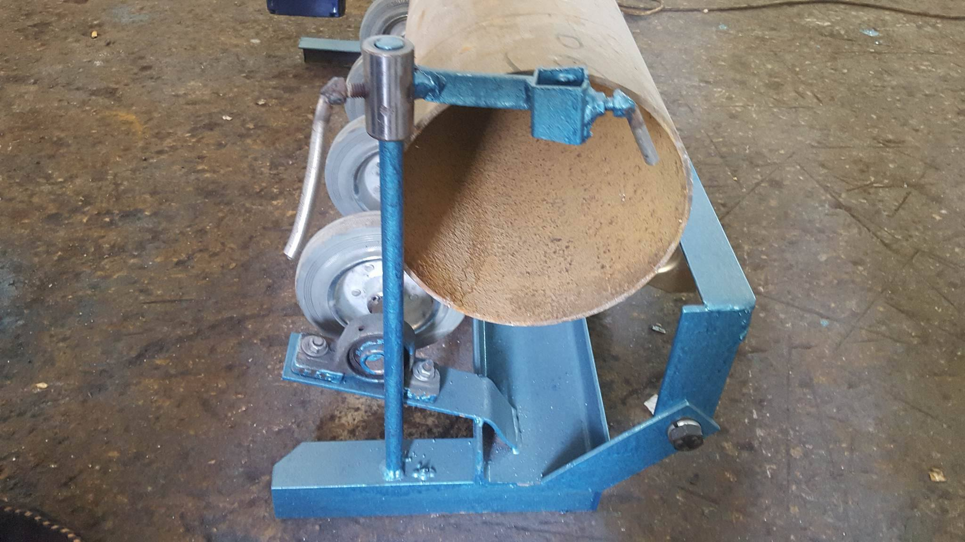
Design section:
The design section consists of four main parts, these parts are, vertical rail, horizontal head, cutting components, and pipe holder
1. Vertical rail:
It is a vertical steel piece which carries the horizontal head and the torch, where the horizontal head is moving up and down, the rail is made from steel

Slide 7
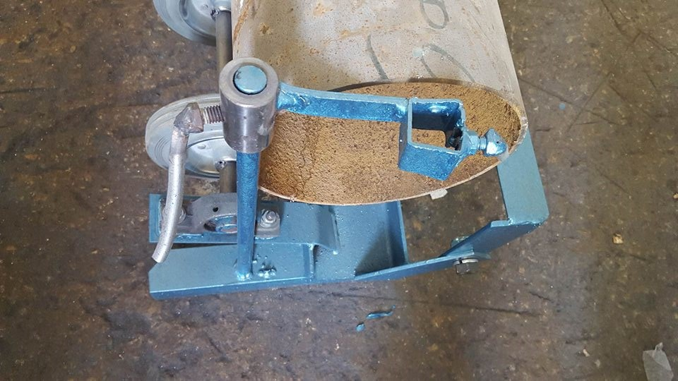
2 - Horizontal head:
It is a component which is in contact with the vertical rail, its main work is to carry the torch and copper pipes that allow the flow of cutting gases,

Slide 8
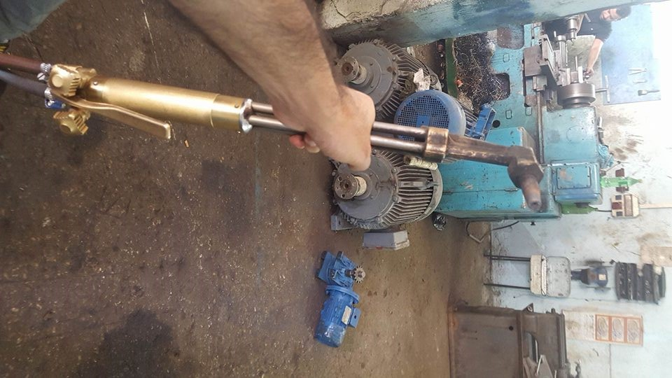
3. Cutting components:
Torch:
The cutting torch carries the fuel gas and oxygen in separate tubes to mixing chamber within the torch head or torch body

Slide 9
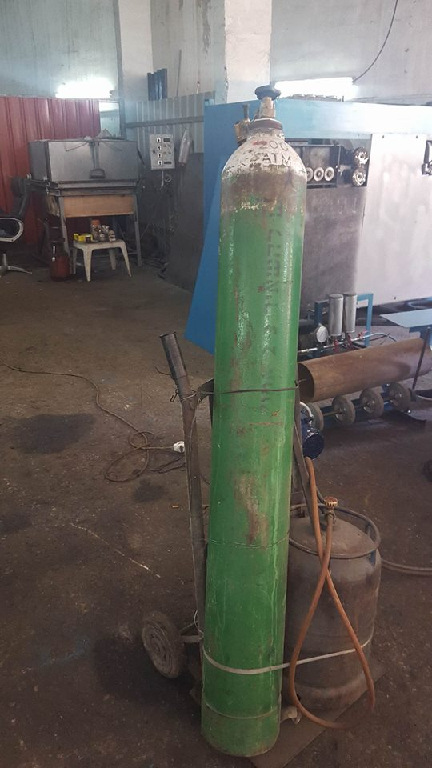
Cylinder:
The cylinders must be securely fastened in an upright position with a chain or clamping device. If the cutting outfit is portable, the cylinder truck must be designed in such a way that it is resistant to tipping.

Slide 10
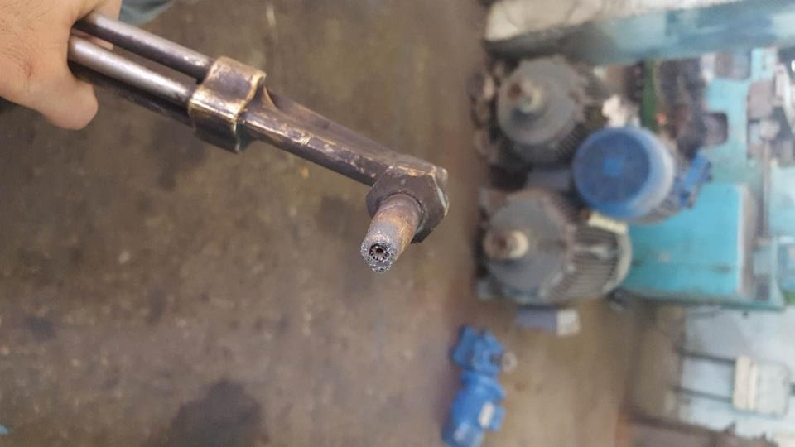
Tip:
In order to get a good quality the proper tips is chosen, the proper size cutting tip is very important
to achieve that purpose
Pipe holder:
It is the forth component of machine design, it’s work is to hold the pipe, and it has a gear which is in contact with a motor, this gear will rotate the pipe circular and regularly. The pipe will be set on four wheels connected to the gear

Slide 11
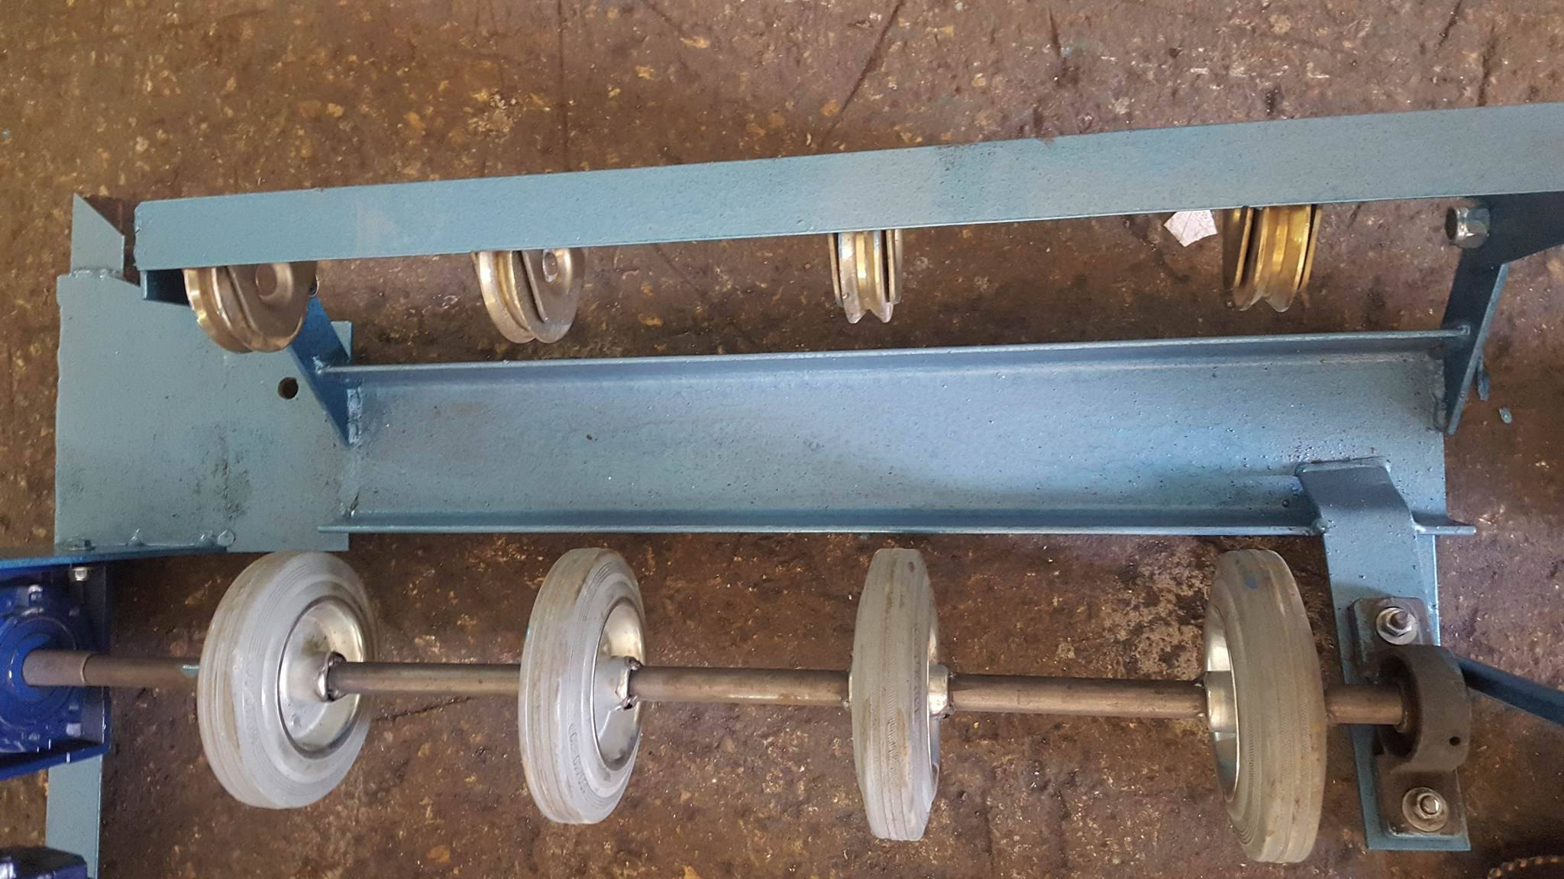
Control section:
This section talks about how the machine operates, all components in design section will be controlled manually, the torch, vertical rail, and horizontal head. But the wheel in pipe holder operates automatically by the gear connected with motor
We used inverter to control the rotation speed of the wheels.

Slide 12
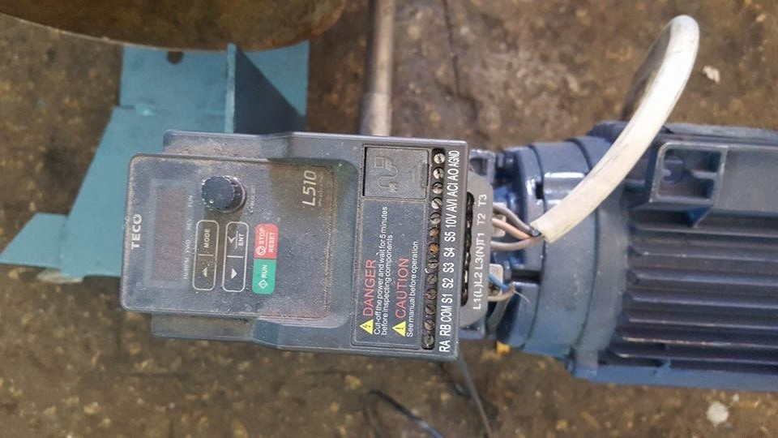

Slide 13
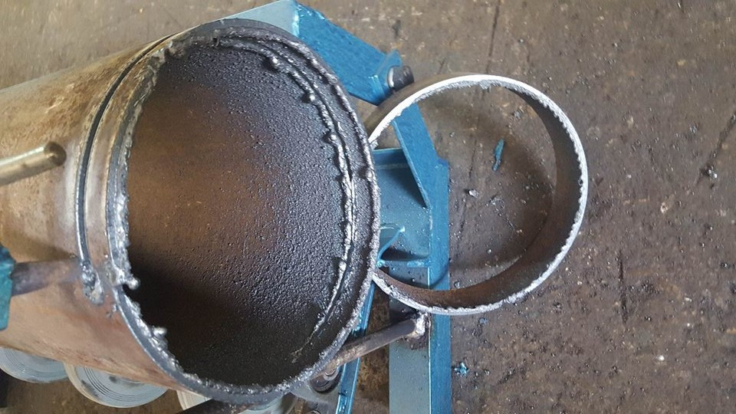
Cutting section:
In order to cut the pipe we use the oxygas cutting process. In this process, allow the gas and oxygen to reach the mixing chamber, then to the tip and use lighter to get the flame. Heats a spot on the metal to the ignition temperature, when penetration occurs switch the inverter

Slide 14
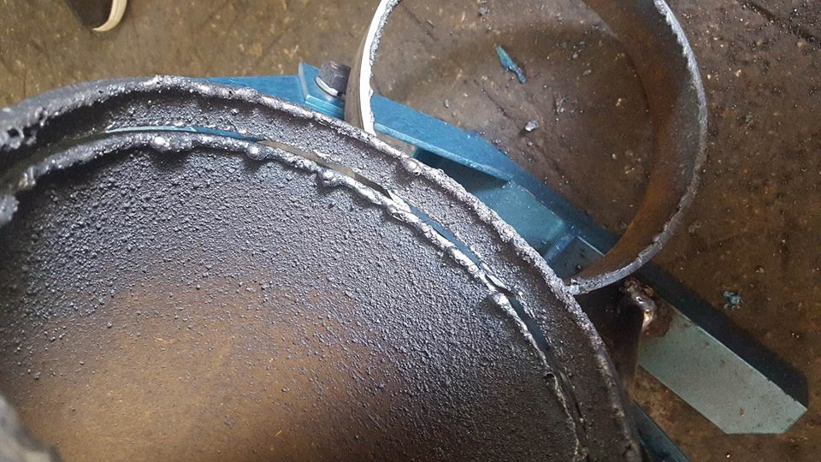
As the torch is moved along the path to cut metal it continues to be removed, a slot is created on the path of cutting, this slot called Kerf.
To achieve a high quality, this Kerf must be removed from the surface of the pipe, in order to do that a desk is used.

Slide 15
Calculations:
In order to calculate the temperature that produced from the reaction that occurs between Butane and oxygen in cutting, and the safety factor of the pipes that contain the gases
The flame temperature can be calculated through the first law of thermodynamics (FLT), assuming an adiabatic process HR=HP.

Slide 16
The chemical reaction of butane burning is:
C4H10+6.5 O2 →4C02+5H2O
kj/kmol
Hp=4(hfCO2+∆hCO2) +5(hfH20+∆hH20)
=4(-393522+∆hCO2) +5(-241826+∆hH2O)
=4∆hCO2+5∆hH2O-2783218
Delta h produced because of the difference of temperature between the room temperature and the resulted temperature due to the reaction.

Slide 17
To find the temperature that produced from reaction:
Suppose T=3000K
∆hCO2=15285 ∆hH2O=126548 4(152853) +5(126548)-2783218 =-1539066 ≠ 126200
Suppose T=5200K
∆hCO2 = 292112 ∆hH2O=254216 4(292112) +5(254216)-2783218 = -343690 ≠-12620
By interpolation:
the temperature that produced from reaction equal 4418K

Slide 18
Calculations for factor of safety: calculations for the stress in the butane plastic pipes:
σ_t= (r_i^2 p_i)/ (r_ (o) ^2-r_i^2) (1+ (r_o^2)/r^2)
= ((〖0.233) 〗^2 (140.5))/((0.255)^2-(0.233)^2) (1+ (0.255) ^2/ (0.233) ^2)
= (710.46) (2.2)
=1563 psi
σ_r= (r_i^2 p_i)/ (r_ (o) ^2-r_i^2) (1-(r_o^2)/r^2)
= ((〖0.233)〗^2 (140.5))/((0.255)^2-(0.233)^2 ) ( 1-(0.255)^2/(0.233)^2 )
=-142 psi

Slide 19
σ_l= (r_i^2 p_i)/ (r_ (o) ^2-r_i^2)
=710.46 psi
Then the factor of safety is:
n = s_y/σ_max
n=8000/1563
= 5.1
By doing the same calculations for the other pipes the results are:
the stress in cupper pipe (inside the torch):
σ_t=15360.16 psi
σ_r=-1390.64 psi
σ_l=698.2 psi
The factor of safety in cupper pipe is: 2.3

Slide 20
The stresses in the tip:
σ_t=16755 psi
σ_r= -4349.6 psi
σ_l=6202psi
The factor of safety is: 2
Stress in the oxygen pipe in the torch:
σ_t= 31724.5psi
σ_r=-2882.46psi
σ_l= 14412.3psi
The factor of safety is: 1.13

Slide 21
The stress of oxygen in the plastic pipe:
σ_t= 32228.9
σ_r=-2932.9
σ_l= 14665.5
The factor of safety is: 0.3

Slide 22
Thank you

