Slide 1
Institutional Development

Slide 2
Institutional Development of Public Services Department at An-Najah National University
Prepared By:
Mahmoud Draghmah
Abdarhman Dababat
Israa Salman
Nour Ihbeisheh
Rehan Shihab
Supervisor :
Eng. Suleiman Daifi

Slide 3
Outline
Introduction
Problem Statement
Our project
Project Objectives
Methodology
Literature Review
Department Description
Conclusion and Recommendation

Slide 4
Introduction
The increasing importance of Institutional Development, recently.
Planned based on knowledge of behavioral sciences and aims to increase the effectiveness.
Three key elements for institutional development: organizational structures, job descriptions and standard operating procedures

Slide 5
Problem Statement
The lack of a clear and detailed organizational structure .
the lack of job descriptions for staff.
NO documentation for the different processes or NO SOPs manual for the department .
All of this led to some mistakes, delays or difficulty of completing some transactions.

Slide 6
Our project
Implement the Institutional Development .
Developing the Organizational Structure of the Department.
Prepare detailed job descriptions for staff.
Document all processes in the department and preparing of SOP manual .

Slide 7
Project objectives:
Organized and standardized methods for working in the establishment that learned to everyone.
Reduce administrative efforts in the follow-up actions and thus reducing the cost.
In addition to ease of training new employees on how to work.
Easy identification of the administrative error in the process path.

Slide 8
Project objectives… II
To expedite the completion of the transactions.
Improve the services provided to the public.
Unify the work performance.
Avoid chaos in departments.
Increasing of Supervision on employee .

Slide 9
Literature review
Data collection
Data analysis
Prepare Institutional Development
Conclusions and recommendations
Establishing a final report
Methodology

Slide 10
Literature Review:
Institutional Development (ID).
Organizational Structure (OS).
Job Description (JD).
Standard Operating Procedures (SOP).

Slide 11
Data collection
Through the historical data contained in the department and through field visits to sections and departments, using the forms, which prepared for it.

Slide 12
Data Analysis
After collecting the required information we analyzed this data and then determine the mistakes and problems that must be dealt and begin to diagnosis and description and then suggest some principled solutions to those problems.

Slide 13
Prepare Institutional Development
Include:
Developed Organizational Structure.
SOPs manual for Services Department at NNU .

Slide 14
Conclusions and Recommendations
Brief conclusions and recommendations that will support the idea and objectives of the project

Slide 15
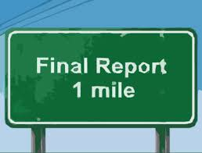
Establishing a final report.
writing and printing of all of the above in a report consistently and submitted to the supervisor to disc.uss the project

Slide 16
Leterature review
Institutional development (ID)
Organizational structure (OS)
Job description (JD)
Standard operating procedures(SOP)

Slide 17
Institutional Development (ID). planned and continuous intervention based on knowledge of behavioral sciences and aims to increase the effectiveness of the organization and includes the entire organization or part of it.
Organizational Structure (OS). Design includes the management three levels : top ( leader) , mid (Tactical) , lower (operational), and represents the organizational relationships between them

Slide 18
Job Description (JD). A job description or JD is a list that a person might use for general tasks, or functions, and responsibilities of a position.
Authority & Responsibility

Slide 19
Standard Operating Procedures (SOP).
A Standard Operating Procedure (SOP) is a set of written instructions that document a routine or repetitive activity followed by an organization.

Slide 20
Public Services Department
It is one of the central departments at the university which functions directly with all of the administrative and academic levels and students.
It is considered as a means to serve all of society at the university.
The department seeks to reach a higher level of services’ quality which are provided to all departments and premises of the university to support its message towards achieving its goals.

Slide 21
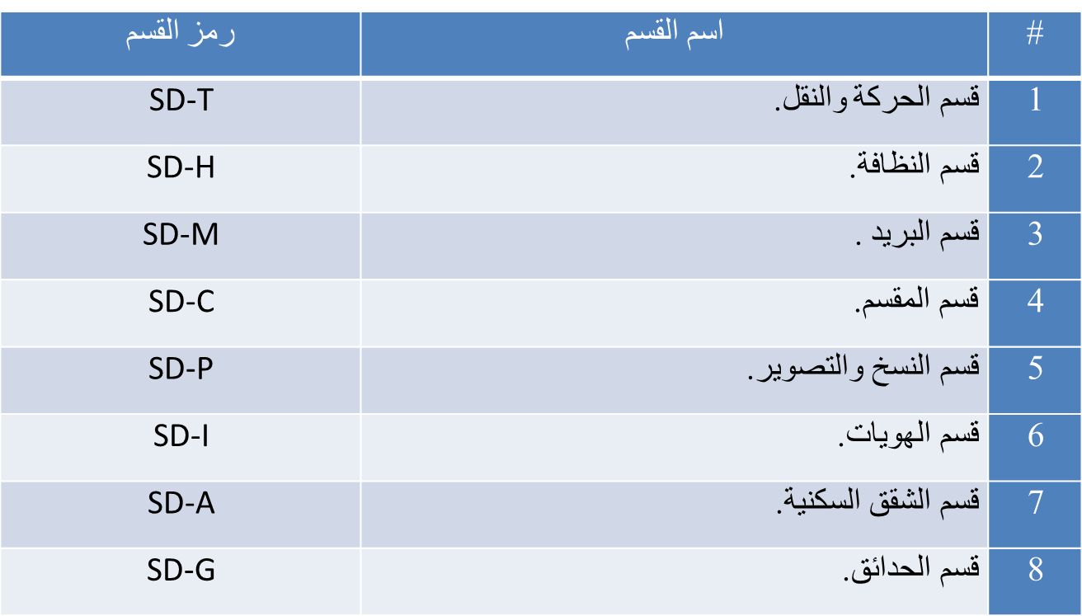
Divisions of Public Services Department

Slide 22
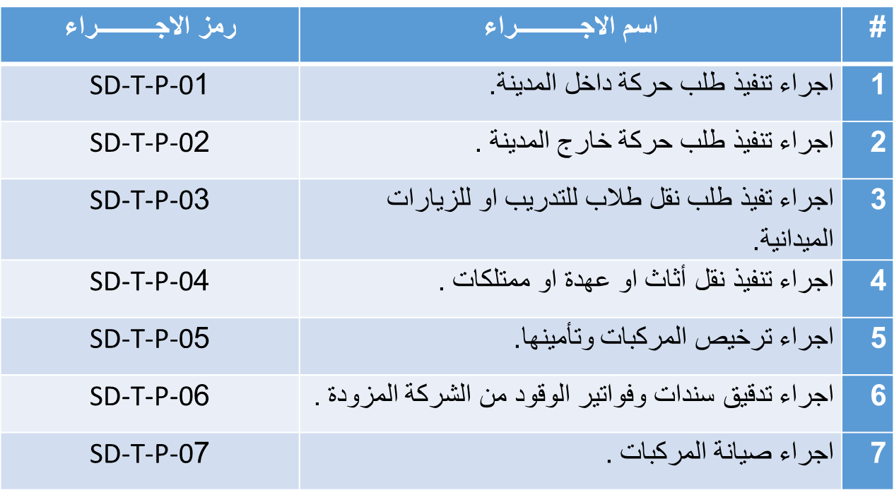
Transportation Division:

Slide 23
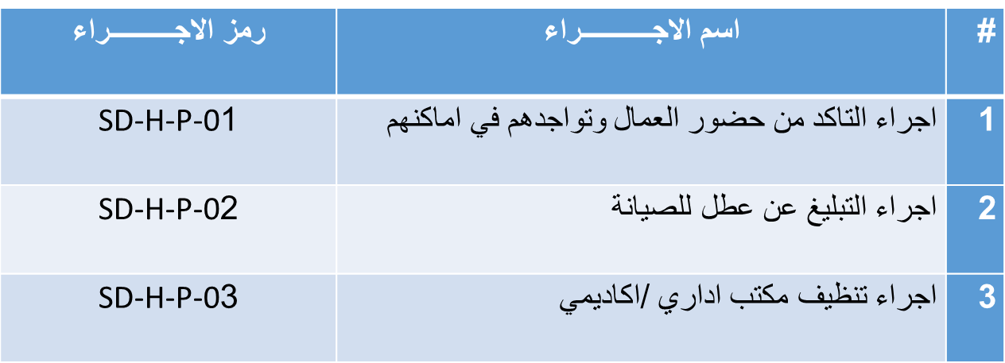
Housekeeping Division:

Slide 24
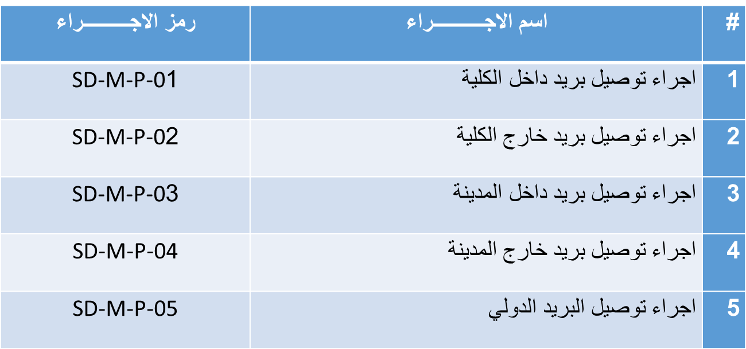
Mail Division:

Slide 25
Students IDs Division:

Slide 26
The Central

Slide 27
Copying and Photographing Division:

Slide 28
Accommodations Division:

Slide 29
Gardening Division:

Slide 30
Conclusion
The absence of any public services superintendent in the new campus.
There is no clear organizational structure which describes the sections of the department
No documentation for any procedure in any division in the department
Not using unified forms in accomplishing the procedures.
Too much touch points between the processes and the procedures in the divisions.
A problem in writing and tracking the mail
The presence of an old device in the communication central .

Slide 31
Recommendations:
It is essential to find a public service superintendent in the new campus. Such a problem could be solved through job enrichment .
clear organizational structure And to find a clear titles for the employees and for their duties.
Documenting all procedures and processes in the divisions.
Design a unified forms with coding system so it can be used in doing the tasks in the divisions.
Putting all the processes and the procedures of the divisions all together and clarify the relation between them.
It is recommended to use advance tools for tracking the mail.
Using advanced and modern devices as an alternative for this one in the communication exchange such as touchscreens .

