Slide 1
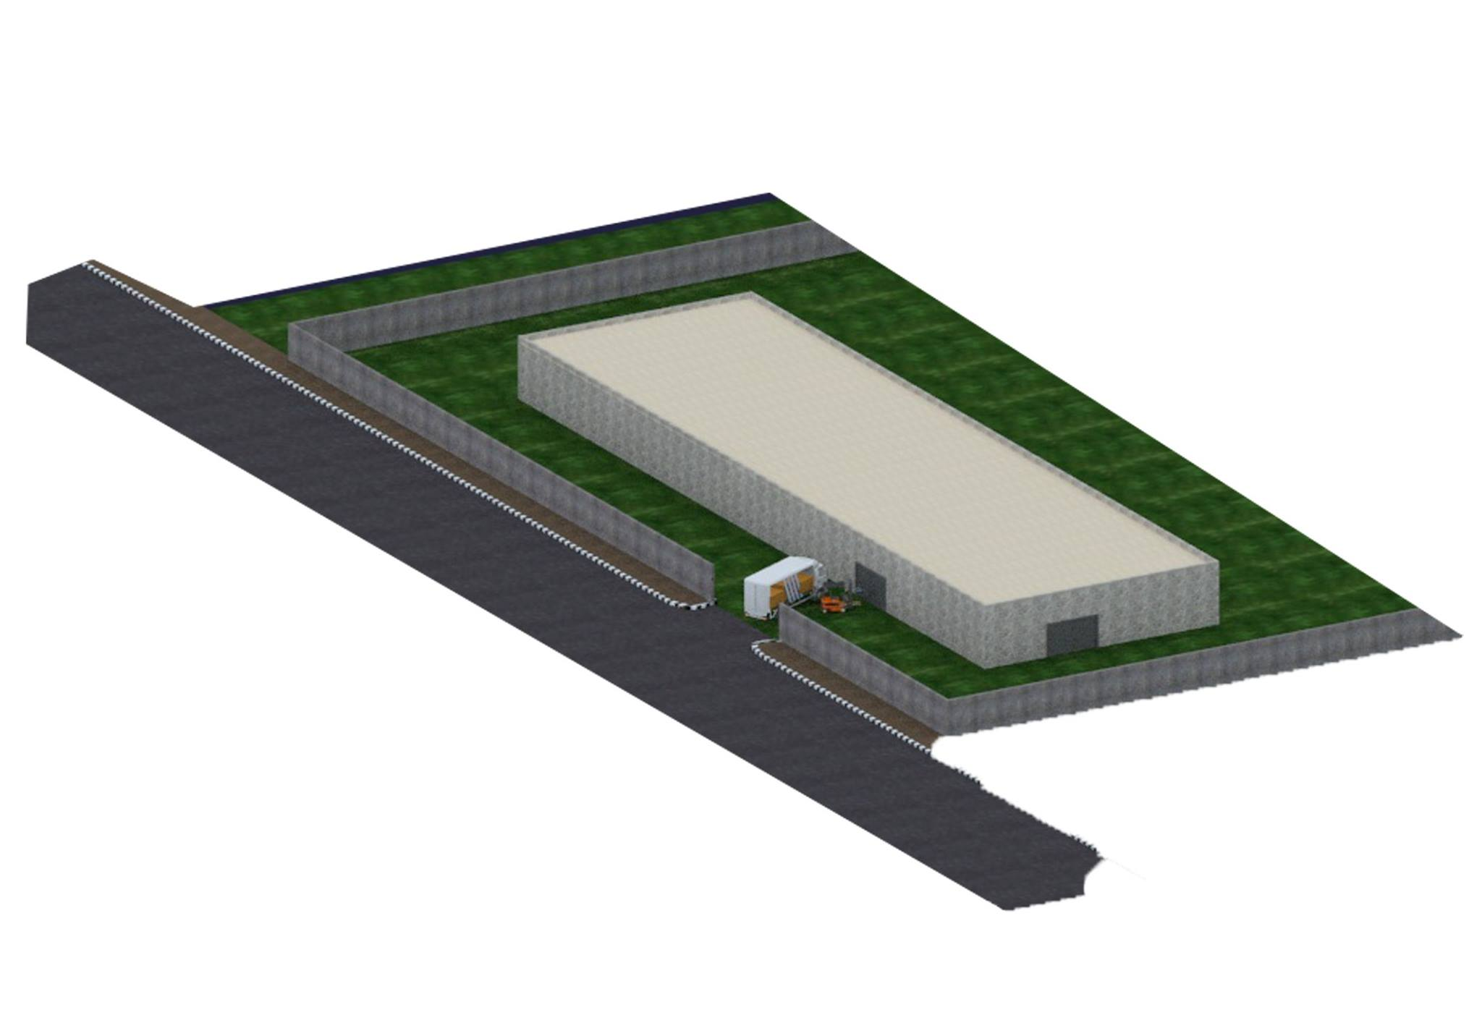
Establishing a New Production Line at National Carton Industry Company
Supervisor :
Dr. Ahmad Ramahi
Wesam Jomaa Tamara Hsheesh
Hashim Mahameed Nida’a Hazem

Slide 2
introduction
Production planning
Plant layout
Economic feasibility study
Conclusion and Recommendation

Slide 3
Introduction
The national Carton Industry Company (NCI) was established in 1989.
The only main branch of (NCI) is located in the east industrial area in Nablus.
focuses its work in the field of manufacturing of carton boxes and in the manufacturing of packaging material including corrugated carton.

Slide 4
Carton Industry company (NCI)aims to Establish a new production line at a particular location and specific area to shaping and cutting cardboard plates, The production line is located in the industrial area of Dier-Sharaf.

Slide 5
Drawing of the hole Factory

Slide 6
Problem Statement
This study need to support the NCI in taking proper decisions:
Production Planning
Plant layout
Economic feasibility study

Slide 7
Production Planning
The planning of production line and manufacturing in a plant. It utilizes the resource allocation of activities, materials and production capacity, in order to serve customers.
Manufacturing metrics
Routing
Inventory management

Slide 8
Data a bout production line
value |  | Descriptions
75.95m |  | Length (m)
23.75m |  | Width(m)
1803.81m |  | Area(m²)
4 truck per day | Row material | Number of truck
3 truck per day | Finished product
7 ton |  | Load for truck
11000 carton board per hour |  | Production speed (standard)
1 machine |  | Number of machine
(martin 1624/28)L shape |  | Shape of machine
(11*33.5)m |  | Dimensions of machine (m)

Slide 9
Manufacturing Metrics
Production Rate
Utilization
Availability
Manufacturing Lead Time
Production Capacity

Slide 10
Production Rate (Rp): Rp=60/Tc
Description | Unit | Value
Tc | min | 0.398
Tr | min | 0.018
Max To | min | 0.38
Rp | cycle/hr | 9060
Production Capacity(PCw):PCw=n*Sw*Hs*Rp/no
Description | Value
n | 1
Sw | 6
Hs | 6.5
Rp | 9060
no | 1
PC_{w} | 353340 unit/wk

Slide 11
Availability(A): A=(MTBF-MTTR)/MTBF
Utilization(U):U=Q/PCw
Description | Value
Quantity of row material per day | 16 ton
# of day in week | 6 day
# of cardboard sheets per ton | 1430
Q | 137280 unit
PCw | 353340 unit
Utilization | 36%
Description | Value
MTBF | 4 hr
MTTR | 0.5 hr
Availability | 87.5%
Manufacturing Lead Time(MLT): MLT=no*Tc
Description | Value
No | 5 operation
Tc | 0.398 min/cycle
MLT | 1.99 min/cycle

Slide 12
Routing
Routing may be defined as the selection of path which each part of the product will follow while being transformed from raw materials to finished products.

Slide 13
Time sheet in the production line
Task number | Symbols | Description of task | Time taken | Machinery required
 | O I T S D |  | 6.913 hr
1 | T | Entrance | 0.8 hr | Forklift
2 | S | Raw material place | 0.977 hr | -
3 | O | Machine | 3.081 hr | -
4 | S | Finished product place | 1.555 hr | -
5 | T | Exit | 0.5hr | Forklift

Slide 14
Routing in the machine

Slide 15
Time sheet inside the machine
Task number | Symbols | Description of task | Time taken | Machinery required
 | O I T S D |  | 3.081 hr
1 | O | Feeder | 0.699 hr | -
2 | O | Printing | 1.271 hr | -
3 | O | Drying | 0.349 hr | -
4 | O | Cutting | 0.540 hr | -
5 | O | Stacking | 0.222 hr

Slide 16
Inventory management
Inventory management supervises the flow of goods from manufacturers to warehouses and from these facilities to point of sale.
Inventory system is First in, first out (FIFO)
The first in, first out (FIFO) method of inventory valuation is a cost flow assumption that the first goods purchased are also the first goods sold.

Slide 17
Plant Layout
Plant layout refers to the arrangement of physical facilities such as machinery, equipment, furniture etc. within the factory building.
Based on production size and product variability, the appropriate layout to use in facility is Product layout.

Slide 18
From to Chart
From-to charts can be helpful in diagnosing problems related to the arrangement of departments and service areas, as well as the location of equipment within a given sector of the plant.
From-to-chart: is a matrix that presents the magnitude of material handling that takes place between two facilities per time period.
we use different scenarios to get the best scenario, which contains less distance between departments.

Slide 19
Scenarios we used
Scenario 1
Distance between each tow department
 | Entrance | Raw Material | Exit | Finished Product | Machine
Entrance | - | 28.35 | 45.15 | 79 | 18.95
Raw Material | 28.35 | - | 44.15 | 51.85 | 44.1
Exit | 45.15 | 44.15 | - | 12.7 | 76
Finished Product | 79 | 51.85 | 12.7 | - | 79.3
Machine | 18.95 | 44.1 | 76 | 79.3 | -

Slide 20
Sum the distances between each two departments
 | Entrance | Raw Material | Exit | Finished Product | Machine
Entrance | - | 56.7 | 90.3 | 158 | 31.9
Raw Material |  | - | 88.3 | 103.7 | 88.2
Exit |  |  | - | 25.4 | 152
Finished Product |  |  |  | - | 158.6
Machine |  |  |  |  | -
Total Distance = 56.7+90.3+158+31.9+88.3+103.7+88.2+152+25.4+158.6 = 951.3 m

Slide 21
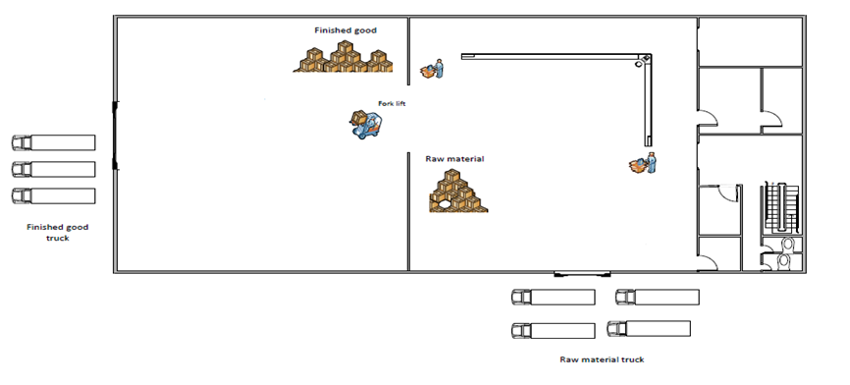
Scenario 2
Scenario 3
T.D = 972.6 m
T.D = 873.4 m

Slide 22
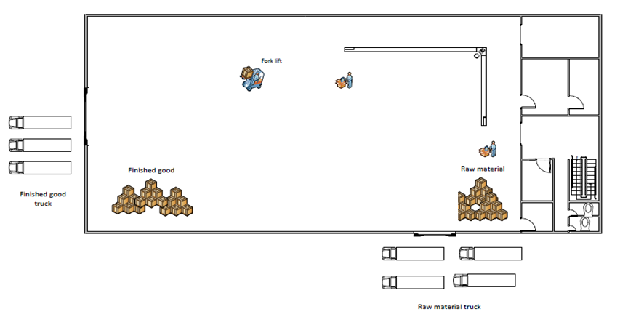
Scenario 4
Scenario 6
T.D = 899.3 m
T.D = 996.6 m

Slide 23
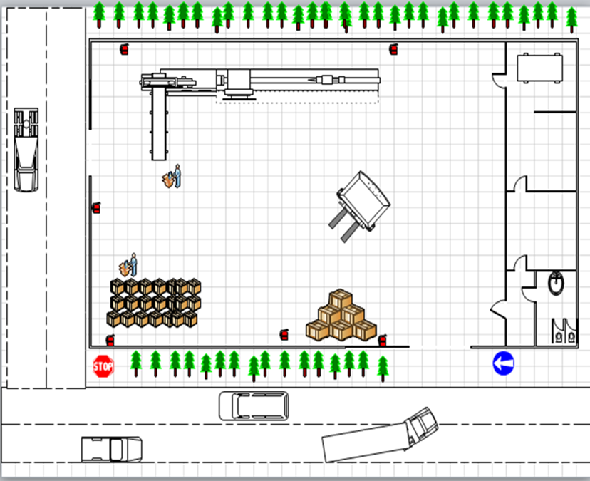
The best scenario
Scenario 5
Total Distances = 872.5 m
The best scenario is the fifth scenario which is based on the assumption of removing the separating wall between departments.

Slide 24
Economic Feasibility study
Assumption
1 | Number of Working Days in a year | 300 Days
2 | Number of Shifts in a day | One
3 | Hours in a Shift | 8 hours
4 | Depreciation | Straight Line Method
5 | Manpower | According to project Requirement
6 | Rent estimate | On the basis of current market price of the area
7 | Potential Area of Marketing the products | Local Industries / Enterprises demand of the area
8 | Number of cardboard sheets per month | 572000 unit/month
9 | proportion of damaged | 1%
10 | Number of good cardboard sheets per month | 566280 unit/month
11 | The price per ton of cardboard | 250$/ton
12 | The amount of daily production based on order | 16 ton/day
13 | assuming the price for one finished cardboard | 0.384 $
study that analyzes data to determine whether the cost of the prospective new venture will ultimately be profitable to the company.

Slide 25
Expenses in the production line
Expenses(per month) | Quantity (per month) | Description
100000$ | 400 ton | Row cardboard sheets
5000$ | 1997.375 m² | Plant rent
119200$ | - | Machinery &equipment
5000$ |  | Ink &packaging material
3895$ | 4 | Staff &labor
532.9$ |  | Depreciation
14200$ |  | Other expenses

Slide 26
Working capital(per month)
S.N | Description | Amounts($)
1. | Raw material | 105000
2. | Salaries & Wages | 3895
3. | Other Expenses | 14200
 | Total | 123095$
Total Capital Investment
Capital Investment | Amount($)
Machinery & Equipment | 119200$
Working capital for one year | 1477140 $
Rent of factory | 60000 $
Total | 1656340 $

Slide 27
Cost of production
Cost of production | value($)
Total working cost per year | 1477140
Depreciation on machinery & equipment | 6395
Total | 1483535$
Sales revenue
S.N | Item | Qty (unit) | Value($)
1 | Cardboard sheets ready | 6795360 unit | 2609418.24 $
2 | Total |  | 2609418.24 $
Break even analysis
 | Break Even Analysis | value
1 | Fixed Cost | 128645 $
2 | revenue per unit | 0.384 $
3 | Variable Cost per unit | 0.03 $
4 | Break Even volume | 363404 unit/monthly
5 | Break Even volume | 254.13 ton/monthly

Slide 28
Payback Period
Profitability guide
Description | Equation | value
Payback Period | P_{p}= initial investment/ annual net cash flow without depreciation | 1.46 year
cost per cardboard sheet | cost per sheet = production cost per year/# of sheets per year | 0.216 $
Profitability guide | Profitability guide = the present value of inflows/the present value of out flows | 1.77

Slide 29
Conclusion
In this project, we collected data about (NCI), conducted relevant literature review, and made some final decisions related to facility layout, production planning and economic feasibility study.
found that establishing the new production line at (NCI) is feasible with a payback period = 1.46 year, break-even point = 363404 unit/month, Profitability guide = 1.77

Slide 30
Recommendations
Based on the number of products and material flow on production line, the production system is mass production (flow line production).
The company does not need to purchase a new machine to perform the same function, because selected machine does not operate at its full capacity.
There is unused space within the production line, which may be exploited through setting up a new different production line in the future.

Slide 31
The company can exploit the empty spaces within the production line by placing safety stock, to avoid problems in the emergency case.
Advising the company to know maximum capacity of the production line, in order to decide if they can make a contractor with other companies and produce additional orders or not.
We recommend the company to give attention to the results of feasibility study: the right price for sale of carton board and the minimum amount to be produced.
Through production planning; the factory can avoid over production or under production.

Slide 32
Thank You

