Slide 1
Design of Jenin-Tubas Highway
Prepared by :
Wisam Mlaitat
Sanaa’ Sbaih
Doaa’ noirat
Subbmitted to :
prof. Sameer Abu-Eisheh

Slide 2
Outline
-introduction
-importance of the project
-objectives
-methodology
-design criteria
-highway geometric design
-Pavement design
-Intersection design
-Bill of quantities
-conclusion & recommendation

Slide 3
introduction
This project is part of an important national highway, Jenin-Al-Dahiryah Highway, which connects most of cities in Palestine.
Jenin Tubas highway is a major highway which connect the northern districts of Jenin and Tubas .

Slide 4
Study area
Notes:
The highway starting from north of Tubas town and passes beside the village of Al-kfair, the towns of Al-Zababdeh and Qabatia, and ending at Jannat park south of Jenin.

Slide 5
Importance of the project
safety
Mobility
Higher speed
Serve the traffic efficiently
Notes:
Many reasons led construct a new highway, with the aim to provide higher speed and more safety.
This road will provide considerable mobility as traffic don’t need to enter the towns and villages.
. The highway is designed to serve the traffic more efficiently, like connection with Arab American University, and will serve the fertile agricultural areas, and the quarries of Qabatya. Finally this new highway is expected to induce and carry increasing commercial and industrial traffic in future.

Slide 6
Objective
After making the necessary studies and determining the design
criteria, based on AASGHTO (2011), and Palestinian standards the following will be done:
1) Geometric design
-Set three alternative of the route and select the best alignment .
-Design the horizontal alignment
-Design the vertical alignment
-Design the cross section elements
-Intersection design
2) Pavement design
3) marking an signing
-

Slide 7
Methodology
Data collection and studies
Traffic studies
Design criteria
Preliminary design
Best alternative choice
Geometric design

Slide 8
traffic
volume
studies
Notes:
We conduct counting at the intarnce of aqqaba , and at al-shuhadaa’ intersection which have the maximum volume

Slide 9
Counting at Al-Shuhada’a intersection
PH=3-4 PM
PHF=0.91
DHV=808
PHV=735

Slide 10
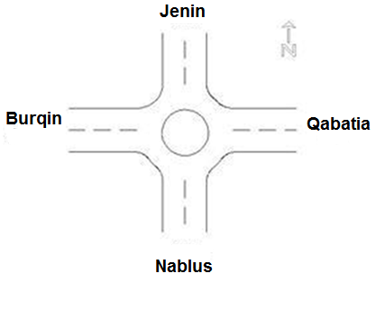
The design volume from Jenin to Nablus and to Qapatia is 808 vehicles/hr, but notice that 50% of them will arrive Nablus (404 veh) and 50% will distributed to villages and places which are before Nablus

Slide 11
Diverted traffic calculations
Travel time for the existing road = 45 min
Travel time foe the new highway = 24 min
Travel time ratio = 0.53
The percentage of the diverted traffic from the existing road to the new highway = 90 %
The diverted trip that will use the new highway = 364 veh / h
Notes:
It’s the redistributed traffic, transferred to the new highway from the current road with the same origin and destination

Slide 12
Natural Growth Traffic
The percentage of growth traffic = 3.3 %
future diverted traffic = 364*(1+.033)²⁰
=697 veh/h

Slide 13
Generated traffic
The expected future generated traffic = 30% * (697) =209 veh /h
The total hourly traffic for one direction = 209+697
=906 veh / h
Notes:
traffic that will be considered when the new facility will be constr
Is the induced traffic that will be considered when the new facility will be constructed. For the study area an assumption is made 5% of traffic will be generated due to a new university and schools which will be built in the future, 5% of agricultural areas development, 5% of new industrial area proposed between Qabatia and Al-Zababdeh and the quarries of Qabatya, and 15% due to new residential development.
ucted

Slide 14
Calculation summery
PHV
404
Diverted traffic
364
Natural growth
697
Generated traffic
906
Notes:
So the one directional traffic that use the highway will be 906 veh/h

Slide 15
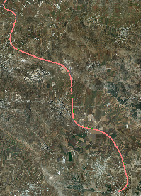
The best Alignment
We set three alternative (as center line ) and then choose the best one .
Modification Based on :
Arial photography
Accurate contour layer

Slide 16
Design control and criteria
Functional classification
Rural Principle Arterial Highway
Level of service
C

Slide 17
Design speed
The highway is divided into 5 zones depending on the
design speed
From station 0+000 to station 3+401.86 V= 90 Kph
From station 3+401.86 to station 5+555.66 V= 70 Kph
From station 5+555.66 to station 6+645.84 V= 80 Kph
From station 6+645.84 to station 9+969.64 V= 70 Kph
From station 9+969.64 to station 16+142 V= 90 Kph
Notes:
For the Rural Arterial Highway and based on the mountainous terrain the design speed ranges from 70 to 90 km/h

Slide 18
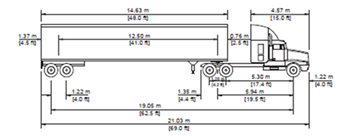
Design vehicle
Semi – trailer WB-19
Notes:
Based on traffic counting it is found that 9% of the traffic is trucks. As it noticed that there are trailers and semi-trailers related to commercial and industrial traffic, so the appropriate design vehicle is chosen to be semi-trailer WB-19. The characteristics of this vehicle as described by AASHTO are shown in Figure 4.1.

Slide 19
Design criteria for horizontal alignment
-Max superelevation 8 %
Design speed (kph) | Side friction (fs) | Min radius (m) | Min length of horizontal curves
90 | 0.13 | 304 | 270
80 | 0.14 | 230 | 240
70 | 0.15 | 168 | 210

Slide 20
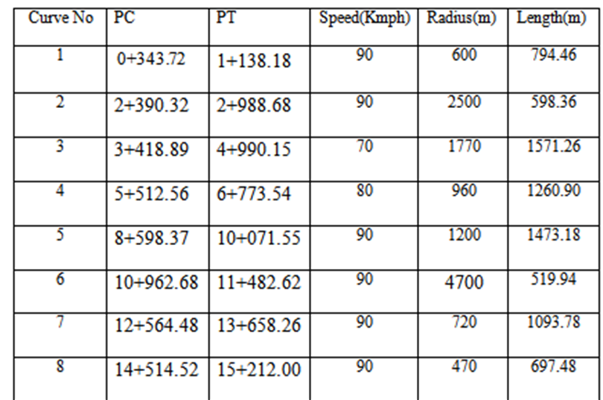
Summery of the horizontal curves

Slide 21
Design criteria for vertical alignment
Grades
Based on the speed of 80 and 70km/h in mountainous terrain , the maximum grade is 7%, and for speed 90 is 6%
The minimum grade is .3%
Minimum length for crest vertical curve: L _{min} = KA

Slide 22
The Crest vertical Curve
L _{min} = KA
K min =17
G1= 6.70%
G2 = -2.85%
A =9.55%
K=23.7
L min = 162.35 m
L = 226.34 m >Lmin

Slide 23
The Sag vertical Curve
L _{min} = KA
K min =38
G1= -5.41%
G2 = 1.21%
A =6.63%
K=43
L min = 252 m
L = 285.1 m >Lmin

Slide 24
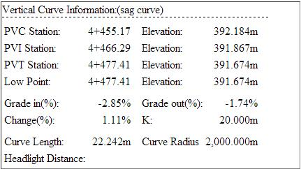

Slide 25
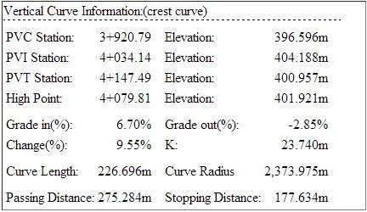

Slide 26
Cross section elements
- 4 lanes with 3.6 m width for each
- Outer Shoulder 2.4m width for each
- Depressed median with 7 m width
- Cross slope is 2% for traveled lanes and 2% for shoulder
- Side slope of 1:4
- Daylight 1:4
Notes:
The cross section elements are designed based on AASHTO recommendation

Slide 27
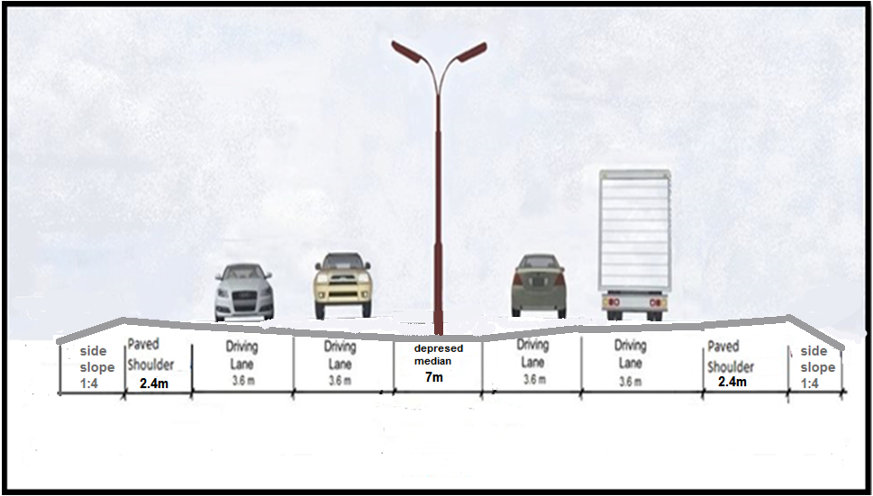

Slide 28
typical assemblies that used in the highway

Slide 29
Pavement Design
The factors considered in AASHTO procedure for the design of flexible pavement are:
1) Pavement performance
2) Traffic
3) Roadbed Soil (subgrade material)
4) Material of construction
5) Environmental
6) Drainage
7) Reliability

Slide 30
The traffic counts, ESAL factors, and design EASL

Slide 31
Reliability | S₀ | ΔPSI | Total ESAL
95% | 0.45 | 2 | 1.28 * 10⁵

Slide 32
Calculation and results
Layer | CBR | Mr | ai | mi | SN | D(in)
Asphalt | - | 450000 | 0.45 | - | 2.25 | 5
Base course | 100 | 31000 | 0.14 | 0.7 | 3.5 | 9
Sub base | 50 | 17500 | 0.128 | 0.7 | 4.3 | 22
Sub grade | 3 | 4118 | - | - | - | -

Slide 33
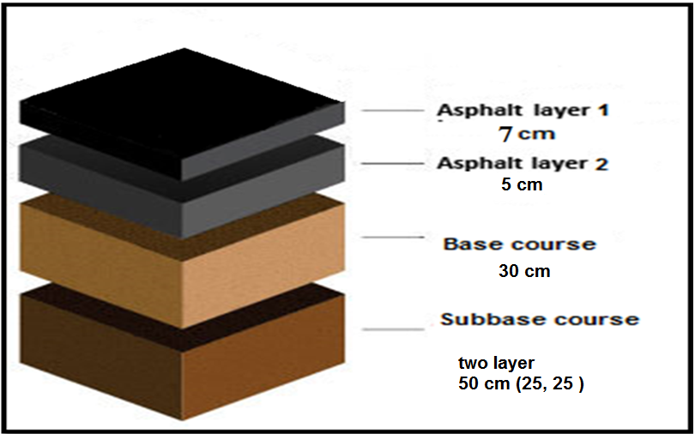
Recommended layers depth

Slide 34
Intersection Design
The main factors that affected the design of intersection are :
- Angle of the turn (90, 60)
-turning speed ( > 15 mi/h)
-design vehicle (WB-12)
-traffic volume ( 906 veh/h)
Notes:
-

Slide 35
Design of Qabatia intersection
The criteria that used in design of Qabatia intersection are :
Speed at intersection = 25 Kph.
Radius = 22m
Turning width = 6.7m (Case 2 condition B )

Slide 36
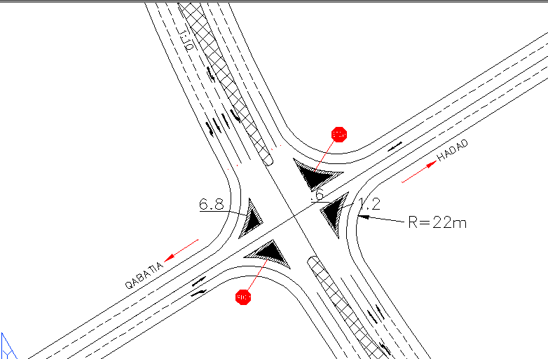
Qabatia Intersection

Slide 37
Design of Janat intersection
The criteria that used in design of Janat intersection are :
Speed at intersection = 25 Kph .
Radius = 47m
Turning width = 7.8m (Case 2 condition B )

Slide 38
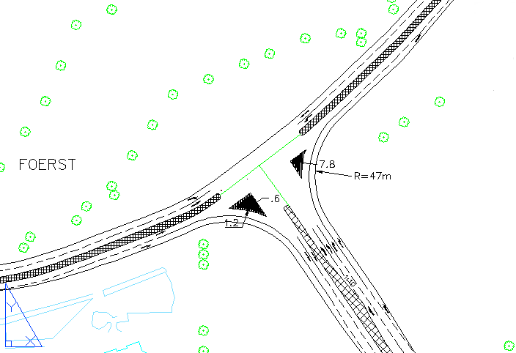
Janat intersection

Slide 39
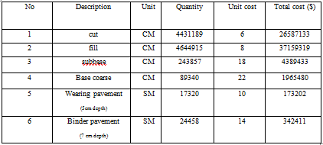
Bill of quantities

Slide 40
Total cost of the project
70616979 $

Slide 41
Conclusion
-The design of this new highway will increase the mobility, and reduce the traffic volumes passing through the cities, and aids in diverting the traffic flow between cities to rural highway.
-The new highway will create economic development, serve the traffic efficiently, provide connection with Arab American University, and will serve the fertile agricultural areas, and the quarries of Qabatia.

Slide 42
Recommendations
Encourage the Ministry of the public works to implement the design of the road
This project is part of an important national highway, Jenin-Al-Dahiryah Highway. Therefore we recommend continuing the design of this highway that includes lighting and drainage structure of highway.
We recommend creating a plan for operation and periodical maintenance for this new highway to complete it in proper work.
Not to cut the trees that is located within the boundary of our design road to preserve the green design and environment.

