Slide 1


An-Najah National University
Graduation Project Report Improving the Maintenance Management System in Palestine Poultry Company
Presented in partial fulfillment of the requirements for Bachelor degree in Industrial Engineering
Group Members :
Abrar Abulail
Sabreen Eran
Zafer jwabreh
Supervisor :
Dr. Mohammed Othman

Slide 2
Contents
Introduction
Statement of the Problem
Research Objective
Methodology
Suggested Maintenance System
Analysis Performance
Conclusion and Recommendations

Slide 3

The Palestine poultry company (AZIZA) :

Slide 4
Statement of the Problem :
The maintenance department doesn’t have a strategy and just depends on emergency maintenance, and this maintenance type is unplanned, unscheduled and inefficient.

Slide 5
Research Objective:
Suggested new templates and reports that should be used in the maintenance department to manage the maintenance process and facilitate the documentation of data and information for the uses of the monitoring and controlling the maintenance process.

Slide 6
Methodology :
Defining the problem
Collecting Data
Data Analysis
Develop solutions

Slide 7


Analysis Performance :

Slide 8
Overview :
The analysis of all maintenance reports
in AZIZA Slaughterhouse in the period from 1 April 2015 to 30 August 2015.

Slide 9

Types of failures:
This part talks about different types of failures
Air conditioning
Mechanical
General maintenance services
Electrical

Slide 10
Mechanical failure :
اسم الماكينة | وصف الصيانة | استلام الطلب
مضخة الدم | تنفيس عن الجوانب | 28/06/15
ماكينة التغليف | المعايرة والغلاف غير مغلق | 17/06/15
ماكينة التغليف | الرولات | 23/06/15
ماكينة التغليف | القشط | 28/06/15
المعاطة | بيليا لا تدور (جرم المعاطة) | 10/08/15
ماكينة التغليف | قشاط فالت | 30/08/15
المعاطة | صيانة دورية | 15/08/15
علاقات الأحشاء | تسريب بربيش ماء الغسيل | 02/08/15
بويلر البخار | عطل في مضخة المازوت | 24/08/15

Slide 11
Electrical failure :
اسم الماكينة | وصف الصيانة | استلام الطلب
كيتور الاحشاء | مفتاح التشغيل Flow switch | 11/04/15
كيتور الاحشاء | المفتاح الرئيسي | 11/04/15
كيتور الاحشاء | مفتاح التشغيل الرئيسي و ال flow switch | 12/04/15
كيتور الاحشاء | مفتاح التشغيل الرئيسي و ال flow switch | 12/04/15
ثلاجة -40 | المراوح | 22/04/15
مكيف مكتب مدير المسلخ | الكنتاكتر | 29/04/15
بطيشات الكهرباء | لا تعمل | 28/07/15
كشافات الاستقبال | إنارة الكشافات لا تعمل | 28/08/15

Slide 12
Air conditioning failure :
اسم الماكينة | شحن غاز | استلام الطلب
Dنظام التبريد | ساعات التبريد | 09/04/15
Dنظام | ساعات التبريد | 09/04/15
F نظام | تنظيف | 09/04/15
C نظام التكييف | معايرة وتشغيل النظام | 26/05/15
Aنظام | معايرة غاز | 02/07/15
Aنظام | دائم النزول over load | 06/07/15
-40 ثلاجة | تسريب غاز في ثلاجة الانتاج | 08/07/15
F نظام | شحن غاز | 20/07/15

Slide 13
General maintenance services failure :
اسم الماكينة | شحن غاز | استلام الطلب
البوابة الرئيسية | لا تفتح عند اغلاقها اغلاق تام | 16/04/15
البوابة الرئيسية | لا تفتح دائما | 25/4/15
مصرف الاستقبال | غطاء المصرف | 02/05/15

Slide 14
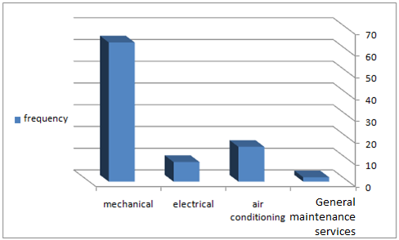
Type of failure with frequency :
Electrical :9
Air conditioning:16
Mechanical : 64
General
maintenance
Services :3

Slide 15
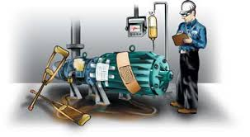
Machine failure :

Slide 16
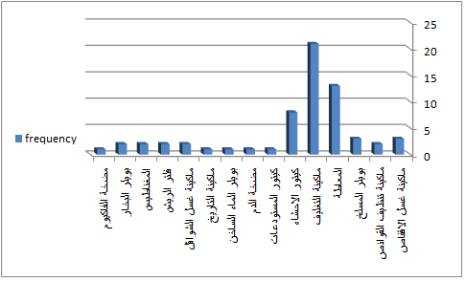
Machine failure :

Slide 17
المعاطة:
نوع العطل | تاريخ حدوث العطل
صيانة دورية | 11/05/15
القشط والبيل | 24/05/15
الاصابع | 25/05/15
صوت غير طبيعي للماكينة | 23/06/15
ريش على الدجاج | 29/06/15
اهتراء الجلدة وتبديلها | 25/07/15
قشاط فالت | 26/07/15
قشاط فالت | 30/07/15
قشاط فالت | 03/08/15
بيليا لا تدور | 10/08/15
صيانة دورية | 15/08/15

Slide 18
ماكينة التغليف :
نوع العطل | تاريخ حدوث العطل
البيل | 23/05/15
توقف متكرر | 21/06/15
الناقل الطويل | 22/06/15
الكلاتش | 22/06/15
الرولات | 23/06/15
القشط | 28/06/15
قشاط فالت | 03/07/15
تغيير البيل | 22/07/15
خط الشرشيرة لا يعمل | 28/07/15
تثبيت القواعد | 28/07/15
قشاط فالت | 19/08/15

Slide 19
كيتور الأحشاء :
نوع العطل | تاريخ حدوث العطل
تسرب من بربيش ماء الغسيل | 10/07/15
تسرب بفرد الماء | 27/07/15
المضخة لا تعمل | 28/07/15
و مفتاح التشغيلFlow switch | 11/04/15
المفتاح الرئيسي | 11/04/15
مفتاح التشغيل الرئيسي و ال flow switch | 12/04/15
تسرب من بربيش مائ الغسيل | 10/07/15
تسرب بفرد الماء | 27/07/15
المضخة لا تعمل | 28/07/15

Slide 20
Kind of failure for each machine with frequency:
المعاطة :

Slide 21
Kind of failure for each machine with frequency:
ماكينة التغليف:

Slide 22
Kind of failure for each machine with frequency:
:كيتور الاحشاء

Slide 23
Summary :
We have discussed all maintenance reports that have been taken from AZIZA Slaughterhouse and show the relations between periods of time with their frequency, and types of failure with their frequency to show the natural of maintenance in this company, and in the next chapter will talk about the result of this analysis.

Slide 24

Suggested Maintenance System:

Slide 25
Overview:
The maintenance system in AZIZA Slaughterhouse is neither managed nor efficient so this chapter aims to enhance the current maintenance system by introducing wide solutions to the problems of the system through restructuring and rearrangement of the overall maintenance process from the beginning of the failure until to maintain it.

Slide 26
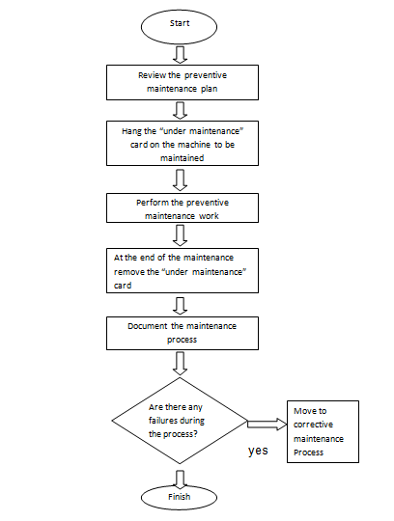
Suggested flow chart:
Preventive maintenance process

Slide 27
Suggested report templates:
1. machine list :
Model | Serial # | Machine name | Machine #
The Head of the maintenance department signature: The date: / /

Slide 28
2. Annual Preventive Maintenance Plan:
Department name : Slaughterhouse
Year: 2015 |  |  | Maintenance Frequency
 | Machine name | Serial # | Daily | Weekly | Monthly | Semi-Annual | Annually | Other

Slide 29
3. Preventive Maintenance card "PMC".
PM card
Department name :
Machine name: | PM code:
Maintenance frequency : Daily Weekly Monthly Semi annually
Task responsibility:
Required equipment/tool(s): 1…………………….. 2…………………….. 3…………………….. 4……………………..
Procedures: 1……………………………………………………… 2……………………………………………………… 3……………………………………………………… 4……………………………………………………… 5……………………………………………………… 6………………………………………………………
Required spare part(s): 1…………………….. 2…………………….. 3…………………….. 4……………………..
Average time to complete task(s):………………………………………..

Slide 30
4. Preventive maintenance checklist:
daily preventive maintenance checklist
department name : | Date : / /
machine name | PM code | maintenance status | results
The head of maintenance department signature :

Slide 31
5S Implementation :
1.Sorting (Seiri)
2.Straightening or Setting in order (seiton)
3.Systematic cleaning or shining (Seiso)
4.Standardizing (Seiketsu)
5.Sustaining the discipline or self-discipline (Shitsuke)

Slide 32
Suggested Measurement Maintenance Activity Performance :
Data sheets
1. Preventive Maintenance Data Sheet:
Preventive Maintenance Sheet
Year:________ Month: _________
Department name: ____________
Number of machines: _______
NO. Of incomplete preventive maintenance: __________
Note: If the semi-annual and annually preventive maintenance are not planned to be performed in this month, then they are considered as incomplete.
The Head of the maintenance department signature: _________ Date: / /

Slide 33
2. Corrective Maintenance Data Sheet for machines :
Corrective Maintenance Sheet for machines
Year:________ Month: ________
Department name: ____________
Number of machines: _______
Machine name: _________ Machine #:_________
NO. of failures:_______
Failure causes (Arrange them in ascending order):_______,________,________,_________
The Mean time between failure:_________
NO. of total maintenance operations :________
NO. of internal maintenance: ________ Percentage % : _______
NO. of external maintenance: ________ Percentage % : _______
Mean Down Time: __________
Mean Time to Repair (MTTR): _________

Slide 34
3.Corrective Maintenance Data Sheet for departments
Corrective Maintenance Sheet for departments Year:_________ Month:___________
Department name: ____________ Number of machines: _______ Total number of failures:_______ Failure causes (Arrange them in ascending order):_______,________,________,_________ NO. of total maintenance operations :________ NO. of internal maintenance operations: ________ Percentage % : _______ NO. of external maintenance operations: ________ Percentage % : _______
Machine name | Failure frequency | Internal maintenance frequency | External maintenance frequency

Slide 35
4. Corrective Maintenance Data Sheet for the maintenance department.
Corrective Maintenance Sheet of the maintenance department. Year :_________ Month:__________ Total number of maintenance activities in all department: ______ NO. of internal maintenance activities: ________ Percentage % : _______ NO. of external maintenance activities: ________ Percentage % : _______

Slide 36

Conclusion and Recommendations:

Slide 37
The current report | The new suggested report | Advantages
The request number is not exist | The request number is exist | It help documenting the reports in the right sequence
The failure classification is not exist | The failure classification is exist | 1-It help the head of department in sorting and documentation process 2- It helps the head of department in sending the specialist engineer to the failure site.
The failure causes are not exist | The failure causes are exist | It helps identifying the most failure causes in every department or for each machine in that department, which leads to give more attention to monitor, control, and eliminate the failure causes.
The spent time in maintenance operation is not exist | The spent time in maintenance operation is exist | 1-It helps monitoring the process 2-identfying the time required for maintenance in case of repeating the same failure.

Slide 38
Recommendations:
1
Creating a computerized system to deal with the data and to ensure the documentation of information to save time.
2
Training sessions for the maintenance crew every now and then
Apply the 5S system to arrange the workshop and reduce the time taken in the maintenance
3
4
Modify the maintenance models and applying models that are clearer and easier to handle.

Slide 39

Abrar Abulail
Sabreen Eran
Zafer jwabreh
Group Members :

