Slide 1


AN – Najah National University
Design of a wastewater collection Network and a Water Distribution Network for Azmut using SewerCAD and WaterCAD
Prepared By:
Mohammad noor Shawer
Ayman Hani Kabaha
Fahmi Zahi Alawni
Supervisor : Dr. Mohammad N. Almasri
2012

Slide 2
Objectives

Slide 3
The Objectives of the Project:
The main objectives of this project are to:
1) Design a Wastewater collection network for Azmut village
2) Design a water distribution network for Azmut Village

Slide 4
The Study Area

Slide 5
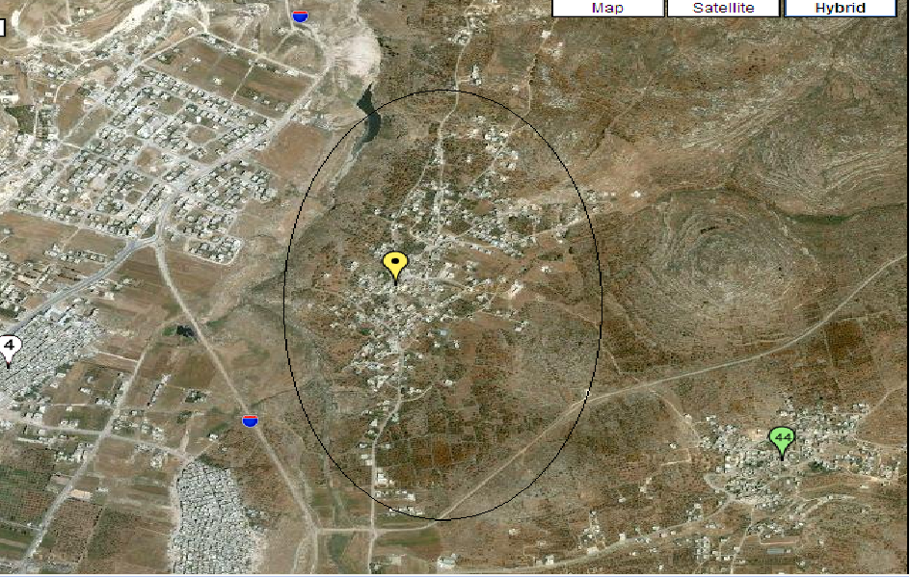
Geography and Topography:
Azmut is located to the north - east of Nablus City, 5 km away from the city center. It stands at elevation of around 469m, the maximum elevation is 560 m and minimum elevation is 440 m above sea level .And total area of 11000 donums, ) the population in Azmut in 1997 was 2035 persons . this number increased in 2007 to 2797 persons. So , we can calculate population growth rate = 3.2%

Slide 6
Design of Azmut Wastewater Collection Network

Slide 7
Introduction
Azmut Village without a wastewater net work.
The disposal of sewage was done through traditional methods as cesspits , but the disadvantages of this method such as ( pollution ,disease and the cost of evacuation of wastes ) requires the presence of sewage system .
So it is necessary to design a sewage collection network in the areas expected to be populated in the future since these networks are in general essential parts of the infrastructure of these areas

Slide 8
Objective
The main goals of the design:
1- Prevent pollution.
2- Make people comfortable.
3- In the future we can reuse wastewater after treatment

Slide 9
Methodology
Project Processing Steps:
Collecting Data
Azmut Village Council
Working with Data
AutoCAD map
AutoCAD
DXF to SewerCAD
Excel sheet
Entering the data
Load
Manholes and Conduit
SewerCAD
Design
Results

Slide 10
Excel Sheet Data
1- Calculate the future population by the following equation:
P=p₀ *(1+r)^{n}
where:
P : is the future population .
P₀: is the present population .
r : is the annual population growth rate .
n : is the period of projection .
2-The population of Azmut in 2061 = 6840
3- The water consumption was (100) L/c.d
4- 80% of demand taken as waste water.
5-Max.hourly demand = 3
6-Design period = 50 years

Slide 11
Constraints used in design
Velocity: we consider velocity constraints as Nablus municipality which is between (0.5-3) m/s.
The slope: to be between (0.002-0.2).
Size of pipes: we used circular pipes with minimum diameter of 8 inches .

Slide 12
Design of sewers
The most commonly formula is Manning formula:
V=1/n * R^2/3 * S ^1/2
Where:
n: Manning coefficient.
S: slope of the pipe.
R= (A/P) :hydraulic radius.
A: cross section area
P: wetted parameter

Slide 13
Results
Diameter: all pipe diameters are 8 in
Manholes : number of manholes = 159.
Pipes: number of pipes = 159 .
Outlet : we use two outlets .
Pipe materials: Polyvinyl chloride PVC.

Slide 14
Velocity

Slide 15
Conclusion and Recommendation
Slopes : We face some problems, such that slope is largest than max. slope ,so we use droop manhole to solve this problem
Velocity : low speed for some pipes in the network reached a speed of less than 0.5 m / s, we have to solve this problem by changing the slope of the low-speed tube by drilling an appropriate distance .

Slide 16
Total Cost of the Sewage Network
Total cost of sewer is 82447.5 $
Total cost of excavation is 36220 $
Total cost of manholes is 33857.2 $
Total cost of covers is 22260 $
Total cost of basement concrete is 1827 $
Total cost of base coarse is 7800 $
Total cost of asphalt is 65958 $
The total cost of the network is 250370 $

Slide 17
Design of Azmut Water Distribution Network

Slide 18
Introduction

Slide 19
The importance of water distribution network
Water distribution networks are used to distribute water from the sources to the consumptions.
WDNs decrease the effort, time, cost and make the life easier
The efficiency is very important, and to check on this, a hydraulic analysis is carried out

Slide 20
Water distribution networks
The WDNs should be capable of:
    Meeting the demands
    Satisfactory the pressure head
The WDNs may be classified as:
    Grid (looped) systems
    Branching systems
    Combination of the both. In our design we considered the combination of both

Slide 21
Methodology

Slide 22
Methodology
Project Processing Steps:
Collecting Data
Azmut Village Council
Working with Data
AutoCAD map
AutoCAD
DXF to WaterCAD
Entering the data
Demand
Pipes and Nodes
WaterCAD
Results
Design

Slide 23
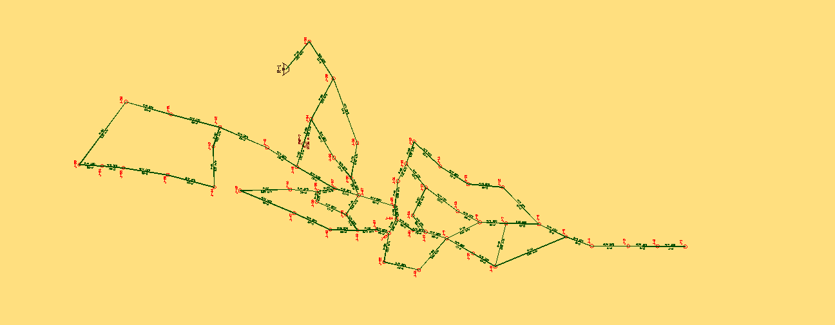
Azmut WDN
Azmut WDN
55 nodes
69 links
Azmut reservoir : Elevation = 506 m,

Slide 24
Data Input:
Growth rate (r) = 3.2%
Design Period = 20 years
water consumption per capita day = 100 L /C-d
Demand : we calculate the num. of capita for each service area by Thiesson Polygon
Diameter : we calculate the largest diameter = 3 in
and we use all diameter ≤ 3 in

Slide 25
Results

Slide 26
Pressure After Adding Pump

Slide 27
Conclusion
Min. head in junction = 15 m
Velocity range : 0.2 m/s ≤ v ≤ 3 m/s
Pump Power = 3.58 KW

Slide 28
Thank You…

