Slide 1


Slide 2
Outline
CH1.Introduction
CH2.Preliminary Design
CH3.3D Model

Slide 3
CH.1 Introduction
This tower “ Nablus Commercial Forum “ has an area of 1800m² of basement.
23 floors and 1 basement garages surrounded by basement wall .
Uses of floors are many: Parking, Offices, Services and Halls.
There heights are 4.1 and 4.6 m.

Slide 4
CH1. Design Data
The following codes and standardS will be used :
ACI 318-08 .
UBC 97.
IBC2009 .

Slide 5
CH1 Design Data
Structural material
The compressive strengths of concrete are :
f’_{c} = 28 Mpa for slabs and beams.
f’_{c} = 44 Mpa for mat foundation , Columns and shear walls .
Yield strength of Steel :
f_{y} = 420 Mpa .

Slide 6
CH1 Design Data
Nonstructural materials :
These materials include bricks, masonry stones, tiles and fill material.
Table below shows the unit weight of some materials :
Table 1.1, Nonstructural material density
Material | Density (KN/m3)
Reinforced concrete | 25
Blocks | 12
Masonry | 26
Tiles | 25
Mortar | 23
Plastering | 23
Selected Filler (compacted base coarse ) | 19
Polycarbonate | 0. 4

Slide 7
CH1 Design Data
Loads:
Gravity loads :
Table 1.2, heights, uses and loads
floor | Height | Use | Live load | SDL
Basement | 4.1 | Garage | 5 | 4
Ground & 1-3 | 4.6 | Retail Market | 5 | 4
4-6 | 4.6 | Stock market, Exchange hall | 5 | 4
7-19 | 4.1 | Offices | 3 | 4
20-24 | 4.1 | Restaurants | 5 | 4

Slide 8
CH1 Design Data
Mechanical masonry: with 5.12 KN/m
Escalators :Reactions of escalators R1, R2
R1=.67 h +3000 kg = 29.4 KN
R2=.67 h +2300 kg = 22.6KN These reactions should be distributed to the beams that carrying the escalators .

Slide 9
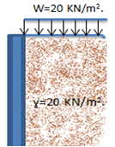
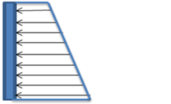
CH1 Design Data
Lateral load :
Seismic loads :
The structure is located in Nablus, which is classified as 2B according to Palestine seismic map .
Soil load:
3

Slide 10
CH1 Building Structural Design
Using two way solid slab that is A concrete slab supported by beams along all four edges and reinforced with steel bars arranged perpendicularly .

Slide 11
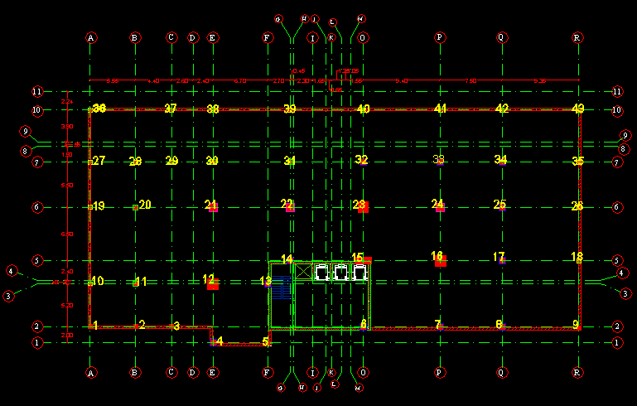
CH.2 Preliminary Design
Fig. 2.1 , grid and column distribution

Slide 12
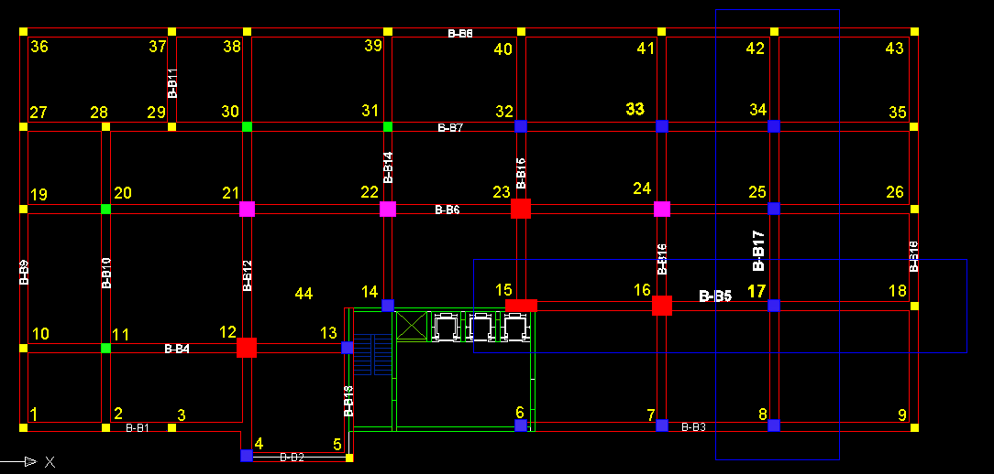
CH.2 Preliminary Design
Fig.2.2, columns and beams name

Slide 13
CH.2 Preliminary Design
The principal purposes for preliminary design of any structure are:
(1)To obtain quantities of materials for making estimates of cost.
(2) Obtain a clear picture of the structural action,
(3) Establish the dimensions of the structure, and,
(4) Use the preliminary design as a check on the final design.

Slide 14
CH.2 Preliminary Design
The principal purposes for preliminary design of any structure are:
(1)To obtain quantities of materials for making estimates of cost.
(2) Obtain a clear picture of the structural action,
(3) Establish the dimensions of the structure, and,
(4) Use the preliminary design as a check on the final design.

Slide 15


CH2 Design of Slab
Using Direct Design Method (DDM)
Thickness of the slab:
h min =
f_{y} = 420 Mpa,
Ln = 9.4 - .8 = 8.6 m
=
So, h min = 0.21 m, we use 23 cm.

Slide 16
CH2 Design of Beams
Maximum Length of the span
in the project = 9.9 m.
Min. depth of beams =
ACI 318 - Table 9.5(a)
So, min. depth = = 0.53 m ,
use 600 X600 mm .

Slide 17
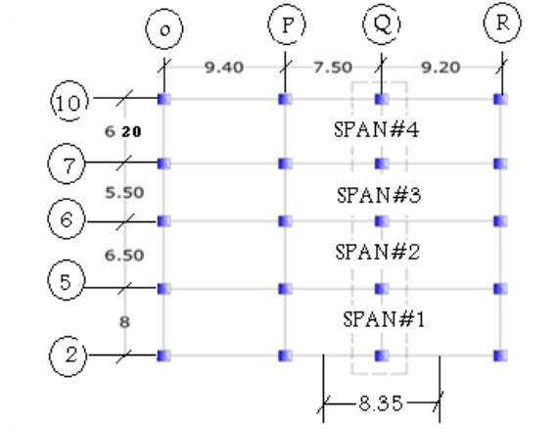
CH2 Design of Frame
The following figures will display the analysis of Frame in y-direction .
Fig.2.4, Frame in Y – direction

Slide 18
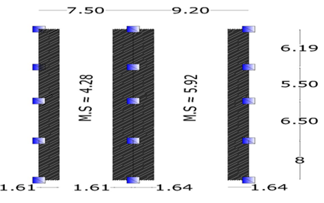
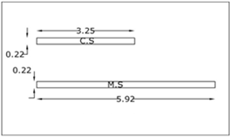
CH2 Design of Frame
Fig 2.5 C.S & M.S

Slide 19
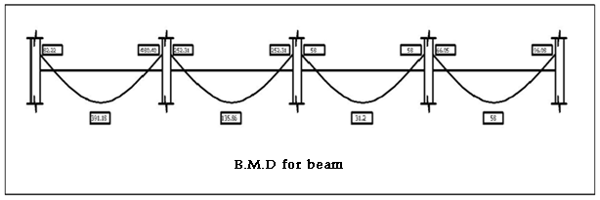
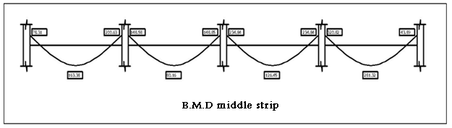
CH2 Design of Frame

Slide 20
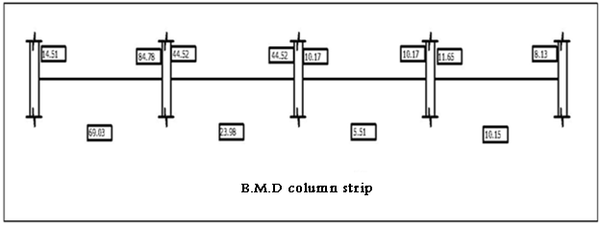
CH2 Design of Frame

Slide 21
CH2 Design of Column
The preliminary columns dimensions can be estimated using the principle of tributary area.
ϕP_{n.max} = 0.8ϕ[0.85fc (Ag – A _{st}) +f_{y} A _{st} ]

Slide 22
CH2 Design of Column
the following figure shows sample of column is to be design using tributary area .
Fig. 2.3, position of column 40

Slide 23
CH2 Design of Column
G2-Column 40:
First Floor
=((9.15х3.095) х (.23 х 25+4))+(9.15+3.095) х 0.47 х 0.6 х 25+0.55 х 0.55 х 25 х 4.1) х 1.2+5 х (9.15 х 3.095) х 1.6=698.7KN.
Floors 2,3
=(((9.15 х 3.095) х (.23 х 25+4))+(9.15+3.095) х 0.47 х 0.6 х 25+0.55 х 0.55 х 25 х 4.6) х 1.2+5 х (9.15 х 3.095) х 1.6=703.2KN.
Floors 4,5
=(((9.15 х 4.295) х (.23 х 25+4))+(9.15+4.259) х 0.47 х 0.6 х 25+0.55 х 0.55 х 25 х 4.6) х 1.2+5 х (9.15 х 4.259) х 1.6=926.7KN.
G2
=698.7+703.2X2+926.7X2=3958.5 KN.

Slide 24
CH2 Design of Column
Table 2.1 , Columns dimensions and groups
Group Name | Sub-Group | Max. Load | Dimensions | Columns
G1 |  | 1501 | 500*500 | 36,27,19,10,3,4
G2 |  | 3959 | 500*500 | 5,28,29,37,38,39,,40,41,42,43,35,26,18,9,2
G3 |  |  |  | 11,30,31,20
 | G3-1 | 7613.52 | 600*600
 | G3-2 | 1380 | 500*500
G4 |  |  |  | 32,33,34,25,17,8,13,14,6,7,1
 | G4-1 | 13854.7 | 800*800
 | G4-2 | 7838.4 | 700*700
 | G4-3 | 6083 | 600*600
 | G4-4 | 2255 | 500*500
G5 |  |  |  | 21,22,24
 | G5-1 | 22991.6 | 1000*1000
 | G5-2 | 14685.2 | 900*900
 | G5-3 | 11356 | 800*800
 | G5-4 | 7291 | 700*700
 | G5-5 | 3226 | 600*600
G6 |  |  |  | 15,16,12,23
 | G6-1 | 36526.8 | 1300*1300
 | G6-2 | 28326.9 | 1200*1200
 | G6-3 | 25038.3 | 1100*1100
 | G6-4 | 16575.9 | 1000*1000
 | G6-5 | 8114 | 900*900

Slide 25
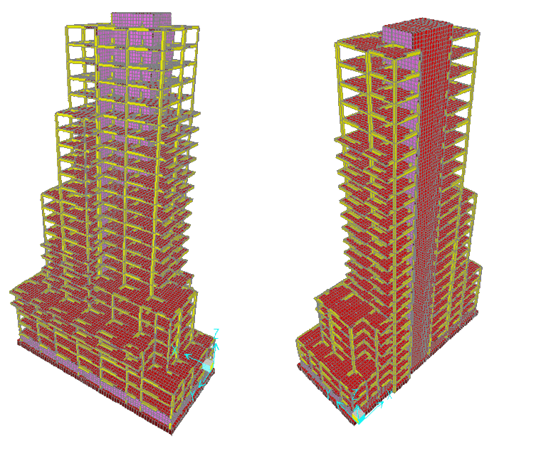
CH.3 3D Model

Slide 26
CH3 Modifications
 | Column | Beam | Wall
Torsional Constant | 0.7 | 0.35 | 0.35
I about 2 axis | 0.7 | 0.35 | 0.35
I about 2 axis | 0.7 | 0.35 | 0.35
 | Slab | Mat
Bending M11 Modifier | 0.25 | 0.25
Bending M22 Modifier | 0.25 | 0.25
Bending M21 Modifier | 0.25 | 0.25

Slide 27
CH3 Seismic LOAD
The UBC97 code seismic parameters are as follows :
- The seismic zone factor, z=0.2.
- The soil is very dense soil and soft rock , so the soil type is Sd.
- The importance factor: I=1.25
- The ductility factor : R = 5.5
- The seismic coefficient Ca= 0.28.
- The seismic coefficient Cv= 0. 40.

Slide 28
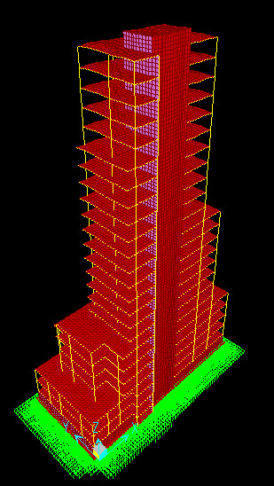
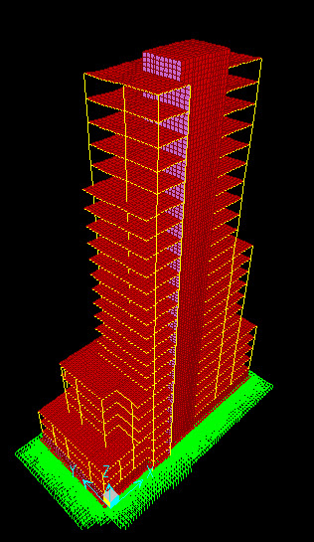
CH3 Verification
Compatibility :
Fig 3.1, compatibility view

Slide 29
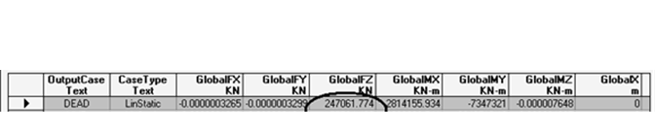
CH3 Verification
Equilibrium :
The results by hand calculation as follow :
Total live load = 84185.45
Live Load with 1.75%
Total dead load =233879.1 with 5% error

Slide 30


CH3 Verification
Stress Strain Relationships :
If we compare the moment values for the previous figure with hand calculation moment for interior beam which equal to:
From SAP :
We have an error = 2.9% which is acceptable .

Slide 31
CH3 Verification
Deflection :
By taking an average of deflection on corners
of max. panel deflection at seven story and
conduct it from deflection in the middle of
panel , the figure below shows the deflection
at panel .

Slide 32
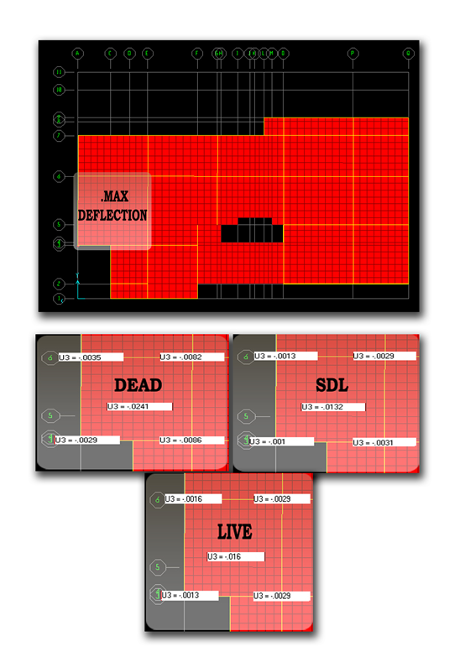
CH3 Verification
Fig 3.2, Max deflection on panel

Slide 33


CH3 Verification
Base Shear :
To design or check base shear the following equations shall be determined as follow :
The total design base shear needn’t exceed the following :
The total design base shear needn’t less than the following :

Slide 34


CH3 Verification
The error in X- direction can be acceptable in this case , because the structure is not symmetric .

Slide 35
CH3 Shear & Basement Walls
The thickness of shear wall change from 0.65 m for first 8 story to 0.55 from story 8-16 and 0,45 from story 16-24 .
The thickness of the basement wall is 30 cm .
The basement has additional lateral load from soil more than other walls.

Slide 36


CH3 Design of Mat Foundation
To determine the mat thickness :
Vu = 30000 KN ( from SAP 2000 )

Slide 37
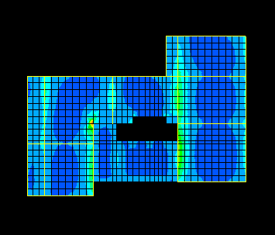
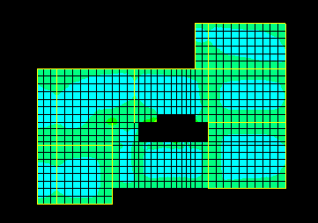
CH3 Design of Slab
The figures below show the moment on the shell :
Fig 3.3, M11 { Min}
Fig 3.4, M22 { Min}

Slide 38
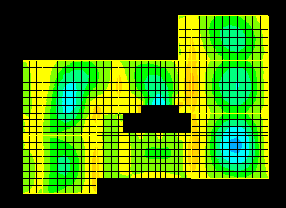
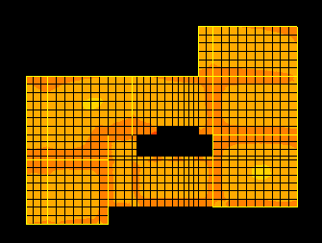
CH3 Design of Slab
Fig 3.5 , M11 {max}
Fig 3.6 , M22 {max}

Slide 39
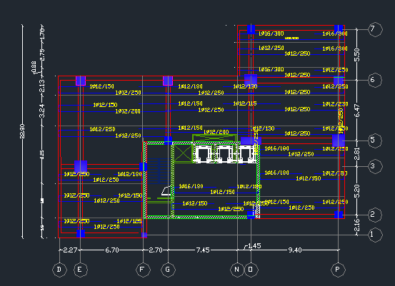
CH3 Design of Slab
Fig 3.7 , Reinforcement in x – direction

Slide 40
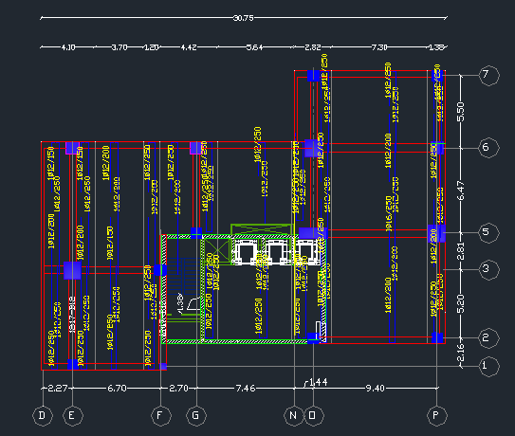
CH3 Design of Slab
Fig 3.8 , Reinforcement in y – direction

Slide 41

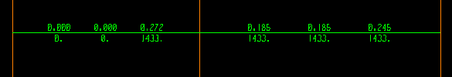
CH3 Design of Beams
Using SAP program to determine the reinforcement needed for a beam :
Fig . 3.9 flexure steel
Fig . 3.10 Torsion steel

Slide 42
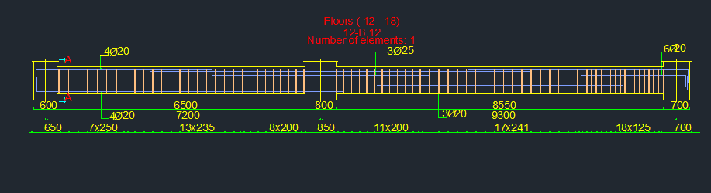
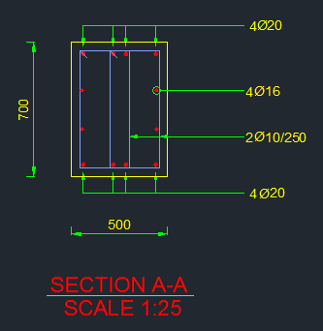
CH3 Design of Beams
Fig . 3.11 , Beam reinforcement

Slide 43


