Slide 1

Design of Bala School
PREPARED BY :
JAD SULAIMAN
JAFAR NATOUR
SUPERVISOR:
DR.RIYAD ABD-ALKARIM

Slide 2
the project consist of five chapter. 1- chapter one : general introduction 2- chapter two: design of floor system 3-chapter three : beams design 4-chapter four : column design 5-chapter five : footing design
PROJECT DESCRIPTION

Slide 3
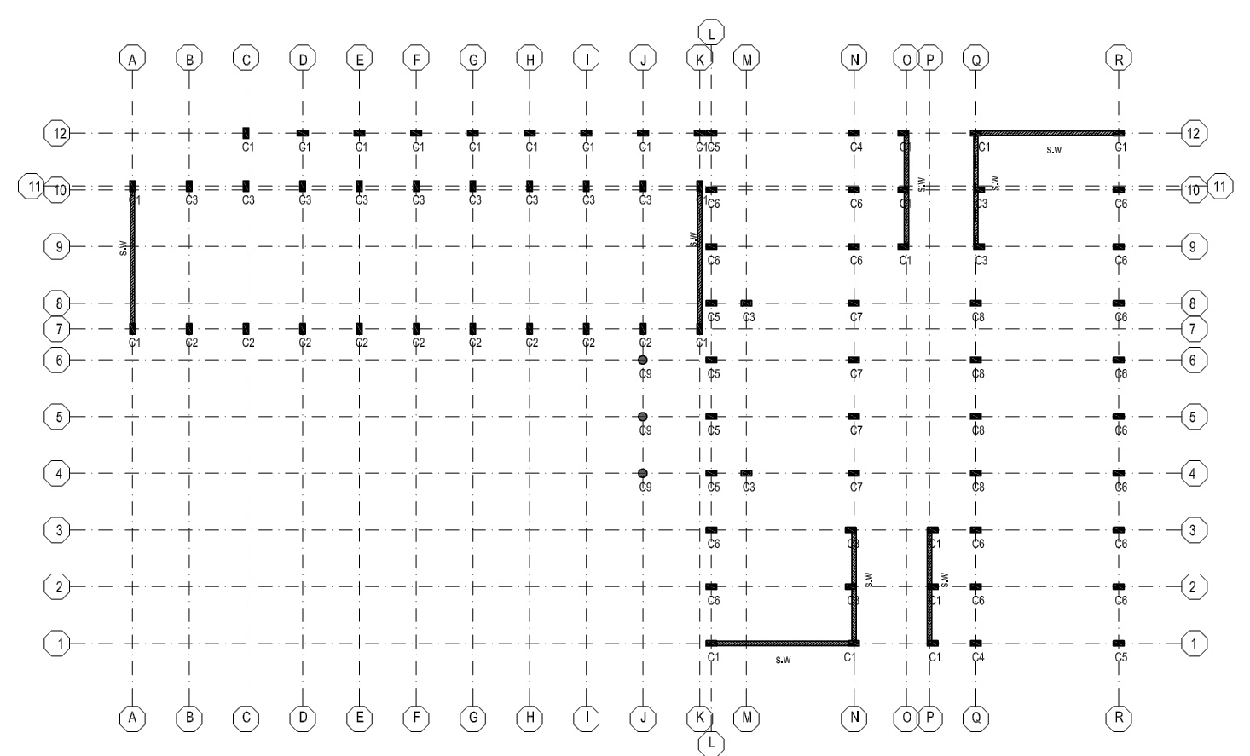
Typical column and wall layout

Slide 4
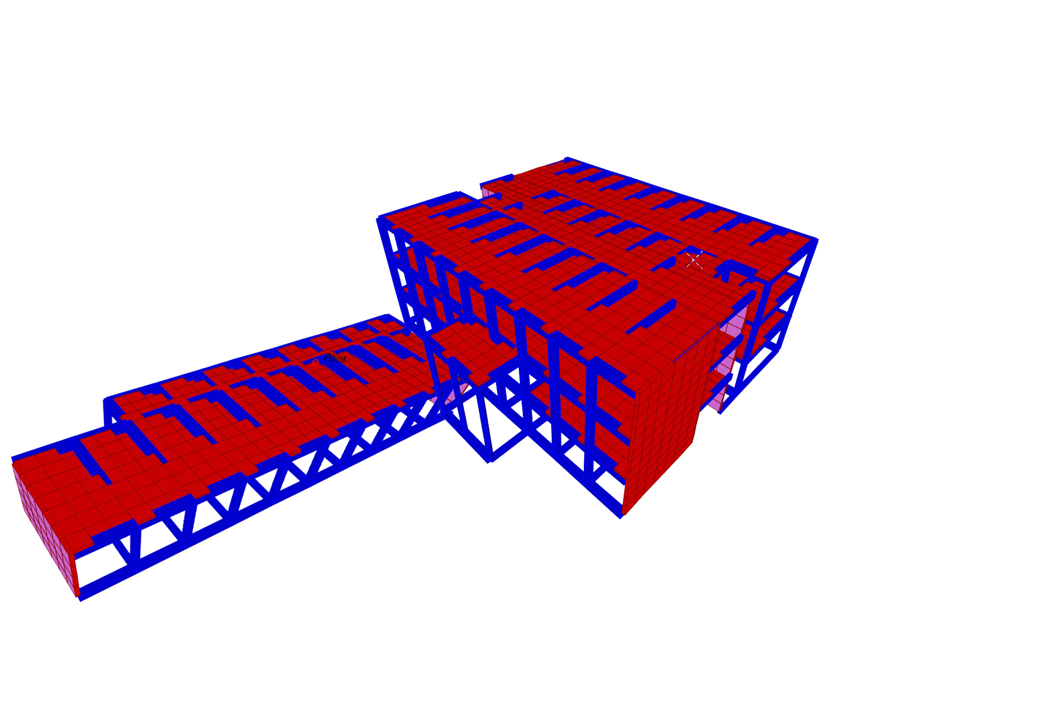
General view of the project

Slide 5
Chapter One: General Introduction
About the project
Philosophy of analysis & design codes
Materials
Loads
Codes

Slide 6
Introduction
About The Project:
The school is located in the "Bala" town in “Tulkarem” district , the school consists of two parts. The first part consists of three floors with 3.25 m per floor and a plan area of 488.5 m² . The second part consists one floor with an area of 275m² separated from the first part by a structural break.

Slide 7
Introduction
Philosophy Of Analysis & Design Codes
The method used in design is the “Ultimate Design Method” .
The codes used:
The American Concrete Institute (ACI) code 2008 .
The International Building Code (IBC-2009).
The analyzing program is SAP 2000 v15.1

Slide 8
Introduction
Material
Concrete strength for footing 30 Mpa.
Concrete strength for column 28 Mpa.
Concrete strength for other element 24 Mpa.

Slide 9
Introduction
Loads :
Live load for class = 2KN/m²
Live load for corridor = 4KN/m²
S.I.D.L = 4 KN/m².
Load Combination :
1.4D
1.2D+1.6 L

Slide 10
Chapter Two Design Of Floor System
Structural system of the slab
Slab thickness
Design of rib slab

Slide 11
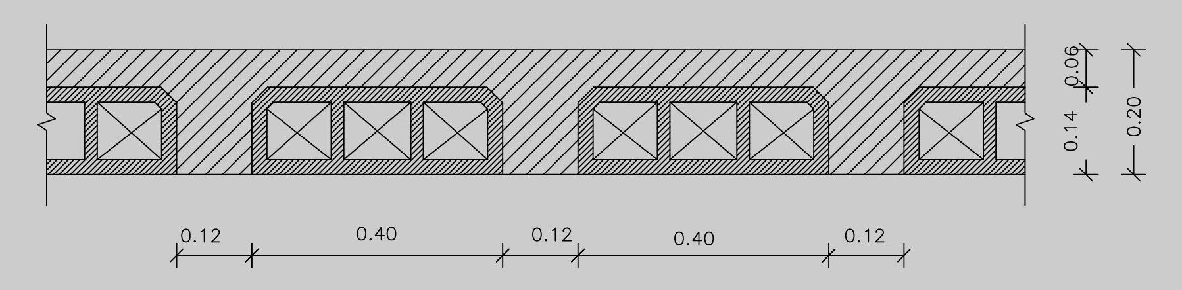
Slabs design
Structural System Of The Slab:
The structural system used is one way ribbed slab.
Slab Thickness:
L/18.5 =270/18.5 =14.5cm (a thickness of 20 cm is considered).
Typical section in the ribbed slab

Slide 12
Slab design
Rib distribution of the right part of the school

Slide 13
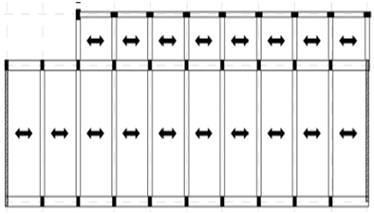
Slab design
Rib distribution of the left part of the school

Slide 14
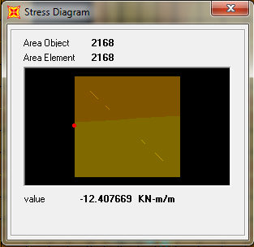
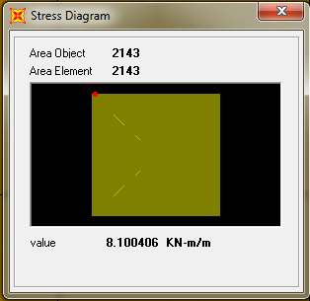
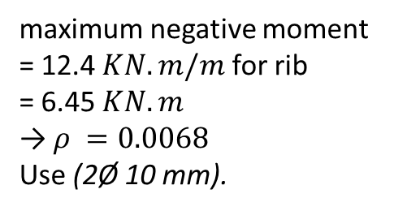
Slab design
Design Of Slab For Flexure:
maximum negative moment = 12.4 $KN.m/m$for rib
= 6.45 $KN.m$
→ $ρ =0.0068$
Use (2Ø 10 mm).

Slide 15
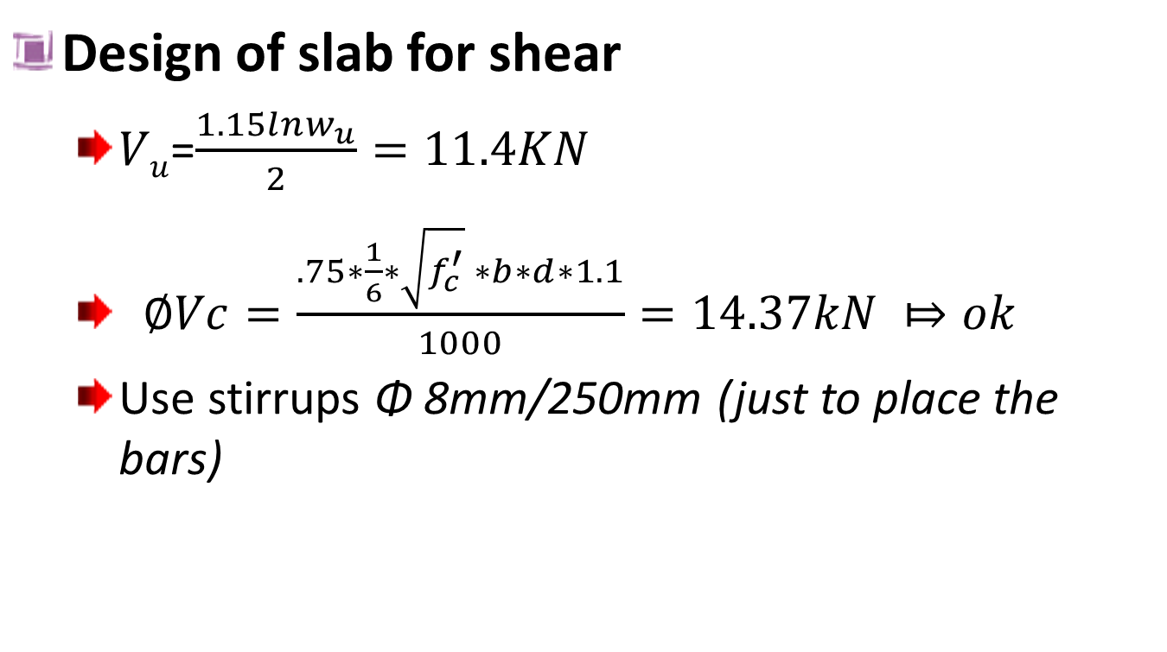
Slab design
Design of slab for shear
$Vu$=$\frac{1.15lnw_{u}}{2}=11.4KN$
$∅Vc=\frac{.75∗\frac{1}{6}∗\sqrt{f_{c}^{′}} ∗b∗d∗1.1}{1000}=14.37kN ⤇ok$
Use stirrups Φ 8mm/250mm (just to place the bars)

Slide 16
Chapter Three: Beams Design
Selection of beams section.
Design for moment.
Design for shear.
Design for torsion.

Slide 17
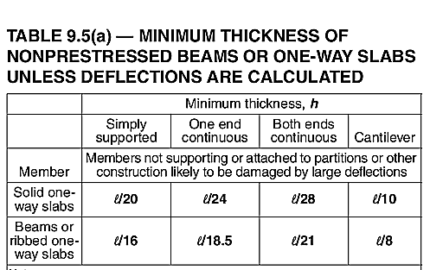
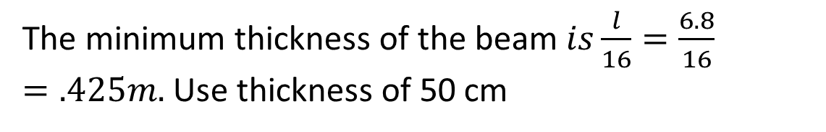
Beams Design
Selection of beams section based on deflection requirement:
The minimum thickness of the beam $is\frac{l}{16}=\frac{6.8}{16}=.425m.$ Use thickness of 50 cm

Slide 18
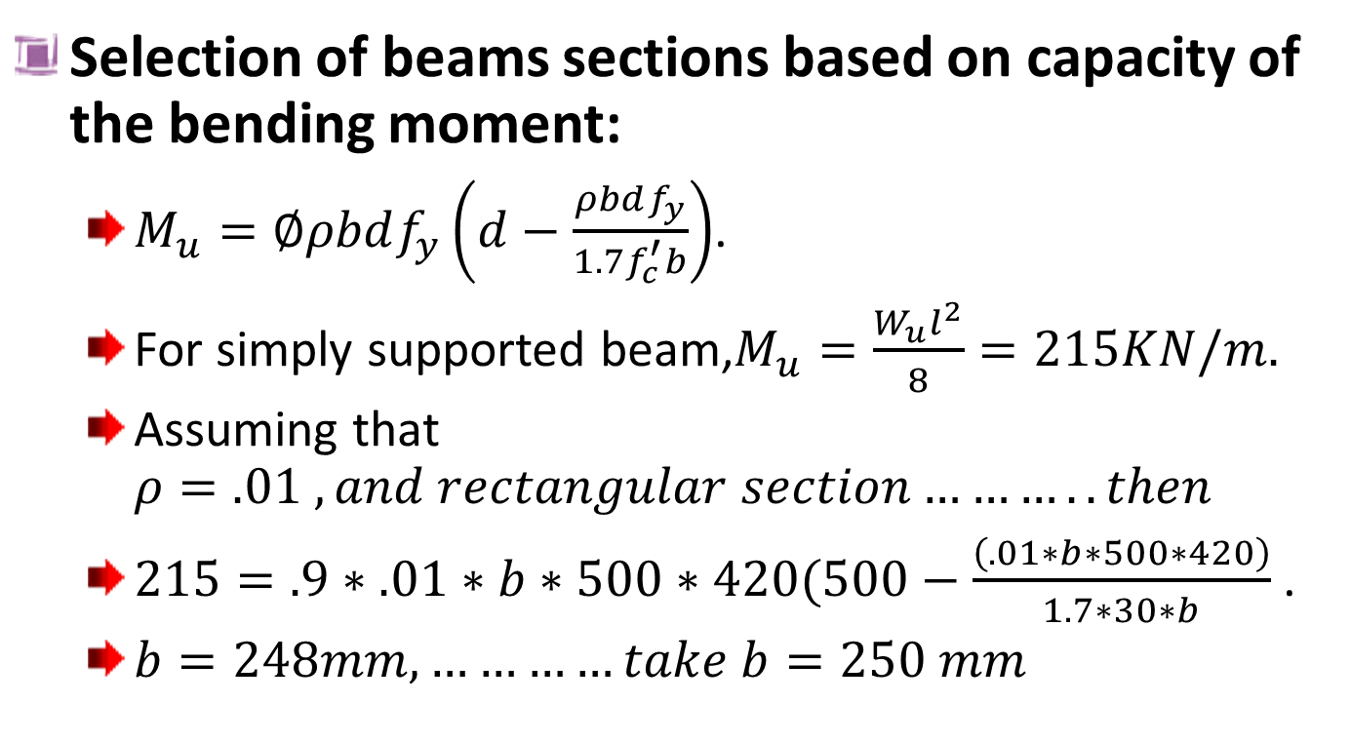
Beams Design
Selection of beams sections based on capacity of the bending moment:
$M_{u}=∅ρbdf_{y}\left(d−\frac{ρbdf_{y}}{1.7f_{c}^{′}b}\right)$.
For simply supported beam,$M_{u}=\frac{W_{u}l^{2}}{8}=215KN/m.$
Assuming that $ρ=.01 , and rectangular section………..then$
$215=.9∗.01∗b∗500∗420(500−\frac{\left(.01∗b∗500∗420\right)}{1.7∗30∗b}$ .
$b=248mm, …………take b=250 mm$

Slide 19
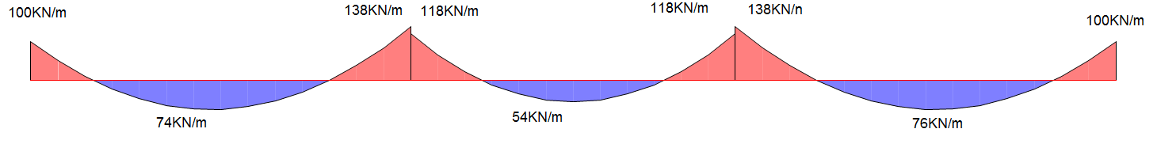
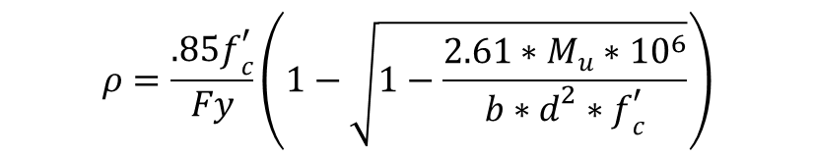

Beams Design
Design of beams for flexure
Beams design based on the value of the ${(+}_{ve})$&($−_{ve} )$moment that subjected to it
$$ρ=\frac{.85f_{c}^{′}}{Fy}\left(1−\sqrt{1−\frac{2.61∗M_{u}∗{10}^{6}}{b∗d^{2}∗f_{c}^{′}}}\right)$$
A value of (¼) of the longitudinal torsion reinforcing is add for each bottom and top steel for the beams that subjected to torsional forces

Slide 20
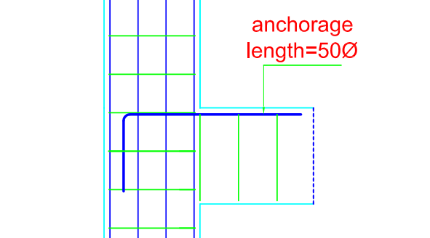
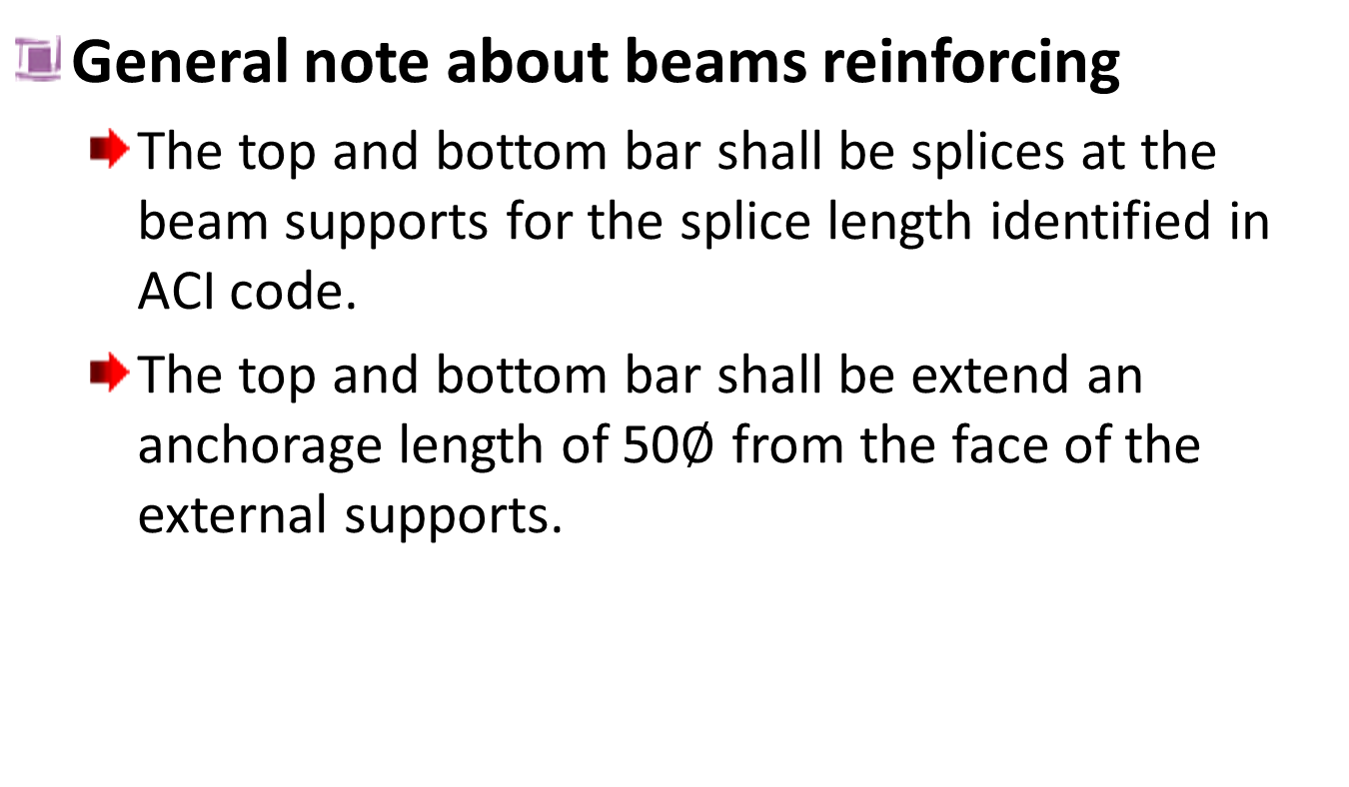
Beams Design
General note about beams reinforcing
The top and bottom bar shall be splices at the beam supports for the splice length identified in ACI code.
The top and bottom bar shall be extend an anchorage length of 50$∅$ from the face of the external supports.

Slide 21
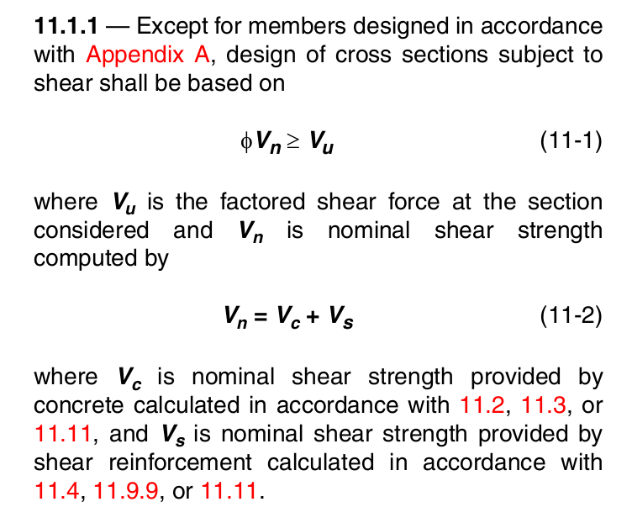
Beams Design
Design of beams for shear:

Slide 22
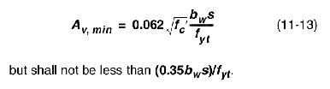
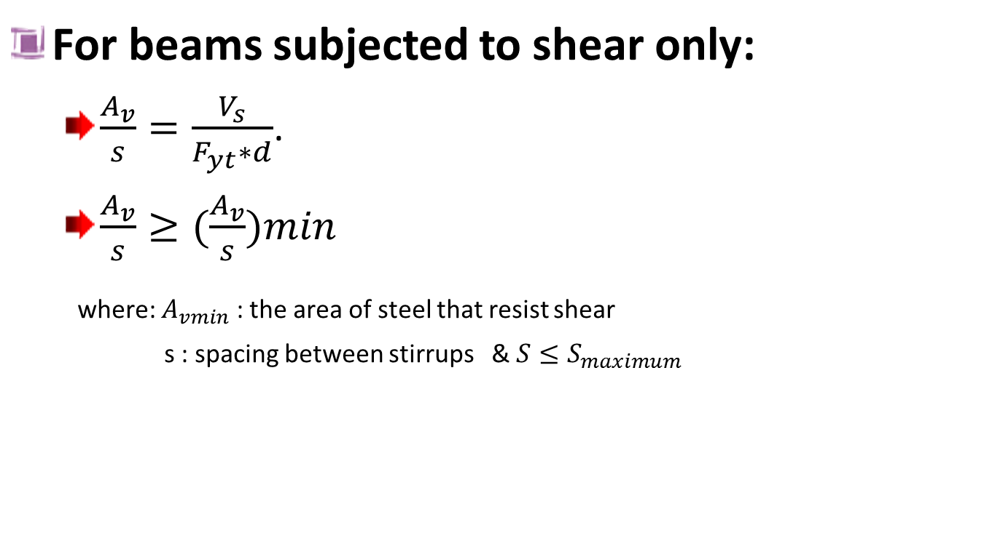
Beams Design
For beams subjected to shear only:
$\frac{A_{v}}{s}=\frac{V_{s}}{F_{yt}∗d}$.
$\frac{A_{v}}{s}≥(\frac{A_{v}}{s})min$
where: $A_{vmin}$ : the area of steel that resist shear
s : spacing between stirrups &$S≤S_{maximum}$

Slide 23
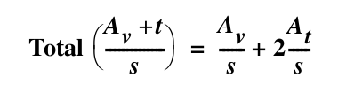
Beams Design
Design Of Beams For Torsion
Torsion reinforcement shall consist of longitudinal and traverse reinforcing.
the longitudinal reinforcing distribute on the bottom and top reinforcing of the beams with a percent of (1/4) of torsional reinforcement and (1/2) on the middle of the beam.
Torsional travers reinforcement is add to the shear reinforcement as

Slide 24
Chapter Four: Columns Design
Selection of columns cross section.
Check the slenderness of columns.
Column interaction diagram .
Column grouping .

Slide 25
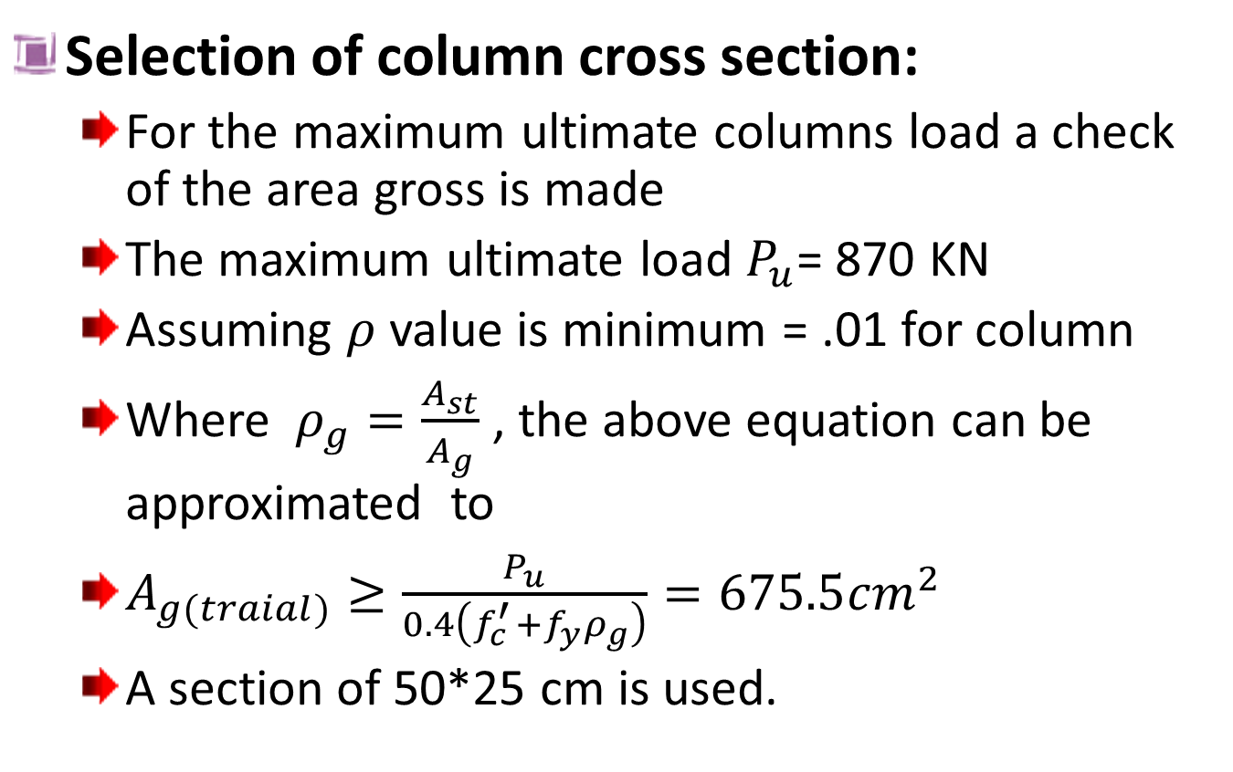
Columns Design
Selection of column cross section:
For the maximum ultimate columns load a check of the area gross is made
The maximum ultimate load $P_{u}$= 870 KN
Assuming $ρ$ value is minimum = .01 for column
Where $ρ_{g}=\frac{A_{st}}{A_{g}}$ , the above equation can be approximated to
$A_{g(traial)}≥\frac{P_{u}}{0.4\left(f_{c }^{′}+f_{y}ρ_{g}\right)}=675.5{cm}^{2}$
A section of 50*25 cm is used.

Slide 26
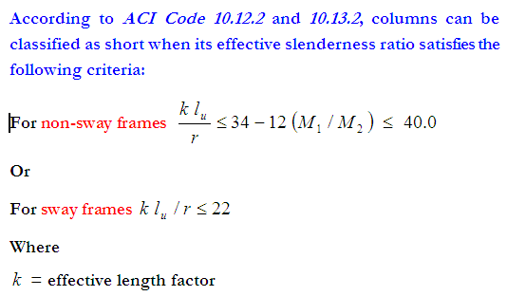
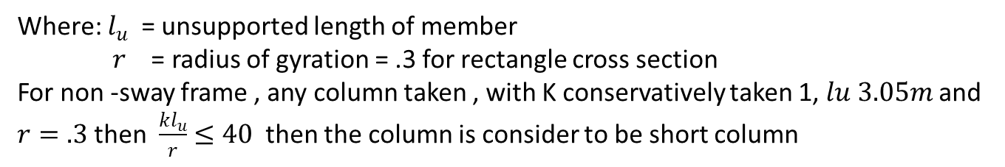
Columns Design
Check The Slenderness Of The Columns
Where: $l_{u}$ = unsupported length of member
$r$ = radius of gyration = .3 for rectangle cross section
For non -sway frame , any column taken , with K conservatively taken 1, $lu 3.05m$and $r=.3$then $\frac{kl_{u}}{r}$$≤40$then the column is consider to be short column

Slide 27
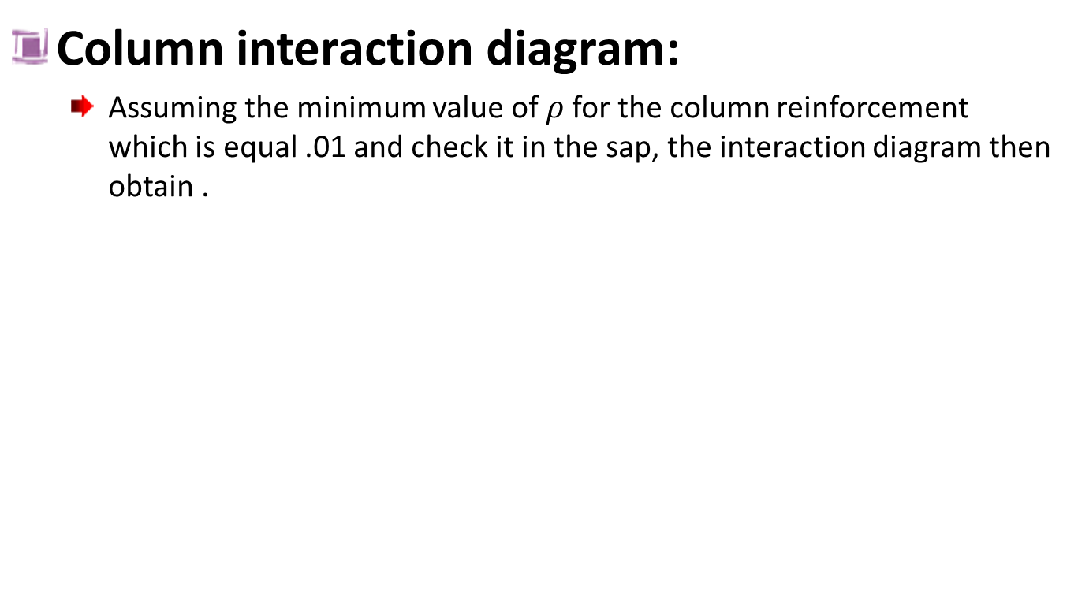
Columns Design
Column interaction diagram:
Assuming the minimum value of $ρ$for the column reinforcement whichis equal .01 and check it in the sap, the interaction diagram then obtain .

Slide 28
Columns Design
Column Grouping:
Column is classified based on ultimate loads and based on reinforcement.
Based on load
Columns is classified from c1 to c9
Based on reinforcing
Columns is classified from c1 to c3
An illustrator drawings in the next two slides

Slide 29
Columns Design

Slide 30
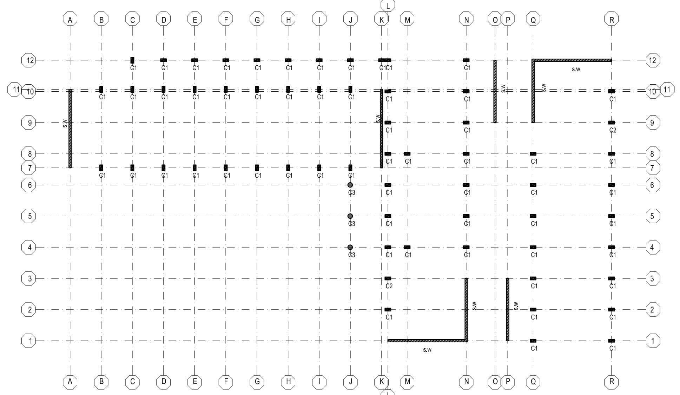
Columns Design

Slide 31
chapter Five: Footings Design
Selection of footings type .
Distribution of footings on the columns and shear wall.
Distribution of the tie beams

Slide 32
Footing Design
The footing type used is four types
Single footings.
Used for the most of the columns where either near columns footings nor structural break
Companied footings
Used for the columns footings which is closely to each other and no enough space for single footings for each columns
Strap footings.
Used for the column lies on the structural break
Wall footings.
Used for the wall

Slide 33
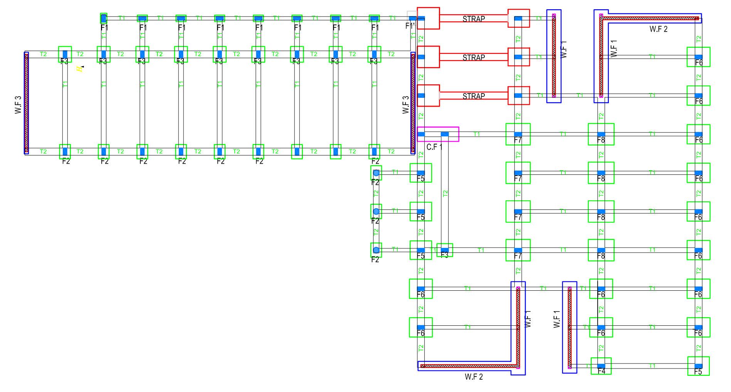
Footing Design

