Slide 1

Construction Project Management
An-Najah National University
Faculty of Engineering
Civil Engineering Department
Prepared by:
Mohammed Jamal Tarif
Ahmed Usama Al-Ghool
Loay Ahmed Salahat
Supervised by:
Eng. Reema Riyad Nassar

Slide 2
Introduction
In Graduation Project II, we will apply theoretical concepts mentioned in Project one, which will be mainly the cost and time management.
The main idea is to recalculate the cost and reschedule of Tulkarem Directorate of education building, which is already executed
Notes:
The main idea is to recalculate the cost and reschedule of Tulkarem Directorate of education building, which is already executed

Slide 3
Problem facing Construction Project in Palestine
Israeli Occupation
Financial problem:
Delays in project delivery especially in governmental project due to weak enforcement on contractors
Poor planning, poor project management and poor communication between all parties to reach optimal solution.
Notes:
The main idea is to recalculate the cost and reschedule of Tulkarem Directorate of education building, which is already executed

Slide 4
Project Description
Project name | Tulkarem Directorate of Education
Area of Land | 750 m2
Total Area of building | 1200 m2
Number of Stories | 4
Project funded | Ministry of Education
Project Consultant | Engineering Dept. in DoE.
Date of Project | 2004 to 2005
Directorate of education in Tulkarem city, located at the entrance of Tulkarem city near Shwaikeh Rotary.
Notes:
defvaefaefeaf

Slide 5
Work Methodology
The main procedures in scheduling are:
Substructure work.
Super structure work.
Finishing Work

Slide 6

Quantity Surveying Summary

Slide 7
Sub-Structure Works
Site Leveling
Site leveling | m³ | 500
Fill and compaction | m³ | 30
Piles excavation
 | Diameter | NO | Height | Volume (m³)
P1 | 1 | 11 | 10 | 86.39
P2 | 0.8 | 19 | 10 | 95.50
P3 | 0.6 | 5 | 10 | 14.14
 |  |  | Total | 196.04
Foundation
Piles
Reinforcement | Ton | 3.7
Concrete | m³ | 197
Pile Caps
Blinding | m² | 4.25
Formwork | m² | 82
Reinforcement | Ton | 0.5
Concrete | m³ | 25.5
Ground Beams
Formwork | m² | 115
Reinforcement | Ton | 3.31
Concrete | m³ | 30
Ground Slab
Formwork | m² | 12
Reinforcement | Ton | 3.7
Concrete | m³ | 45

Slide 8
Super-Structure Work
Columns
 | No/floor | Dimensions (m) |  |  | Formwork/Column (m2) | MainSteel/ Column (kg) | Stirrups/Column (kg) | Total Steel/Columns (kg)
 |  | L | B | H
C1 | 21 | 0.5 | 0.3 | 3.5 | 5.6 | 57.68 | 17.39 | 75.06173
C2 | 5 | 0.4 | - | 3.5 | 4.39 | 46.14 | 9.88 | 56.01975
C3 | 2 | 0.4 | 0.2 | 3.5 | 4.2 | 35.32 | 15.81 | 51.13086
C4* | 1 | 0.4 | 0.2 | 3.5 | 4.2 | 35.32 | 15.80 | 51.13086
C5* | 4 | 0.4 | 0.4 | 3.5 | 5.6 | 52.99 | 35.56 | 88.54815
(*) Only in Ground floor
Slabs
 | Concrete (m³) | Block (No) | Beams Steel (ton) | Slab Steel (ton)
GF | 50.6064 | 1676 | 4 | 2.5
1 | 55.1608 | 1697 | 3.33 | 2.3
2 | 51.0708 | 1697 | 3.33 | 2.3
3 | 51.0708 | 1697 | 3.33 | 2.3
Sum | 207.9088 | 6767 | 14 | 9.4
External (Perimeter) Walls
 | Total Stone area m2 | Total # of 7 cm Blocks for walls | Volume of mortar m3 | Insulation m2
East | 350.96 | 4387.02 | 52.64 | 350.96
West | 376.45 | 4705.58 | 56.47 | 376.45
North | 201.14 | 2514.24 | 30.17 | 201.14
South | 200.91 | 2511.36 | 30.14 | 200.91
Sum | 1129.46 | 14118.20 | 169.42 | 1129.46

Slide 9
Internal Finishes
Internal walls, Plastering and Painting
Floor | Internal Blocks (m²) | Plastering (m²) | Celling (m²) | Paints (Oil) | Paint (Ametion) | Paint (Polyced)
GF | 244.3 | 817.25 | 293 | 408.625 | 408.63 | 293
1 | 257.075 | 842.8 | 294 | 421.4 | 421.40 | 294
2 | 244.3 | 817.25 | 296 | 408.625 | 408.63 | 296
3 | 244.3 | 817.25 | 296 | 408.625 | 408.63 | 296
Roof | 0 | 62.7263 | 28 | 31.36315 | 31.36 | 28
Sum | 989.975 | 3358 | 1207 | 1680 | 1680 | 1207
Tiling
Terrazo tile
GF | 186.12
1 | 181.93
2 | 181.715
3 | 185.2
Total | 734.965 m²
Parlato for Corridors
GF | 41.2
1 | 41.2
2 | 41.2
3 | 41.2
Total | 164.8 m²
Ceramic for floors | Non-Slip | Glazed Ceramic
GF | 17.69 | 80
1 | 17.69 | 80
2 | 17.69 | 80
3 | 17.69 | 80
Total | 70.76 m² | 320 m²
Marbles
Marble for door sills | 45 m²
Marble for stair (include thread, riser and skirting) | 120 M.R
Stair Landing (Perlato Tile) | 18.25 m²

Slide 10
External Works
Excavation for 6 m piles | m³ | 50
External Fences
Piles
Reinforcment | Ton | 1
Concrete | m³ | 48
Column
Formwork | m² | 60
Reinforcment | Ton | 0.4
Concrete | m³ | 4.5
External Walls
7 cm block | No | 1050
Multash stone | M.R | 840
Concrete | m³ | 12
Steel Guard | M.R | 130
External Steel Gates
Gate 1 (420*210) cm | No | 1
Gate 2 (200*210) cm | No | 1
Gate3 (460*210) cm | No | 1
Parking (include 70 cm rock fill, 20 cm base coarse and 5cm asphalt) + Cross walk | m² | 350
External Plastering | m² | 90

Slide 11
Total Cost Percentages
Items | Percentage (%)
Sub-Structure | 8.61%
Super structure | 43.75%
Finishing works | 47.64%
Total | 100.00%

Slide 12
Major Material Cost Percentages
Item | Percentage (%)
Concrete | 15.41%
Stone | 9.86%
Electrical works | 9.73%
Tiling Works | 8.83%
Steel | 8.51%
Aluminum works | 8.47%
Elevator | 5.78%
Plastering | 5.74%
Painting | 3.49%
Mechanical works | 2.79%
Sum | 78.61%

Slide 13

Project Analysis using primavera

Slide 14
Assumptions
Project start in 2/6/2012
Working day = 8 hours
Non-working days are Fridays and holydays
Currency used US-Dollar, with exchange rate = 3.78 NIS
Electrical and Mechanical works have taken as lump sum.

Slide 15
Work Breakdown Structure (WBS)
Project
Mechanical Works
Structure
Finishing Work
Sub-Structure
Super-Structure
Internal Finishing
External Finishing
Electrical Works

Slide 16
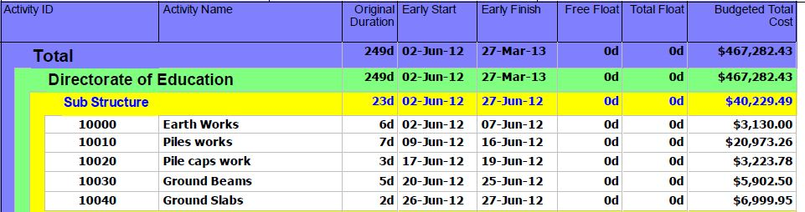
Activity List

Slide 17
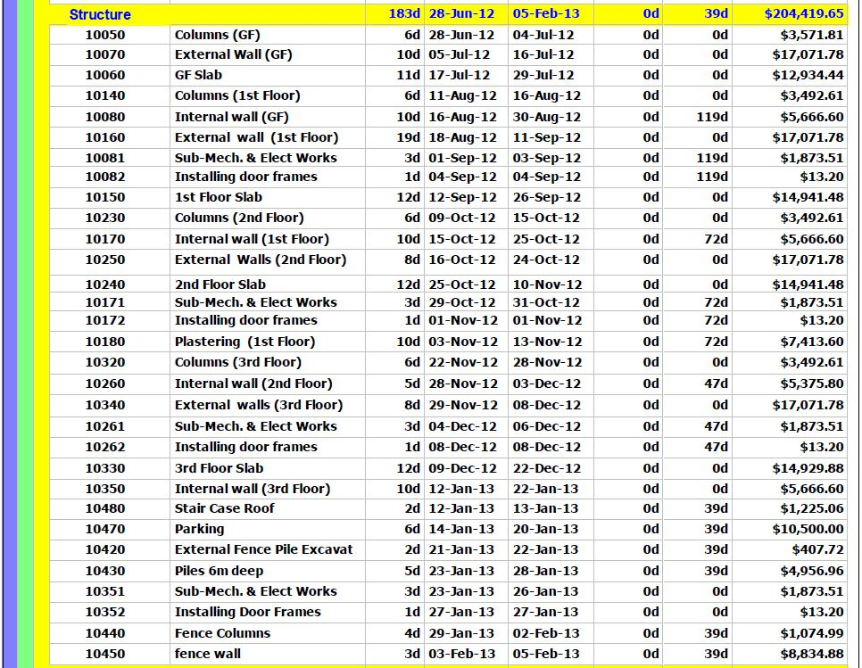
Activity List (continued)

Slide 18
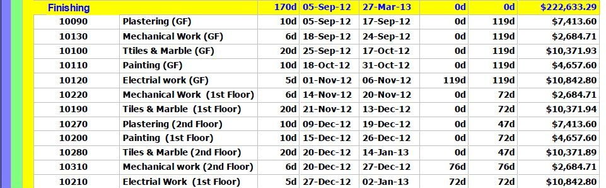
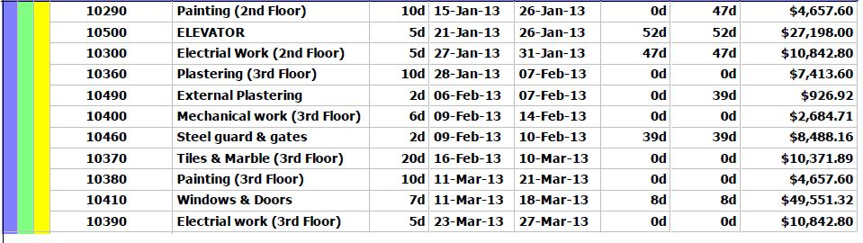
Activity List (continued)

Slide 19
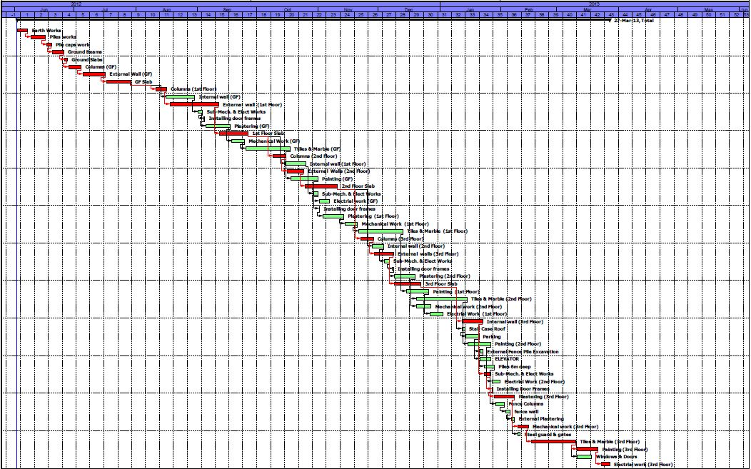
Bar (Gantt) chart
Bar (Gantt) Chart

Slide 20
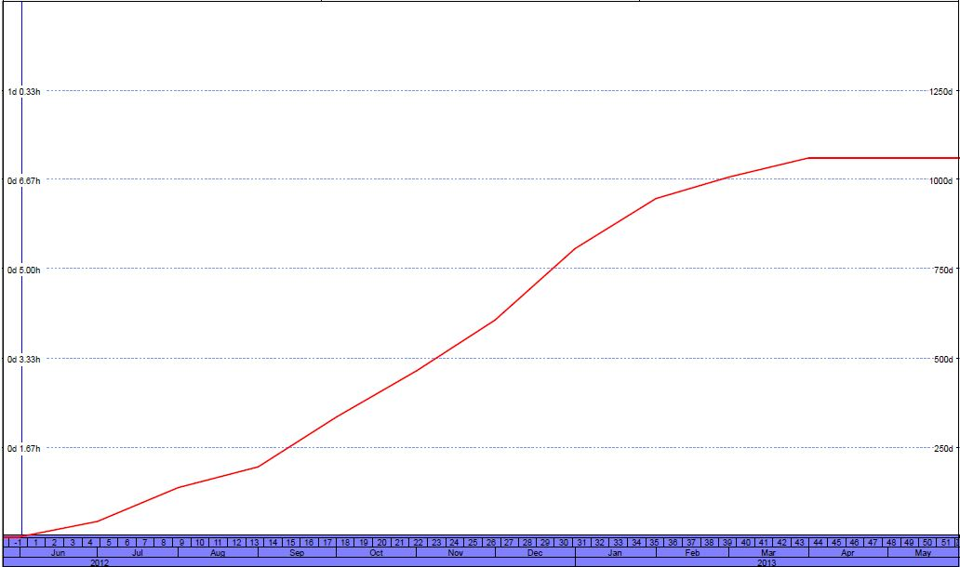
Labors Unit S-Curve

Slide 21
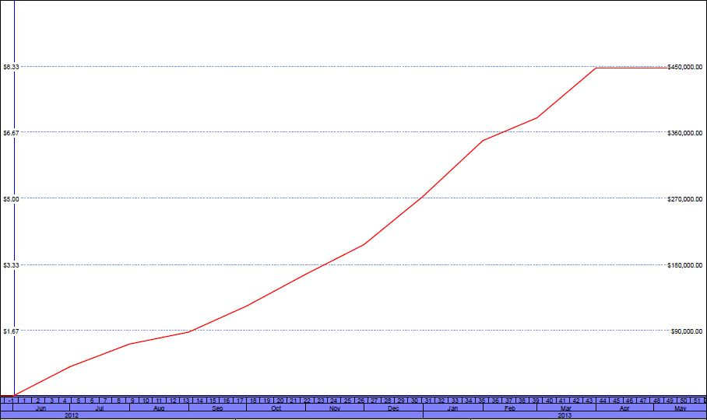
Material Cost S-Curve

Slide 22
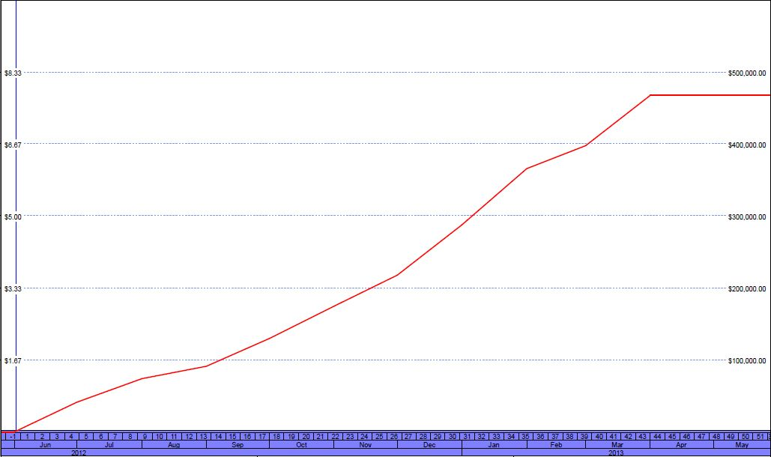
Total Cost S-Curve

Slide 23

Final conclusion

Slide 24
Schedule
Assuming that the project starts in 2/6/2012
The rescheduled duration is 249 working days:
it will finish in 23/3/2013, so it will take 294 calendar days.
The actual duration obtained from the project consultant is 6 month for the first stage (external Skelton) and 6 month for the finishes, so the total duration was 12 month and this reflects and emphasizes the effectiveness of the way we reschedule the project.
Notes:
The main idea is to recalculate the cost and reschedule of Tulkarem Directorate of education building, which is already executed

Slide 25
Cost
The recalculated cost is $467288.43 without taking any consideration to profit and taxes
Adding 10% as profit and taxes the final Price of contract will be $514,010.67
From data we took from consultant the total cost which is about $450,000
The difference in cost could be from
Difference in material cost especially steel, concrete which has largest portion of cost
Increase in mobilization to highs increase in cost of Oil
Increase in wages of labor
Increase in percentages of taxes.
Notes:
The main idea is to recalculate the cost and reschedule of Tulkarem Directorate of education building, which is already executed

Slide 26
Thank You
We pleased to receive your questions

